Slide 1
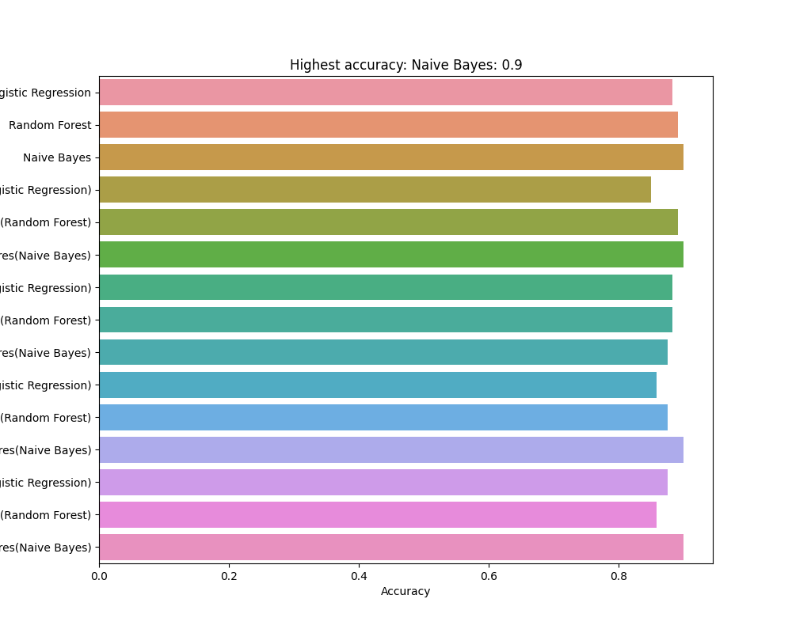
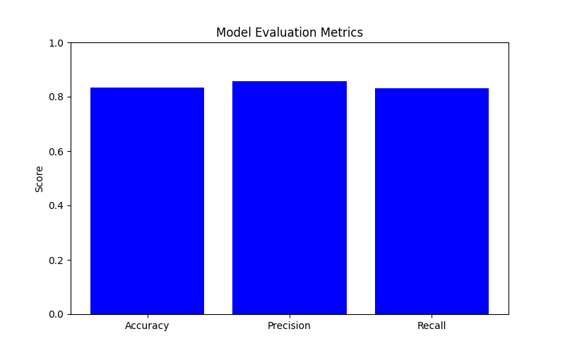
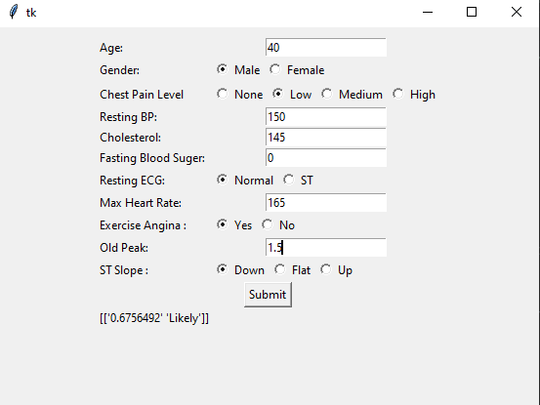

tkinter
tkinter
AI Medical Analysis
Introduction
Results:
Evaluation
The goal of the project is to develop a Medical AI Disease Diagnostic Tool that uses machine learning to predict diseases or conditions based on patient data, medical history, and test results. The need for accurate and efficient disease diagnosis, which is crucial for the effective treatment and administration of a variety of medical conditions, is the general problem addressed by the project. The instrument seeks to aid healthcare providers and clinicians in making informed decisions by providing them with accurate and timely disease or condition predictions.
Our model is about 80% accurate based on the data we have and tries to predict whether the data indicates heart disease and subsequently labels its predication as one of four bins: Not Likely, Less Likely, Likely, and Highly Likely. This allows the prediction to be easy read and can be used by our application to allow users to input their data and have the model predict if they should get checked.
To determine how effective a tool is, several significant criteria are evaluated, including:
Accuracy: The tool's predictions must be reliable and precise, and its performance should be evaluated in terms of its sensitivity, specificity, and precision for various diseases or conditions.
Data privacy: The tool must ensure that patient information is kept safe and accessible only by authorized personnel. It must comply with all relevant data protection regulations.
Transparency: Users must be able to understand how the tool works and what data it uses to make predictions. This requires a detailed explanation of the models used and how the tool arrives at its results.
Validation and testing: The tool should undergo rigorous validation and testing to determine its efficacy. It should be tested on a variety of populations to ensure its accuracy and reliability.
By considering these criteria, we can determine the effectiveness of a tool and ensure that it is reliable and trustworthy for use in healthcare settings.
Implementation: Overview
The Medical AI - Disease Diagnostic Tool is an application that uses machine learning and statistical models to predict diseases or medical conditions based on input data from the user. The application includes the following key characteristics:
Inputting patient symptoms and medical history
Data Cleaning and Preparation
Machine Learning/Statistical Models
Prediction Results
Build with
TensorFlow, Tkinter and Python
Conclusion
The Medical AI Disease Diagnostic Tool has potential to revolutionize the medical industry, but its effectiveness is dependent on quality data input. Ethical considerations, such as protecting patient privacy and avoiding bias, must be considered. Responsible development and utilization of the tool is essential for maximizing its potential for improving healthcare outcomes while keeping patient care at the forefront of efforts.
UNIVERSITY OF THE PACIFIC
Mansoor H., Korie. W, Kelvin L.

