Slide 1
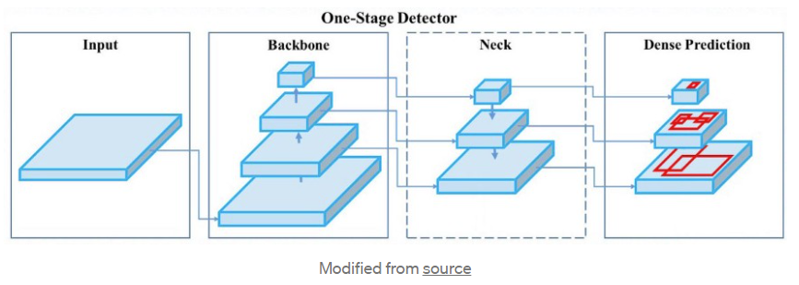
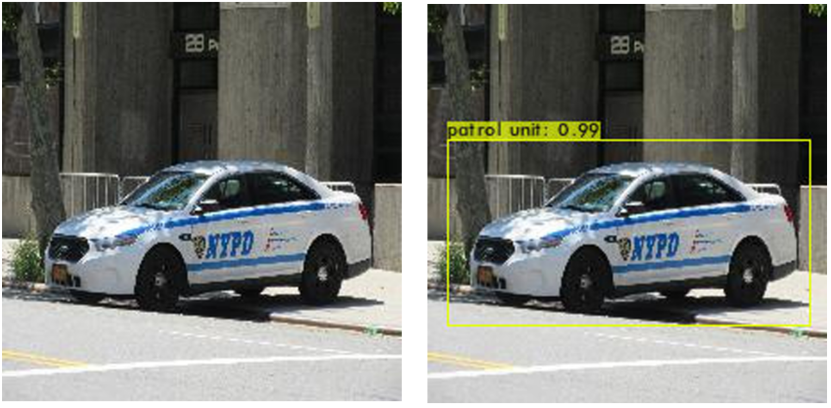

AI Eye
1 Introduction
2.2 What is YOLO v4
AI Eye provides a perspective on how autonomous vehicles “see” the world. The emphasis of our project revolved around creating a custom object detection model based on YOLOv4 architecture that through image classification allowed training and recognition of images. We also built a website to give other users the ability to publicly access the model with instructions as well as provide additional information about our project.
The You Only Look Once (YOLO) model is a single neural network used for real-time object recognition based on regression. Unlike other object detection models, YOLO aims to predict the class of an object and the bounding box that specifies its location in an image. This is done by splitting the image into a grid of S x S cells, who are responsible for predicting the location of the bounding box, confidence score and, class probabilities.
The created model allowed us to work with an X number of images for training and an X number of images to be used for validating. Resulting in a precision rate after each training session.
3 Results
During the project, we focused on training datasets that supported autonomous driving technology. Focusing the training on emergency vehicles, and traffic sign images. We sought to work our custom YOLOv4 model from scratch by training multiple datasets to accurately depict each object in every image. The training showed great precision for object classification and successfully outputted the detection along with the percentage of accuracy.
2.1 Image Classification
Refers to a supervised learning problem within machine learning from which the process of defining sets of target objects in an image supports the training of computer systems. Through the use of statistical models and algorithms these systems can learn, adapt and make inferences freely.
For our project, an object-based image classification approach was used. This process consisted of preparing image datasets by adding labels around certain objects of the image. These labels served to identify the object classes and location in our images.
YOLOs architecture is composed of a neural network which serves as the backbone of this model. The main objective of the backbone is to extract the essential features of the image during the training phase. The neck’s essential role is to detect and collect feature maps from different stages to be passed over the head (dense prediction) stage which is responsible for doing the final prediction containing the coordinates, confidence score, and label of the images.
4 Conclusion
The larger the data set the more accurate the model will be. This largely depends on the variance of training images which takes up a significant amount of resources.
This model can be used by many real-world applications that allows computers to detect and recognize objects through their camera and make decisions based on the information collected.
2.3 Our YOLO Model
For our project, the environment we chose to build our model in was Google’s Colab space because of its built-in GPU, and collaborative nature which not many other environments supported making it the best option for us.
We referenced the Colab’s existing YOLO project and modified it to meet our needs. The core functions of the model were not altered but this allowed us to train static images and custom datasets.
5 References
P. RUGERY, “Explaining YoloV4 a one stage detector,” Medium, 15-Sep-2020. [Online]. Available: https://becominghuman.ai/explaining-yolov4-a-one-stage-detector-cdac0826cbd7.
“Image Classification,” Image Classification - an overview | ScienceDirect Topics. [Online]. Available: https://www.sciencedirect.com/topics/computer-science/image-classification.
UNIVERSITY OF THE PACIFIC
Iris Huang
Haya Syed
Angela Ayala

