Slide 1
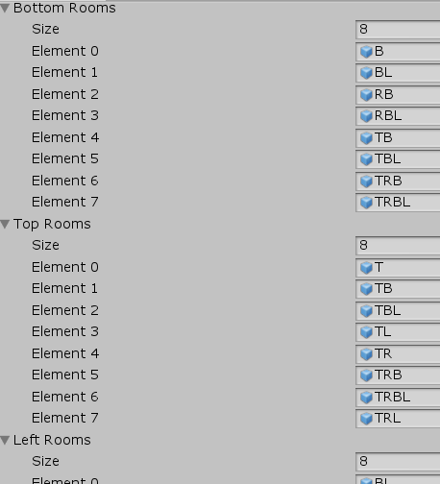
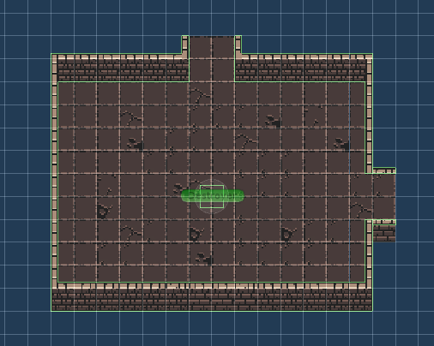

Dungeon Diver
Introduction
Implementation 2
Implementation 4
Dungeon Diver is a top-down, 2D Dungeon Crawler game. You play as a knight that ventures into a newly discovered dungeon to find treasures and get rich. However, rumor has it that so far, every person that enters is never seen again.
The main selling point of this game is its replayability, as each level is randomly generated. Each time you boot up the game, you will experience a different map filled with a small assortment of enemies to defeat.
I then created 4 different arrays, representing the 4 directions, and added the rooms that contained the different doors into the corresponding array. For example, a room that has doors to the top and right would be added to both the TopRooms and RightRooms array.
When spawning a room, my algorithm would randomly choose a room from an array that has a door on that side. If a room has a top door, a random room from the TopRooms array would be spawned.
The player would not be able so save their games. Each time the player dies or quits the game, the game will restart as if the game was played for the first time.
The main goal of the player would be to explore the dungeon and defeat the boss. Once the boss is defeated you would be able to go to the next dungeon floor. Of course, each new floor level would be randomly generated as well. There is no ending, because I intend for the game to go on forever until the player quits or dies.
Implementation 1
Conclusion
This picture shows how the rooms are inserted into the 4 different arrays.
In conclution, developing this game by myself was a great milestone for me. Although small in scale, it was a challenge because I needed to do everything myself. Of course, I leveraged this by using free assets and whatnot, but I chose this as my senior project because I wanted to challenge myself. Things I thought were easy to do, such as creating the rooms were harder than I believed. In addition, because I am not adept in Unity, I had to learn how to use it while working on the game. Things such as time mangament, and motivation were a struggle to manage, and I very quckly realized many of my shortcomings in doing this project. In the end, I found my senior project to be enjoyable to work on and a great measure of my current abilities and work ethic.
I developed this game using Unity, which uses C# code. For game assets, including the player character, enemies, and items, I used a free asset pack I found online.
The biggest hurdle I had to overcome was actually coding the random map generation. I implemented it like this:
First, I had to create 15 different preset rooms that contained all the combinations of different direction rooms. For example, one room had doors at the top and right sides of the room as shown below.
Implementation 3
After making sure my game was able to randomly generate a dungeon, I then was able to focus on randomly spawning in enemies and items.
Players would not level up upon defeating enemies, but would be able to increase their damage to enemies and health through certain items. The player would die easily, but at the same time the enemies would too. However, the enemies get stronger with each floor completed.
Team Members:
Ethan Lo
UNIVERSITY OF THE PACIFIC

