Slide 1
L14/15 - AVL
7/16/24, 7/17/24

Slide 2
Announcements
Schedule updated through to final exam
2 more quizzes
QZ04 graded
EX08 due tonight
EX09 releases today
Only 3-4 exercises left, EX09 (AVL), EX10 (HashMap), EX11 (Dijkstra’s algorithm)

Slide 3
AVL tree – BST with balance
BST gets more linear as it is used (deletes) and if the build has a poor element sequence (partially sorted)
BST ops are only efficient (O(log n)) if the tree is close to minimal height (where n is #nodes)
Recall that operations such as contains, insert, remove must traverse down a level at most height times
AVL tree (Adelson-Velskii and Landis) is a BST with a balance condition that maintains low height, bushy structure as we add and delete nodes

Slide 4
Imbalanced BST example
After only a few ops
10
9
15
2
12
20
1
4
25
22
8
31
5
27
45

Slide 5
AVL balance condition
At every node,
| h_{L}– h_{R} | ≤ 1
Height of left subtree and height of right subtree differ by at most 1
We will define the height of a null subtree to be -1

Slide 6
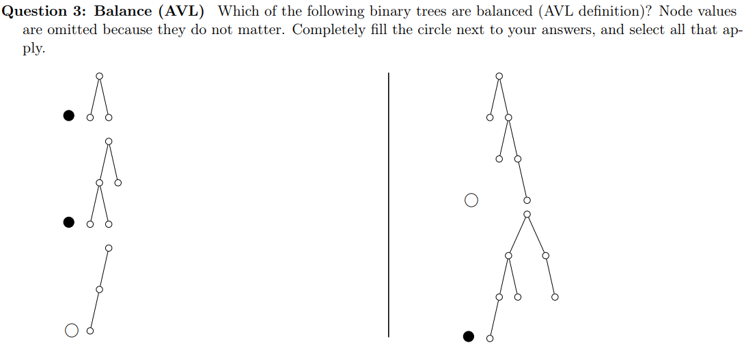
AVL balance examples
0 0
On each node, the left number is height of left subtree
The right number is height of right subtree
-1 -1 -1 -1
1 -1
0 -1
-1 -1

Slide 7
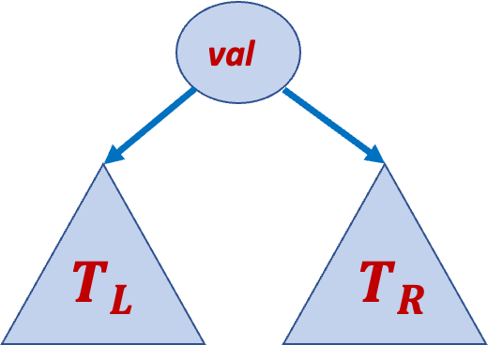
AVL invariants
All values in T_{L} < val
All values in T_{R} > val
Note: duplicates not allowed like in BST
See left-rotate and right-rotate diagrams
| h_{L}– h_{R} | ≤ 1
T_{L} is an AVL BST
T_{R} is an AVL BST

Slide 8
Rotate to maintain balance
When we insert a node (or remove), it might make two subtrees differ in height by 2
When this happens, re-balance with rotation

Slide 9
Rotate to maintain balance, cont.
When we insert a new node (new leaf), it may or may not cause an imbalance
If there is, the imbalance point occurs somewhere along the path from insertion (new leaf) to root
Keep track of h_{L} and h_{R} at each node
When some node has h_{L} = h_{R} + 2 or h_{R} = h_{L} + 2, do a rotation
We have single and double rotations

Slide 10

Imbalance
$$we define$$
$$height of$$
$$null as −1$$
P
-1
-1
Imbalance at this node because -1 – 1 = -2
All other nodes on this slide are fine, difference at most 1
P
1
-1
R
R
-1
0
0
-1
X
P
-1
-1
-1
-1
P
0
0
G
R
-1
-1
-1
-1

Slide 11
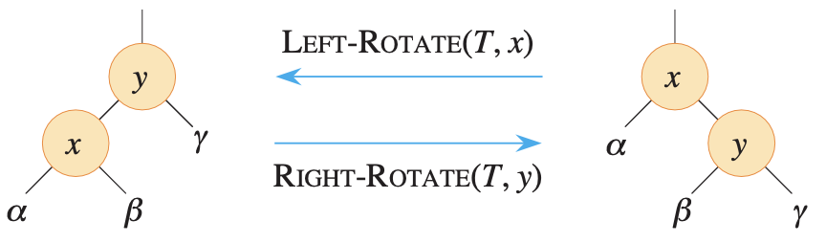
Basic single rotation
Root becomes child, pivot (child) becomes root
Root and pivot “switch places”
Subtree β moves from pivot R to root L (or pivot L to root R)
When rotating on x, y must not be empty (null) and vice versa
Check BST inequalities
x < y on both sides
β parent link is moving
β > x, β < y on both sides

Slide 12
LL single rotation example
Insert 3, 2, 1 (inserting 1 causes imbalance)
Imbalance at 3 because 1 – (-1) is 2
So right-rotate at 3
3
1
-1
2
0
-1
R
3
P
1
Right-rotate(3)
2
-1
-1
P
2
Z
R
3
1
Y
1
X
X
Y
Z

Slide 13
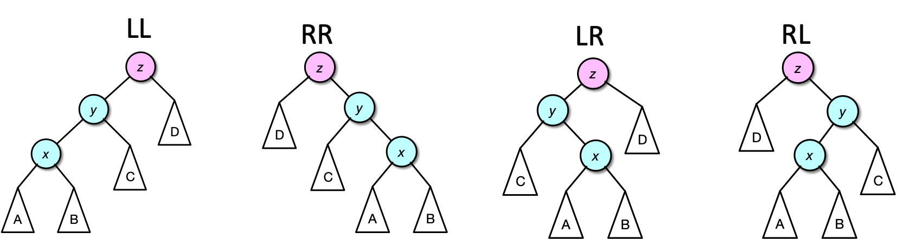
4 rotation cases – LL, RR, LR, RL
We called the previous slide’s case “LL” because at the imbalance point, its child and grandchild on the path to newly-inserted leaf both follow left pointers
Similar reasoning for all 4 cases, shown below
Insertion must create a new leaf in either subtree A or B because x is on path from insertion to imbalance point (by definition above)
x and y are not imbalanced (before and now), otherwise either of those would be the first place there is imbalance

Slide 14
RR single rotation example
Insert 4, 5, 6, 7
Imbalance at 3 because -1 – 1 = 2
Case is RR (why?)
So left-rotate at 3
2
2
2
0
2
1
3
Left-rotate(3)
Insert(6)
-1
1
1
4
1
4
0
1
4
-1
0
3
3
5
5
-1
0
5
-1
-1
6
-1
-1
Need only write heights and check balance on path from new leaf to root (i.e., can ignore node 1)
Imbalance at 2 after insert(6) because 0 – 2 = -2
Another RR case (why?)

Slide 15




RR, cont.
Fix imbalance at 2 (RR case) with left-rotation
Draw pattern chart for more complex case
P
R
4
2
Left-rotate(2)
R
2
5
P
4
1
1
3
6
Z
X
3
5
X
Y
Y
Z
6
Check BST inequalities
Y parent link is moving
$$Y<P$$
$$Y>R$$
Z $>P$
Z $>R$

Slide 16
RR, cont.
Finally, insert(7)
Imbalance at 5
RR case
Left-rotate at 5
4
2
5
-1
1
4
Left-rotate(5)
1
3
6
0
2
Balanced!
-1
6
7
1
3
5
7
-1
-1

Slide 17
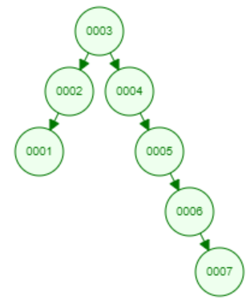
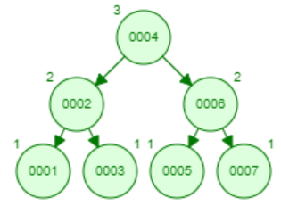
BST vs. AVL
In previous slides, inserted [3, 2, 1, 4, 5, 6, 7], a partially sorted sequence
Terrible insertion sequence for BST
As pictured, double linked list structure
AVL balancing makes a balanced tree that maintains O(log n) operations
Visualization
Note: Does weird double rotations seemingly in a single step for LR and RL cases
But if you follow our examples, you’ll end up with the same result
Also doesn’t number at the left and right of each node, but it’s basically the same

Slide 18
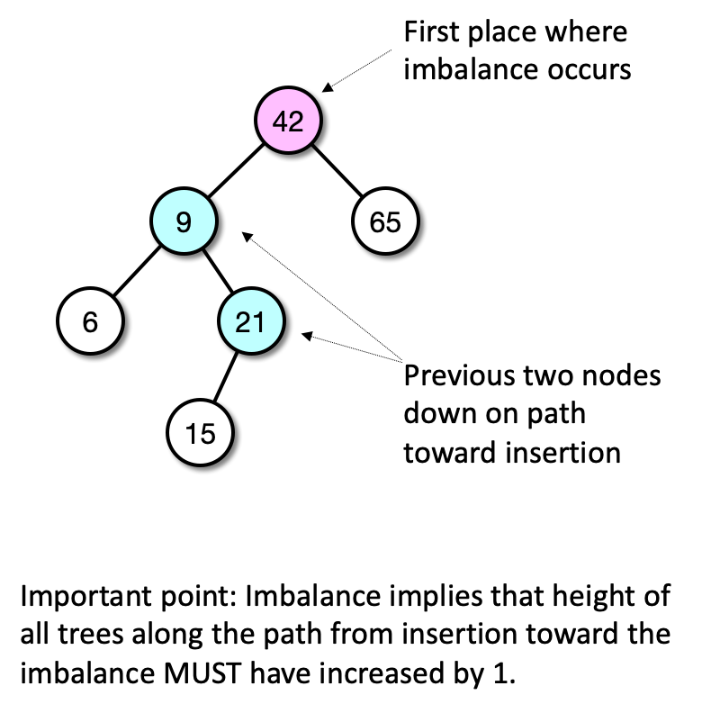
AVL insertion rebalancing
After inserting value into an AVL tree, walk back up from new leaf to root and find the first place where balance factor is illegal (if any)
Keep track of the previous two nodes down toward the new leaf (child and grandchild of imbalance point on that path)
This is where we are going to rotate to restore the AVL balance invariant
Now we’ll discuss how to fix all 4 cases (in general)

Slide 19
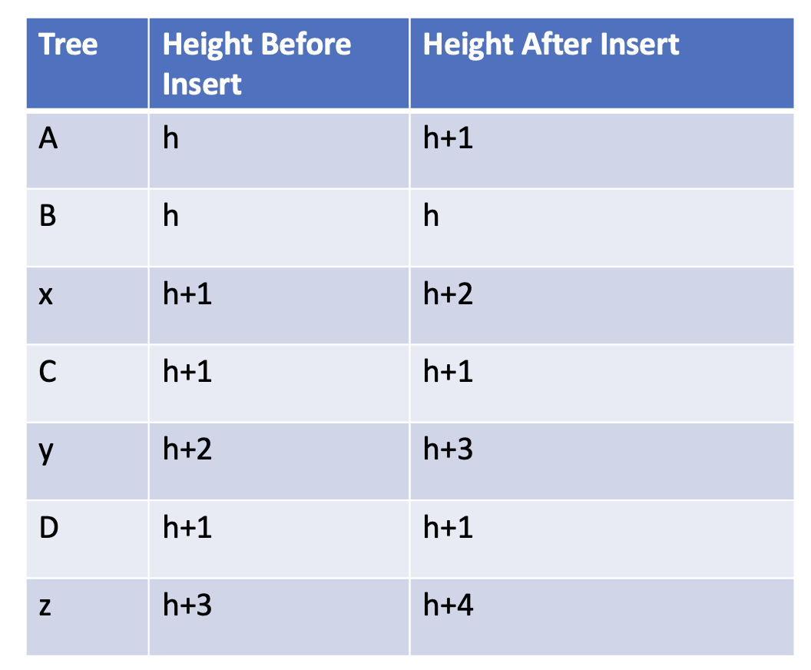
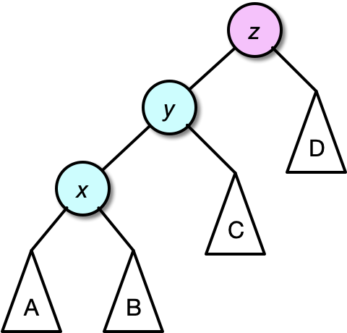
LL
Without loss of generality, say the insertion occurred in A (the same logic will work for B) and that height of A went from h to h+1

Slide 20
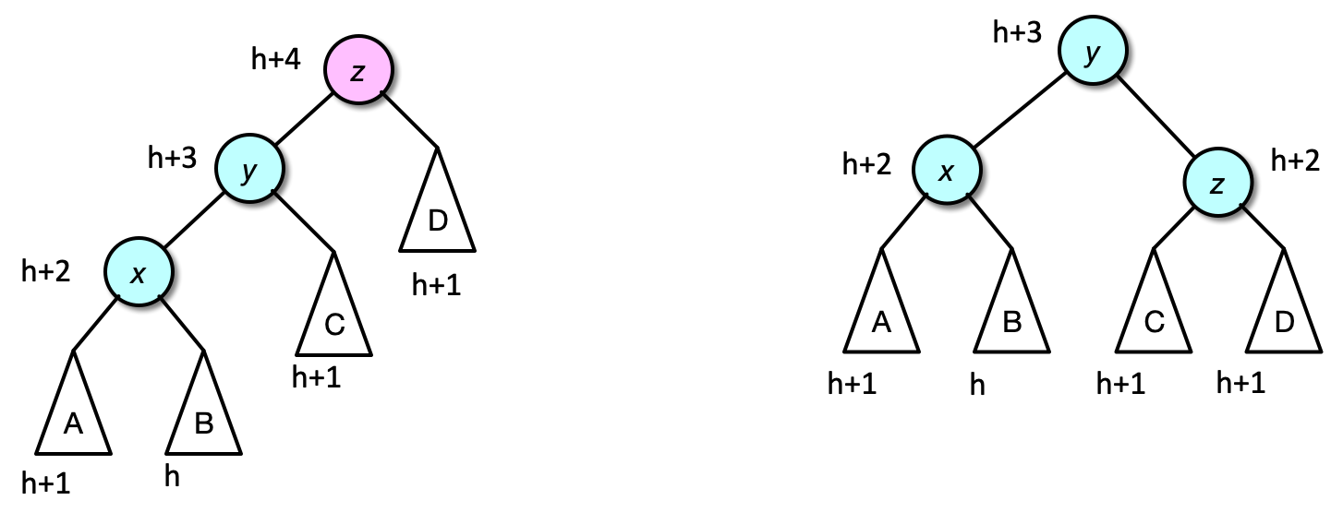
Fix LL with right-rotation at imbalance
Right-rotate(z)
Recall that z is our imbalance point, x and y are the child and grandchild of z on path to new leaf
Check inequalities, if needed

Slide 21
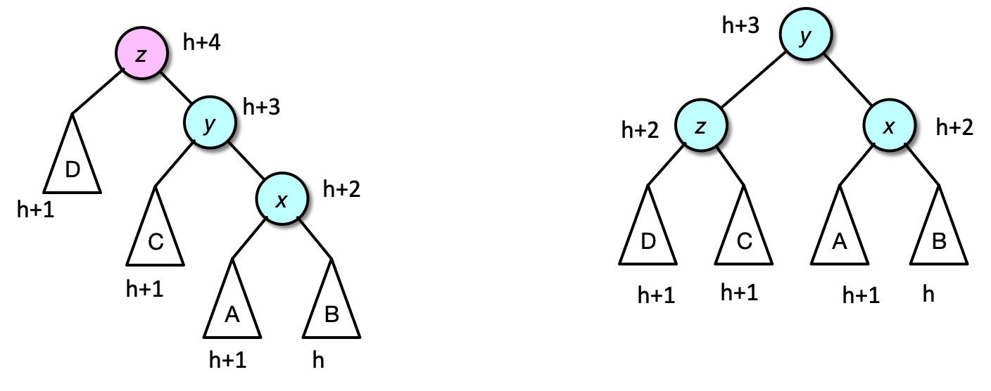
Fix RR with left-rotation at imbalance
Left-rotate(z)

Slide 22
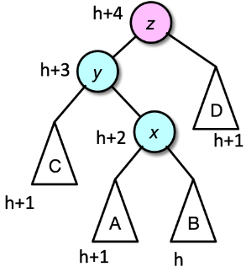
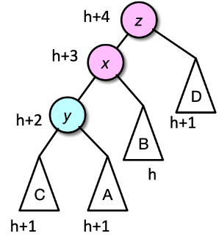
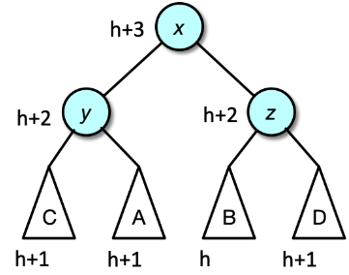
Fix LR with double rotation
Reduced to LL!
Left-rotate(y)
Right-rotate(z)

Slide 23
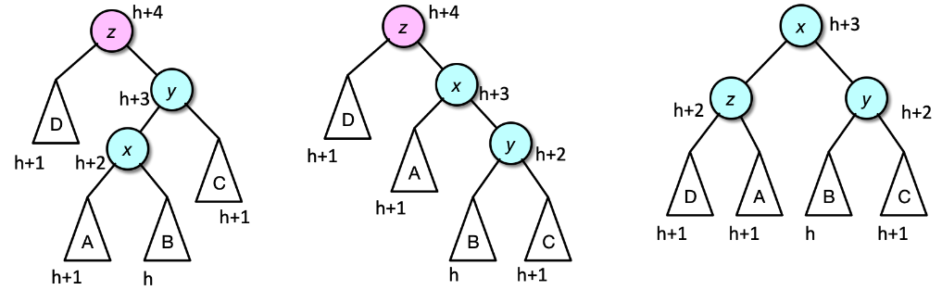
Fix RL with double rotation
Reduced to RR!
Right-rotate(y)
Left-rotate(z)

Slide 24
RL double example
Now insert 16 then 15
Insert(15) causes imbalance at 7
RL (why?)
Right-rotate(16)
16 is child of imbalance
Now RR
Left-rotate(7)
7 was original imbalance point
4
4
2
6
2
6
1
3
7
Right-rotate(16)
5
Left-rotate(7)
1
3
5
7
15
-1
1
16
16
4
0
-1
15
2
6
-1
-1
1
3
5
15
7
16

Slide 25
RL double example, cont.
Now RR case
Left-rotate(6) (draw pattern chart)
6 was original imbalance point
4
2
6
Now insert 14
1
3
5
7
4
Imbalance at 6 (and 4, but fixing 6 will fix 4 automatically)
RL case (why?)
Right-rotate(15)
15 is child of imbalance
1
3
15
2
6
0
2
Left-rotate(6)
14
16
1
3
5
15
Right-rotate(15)
1
0
7
16
4
-1
0
-1
-1
14
2
7
-1
-1
1
3
6
15
5
14
16

Slide 26
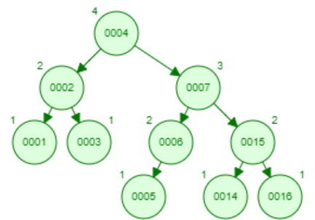
Final tree
Final balance
4
1
2
The imbalance at 4 went away by rotating the lower imbalance at 6
I.e., don’t need to handle upper imbalance points, just handle the lowest one
2
7
0
0
1
1
15
1
3
6
0
0
-1
-1
-1
-1
0
-1
5
14
16
-1
-1
-1
-1
-1
-1

Slide 27
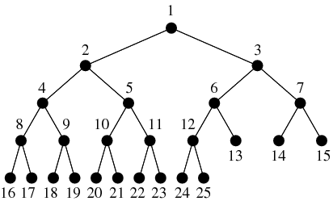
AVL path lengths
In a complete BT, paths root to leaf differ by at most 1

Slide 28
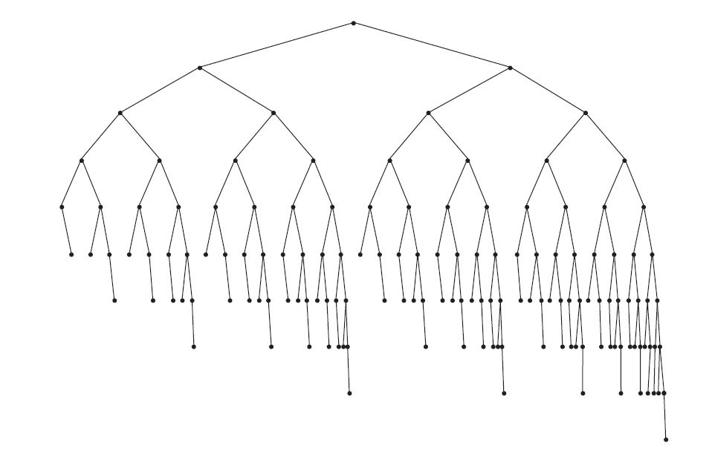
AVL path lengths
AVL balance does not create complete BT’s
Here’s a valid AVL tree
Check out the path lengths root to leaf, do any differ by more than 1?

Slide 29
AVL tree operation time complexities
Operation | Worst ( O(·) ) | Average ( O(·) )
insert | log n | log n
remove | log n | log n
findMin/findMax | log n | log n
contains | log n | log n
empty | 1 | 1
size | 1 with counter, n without | 1 with counter, n without
getValue | 1 | 1
Pretend everything in the table is inside O(·)
The only difference in code for the methods is for insert and remove, balance happens as needed

Slide 30
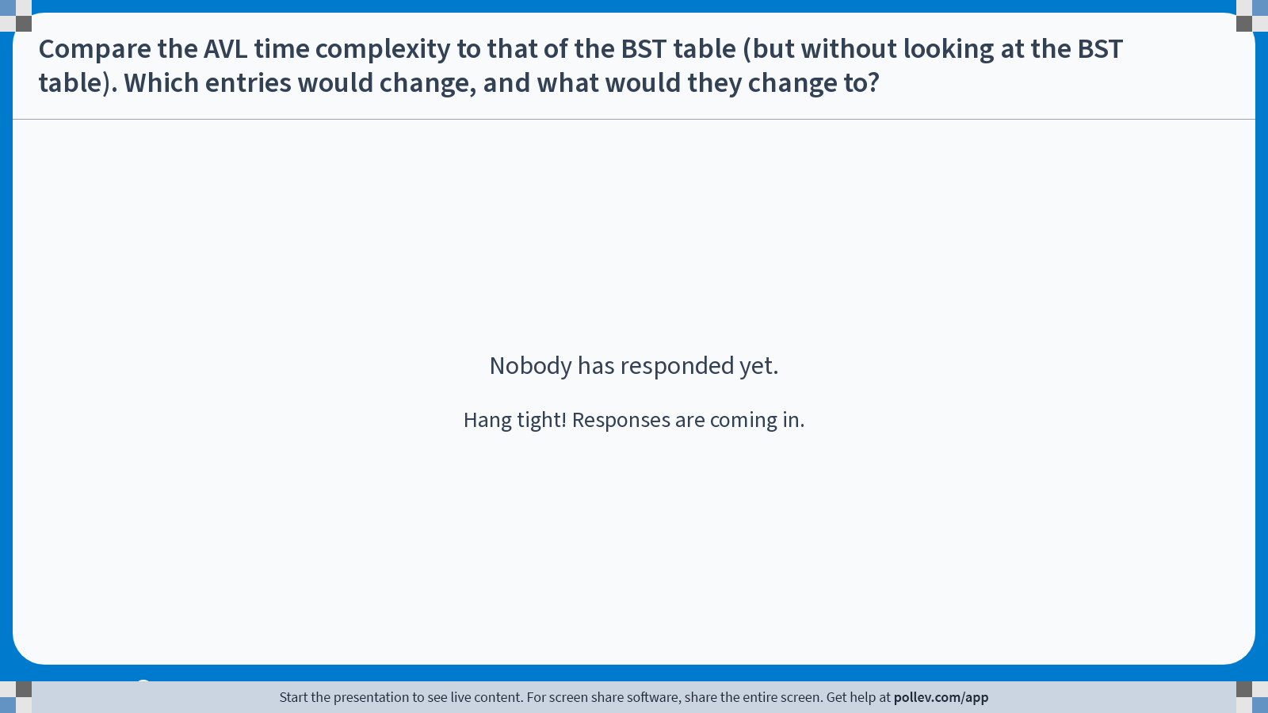
Notes:
Poll Title: Do not modify the notes in this section to avoid tampering with the Poll Everywhere activity. More info at polleverywhere.com/support Compare the AVL time complexity to that of the BST table (but without looking at the BST table). Which entries would change, and what would they change to? https://www.polleverywhere.com/free_text_polls/sRFEKcATvGmhGFWOFjHBt

