Slide 1
L18 – Graphs
7/22/24

Slide 2
Announcements
EX10 due tomorrow 7/23
EX11 releases tonight, due LDOC
QZ06 on Wednesday or Thursday (tentative)

Slide 3
Bipartite question
Prove that trees (no parent pointer) are bipartite using induction
Base case: single node is bipartite
Inductive case: assuming tree with n nodes is bipartite, show that tree with n+1 nodes (i.e., add a leaf) is bipartite

Slide 4
Modeling with graphs
bost
seatt
20
70
chi
nyc
30
10
20
50
30
10
5
denv
50
sfr
20
70
dc
25
40
10
10
40
30
20
char
15
90
20
20
la
dall
25
atl

Slide 5
Modeling with graphs, cont.
What is the min cost from NYC to LA?
NYC –5> DC –10> Char –30> Dall –20> Denv –40> LA
105
We’ll learn some algorithms for determining this
From any city, can I get to any other city?
I.e., is graph strongly connected?

Slide 6
Modeling with graphs, cont.
301
493
524
533
210
311
523
431
283
455
426
520
541
535
550
(numbers are outdated)

Slide 7
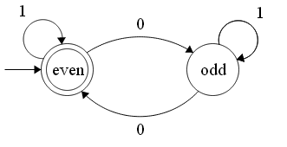
Modeling with graphs, cont.
FSM (finite state automaton) – simple computer
Details in 455
This one checks if a string has an even number of 0’s
Vertices are “states”
Numbers on edges are not weights, they’re input characters
Find (cmd/ctrl + F) implemented with regex, implemented with FSM

Slide 8

Modeling with graphs, cont.
Graph of Wikipedia
Each color is a community the author found, of which there are 28 (e.g., politics & law, football (soccer), video games)

Slide 9
Graph representation
2 main approaches
Adjacency matrix
Edge information tracked in 2D array
AM[i][j] represents an edge from vertex i to vertex j
Adjacency list
Each vertex object maintains a list of edge objects

Slide 10
Adjacency matrix (unweighted)
For N nodes, use N x N array of Boolean
If AM[a,b] then (a,b)∈E
Edge from A to B
destination
A B C D
A
D
A
B
C
D
F
T
T
T
source
F
F
F
F
F
T
F
F
B
C
F
F
T
F

Slide 11
Adjacency matrix (weighted)
Array elements now integer or float
destination
2
A B C D
A
D
A
B
C
D
0
3
6
2
6
4
3
source
0
0
0
0
0
2
0
0
B
C
2
0
0
4
0

Slide 12
Adjacency matrix performance
Pros and cons in terms of time and space complexity?
Use V = vertices, E = edges, |V| = # vertices, |E| = # edges
How fast to determine if there’s an edge from A to B?
How fast to find all edges of A?
Amount of space used?
O(1)
O(|V|)
O(|V|²)

Slide 13
Adjacency matrix space problem
Problem is wasted space
64 spaces, 55 not used
O(|V|²) space
If |E| << |V|², the graph is sparse
If |E| ≈ |V|², the graph is dense
T
8 nodes
T
T
T
T
T
T
T
T

Slide 14
Sparse or dense? Traffic example
Let V be street intersections
Let E be streets between V
Model as digraph
Undirected might make more sense
Is it sparse or dense?

Slide 15
Traffic example explanation
Each node has maximum 4 edges out
Nodes on the perimeter have fewer than 4
|E| ≈ 4|V|
For large V, |E| << |V|²
Suppose there are 3000 intersections
Matrix has 3000² = 9000000 cells
Number of cells used is 4(3000) = 12000
0.13% used
Sparse

Slide 16
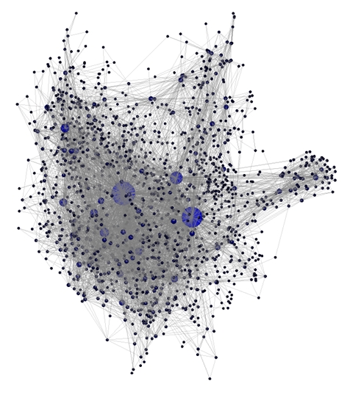
Sparse or dense?
1538 nodes, 8032 edges
1538² = 2365444
8032 << 2365444
Sparse

Slide 17
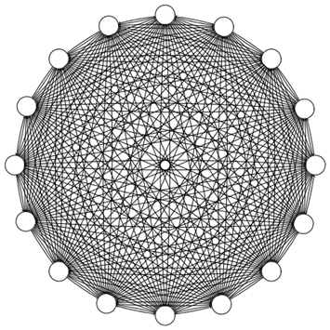
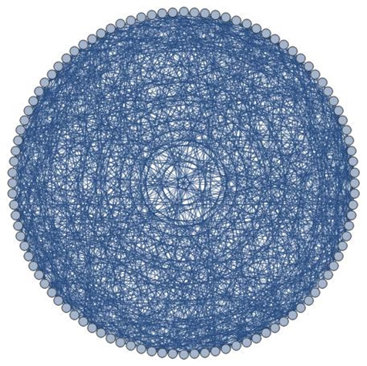
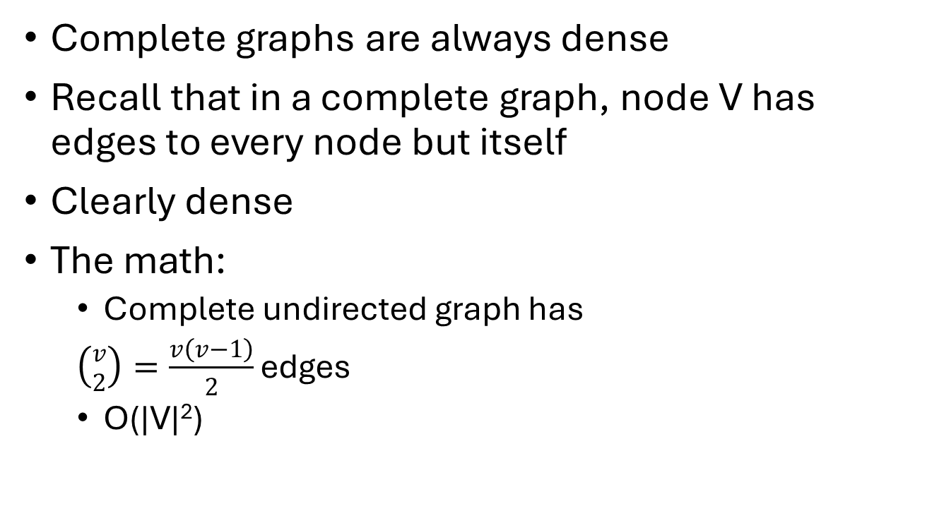
Complete graph density
Complete graphs are always dense
Recall that in a complete graph, node V has edges to every node but itself
Clearly dense
The math:
Complete undirected graph has
$\left({v \atop 2}\right)=\frac{v\left(v−1\right)}{2}$ edges
O(|V|²)
K4
K16
K4 | 0 | 1 | 2 | 3
0 | F | T | T | T
1 | T | F | T | T
2 | T | T | F | T
3 | T | T | T | F
K100

Slide 18
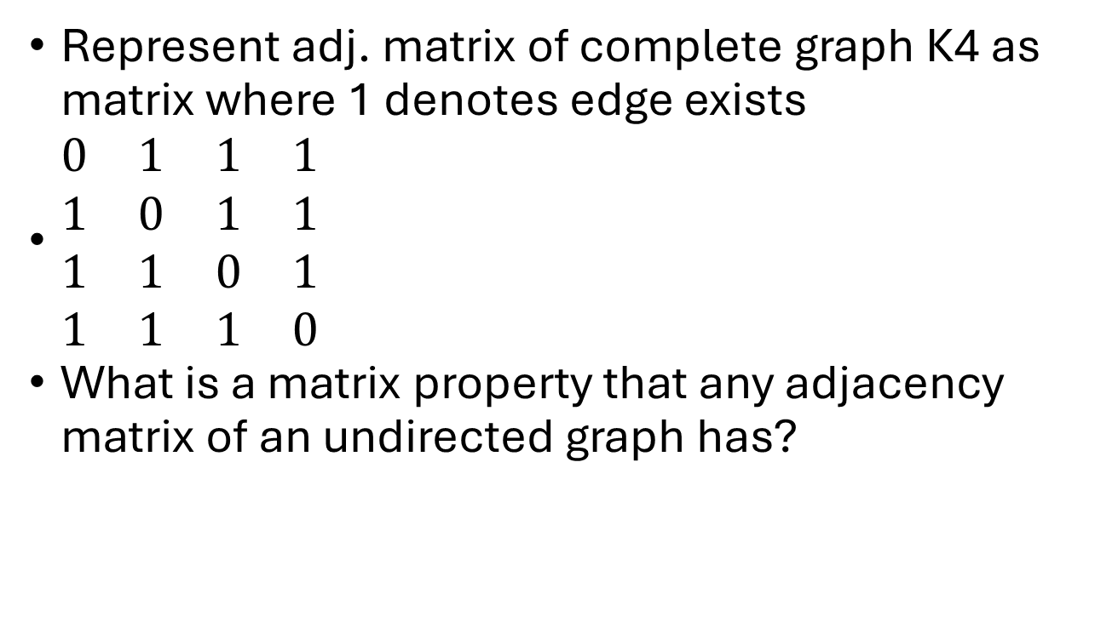
Adjacency matrix of undirected graph
Represent adj. matrix of complete graph K4 as matrix where 1 denotes edge exists
$\begin{matrix}0 & 1 & 1 & 1 \\ 1 & 0 & 1 & 1 \\ 1 & 1 & 0 & 1 \\ 1 & 1 & 1 & 0\end{matrix}$
What is a matrix property that any adjacency matrix of an undirected graph has?
Symmetric
A = A^{T}
For every i, j, a_{ij} = a_{ji}

Slide 19
Adjacency matrix summary
Easy to code
Usually wastes most of its space
When sparse, finding adjacent nodes is expensive
O(|V|) to find only a few adjacent vertices

Slide 20
Adjacency list
Keep list of vertices
Each vertex has a list of adjacent vertices
Remind you of anything we learned recently?
A
B
C
D
A
D
B
C
B
D
C
B
C

Slide 21
Adjacency list typing
List of lists
List<List<Vertex>>
Get edges of vertex 0 with al.get(0)
HashMap of lists
HashMap<String, List<Vertex>>
Suppose we represent node a with the String “a”
Then get its edges with al.get(“a”)
Array of lists
List<Vertex>[]
al[0]
Pros and cons?

Slide 22
Adjacency list (weighted)
If edges are weighted, store the weight in the cell
This example uses array for vertices and linked list for edges
What would HashMap for vertices look like?
4
A
3
E
0
1
2
3
4
A
2
2
3
1
4
3
6
B
2
1
B
2
1
C
1
3
3
5
D
1
D
C
5
E
1
6
0
4
3

Slide 23
Adjacency list performance
Amount of space used in terms of V and/or E?
Worst-case, find all vertices adjacent to some node v?
Normally O(|list for v|)
O(|V| + |E|)
We call this “linear” for graphs
“size” of graph is |V| + |E|
O(|V|)
Complete graph

Slide 24
Adjacency list efficiency
Need a HashMap for vertices
See Adjacency list typing slide
Many graph algorithms will be inefficient without
If you need to find a vertex, cannot afford to do O(|V|) search through all vertices list without making many algorithms become quadratic or worse
May want similar hash structure for edges
E.g., HashMap<String, HashMap<String, Vertex>>
If a and b are nodes, to see if b is adjacent to a, do map.get(“a”).containsKey(“b”)
O(1)
Inner LinkedList for edges is instead O(|V|)
To get all edges of a, use a for-each loop, keySet(), etc., on map.get(“a”)

Slide 25
Topological sort (topo sort)
First graph algorithm
Computed for DAG G
An ordering of all vertices in G such that if (u,v) ∈ E, then u<v in the sort (u precedes v in the sequence)
Every DAG has at least 1 topo sort
Some have more than 1
If a graph has a cycle, then it does not have a topo sort (why?)

Slide 26
Examples
In-degree of vertex b
Number of edges coming to b
Number of edges (a, b) ∈ E for distinct a
Number of vertices b is adjacent to
A
Note that A has no in-edges,
and B has no out-edges
A
B
C
only 1 topo sort
A, C, B
Check:
(A,B) in E… A<B in sort
(A,C) in E… A<C in sort
(C,B) in E… C<B in sort
B
C
no topo sort
Note that every vertex has at least one in-edge and one out-edge

Slide 27
Examples
A
D
A
D
B
C
B
C
3 topo sorts
A, B, D, C
A, D, C, B
A, D, B, C
only 1 topo sort
A, D, C, B

Slide 28
Properties
A
Topo sort -> at least one vertex with no in-edge and
at least one vertex with no out-edge
X
Y
B
C
Not sufficient: If there is some vertex with no in-edge and some vertex with no out-edge, there may still be no Topo Sort (may or may not)
A
If all vertices have both
in-edges and out-edges,
there is no Topo Sort
B
C
A
D
Necessary: If a graph has a Topo Sort, there is some vertex with no in-edge and some vertex with no out-edge
Necessary and sufficient meaning
B
C

Slide 29
Uses
401
493
524
533
Use topo sort for structures like course pre-requisites
The sorts give OK orders of classes to take
410
411
523
431
283
455
426
520
541
535
550
Numerous topological sorts
283, 401, 455, 410, 426, 535, 493, 520, 550, 411, 431, 533, 541, 520, 523
401, 283, 455, 410, 426, 535, 493, 520, 550, 411, 431, 533, 541, 520, 523
401, 283, 455, 410, 426, 535, 493, 520, 550, 411, 431, 533, 541, 523, 520
Outdated numbers, but good example
etc.

Slide 30
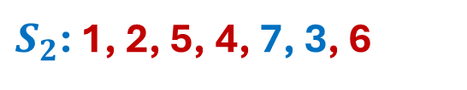

Algorithm to find a topo sort
We’ll use this graph for our example
1
2
3
4
5
Two topo sorts
6
7
$S_{1}$: 1, 2, 5, 4, 3, 7, 6
$S_{2}$: 1, 2, 5, 4, 7, 3, 6

Slide 31
Algorithm
Find a topo sort in O(|V| + |E|) (linear time)
Assume G = (V, E) was built using adjacency list and that in-degree of each node was stored during the build
Any nodes with in-degree 0? If no, then cycle, done.
Pick any node v with in-degree 0. Put v into the TS
Decrement in-degree of any node w where (v, w) ∈ E (essentially remove v and its out-edges from graph)
More nodes? Goto step 1, else done

Slide 32
Execute on Example
0
1
1
2
2
3
1
1
TS:
, 2
3
4
5
Node 1 has in-deg 0 so put it into TS
6
7
Remove node 1, out edges, and redo in-degrees
3
2
0
Node 2 has in-deg 0 so put it into TS
2
Remove node 2, out edges, and redo in-degrees
1
2
1
3
4
5
1
1
0
3
4
5
6
7
3
2
6
7
3
2

Slide 33
Execute on Example
1
1
0
3
4
5
TS:
1
, 2
, 5
, 4
, 7
, 3
, 6
6
7
Node 5 has in-deg 0 so put it into TS
3
2
Remove node 5, out edges, and redo in-degrees
1
0
Node 4 has in-deg 0 so put it into TS
3
4
Remove node 4, out edges, and redo in-degrees
Nodes 3 and 7 have in-deg 0 so pick one, put in TS
6
7
3
1
Node 3 into TS, remove it
3
0
Node 6 into TS, remove, done
2
0
3
0
0
6
1
6
7
6

Slide 34
What happens with cycles?
1
2
TS:
A
D
Can’t even start this one
1
1
C
There are no vertices with
in-degree 0
B

Slide 35
What happens with cycles?
0
1
C
A
TS:
C
A
Length is not |V|, invalid
2
2
B
E
0
A
1
1
B
E
D
1
2
2
B
E
D
1
D
1
There are no vertices with
in-degree 0
However there are unprocessed nodes
So, we have found cycle(s)
So, no Topo Sort possible

Slide 36
Try on this graph (several topo sorts)
1
0
1
1
Topo Sort:
1 choice: 0, 1
5 choice: 0, 5
0 choice: 0, 8
8
2
7
6
3
4
10 choice: 9, 10
9
8
2
2
2
2
5
7
3
0
2
4
0
3
9
3
6
10
2

Slide 37
Topo sort algorithm analysis
O(|V| + |E|)
Examine and remove each vertex, each removal O(1) so O(|V|)
While examining, operate on each out edge once by decrementing in-degree of destination vertex, so O(|E|)
This is what we hope for, actually depends on several factors
Remove each vertex O(1)
Decrement in-degree of destination vertex O(1)
Find vertex with in-degree 0 O(1)
If you have to do a linear search through all vertices, then O(|V|), and the algorithm’s complexity is then O(|V|² + |E|)

Slide 38
Efficient topo sort impl
Compute initial in-degree of each vertex while graph is built
O(|E|)
While building graph, while making the entry for vertex u, for each of its edges (u, v_{i}), access Vertex v_{i} in O(1) and increment its in-degree (store it as field in Vertex class) in O(1)
Scan through all vertices and identify all with in-degree 0, add to queue
O(|V|)
While the 0-in-degree queue is not empty
Take a vertex off the queue and add it to the topo list
Examine each edge and “remove” it by decreasing the in-degree associated with the edge’s destination
If in-degree of a destination vertex falls to 0, add it to the 0-in-degree queue
When 0-in-degree queue is empty, if topo list does not contain |V| vertices, then must have found a cycle, no topo sort possible
Otherwise, topo list is valid
Now O(|V| + |E|)

Slide 39
Shortest path
Many problems require us to find shortest path from vertex v to vertex w
Simple example, road navigation
Look at 2 situations
Digraph with unweighted edges
Weight 1 on all (want shortest path length)
Digraph with weighted edges
Want lowest cost
Digraph Example
2
A
B
Going from A to F
4
1
3
10
Weighted: shortest path is
A, D, G, F with a cost of 6
2
7
C
D
E
5
8
4
6
Unweighted: shortest path is
A, D, F with a length/cost of 2
F
1
G

Slide 40
Unweighted shortest path
Input: Unweighted digraph G = (V, E), start vertex s where s∈V
Output: shortest path(s) from s to every other vertex
Unweighted algorithm in O(|V|²) fairly simple
Adding weights complicates things, Dijkstra’s algorithm

Slide 41
Bad unweighted shortest path
Recognize that no shortest path can be longer than |V| - 1
Run a loop with len going from 0 to |V| - 1 (inclusive)
In loop, go through all nodes and when we find one with distance “len”, we mark all unmarked adjacent nodes with distance “len + 1”
Double nested loops O(|V| - 1) * O(|V|) is O(|V|²)

Slide 42
(Bad) Unweighted Shortest Path
C is marked 0 to start
currDist = 0,
find all nodes marked 0
A
B
2
We find C, and mark adjacencies 0+1
1
2
3
currDist = 1,
find all nodes marked 1
C
D
E
We find A, and mark adjacencies 1+1
0
1
3
We find F, no adjacencies
F
G
currDist = 2,
find all nodes marked 2
We find B, and mark unmarked adjacencies 2+1
Output is a graph with each node being labeled with the shortest distance from C
We find D, and mark unmarked adjacencies 2+1

