Slide 1
L14/15 - AVL
7/16/24, 7/17/24

Slide 2
Announcements
Schedule updated through to final exam
2-3 more quizzes
QZ04 graded
Great job! Super detailed, rigorous answers
Release quiz medians?
EX08 due tonight
EX09 releases today
Only 3-4 exercises left, EX09 (AVL), EX10 (HashMap), EX11 (Dijkstra’s algorithm)

Slide 3
AVL tree – why?
BST gets more linear as it is used (deletes) and if the build has a poor element sequence (partially sorted)
BST ops are only efficient (O(log n)) if the tree is close to minimal height (where n is #nodes)
Recall that operations such as contains, insert, remove must traverse down a level at most height times
AVL tree (Adelson-Velskii and Landis) is a BST with a balance condition that maintains low height, bushy structure as we add and delete nodes

Slide 4
Imbalanced BST example
After only a few ops
10
9
15
2
12
20
1
4
25
22
8
31
5
27
45

Slide 5
AVL balance condition
At every node,
| h_{L}– h_{R} | ≤ 1
Height of left subtree and height of right subtree differ by at most 1
We will define the height of a null subtree to be -1

Slide 6
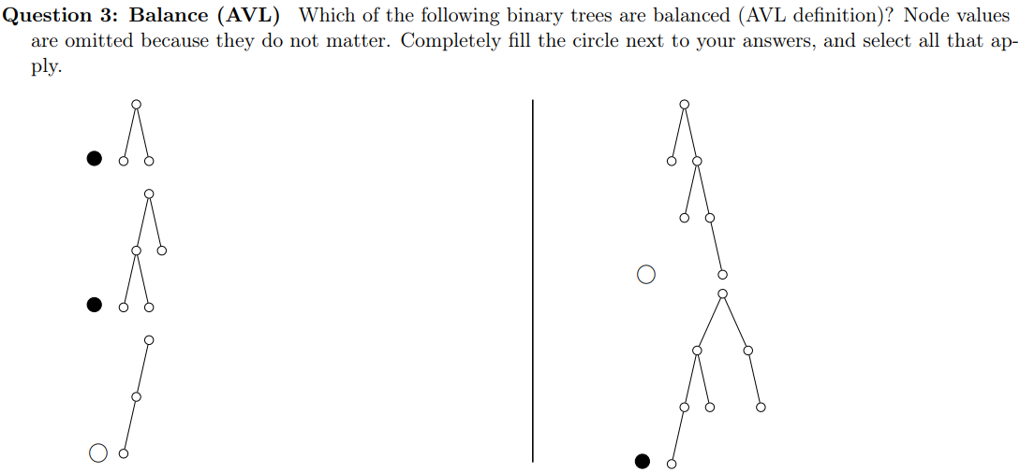
AVL balance examples
0 0
On each node, the left number is height of left subtree
The right number is height of right subtree
-1 -1 -1 -1
1 -1
0 -1
-1 -1

Slide 7
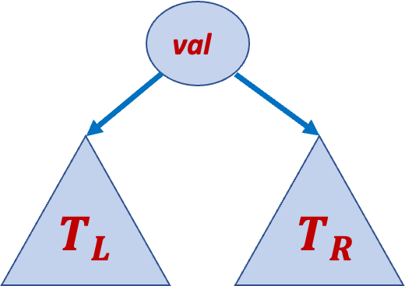
AVL invariants
All values in T_{L} < val
All values in T_{R} > val
Note: duplicates not allowed like in BST
See left-rotate and right-rotate diagrams
Duplicate value would break BST order invariants
| h_{L}– h_{R} | ≤ 1
T_{L} is an AVL BST
T_{R} is an AVL BST

Slide 8
Rotate to maintain balance
When we insert a node (or remove), it might make two subtrees differ in height by 2
When this happens, re-balance with rotation

Slide 9
Rotate to maintain balance, cont.
When we insert a new node (new leaf), it may or may not cause an imbalance
If there is, the imbalance point occurs somewhere along the path from insertion (new leaf) to root
Keep track of h_{L} and h_{R} at each node
When some node has h_{L} = h_{R} + 2 or h_{R} = h_{L} + 2, do a rotation
We have single and double rotations

Slide 10

Imbalance
$$we define$$
$$height of$$
$$null as −1$$
P
-1
-1
Imbalance at this node because -1 – 1 = -2
All other nodes on this slide are fine, difference at most 1
P
1
-1
R
R
-1
0
0
-1
X
P
-1
-1
-1
-1
P
0
0
G
R
-1
-1
-1
-1

Slide 11
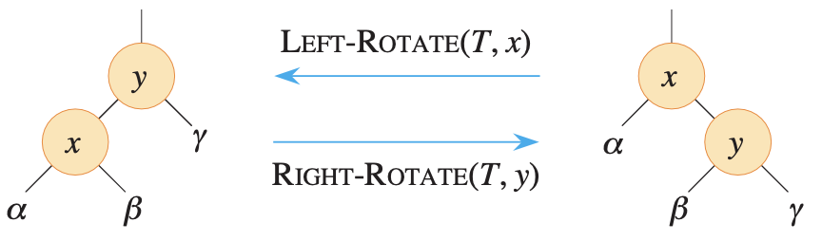
Basic single rotation
Root becomes child, pivot (child) becomes root
Root and pivot “switch places”
Subtree β’s parent switches from pivot to root
Its parent is x on left, its parent is y on right
Switches from pivot’s R to root’s L or pivot’s L to root’s R
When right-rotating y, x must not be null. When left-rotating x, y must not be null. α, β, γ may be null
Check BST inequalities
x < y on both sides
β parent link is moving, β > x, β < y on both sides

Slide 12
LL single rotation example
Insert 3, 2, 1 (inserting 1 causes imbalance)
Imbalance at 3 because 1 – (-1) is 2
So right-rotate at 3
3
1
-1
2
0
-1
R
3
P
1
Right-rotate(3)
2
-1
-1
P
2
Z
R
3
1
Y
1
X
X
Y
Z

Slide 13
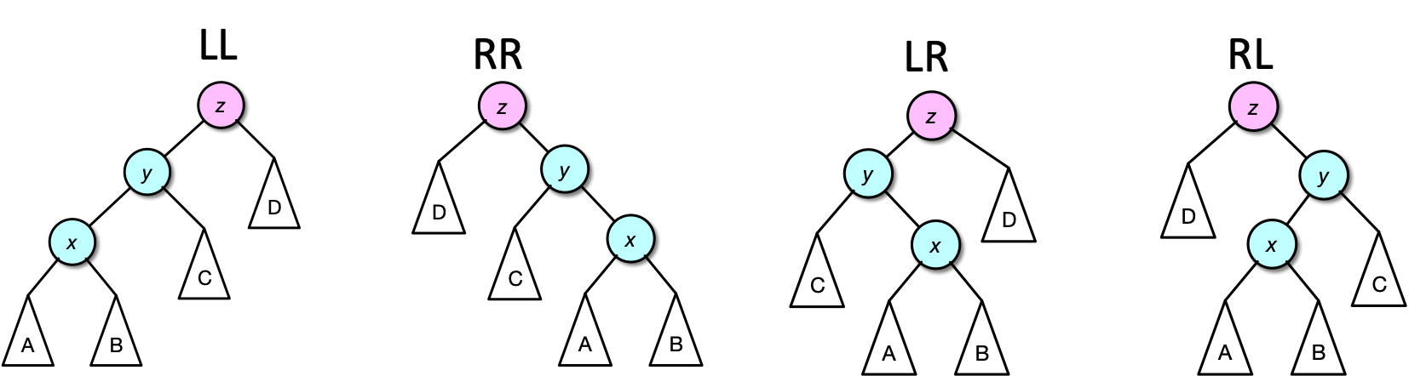
4 rotation cases – LL, RR, LR, RL
We called the previous slide’s case “LL” because at the imbalance point, its child and grandchild on the path to newly-inserted leaf both follow left pointers
Similar reasoning for all 4 cases, shown below
Insertion must create a new leaf in either subtree A or B because x is on path from insertion to imbalance point (by definition above)
x and y are not imbalanced (before and now), otherwise either of those would be the first place there is imbalance
z, x, y must be non-null. A, B, C, D may be null

Slide 14
RR single rotation example
Insert 4, 5, 6, 7
Imbalance at 3 after insert(5) because -1 – 1 = 2
Case is RR (why?)
So left-rotate at 3
Imbalance at 2 after insert(6) because 0 – 2 = -2
Another RR case (why?)
So left-rotate at 2
2
2
2
0
2
1
3
Left-rotate(3)
Insert(6)
-1
1
1
4
1
4
0
1
4
-1
0
3
3
5
5
-1
0
5
-1
-1
6
-1
-1
Need only write heights and check balance on path from new leaf to root (i.e., can ignore node 1)

Slide 15




RR, cont.
Fix imbalance at 2 (RR case) with left-rotate(2)
Draw pattern chart for more complex case
P
R
4
2
Left-rotate(2)
R
2
5
P
4
1
1
3
6
Z
X
3
5
X
Y
Y
Z
6
Check BST inequalities
Y parent link is moving
$$Y<P$$
$$Y>R$$
Z $>P$
Z $>R$

Slide 16
RR, cont.
Insert(7)
Imbalance at 5
RR case
Left-rotate at 5
4
2
5
-1
1
4
Left-rotate(5)
1
3
6
0
2
Balanced!
-1
6
7
1
3
5
7
-1
-1

Slide 17
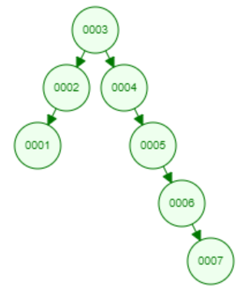
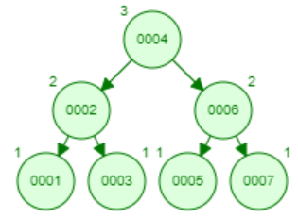
BST vs. AVL
In previous slides, inserted [3, 2, 1, 4, 5, 6, 7], a partially sorted sequence
Terrible insertion sequence for BST
As pictured, double linked list structure
AVL balancing makes a balanced tree that maintains O(log n) operations
Visualization
Note: Does weird double rotations seemingly in a single step for LR and RL cases
But if you follow our examples, you’ll end up with the same result
Also doesn’t number at the left and right of each node, but it’s basically the same

Slide 18
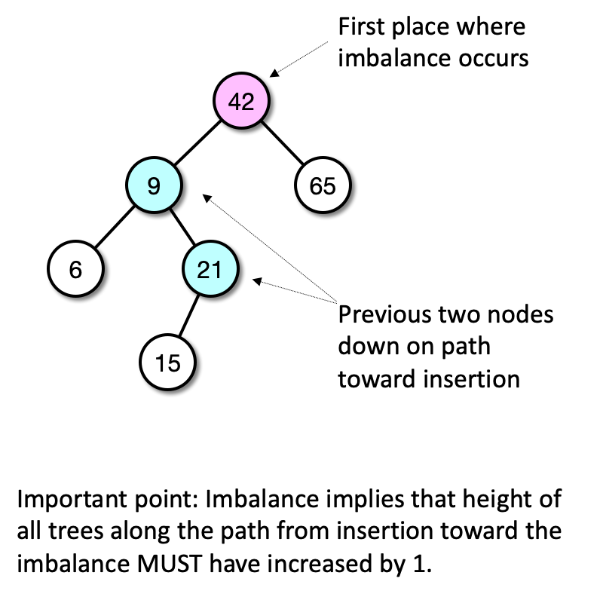
AVL insertion rebalancing
After inserting value into an AVL tree, walk back up from new leaf to root and find the first place where balance factor is illegal (if any)
Keep track of the previous two nodes down toward the new leaf (child and grandchild of imbalance point on that path)
This is where we’ll rotate to restore the AVL balance invariant
Now we’ll discuss how to fix all 4 cases (in general)

Slide 19
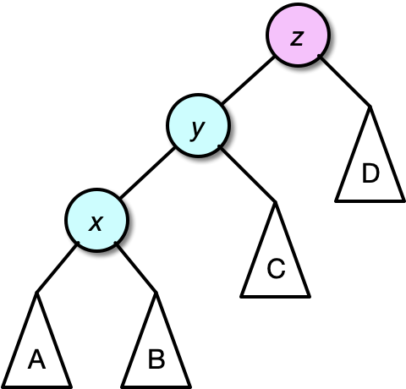
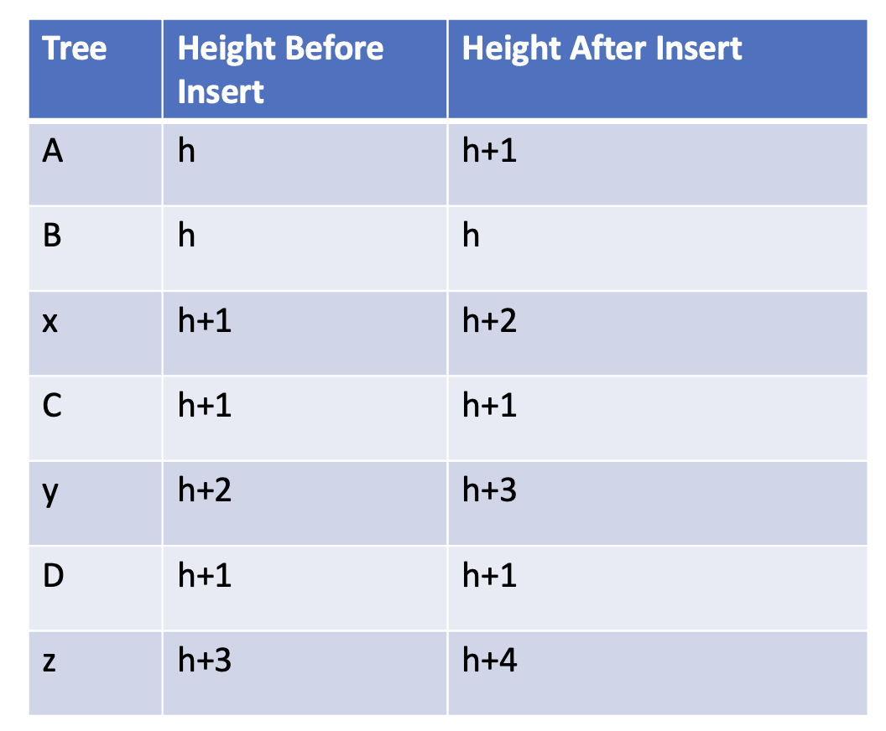
LL
Recall from a previous slide that in this diagram, the inserted leaf must be in A or B
Without loss of generality, say the insertion occurred in A (the same logic will work for B) and that height of A went from h to h+1

Slide 20
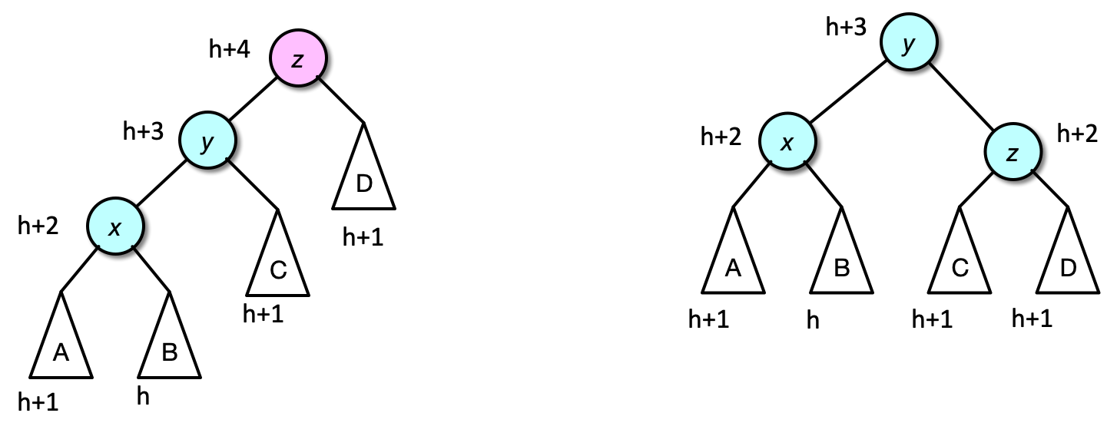
Fix LL with right-rotation at imbalance
Right-rotate(z)
Recall that z is our imbalance point, x and y are the child and grandchild of z on path to new leaf
Check inequalities, if needed

Slide 21
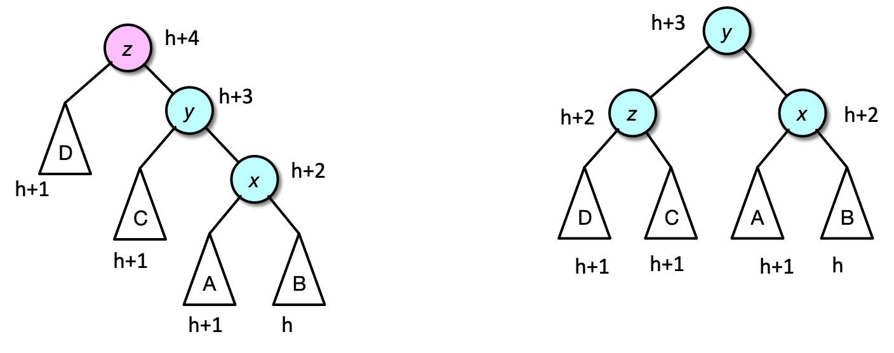
Fix RR with left-rotation at imbalance
Left-rotate(z)

Slide 22
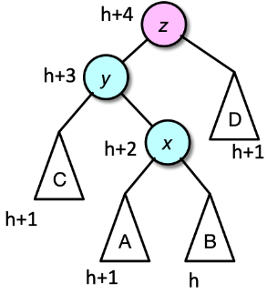
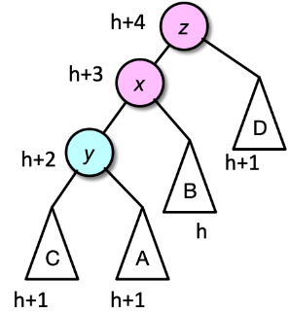
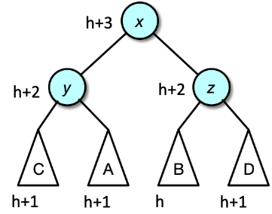
Fix LR with double rotation
Reduced to LL!
Left-rotate(y)
Right-rotate(z)

Slide 23
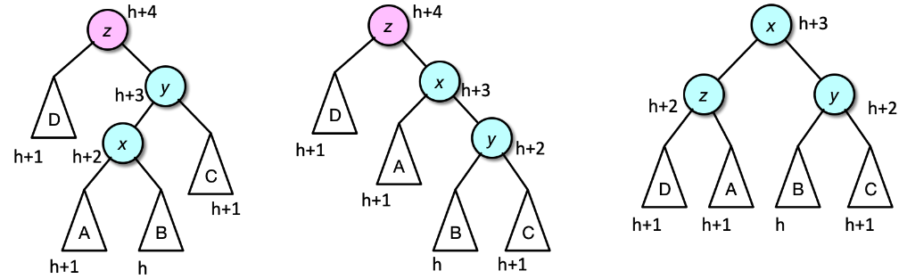
Fix RL with double rotation
Reduced to RR!
Right-rotate(y)
Left-rotate(z)

Slide 24
RL double example
Now RR
Left-rotate(7)
7 was original imbalance point
Now insert 16 then 15
Insert(15) causes imbalance at 7
RL (why?)
Right-rotate(16)
16 is child of imbalance
4
4
2
6
2
6
1
3
7
Right-rotate(16)
5
Left-rotate(7)
1
3
5
7
15
-1
1
16
16
4
0
-1
15
2
6
-1
-1
1
3
5
15
7
16

Slide 25
RL double example, cont.
Now RR case
Left-rotate(6)
6 was original imbalance point
4
2
6
Now insert 14
1
3
5
7
4
Imbalance at 6 (and 4, but fixing 6 will fix 4 automatically)
RL case (why?)
Right-rotate(15)
15 is child of imbalance
1
3
15
2
6
0
2
Left-rotate(6)
14
16
1
3
5
15
Right-rotate(15)
1
0
7
16
4
-1
0
-1
-1
14
2
7
-1
-1
1
3
6
15
5
14
16

Slide 26
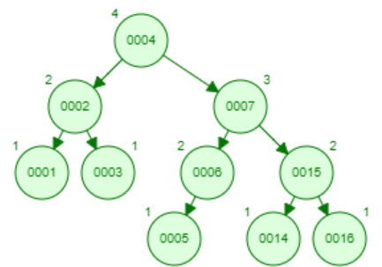
Final tree
Final balance
4
1
2
The imbalance at 4 went away by rotating the lower imbalance at 6
I.e., don’t need to handle upper imbalance points, just handle the lowest one
2
7
0
0
1
1
15
1
3
6
0
0
-1
-1
-1
-1
0
-1
5
14
16
-1
-1
-1
-1
-1
-1

Slide 27
Remove
Overall, similar to insert. Do the remove as normal and then check if there is imbalance. If so, rotate
For imbalance, check starting from the parent of the actually deleted node
Recall remove has 3 cases: 0-child, 1-child, 2-child
For 0-child, we simply unlink the node to be removed. Check starting from its parent
For 1-child, we make the removed node’s parent point to the removed node’s child. Check starting from the removed node’s parent
The removed node’s child was balanced and will still be balanced because the heights of its subtrees don’t change
For 2-child, we find the value to be deleted, set that node’s value to that of its R subtree’s min, then delete the R subtree’s min, which is always a 0-child or 1-child case. Follow the 0 or 1 child rule above for the deleted min of R subtree
i.e., Don’t check starting from the original node to be removed to which a value was copied
May get LL, RR, LR, or RL case as with insertion. Case recognition is different, however (next slide)
May have to rotate on a node not on the path to the deleted node

Slide 28
LL, RR, LR, RL case recognition for delete
Let imbalance point be z (i.e., balance factor > 1) and let h_{L} and h_{R} denote heights of left and right subtrees
if z.h_{L} > z.h_{R} // Lx case, but need to figure out which
if z.left.h_{R} > z.left.h_{L}
LR case
else
LL case
else // z.h_{R} > z.h_{L}, Rx case, but need to figure out which
if z.right.h_{L} > z.right.h_{R}
RL case
else
RR case
Once you have the case, it is trivial to identify z, x, and y in our diagrams. Fix the case as usual, but continue to overall root to check any other imbalances (unlike insertion)
This algorithm is derived from our 4 diagrams and also holds for insertion (did not use it earlier because case recognition is easy for insertion without this algorithm)

Slide 29
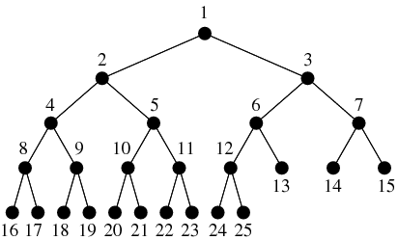
AVL path lengths
In a complete BT, paths root to leaf differ by at most 1

Slide 30
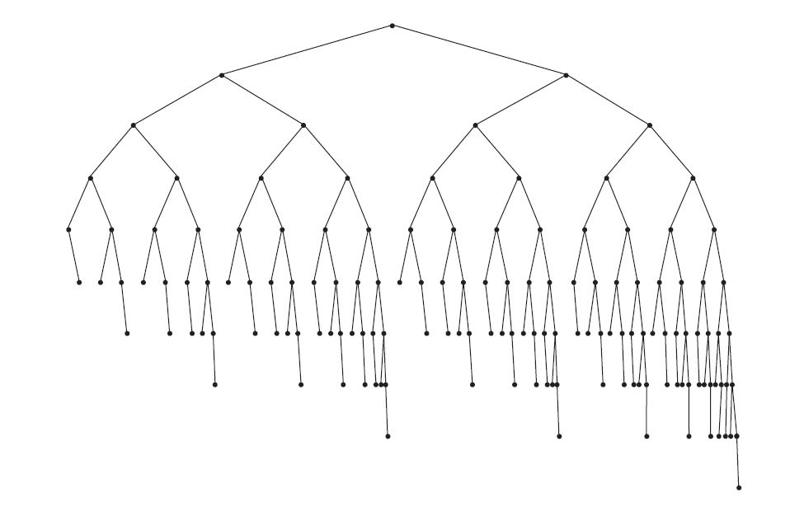
AVL path lengths
AVL balance does not create complete BT’s
Here’s a valid AVL tree
Check out the path lengths root to leaf, do any differ by more than 1?

Slide 31
AVL tree operation time complexities
Operation | Worst ( O(·) ) | Average ( O(·) )
insert | log n | log n
remove | log n | log n
findMin/findMax | log n | log n
contains | log n | log n
empty | 1 | 1
size | 1 with counter, n without | 1 with counter, n without
getValue | 1 | 1
Very similar to BST time complexities
The only code differences are in insert and remove
Balance as needed
Disallow duplicates

Slide 32
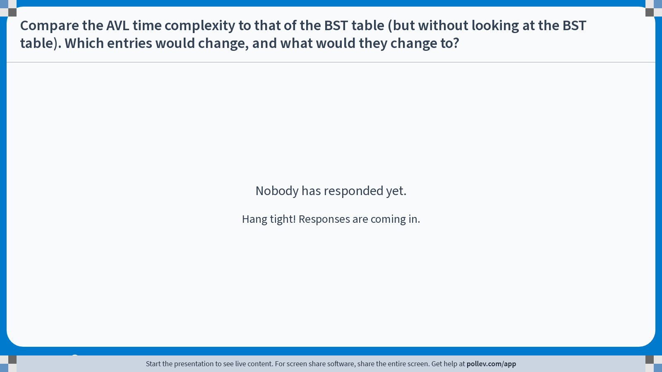
Notes:
Poll Title: Do not modify the notes in this section to avoid tampering with the Poll Everywhere activity. More info at polleverywhere.com/support Compare the AVL time complexity to that of the BST table (but without looking at the BST table). Which entries would change, and what would they change to? https://www.polleverywhere.com/free_text_polls/sRFEKcATvGmhGFWOFjHBt

Slide 33
EX09 (AVL) details
Most details will be given in the EX09 README, similar to EX08
For EX09, you will copy-paste your EX06/07 BST code and make a few modifications
Should write the following helper methods
AVLTree<T> rotateLeft(), AVLTree<T> rotateRight()
Implements basic single rotation
Calls updateHeightAndSize
void updateHeightAndSize()
Modifies _height and _size fields after AVL rotation or insert/remove
AVLTree<T> fixIfImbalanced()
Call fixIfImbalanced at the end of insert and remove (i.e., copy-paste your previous insert/remove code and add this at the end)
Detect whether this is imbalanced. If so, detect LL/RR/LR/RL and call rotation method(s) to fix
Requires _height and _size to be correct

Slide 34
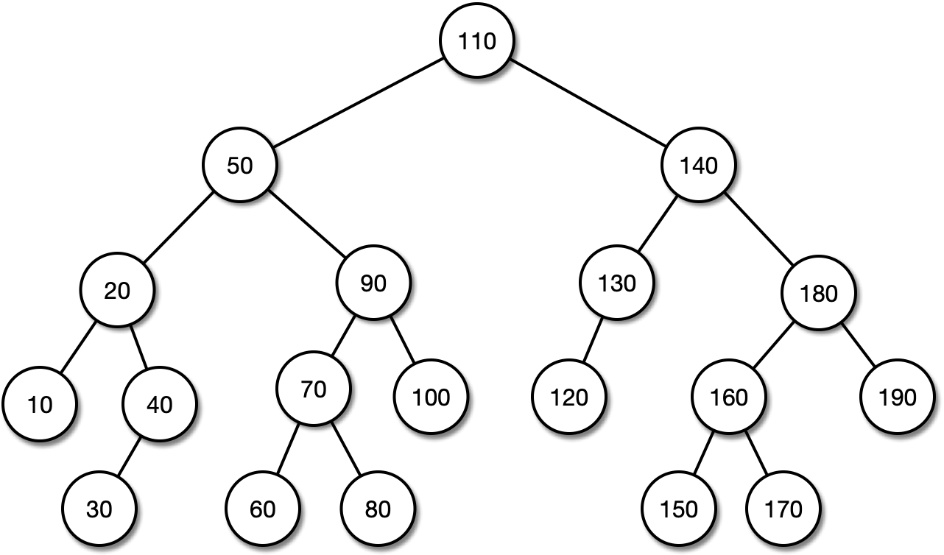
Practice problem 1
Insert 55

Slide 35
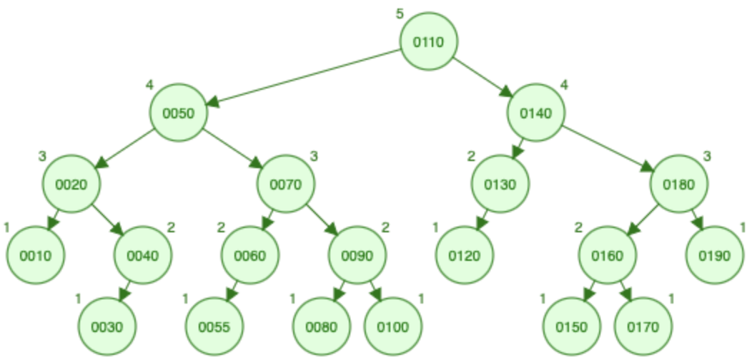
Practice problem 1 solution
55 goes to the left of 60
Causes imbalance at 90
LL case
Right-rotate(90)

Slide 36
Practice problem 2
Remove 110
Use R subtree method

Slide 37
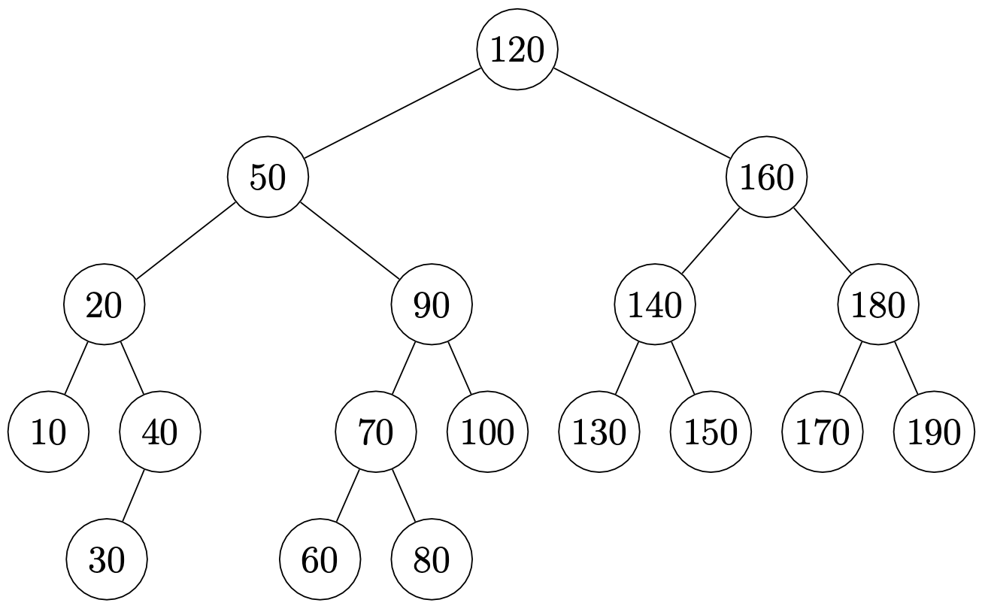
Practice problem 2 solution
Using min of R subtree method, 120 is copied to where the 110 was
Then the 120 to the left of 130 is removed
Check for imbalance starting at 130 and going to root
There is imbalance at 140
RL case
Following the case recognition algorithm on previous slide
z=140, y=180, x=160
Solve with right-rotate(180), then left-rotate(140)
Ancestors also balanced
Whole tree is balanced
Note: Visualization site gives different result since it uses L subtree method

Slide 38
Practice problem 3
Remove 40

Slide 39
Practice problem 3 solution
Remove the 40 normally
No rotations required, tree remains balanced

Slide 40
Another example question
You should be able to identify
A value that when inserted will
not cause a rotation
cause a single rotation
cause a double rotation
A value that when deleted will
not cause a rotation
will cause a single rotation
will cause a double rotation

