Slide 1
L19 – Graph Algorithms
7/23/24

Slide 2
Announcements
QZ06 on LDOC
Topics are L18-L20 (everything before LDOC)
Can hold a review session tomorrow after class or on Zoom later in the evening
EX11 out, due LDOC
After quiz on LDOC, the rest of class will be a final exam review session

Slide 3
Outline
Topo sort warmup
Finish yesterday’s slides
Move on to these

Slide 4
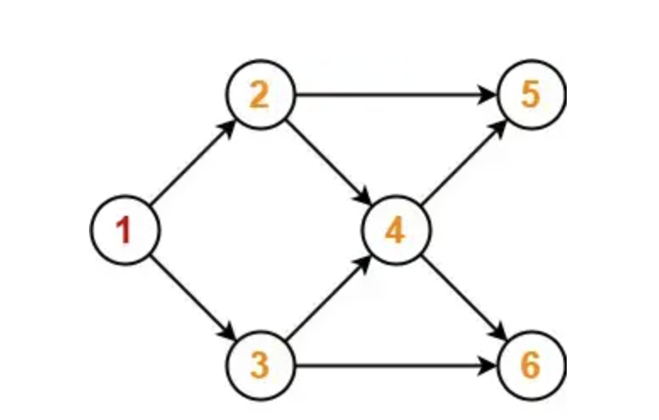
Find the topo sort(s)
Number | Choice(s)
1
2 | 2, 3
3
4
5 | 5, 6
6

Slide 5
Bad SSSP code
void badSSSPunweighted( Vertex s ) {
for each Vertex v { v.dist = -1; }
s.dist = 0;
for( int currDist=0; currDist<|V|; currDist++ ) {
for each Vertex v
if( v.dist == currDist ) {
for each Vertex w adjacent to v
if( w.dist == -1 ) {
w.dist = currDist + 1;
}
}
}
}
For each distance
For each node
Where is the inefficiency (or inefficiencies) (mentioned on earlier slide)?
What is the best possible time for this simple algorithm (unweighted SSSP)?

Slide 6
Get smarter
Notice that once we assign a node (e.g., A) its distance from source (e.g., 1), we do not work on that node again
However, “for each Vertex v” revisits A every time the outer loop runs
We can visit only the “rest of the nodes” by doing a breadth-first search

Slide 7
Unweighted Shortest Path
Consider G and start node C
We will annotate each node N with an integer
This integer tells the shortest path from C to N
Start with 0 on C, since there is a path length 0 from C to C
Now visit vertices adjacent to C
If we can go from C to C in 0, then we can go from C to A in 1
A
B
1
If we can go from C to C in 0, then we can go from C to F in 1
C
D
E
0
Now visit adjacent to A, then F,
continue visiting vertices in breadth-first order
1
F
G

Slide 8
Unweighted Shortest Path
Now consider vertices adjacent to A
B: C to A is 1, so C to B is 2
D: C to A is 1, so C to D is 2
Now visit vertices adjacent to F
No vertices adjacent to F
Now visit vertices adjacent to B
A
B
D: D is already done (in 2)
1
E: C to B is 2, so C to E is 3
2
2
Now visit vertices adjacent to …
D
C
D
E
E: E is already done (in 3)
0
3
F: F is already done (in 1)
1
3
F
G
G: C to D is 2, so C to G is 3

Slide 9
Unweighted shortest path improvement
With breadth-first search (BFS), we now visit each node once
At each node, visit each adjacent out-edge
Thus, O(|V| + |E|)
Key is to efficiently find “next node” and avoid redoing work using BFS
We can implement BFS similarly to how we did it for tree (remember that tree ⊂ graph)
Describe how we implement BFS on a graph? Suppose the method signature is void printBFS(Vertex start), and Vertex has a getAdjacentVertices method.

Slide 10
Queue gives breadth-first
Deq C
Let’s look at Queue
Q:
Enq adjacent to C: A, F
Deq A
C
A
F
B
D
E
G
Enq adjacent to A: B, D
Deq F
Put start node C on Q
Enq adjacent to F:
Deq B
A
B
Enq adjacent to B: D, E
1
2
Deq D
2
3
Enq adjacent to D: E, G
C
D
E
Deq E
Enq adjacent to E: G
0
Q is empty
1
3
Deq G
F
G
Enq adjacent to G: F

Slide 11
Dijkstra’s algorithm
Weighted shortest path
Now use a priority queue to hold adjacent nodes
(0,A)
V known dist prev
----------------------------
A F ∞
B F ∞
C F ∞
D F ∞
E F ∞
F F ∞ G F ∞
(2,B)
(2,B)(3,C)
(2,B)
PQ:
(1,D)(2,B)
(2,B)(3,C)(9,F)
(8,F)(9,F)
(2,B)(3,C)(4,E)(5,G)(9,F)
(2,B)(3,C)(5,G)(9,F)
(9,F)
(8,F)(9,F)
(6,F)(8,F)(9,F)
(5,G)(8,F)(9,F)
(3,E)(4,E)(5,G)(8,F)(9,F)
(3,C)(3,E)(4,E)(5,G)(9,F)
(4,E)(5,G)(8,F)(9,F)
(3,C)(4,E)(5,G)(9,F)
(3,E)(4,E)(5,G)(9,F)
T
0
_
2
T
2
A
A
B
T
3
D
1
3
1
4
T
1
A
2
3
T
4
3
D
B
C
D
E
T
9
8
6
D
C
G
8
4
5
D
5
6
T
1
F
G
(0,A)
(1,D)
(2,B)
(3,C)
(3,E)
(5,G)
(6,F)
DONE

Slide 12
Dijkstra’s algorithm questions
Why do we need the known column?
Why do we need the prev column? In example, we only set its value but never read it.

Slide 13
Dijkstra’s algorithm answers
Only enqueue unknown nodes because we already know the shortest distance to the known nodes.
Also, another case - once a node and distance (e.g., (3, E)) is in the output, that is the shortest distance. However, prior to it being in the output, it’s possible that there might be both (3, E) and (4, E) in the queue already. (3, E) is outputted, but (4, E) is still in the PQ. When dequeued, we see that E is known, so we ignore it and continue the loop.
Use prev to trace path to start node. The output has only the cost, not the path.

Slide 14
Dijkstra’s algorithm pseudocode
Put start s node in table with dist of 0
Put (0,s) in priority queue PQ
Loop until PQ is empty:
n=PQ.getMin().node; d=PQ.getMin().getValue(); PQ.delMin()
Is n known? Back to loop (get another from PQ)
Mark n as known
For each unknown node a adjacent to n
if a.dist>d+edge.weight then
Update a.dist in table to be d+edge.weight
Add a to PQ with priority d+edge.weight
Trace the path itself using “prev” fields

Slide 15
EX11 overview
Overview Vertex, Edge, Graph

Slide 16
Misc. EX11 notes
Starter code contains Vertex distance and implementation that supports keeping track of distance from source. However, maybe you want to add fields for tracking “prev” (prior vertex) or “known”
You can add the field(s) to the Vertex class or handle it in the dijkstra() method (latter preferred)

Slide 17
Minimum Spanning Tree
For undirected graph G=(V,E)
Spanning tree ST of G is a tree formed in edges in E such that all vertices in V appear in ST
Minimum Spanning Tree MST of G is a spanning tree such that edge weights sum as small as possible for G
MST is
M (no other ST has smaller edge weight sum)
S (all nodes in G are in MST)
T (tree, acyclic)

Slide 18
Example
Graph G
3
A
B
2
3
2
A
B
1
1
2
2
C
D
E
1
1
2
C
D
E
3
Another
Spanning Tree (now MST)
Cost: 8
F
2
F
3
A
B
2
How do we know 8 is minimum?
One Spanning Tree
Cost: 11
1
All 1 edges are used
All 2 edges are used
Any other edge would replace a 1 or 2 with 3 or higher
C
D
E
2
3
F

Slide 19
(M)ST questions
ST has ___ edges? Use V and/or E
ST exists iff G is _______ ?
|V|-1
Connected

Slide 20
Applications
Consider connecting |V| cities with wire/fiber. How do we decide which cities to connect? MST

Slide 21
Trees?
A
B
2
2
1
1
C
D
E
B
Grab a node, let the others “hang” down from it
2
2
F
E
1
2
A
B
2
2
D
F
1
1
2
C
D
E
1
2
A
C
F

Slide 22
Properties
Saw that a graph may have >1 ST
A graph may also have >1 MST
1
1
A
B
C
A
B
C
4
3
2
5
3
3
3
2
D
3
D
2
E
F
2
E
F
MST: cost 11
1
A
B
C
2
3
MST: cost 11
D
3
2
E
F

Slide 23
More properties
In a weighted undirected graph G = (V, E)
If all edge weights are equal (say cost c)
Every ST is also an MST
Because all ST have |V| - 1 edges, with c(|V| - 1) cost
If each edge has a unique weight
There is exactly 1 MST
Informal proof by Kruskal’s algorithm, we’ll see that Kruskal’s algorithm for MST builds MST based on relative order of edge weights. Duplicate weights can result in different MST’s, but all distinct => only that one MST can be created
More formal proof

Slide 24
Kruskal’s algorithm for MST
Greedy algorithm
Pick locally optimal solution at each step without considering the entire “global” picture
Build forest, merge the trees into one
Start with all nodes, no edges (initial forest)
Select edges in order of smallest weight up
Stop when all vertices have been included (have connected graph)
Reject an edge if it creates cycle
Could be costly

Slide 25
Example
Small examples easy
by inspection
2
1
2
1
2
4
3
10
1
1
2
7
3
4
5
3
4
5
8
4
5
6
6
7
6
7
1
1
2
1
3
4
5
1
6
7

Slide 26
Example
2
1
2
1
2
4
1
3
10
1
2
7
3
4
5
3
4
5
8
4
5
6
1
6
7
6
7
1
1
2
1
2
2
2
1
1
3
4
5
3
4
5
2
1
1
6
7
6
7

Slide 27
Example
2
1
2
1
2
4
1
3
10
2
1
2
7
3
4
5
3
4
5
8
4
2
5
6
1
6
7
6
7
1
reject
1
2
2
1
2
1
2
reject
4
1
3
3
4
5
2
4
3
4
5
6
2
4
5
1
1
6
7
6
7
reject
Now connected (|V|-1=6 edges), so done
MST cost is 16

Slide 28
How to accomplish smallest edge weights first? (PEW)
O(|E| log |E|) to sort (in array) and O(1) to get next
To get next, just advance the index, no need to remove
Or use priority queue (min-heap) with edge-weight as priority
O(|E|) to build (efficient)
O(log |E|) to get next
But we don’t usually do this |E| times

Slide 29
How to accomplish cycle detection?
Disjoint set structure

Slide 30
Prim’s algorithm for MST
Another greedy algorithm
Start with empty tree T
Pick any node n, add to T
Examine edges (n, k) and add the one with lowest weight
Now add min weight edge (u, v) where u is in the tree, but v is not (reject cycles)
Repeat until all vertices are included

Slide 31
Example
2
1
2
4
1
3
10
2
7
1
3
4
5
1
8
4
5
6
1
6
7
1
4
2
2
1
2
1
2
reject
1
1
2
3
1
2
2
3
4
4
1
4
2
3
4
7

Slide 32
Example
2
1
2
4
1
3
10
2
1
2
2
7
3
4
5
1
8
4
5
6
2
6
7
3
4
1
4
7
2
All nodes in
so done
MST cost is 16
1
2
2
1
1
2
2
1
3
4
2
5
3
4
4
6
7
4
6
1
6
7
1

Slide 33
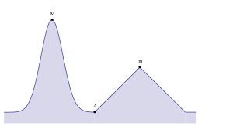
Greedy algorithm
Pick locally optimal solution at each step without considering the entire “global” picture
In the graph, a greedy algorithm would find the local maximum at m but miss the global max at M
In the BT animation, a greedy algorithm would pick the local max 12 and miss the global max 99
Both examples from Wikipedia

Slide 34
Dijkstra’s greedy algorithm questions
Is Dijkstra’s algorithm greedy?
Argue why Dijkstra’s algorithm is greedy.

Slide 35
Are greedy algorithms always correct?
The ones we’ve learned so far are, but in general no
Consider coin-change-making problem
Given coin denominations {1, 5, 10, 20}, make change for 36 using the fewest number of coins using the obvious greedy algorithm that you already know
Now try with {5, 10, 20, 25} to make 40
Is the greedy algorithm’s output correct?
Correct solution should use dynamic programming (DP)
Topic for tomorrow

