Slide 1
L17 – Graph Concepts
7/19/2024

Slide 2
Definitions
Graph is not a picture or a chart
Mathematical structure based in sets and relations/functions
G = ( V, E ) where
V is a set of vertices (nodes)
E is a set of edges (arcs)
E is a set of ordered pairs E = { (a,b) | a ∈ V ∧ b ∈ V }
directed graph
E is a set of sets, E = { {a,b} | a ∈ V ∧ b ∈ V }
undirected graph
We let edges represent (model) different things
Road from a to b, a is parent of b, a employs b, a must be taken before b

Slide 3
Directed Graph
Adjacent
We say b is adjacent to a iff (a,b) ∈ E
Directed graph (“digraph”)
Edges in E are directional
Each pair in E is ordered
Draw with arrows
(a,b) ∈ E
a
b
V = { a, b, c, d }
a
b
E = { (a,b), (b,c), (c,a), (c,d), (d,b) }
so
G = ( { a, b, c, d },
{ (a,b), (b,c), (c,a), (c,d), (d,b) } )
c
d

Slide 4
Undirected Graph
Edges have no direction
If b is adjacent to a, then a is also adjacent to b
Elements in E are sets, not ordered pairs
We say
a is adjacent to b, AND
b is adjacent to a
{a,b} ∈ E
a
b
V = { a, b, c, d }
a
b
E = { {a,b}, {a,c}, {b,c}, {b,d} }
G = ( V, E )
c
d

Slide 5
Symmetry in Digraph
Symmetry: (a,b) ∈ E ∧ (b,a) ∈ E
Not so here - only one edge
a
b
a
b
Not the same as this

Slide 6
Weighted Edges
Some problems may need a “weight” associated with each edge
2
4
a
b
a
b
5
E = { (s,d,w) |
s∈V ∧ d∈V ∧ w∈Int }
Or weights might be real numbers
Unweighted graphs can be thought of as having weight of 1 on each edge

Slide 7
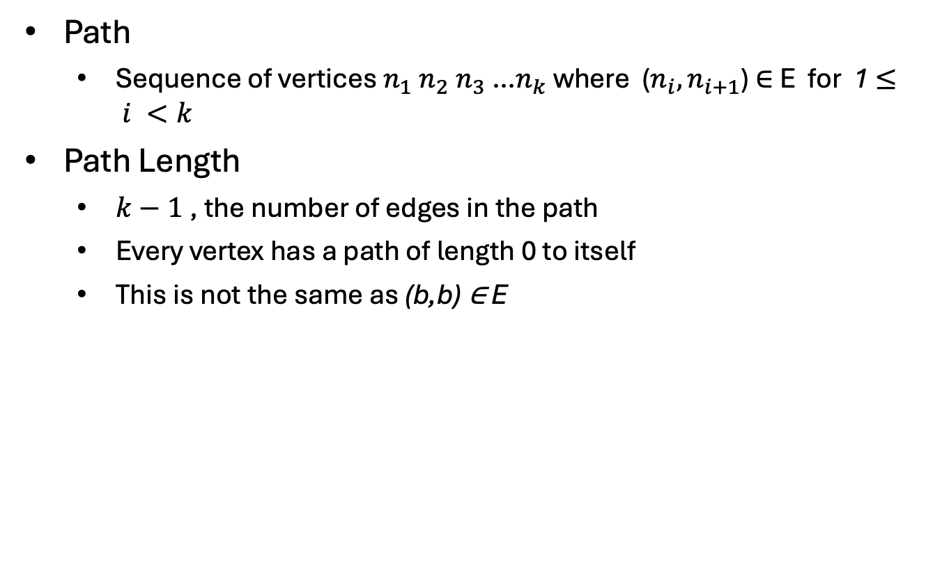
Path
Path
Sequence of vertices $n_{1} n_{2}{ n}_{3}$ …$n_{k}$ where ($n_{i}, n_{i+1}$) ∈ E for 1 $≤ i <k$
Path Length
$k−1$, the number of edges in the path
Every vertex has a path of length 0 to itself
This is not the same as (b,b) ∈ E
Here (b, b) ∈ E
So there is a path b to b
that has length 1
b
c
d

Slide 8
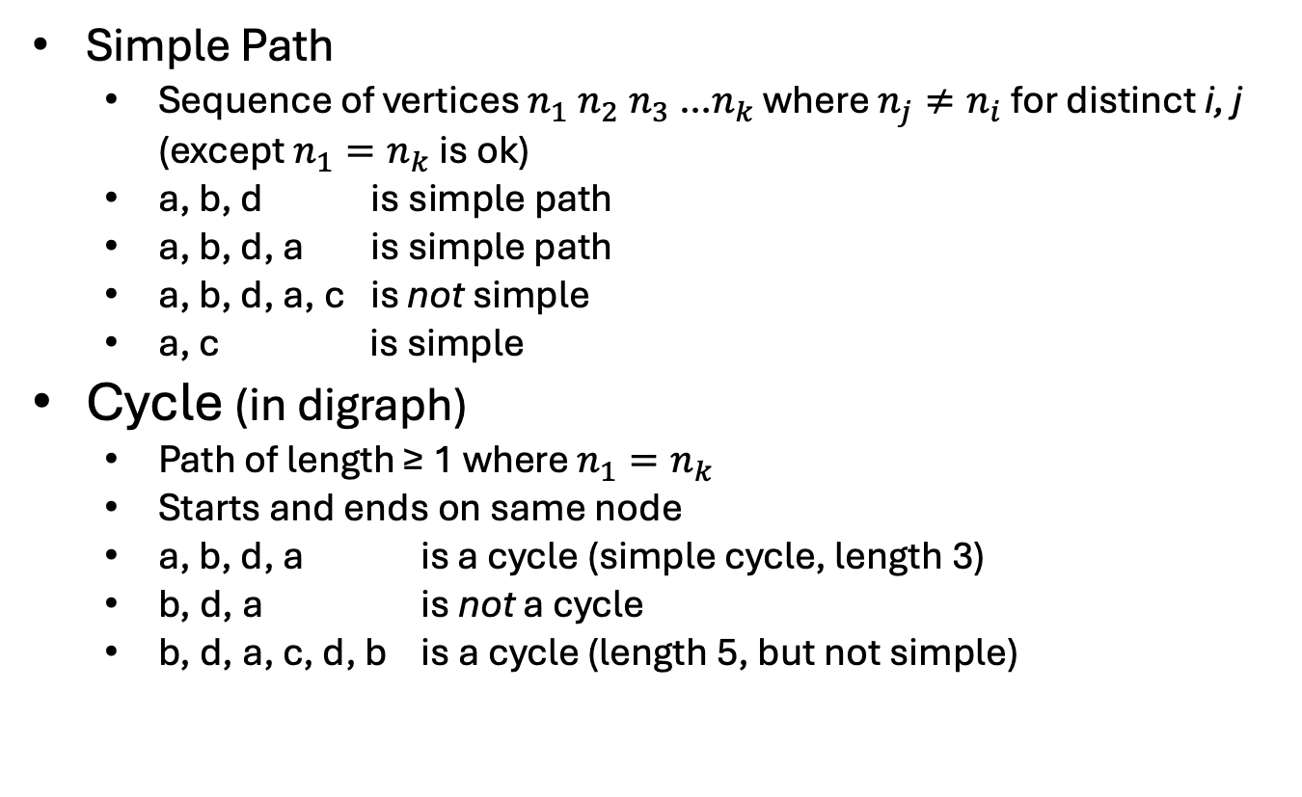
Simple Cycle
Simple Path
Sequence of vertices $n_{1} n_{2}{ n}_{3}$ …$n_{k}$ where $n_{j}≠n_{i}$ for distinct i, j (except $n_{1}=n_{k}$ is ok)
a, b, d is simple path
a, b, d, a is simple path
a, b, d, a, c is not simple
a, c is simple
Cycle (in digraph)
Path of length ≥ 1 where $n_{1}=n_{k}$
Starts and ends on same node
a, b, d, a is a cycle (simple cycle, length 3)
b, d, a is not a cycle
b, d, a, c, d, b is a cycle (length 5, but not simple)
a
c
b
d

Slide 9
Cycle in Undirected Graph
We require the edges to be distinct
If {a,b} ∈ E, there is not necessarily a cycle between a and b
If a, b, a is a cycle, this would imply an edge (a,b) and another edge (b,a) (path length 2)
But {a, b} is one edge, the same edge
a
b
Another reason these are technically not the same
a
b

Slide 10
Cycle in Undirected Graph
a
b
a
b
No cycles in this graph
c
cycles in this one:
a,b,a
a,b,a,c,a
b,a,c,a,b
etc.
c
a
b
cycles now:
a,b,c,a
b,c,a,b
etc.
c

Slide 11
DAG example
DAG
Directed Acyclic Graph
Special form used in many problems
Directed edges
No cycles
DAG
a
b
a
b
e
c
e
d
f
c
Directed edges
But cycles
Not a DAG
d
f

Slide 12
DAG
We have already been using DAG’s
Where?
Trees (no parent pointer), linked lists (not doubly linked)
b
a
e
c
d
h
i
f
g

Slide 13
Graph algorithm – cycle detection
How can we detect whether there are cycles?
Now?
No, DAG
Now?
No, DAG
a
b
Now?
No, DAG
Now?
Yes
e
Graph Algorithm:
For each vertex v {
trace paths from v
see if you revisit a node on the path
each path must end or revisit (why?)
}
c
d
f

Slide 14
Connected - Undirected
Connected
Has a path from every vertex to every other vertex
a
b
a
b
e
e
c
c
d
f
d
f
connected
Not connected

Slide 15
Connected - Directed
Strongly Connected
Has a path from every vertex to every other vertex
a
d
a
d
b
c
b
c
Strongly connected
Not strongly connected

Slide 16
Connected - Directed
Weakly Connected
Underlying undirected graph is connected
a
d
a
d
Underlying undirected graph
b
c
b
c
Not strongly connected
this is connected, so
This is weakly connected

Slide 17
More Examples
a
a
s.c. no
s.c. yes
so also
w.c. yes
w.c. yes
b
c
b
c
a
e
d
w.c. no
so also
s.c. no
we just say
not connected
b
c

Slide 18

Complete Graph
An edge between any two distinct vertices
{$n_{i}$,$n_{j}\}$ ∈ E for every${ n}_{i}$,$n_{j}$ ∈ V, and $i≠j$ (undirected graph)
K1
K2
K3
K4
K5
K6

Slide 19
How many edges in an undirected complete graph?
How many edges are in an undirected complete graph with v vertices?
v(v-1)/2
Sum of natural numbers
What about digraph?

Slide 20
Planar Graph
All edges can be drawn on a plane with none crossing
This earlier graph
is planar
K3
is planar
K4 planar?

Slide 21
Planar Graph
May be planar but drawn poorly
Redraw one of the crossing edges, “rubber-band” it outside the others
K4
K4 is planar

Slide 22
Planar Graph
K5
not planar
What about K5?
No matter which inner edge you “stretch” you get a cross
Turns out that K4 is the largest complete graph that is planar

Slide 23
Planar Graph
Rule of thumb
This graph “drawing” looks not planar…
This graph “drawing” looks planar… so the graph IS planar
The graph might still be planar… it just might be drawn poorly to show that
A graph is not the drawing… a graph is the math object

Slide 24
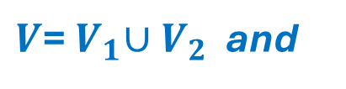
Bipartite Graph
Nodes are in two disjoint sets (types), and every edge connects different type nodes
$V$=${ V}_{1}∪V_{2}$ and
$E$ = { $(a,b)$| $(a$∈$V_{1}$∧$b$∈$V_{2})$∨ $(a$∈$V_{2}$∧$b$∈$V_{1})$}
$or, E$ = { $\{a,b\}$| $(a$∈$V_{1}$∧$b$∈$V_{2})$∨ $(a$∈$V_{2}$∧$b$∈$V_{1})$}
is bipartite
still is …
is bipartite
not bipartite
but now not

Slide 25
More Bipartite
Can think of bipartite as colorable with 2 colors
Every edge goes between the 2 color collections
a
e
a
e
b
b
d
f
c
g
g
d
f
c
is bipartite

