Slide 1
L12/13 – Heap
7/12/24, 7/15/24

Slide 2
Announcements
QZ04 tomorrow 7/16 (topics)
EX07 due tonight
EX08 releases after class
This slide presentation in .pptx format has animations in slideshow mode (credit: Prof. Stotts)

Slide 3
PrQueue slides from L11
See PrQueue slides from L11
PrQueue is an ADT we will implement with (binary) heap

Slide 4
Min binary heap (min-heap)
Structure property - Complete binary tree
All levels fully filled except possibly the last level, which is filled from left to right
Heap-order property
Min element at root
Every child ≥ parent
Every path from root to leaf is an ordered (nondecreasing, small to large) list
Every subtree of heap is also a heap
Visualization

Slide 5
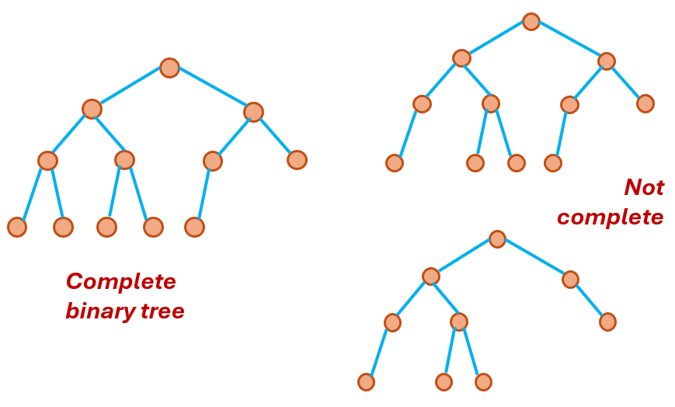
Structure property (complete BT)

Slide 6
Binary Heap
Heap-order property
Min at root
3
7
4
16
12
11
9
every child >= parent
31
18
21
every path root to leaf is an ordered sequence small to large

Slide 7
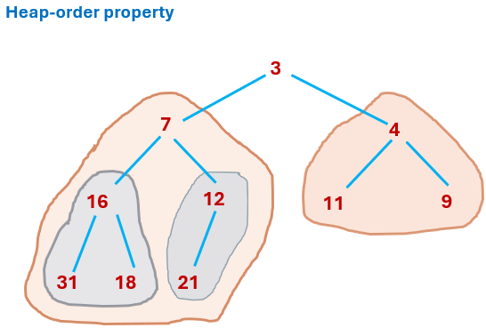
Every subtree is a min-heap

Slide 8
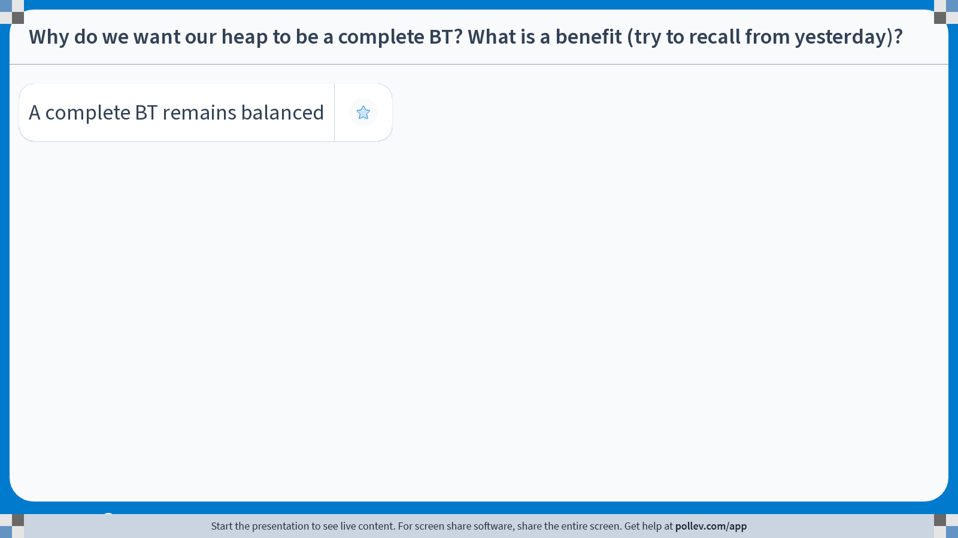
Complete BT is balanced (AVL definition, |h_{L}-h_{R}| ≤ 1), leading to worst-case O(log n) time complexities instead of O(n) like degenerate BST
Complete BT allows array representation of heap with formulas for indices of parent and child of node i, shown on next slide
Notes:
Poll Title: Do not modify the notes in this section to avoid tampering with the Poll Everywhere activity. More info at polleverywhere.com/support Why do we want our heap to be a complete BT? What is a benefit (try to recall from yesterday)? https://www.polleverywhere.com/free_text_polls/vHmQandwUYZvGnJBa7k5F

Slide 9
Implementation
Another benefit of structure property: allows very efficient representation with an array
Leave slot 0 unused (start at 1)
Store node value as array element
For node in slot i
Parent is at ⌊i / 2⌋ (floor, int division)
Left child at 2i
Right child at 2i+1
Array representation => Node class not needed (save memory)

Slide 10
Example
3
To fill array, breadth-first across tree
root in slot 1: 3
then level 1 in slots 2,3: 7, 4
level 2 in slots 4,5,6,7: 16,12,11,9
next level in slots 8, 9, 10 …15: 31,18,21
Next item causes slot 11 to fill
7
4
16
12
11
9
31
18
21
3
7
4
16
12
11
9
31
18
21
0 1 2 3 4 5 6 7 8 9 10 11 ...

Slide 11
Example
To infer tree structure from array
node in slot 1: 3
Parent: floor(1/2) is 0 (root, no parent)
Lchild: 2*1 is 2, slot 2 has 7
Rchild: (2*1)+1 is 3, slot 3 has 4
3
7
4
16
12
11
9
31
18
21
3
7
4
16
12
11
9
31
18
21
0 1 2 3 4 5 6 7 8 9 10 11 ...

Slide 12
Example
To infer tree structure from array
node in slot 4 is 16
Parent: floor(4/2) is 2, slot 2 has 7
Lchild: 4*2 is 8, slot 8 has 31
Rchild: (4*2)+1 is 9, slot 9 has 18
3
7
4
16
12
11
9
31
18
21
3
7
4
16
12
11
9
31
18
21
0 1 2 3 4 5 6 7 8 9 10 11 ...

Slide 13
Example
3
7
4
node in slot 4 is 16
Parent: floor(4/2) is 2, slot 2 has 7
Lchild: 4*2 is 8, slot 8 has 31
Rchild: (4*2)+1 is 9, slot 9 has 18
16
12
11
9
31
18
21
parent
L-child
R-child
3
7
4
16
12
11
9
31
18
21
0 1 2 3 4 5 6 7 8 9 10 11 ...
half back
double forward

Slide 14
Insert
3
Next item causes slot 11 to fill
this maintains structure property
insert ( 17 )
still has heap-order property ?
We are good
( by luck of it being 17, > parent 12 )
7
4
16
12
11
9
31
18
21
17
3
7
4
16
12
11
9
31
18
21
17
0 1 2 3 4 5 6 7 8 9 10 11 ...

Slide 15
Insert… what if ?
3
insert ( 10 )
still has heap-order property ?
We are not good
( since 10 < parent 12 )
swap 10 with parent 12
Good here
And good here
7
4
16
12
11
9
31
18
21
10
3
7
4
16
12
11
9
31
18
21
10
0 1 2 3 4 5 6 7 8 9 10 11 ...
Slot 11 parent is floor(11/2) = 5

Slide 16
Swap-Up the Value
3
insert ( 2 )
Check for heap-order, swap upwards
repeat until we get it
In the array representation…
Slot 11 parent is floor(11/2) = 5
Slot 5 parent is floor(5/2) = 2
Slot 2 parent is floor(2/2) = 1
7
4
16
12
11
9
31
18
21
2
3
7
4
16
12
11
9
31
18
21
2
0 1 2 3 4 5 6 7 8 9 10 11 ...
Slot 11 parent is floor(11/2) = 5

Slide 17
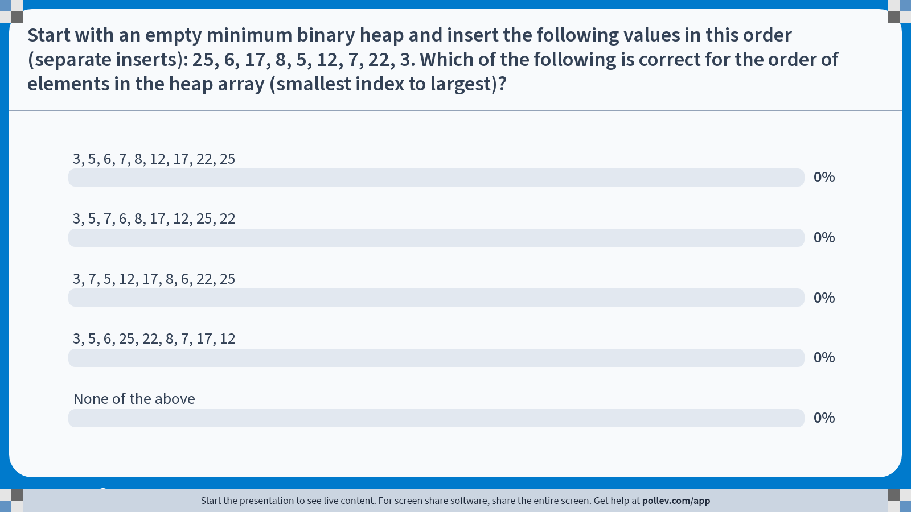
✓
Notes:
Poll Title: Do not modify the notes in this section to avoid tampering with the Poll Everywhere activity. More info at polleverywhere.com/support Start with an empty minimum binary heap and insert the following values in this order (separate inserts): 25, 6, 17, 8, 5, 12, 7, 22, 3. Which of the following is correct for the order of elements in the heap array (smallest index to largest)? https://www.polleverywhere.com/multiple_choice_polls/dNZwlCGpha1KrJsdXf3FB?state=opened&flow=Default&onscreen=persist

Slide 18
Alternate array representation – use index 0
Why leave slot 0 unused? Wastes space?
If we used slot 0,
For node in slot i
Parent is at ⌊(i-1) / 2⌋ (floor, int division)
Left child at 2i +1
Right child at 2i+2
Our previous formulas (leaving 0 unused) were
For node in slot i
Parent is at ⌊i / 2⌋
Left child at 2i
Right child at 2i+1

Slide 19
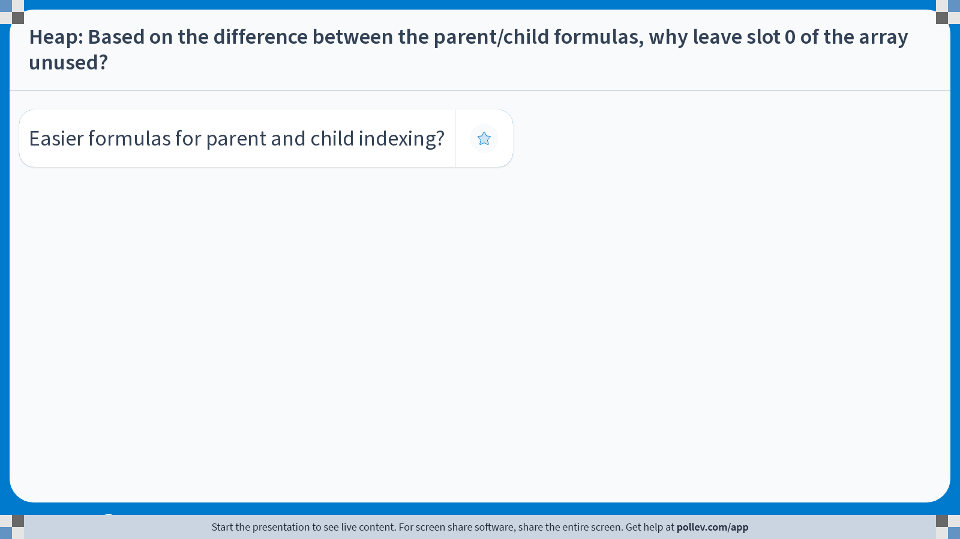
Easier formulas for parent and child index of node i
Also, faster for computer to compute
Notes:
Poll Title: Do not modify the notes in this section to avoid tampering with the Poll Everywhere activity. More info at polleverywhere.com/support Heap: Based on the difference between the parent/child formulas, why leave slot 0 of the array unused? https://www.polleverywhere.com/free_text_polls/rOcVmq8sRdVfubqS7z70c

Slide 20
Insert code details
Bubble up element
Each swap takes 3 assignments (temp variable)
O(log n) swaps
O(3 log N) = O(log n)
Alternatively, “bubble-up the hole” to avoid swaps, as shown on next slides

Slide 21
Bubble-up the hole
3
insert ( 2 )
Check for heap-order, if 2 were put in the hole
Move parent down into hole,
check 2 again, and again
In the array representation
Move values into the hole,
hole moves toward slot 1
7
4
16
12
11
9
31
18
21
temp
2
2
3
7
4
16
12
11
9
31
18
21
0 1 2 3 4 5 6 7 8 9 10 11 ...

Slide 22
Insert time complexity
Put new value in next open slot in array/tree
Swap/bubble up towards root until heap-order is achieved
Worst-case O(log N) as it follows path to root (height)

Slide 23
Insert average case O(1)!
insert average-case O(1)!
In short, ½ to ¾ of nodes are in the bottom 2 layers
New elements will probably end up at bottom 2 layers or near
We consider bottom 2 layers, not bottom layer only, because bottom layer of complete tree may have only one element
To make the rest of this analysis easier, assume the tree is perfect so that ½ of nodes are leaves
Leaves tend to be larger due to heap-order
If we assume (for now) the leaves are the largest elements in the heap, then the probability that the new element will be a leaf (upper half of values) is 0.5
Otherwise, suppose the new element will be in the second-to-last layer, with probability 0.25
Full second to last-layer has ½ the nodes of full last layer
Compute expected value
Expected number of comparisons is 1(0.5) + 2(0.25) + 3(0.125) + … = 2
Previous assumption that the new element will be a leaf is 0.5 is false (slightly less), but still bounded by a constant, so the reasoning holds. Also may not be the case that the tree is perfect
Average number of comparisons for insert is 2.67, O(1)

Slide 24
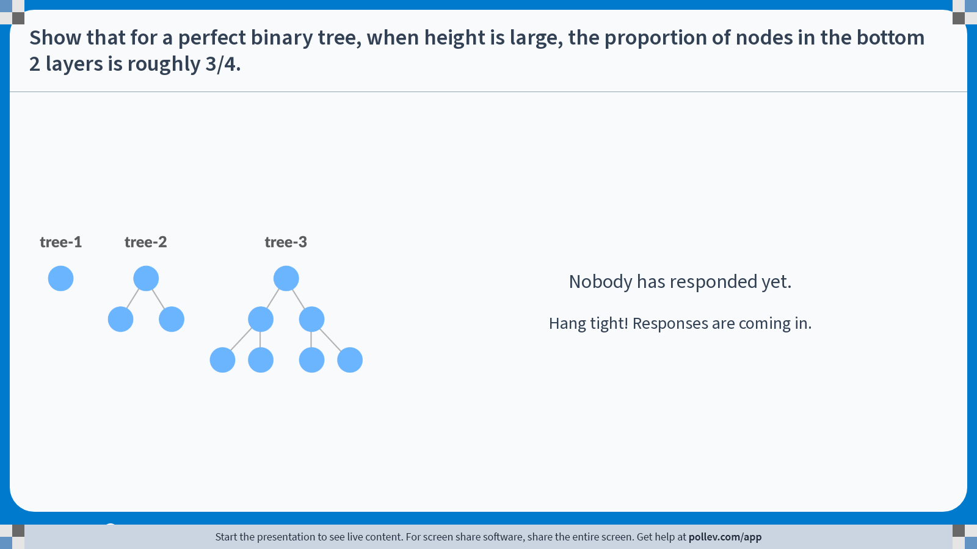
Perfect BT of height h has 2^{h} nodes in bottom layer
Perfect BT of height h has 2^{h+1}-1 nodes
Ignoring the -1 (negligible difference for large h), ½ of a perfect BT’s nodes are in the bottom layer
Thus, ½ (½) = ¼ of a perfect BT’s nodes are in the layer above
½ + ¼ = ¾
Notes:
Poll Title: Do not modify the notes in this section to avoid tampering with the Poll Everywhere activity. More info at polleverywhere.com/support Show that for a perfect binary tree, when height is large, the proportion of nodes in the bottom 2 layers is roughly 3/4. https://www.polleverywhere.com/free_text_polls/P4obOH4RjzQx55lgGQeQO

Slide 25
getMin time complexity
O(1)
Read the value at root

Slide 26
delMin
Delete the minimum (root node) of the min heap and ensure that the new minimum bubbles to the root
Remove root node val (it is min val)
Leaves a “hole” at root node
Pull out val in last leaf (eliminates a node)
See if it fits in root hole
If so, put leaf val into root hole
If not, move hole down to smaller child
Repeat

Slide 27
delMin Example
2
delMin ( )
Remove root value
Save out last element
Bubble hole down from root, swapping with smaller child
Stop when last element causes heap-order in the hole
Array representation
3
4
16
7
11
9
31
18
21
12
temp
2
3
4
16
7
11
9
31
18
21
12
0 1 2 3 4 5 6 7 8 9 10 11 ...

Slide 28
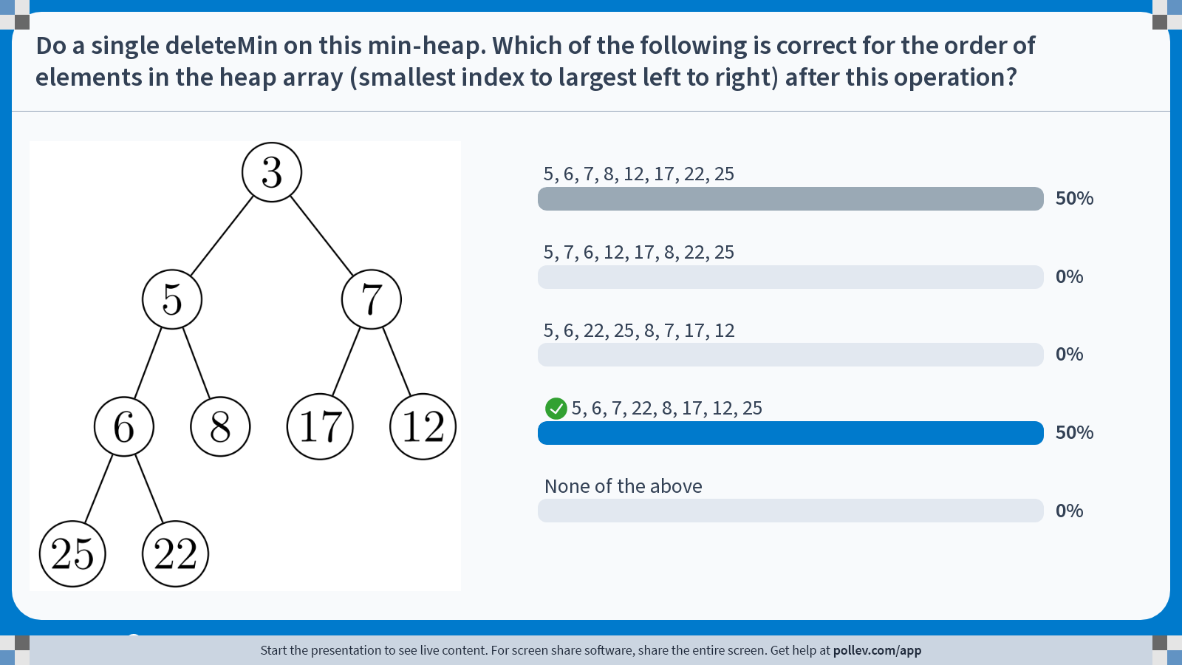
Notes:
Poll Title: Do not modify the notes in this section to avoid tampering with the Poll Everywhere activity. More info at polleverywhere.com/support Do a single deleteMin on this min-heap. Which of the following is correct for the order of elements in the heap array (smallest index to largest left to right) after this operation? https://www.polleverywhere.com/multiple_choice_polls/BeHsNhm1L3jfHUgaDlmu6?state=opened&flow=Default&onscreen=persist

Slide 29
delMin time complexity
Worst-case O(log n)
Remove root node: O(1)
Save out last element: O(1)
Bubble down the hole: O(log N)
One copy per bubble move
+1 at end for copying temp value into hole
Swap down method: O(log N)
3 assigns per swap, O(log N) swaps
O(3 log N) is O(log N)

Slide 30
increaseKey/decreaseKey
Find the tree element with the key
Change priority by adding some increment
Swap/bubble down (with smaller child) toward leaves until heap-order is achieved
Worst-case O(log N) as it follows path root to leaf (height)
For decreaseKey, bubble up toward root

Slide 31
increaseKey Example
2
6
4
16
8
11
19
increaseKey(curPriority, delta)
increaseKey(6, 8)
Find element with priority 6
Bump up by delta 8 to 14
Bubble hole down from elt
Stop when heap-order is restored
31
18
21
10
2
14
4
16
8
11
19
31
18
21
10
2
2
8
4
8
4
16
14
11
19
16
10
11
9
31
18
21
10
31
18
21
14

Slide 32
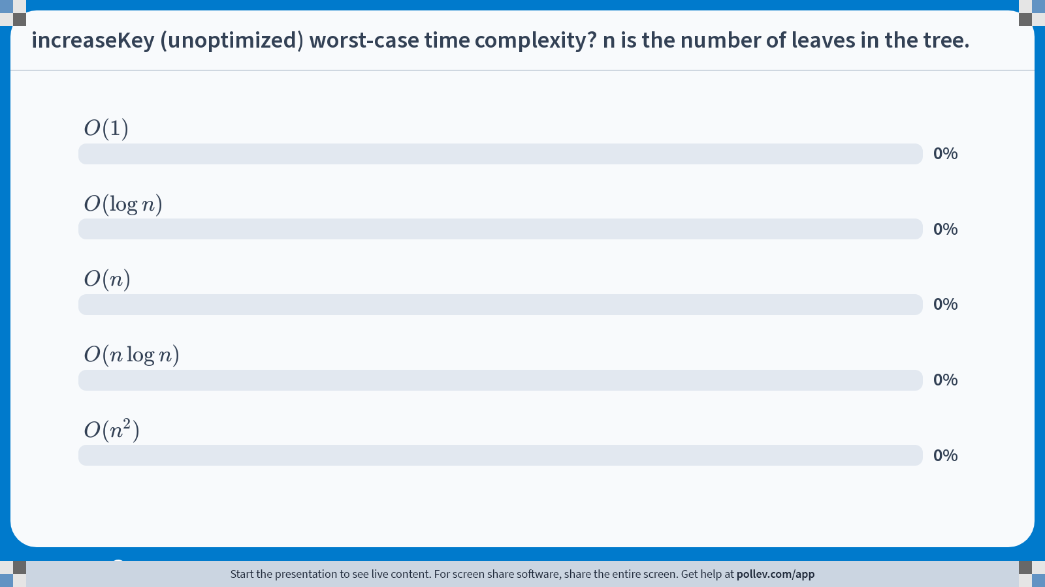
✓
Notes:
Poll Title: Do not modify the notes in this section to avoid tampering with the Poll Everywhere activity. More info at polleverywhere.com/support increaseKey (unoptimized) worst-case time complexity? n is the number of leaves in the tree. https://www.polleverywhere.com/multiple_choice_polls/5tnHvjM1WlDXntijOQjPl?state=opened&flow=Default&onscreen=persist

Slide 33
increaseKey issues
As we just saw, can be worst-case O(n) to find element with some priority
To speed up find to O(1), can use a HashMap along with the heap
HashMap is similar to Python dict
Attach unique data field (id) to each node
Find node by id
Key is id, value is array index
Now finding is O(1), but still O(log n) cost for bubbling

Slide 34
Heap time complexities
 | Average | Worst-case
insert | O(1) | O(log n)
delMin | O(log n) | O(log n)
getMin | O(1) | O(1)
find(priority) | O(n) | O(n)
incKey(curPriority, delta) | O(n) or O(log n) (optimized) | O(n) or O(log n) (optimized)
n is the number of nodes

Slide 35
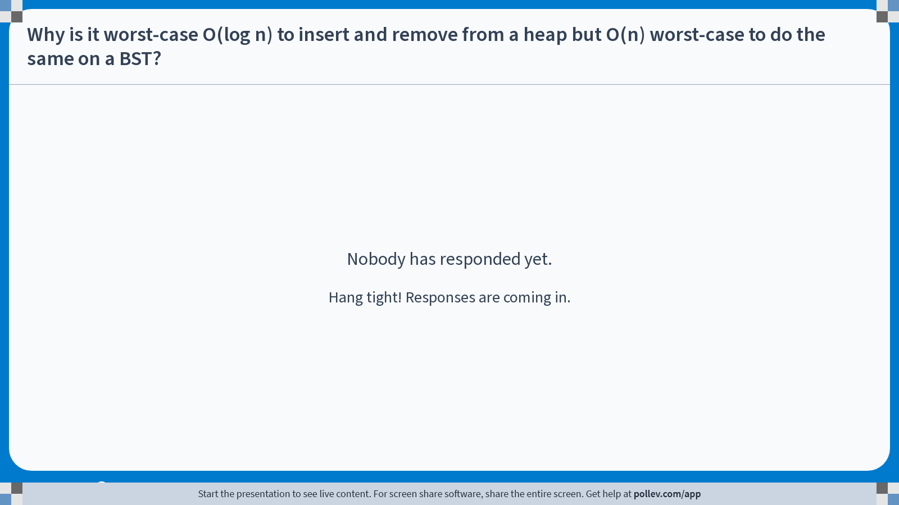
Degenerate BST has O(n) insert and remove because height is n – 1, not log(n). Insert and remove thus function similarly to linked list insert/remove
Heap is complete, thus balanced (AVL)
No degenerate case
Height is always ⌊log₂(n)⌋
Insert and remove worst-case O(log n)
Notes:
Poll Title: Do not modify the notes in this section to avoid tampering with the Poll Everywhere activity. More info at polleverywhere.com/support Why is it worst-case O(log n) to insert and remove from a heap but O(n) worst-case to do the same on a BST? https://www.polleverywhere.com/free_text_polls/OllyQDFZ3xLFX75rFO6Hs

Slide 36
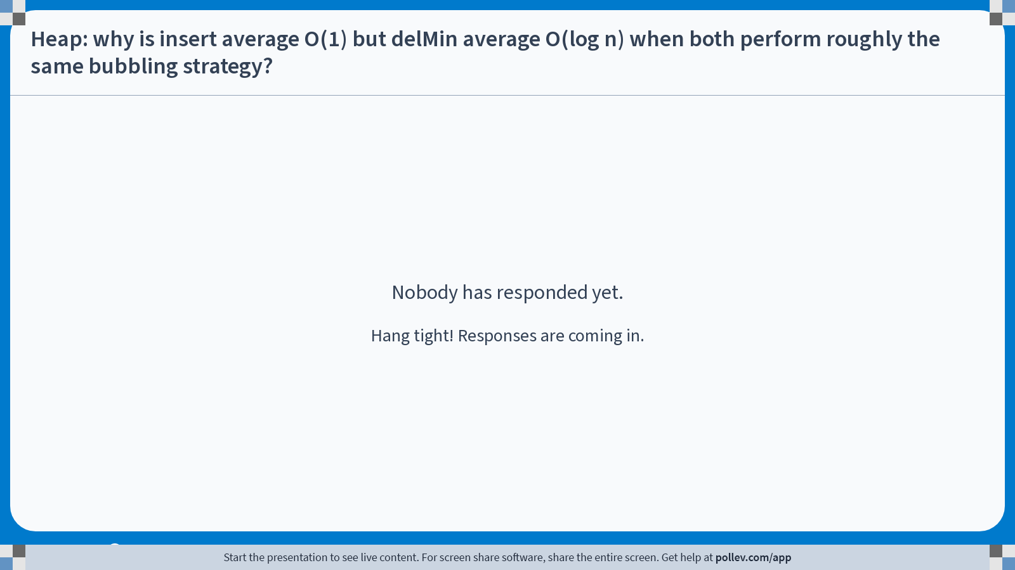
Insert avg O(1) reasoning shown on previous slide
Insert bubbles up starting from bottom layer, and most nodes are at the bottom. On average, won’t have to go far
delMin always bubbles down starting from the root, but most nodes should be near the bottom
Notes:
Poll Title: Do not modify the notes in this section to avoid tampering with the Poll Everywhere activity. More info at polleverywhere.com/support Heap: why is insert average O(1) but delMin average O(log n) when both perform roughly the same bubbling strategy? https://www.polleverywhere.com/free_text_polls/TWXm9eBX4XRTN3jEeMPpz

Slide 37
Heap limitations
Although heap has much faster getMin than BST, it has less sort information
Can’t get full sort out of heap directly like a BST with in-order traversal
How to sort with heap?
Recall, quicksort and mergesort average case O(n log n)
BST sort average O(n log n), worst O(n²)

Slide 38
Sorting with heap (naïve)
Worst-case
insert O(log n)
Insert n items O(n log n)
To get sorted sequence, delMin n times
delMin is O(log n)
Retrieve sequence is O(n log n)
O(n log n) + O(n log n) = O(n log n) is not practically as good as BST sort’s average case
BST sort average-case is O(n log n) + O(n)

Slide 39
Make BHEAP by N Inserts
Insert(6)
Insert(12)
Insert(9)
Insert(4)
6
6
6
6
6
4
12
12
9
12
9
4
9
6
9
4
12
12
Insert(5)
Insert(3)
4
4
4
4
3
6
9
5
9
5
9
5
3
5
4
12
5
12
6
12
6
3
12
6
9
12
6
9
O( N log N)

Slide 40
Efficient build heap
There is a way to convert a list of unsorted n elements to a heap in O(n) time
Structural property
Load n elements into array from slot 1 to last (order unimportant)
Heap-order
Call min-heapify ⌊n / 2⌋ times
Shown on next slide

Slide 41
Min-heapify(A, i)
i is the index of the node that we “min-heapify”
Min-heapify assumes that the children of i (left and right) are both min heaps, but i may violate heap order
Bubble-down node at index i until heap-order is satisfied
Similar to deleteMin, must swap with smaller element

Slide 42
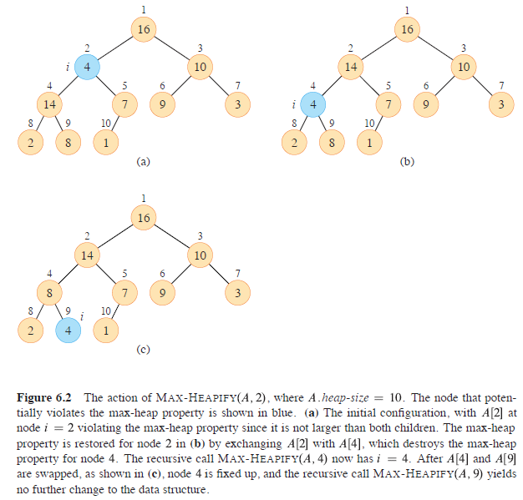
This is max-heap but ignore, pretend it’s a min-heap

Slide 43
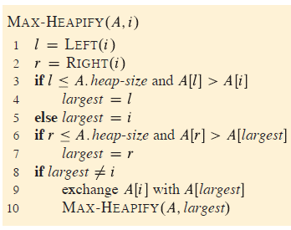
Min-heapify
This is max-heapify, where we swap (possibly) with the larger child, then recur. For min-heapify, simply find the smaller child and swap (possibly) with that

Slide 44
Min-heapify analysis
Lines 1-9 are Θ(1)
Recursive call on line 10 will operate on a child subtree of size at most 2n/3
Proof that children subtrees have size at most 2n/3 is omitted
Thus, min-heapify recurrence is
Solution by master theorem (not covered in COMP 210) is O(log n)
Or use recursion tree

Slide 45

Efficient build heap
Start with parent of last node, bubble down (call min-heapify) as needed
Go breadth-order backward to root

Slide 46
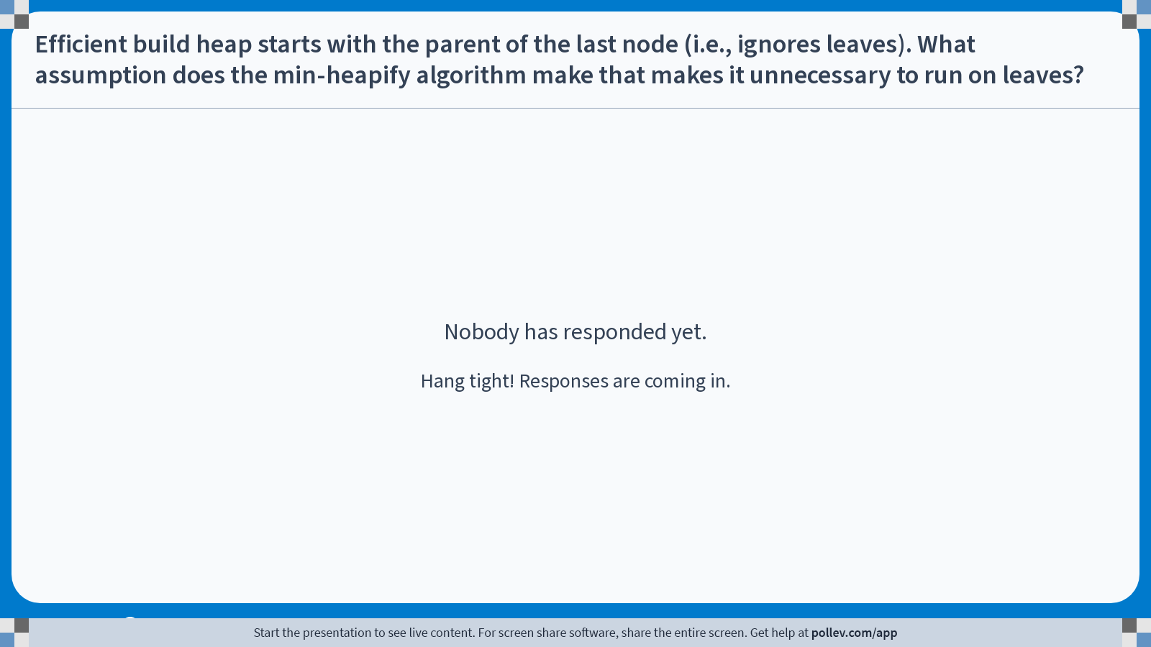
Assumes that node at index i may violate heap-order
I.e., subtree rooted at index i may not be a min-heap
But each leaf is a trivial min-heap
Notes:
Poll Title: Do not modify the notes in this section to avoid tampering with the Poll Everywhere activity. More info at polleverywhere.com/support Efficient build heap starts with the parent of the last node (i.e., ignores leaves). What assumption does the min-heapify algorithm make that makes it unnecessary to run on leaves? https://www.polleverywhere.com/free_text_polls/D1OqXmjST05bdRmEsui0E

Slide 47
Make BHEAP by Build
Insert 6, 12, 9, 4, 5, 3
We have all values at the start, no need to do individual insert ops
6
12
9
4
5
3
0 1 2 3 4 5 6 7 8 9 10 11 …
Initial tree form
Now bubble down
Start with first non-leaf that has a child
6
What array slot is this?
parent of the last array item
Last item (3) is in slot 6
Parent of 3 is floor(6/2) which is 9, in slot 3
12
9
4
5
3
So start bubble down at item in slot 3.

Slide 48
Bubble Down in Build
Initial tree form
6
6
6
12
9
12
3
4
3
4
5
3
4
5
9
12
5
9
Heap we got with N separate inserts
3
3
5
4
4
6
12
6
9
12
5
9

Slide 49
Bubble Down in Build
Initial tree form
16
16
16
12
9
12
3
4
3
4
5
3
4
5
9
12
5
9
Bubble down goes to leaf if needed
3
3
4
16
4
9
12
5
9
12
5
16

Slide 50
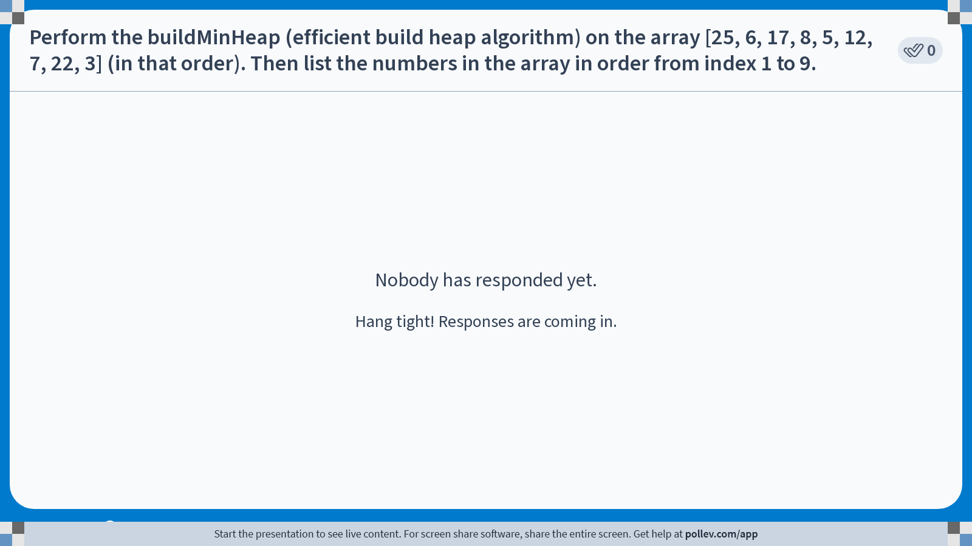
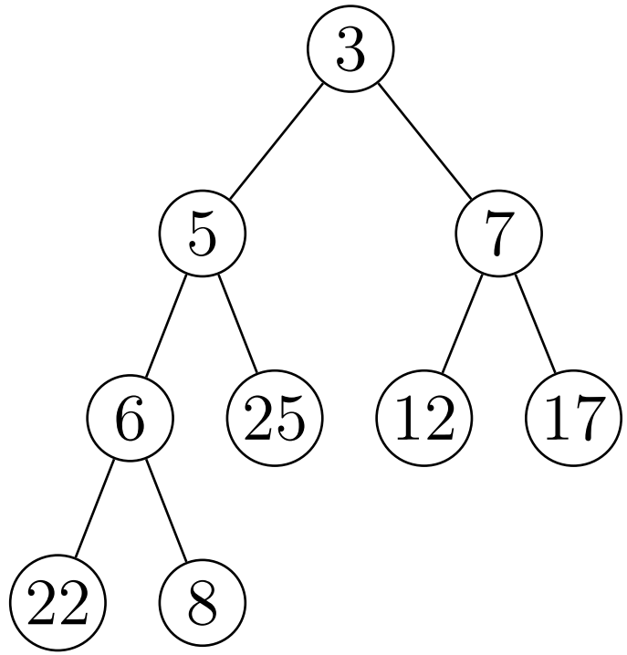
3, 5, 7, 6, 25, 12, 17, 22, 8
Notes:
Poll Title: Do not modify the notes in this section to avoid tampering with the Poll Everywhere activity. More info at polleverywhere.com/support Perform the buildMinHeap (efficient build heap algorithm) on the array [25, 6, 17, 8, 5, 12, 7, 22, 3] (in that order). Then list the numbers in the array in order from index 1 to 9. https://www.polleverywhere.com/free_text_polls/gkGV4AQezT4RZuWqtgk46

Slide 51
Efficient build heap analysis (informal)
Naïve worst-case upper bound O(n log n)
Each min-heapify call is worst-case O(log n)
Build makes O(n) calls
O(n log n)
Tighter asymptotic upper bound O(n)
min-heapify’s runtime depends on the height of the node
The height of most nodes are small (e.g., ½ to ¾ of nodes are in the bottom 2 layers)
Similar to insert average case O(1) analysis
Full proof on CLRS 4 ed. pg. 169

Slide 52
Heapsort time complexity
Build heap (efficient) O(n)
Retrieve sequence by performing delMin n times
O(n log n)
O(n log n) + O(n) = O(n log n)
Theoretically same as BST sort

Slide 53
Real heapsort
Heapsort can be done in-place (no extra array memory needed to store results of delMin)
delMin removes an element from heap array at end, leaving an array slot open at end
Simply put the removed element at array end (heap last + 1)
Repeat until heap empty
Array will contain all elements in reverse order

Slide 54
In-Place Heap Sort
Elements: 7, 2, 19, 8, 11, 4, 16
Initial heap array: x 7 2 19 8 11 4 16
0 1 2 3 4 5 6 7
Complete Build: x 2 7 4 8 11 19 16
0 1 2 3 4 5 6 7
First delMin: x 4 7 16 8 11 19 2
0 1 2 3 4 5 6 7
Next delMin: x 7 8 16 19 11 4 2
0 1 2 3 4 5 6 7
Final array: x 19 16 11 8 7 4 2
0 1 2 3 4 5 6 7

Slide 55
In-place heapsort details
Final sort ends up in reversed order in array
Previous slide used min-heap, but sorted sequence is in nonincreasing (large to small) order
For sort in nondecreasing order,
Use max-heap
Or reverse the array
Swap first and last, then second and next-to-last
n / 2 swaps, each swap 3 assignments
O(n)
Use a stack
2n pushes and pops
O(n)
But needs twice as much memory

