Slide 1
L16 - Hashing
7/18/24

Slide 2
Hashing demo
hash.py

Slide 3
Hashing applications
When I download a file, how can I verify that the download was successful (no errors or tampering)?
Using a common hash function (e.g., SHA256), the website can post the hash of the file. I can then hash my file and compare
Websites need to verify my password when I login, but they can’t store it in plaintext (insecure)
They store the hash of my plaintext password
Cryptocurrency/blockchain (simplified example)
The blockchain can be thought of as a linked list of blocks where the links are hashes
The system generates a “target” hash value (say, a hash where the first 30 bits are all 0) for the current block, and you need to find a value that, after being hashed, is less than that value
If so, you get a Bitcoin (and create a new block)
For us,
Hashing is O(1), allowing us to implement some operations such as insert, delete, find in O(1)
But ordering operations (findMin, traversal) cannot be done
Basic idea, we can index into an array (integer indices) in O(1). What if the key is not an integer? Convert it to an integer by hashing, then use the hash to locate data in an array-like structure

Slide 4
Hash terms
Hashing is the basic concept of computing an integer (the “hash” or “hash value” ) from some data value (the “key” )
We intend to use that hash integer as an index into an array or table of associated data (keys and associated values)
Map is an ADT similar to Python’s dict
void put(k, v)
V get(k)
void remove(k)
boolean contains(k)
HashMap is an implementation of Map using a hash function
Hash table is the array where data is stored

Slide 5
Hash function
The computation that generates a hash value from a key
hash(key) -> int
Used to implement Map via hash table
get(key) generally becomes table[hash(key)] in the implementation

Slide 6
Hash table
0
1
2
Hash table is an array of key/value pairs
put(“jones”, 4834173)
Suppose hash(“jones”) is 5
So we put this K, V pair into array slot 5
get(“jones”)
hash(“jones”) is again 5
We look at array slot 5 and retrieve the associated value 4824173
What if hash is bigger than table size?
Use modulus, i.e., index = hash(“jones”) % size
May omit the % later, but you should assume it’s there
3
4
5
jones, 4824173
6
7
8
9
10

Slide 7
Time complexity
Since we assume the hash function is O(1) to compute, put, get, and find are O(1)
Compute hash
Look in array slot
Find is O(n) for simple array, average-case O(log n) for BST

Slide 8
Collision
0
1
2
bob
For simplicity, can show hash tables with just the key, but remember for a Map, there can be associated data
In this table, suppose hash(“sam”) is 7
Suppose hash(“lara”) is also 7
Slot already taken
Collision!
3
jane
4
bill
5
6
7
sam
lara
8
9
amy
10

Slide 9
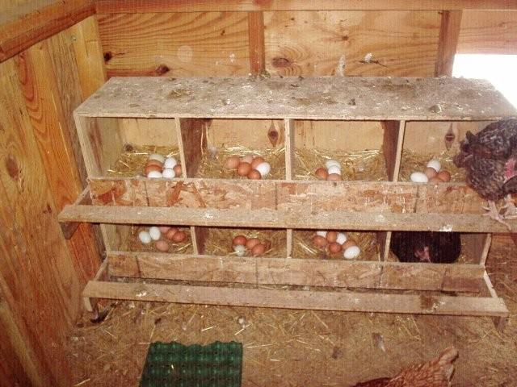
Pigeonhole principle
Are collisions possible to avoid entirely?
Would be possible if two distinct keys always get two different hash values
But we allow our keys to be anything, whereas the hash output is fixed-size
Pigeonhole principle: if there are 8 chicken boxes and 9 chickens, there must be 2 chickens in some box
Best we can do is design the hash function so that it distributes keys evenly over the available array subscripts

Slide 10
Hash functions and collisions in practice
A good hash function makes collisions very rare
E.g., SHA256 has a 256 bit output, thus 2²⁵⁶ possible outputs
How large is 2²⁵⁶?
10⁷⁸ to 12⁸² atoms in the universe
To date, no one has found a collision for SHA256 (doing so would break it for cryptographic purposes)
But for our purposes, we can’t always spare 256 bits of output per key (SHA256 is more for cryptography)
We have to deal with collisions

Slide 11
Good hash functions
Hash function must be fast to compute
O(1)
Really, something like O(K) where K is the key size, but we’ll assume keys are fixed-size (e.g., strings have a max length) so that this becomes O(1)
Hash function must distribute keys evenly over the available range of values
For us, the available range is {0, 1, …, array size-1}
Incorporates all data of the key
Decorrelates keys such that if two keys are similar, they should not get similar hash values
Ideally, two distinct keys should get two different hash values

Slide 12
Probability of collisions
Probability of collision affected by
Quality of hash function
How well it evenly distributes keys over the index range
Table structure
Number of array slots
Mathematical properties of the maximum index
E.g., if size is prime or not
Will show example soon
For the rest of lecture, assume keys are lowercase Strings with some reasonable maximum upper bound

Slide 13
Example bad hash function
Suppose our hash function for String is the first letter of the key as its position in the alphabet
static int badHash(String key) {
return (((int) key.charAt(0)) - ((int) 'a'));
}

Slide 14
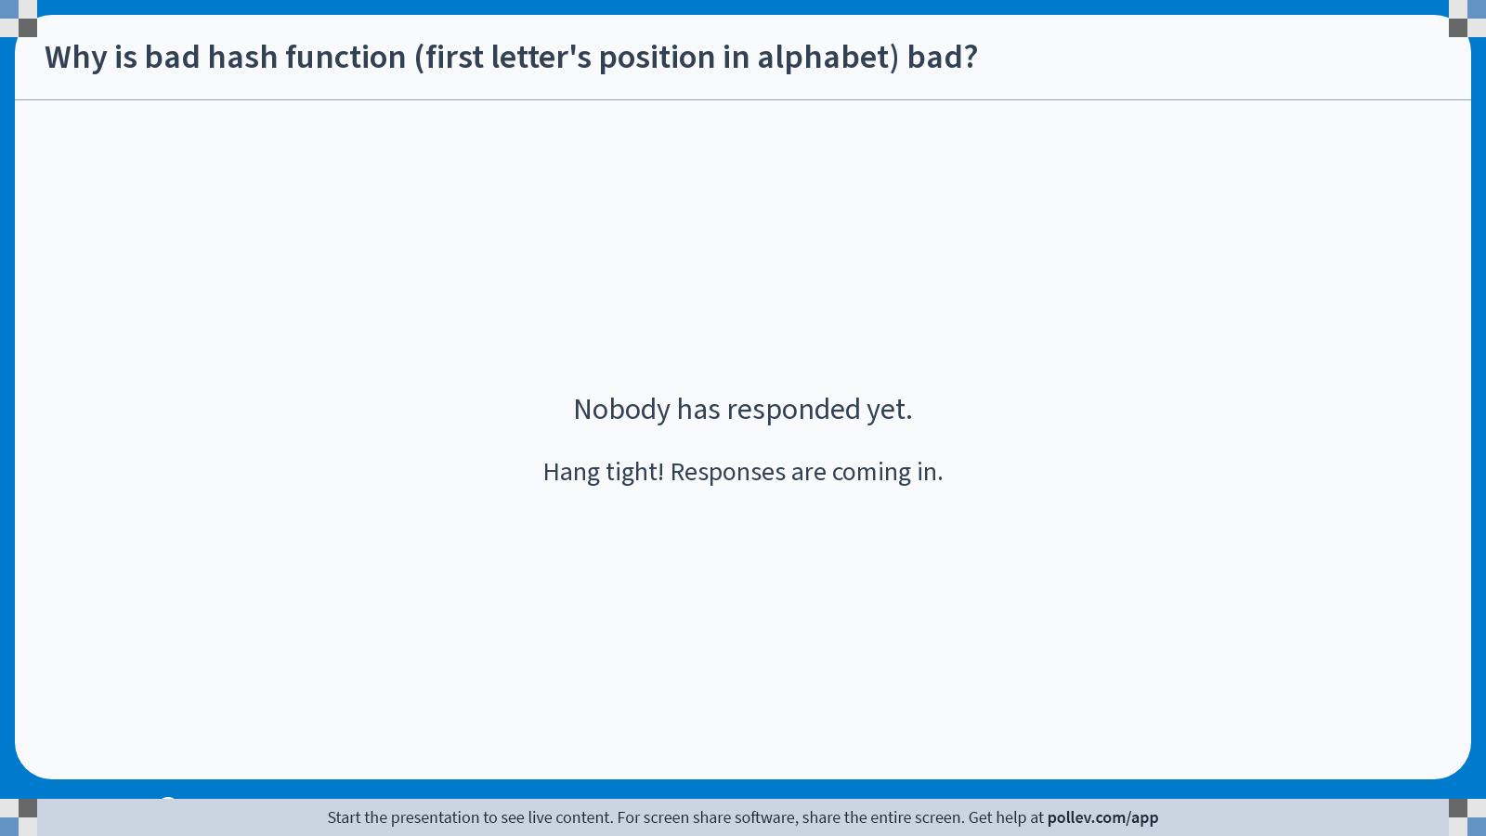
Notes:
Poll Title: Do not modify the notes in this section to avoid tampering with the Poll Everywhere activity. More info at polleverywhere.com/support Why is bad hash function (first letter's position in alphabet) bad? https://www.polleverywhere.com/free_text_polls/tq3TuexpWZnxkenLtmKNP

Slide 15
Why is it bad?
Only 26 different range elements
Can only store 26 keys before guaranteed collisions
First character is not evenly distributed over alphabet
Lots of “s”, “m”, “t” words
Not many “x”, “z”, “q” words

Slide 16
Better hash function
Sum all chars, mod by table size
static int betterHash(String key, int tabSize) {
int hval = 0;
for (int i=0; i<key.length(); i++) {
hval += key.charAt(i);
}
return hval % tabSize;
}
If tabSize is large (say 10007)
And keys short (say 8-15 chars)
Then the sum of the chars is small
and will cluster at low end of table

Slide 17
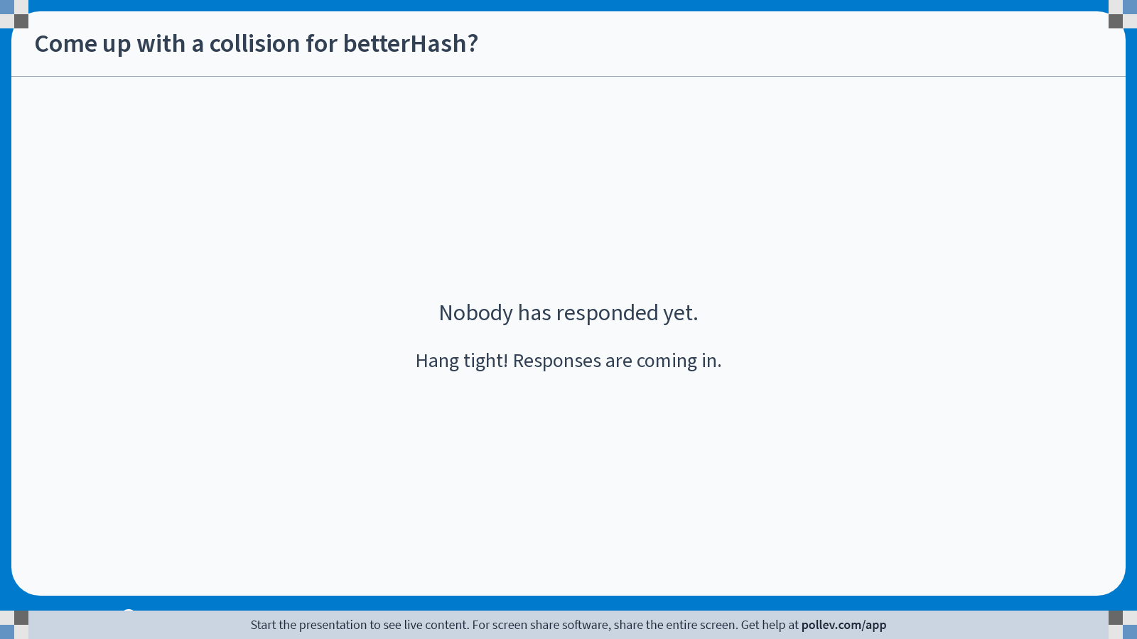
“cat”, “act” (doesn’t matter what table size is)
Notes:
Poll Title: Do not modify the notes in this section to avoid tampering with the Poll Everywhere activity. More info at polleverywhere.com/support Come up with a collision for betterHash? https://www.polleverywhere.com/free_text_polls/g1TFp0YgEi6Vy7Vyp5Wrm

Slide 18
Pretty good hash
Use multiplication for bigger numbers to avoid clustering
Use prime multiplications to avoid small cycles
Example cycle: [0…9] % 8 = [0, 1, 2, 3, 4, 5, 6, 7, 0, 1…]
Multiplier and tabSize should be coprime
Consider multiplier 2 and tabSize 8, what goes wrong?
static int prettyGoodHash(String key, int tabSize) {
int hval = 7;
for (int i = 0; i < key.length(); i++) {
hval = 31 * hval + key.charAt(i);
}
hval = hval % tabSize;
if (hval < 0) {
hval += tabSize;
}
return hval;
}
Another idea: multiply by multiplier^{i}, e.g. 31 * charAt(0), 31² * charAt(1), etc.

Slide 19
Table size
Best to use a prime table size
Or, for convenience (i.e., don’t have to choose prime number), power of 2 as the table size, but do not use even multipliers for the multiplication
Load factor
# elements in table / table size
500 elements, size 997 table => load factor 500/997
Table half-full?
Depends on how collisions are handled

Slide 20
Collision resolution
Two main forms
Chaining
Each array slot contains not a single element but a list
Linear probing
Each array slot contains one element
If we hash to full slot, we have a plan for going to a next slot to try
How does this affect O(1) of insert and find?

Slide 21
Chaining
Each entry is null or a list of cells
If a new key hashes to an empty slot, start a new list with that key data
If a new key hashes to an occupied slot, add that key data to the list

Slide 22
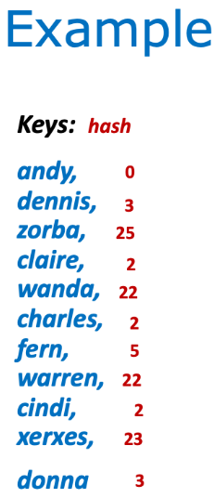
0
andy
1
2
claire
charles
cindi
3
dennis
donna
4
5
fern
22
wanda
warren
23
xerxes
24
25
zorba
Use bad hash function (first char) for simplicity

Slide 23
Chaining operations
put(key, value)
hash(key) to get table index
Look for key in the list at that index in the table
If key exists in that list, replace associated value with new value
If key does not exist in that list, add key/value pair to that list
find(key)
hash(key) to get table index
Look for key in the list at that index in the table
If key exists in that list, return associated value
Otherwise, does not exist (return null or throw exception, etc.)

Slide 24
Chaining operations
remove(key)
hash(key) to get table index
Look for key in the list at that index in the table
If key exists in that list, remove key/value pair from list

Slide 25
Chaining operations time complexity
Get (average and worst)
Calculate hash to find right list
O(k) => O(1) for bounded key size
Traverse list looking for key
O(average list size)
Average list size == load factor
If we resize table when load factor hits a constant limit, this is amortized O(1)
O(1)

Slide 26
Chaining operations time complexity
put (average)
Calculate hash to find right list
O(K) => O(1)
Traverse list
O(avg. list size) => O(load) => O(1)
Insert into list if not found
O(1), add to head of list
No need for tail pointer
O(1)
put (worst)
May need to resize table if load limit exceeded to reduce average list size and spread keys out
Each existing K needs to be rehashed
O(n)
Best practice: resize when load exceeds 1.0

Slide 27
Is BST instead of list worth it?
In the case of a collision where we have to traverse a list to find some element, why don’t we store a BST to make traversal faster? That is, log(list length) instead of ½ list length
BST is over-complicated for little gain, if any
Prefer to focus on keeping lists short so that we can consider O(list length) to be O(1)
Make table size bigger, make hash function distribute over more slots

Slide 28
Probing
Table entry is null or a single cell
If a new key hashes to an empty slot, then store a cell there with that key data
If a new key hashes to an occupied slot, compute a next slot to try (repeat as needed)

Slide 29
Linear probing
Linear probing says to try other “nearby” slots
If table[hash(key)] % size is full
Try table[hash(key)+1] % size, and if that’s full
Try table[hash(key)+2] % size
...
Until a slot is open

Slide 30
Example
andy
0
1
Keys: hash
andy,
dennis,
zorba,
claire,
wanda,
charles,
fern,
warren,
cindi,
xerxes,
donna
2
claire
Shows “clustering” or “clumping”
where you get heavily used crowded parts,
empty parts…
0
3
dennis
3
4
charles
25
5
fern
2
22
6
cindi
2 → 3 → 4
7
donna
5
8
22 → 23
2 → 3 → 4 → 5 → 6
23 → 24
3 → 4 → 5 → 6 → 7
22
wanda
23
warren
24
xerxes
25
zorba

Slide 31
Probing operations
put(key, value)
Hash(key) to get table index
If table entry contains correct key or is empty, then replace value or store key/value pair at that spot as appropriate
Else, try the next table entry
Continue until success
find(key)
Hash(key) to get table index
If table entry contains matching key, then return associated value
Else, try the next table entry
Continue until key is found or empty spot is encountered
If empty spot is encountered, then key is not in map

Slide 32
Probing operations - remove
remove(key)
Not so simple, can’t just empty the table cell which might create a gap in some probe chain
E.g., on slide before previous one, suppose we actually delete ”dennis”
Then when attempting to find “charles”, we go 2 -> 3, but 3 is now empty, so we assume “charles” is not in the table and stop finding
Lazy deletion required
Replace removed key with some “inactive” marker
On find, “inactive” says “occupied, keep probing”
On put, “inactive” says “open, free for use”

Slide 33
Clustering issue
Clustering slows access
It’s like having to search a list in hashing to lists
Solution: larger table size
Table space in probing is like the list cells in chaining
More space means more open slots for initial hash, less hopping to probe
Load λ should be ½ for probing (assumes well distributed hash function)
Probing guaranteed to work if λ < 1.0 (i.e., not full), but 0.5 for better performance

Slide 34
Clustering solution?
Need custom hash function?
Some data may have a form that makes clusters with some hash function, not others
Consider a hash function that uses first 3 chars
McDuff, MacBeth, McBride, McDaniel, MacGraw, MacDonald, MacLean, McKensie, McDermott, …
These will collide
No hash function is perfect for all data

Slide 35
Clustering solution: probe randomly
We’ll actually probe “more randomly”
Probe farther away from collision site and leave some slots near the collision open for future keys
General probing formula
h_{i} = hash(key) + f(i)
f(0) = 0
Can get different probing patterns using different formulas f(i)

Slide 36
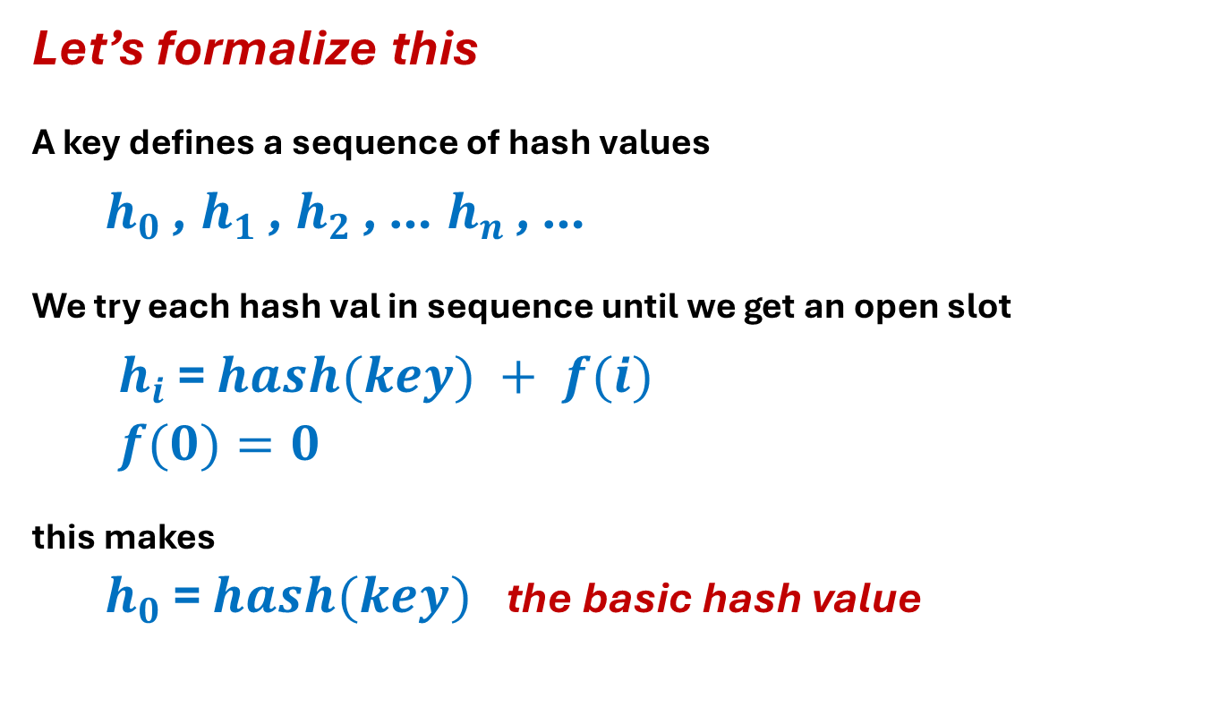
General Probing
Let’s formalize this
A key defines a sequence of hash values
$h_{0}$ , $h_{1}$ , $h_{2}$ , … $h_{n}$ , …
We try each hash val in sequence until we get an open slot
$h_{i}$ = $hash(key) + f(i)$
$f(0)=0$
this makes
$h_{0}$ = $hash(key)$the basic hash value

Slide 37
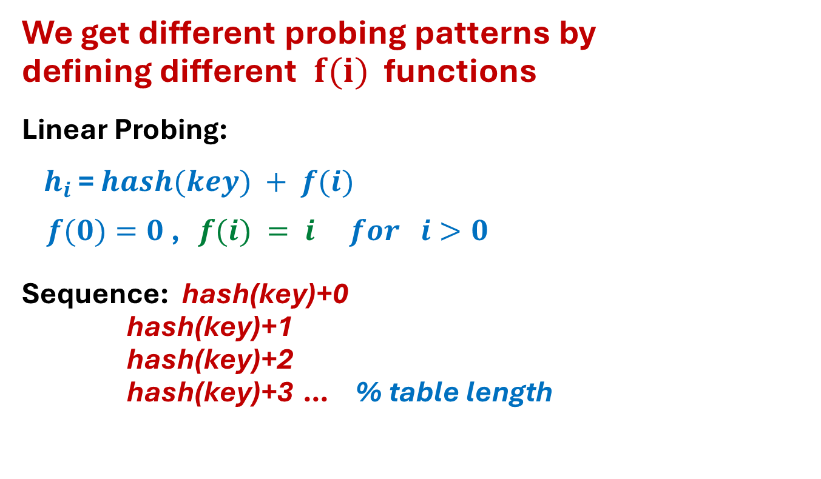
Linear Probing
We get different probing patterns by
defining different $f(i)$ functions
Linear Probing:
$h_{i}$ = $hash(key) + f(i)$
$f(0)=0$ , $f(i) = i for i>0$
Sequence: hash(key)+0
hash(key)+1
hash(key)+2
hash(key)+3 … % table length

Slide 38
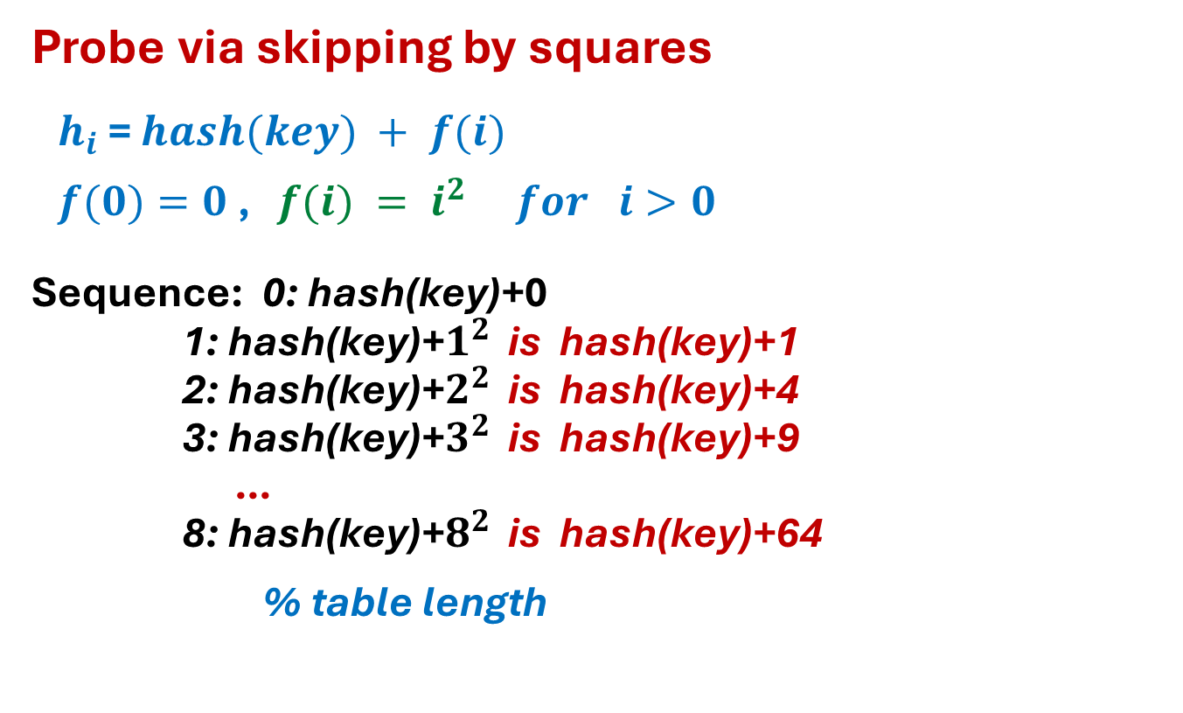
Quadratic Probing
Probe via skipping by squares
$h_{i}$ = $hash(key) + f(i)$
$f(0)=0$ , $f(i) = i^{2} for i>0$
Sequence: 0: hash(key)+0
1: hash(key)+$1^{2}$ is hash(key)+1
2: hash(key)+$2^{2}$ is hash(key)+4
3: hash(key)+$3^{2}$ is hash(key)+9
…
8: hash(key)+$8^{2}$ is hash(key)+64
% table length

Slide 39
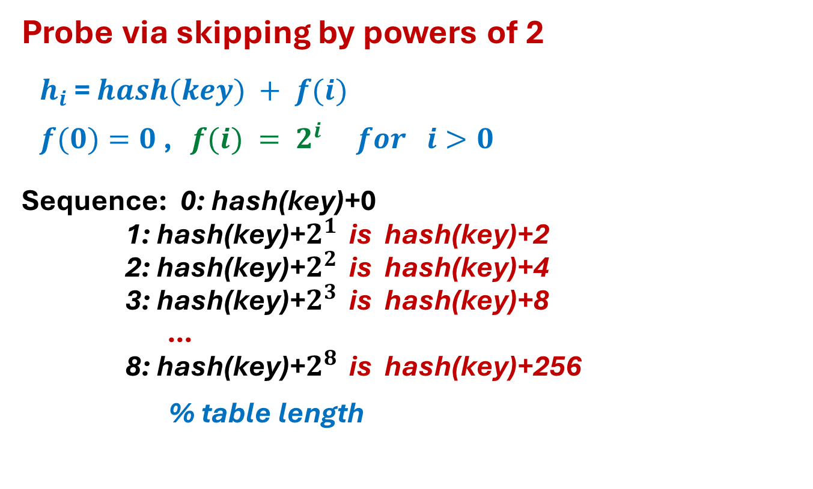
Exponential Probing
Probe via skipping by powers of 2
$h_{i}$ = $hash(key) + f(i)$
$f(0)=0$ , $f(i) = 2^{i} for i>0$
Sequence: 0: hash(key)+0
1: hash(key)+$2^{1}$ is hash(key)+2
2: hash(key)+$2^{2}$ is hash(key)+4
3: hash(key)+$2^{3}$ is hash(key)+8
…
8: hash(key)+$2^{8}$ is hash(key)+256
% table length

Slide 40
Probing performance
get (average and worst)
Hash(key) to find initial slot
O(1)
Traverse probing sequence looking for key
O(avg. cluster size)
Avg. cluster size based on load factor
If we resize table when load factor hits constant limit, then O(1)
O(1)

Slide 41
Probing performance
put (average)
Hash(key) to find initial slot
O(1)
Traverse probing sequence looking for key
O(avg. cluster size) = O(load) = O(1)
Insert into empty slot O(1)
O(1)
put (worst)
May need to resize table if load limit exceeded
Each existing K rehashed
O(n)

Slide 42
Practice problem 1
Using an initially empty HashTable of size 11 and the Hash Function H(k) = k % 11, insert the following keys, in the given order, using the linear probing method: 0, 1, 8, 9, 41, 33, 45, 42, 61, 53

Slide 43
Practice problem 1 solution
Index | Key
0 | 0
1 | 1
2 | 33
3 | 45
4 | 42
5 | 53
6 | 61
7
8 | 8
9 | 9
10 | 41
To save work, first apply the hash function to all values (though not what would happen in reality)
[0, 1, 8, 9, 41, 33, 45, 42, 61, 53] % 11 =
[0, 1, 8, 9, 8, 0, 1, 9, 6, 9]

Slide 44
Practice problem 2
Using an initially empty HashTable of size 11 and the Hash Function H(k) = k % 11, insert the following keys, in the given order, using the quadratic probing method: 0, 1, 8, 9, 41, 33, 45, 42, 61, 53

Slide 45
Practice problem 2 solution
Index | Key
0 | 0
1 | 1
2 | 45
3 | 53
4 | 33
5
6 | 41
7 | 61
8 | 8
9 | 9
10 | 42
To save work, first apply the hash function to all values (though not what would happen in reality)
[0, 1, 8, 9, 41, 33, 45, 42, 61, 53] % 11 =
[0, 1, 8, 9, 8, 0, 1, 9, 6, 9]

