Slide 1
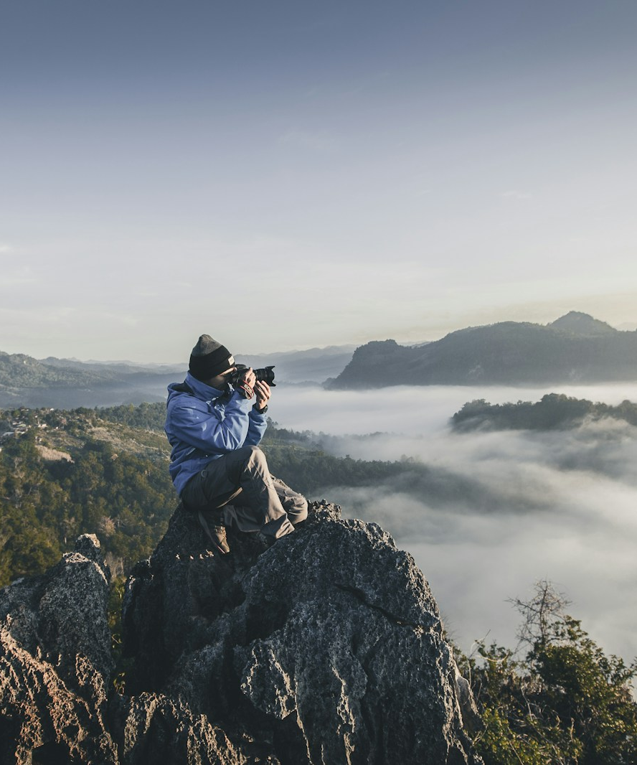
SLOP / UNIVERSITY
SLOP1416 / WEEK 2
Camera and Phone
Control
A technical workshop on exposure, motion, focus, sound and dependable media
Notes:
Cover image: Unsplash, https://images.unsplash.com/photo-1492691527719-9d1e07e534b4
Course teaching content is original.

Slide 2
SLOP / UNIVERSITY
WEEK 2 / 02
Technical outcomes
By the end of the workshop, students can explain each setting and test its result.
Configure
Diagnose
Verify
Set frame rate, shutter, exposure, white balance and focus with a stated purpose.
Recognise clipping, noise, colour shifts, focus errors and continuity breaks.
Read scopes or camera aids, play back a test and check media before leaving location.
SLOP1416 Visual Storytelling for Short-Form Media
Notes:
Original course learning outcomes.

Slide 3
SLOP / UNIVERSITY
WEEK 2 / 03
The camera decision chain
Set the conditions before you compose the shot.
Story requirement
delivery format
camera setup
1 Choose the final frame and project frame rate
2 Set shutter for natural or deliberate motion
3 Set aperture or ND, then ISO, then lock focus and white balance
SLOP1416 Visual Storytelling for Short-Form Media
Notes:
Original course workflow. Frame-rate export options are documented by Adobe: https://helpx.adobe.com/premiere/desktop/render-and-export/export-files/video-encoding-settings.html

Slide 4
SLOP / UNIVERSITY
WEEK 2 / 04
Exposure as a stop system
One stop doubles or halves the light reaching the recorded image.
Exposure change
Light
Example
+1 stop
2× as much
f/4 to f/2.8 or 1/100 to 1/50
−1 stop
½ as much
f/4 to f/5.6 or 1/50 to 1/100
+2 stops
4× as much
ISO 100 to ISO 400
SLOP1416 Visual Storytelling for Short-Form Media
Notes:
Original explanation of exposure stops. Camera controls are commonly labelled shutter, aperture and ISO in Canon manuals: https://files.canon-europe.com/files/soft31311/manual/CUG_EOS1000D_EN_Flat.pdf

Slide 5
SLOP / UNIVERSITY
WEEK 2 / 05
Aperture and depth of field
Aperture changes exposure and changes what looks sharp.
Smaller f-number
More light
Larger f-number
larger aperture opening
shallower depth of field
less light, deeper focus range
Phone note: many phones have a fixed physical aperture. Control exposure with shutter, ISO, ND, lighting or distance to the subject. Portrait blur often uses computational processing.
SLOP1416 Visual Storytelling for Short-Form Media
Notes:
Original course explanation. Verify the actual controls available on the specific phone or camera used in class.

Slide 6
SLOP / UNIVERSITY
WEEK 2 / 06
Shutter time and motion blur
Choose shutter time from the movement you need the viewer to read.
Longer shutter time
Shorter shutter time
Starting point
More light reaches the sensor. Moving hands, cars and camera shake leave more blur.
Less light reaches the sensor. Fast action looks sharper but may look staccato.
At 25 fps, try 1/50 s. At 24 fps, use about 1/48 s. Adjust intentionally when the shot needs another look.
SLOP1416 Visual Storytelling for Short-Form Media
Notes:
Original instructional rule of thumb. The exact visual result depends on subject speed, camera movement and shutter angle/time.

Slide 7
SLOP / UNIVERSITY
WEEK 2 / 07
Frame rate and shutter pairs
Use a base frame rate for a sequence, then set a compatible shutter.
Capture fps
Typical 180° shutter time
24 fps
1/48 s
25 fps
1/50 s
30 fps
1/60 s
50 fps
1/100 s
SLOP1416 Visual Storytelling for Short-Form Media
Notes:
Original teaching table using the 180-degree shutter convention. Capture and timeline settings should match the project intention. See Adobe media preferences: https://helpx.adobe.com/premiere/desktop/get-started/preferences-and-settings/media-preferences.html

Slide 8
SLOP / UNIVERSITY
WEEK 2 / 08
ISO and sensor noise
ISO amplifies the recorded signal. It does not create more light.
ISO raises the gain applied to the sensor signal. A higher ISO can make a dark scene appear brighter, but it cannot recover detail that the sensor did not record.
Base ISO
Noise test
Exposure choice
Start at the camera’s lower native setting when light allows.
Record skin, shadow and a flat wall. Compare 100% crops on a larger screen.
Add light or open aperture before raising ISO when possible.
SLOP1416 Visual Storytelling for Short-Form Media
Notes:
Original course content. Results vary by camera sensor and processing mode.

Slide 9
SLOP / UNIVERSITY
WEEK 2 / 09
Exposure workflow
Use a repeatable order so every change has a visible reason.
1
Select delivery frame rate and resolution
2
Set shutter time for the intended motion
3
Set aperture or attach ND for the desired depth of field
4
Raise ISO only as far as the shot still holds detail
5
Check histogram, zebra or waveform if available
6
Lock focus and white balance, then record a five-second test
SLOP1416 Visual Storytelling for Short-Form Media
Notes:
Original course workflow.

Slide 10
SLOP / UNIVERSITY
WEEK 2 / 10
Histogram and clipping
The graph checks distribution. It does not tell you what the subject should look like.
Shadow detail
Midtones
Highlights
A pile-up against either edge can indicate clipping. Check the image itself, then decide whether the loss matters to the story.
SLOP1416 Visual Storytelling for Short-Form Media
Notes:
Original histogram diagram. Histogram implementation differs by device.

Slide 11
SLOP / UNIVERSITY
WEEK 2 / 11
Neutral-density filters
ND reduces light so daylight does not force an unwanted shutter or aperture.
Bright daylight
Without ND
With ND
You may need a very fast shutter or a closed aperture to avoid overexposure.
Motion can lose its intended blur and depth of field can become deeper than planned.
ND lowers incoming light, preserving the shutter and aperture choices you already made.
Test: add ND, re-check colour cast, re-check focus and record the same movement twice for comparison.
SLOP1416 Visual Storytelling for Short-Form Media
Notes:
Original course explanation. Filter density and colour cast vary by manufacturer.

Slide 12
SLOP / UNIVERSITY
WEEK 2 / 12
White balance and colour temperature
Lock colour before recording a sequence under stable light.
Tungsten interior
about 3200 K
warmer source
Daylight
about 5600 K
cooler source
Mixed light
no single correct value
choose the dominant source or add correction
Workflow: frame a neutral target under the source, set manual white balance if available, lock it, then re-set only when the source changes.
SLOP1416 Visual Storytelling for Short-Form Media
Notes:
Original course workflow. Kelvin values are approximate conventions, not a guarantee of the rendered colour.

Slide 13
SLOP / UNIVERSITY
WEEK 2 / 13
Focus control
Focus has a subject, a distance and a verification step.
Subject
Distance
Verification
Identify the one thing the viewer must read first. Put the focus point there.
Re-check after camera movement, reframing or a subject step toward the lens.
Magnify playback or use focus peaking. A small phone screen can hide a miss.
SLOP1416 Visual Storytelling for Short-Form Media
Notes:
Original course focus procedure.

Slide 14
SLOP / UNIVERSITY
WEEK 2 / 14
Resolution, codec and bitrate
These settings describe image size, compression method and data per second.
Resolution
pixel dimensions
1920 × 1080, 3840 × 2160
Codec
compression method
H.264, HEVC, ProRes
Bitrate
data recorded per second
higher can preserve more detail but uses more storage
Keep original clips. Transcode only when your editor needs a smoother proxy workflow.
SLOP1416 Visual Storytelling for Short-Form Media
Notes:
Codec and export setting terminology: Adobe, Video encoding settings reference, https://helpx.adobe.com/premiere/desktop/render-and-export/export-files/video-encoding-settings.html

Slide 15
SLOP / UNIVERSITY
WEEK 2 / 15
Aspect ratio and framing
Record for the intended screen shape before editing begins.
16:9
9:16
1:1
landscape screens, many presentations and web players
vertical platforms and phone-first viewing
square layouts when the distribution requires it
Frame a safety margin around text, faces and important action when versions may be cropped for another platform.
SLOP1416 Visual Storytelling for Short-Form Media
Notes:
Original course delivery guidance.

Slide 16
SLOP / UNIVERSITY
WEEK 2 / 16
Slow motion and conforming
Higher capture fps changes how much time the same action occupies in the timeline.
50 fps capture
25 fps timeline
2× longer action
Example: 2 seconds of action captured at 50 fps contains 100 frames. Played at 25 fps, those 100 frames occupy 4 seconds.
Keep the shutter near 1/100 s for this 50 fps capture if you want the usual amount of blur in each recorded frame.
SLOP1416 Visual Storytelling for Short-Form Media
Notes:
Original calculation. Frame-rate relationships are basic arithmetic; project setup must match the intended delivery.

Slide 17
SLOP / UNIVERSITY
WEEK 2 / 17
Stability and intentional movement
A stable frame needs physical support. A moving frame needs a reason.
Handheld support
Movement rehearsal
Stabilisation
Use two hands, keep elbows near the body and control breathing during a static shot.
Mark start and end frames. Rehearse at least once before the recorded take.
Digital stabilisation may crop or warp edges. Compare stabilised and unstabilised footage before committing.
SLOP1416 Visual Storytelling for Short-Form Media
Notes:
Original course guidance. Stabilisation behaviour varies by device and software.

Slide 18
SLOP / UNIVERSITY
WEEK 2 / 18
Screen direction and the 180-degree line
A consistent camera side keeps movement and eyelines legible.
Camera side A
Subject 1
Subject 2
Camera side B
Keep the camera on one side of the action line for a continuous conversation or movement. Cross only after a neutral reset shot establishes the new geography.
SLOP1416 Visual Storytelling for Short-Form Media
Notes:
Original course diagram and explanation of the 180-degree line.

Slide 19
SLOP / UNIVERSITY
WEEK 2 / 19
Coverage and continuity
Build edits from a planned set of shots, not a single fortunate take.
Master shot
Medium shot
Close-up
Cutaway
Records the full action and preserves geography. Hold extra time before and after action.
Shows action and expression together. Check screen direction before moving closer.
Supplies detail for emphasis and edit points. Re-focus after every distance change.
Shows a related detail or environment. Use it to bridge a cut, never as random filler.
SLOP1416 Visual Storytelling for Short-Form Media
Notes:
Original course coverage guidance.

Slide 20
SLOP / UNIVERSITY
WEEK 2 / 20
Sound capture
Picture can tolerate imperfection. Unclear dialogue can stop the story.
Sample rate
Levels
Room tone
Set 48 kHz for video projects when the device offers a choice. Keep one setting across the project.
Listen with headphones. Avoid clipping and leave margin for sudden louder speech.
Record 30 seconds of the location after the action. It makes sound edits less abrupt.
SLOP1416 Visual Storytelling for Short-Form Media
Notes:
Original course guidance. The 48 kHz convention is widely used for video, but project requirements take priority.

Slide 21
SLOP / UNIVERSITY
WEEK 2 / 21
Media management
A file structure and verification routine protect the work before editing.
Project folder
File name pattern
01_ORIGINALS
YYYYMMDD_location_subject_take
02_AUDIO
Example: 20260913_library_interview_T03
03_PROJECTS
04_EXPORTS
Before leaving: duplicate media to a second location, open several copied files, and only then clear a card.
05_DOCUMENTS
SLOP1416 Visual Storytelling for Short-Form Media
Notes:
Original course workflow.

Slide 22
SLOP / UNIVERSITY
WEEK 2 / 22
Week 2 laboratory exercise
Produce a 25-second continuity sequence with controlled camera settings.
Brief
Film a person making tea, packing a bag or entering a room. Deliver a 25-second edited sequence.
Capture rules
Use one base frame rate, manual or locked white balance, a master, two closer shots and one cutaway. Record room tone.
Evidence to submit
Final edit, three unedited source clips, screenshot of settings, and 200 words on one technical choice and one problem solved.
SLOP1416 Visual Storytelling for Short-Form Media
Notes:
Original SLOP1416 Week 2 laboratory exercise.

Slide 23
SLOP / UNIVERSITY
WEEK 2 / 23
Technical review rubric
Assess evidence from the footage rather than intentions written after the fact.
Exposure
No unintended clipping on the essential subject. Chosen motion blur remains readable.
Focus
The intended subject remains sharp at the moment the viewer needs it.
Continuity
Screen direction, action and sound make each cut understandable.
Media
Footage is named, backed up and traceable to the edit.
SLOP1416 Visual Storytelling for Short-Form Media
Notes:
Original course review rubric.

Slide 24
SLOP / UNIVERSITY
WEEK 2 / 24
Recommended practice and preparation
External guides support the next stage of the course.
Camera and exposure practice
Canon camera manuals: https://www.canon-europe.com/support/
Editing and delivery
Adobe video encoding settings: https://helpx.adobe.com/premiere/desktop/render-and-export/export-files/video-encoding-settings.html
DaVinci Resolve training
Blackmagic Design: https://www.blackmagicdesign.com/au/products/davinciresolve/training
Preparation: bring a 10-second daylight test and a 10-second indoor-light test. Label the camera settings used for each.
SLOP1416 Visual Storytelling for Short-Form Media
Notes:
External resources: Canon support manuals, https://www.canon-europe.com/support/; Adobe, Video encoding settings reference, https://helpx.adobe.com/premiere/desktop/render-and-export/export-files/video-encoding-settings.html; Blackmagic Design, DaVinci Resolve training, https://www.blackmagicdesign.com/au/products/davinciresolve/training. Accessed 13 September 2026.

