Slide 1
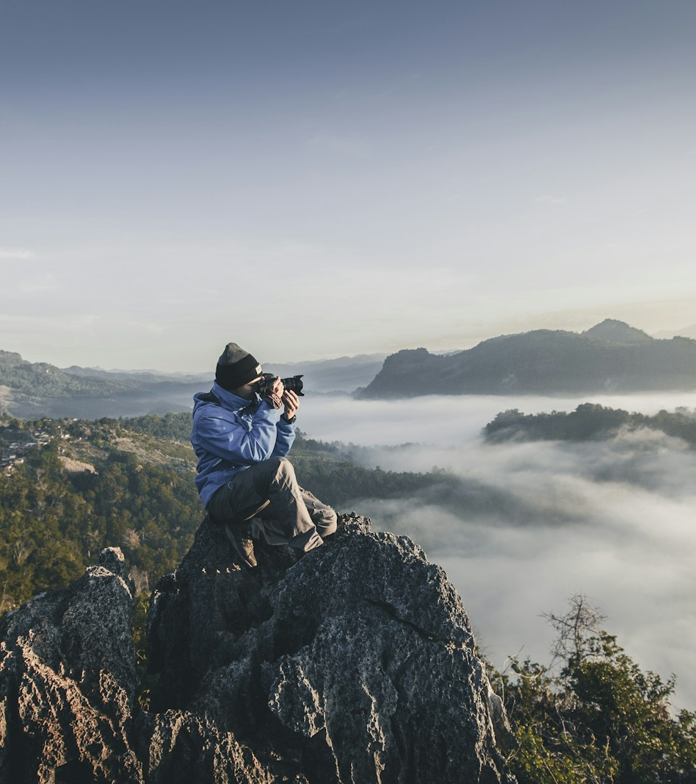
SLOP / UNIVERSITY
SLOP1416
Camera and Phone
Control
Week 2: Exposure, focus, movement and reliable files
Notes:
Image asset: Unsplash https://images.unsplash.com/photo-1492691527719-9d1e07e534b4
Course content is original.

Slide 2
SLOP / UNIVERSITY
WEEK 2
Today’s practice
Control the camera before the camera controls your story
Observe
Test
Review
What changes in the image when you change one setting?
Repeat the action from the same position.
Decide which version serves the story.
02
Notes:
Original SLOP1416 Week 2 teaching content.

Slide 3
SLOP / UNIVERSITY
WEEK 2
The exposure triangle
Aperture, shutter speed and ISO change brightness in different ways
Aperture
Shutter speed
ISO
Controls depth of field on cameras with adjustable apertures.
Controls motion blur and affects brightness.
Raises sensitivity and may add visible noise.
03
Notes:
Original SLOP1416 Week 2 teaching content.

Slide 4
SLOP / UNIVERSITY
WEEK 2
Exposure priority
Choose the setting that protects the story first
For a moving subject, protect readable motion. For a face, protect focus. For a dark location, protect useful detail before you chase a perfect number.
04
Notes:
Original SLOP1416 Week 2 teaching content.

Slide 5
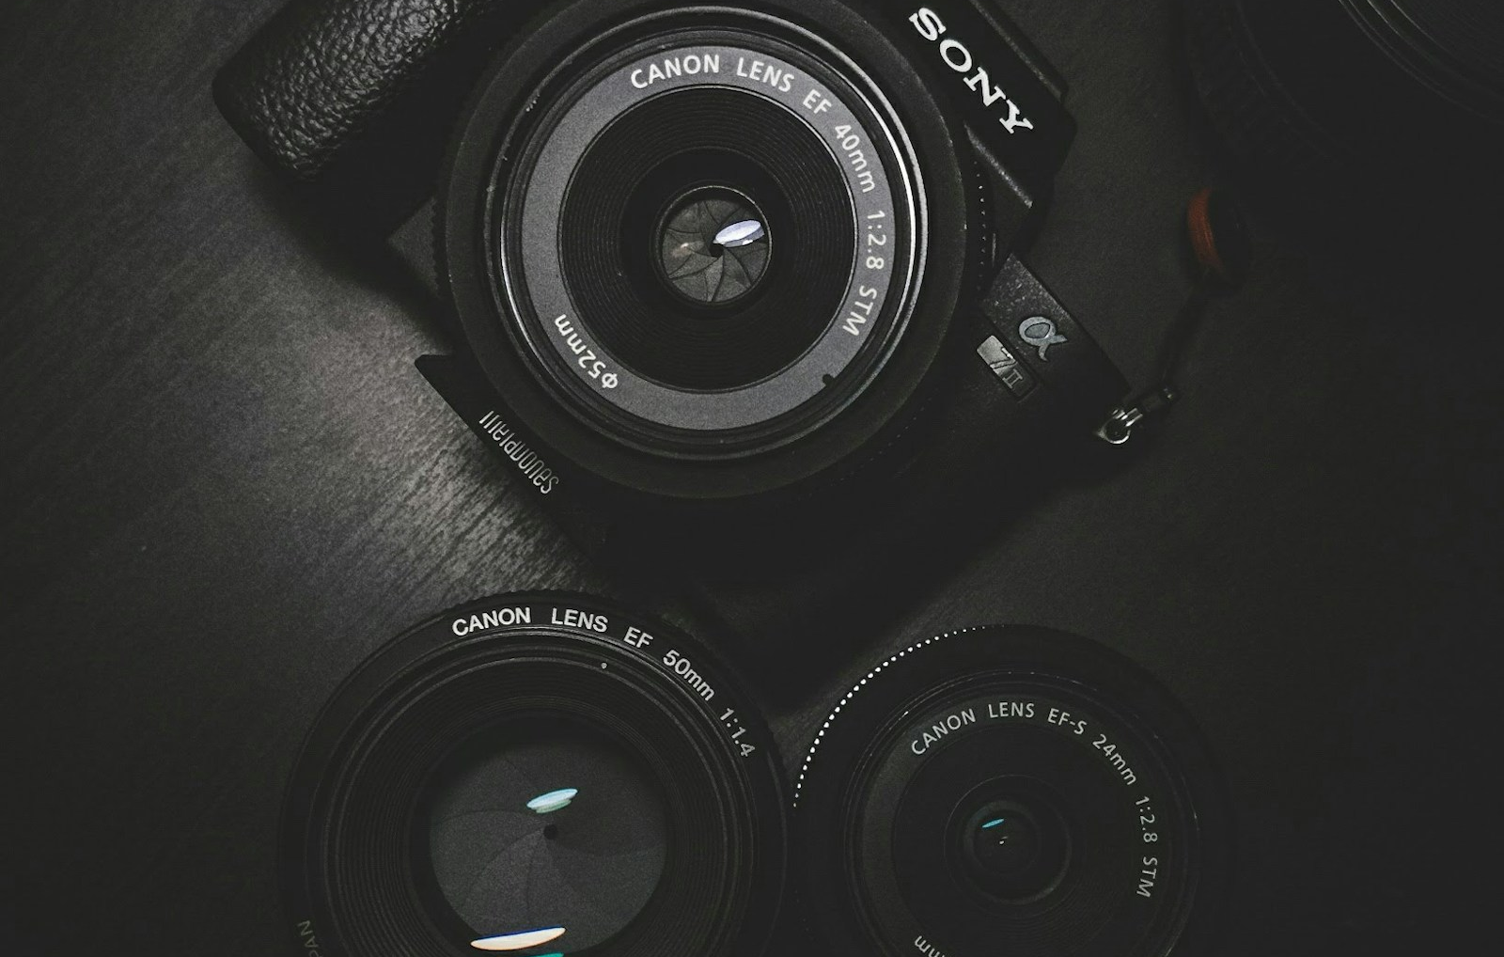
SLOP / UNIVERSITY
WEEK 2
Focus
Decide what the viewer should see clearly
Tap or set focus deliberately. Re-check it after moving the camera or changing the distance to the subject.
05
Notes:
Original SLOP1416 Week 2 teaching content.

Slide 6
SLOP / UNIVERSITY
WEEK 2
Frame rate
Frame rate changes movement, motion blur and editing options
Use one frame rate for a sequence unless a change has a clear purpose. Keep enough light for the setting you choose.
06
Notes:
Original SLOP1416 Week 2 teaching content.

Slide 7
SLOP / UNIVERSITY
WEEK 2
Resolution and aspect ratio
Choose a format before shooting, not after editing
Decide whether your story belongs in vertical 9:16, horizontal 16:9, or another format before you frame the first shot.
07
Notes:
Original SLOP1416 Week 2 teaching content.

Slide 8
SLOP / UNIVERSITY
WEEK 2
Stability
Handheld movement needs a reason
Hold the camera close to your body, move your feet before moving the frame, and avoid motion that distracts from the subject.
08
Notes:
Original SLOP1416 Week 2 teaching content.

Slide 9
SLOP / UNIVERSITY
WEEK 2
Camera movement
Pan, tilt and tracking each change what the viewer learns
A pan reveals space. A tilt changes attention. A tracking shot follows action. Rehearse each move once before recording.
09
Notes:
Original SLOP1416 Week 2 teaching content.

Slide 10
SLOP / UNIVERSITY
WEEK 2
The 180-degree line
Screen direction helps a viewer understand space
Imagine a line between two people or two directions of action. Keep the camera on one side unless you deliberately reset the viewer’s orientation.
10
Notes:
Original SLOP1416 Week 2 teaching content.

Slide 11
SLOP / UNIVERSITY
WEEK 2
Continuity
Match action, direction and sound across a cut
Cut on a change in action, retain screen direction, and capture room tone so sound does not jump between shots.
11
Notes:
Original SLOP1416 Week 2 teaching content.

Slide 12
SLOP / UNIVERSITY
WEEK 2
Phone camera settings
Lock focus and exposure when the scene demands consistency
Phones are capable cameras when you control focus, exposure and orientation instead of relying on every automatic choice.
12
Notes:
Original SLOP1416 Week 2 teaching content.

Slide 13
SLOP / UNIVERSITY
WEEK 2
Camera settings checklist
Battery, storage, format, focus, exposure and sound
Before every shoot: charge battery, clear storage, choose format, test focus and exposure, record ten seconds of sound, then make a backup.
13
Notes:
Original SLOP1416 Week 2 teaching content.

Slide 14
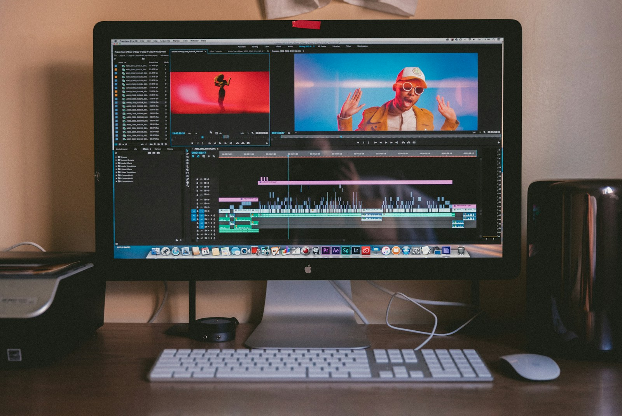
SLOP / UNIVERSITY
WEEK 2
File management
A simple folder structure protects creative work
Use one project folder with subfolders for originals, audio, project files, exports and documents. Name files by date and subject.
14
Notes:
Original SLOP1416 Week 2 teaching content.

Slide 15
SLOP / UNIVERSITY
WEEK 2
Backup rule
Keep two copies before you delete footage
Keep two copies in different places. A cloud copy and an external drive are useful only when you check that the files open.
15
Notes:
Original SLOP1416 Week 2 teaching content.

Slide 16
SLOP / UNIVERSITY
WEEK 2
Week 2 continuity exercise
Make a 20-second action readable across three shots
Record a person making a simple action. Use a wide shot, a medium shot and a close-up. Match the direction of movement across cuts.
16
Notes:
Original SLOP1416 Week 2 teaching content.

Slide 17
SLOP / UNIVERSITY
WEEK 2
Assignment 1 portfolio
Use this week’s exercise as your framing and movement evidence
Add the continuity exercise to your portfolio. In the reflection, name one camera setting you controlled and one result you would improve.
17
Notes:
Original SLOP1416 Week 2 teaching content.

Slide 18
SLOP / UNIVERSITY
WEEK 2
Review vocabulary
Name a choice, describe its effect, ask a useful question
Useful feedback points to a visible or audible choice: where focus lands, when a cut occurs, or what the background sound contributes.
18
Notes:
Original SLOP1416 Week 2 teaching content.

Slide 19
SLOP / UNIVERSITY
WEEK 2
Common problems
Auto exposure shifts, distracted focus, rushed cuts and missing room tone
Solve one problem at a time. Re-shoot when focus is unusable. Re-record sound when speech cannot be understood. Keep enough handle before and after action.
19
Notes:
Original SLOP1416 Week 2 teaching content.

Slide 20
SLOP / UNIVERSITY
WEEK 2
External resources
Use these after class to extend your practice
1. Videomaker: Composition 101
https://www.videomaker.com/article/c10/12190-composition-101-part-1
2. W3C: Making Audio and Video Media Accessible
https://www.w3.org/WAI/media/av/
3. NFSA: Exploring the language of film
https://shop.nfsa.gov.au/assets/files/Story%20of%20Rosy%20Dock_TN.pdf
20
Notes:
External links shown on slide.

Slide 21
SLOP / UNIVERSITY
WEEK 2
Preparation for Week 3
Bring two versions of the same place in different light
Prepare two clips of the same place in different light. Note exposure, colour, shadow and where the viewer looks first.
21
Notes:
Original SLOP1416 Week 2 teaching content.

Slide 22
NEXT: LIGHT AND COLOUR
Control the camera
so you can notice light
Bring two versions of one place, recorded at different times of day.
Notes:
Original teaching prompt.

