Slide 1
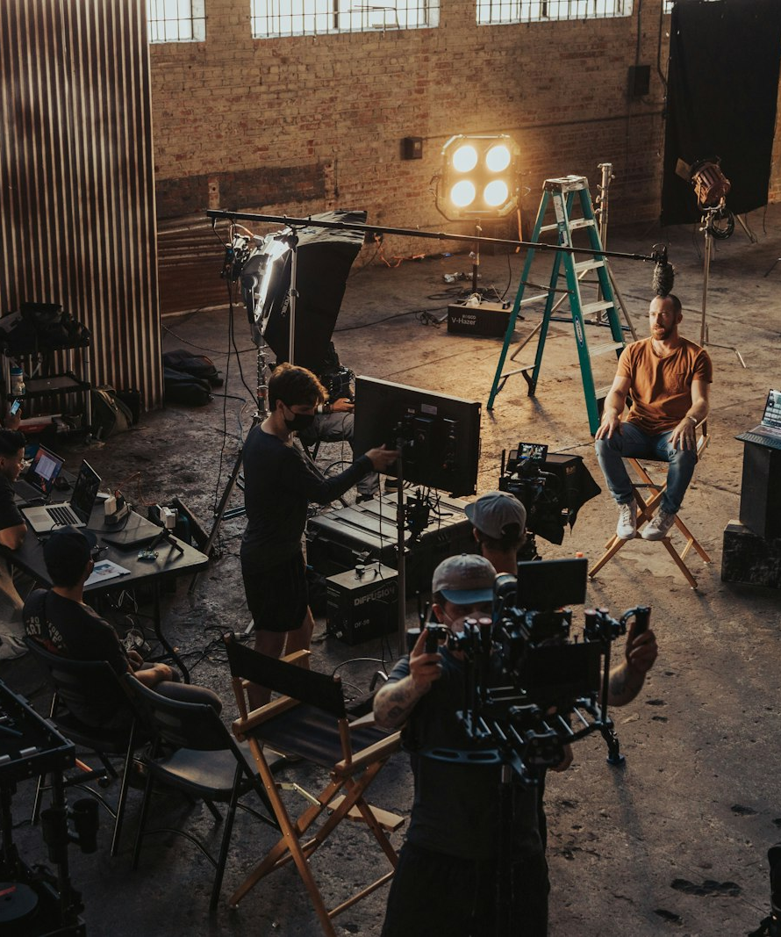
SLOP / UNIVERSITY
SLOP1416 / WEEK 6
Storyboards and Production Plans
Turning a logline into a shot list you can trust on the day: structure, previsualisation, coverage, continuity, risk and the production log.
Notes:
Unsplash: https://images.unsplash.com/photo-1632187981988-40f3cbaeef5e — photographer Jakob Owens (@jakobowens1), accessed 13 Sep 2026
Course teaching content is original.

Slide 2
SLOP / UNIVERSITY
WEEK 6 / 02
Technical outcomes
By the end of this lecture you can turn an idea into a plan a crew can execute.
Structure
Plan
Protect
Map a logline onto setup, development and resolution before a single frame is shot.
Build a storyboard and shot list that a stranger could shoot from without you present.
Carry a risk, permission and backup plan into every shoot day, and log what actually changed.
SLOP1416 Visual Storytelling for Short-Form Media
Notes:
Original course learning outcomes, aligned to session 6's brief.

Slide 3
SLOP / UNIVERSITY
WEEK 6 / 03
From logline to sequence
A logline is a compression test, not a summary.
A logline states who wants what, what is stopping them, in one or two sentences. If you cannot compress your idea this far, the shoot itself will be where you discover you did not know what the sequence was about.
Too loose
Compressed enough
“A short film about change” gives a crew nothing to point a camera at — no subject, no action, no stakes.
“A commuter notices the same stranger on their route three days running” gives a subject, an action and a question.
SLOP1416 Visual Storytelling for Short-Form Media
Notes:
Original framing device opening the lecture, directly answering session 6's instruction to bring a logline.

Slide 4
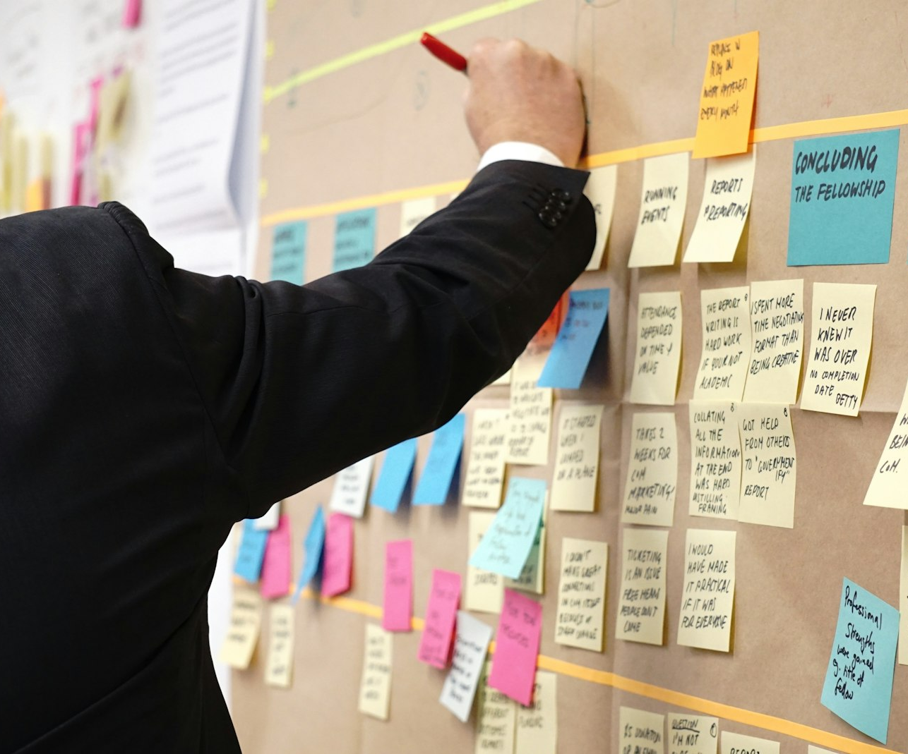
SLOP / UNIVERSITY
WEEK 6 / 04
The rough list of moments
Before structure, capture every moment that might belong in the sequence — unordered.
Write one moment per note: an action, a look, a change of location. Do not sequence them yet — sequencing too early makes you defend an order before you have tested whether the moments are the right ones.
Aim for
Ten to twenty raw moments, more than you will use — structure is easier as subtraction than invention.
Bring to session
Your logline, a location, and this rough list — exactly what session 6 asks you to arrive with.
SLOP1416 Visual Storytelling for Short-Form Media
Notes:
Directly answers session 6's brief: "bring a logline, a location and a rough list of moments." Unsplash: https://images.unsplash.com/photo-1542626991-cbc4e32524cc — photographer Jo Szczepanska (@joszczepanska), accessed 13 Sep 2026

Slide 5
SLOP / UNIVERSITY
WEEK 6 / 05
Setup, development, resolution
The smallest structure that still has a shape.
Part
What it does
Ask yourself
Setup
Establishes the subject, the location and the ordinary state before anything changes
who / where / what is normal
Development
The change happens, complicates, or is tested — the reason this sequence exists
what shifts, and what it costs
Resolution
The new state settles — not necessarily happy, but no longer in motion
what is true now that was not before
SLOP1416 Visual Storytelling for Short-Form Media
Notes:
Original three-part structural framework directly implementing session 6's instruction to map setup, development and resolution.

Slide 6

SLOP / UNIVERSITY
WEEK 6 / 06
Mapping structure to images
One representative shot per beat turns structure into something you can look at.
For each of setup, development and resolution, choose one image — drawn, photographed or described — that stands for that part. If you cannot picture a representative image for a part, that part is not yet specific enough to shoot.
Test
Show the three images to someone cold. If they can guess the logline from the images alone, the structure is legible.
Common failure
Two images that could belong to either setup or development — the boundary between parts is not yet clear.
SLOP1416 Visual Storytelling for Short-Form Media
Notes:
Original method translating session 6's "map setup, development and resolution as images" into a concrete test. Unsplash: https://images.unsplash.com/photo-1532622785990-d2c36a76f5a6 — photographer Kaleidico (@kaleidico), accessed 13 Sep 2026

Slide 7
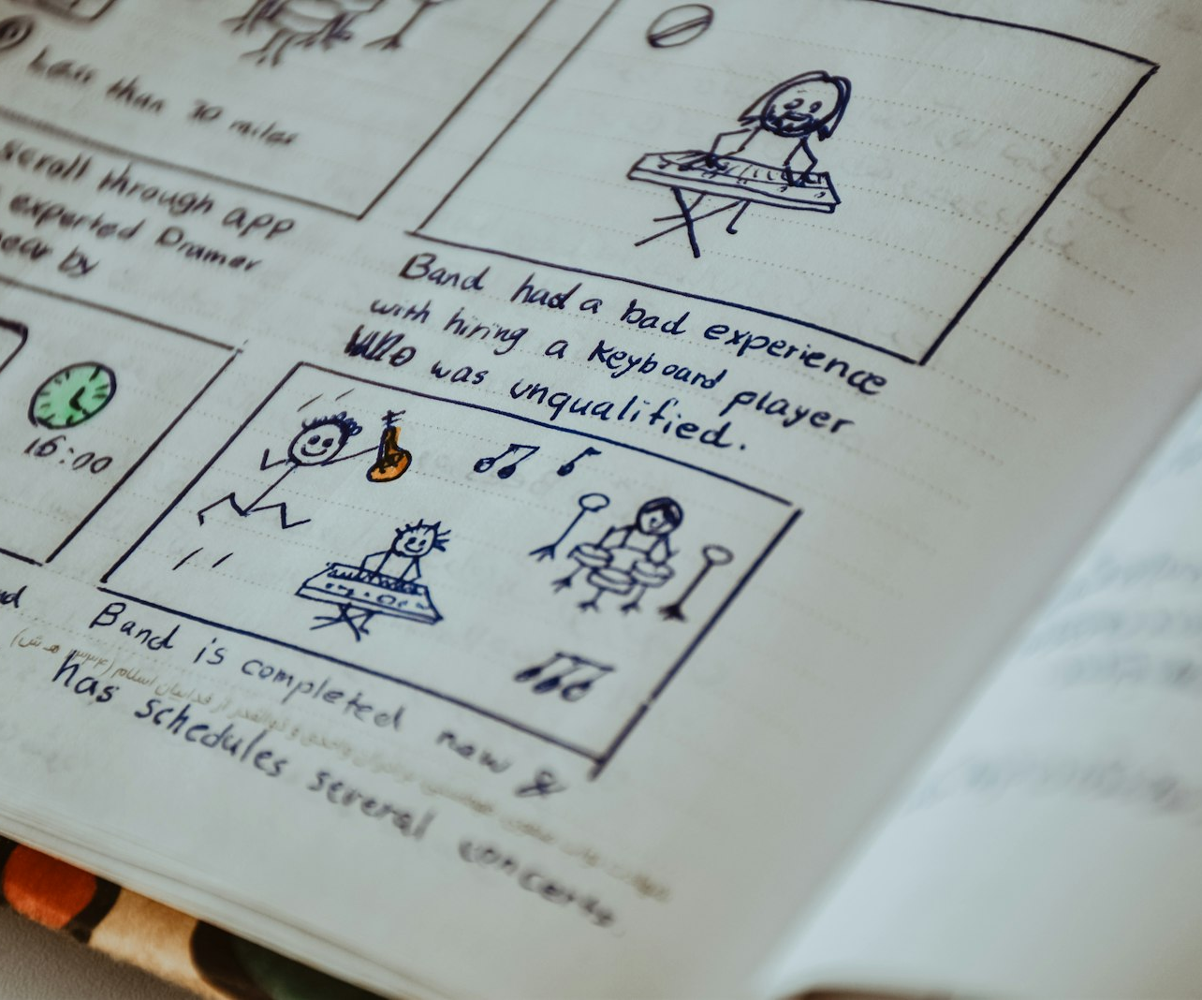
SLOP / UNIVERSITY
WEEK 6 / 07
Storyboarding as previsualisation
A storyboard answers questions before they cost you time on location.
A storyboard panel is not an art object — it is a fast answer to three questions: what is in frame, how is it framed, and what happens during the shot.
What it prevents
Discovering on location that two consecutive shots do not actually cut together, or that a planned move has nowhere to happen.
What it does not need
Drawing skill. Stick figures, arrows and one line of description are enough if the information is there.
SLOP1416 Visual Storytelling for Short-Form Media
Notes:
Unsplash: https://images.unsplash.com/photo-1681372751506-1586b0542195 — photographer Nasim Keshmiri (@nasimkeshmiri), accessed 13 Sep 2026

Slide 8
SLOP / UNIVERSITY
WEEK 6 / 08
Storyboard panel anatomy
Four elements, every panel, no exceptions.
Element
What it carries
Frame
A rectangle showing the composition — subject position, horizon, foreground
Movement arrow
A line showing camera movement or subject movement inside the frame
Shot number
Matches the shot list row this panel will become
Caption
One line: the action, and any sound or dialogue cue
SLOP1416 Visual Storytelling for Short-Form Media
Notes:
Original storyboard-panel standard used across the course; directly supports building panels that translate cleanly into a shot list.

Slide 9
SLOP / UNIVERSITY
WEEK 6 / 09
From storyboard to shot list
The storyboard is what you imagine; the shot list is what you schedule.
Every panel becomes one row. The storyboard's arrows and captions expand into the shot list's movement, duration and location columns — information a panel implies, a shot list must state.
Storyboard answers
Shot list answers
What is in frame, and roughly what happens — built for quick review and revision.
How long it takes, where it happens, and in what order — built for scheduling a day.
SLOP1416 Visual Storytelling for Short-Form Media
Notes:
Original bridge slide connecting storyboard and shot list as two views of the same plan.

Slide 10
SLOP / UNIVERSITY
WEEK 6 / 10
Shot list anatomy
The columns a usable shot list needs — no fewer.
Column
Example entry
#
3
Description
Commuter looks up and notices the stranger again
Size
Medium close-up
Movement
Static, locked off
Location
Platform, east end, 8:10am light
Est. duration
4 min setup, 3 takes
SLOP1416 Visual Storytelling for Short-Form Media
Notes:
Original shot-list standard for the course; matches the columns a location manager or camera assistant expects to see.

Slide 11
SLOP / UNIVERSITY
WEEK 6 / 11
Shot sizes, as a shared vocabulary
A shot list is only useful if everyone reads “medium close-up” the same way.
EWS
WS
MS
Extreme wide
Wide
Medium
Establishes scale and place
Full subject, room to move
Waist up, conversational
MCU
CU
ECU
Medium close-up
Close-up
Extreme close-up
Chest up, reads expression
Face fills the frame
A single detail: eyes, hands
SLOP1416 Visual Storytelling for Short-Form Media
Notes:
Standard shot-size abbreviations shared across the shot list and storyboard — consistent with Week 2's framing vocabulary.

Slide 12
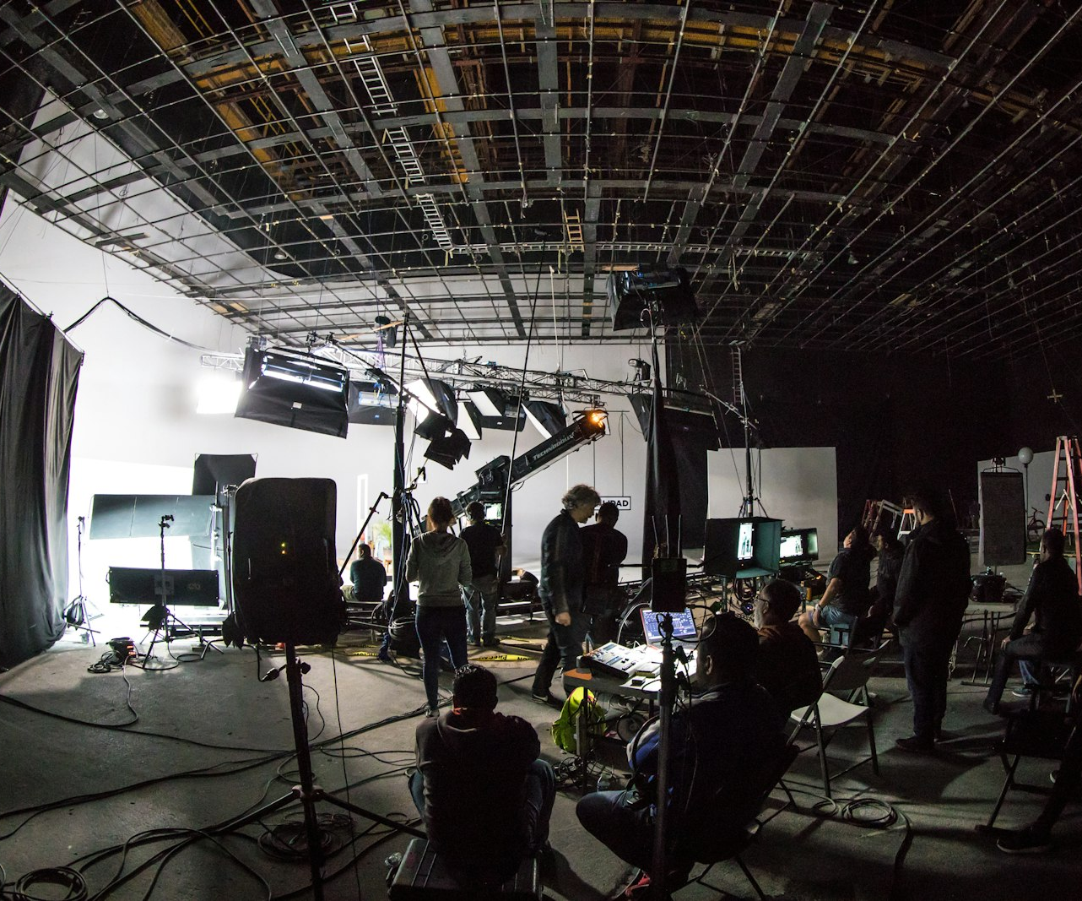
SLOP / UNIVERSITY
WEEK 6 / 12
The coverage principle
Shoot more angles of a moment than you think you need.
A single perfect take, shot once, gives an editor no options. Coverage — a wide master plus closer angles of the same action — lets a cut be built and rebuilt after the shoot, when problems are easiest to see.
Minimum coverage
One master shot for the whole action, plus one closer shot on whichever part carries the meaning.
Cost
Coverage takes time — budget it explicitly rather than discovering you have none left.
SLOP1416 Visual Storytelling for Short-Form Media
Notes:
Unsplash: https://images.unsplash.com/photo-1612544409025-e1f6a56c1152 — photographer Brands&People (@brandsandpeople), accessed 13 Sep 2026

Slide 13
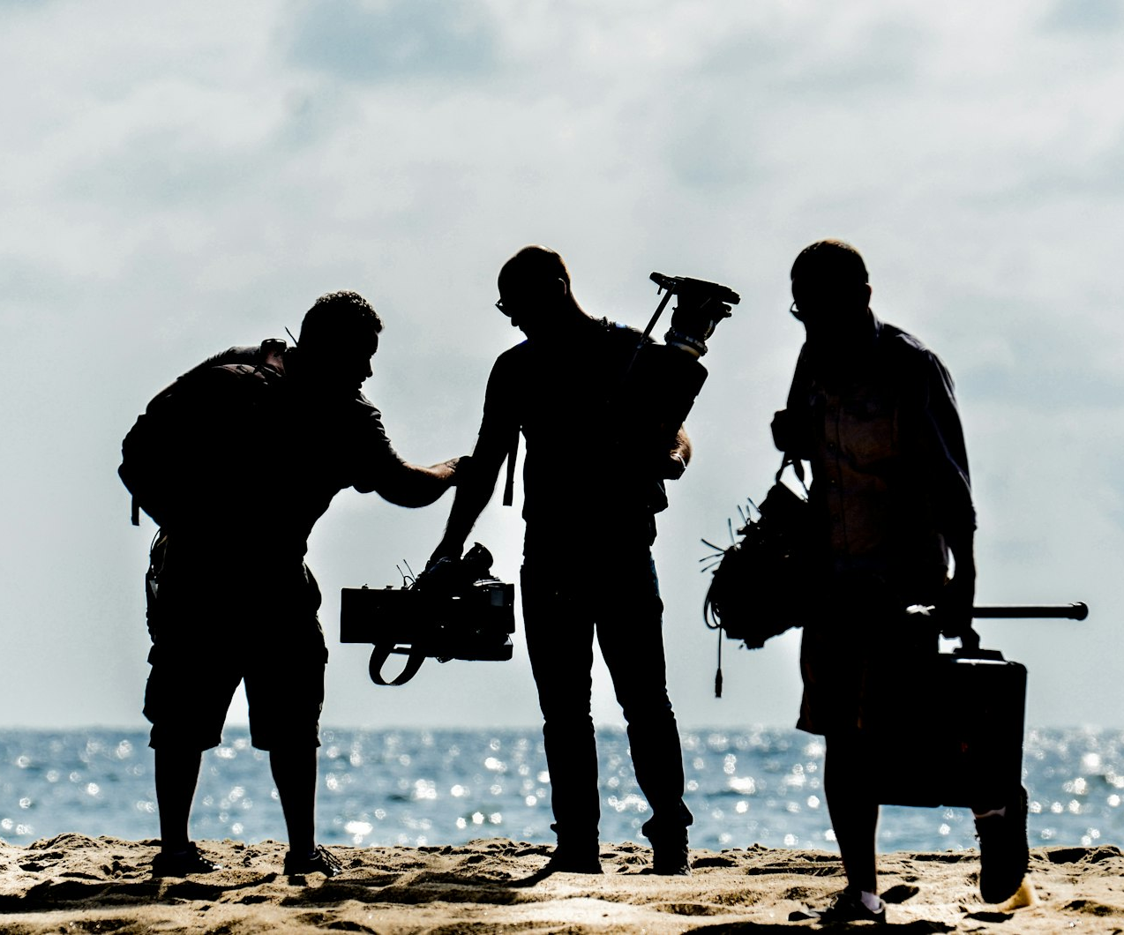
SLOP / UNIVERSITY
WEEK 6 / 13
Screen direction across a sequence
The 180-degree line, extended from one cut to a whole shot list.
Fix an imaginary line along the subject's main axis of movement or attention before you shoot the first frame. Every shot in the list should be planned from the same side of that line.
In the shot list
Add a direction note per shot: “subject moves left to right” — so anyone shooting from the list keeps the line.
Deliberate crossing
Crossing the line is a tool for disorientation — mark it explicitly so it reads as a choice, not an error.
SLOP1416 Visual Storytelling for Short-Form Media
Notes:
Extends Week 2's screen-direction rule from a single cut to a planned sequence. Unsplash: https://images.unsplash.com/photo-1524834671419-aa7d41c1c657 — photographer Stephane YAICH (@stefyaich), accessed 13 Sep 2026

Slide 14
SLOP / UNIVERSITY
WEEK 6 / 14
Continuity across cuts
Four things an editor checks between any two shots meant to sit together.
Direction
Subject's screen direction and eyeline match across the cut
Light
Dominant direction and colour temperature match (Week 3)
Props and wardrobe
Position and state match — a held object does not jump hands
Action
Movement started in one shot completes or continues logically in the next
SLOP1416 Visual Storytelling for Short-Form Media
Notes:
Original continuity checklist drawing together Week 2's screen direction and Week 3's light continuity into one review pass.

Slide 15
SLOP / UNIVERSITY
WEEK 6 / 15
Shot count and pacing budget
For a one-minute sequence: how many shots is enough?
A one-minute sequence at an average shot length of six to ten seconds needs roughly six to ten shots — fewer if a shot holds longer for observation, more if the pace is meant to feel urgent.
Too few shots
Too many shots
One or two long static takes can feel observational — or simply under-covered if the moment needed more angles.
A cut every one to two seconds reads as urgency — or as a sequence that never lets a moment land.
SLOP1416 Visual Storytelling for Short-Form Media
Notes:
Original pacing guidance directly supporting session 6's reference-viewing task of sketching six frames for a one-minute sequence.

Slide 16
SLOP / UNIVERSITY
WEEK 6 / 16
Time budgeting on the shoot day
A shot list without time estimates is a wish list.
1
Estimate setup time per shot: lighting, camera position, rehearsal.
2
Estimate takes per shot: how many attempts before it is usable.
3
Add strike and travel time between locations or setups.
4
Total the estimate, then add a 20-30% buffer for the unplanned.
If the total exceeds the time you actually have, cut shots before the day — not on location, when you are choosing under pressure.
SLOP1416 Visual Storytelling for Short-Form Media
Notes:
Original time-budgeting method for translating a shot list into a realistic shoot-day schedule.

Slide 17
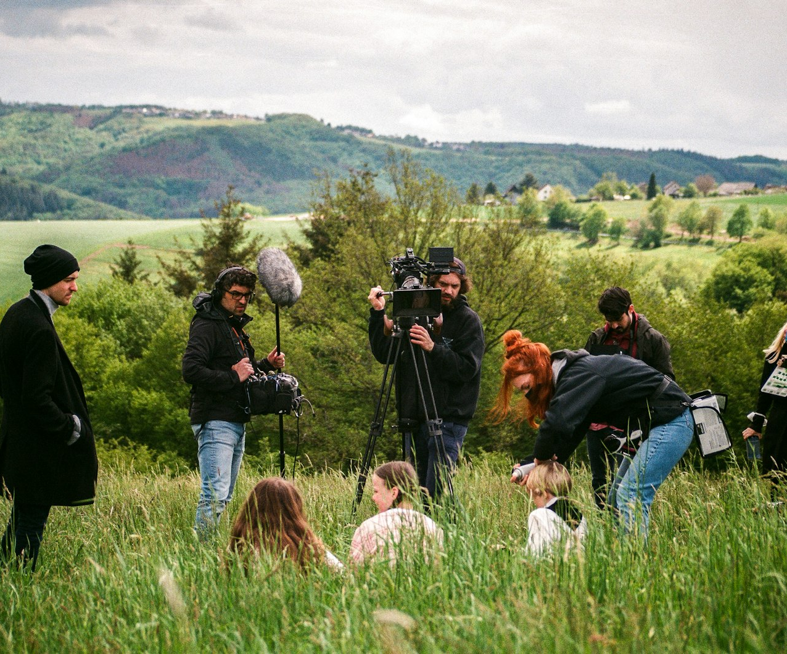
SLOP / UNIVERSITY
WEEK 6 / 17
Risk assessment and safety planning
Every location and every shot carries some risk — name it before the day.
Walk the shot list against the location: traffic, terrain, weather, equipment near water or heights, and anyone who is not part of the shoot but is present in frame.
Minimum check
For each risky shot: what could go wrong, how likely, and what you will do if it does.
Non-negotiable
If a shot cannot be made safe, redesign the shot — do not shoot it anyway and hope.
SLOP1416 Visual Storytelling for Short-Form Media
Notes:
Unsplash: https://images.unsplash.com/photo-1657184925977-30a2d89fe72f — photographer Gerrit Fröhlich (@gerrit_froe), accessed 13 Sep 2026

Slide 18
SLOP / UNIVERSITY
WEEK 6 / 18
Access and permission planning
Being allowed to be there is a separate question from being safe there.
Public space
Generally accessible for filming, but check local rules on tripods, drones and commercial use
Private property
Needs explicit permission from the owner or manager — in writing where possible
Bystanders in frame
Anyone identifiable and not part of the shoot may need to be avoided, blurred, or asked
Timing
Some permissions are time-boxed — confirm the exact window you are covered for
SLOP1416 Visual Storytelling for Short-Form Media
Notes:
Original access/permission checklist, directly supporting session 6's shot-list review criterion of safety and permission.

Slide 19
SLOP / UNIVERSITY
WEEK 6 / 19
Consent and the media record
Assignment 1 asks for a media/consent record — build it as you shoot, not after.
Anyone who appears identifiably in your footage — a subject, a bystander who becomes unavoidable, an interviewee from Week 5 — needs a documented, informed yes before the footage is used.
Record as you go
Feeds Assignment 1
Note who consented, to what use, and when — a line in a shoot log is enough; reconstructing it later is not.
This record is graded directly under ‘Reflection, consent and media record’ — 20% of the portfolio.
SLOP1416 Visual Storytelling for Short-Form Media
Notes:
Directly answers Assignment 1's required 'media/consent record' and its 20%-weighted reflection/consent criterion.

Slide 20
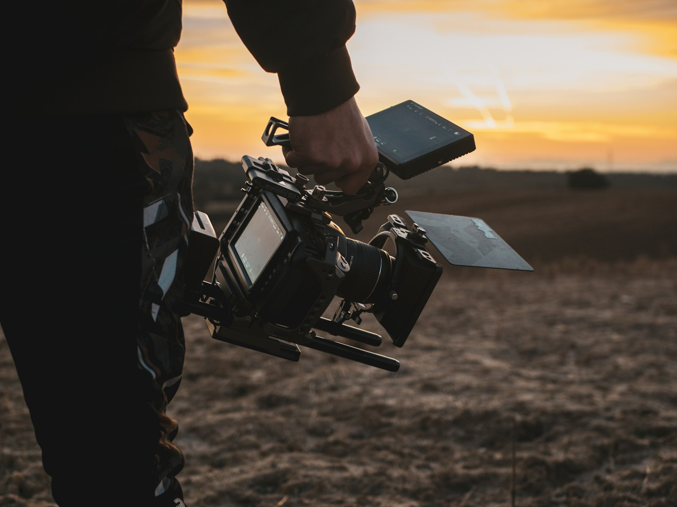
SLOP / UNIVERSITY
WEEK 6 / 20
Backup planning
A plan with no alternative is a plan for the weather to write your sequence.
For each condition your plan depends on — weather, light, a specific person's availability, a piece of gear — write one fallback before the shoot, not during it.
Cheap insurance
An indoor alternative location, a backup subject, a second body or lens — decide now what you would swap in.
What not to do
Improvise an entirely new sequence on location — that is where a shot list stops protecting you.
SLOP1416 Visual Storytelling for Short-Form Media
Notes:
Unsplash: https://images.unsplash.com/photo-1642601361159-7b58d9055ccc — photographer Jose P. Ortiz (@joseportiz), accessed 13 Sep 2026

Slide 21
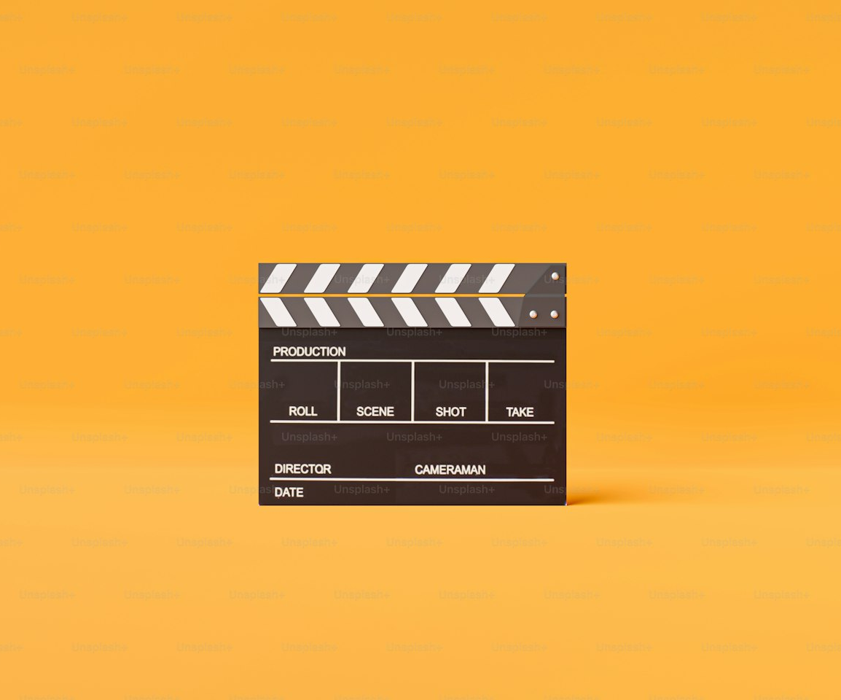
SLOP / UNIVERSITY
WEEK 6 / 21
The production log
What you shoot rarely matches what you planned — the log is where that gap is recorded.
For every shot that changed — skipped, added, reframed, reshot — note what changed and why. This is not an apology; it is evidence you made deliberate decisions under real conditions.
Log entry
Shot number, what changed, and the reason — weather, access, a better idea on the day.
Due before Week 7
Complete your first shoot and this log before the next session, per session 6's brief.
SLOP1416 Visual Storytelling for Short-Form Media
Notes:
Directly answers session 6's brief: "complete your first shoot before Week 7, with a production log of what changed." Unsplash (Unsplash+): https://plus.unsplash.com/premium_photo-1709361852376-c3a7280cb1e9 — photographer Sumaid pal Singh Bakshi (@sumaidsingh), accessed 13 Sep 2026

Slide 22
SLOP / UNIVERSITY
WEEK 6 / 22
Revising the plan after the first shoot
A shot list survives contact with a location by being updated, not defended.
Review each shot list row against what actually happened: did the size, movement and duration you planned still make sense once you saw the location and the light?
Kept as planned
Revised on the day
Rows that matched — confirms your previsualisation was accurate for that beat.
Rows that changed — feed these directly into the production log, with the reason attached.
SLOP1416 Visual Storytelling for Short-Form Media
Notes:
Original review method connecting the shot list back to the production log after the first shoot.

Slide 23
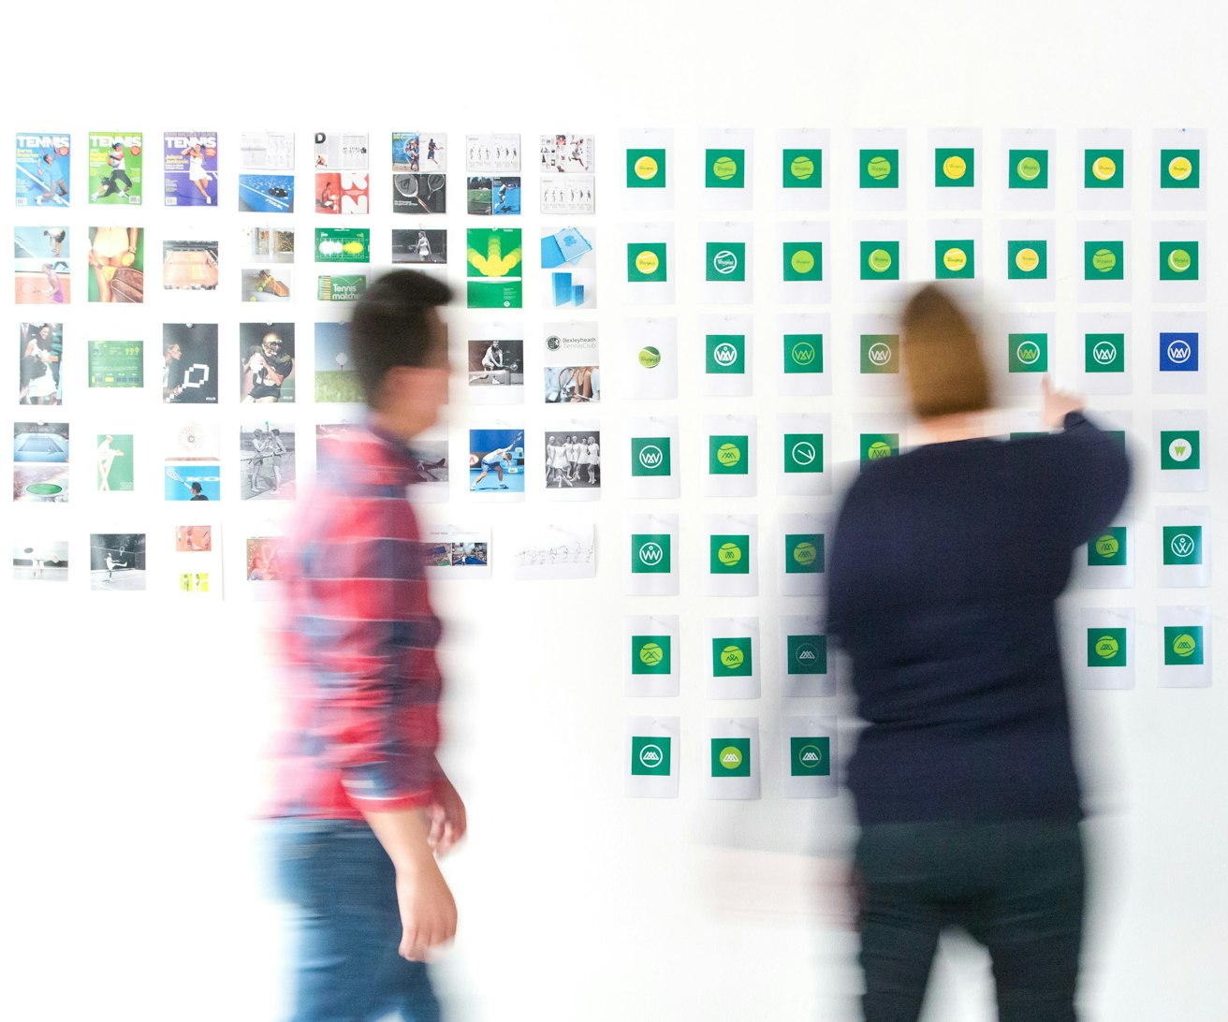
SLOP / UNIVERSITY
WEEK 6 / 23
Reading reference footage for structure
A repeatable method for this week's reference-viewing task.
1
Watch a one-minute sequence once, uninterrupted.
2
Sketch six frames that mark its key shots, in order.
3
Label each frame: setup, development or resolution.
4
Check whether six frames were enough to tell the whole story.
SLOP1416 Visual Storytelling for Short-Form Media
Notes:
Directly answers session 6's reference-viewing prompt: "sketch six frames of a one-minute sequence." Unsplash: https://images.unsplash.com/photo-1613759612065-d5971d32ca49 — photographer Brands&People (@brandsandpeople), accessed 13 Sep 2026

Slide 24
SLOP / UNIVERSITY
WEEK 6 / 24
Week 6 in-session exercise
What you produce and bring to this session.
Brief
Bring a logline, a location and a rough list of moments; map setup, development and resolution as images; build a storyboard and a shot list from them.
Review
Trade shot lists with a partner and review each other's for clarity, time, safety and permission before anyone shoots.
Evidence to submit
A storyboard, a shot list, and — by Week 7 — a completed first shoot with a production log of what changed.
SLOP1416 Visual Storytelling for Short-Form Media
Notes:
Original SLOP1416 Week 6 in-session exercise, directly implementing the session brief.

Slide 25
SLOP / UNIVERSITY
WEEK 6 / 25
Technical review rubric
How your storyboard and shot list are assessed before you shoot.
Clarity
Any reader can identify what each shot shows and where it sits in the structure.
Time
Estimated durations sum to a total that fits the time actually available.
Safety
Named risks have a stated mitigation; no shot depends on hoping nothing goes wrong.
Permission
Every location and identifiable person has a stated, checkable basis for being filmed.
SLOP1416 Visual Storytelling for Short-Form Media
Notes:
Original review rubric, aligned to Assignment 1's exercise-completion and consent/reflection criteria (25% and 20% weight).

Slide 26
SLOP / UNIVERSITY
WEEK 6 / 26
Recommended practice and preparation
Before next session.
Storyboarding reference
Blain Brown, Cinematography: Theory and Practice, chapter on previsualisation and shot design.
Shot-listing reference
No Film School, How to make a shot list: https://nofilmschool.com/shot-list
Bring to Week 7
Your completed first shoot and production log, ready to review against the original shot list.
SLOP1416 Visual Storytelling for Short-Form Media
Notes:
External resources: Blain Brown's Cinematography: Theory and Practice; No Film School shot-list guide. Accessed 13 September 2026.

