Slide 1

SLOP / UNIVERSITY
SLOP1416 / WEEK 7
First Assemblies
Building a first cut, learning to see what story it actually tells, and choosing one revision that matters more than the rest.
Notes:
Unsplash: https://images.unsplash.com/photo-1779896412277-c4fd15c7a89c — photographer Sandisk (@sandisk), accessed 13 Sep 2026
Course teaching content is original.

Slide 2
SLOP / UNIVERSITY
WEEK 7 / 02
Technical outcomes
By the end of this lecture you can assemble, diagnose and prioritise — not just cut clips together.
Assemble
Diagnose
Prioritise
Turn a shot list and a production log into an ordered first cut that exists to be judged, not admired.
Name what a cut is doing using shared vocabulary: framing, rhythm, continuity, point of view.
Choose one revision with the most leverage instead of a long list of small fixes.
SLOP1416 Visual Storytelling for Short-Form Media
Notes:
Original course learning outcomes, aligned to session 7's brief.

Slide 3
SLOP / UNIVERSITY
WEEK 7 / 03
Three names for three different jobs
“Rough cut” gets used loosely; a production actually moves through three distinct states.
Stage
What is actually decided
The question it answers
First assembly
Every planned shot placed in story order, at rough length. Structure not yet judged.
Does the material exist and is it in the right order?
Rough cut
Story and structure decided; pacing tightened. Sound, colour and titles still open.
Does the story work at this length, in this order?
Fine cut
Picture locked. Only sound, colour and finishing remain.
Is every remaining change cosmetic, not structural?
SLOP1416 Visual Storytelling for Short-Form Media
Notes:
Original terminology distinction. A first assembly is judged on completeness and order; a rough cut on story; a fine cut on finishing only — conflating the stages produces feedback aimed at the wrong problem.

Slide 4
SLOP / UNIVERSITY
WEEK 7 / 04
What a first assembly is actually for
It exists to be looked at critically, not to already be good.
A first assembly is a container of usable material arranged in a guessed order — its job is to make the cut's real problems visible early, while there is still time and footage to fix them.
Common mistake
Correct posture
Treating an incomplete or rough-looking assembly as a failure, and hiding it instead of screening it.
Bring it in exactly as rough as it is. A polished-looking assembly that hides a structural problem wastes the one chance to catch that problem cheaply.
This session's screening only works if what you bring is genuinely still a first assembly, not a disguised rough cut.
SLOP1416 Visual Storytelling for Short-Form Media
Notes:
Directly answers session 7's instruction to bring “an editable first assembly, even if it is incomplete”.

Slide 5

SLOP / UNIVERSITY
WEEK 7 / 05
Critique vocabulary, term 1 — framing
In a critique, framing means the frame chosen from what you shot, not the shot itself.
An editor reframes a scene the moment they choose which shot, and which portion of it, represents a beat. Headroom, looking room and what sits at frame edges all change with that choice — without touching the camera again.
Ask in critique
Does this frame include everything the beat needs and exclude everything that competes with it?
Common flaw
A frame that shows the whole coverage option available, rather than the one the story beat actually needs.
SLOP1416 Visual Storytelling for Short-Form Media
Notes:
Original explanation reframing 'framing' as an editorial choice among available coverage, not only a camera-operation choice — directly supports session 7's critique-vocabulary term.

Slide 6
SLOP / UNIVERSITY
WEEK 7 / 06
Critique vocabulary, term 2 — rhythm
Rhythm is the pattern of shot durations, not overall speed.
Two cuts can run the same total length and feel completely different: one holds each shot to a settled beat, the other varies duration to match rising or falling tension. Rhythm is that pattern, read across a whole scene.
Even rhythm
Accelerating rhythm
Similar shot lengths throughout. Reads as calm, procedural, observational — useful when the content itself should carry attention.
Shot lengths shorten toward a beat. Reads as urgency or climax — and loses force if used everywhere.
In critique: name the pattern first (“shots get shorter here”), then judge whether that pattern matches what the scene needs.
SLOP1416 Visual Storytelling for Short-Form Media
Notes:
Original explanation of rhythm as a describable pattern of shot duration, distinct from pacing-as-vibe — gives students a concrete way to use the term in the session's screening.

Slide 7

SLOP / UNIVERSITY
WEEK 7 / 07
Critique vocabulary, term 3 — continuity
Continuity is whether consecutive shots agree on space, time and direction.
A cut promises the viewer that two adjoining shots belong to one continuous reality unless it signals otherwise. Screen direction, eyeline and prop or costume state are the checks that promise depends on.
Ask in critique
Do consecutive shots agree on which way people and objects are moving, and where they are looking?
Deliberate break
A jump cut or discontinuity can be a choice — but only if it reads as intentional, not as a missed match.
SLOP1416 Visual Storytelling for Short-Form Media
Notes:
Original explanation of continuity as a checkable promise between adjoining shots, extending the 180-degree-line idea from earlier weeks into a critique-session vocabulary term. Unsplash: https://images.unsplash.com/photo-1637248578458-934f03db3ea2 — photographer Leuchtturm Entertainment (@leuchtturm_entertainment), accessed 13 Sep 2026

Slide 8
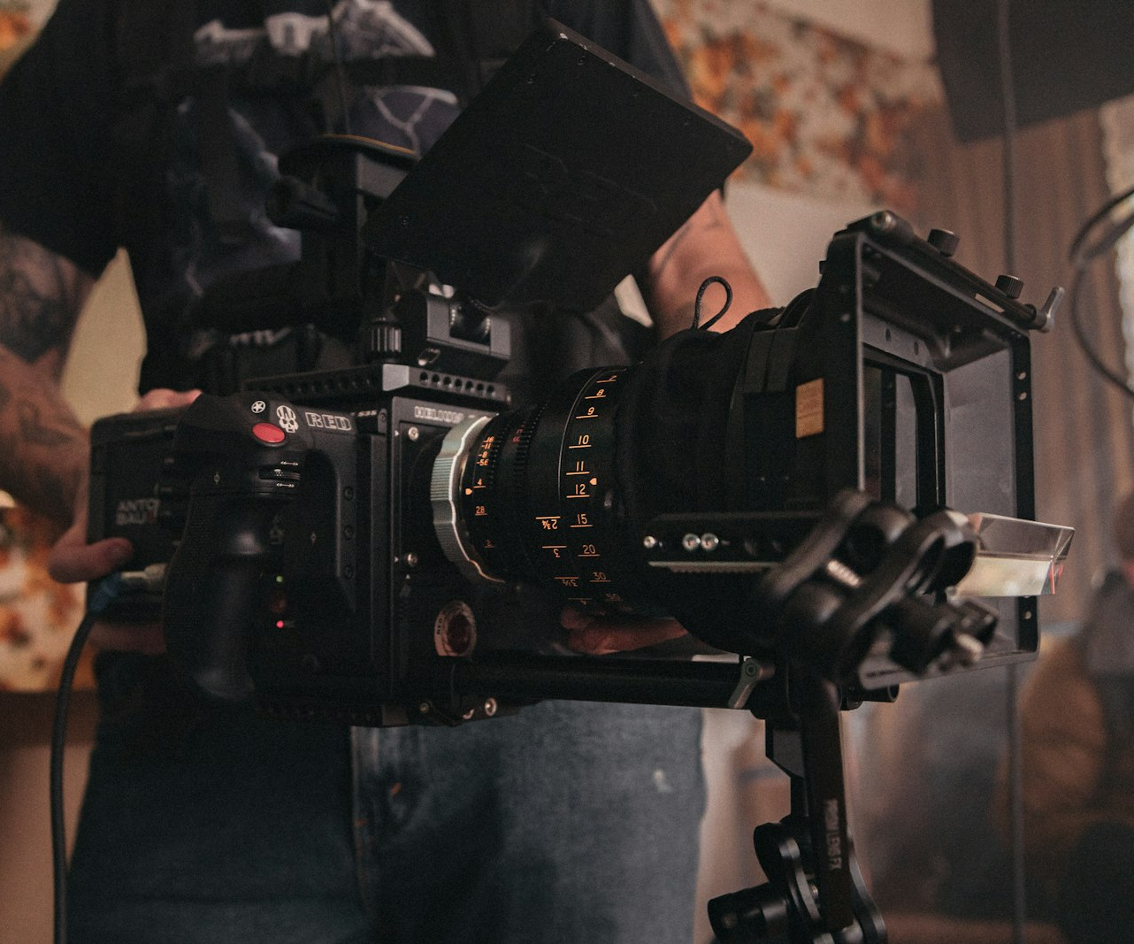
SLOP / UNIVERSITY
WEEK 7 / 08
Critique vocabulary, term 4 — point of view
Point of view is whose knowledge and position the edit gives the viewer.
Every cut decides who the viewer effectively stands next to: a participant inside the scene, an observer outside it, or a floating, all-seeing position. That decision changes what information the viewer has at any moment.
Ask in critique
Whose understanding does this shot match — a character's, an onlooker's, or no one's in particular?
Common flaw
Point of view drifting mid-scene without reason, so the viewer's implied position keeps resetting.
SLOP1416 Visual Storytelling for Short-Form Media
Notes:
Original explanation of point of view as an editorial/positional choice for a first-cut critique, not only a shot-type choice. Unsplash: https://images.unsplash.com/photo-1548607634-9f8cfca5d944 — photographer Jakob Owens (@jakobowens1), accessed 13 Sep 2026

Slide 9
SLOP / UNIVERSITY
WEEK 7 / 09
Reading one scene with all four terms
A worked example: the same three-shot scene, described four ways.
Framing
Wide shot chosen over the tighter option available — keeps both people in frame.
Rhythm
All three shots run 4–5 seconds — an even, unhurried pattern.
Continuity
Eyelines match across the cut; both speakers stay on their established side.
Point of view
Camera stays at onlooker height and distance throughout — the viewer never enters the conversation.
SLOP1416 Visual Storytelling for Short-Form Media
Notes:
Original worked example applying all four critique-vocabulary terms to one imagined scene, modelling the language students should use when giving feedback in this session.

Slide 10
SLOP / UNIVERSITY
WEEK 7 / 10
The self-critique problem
You cannot watch your own cut the way a first-time viewer does.
You already know what every shot is supposed to mean, what happens next, and what the plan was before you filmed. That knowledge fills gaps a stranger's viewing cannot fill — so a cut can feel finished to its editor while confusing everyone else.
The mechanism
Familiarity with intention gets mistaken for evidence that the intention actually reads on screen.
The fix is not talent
It is deliberately manufacturing distance from your own cut before you trust your judgement of it.
SLOP1416 Visual Storytelling for Short-Form Media
Notes:
Original explanation of familiarity bias in self-editing — sets up the four distance techniques on the next two slides.

Slide 11
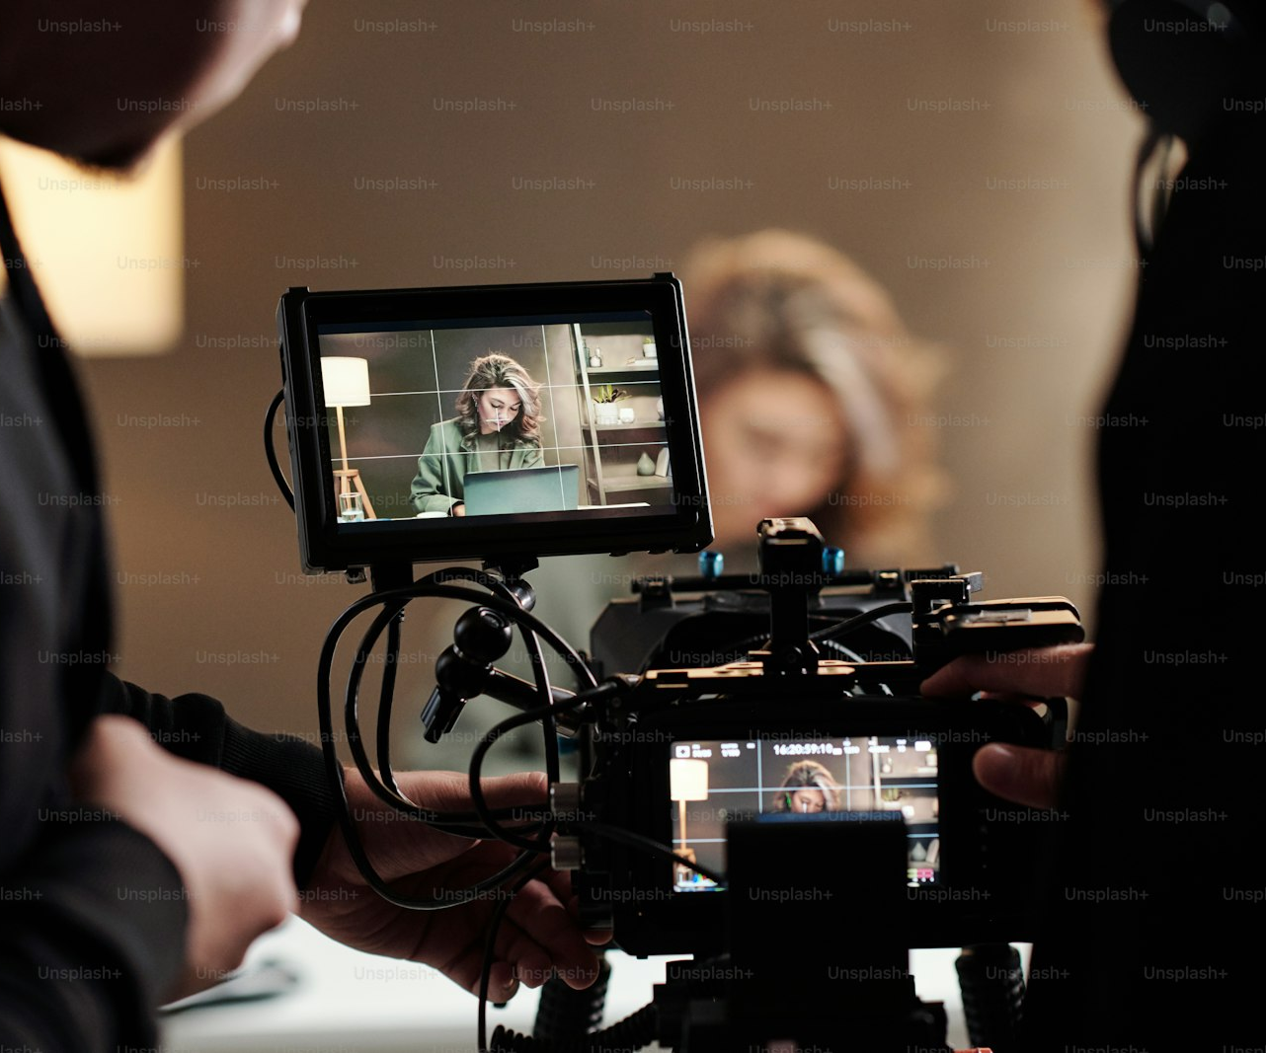
SLOP / UNIVERSITY
WEEK 7 / 11
Manufacturing distance, part 1 — time and silence
Two techniques that separate you from your own memory of intention.
Time away
Leave the cut for at least a day before reviewing it. Memory of your intention fades faster than the footage does — you start reacting to what is on screen instead of what you meant.
Watching muted
Turn the sound off. Dialogue and music routinely carry meaning the picture alone does not — muting exposes whether the images and cuts tell the story on their own.
SLOP1416 Visual Storytelling for Short-Form Media
Notes:
Original explanation of two self-critique distance techniques, directly supporting the reference-viewing task's request to identify a story decision distinct from polish. Unsplash image asset (accessed 13 Sep 2026); reused from the Week 5 asset set.

Slide 12

SLOP / UNIVERSITY
WEEK 7 / 12
Manufacturing distance, part 2 — order and strangers
Two more techniques, escalating from self-review to a real second opinion.
Watch out of order
Review the scene list, or the shots within one scene, out of sequence. Narrative momentum hides slow patches and gaps — examining pieces in isolation exposes what momentum was covering for.
Show a stranger
Someone with no context, no investment and no memory of the shoot. Their confusion or boredom is data your own viewing structurally cannot produce.
SLOP1416 Visual Storytelling for Short-Form Media
Notes:
Original explanation, framing the in-session peer screening as a structured instance of the 'show a stranger' distance technique rather than a separate idea. Unsplash image asset (accessed 13 Sep 2026); reused from the Week 6 asset set.

Slide 13
SLOP / UNIVERSITY
WEEK 7 / 13
Diagnosing the story your cut is actually telling
A structural exercise, separate from judging quality.
Before asking whether a cut is good, ask a narrower question: what story does this arrangement of shots currently deliver to someone with no other information? That is often different from the story you set out to tell.
Method
After a single uninterrupted viewing, have a viewer describe the story back to you in their own words — do not correct them while they talk.
What the gap tells you
Any difference between their summary and your intention marks exactly where the structure, not the footage, needs work.
SLOP1416 Visual Storytelling for Short-Form Media
Notes:
Original method for diagnosing structural intent-vs-delivery gaps, directly implementing session 7's 'identify the story it currently tells' instruction.

Slide 14
SLOP / UNIVERSITY
WEEK 7 / 14
The one-sentence test
If you cannot state the throughline in one sentence, that is a structure problem, not a wording problem.
1
Write one sentence describing what changes from the start of the cut to its end.
2
If the sentence needs “and then” more than once, the cut currently has more than one throughline.
3
If you cannot finish the sentence at all, some material is doing work the structure has not assigned it.
4
Test the sentence against what your stranger-viewer described — the two should be close.
Pass this test before choosing a revision priority: a structural gap should outrank any cosmetic fix.
SLOP1416 Visual Storytelling for Short-Form Media
Notes:
Original diagnostic tool for testing structural clarity before committing to a revision, feeding directly into the revision-triage slides that follow.

Slide 15

SLOP / UNIVERSITY
WEEK 7 / 15
L-cuts and J-cuts
Overlapping sound and picture across a cut point smooths both continuity and rhythm.
A straight cut changes picture and sound at the same instant, which can feel abrupt. An L-cut lets outgoing audio continue under the new picture; a J-cut brings incoming audio in before its picture arrives.
L-cut effect
The previous speaker's voice bridges into the new shot — reads as a natural continuation, not an interruption.
J-cut effect
A sound arrives first and pulls the viewer toward what is about to appear — a small, controlled anticipation.
SLOP1416 Visual Storytelling for Short-Form Media
Notes:
Original explanation of L-cuts and J-cuts as a named editing technique for softening cut points. Unsplash (Unsplash+): https://plus.unsplash.com/premium_photo-1723827940632-386e1bed4003 — photographer Behnam Norouzi (@behy_studio), accessed 13 Sep 2026

Slide 16

SLOP / UNIVERSITY
WEEK 7 / 16
Read the production log against the footage
The log tells you what you meant to shoot; the footage tells you what you actually have.
Before assembling, check the log's shot list against the clips in your bin. A first assembly built around a shot that does not actually exist, or exists but is unusable, wastes structure-fixing time on a problem that is really a coverage gap.
If a shot is missing
Note it as a coverage gap, not a structure problem — the fix is reshooting or restructuring around what exists.
If a shot is unusable
Focus, exposure or audio faults belong in your media record, not silently worked around in the edit.
SLOP1416 Visual Storytelling for Short-Form Media
Notes:
Original audit method connecting the production log (carried since session 1) to first-assembly diagnosis. Unsplash image asset (accessed 13 Sep 2026); reused from the Week 5 asset set.

Slide 17
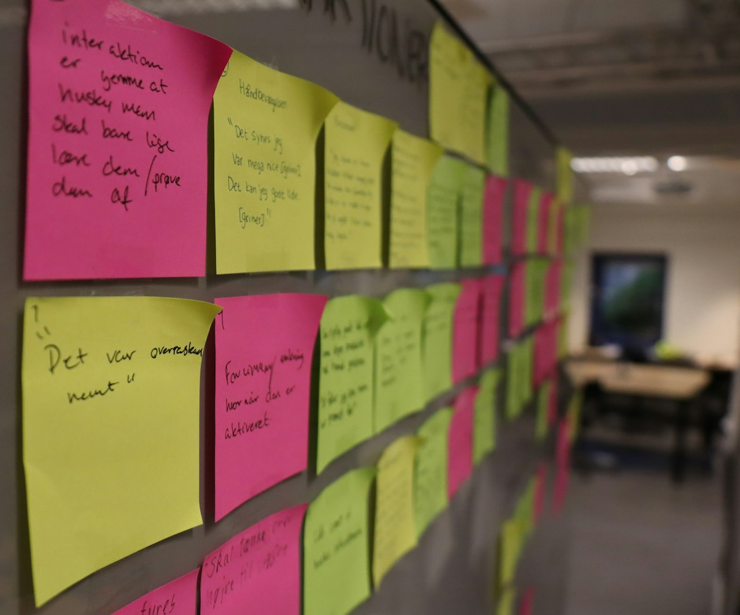
SLOP / UNIVERSITY
WEEK 7 / 17
Revision triage — pick one priority
A first assembly always has more problems than time to fix them all before submission.
List every issue a viewing surfaces, then rank by leverage: which single change would most improve a stranger's understanding of the story? Fix that one first — many small fixes rarely add up to the effect of one structural one.
High leverage
A reorder, a cut scene, or a clarified opening — changes that affect what the whole cut communicates.
Low leverage
A slightly-too-long shot or a rough transition — real, but safe to defer past this priority.
SLOP1416 Visual Storytelling for Short-Form Media
Notes:
Original revision-triage method, directly implementing session 7's ‘you leave with one revision priority’ outcome. Unsplash: https://images.unsplash.com/photo-1674509036252-5a517959a3b4 — photographer Christian Brok (@jcbrok), accessed 13 Sep 2026

Slide 18
SLOP / UNIVERSITY
WEEK 7 / 18
Structural fixes before cosmetic fixes
Order revision work so you never polish something you may later cut.
Category
Typical changes
Effect
Order
Structural
Reorder scenes, cut or add material, change what the story leads with
Changes what the cut communicates
Do first
Continuity / rhythm
Trim shot lengths, fix mismatched action or eyelines
Changes how smoothly it communicates
Do second
Cosmetic
Colour, sound sweetening, titles, minor stabilisation
Changes how polished it looks
Do last, in the fine cut
SLOP1416 Visual Storytelling for Short-Form Media
Notes:
Original ordering principle: fixing colour or sound on a scene that later gets cut wastes the work — structure must stabilise first.

Slide 19
SLOP / UNIVERSITY
WEEK 7 / 19
Giving feedback in the critique circle
Use the four vocabulary terms as the language of feedback, not just of analysis.
“I got confused” is a real reaction but not yet actionable feedback. Naming which term the confusion sits in — framing, rhythm, continuity or point of view — turns a reaction into something the editor can act on.
Weak feedback
“The middle section dragged.”
Actionable feedback
“The middle section holds an even rhythm through three shots that could accelerate toward the reveal.”
SLOP1416 Visual Storytelling for Short-Form Media
Notes:
Original coaching on how to phrase peer feedback using the session's shared critique vocabulary, so feedback names a mechanism rather than only a reaction.

Slide 20

SLOP / UNIVERSITY
WEEK 7 / 20
From critique to checklist
What this session's screening leaves you with.
1
One diagnosed story: what your cut currently communicates, checked against a stranger's summary.
2
One revision priority: the single highest-leverage change, chosen through triage, not a wish list.
3
A production-log audit: any coverage gap or unusable shot logged for the record.
4
A short list of questions answered by your viewers, ready to guide the actual edit session.
SLOP1416 Visual Storytelling for Short-Form Media
Notes:
Original synthesis of the session deliverable, directly matching session 7's 'you leave with one revision priority and a submission checklist' outcome. Unsplash (Unsplash+): https://plus.unsplash.com/premium_photo-1683309563255-fef9e541cdec — photographer Olivie Strauss (@olivie_strauss), accessed 13 Sep 2026

Slide 21
SLOP / UNIVERSITY
WEEK 7 / 21
Assignment 1 — what is actually marked
Four criteria, weighted unevenly — know where the marks sit before you finish the edit.
Exercise completion and development
25%
All four exercises present and showing progression across the six weeks.
Image, light and sound choices
30%
Deliberate technical decisions, not just correct exposure or audible dialogue.
Editing and technical care
25%
Framing, rhythm, continuity and point of view applied with control, not by accident.
Reflection, consent and media record
20%
A substantive 250-word reflection plus a complete consent and media record.
SLOP1416 Visual Storytelling for Short-Form Media
Notes:
Original rubric walkthrough of Assignment 1's exact marking weights, so revision priorities are chosen against real marks rather than guessed importance.

Slide 22
SLOP / UNIVERSITY
WEEK 7 / 22
The final sequence's real test
“A recognisable beginning and ending” rules out a video that only documents a place.
The brief asks for a small change over 60–90 seconds — something is different at the end from how it was at the start. A sequence that shows a place, a process or an activity without a change is documentation, not the structure this assignment is grading.
Passes the test
A specific task begun and completed; a state that visibly shifts; a small before-and-after the viewer can name.
Fails the test
A tour of a location, a mood piece with no throughline, or footage with no clear starting or ending point.
SLOP1416 Visual Storytelling for Short-Form Media
Notes:
Original explanation directly addressing Assignment 1's spec line: ‘the final sequence shows a real change rather than simply documenting a place.’

Slide 23
SLOP / UNIVERSITY
WEEK 7 / 23
Media record and consent, checked now
The 20% reflection criterion is graded on the record, not on memory of it.
Every participant and every piece of external media — music, archival clips, photographs — needs to be logged as you assemble, not reconstructed the night before submission. A first assembly is the natural checkpoint to verify the record actually matches what is in the cut.
Check now
Does every person on screen who can be identified have a logged consent entry?
Check now
Does every non-original sound or image have a source noted, ready for the reflection PDF?
SLOP1416 Visual Storytelling for Short-Form Media
Notes:
Original checkpoint tying Assignment 1's 'reflection, consent and media record' criterion (20%) directly to the first-assembly review, not left until submission.

Slide 24
SLOP / UNIVERSITY
WEEK 7 / 24
Reference viewing, applied
A repeatable method for this week's task: a rough-looking video that still holds attention.
1
Watch once without pausing, exactly as a stranger would see it.
2
Write the one-sentence throughline you took from it, unprompted.
3
List what looked technically rough: framing, light, audio, stabilisation.
4
Separate that list from the story decision that made you keep watching despite the roughness.
The answer you are looking for: which single story decision mattered more than any of the technical roughness you listed.
SLOP1416 Visual Storytelling for Short-Form Media
Notes:
Directly answers session 7's reference-viewing prompt: ‘Watch a rough-looking short video that still holds your attention. Which story decision matters more than polish?’

Slide 25
SLOP / UNIVERSITY
WEEK 7 / 25
Starting the final-project question
Begin noting it now — do not wait for a dedicated session to arrive.
The final project asks for a question worth two to three minutes of someone else's attention. The clearest source for that question is usually something you noticed while making this portfolio: a technical choice that changed meaning, or a story you could not quite finish telling.
Keep a running note
Any question, image or moment from this portfolio that you want to return to — do not trust memory to hold it until Week 8.
Do not commit yet
Week 8 works with premise development directly — this week only asks you to start collecting candidates.
SLOP1416 Visual Storytelling for Short-Form Media
Notes:
Directly answers session 7's 'Afterwards' instruction to start noting the final-project question, without pre-empting Week 8's premise-development content.

Slide 26
SLOP / UNIVERSITY
WEEK 7 / 26
Recommended practice and preparation
Before next session.
Editing vocabulary reference
Walter Murch, In the Blink of an Eye — the standard practitioner text on cut selection, rhythm and continuity.
L-cut / J-cut reference
Adobe, Understanding J-cuts and L-cuts in video editing: https://helpx.adobe.com/premiere-pro/using/j-and-l-cuts.html
Bring to Week 8
Your submitted Assignment 1 rough cut and one candidate final-project question, ready to develop into a premise.
SLOP1416 Visual Storytelling for Short-Form Media
Notes:
External resources: Walter Murch, In the Blink of an Eye; Adobe J-cut/L-cut reference. Accessed 13 September 2026.

