Slide 1
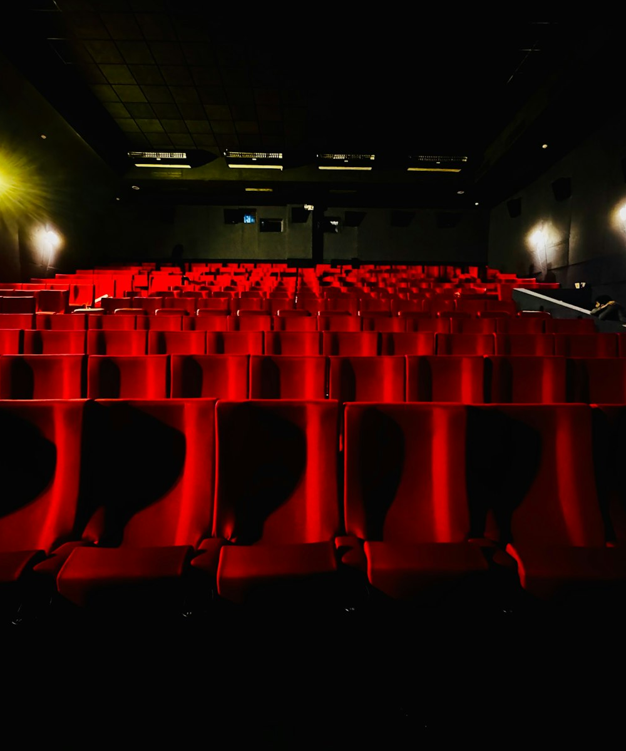
SLOP / UNIVERSITY
SLOP1416 / WEEK 12
Screening and Portfolio
The final test of the semester: a real audience, a submission checklist, and a portfolio that shows a term of deliberate craft.
Notes:
Unsplash: https://images.unsplash.com/photo-1751977146227-4fc506ca71a9 — photographer Sadia Alam (@sadiaalam), accessed 13 Sep 2026
Course teaching content is original.

Slide 2
SLOP / UNIVERSITY
WEEK 12 / 02
Technical outcomes
By the end of this lecture you can run a screening as research, and close the semester with a defensible submission.
Test
Protect
Synthesise
Use a screening as a genuine audience test — what strangers actually read from your form and content, not what collaborators already know.
Apply real backup and submission discipline so a term of footage and project files cannot be lost to a single point of failure.
Trace specific technical decisions in your final project back to specific weeks of the course, as evidence of integration.
SLOP1416 Visual Storytelling for Short-Form Media
Notes:
Original course learning outcomes, aligned to session 12's brief.

Slide 3
SLOP / UNIVERSITY
WEEK 12 / 03
The screening is a different kind of test
Every review before this one had an audience who already knew the project.
Your supervisor, your peer-review group, even your Week 10 rough-cut clinic viewers had been following the project for weeks. A public screening puts the work in front of people meeting it for the first time, with none of that accumulated context.
What changes
Why it matters now
A stranger cannot fill in a gap with something you told them last week. Whatever the cut communicates, it has to communicate on its own.
This is the closest simulation you get, before the real deadline, of how an assessor who has not been in the room will actually read the work.
SLOP1416 Visual Storytelling for Short-Form Media
Notes:
Original framing device opening the lecture, distinguishing screening from every earlier feedback stage this course has used.

Slide 4

SLOP / UNIVERSITY
WEEK 12 / 04
Form communicates whether you meant it to or not
Pacing, shot choice, sound design and structure are read as meaningful even when they were accidental.
An audience does not distinguish a deliberate stylistic choice from an unresolved editing problem — both read as “what the film is doing.” A long, static shot reads as contemplative if the rest of the film supports that register, or as a mistake if it does not.
The practical test
After the screening, ask what people thought the piece was about — then compare that answer to your own audience statement.
SLOP1416 Visual Storytelling for Short-Form Media
Notes:
Original explanation of form-as-meaning in screening contexts. Unsplash: https://images.unsplash.com/photo-1758691736580-a41e0cfe9e9f — photographer Vitaly Gariev (@silverkblack), accessed 13 Sep 2026

Slide 5
SLOP / UNIVERSITY
WEEK 12 / 05
The one-question exercise
A specific question produces a usable answer; a vague one does not.
The vague version
The specific version
“What did you think?” invites a polite, general reaction that tells you almost nothing you can act on.
“Did you understand why the subject changed their mind at the midpoint?” gives a yes/no plus a reason — evidence, not opinion.
Write your one question before the screening, aimed at the single thing you are least sure the cut actually delivers.
SLOP1416 Visual Storytelling for Short-Form Media
Notes:
Direct expansion of session 12's brief: “bring one question you want an audience to answer.” Original teaching content.

Slide 6
SLOP / UNIVERSITY
WEEK 12 / 06
Reading the room without leading it
How to ask your one question so the answer stays honest.
1
Do not explain the film or your intention before the screening.
2
Ask your prepared question first, before any general reaction.
3
Ask what people believe the piece is about, and only then reveal your audience statement.
4
Note where the two answers diverge — that gap is your real revision priority, not a hurt feeling.
SLOP1416 Visual Storytelling for Short-Form Media
Notes:
Original method for protecting the honesty of the screening test, extending Week 10 and 11's feedback discipline to a mixed audience.

Slide 7
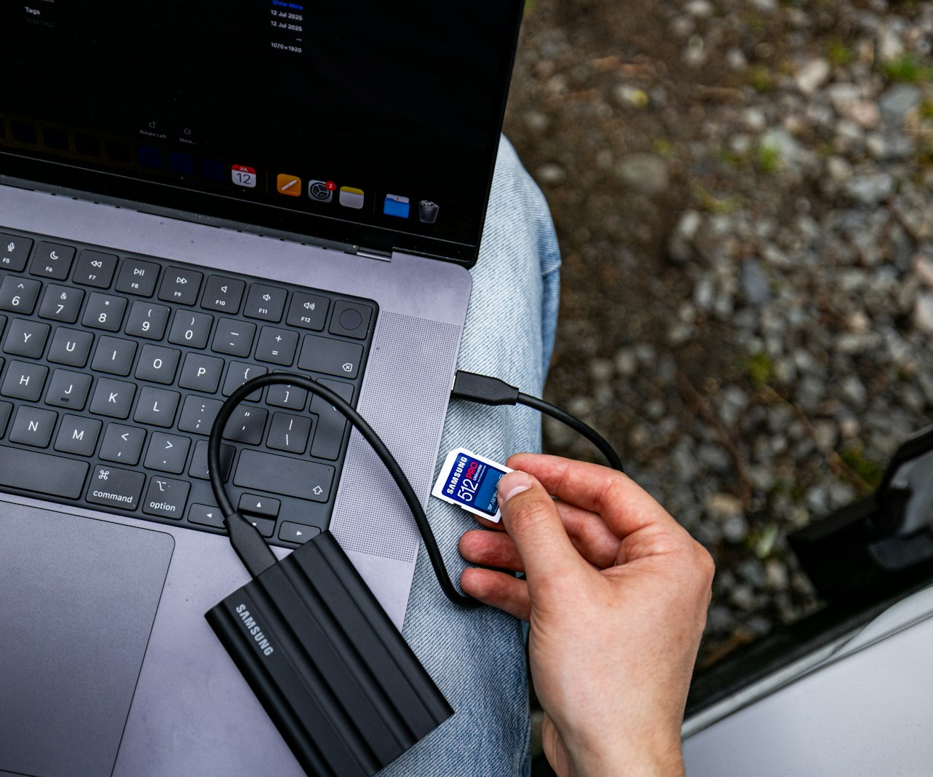
SLOP / UNIVERSITY
WEEK 12 / 07
Backup discipline is not optional
Losing the only copy of a term's footage is entirely preventable.
A single laptop drive failure, a stolen bag or a corrupted card can erase months of shooting in one moment — and it is a common, well-documented failure, not bad luck.
The 3-2-1 principle
At least 2 copies, on at least 2 different pieces of media, with at least 1 copy stored somewhere other than your main working device.
What to duplicate
Raw footage, the project file itself (not just an export), and the dossier — all three, not just the finished MP4.
SLOP1416 Visual Storytelling for Short-Form Media
Notes:
Original explanation of the 3-2-1 backup principle applied to a student production, directly extending session 12's instruction to keep footage, project file and dossier “in more than one location.” Unsplash: https://images.unsplash.com/photo-1756142752397-9d2ace3ba0d1 — photographer Samsung Memory US (@samsungmemoryus), accessed 13 Sep 2026

Slide 8

SLOP / UNIVERSITY
WEEK 12 / 08
The submission-checklist mentality
A checklist catches the failure mode of assuming a file is fine because it looks fine on your machine.
The riskiest failure is a file that opens on your editing workstation but not on the marker's device — a codec, a missing caption track, a corrupted export nobody caught before the deadline.
Before you submit
Play the actual exported file, start to finish, on a device other than your edit machine — not the timeline preview.
Check the spec, not your memory
H.264 MP4, 1080p or lower, captions burned in or embedded and legible — confirm each one against the brief.
SLOP1416 Visual Storytelling for Short-Form Media
Notes:
Unsplash (Unsplash+): https://plus.unsplash.com/premium_photo-1679860750908-44be335e68da — photographer A. C. (@3tnik), accessed 13 Sep 2026

Slide 9
SLOP / UNIVERSITY
WEEK 12 / 09
Export specification, checked against the brief
The final project's exact technical requirements — verify each one before upload.
Requirement
Spec
Container / codec
H.264 MP4
Resolution
1080p or lower
Captions
Burned in or embedded and legible
Duration
2–3 minutes, self-contained
Directly from the final project brief: a captioned H.264 MP4, 1080p or lower, working as a self-contained viewing experience.
SLOP1416 Visual Storytelling for Short-Form Media
Notes:
Direct restatement of the final-project assessment's submission spec, made explicit as a checklist.

Slide 10
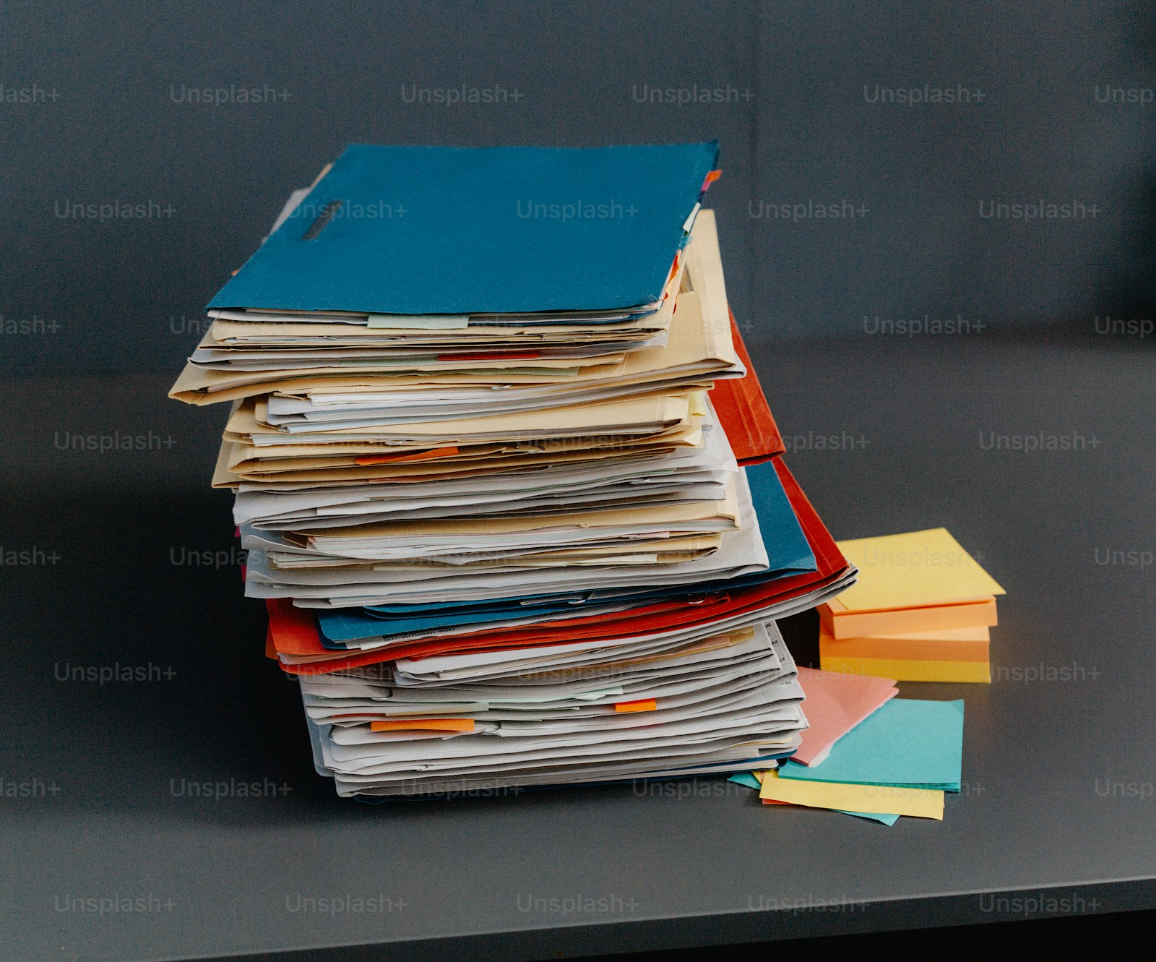
SLOP / UNIVERSITY
WEEK 12 / 10
The dossier is an argument, not a checklist
Every required element exists to make a specific claim about your process.
A logline and audience statement claim you knew what you were making. A production log and two documented feedback changes claim you revised in response to real input, not just polished what you already had.
Consent and media record
Claims that every subject and every piece of external media in the film was used with permission — an ethics claim, not paperwork.
400-word reflection
Claims you can name what changed in your own practice, not just what changed in the edit.
SLOP1416 Visual Storytelling for Short-Form Media
Notes:
Unsplash (Unsplash+): https://plus.unsplash.com/premium_photo-1705091310871-eac4ca9a06b7 — photographer A F (@ag_fs), accessed 13 Sep 2026

Slide 11
SLOP / UNIVERSITY
WEEK 12 / 11
Dossier completeness, checked against the brief
Six required elements — an assessor should find each one without hunting.
1
Logline and audience statement — what the piece is and who it is for.
2
Storyboard or edit map — the planned or as-cut structure.
3
Production log — what actually happened during shooting and editing.
4
Two documented feedback changes — with the reasoning behind each.
5
Consent and external-media record — permissions for every subject and source.
6
400-word critical reflection — what changed in your own practice.
SLOP1416 Visual Storytelling for Short-Form Media
Notes:
Direct restatement of the final-project dossier requirements as a completeness checklist, aligned to the 20% dossier/ethics/attribution weighting.

Slide 12
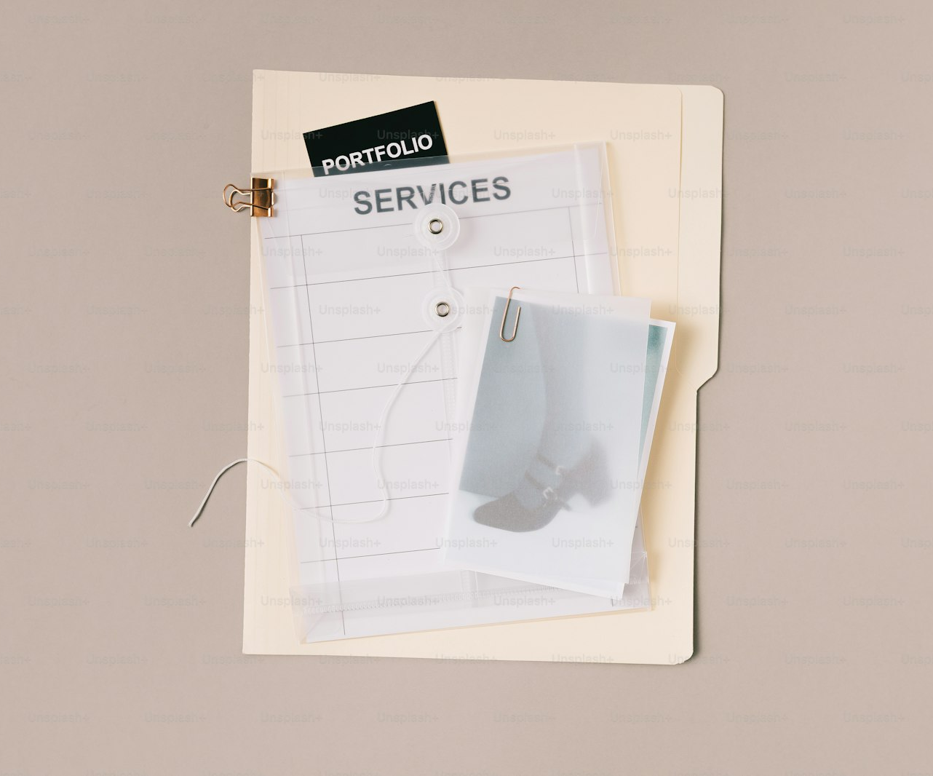
SLOP / UNIVERSITY
WEEK 12 / 12
Labelling makes an assessor's job possible
A portfolio that hides its own evidence loses marks it earned.
Two projects with identical craft can be marked differently if one buries its production log inside an unlabelled folder and the other names every file for what it is.
Practical rule
File names should describe content: final-export, dossier, consent-forms — not export-v7-FINAL2-use-this-one.
The dossier should be skimmable
Use the same six headings the brief lists, in that order, so a marker can check each one in seconds.
SLOP1416 Visual Storytelling for Short-Form Media
Notes:
Unsplash (Unsplash+): https://plus.unsplash.com/premium_photo-1775807632425-150556669546 — photographer Antonio Verdín (@verrrdin), accessed 13 Sep 2026

Slide 13
SLOP / UNIVERSITY
WEEK 12 / 13
Watching your project with a stranger's eyes
A structured self-check before the screening, so the audience test surfaces something new.
Cold open test
Midpoint test
Ending test
Watch only the first 15 seconds. Would a stranger know what kind of film this is and who it is about?
Pause at the middle. Could a first-time viewer state what has happened and what is still unresolved?
Watch only the last 20 seconds. Does it read as a deliberate close, or as the film simply stopping?
Run all three before the screening — they rehearse the exact reading a stranger will do in real time.
SLOP1416 Visual Storytelling for Short-Form Media
Notes:
Original self-check method, preparing the maker for the audience test described earlier in this lecture.

Slide 14
SLOP / UNIVERSITY
WEEK 12 / 14
The course's throughline, part 1 — seeing and shaping
Weeks 1–3 built the tools for deciding what a shot shows.
Week 1–2
Framing and camera/phone control — deciding what is inside the frame and why.
Week 3
Light and colour as authored decisions — direction, quality and colour temperature set mood and readability.
Ask yourself: where in your final project did a specific lighting or framing decision come directly from these weeks?
SLOP1416 Visual Storytelling for Short-Form Media
Notes:
Original course-synthesis slide, part 1 of 3, tying weeks 1-3 to the final project as required by the portfolio-reflection exercise.

Slide 15
SLOP / UNIVERSITY
WEEK 12 / 15
The course's throughline, part 2 — recording and planning
Weeks 4–6 built the tools for capturing real material responsibly.
Week 4
Recording sound — distance, room tone, wind and monitoring as deliberate audio choices.
Week 5
Interview and observation — consent conversations, open questions, permission for a real subject.
Week 6
Storyboards and production plans — logline, shot-list review, a written production log.
Your production log and consent record in the dossier are the direct evidence of these three weeks.
SLOP1416 Visual Storytelling for Short-Form Media
Notes:
Original course-synthesis slide, part 2 of 3, tying weeks 4-6 to the final project's dossier requirements.

Slide 16
SLOP / UNIVERSITY
WEEK 12 / 16
The course's throughline, part 3 — assembling for an audience
Weeks 7–11 built the tools for cutting, reading and revising.
Week 7–8
First assemblies, continuity and rhythm — what story a cut tells, screen direction, pacing.
Week 9
Captions, music and audience — accessibility and reading context as design decisions.
Week 10–11
Rough-cut clinic and revision — structured peer feedback, picture lock discipline.
Your two documented feedback changes are the direct evidence that this revision loop actually ran.
SLOP1416 Visual Storytelling for Short-Form Media
Notes:
Original course-synthesis slide, part 3 of 3, tying weeks 7-11 to the final project's editing/revision criterion (25% weight).

Slide 17
SLOP / UNIVERSITY
WEEK 12 / 17
One escalating practice, not eleven separate topics
Each week's tool had to work together inside a single 2–3 minute film.
Seeing → light → sound → interview and observation → planning → a first cut → continuity and rhythm → audience and accessibility → peer feedback → revision and lock → screening.
Why this matters for marking
The portfolio-reflection criterion rewards demonstrating that these skills were integrated — used together under real constraints — not simply that each was practised once in isolation.
SLOP1416 Visual Storytelling for Short-Form Media
Notes:
Original closing synthesis, restating the full 12-week arc as a single chain of skills the final project had to combine.

Slide 18
SLOP / UNIVERSITY
WEEK 12 / 18
Portfolio reflection as evidence, not decoration
Naming a specific technical decision is stronger than a general statement of growth.
Weak reflection
Strong reflection
“I learned a lot about editing and sound this semester and feel more confident.” True, but unverifiable and generic.
“After Week 9 I re-timed my captions to a slower reading speed, which changed how the midpoint scene played on a muted phone.” Specific and checkable against the cut itself.
Write your 400-word reflection the same way: name the week, the concept, and the exact decision it produced.
SLOP1416 Visual Storytelling for Short-Form Media
Notes:
Original guidance on writing a strong portfolio reflection, aligned to the final project's 400-word critical reflection requirement.

Slide 19

SLOP / UNIVERSITY
WEEK 12 / 19
Two ways an audience watches your work
A screening room and a phone feed are different reading contexts, both real.
A cinema screening gives full sound, full attention and a fixed seat. A private screening on a laptop with others gathered around gives partial attention and casual talk over the soundtrack — both are legitimate ways this work may actually be watched.
The test that matters
If your film only works in ideal conditions with full attention, it has not yet met the audience-context lessons from Week 9.
SLOP1416 Visual Storytelling for Short-Form Media
Notes:
Unsplash: https://images.unsplash.com/photo-1758270705317-3ef6142d306f — photographer Vitaly Gariev (@silverkblack), accessed 13 Sep 2026

Slide 20

SLOP / UNIVERSITY
WEEK 12 / 20
Reading the discussion after a screening
Distinguishing a pattern worth acting on from one person's individual taste.
If three separate viewers all misread the same moment, that is a structural problem in the cut. If one viewer objects to a stylistic choice everyone else understood, that is a preference — not evidence the piece failed.
Same rule as Week 10–11
Screening feedback is read with the same discipline as rough-cut clinic feedback — look for the pattern, not the loudest voice.
SLOP1416 Visual Storytelling for Short-Form Media
Notes:
Original extension of the Week 10-11 feedback-discipline principle to the final screening context. Unsplash: https://images.unsplash.com/photo-1758270705518-b61b40527e76 — photographer Vitaly Gariev (@silverkblack), accessed 13 Sep 2026

Slide 21
SLOP / UNIVERSITY
WEEK 12 / 21
What a screening cannot tell you
The limits of a single event, and why the checklist still matters afterward.
Small sample
One viewing only
No substitute for the checklist
A handful of viewers is not a statistically reliable audience — treat strong reactions as a signal to investigate, not a verdict.
A screening tests a first watch. It tells you nothing about how the piece holds up on a second viewing or over time.
A screening can go well and the submission can still fail on a technical spec the room never tested.
SLOP1416 Visual Storytelling for Short-Form Media
Notes:
Original limitations slide, keeping the screening in proportion against the technical submission-checklist work that follows it.

Slide 22
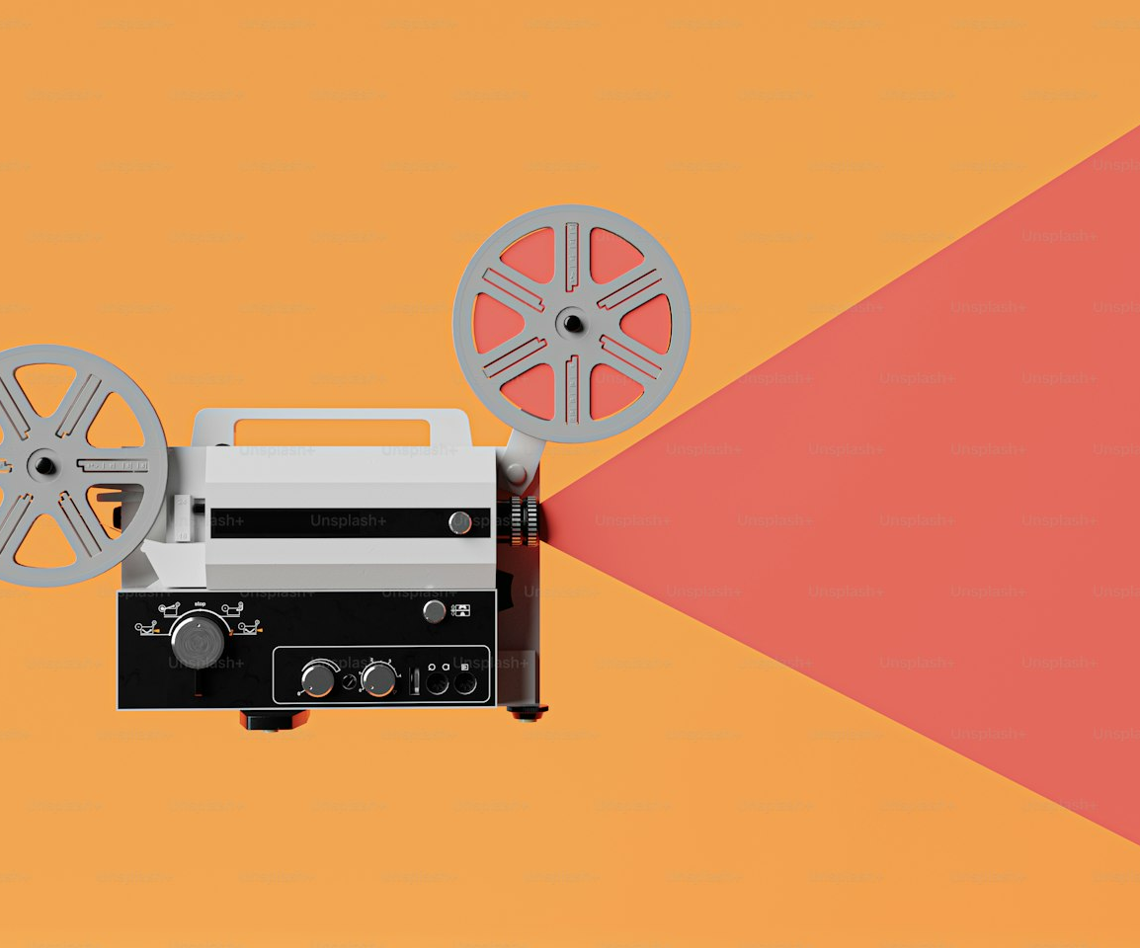
SLOP / UNIVERSITY
WEEK 12 / 22
Film history's long relationship with the screening test
The projector booth is where a cut first meets an audience it cannot control.
Long before digital review tools, editors relied on the same principle: cut a version, screen it for an audience that had not seen earlier drafts, and revise based on where the room's attention actually went.
What has not changed
The value of a first, uninformed audience reaction — whatever the projection technology, that test still catches what the maker cannot see alone.
SLOP1416 Visual Storytelling for Short-Form Media
Notes:
Unsplash (Unsplash+): https://plus.unsplash.com/premium_photo-1709396656117-97a5cc881f38 — photographer Sumaid pal Singh Bakshi (@sumaidsingh), accessed 13 Sep 2026

Slide 23
SLOP / UNIVERSITY
WEEK 12 / 23
Closing the loop after submission
What to do the day after the final project is uploaded.
1
Confirm the uploaded file opens correctly from the submission system itself, not just your own copy.
2
Keep the raw footage, project file and dossier backed up in more than one location, as instructed.
3
Write down, briefly, what you would change if you had one more week — this is often the seed of your next project.
4
Note which of this semester's concepts you want to deliberately practise again.
SLOP1416 Visual Storytelling for Short-Form Media
Notes:
Direct expansion of session 12's “afterwards” instruction: submit by 5pm Friday 28 May, and keep footage, project file and dossier in more than one location.

Slide 24
SLOP / UNIVERSITY
WEEK 12 / 24
Week 12 in-session exercise
What you bring and do in this final session.
Bring
Your current export, your dossier, and one specific question you want an audience to answer.
In session
Screen selected work, discuss how audiences interpret form and content, and complete a submission and backup checklist.
Reference viewing
Choose one work from the semester and write a short note on how your own attention to image, sound or editing has changed.
SLOP1416 Visual Storytelling for Short-Form Media
Notes:
Original SLOP1416 Week 12 in-session exercise, directly implementing the session brief and its reference-viewing task.

Slide 25
SLOP / UNIVERSITY
WEEK 12 / 25
Final-project rubric, one last check
How the whole semester's work is actually weighted.
Criterion
Weight
Check
Story, structure and audience
30%
Is the point of view clear and is the formal approach justified?
Cinematography and sound
25%
Do image and sound choices serve the story deliberately?
Editing and revision
25%
Does the cut show evidence of structured revision through feedback?
Dossier, ethics and attribution
20%
Is planning, consent and external media fully and honestly documented?
SLOP1416 Visual Storytelling for Short-Form Media
Notes:
Direct restatement of the final-project assessment's weighted marking criteria as a closing checklist.

Slide 26
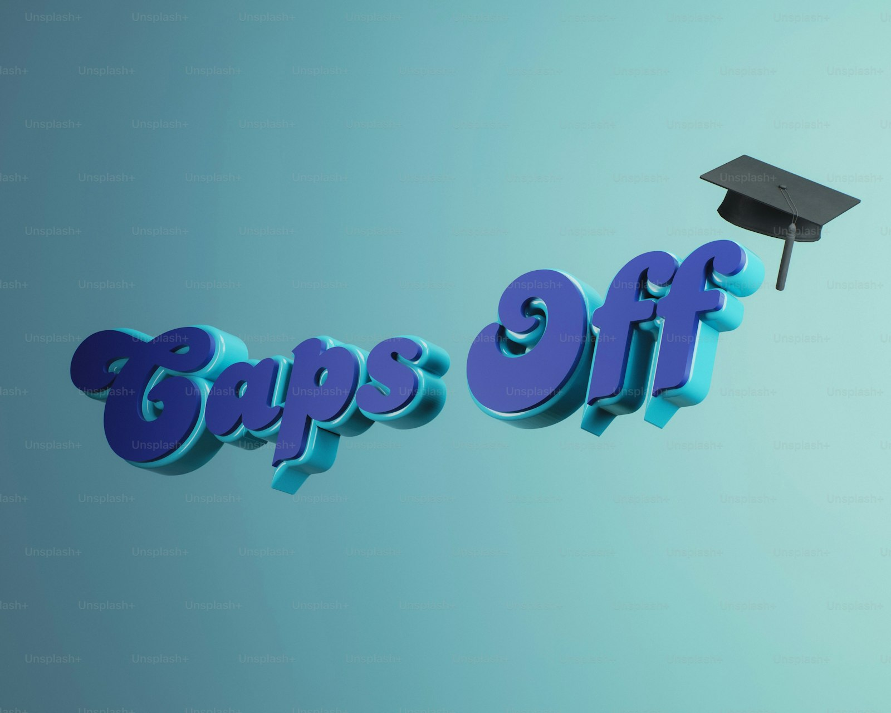
SLOP / UNIVERSITY
WEEK 12 / 26
You have completed the arc
One semester, twelve tools, one film that had to use all of them.
You began by learning to notice light and framing as decisions. You end having recorded real sound, gained real consent, planned, shot, cut, revised through real feedback, and shown the result to a real audience.
What to carry forward
Not the specific film, but the habit: plan deliberately, record responsibly, revise from evidence, and check the submission before the deadline decides for you.
SLOP1416 Visual Storytelling for Short-Form Media
Notes:
Original closing statement for the twelve-week SLOP1416 arc. Unsplash (Unsplash+): https://plus.unsplash.com/premium_photo-1776360449039-129da1035c55 — photographer Cash Macanaya (@cashmacanaya), accessed 13 Sep 2026

Slide 27
SLOP / UNIVERSITY
WEEK 12 / 27
Recommended practice and preparation
Beyond this course.
Backup discipline reference
Backblaze, The 3-2-1 backup strategy: https://www.backblaze.com/blog/the-3-2-1-backup-strategy/
Accessibility reference
W3C Web Accessibility Initiative, Captions/Subtitles: https://www.w3.org/WAI/media/av/captions/
Beyond SLOP1416
Keep a copy of this portfolio: it is the clearest record you have of how your own attention to image, sound and structure changed this semester.
SLOP1416 Visual Storytelling for Short-Form Media
Notes:
External resources: Backblaze 3-2-1 backup strategy explainer; W3C WAI captions/subtitles guidance. Accessed 13 September 2026.

