Slide 1

SLOP1512 / WEEK 1
01
Course introduction
This course treats a website as a public argument made from content, structure, visual decisions and behaviour. A page can look polished while failing its readers when headings hide the main subject, links promise the wrong destination, images carry information without text alternatives, or a narrow screen turns a simple task into a search. During the semester, you will learn to notice those failures before a visitor has to. The course begins with documents because every interface ultimately delivers information to a person with a purpose. We will gradually add typography, layout, responsive behaviour, forms, testing and publication. Your work should make a specific audience able to find, understand and act on information without needing a private explanation from its designer. This lecture page is deliberately detailed because web design requires reasons, not just outcomes. As you read, connect each claim to a concrete browser behaviour, a reader task or a line of markup. Ask what would happen on a small screen, with a keyboard, without an image, or when another person inherits the file. Write down one decision you can test today and one assumption you need to challenge. The strongest work in this course remains specific: it names the content, identifies the audience, describes the interface behaviour and records evidence after testing. Keep the original version of your file so that later revisions remain visible. Page 1 belongs to a sequence, but it should still stand on its own as a record of a useful design question.
Visual source is listed in speaker notes.
Web Design and Interactive Publishing
Notes:
Slide 1: original SLOP1512 teaching content. Visual asset: https://images.unsplash.com/photo-1498050108023-c5249f4df085?auto=format&fit=crop&w=1200&q=85

Slide 2

SLOP1512 / WEEK 1
02
How the course works
Each studio follows a repeatable cycle. First, we inspect an existing page and describe evidence rather than personal taste. Next, we make a small change in HTML or CSS and predict what it should affect. We then test the change in a browser, at a different viewport width, and with a keyboard. Finally, we record what changed, what remained unresolved and what a visitor would experience. This cycle makes design decisions accountable. A useful portfolio does not merely show a final screen. It reveals how content, layout and feedback shaped the screen. You will keep source files and short decision notes throughout the semester, because publishing work without a record makes later revision much harder. This lecture page is deliberately detailed because web design requires reasons, not just outcomes. As you read, connect each claim to a concrete browser behaviour, a reader task or a line of markup. Ask what would happen on a small screen, with a keyboard, without an image, or when another person inherits the file. Write down one decision you can test today and one assumption you need to challenge. The strongest work in this course remains specific: it names the content, identifies the audience, describes the interface behaviour and records evidence after testing. Keep the original version of your file so that later revisions remain visible. Page 2 belongs to a sequence, but it should still stand on its own as a record of a useful design question.
Visual source is listed in speaker notes.
Web Design and Interactive Publishing
Notes:
Slide 2: original SLOP1512 teaching content. Visual asset: https://akm-img-a-in.tosshub.com/indiatoday/images/story/202401/coding-for-fun-how-students-embrace-computer-science-through-gaming-111032866-1x1.jpg?VersionId=LhXZdvCHIefKXwGQxF6FunRtNCjMR_AA

Slide 3
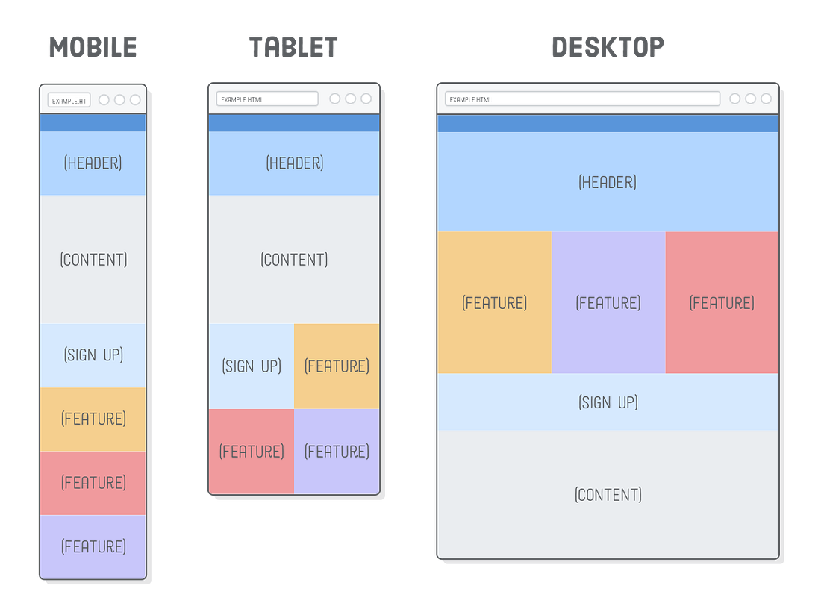
SLOP1512 / WEEK 1
03
Learning outcomes
By the end of this course, you should be able to convert an information problem into a structured document, build a responsive visual system, create an accessible interaction, and test a multi page publication with another person. These outcomes depend on each other. Semantic HTML supplies a meaningful skeleton. CSS creates a readable visual hierarchy. Interaction design makes tasks visible and reversible. Accessibility testing asks whether the result still works for people using another input method, screen size or assistive technology. The final project therefore assesses more than technical syntax. It asks whether every element contributes to a clear relationship between purpose, audience and published material. This lecture page is deliberately detailed because web design requires reasons, not just outcomes. As you read, connect each claim to a concrete browser behaviour, a reader task or a line of markup. Ask what would happen on a small screen, with a keyboard, without an image, or when another person inherits the file. Write down one decision you can test today and one assumption you need to challenge. The strongest work in this course remains specific: it names the content, identifies the audience, describes the interface behaviour and records evidence after testing. Keep the original version of your file so that later revisions remain visible. Page 3 belongs to a sequence, but it should still stand on its own as a record of a useful design question.
Visual source is listed in speaker notes.
Web Design and Interactive Publishing
Notes:
Slide 3: original SLOP1512 teaching content. Visual asset: https://miro.medium.com/v2/resize%3Afit%3A1104/1%2AvjDkKo_f-_CImlKf1P1hcg.png

Slide 4
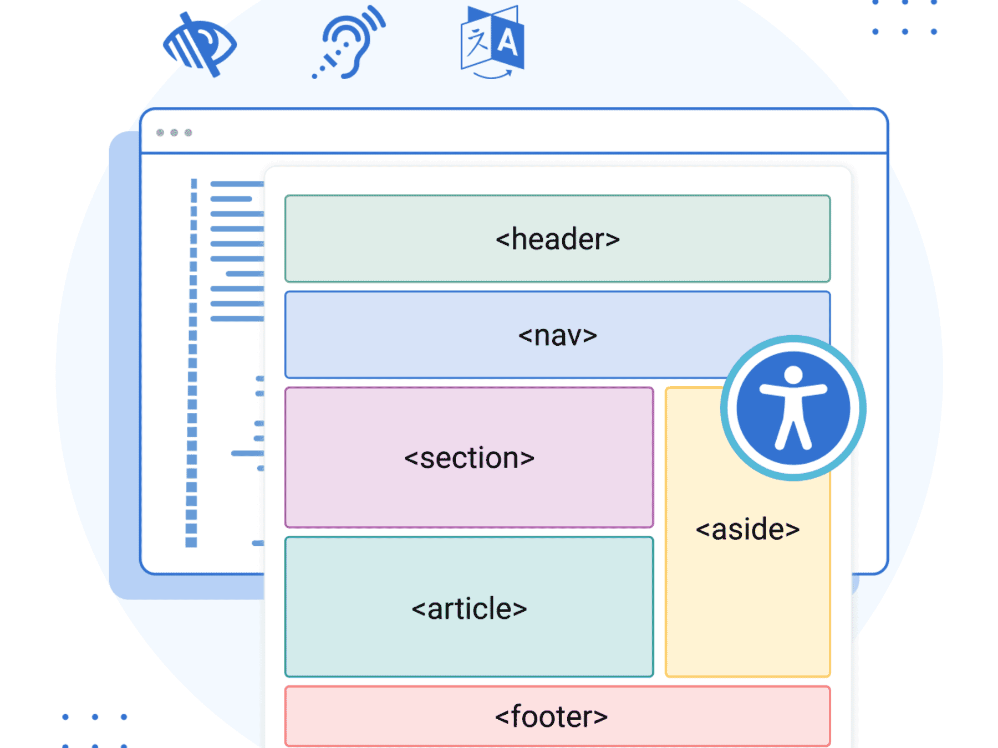
SLOP1512 / WEEK 1
04
Twelve-week roadmap
Weeks one to three establish the document, semantic structure and typographic hierarchy that readers need before they can navigate confidently. Weeks four to six introduce layout, visual systems and responsive design. Weeks seven and eight focus on interaction and accessibility, particularly labels, focus order, error feedback and keyboard access. Weeks nine to eleven turn individual pages into a multi page information system, then use testing and publication checks to guide revision. Week twelve is a portfolio review. This order matters because a complex interface amplifies weak content structure. Students who learn to name content relationships early can make later CSS and JavaScript decisions with more confidence. This lecture page is deliberately detailed because web design requires reasons, not just outcomes. As you read, connect each claim to a concrete browser behaviour, a reader task or a line of markup. Ask what would happen on a small screen, with a keyboard, without an image, or when another person inherits the file. Write down one decision you can test today and one assumption you need to challenge. The strongest work in this course remains specific: it names the content, identifies the audience, describes the interface behaviour and records evidence after testing. Keep the original version of your file so that later revisions remain visible. Page 4 belongs to a sequence, but it should still stand on its own as a record of a useful design question.
Visual source is listed in speaker notes.
Web Design and Interactive Publishing
Notes:
Slide 4: original SLOP1512 teaching content. Visual asset: https://f1.madcapsoftware.com/blogImages/2024/03/ill-the%20power-of-semantic-styles-for-accessibility-1200x1200.png?w=1800

Slide 5
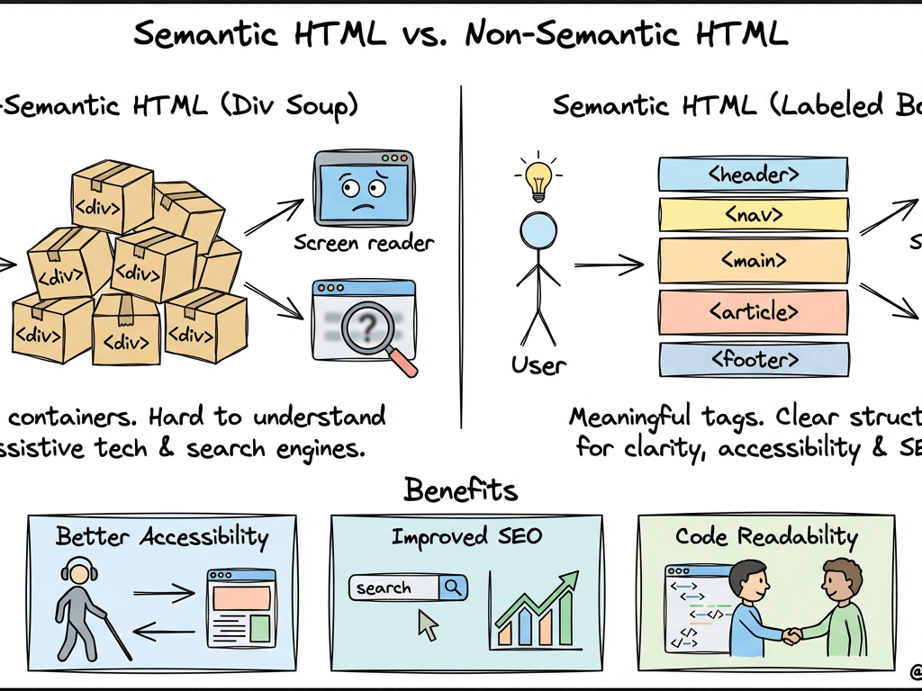
SLOP1512 / WEEK 1
05
Weeks 1 to 4
The first four weeks move from a single reading task to the basic mechanics of layout. In Week 1, you will examine how a page announces its subject, establishes headings and supports a reader moving through content. Week 2 introduces landmarks, lists, figures and links as semantic commitments. Week 3 asks how type scale, line length, white space and contrast control reading speed and attention. Week 4 turns those decisions into CSS layout using normal flow, flexbox and grid. The aim is not to memorise properties in isolation. You will connect each property to a content relationship: a navigation group, a repeated list, a supporting aside, or a reading column. This lecture page is deliberately detailed because web design requires reasons, not just outcomes. As you read, connect each claim to a concrete browser behaviour, a reader task or a line of markup. Ask what would happen on a small screen, with a keyboard, without an image, or when another person inherits the file. Write down one decision you can test today and one assumption you need to challenge. The strongest work in this course remains specific: it names the content, identifies the audience, describes the interface behaviour and records evidence after testing. Keep the original version of your file so that later revisions remain visible. Page 5 belongs to a sequence, but it should still stand on its own as a record of a useful design question.
Visual source is listed in speaker notes.
Web Design and Interactive Publishing
Notes:
Slide 5: original SLOP1512 teaching content. Visual asset: https://mwofqqzjzhhinqamxmxt.supabase.co/storage/v1/object/public/blog-images/88d13d47-10d2-45dc-a734-6b89b6200de0/9rxd89-1770330476197.png

Slide 6
SLOP1512 / WEEK 1
06
Weeks 5 to 8
The middle of the course develops the visual and behavioural consequences of a design system. Week 5 considers image selection, crops, colour and identity. Week 6 tests responsive decisions across narrow and wide screens. Week 7 builds a focused interaction such as a form or filter, with labels and errors that explain what a person should do. Week 8 conducts an accessibility review of structure, contrast, focus, alternative text and motion. These weeks show why visual consistency alone does not guarantee usability. A system earns trust when people can predict what controls do, recover from errors and continue using the page with the input method available to them. This lecture page is deliberately detailed because web design requires reasons, not just outcomes. As you read, connect each claim to a concrete browser behaviour, a reader task or a line of markup. Ask what would happen on a small screen, with a keyboard, without an image, or when another person inherits the file. Write down one decision you can test today and one assumption you need to challenge. The strongest work in this course remains specific: it names the content, identifies the audience, describes the interface behaviour and records evidence after testing. Keep the original version of your file so that later revisions remain visible. Page 6 belongs to a sequence, but it should still stand on its own as a record of a useful design question.
Visual source is listed in speaker notes.
Web Design and Interactive Publishing
Notes:
Slide 6: original SLOP1512 teaching content. Visual asset: https://semantichtml.dev/images/img-5.webp

Slide 7

SLOP1512 / WEEK 1
07
Weeks 9 to 12
The final quarter treats a website as a connected publishing system. Week 9 plans information architecture and shared navigation across pages. Week 10 uses a short user test to identify concrete obstacles rather than collecting general opinions. Week 11 prepares a release by checking assets, attribution, metadata, performance choices and exported files. Week 12 presents the project and reviews the evidence behind its revisions. The final site should tell a coherent story about its topic while giving its audience a practical path through information. You will learn that publication is a checkpoint, not a finish line, because every release creates new evidence for the next revision. This lecture page is deliberately detailed because web design requires reasons, not just outcomes. As you read, connect each claim to a concrete browser behaviour, a reader task or a line of markup. Ask what would happen on a small screen, with a keyboard, without an image, or when another person inherits the file. Write down one decision you can test today and one assumption you need to challenge. The strongest work in this course remains specific: it names the content, identifies the audience, describes the interface behaviour and records evidence after testing. Keep the original version of your file so that later revisions remain visible. Page 7 belongs to a sequence, but it should still stand on its own as a record of a useful design question.
Visual source is listed in speaker notes.
Web Design and Interactive Publishing
Notes:
Slide 7: original SLOP1512 teaching content. Visual asset: https://asimov.cloud/web/image/10520-2b7c5a2a/image.png?access_token=71a2335c-3337-4625-bd86-8bf15df0c101

Slide 8
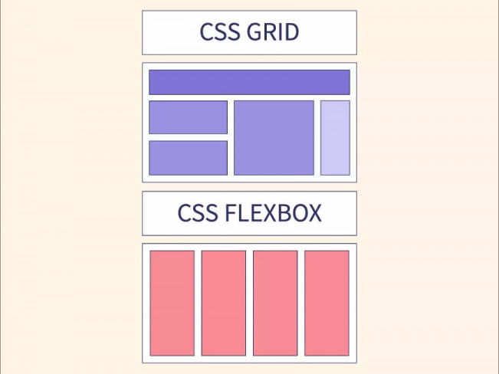
SLOP1512 / WEEK 1
08
Assessment overview
The four assessments create a ladder of complexity. Assignment 1 asks you to make one document understandable. Assignment 2 asks you to establish a visual system that survives different screen widths. Assignment 3 adds an interaction that must work with keyboard input and communicate its state. Assignment 4 combines these skills in a multi page publication and asks you to document testing and revision. The weighting increases as the work requires more integrated judgement. This structure rewards a student who improves through evidence, not a student who attempts to produce a large final product without testing the smaller decisions that make it usable. This lecture page is deliberately detailed because web design requires reasons, not just outcomes. As you read, connect each claim to a concrete browser behaviour, a reader task or a line of markup. Ask what would happen on a small screen, with a keyboard, without an image, or when another person inherits the file. Write down one decision you can test today and one assumption you need to challenge. The strongest work in this course remains specific: it names the content, identifies the audience, describes the interface behaviour and records evidence after testing. Keep the original version of your file so that later revisions remain visible. Page 8 belongs to a sequence, but it should still stand on its own as a record of a useful design question.
Visual source is listed in speaker notes.
Web Design and Interactive Publishing
Notes:
Slide 8: original SLOP1512 teaching content. Visual asset: https://academy.hsoub.com/uploads/monthly_2023_06/css-grid-vs-flexbox_thumbnail.thumb.jpg.b0f17807c4c723ee128f22d2a8397954.jpg

Slide 9
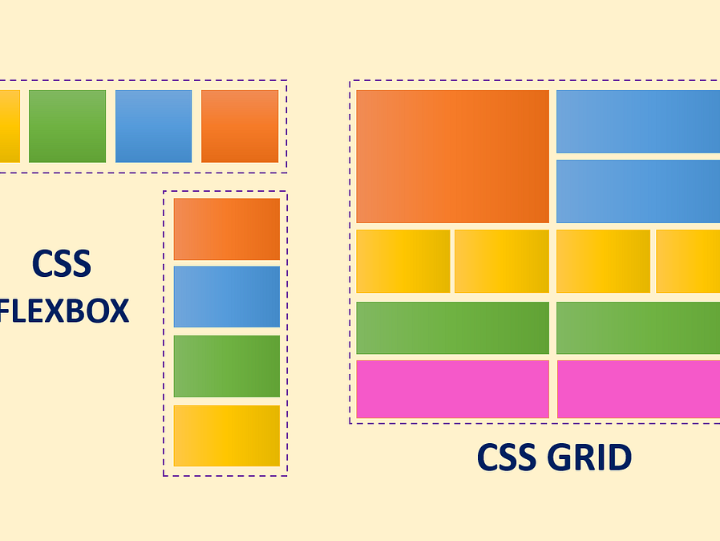
SLOP1512 / WEEK 1
09
Assignment 1
Assignment 1 is a structured reading page worth fifteen percent. You will choose a real or imagined article, guide or event and turn its material into semantic HTML. The page should answer basic reader questions: what is this, who is it for, what is the main idea, where does supporting information belong, and what happens when a link is selected? You will submit a preview, source files, a content outline and a short reflection. The strongest submissions use headings to express genuine hierarchy, images to support rather than decorate, and links whose wording makes sense when read out of context. This lecture page is deliberately detailed because web design requires reasons, not just outcomes. As you read, connect each claim to a concrete browser behaviour, a reader task or a line of markup. Ask what would happen on a small screen, with a keyboard, without an image, or when another person inherits the file. Write down one decision you can test today and one assumption you need to challenge. The strongest work in this course remains specific: it names the content, identifies the audience, describes the interface behaviour and records evidence after testing. Keep the original version of your file so that later revisions remain visible. Page 9 belongs to a sequence, but it should still stand on its own as a record of a useful design question.
Visual source is listed in speaker notes.
Web Design and Interactive Publishing
Notes:
Slide 9: original SLOP1512 teaching content. Visual asset: https://miro.medium.com/v2/resize%3Afit%3A1200/0%2AWFm9wI5yFlGA5P9f.png

Slide 10
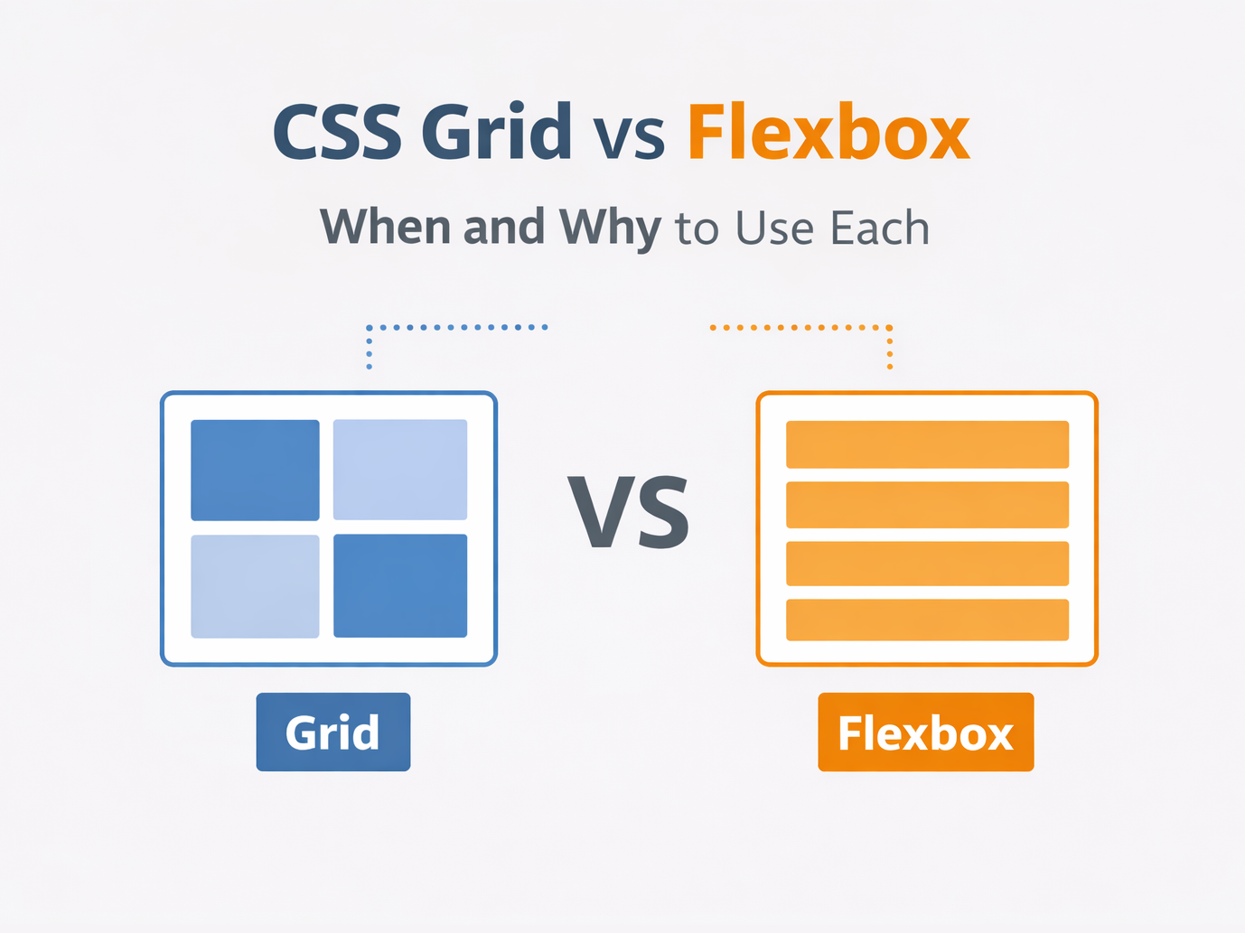
SLOP1512 / WEEK 1
10
Assignment 2
Assignment 2 is a responsive visual system worth twenty percent. You will extend a content page into a coherent set of typographic, spacing, colour and image rules, then demonstrate the design at narrow and wide viewport widths. The assessment rewards a clear relationship between the material and the visual language. For example, a dense guide may need a stable reading measure and generous section spacing, while an event listing may need repeated date, title and location patterns that scan quickly. Your rationale should explain what changes across widths and why. Avoid treating the mobile layout as a compressed desktop screenshot. This lecture page is deliberately detailed because web design requires reasons, not just outcomes. As you read, connect each claim to a concrete browser behaviour, a reader task or a line of markup. Ask what would happen on a small screen, with a keyboard, without an image, or when another person inherits the file. Write down one decision you can test today and one assumption you need to challenge. The strongest work in this course remains specific: it names the content, identifies the audience, describes the interface behaviour and records evidence after testing. Keep the original version of your file so that later revisions remain visible. Page 10 belongs to a sequence, but it should still stand on its own as a record of a useful design question.
Visual source is listed in speaker notes.
Web Design and Interactive Publishing
Notes:
Slide 10: original SLOP1512 teaching content. Visual asset: https://blog.codexcider.com/content/images/size/w2000/2026/01/FlexVSGrid-2.png

Slide 11
SLOP1512 / WEEK 1
11
Assignment 3
Assignment 3 is an accessible interaction prototype worth twenty five percent. Choose a specific task such as joining an event, finding an item, filtering a collection or requesting information. Build the smallest interface that lets a visitor complete that task. The assessment focuses on labels, keyboard order, visible focus, error messages, feedback after submission and the relationship between control names and outcomes. You will document an interaction map and a keyboard test. A good prototype does not rely on a hover state, colour alone or a placeholder label to explain a control. It gives the user enough information before, during and after the action. This lecture page is deliberately detailed because web design requires reasons, not just outcomes. As you read, connect each claim to a concrete browser behaviour, a reader task or a line of markup. Ask what would happen on a small screen, with a keyboard, without an image, or when another person inherits the file. Write down one decision you can test today and one assumption you need to challenge. The strongest work in this course remains specific: it names the content, identifies the audience, describes the interface behaviour and records evidence after testing. Keep the original version of your file so that later revisions remain visible. Page 11 belongs to a sequence, but it should still stand on its own as a record of a useful design question.
Visual source is listed in speaker notes.
Web Design and Interactive Publishing
Notes:
Slide 11: original SLOP1512 teaching content. Visual asset: https://media2.dev.to/dynamic/image/width%3D1000%2Cheight%3D420%2Cfit%3Dcover%2Cgravity%3Dauto%2Cformat%3Dauto/https%3A%2F%2Fdev-to-uploads.s3.amazonaws.com%2Fuploads%2Farticles%2Fzidylnqvigaf64ward3p.jpeg

Slide 12
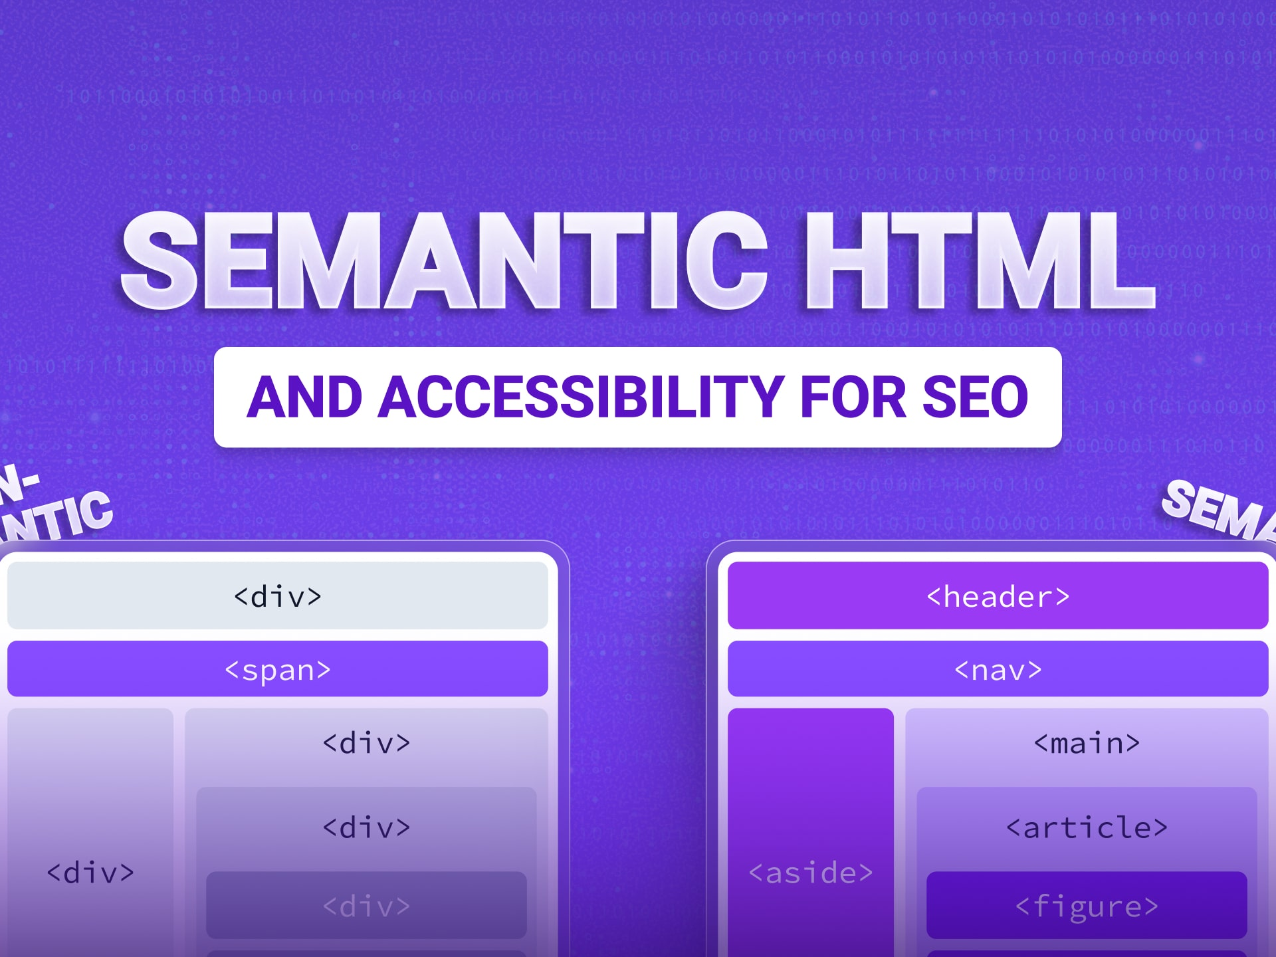
SLOP1512 / WEEK 1
12
Assignment 4
Assignment 4 is an interactive publishing site worth forty percent. It combines the semester into a small multi page site with a clear audience, information architecture, shared navigation, visual system and evidence of testing. Your process dossier records an information map, design system, test observations, change log and critical reflection. The project is intentionally limited in scope. A small collection, guide, archive or story can demonstrate better judgement than a large site with unfinished pages. The assessor will look for a connection between your research, structural choices, visual decisions, interaction details and revisions. Every page should earn its place in the navigation. This lecture page is deliberately detailed because web design requires reasons, not just outcomes. As you read, connect each claim to a concrete browser behaviour, a reader task or a line of markup. Ask what would happen on a small screen, with a keyboard, without an image, or when another person inherits the file. Write down one decision you can test today and one assumption you need to challenge. The strongest work in this course remains specific: it names the content, identifies the audience, describes the interface behaviour and records evidence after testing. Keep the original version of your file so that later revisions remain visible. Page 12 belongs to a sequence, but it should still stand on its own as a record of a useful design question.
Visual source is listed in speaker notes.
Web Design and Interactive Publishing
Notes:
Slide 12: original SLOP1512 teaching content. Visual asset: https://www.cms.influize.com/sites/default/files/2025-12/semantic-html-and-accessibility-for-seo.jpg

Slide 13

SLOP1512 / WEEK 1
13
Week 1 agenda
Week 1 introduces the web as a publishing medium. We begin by comparing pages that contain similar information but guide readers differently. You will identify a page’s main subject, its heading hierarchy, the purpose of its links and the evidence carried by images. We will then build a short HTML document, inspect it with browser tools and read it without CSS. This method exposes the difference between content structure and appearance. The studio task asks you to create a reading profile for a page you admire, then build a simple document for a different audience. The work becomes the starting material for Assignment 1. This lecture page is deliberately detailed because web design requires reasons, not just outcomes. As you read, connect each claim to a concrete browser behaviour, a reader task or a line of markup. Ask what would happen on a small screen, with a keyboard, without an image, or when another person inherits the file. Write down one decision you can test today and one assumption you need to challenge. The strongest work in this course remains specific: it names the content, identifies the audience, describes the interface behaviour and records evidence after testing. Keep the original version of your file so that later revisions remain visible. Page 13 belongs to a sequence, but it should still stand on its own as a record of a useful design question.
Visual source is listed in speaker notes.
Web Design and Interactive Publishing
Notes:
Slide 13: original SLOP1512 teaching content. Visual asset: https://images.unsplash.com/photo-1516321318423-f06f85e504b3?auto=format&fit=crop&w=1200&q=85

Slide 14
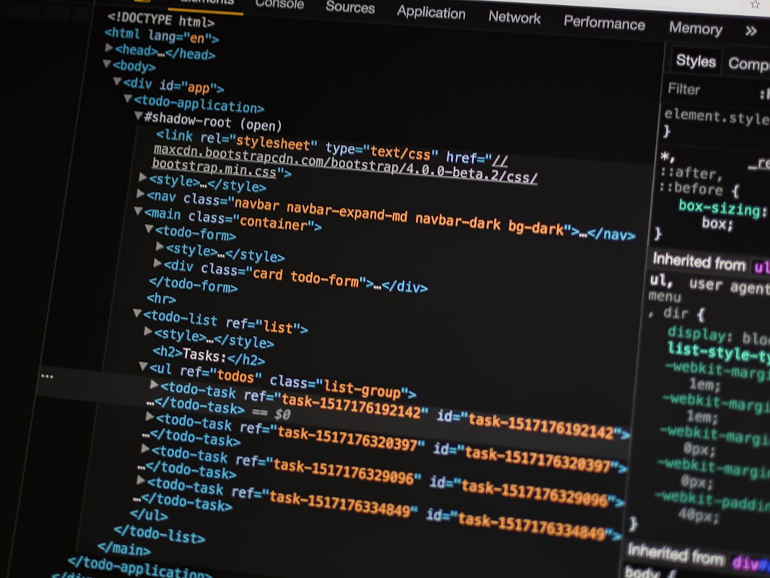
SLOP1512 / WEEK 1
14
The web as a document
A web page is a document that a browser renders according to a set of rules. HTML describes elements and relationships. CSS changes presentation. JavaScript can change behaviour. This separation helps you debug: when a heading has the wrong meaning, CSS cannot repair it; when a layout collapses at a narrow width, adding another div rarely solves the underlying content decision. Documents also travel. A visitor may use a phone, a desktop monitor, a text browser, a screen reader, translation software, reader mode or a slow connection. A robust page gives each of those tools a structure they can interpret before visual styling becomes available. This lecture page is deliberately detailed because web design requires reasons, not just outcomes. As you read, connect each claim to a concrete browser behaviour, a reader task or a line of markup. Ask what would happen on a small screen, with a keyboard, without an image, or when another person inherits the file. Write down one decision you can test today and one assumption you need to challenge. The strongest work in this course remains specific: it names the content, identifies the audience, describes the interface behaviour and records evidence after testing. Keep the original version of your file so that later revisions remain visible. Page 14 belongs to a sequence, but it should still stand on its own as a record of a useful design question.
Visual source is listed in speaker notes.
Web Design and Interactive Publishing
Notes:
Slide 14: original SLOP1512 teaching content. Visual asset: https://images.unsplash.com/photo-1517180102446-f3ece451e9d8?auto=format&fit=crop&w=1200&q=85

Slide 15

SLOP1512 / WEEK 1
15
Audience and task
Every design decision begins with a reader and a task. A visitor looking for an event time needs quick confirmation, while a reader comparing policy options needs definitions, evidence and predictable links. Describe the task in observable terms: find a date, decide whether to attend, understand a process, compare two options or complete a request. Then identify the content needed at each step. This prevents a common failure in beginner web work, where every piece of content receives the same visual weight. The page should make the next useful action easy to locate without hiding the information that supports a careful decision. This lecture page is deliberately detailed because web design requires reasons, not just outcomes. As you read, connect each claim to a concrete browser behaviour, a reader task or a line of markup. Ask what would happen on a small screen, with a keyboard, without an image, or when another person inherits the file. Write down one decision you can test today and one assumption you need to challenge. The strongest work in this course remains specific: it names the content, identifies the audience, describes the interface behaviour and records evidence after testing. Keep the original version of your file so that later revisions remain visible. Page 15 belongs to a sequence, but it should still stand on its own as a record of a useful design question.
Visual source is listed in speaker notes.
Web Design and Interactive Publishing
Notes:
Slide 15: original SLOP1512 teaching content. Visual asset: https://images.unsplash.com/photo-1461749280684-dccba630e2f6?auto=format&fit=crop&w=1200&q=85

Slide 16
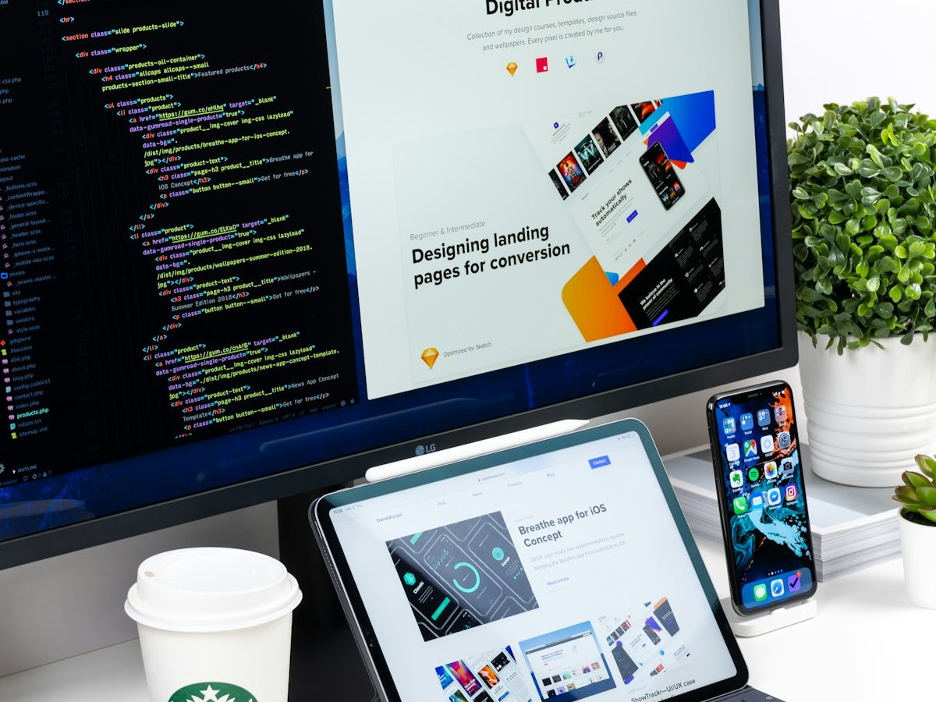
SLOP1512 / WEEK 1
16
Content before interface
Design often begins with a screen because screens are easy to imagine. Publishing begins with a content model. Before choosing colours or components, list the things the audience needs to know and the relationships between them. An event may include title, date, venue, speaker, cost, accessibility information and booking link. A guide may include an introduction, steps, warnings, examples and references. When you name those parts, HTML becomes more deliberate. You can decide which content belongs in the main article, which belongs in a supporting aside, which repeats across pages and which must remain visible when a screen becomes narrow. This lecture page is deliberately detailed because web design requires reasons, not just outcomes. As you read, connect each claim to a concrete browser behaviour, a reader task or a line of markup. Ask what would happen on a small screen, with a keyboard, without an image, or when another person inherits the file. Write down one decision you can test today and one assumption you need to challenge. The strongest work in this course remains specific: it names the content, identifies the audience, describes the interface behaviour and records evidence after testing. Keep the original version of your file so that later revisions remain visible. Page 16 belongs to a sequence, but it should still stand on its own as a record of a useful design question.
Visual source is listed in speaker notes.
Web Design and Interactive Publishing
Notes:
Slide 16: original SLOP1512 teaching content. Visual asset: https://images.unsplash.com/photo-1547658719-da2b51169166?auto=format&fit=crop&w=1200&q=85

Slide 17
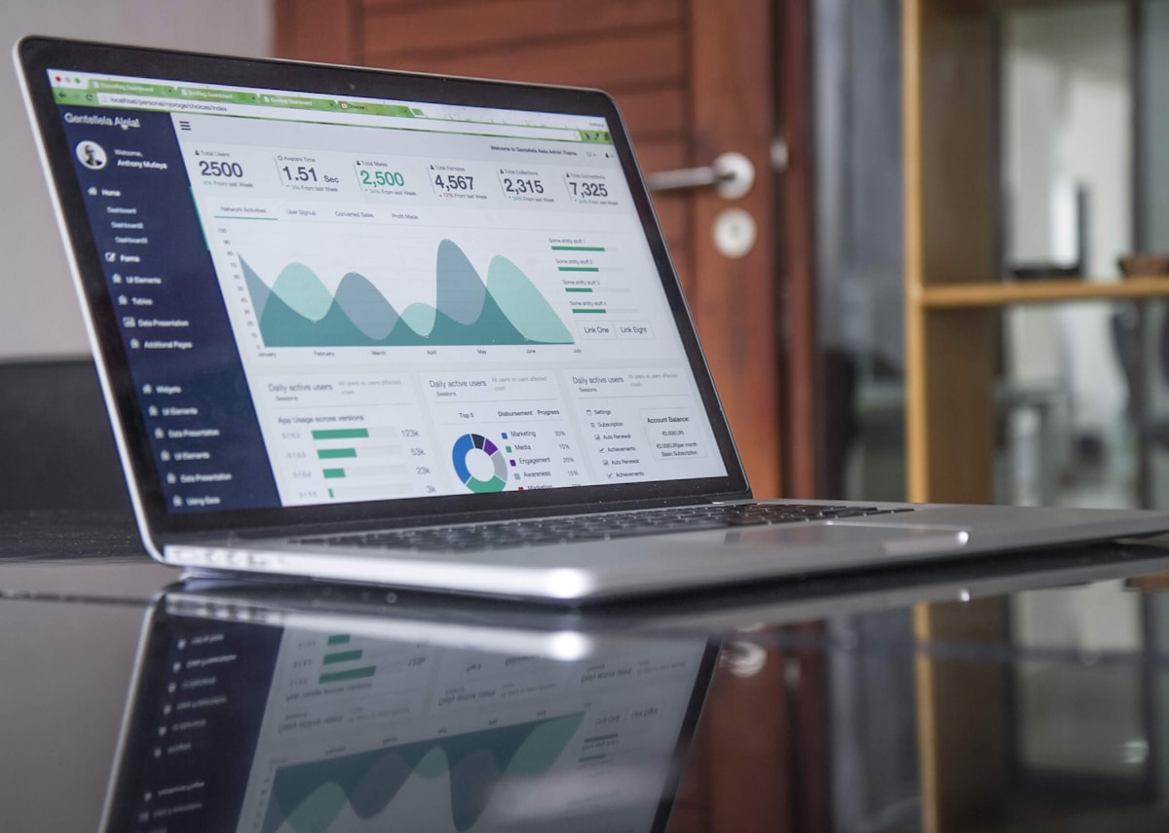
SLOP1512 / WEEK 1
17
Semantic HTML
Semantic HTML uses elements whose names describe their role. A header introduces a page or section. Navigation contains major links. Main identifies the unique primary content. Article contains a self contained composition. A button performs an action. A link changes location. These choices affect the browser’s accessibility tree and help future developers read the document. Semantic markup does not require more code than generic div elements; it requires better questions. Ask what the content is doing before asking how it should look. Use ARIA only when native HTML cannot express the required behaviour, because unnecessary ARIA can create conflicting instructions. This lecture page is deliberately detailed because web design requires reasons, not just outcomes. As you read, connect each claim to a concrete browser behaviour, a reader task or a line of markup. Ask what would happen on a small screen, with a keyboard, without an image, or when another person inherits the file. Write down one decision you can test today and one assumption you need to challenge. The strongest work in this course remains specific: it names the content, identifies the audience, describes the interface behaviour and records evidence after testing. Keep the original version of your file so that later revisions remain visible. Page 17 belongs to a sequence, but it should still stand on its own as a record of a useful design question.
Visual source is listed in speaker notes.
Web Design and Interactive Publishing
Notes:
Slide 17: original SLOP1512 teaching content. Visual asset: https://images.unsplash.com/photo-1460925895917-afdab827c52f?auto=format&fit=crop&w=1200&q=85

Slide 18

SLOP1512 / WEEK 1
18
Document outline
Headings create an outline that lets a reader predict the shape of a page. Use one clear h1 for the page subject, then use h2 headings for major sections and h3 headings for subsections that genuinely belong under them. Do not choose a heading level because it looks attractive at a particular size. CSS can change appearance without changing semantic rank. A useful test is to copy only the headings into a list. If the list reads like a coherent table of contents, the document probably has an understandable structure. If it reads like slogans, decorative fragments or unrelated nouns, revise the content before styling. This lecture page is deliberately detailed because web design requires reasons, not just outcomes. As you read, connect each claim to a concrete browser behaviour, a reader task or a line of markup. Ask what would happen on a small screen, with a keyboard, without an image, or when another person inherits the file. Write down one decision you can test today and one assumption you need to challenge. The strongest work in this course remains specific: it names the content, identifies the audience, describes the interface behaviour and records evidence after testing. Keep the original version of your file so that later revisions remain visible. Page 18 belongs to a sequence, but it should still stand on its own as a record of a useful design question.
Visual source is listed in speaker notes.
Web Design and Interactive Publishing
Notes:
Slide 18: original SLOP1512 teaching content. Visual asset: https://images.unsplash.com/photo-1526374965328-7f61d4dc18c5?auto=format&fit=crop&w=1200&q=85

Slide 19

SLOP1512 / WEEK 1
19
Landmarks and navigation
Landmarks help users move through a page efficiently. A typical document may have header, navigation, main and footer regions, with complementary information in an aside when appropriate. Landmarks should represent meaningful areas, not every visual rectangle. Navigation should contain links that form a recognisable set and should use labels that predict their destination. Repeating a utility link in every region can make keyboard navigation tiring. Consider the order in which a person tabbing through the page encounters controls. The order should follow the reading and task sequence, not the order in which a designer happened to position elements with CSS. This lecture page is deliberately detailed because web design requires reasons, not just outcomes. As you read, connect each claim to a concrete browser behaviour, a reader task or a line of markup. Ask what would happen on a small screen, with a keyboard, without an image, or when another person inherits the file. Write down one decision you can test today and one assumption you need to challenge. The strongest work in this course remains specific: it names the content, identifies the audience, describes the interface behaviour and records evidence after testing. Keep the original version of your file so that later revisions remain visible. Page 19 belongs to a sequence, but it should still stand on its own as a record of a useful design question.
Visual source is listed in speaker notes.
Web Design and Interactive Publishing
Notes:
Slide 19: original SLOP1512 teaching content. Visual asset: https://images.unsplash.com/photo-1555066931-4365d14bab8c?auto=format&fit=crop&w=1200&q=85

Slide 20
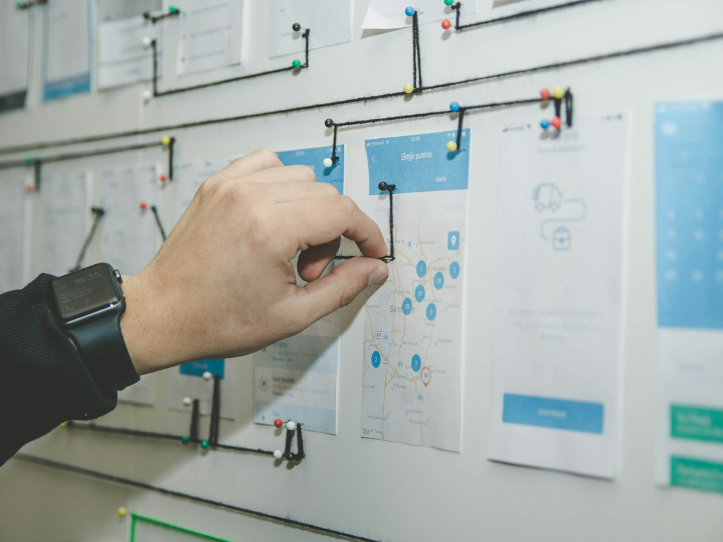
SLOP1512 / WEEK 1
20
Link language
A link is a promise about a destination. Phrases such as “click here” or “read more” often fail when a screen reader lists links without surrounding paragraphs. Prefer language that names the destination or action, such as “Read the exhibition accessibility guide” or “Download the programme PDF.” Link wording also reveals weak information architecture. If you cannot name the destination clearly, the page may not have a clear purpose. Links should remain visually identifiable without relying only on colour. Underlines, focus states and sufficient contrast help readers distinguish linked text from adjacent text. This lecture page is deliberately detailed because web design requires reasons, not just outcomes. As you read, connect each claim to a concrete browser behaviour, a reader task or a line of markup. Ask what would happen on a small screen, with a keyboard, without an image, or when another person inherits the file. Write down one decision you can test today and one assumption you need to challenge. The strongest work in this course remains specific: it names the content, identifies the audience, describes the interface behaviour and records evidence after testing. Keep the original version of your file so that later revisions remain visible. Page 20 belongs to a sequence, but it should still stand on its own as a record of a useful design question.
Visual source is listed in speaker notes.
Web Design and Interactive Publishing
Notes:
Slide 20: original SLOP1512 teaching content. Visual asset: https://images.unsplash.com/photo-1531403009284-440f080d1e12?auto=format&fit=crop&w=1200&q=85

Slide 21
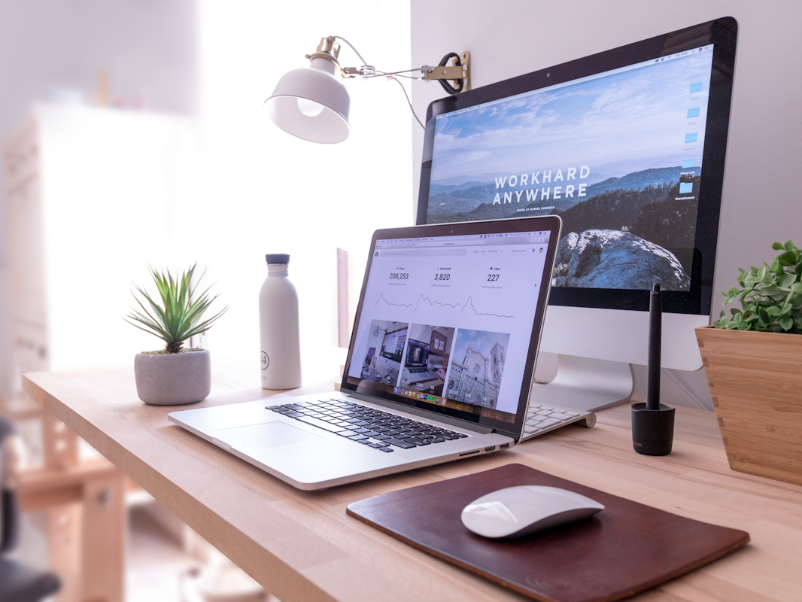
SLOP1512 / WEEK 1
21
Images and text alternatives
Images can establish mood, show evidence, explain a process or repeat information already available in text. The correct alternative text depends on that role. For an informative image, describe the information needed to understand the page. For a decorative image, use an empty alternative so assistive technology does not announce irrelevant content. For a chart or diagram, provide an equivalent explanation in nearby text or a longer description. Avoid beginning every alternative with “image of.” A useful test asks: if this image disappeared, what would the reader lose? Write the alternative to supply that missing information, rather than narrating pixels or guessing at details. This lecture page is deliberately detailed because web design requires reasons, not just outcomes. As you read, connect each claim to a concrete browser behaviour, a reader task or a line of markup. Ask what would happen on a small screen, with a keyboard, without an image, or when another person inherits the file. Write down one decision you can test today and one assumption you need to challenge. The strongest work in this course remains specific: it names the content, identifies the audience, describes the interface behaviour and records evidence after testing. Keep the original version of your file so that later revisions remain visible. Page 21 belongs to a sequence, but it should still stand on its own as a record of a useful design question.
Visual source is listed in speaker notes.
Web Design and Interactive Publishing
Notes:
Slide 21: original SLOP1512 teaching content. Visual asset: https://images.unsplash.com/photo-1499951360447-b19be8fe80f5?auto=format&fit=crop&w=1200&q=85

Slide 22

SLOP1512 / WEEK 1
22
Content model exercise
Today’s exercise begins with a plain brief: create a page that helps a first year student decide whether to attend a public workshop. Before writing tags, list the content fields, their priority and their relationship. The workshop title and date belong near the top. The description explains purpose. The location, cost, access information and booking action support a decision. The facilitator biography may be secondary. A list of requirements may need its own section. Once the model is clear, map each field to a semantic element. Your goal is not visual originality in Week 1; it is a document another person can understand when styling disappears. This lecture page is deliberately detailed because web design requires reasons, not just outcomes. As you read, connect each claim to a concrete browser behaviour, a reader task or a line of markup. Ask what would happen on a small screen, with a keyboard, without an image, or when another person inherits the file. Write down one decision you can test today and one assumption you need to challenge. The strongest work in this course remains specific: it names the content, identifies the audience, describes the interface behaviour and records evidence after testing. Keep the original version of your file so that later revisions remain visible. Page 22 belongs to a sequence, but it should still stand on its own as a record of a useful design question.
Visual source is listed in speaker notes.
Web Design and Interactive Publishing
Notes:
Slide 22: original SLOP1512 teaching content. Visual asset: https://images.unsplash.com/photo-1499750310107-5fef28a66643?auto=format&fit=crop&w=1200&q=85

Slide 23
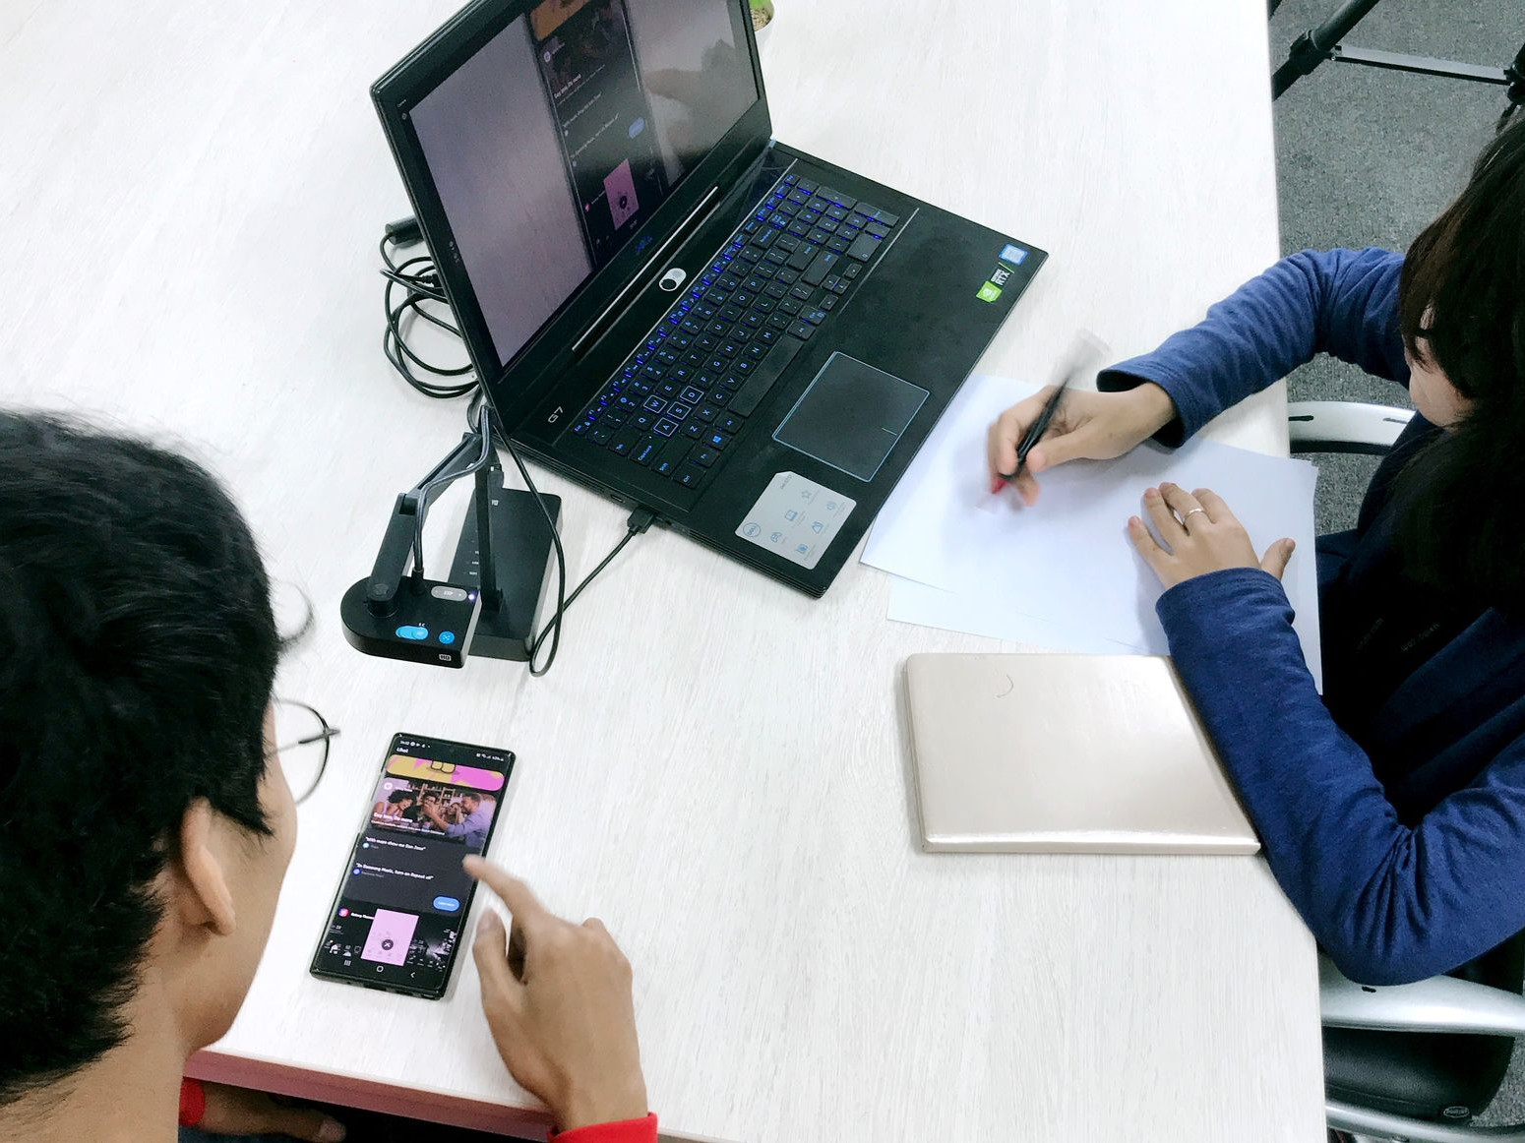
SLOP1512 / WEEK 1
23
Source records
Web publishing combines text, images, code and references from many places. Keep a source record from the first hour of a project. For each asset, record its author, URL, licence or permission, date accessed and how you changed it. For code, record the source and explain the part you adapted. This habit protects you from losing evidence when a project grows. It also makes attribution an ordinary part of design rather than a hurried footer added before submission. Your source record should distinguish between inspiration, direct reuse and original work. A page becomes more credible when its claims, media and technical choices can be traced. This lecture page is deliberately detailed because web design requires reasons, not just outcomes. As you read, connect each claim to a concrete browser behaviour, a reader task or a line of markup. Ask what would happen on a small screen, with a keyboard, without an image, or when another person inherits the file. Write down one decision you can test today and one assumption you need to challenge. The strongest work in this course remains specific: it names the content, identifies the audience, describes the interface behaviour and records evidence after testing. Keep the original version of your file so that later revisions remain visible. Page 23 belongs to a sequence, but it should still stand on its own as a record of a useful design question.
Visual source is listed in speaker notes.
Web Design and Interactive Publishing
Notes:
Slide 23: original SLOP1512 teaching content. Visual asset: https://bwaplatformbucket.sgp1.cdn.digitaloceanspaces.com/assets/thumbnail_tips/thumb.jpg

Slide 24
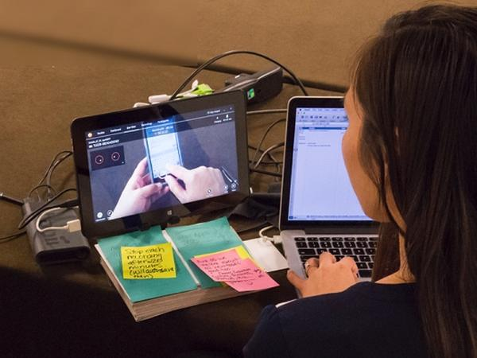
SLOP1512 / WEEK 1
24
Page inspection
Inspection turns vague judgement into evidence. Open an existing page and first read it normally. Next, narrow the browser window. Then navigate with Tab and Shift+Tab. Finally, turn off CSS in a browser tool or use reader mode where available. Record what changes. Does the h1 still name the page? Do links make sense? Does focus remain visible? Does a critical image need explanation? Does the mobile layout hide information or simply rearrange it? These observations are more useful than saying a page feels clean or modern. They name a specific relationship that a redesign can preserve or change. This lecture page is deliberately detailed because web design requires reasons, not just outcomes. As you read, connect each claim to a concrete browser behaviour, a reader task or a line of markup. Ask what would happen on a small screen, with a keyboard, without an image, or when another person inherits the file. Write down one decision you can test today and one assumption you need to challenge. The strongest work in this course remains specific: it names the content, identifies the audience, describes the interface behaviour and records evidence after testing. Keep the original version of your file so that later revisions remain visible. Page 24 belongs to a sequence, but it should still stand on its own as a record of a useful design question.
Visual source is listed in speaker notes.
Web Design and Interactive Publishing
Notes:
Slide 24: original SLOP1512 teaching content. Visual asset: https://media.nngroup.com/media/pagebits/data/images/user-testing-2.jpg.600x450_q75_autocrop_crop-smart_upscale.jpg

Slide 25
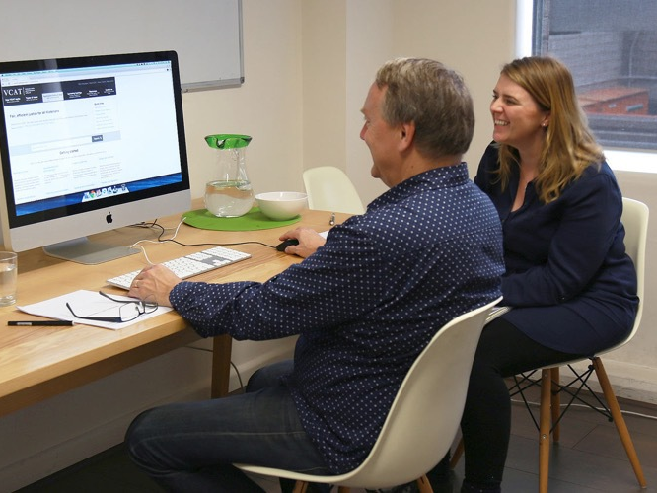
SLOP1512 / WEEK 1
25
HTML anatomy
An HTML file begins with a doctype and html element, then separates metadata in head from visible document content in body. The head may set character encoding, viewport behaviour, title and stylesheet links. The body contains semantic elements that describe the page. Indentation makes nested relationships easier to read, but indentation alone does not create meaning. Browsers tolerate many errors, which can hide a structural problem until the site grows. Close elements carefully, use a validator during development, and keep the first version small enough that you can explain every element. Read the document from top to bottom before adding layout classes. This lecture page is deliberately detailed because web design requires reasons, not just outcomes. As you read, connect each claim to a concrete browser behaviour, a reader task or a line of markup. Ask what would happen on a small screen, with a keyboard, without an image, or when another person inherits the file. Write down one decision you can test today and one assumption you need to challenge. The strongest work in this course remains specific: it names the content, identifies the audience, describes the interface behaviour and records evidence after testing. Keep the original version of your file so that later revisions remain visible. Page 25 belongs to a sequence, but it should still stand on its own as a record of a useful design question.
Visual source is listed in speaker notes.
<header>...</header>
<nav aria-label="Primary">...</nav>
<main>
<article>...</article>
</main>
<footer>...</footer>
Web Design and Interactive Publishing
Notes:
Slide 25: original SLOP1512 teaching content. Visual asset: https://thirststudios.com/assets/uploads/vcat-user-testing-1.jpg

Slide 26
SLOP1512 / WEEK 1
26
A minimal page
A minimal page can already support a real reading task. It needs a document title, one h1, a short introduction, meaningful sections, a link and perhaps an image with appropriate alternative text. The following code pattern demonstrates a starting point, not a finished design. Notice that the main element contains the unique page material and the headings describe a hierarchy. When you add CSS later, preserve this structure. Do not add wrapper elements solely to imitate a visual mockup when an existing semantic element can carry the relationship. Small documents make decisions visible, which is why they are useful in the first week. This lecture page is deliberately detailed because web design requires reasons, not just outcomes. As you read, connect each claim to a concrete browser behaviour, a reader task or a line of markup. Ask what would happen on a small screen, with a keyboard, without an image, or when another person inherits the file. Write down one decision you can test today and one assumption you need to challenge. The strongest work in this course remains specific: it names the content, identifies the audience, describes the interface behaviour and records evidence after testing. Keep the original version of your file so that later revisions remain visible. Page 26 belongs to a sequence, but it should still stand on its own as a record of a useful design question.
<!doctype html>
<html lang="en">
<head><title>Workshop</title></head>
<body>
<main>
<h1>First year workshop</h1>
<p>Learn how to build a readable page.</p>
<a href="/register">Register for the workshop</a>
</main>
</body>
</html>
Web Design and Interactive Publishing
Notes:
Slide 26: original SLOP1512 teaching content.

Slide 27
SLOP1512 / WEEK 1
27
Browser workflow
A browser is a design tool, not only a viewing surface. Use developer tools to inspect the DOM, test a narrow viewport, check computed styles and locate overflow. Use a local development server so the browser refreshes a project as you work. Save files with clear names and keep an organised folder for images, styles and source notes. When a result surprises you, isolate the smallest example that produces the problem. This approach teaches more than copying a large code block into a project. The aim is to understand which rule created a result, then decide whether that rule still serves the content and audience. This lecture page is deliberately detailed because web design requires reasons, not just outcomes. As you read, connect each claim to a concrete browser behaviour, a reader task or a line of markup. Ask what would happen on a small screen, with a keyboard, without an image, or when another person inherits the file. Write down one decision you can test today and one assumption you need to challenge. The strongest work in this course remains specific: it names the content, identifies the audience, describes the interface behaviour and records evidence after testing. Keep the original version of your file so that later revisions remain visible. Page 27 belongs to a sequence, but it should still stand on its own as a record of a useful design question.
Web Design and Interactive Publishing
Notes:
Slide 27: original SLOP1512 teaching content.

Slide 28
SLOP1512 / WEEK 1
28
Week 1 studio brief
For the studio task, choose a public workshop, guide or small event that could plausibly interest a first year student. Draft a content outline before opening an editor. Build a single HTML page with a meaningful title, one h1, at least three h2 sections, a list, a link and one image decision. Add a source record below the document. Test the page by reading the headings alone, tabbing through its interactive elements and viewing it at a narrow width. Bring your file, notes and one unresolved question to the next session. The question matters because it gives feedback a concrete target. This lecture page is deliberately detailed because web design requires reasons, not just outcomes. As you read, connect each claim to a concrete browser behaviour, a reader task or a line of markup. Ask what would happen on a small screen, with a keyboard, without an image, or when another person inherits the file. Write down one decision you can test today and one assumption you need to challenge. The strongest work in this course remains specific: it names the content, identifies the audience, describes the interface behaviour and records evidence after testing. Keep the original version of your file so that later revisions remain visible. Page 28 belongs to a sequence, but it should still stand on its own as a record of a useful design question.
Web Design and Interactive Publishing
Notes:
Slide 28: original SLOP1512 teaching content.

Slide 29
SLOP1512 / WEEK 1
29
Critique method
A studio critique should identify evidence before preference. Start by naming the page’s intended audience and task. Then describe what a visitor can find, read or activate. If something blocks the task, point to the heading, label, link, order or missing information that causes the block. Offer a change only after describing its reason. For example, “the booking link appears after unrelated background information, so a visitor seeking a date may miss it” is more useful than “make the link bigger.” This method helps authors receive feedback without turning design into a vote about personal taste. This lecture page is deliberately detailed because web design requires reasons, not just outcomes. As you read, connect each claim to a concrete browser behaviour, a reader task or a line of markup. Ask what would happen on a small screen, with a keyboard, without an image, or when another person inherits the file. Write down one decision you can test today and one assumption you need to challenge. The strongest work in this course remains specific: it names the content, identifies the audience, describes the interface behaviour and records evidence after testing. Keep the original version of your file so that later revisions remain visible. Page 29 belongs to a sequence, but it should still stand on its own as a record of a useful design question.
Web Design and Interactive Publishing
Notes:
Slide 29: original SLOP1512 teaching content.

Slide 30
SLOP1512 / WEEK 1
30
Accessibility baseline
Week 1 establishes a baseline rather than a final checklist. Use a language attribute, meaningful headings, native links and buttons, visible focus, descriptive link text and appropriate text alternatives. Avoid using colour alone to convey a required distinction. Check that text can remain readable when enlarged and that content order still makes sense when layout changes. These practices help many people, including users on small screens, people in bright environments and people who navigate by keyboard. Accessibility becomes harder when it is postponed until the end, because late changes often reveal decisions that should have shaped the content from the start. This lecture page is deliberately detailed because web design requires reasons, not just outcomes. As you read, connect each claim to a concrete browser behaviour, a reader task or a line of markup. Ask what would happen on a small screen, with a keyboard, without an image, or when another person inherits the file. Write down one decision you can test today and one assumption you need to challenge. The strongest work in this course remains specific: it names the content, identifies the audience, describes the interface behaviour and records evidence after testing. Keep the original version of your file so that later revisions remain visible. Page 30 belongs to a sequence, but it should still stand on its own as a record of a useful design question.
Web Design and Interactive Publishing
Notes:
Slide 30: original SLOP1512 teaching content.

Slide 31
SLOP1512 / WEEK 1
31
Reflection and evidence
A reflection should connect a decision to evidence. Describe what you changed, why you changed it, what you tested and what you would investigate next. Avoid replacing evidence with claims such as “the page is user friendly.” Instead, write what a person did or could not do. You might record that a classmate expected a heading to lead to registration, that the tab order skipped a visible control, or that an image failed to add information beyond its caption. This language creates a useful change log. It also prepares you for the final project, where design quality depends on your ability to revise from observed behaviour. This lecture page is deliberately detailed because web design requires reasons, not just outcomes. As you read, connect each claim to a concrete browser behaviour, a reader task or a line of markup. Ask what would happen on a small screen, with a keyboard, without an image, or when another person inherits the file. Write down one decision you can test today and one assumption you need to challenge. The strongest work in this course remains specific: it names the content, identifies the audience, describes the interface behaviour and records evidence after testing. Keep the original version of your file so that later revisions remain visible. Page 31 belongs to a sequence, but it should still stand on its own as a record of a useful design question.
Web Design and Interactive Publishing
Notes:
Slide 31: original SLOP1512 teaching content.

Slide 32
SLOP1512 / WEEK 1
32
Preparation for Week 2
Next week we will deepen semantic structure with landmarks, lists, figures and link groups. Bring the Week 1 page and a short content inventory that names the major information units on a page you use often. Ask whether each unit belongs in the main reading path, a navigation set or a supporting area. You do not need a polished visual design yet. Bring a document whose structure you can explain. Before class, use a browser’s reader mode or inspector to compare a strong and weak page. Write three observations about headings, links, images or order. Those observations will become material for the Week 2 workshop. This lecture page is deliberately detailed because web design requires reasons, not just outcomes. As you read, connect each claim to a concrete browser behaviour, a reader task or a line of markup. Ask what would happen on a small screen, with a keyboard, without an image, or when another person inherits the file. Write down one decision you can test today and one assumption you need to challenge. The strongest work in this course remains specific: it names the content, identifies the audience, describes the interface behaviour and records evidence after testing. Keep the original version of your file so that later revisions remain visible. Page 32 belongs to a sequence, but it should still stand on its own as a record of a useful design question.
Web Design and Interactive Publishing
Notes:
Slide 32: original SLOP1512 teaching content.

Slide 33
SLOP1512 / WEEK 1
33
Recommended practice
Use the MDN HTML learning area to check the purpose of elements and the W3C Web Accessibility Initiative resources to understand how content structure affects different users. Read web pages as artefacts: inspect headings, test links, reduce window width and identify the task a page supports. Keep examples in a personal reference folder, but record why each example works. A screenshot without a note is easy to admire and hard to learn from. The habit you build this week is deliberate observation. It will support later work on CSS, forms, testing and publication because each later choice begins with a precise account of what the audience needs. This lecture page is deliberately detailed because web design requires reasons, not just outcomes. As you read, connect each claim to a concrete browser behaviour, a reader task or a line of markup. Ask what would happen on a small screen, with a keyboard, without an image, or when another person inherits the file. Write down one decision you can test today and one assumption you need to challenge. The strongest work in this course remains specific: it names the content, identifies the audience, describes the interface behaviour and records evidence after testing. Keep the original version of your file so that later revisions remain visible. Page 33 belongs to a sequence, but it should still stand on its own as a record of a useful design question.
Web Design and Interactive Publishing
Notes:
Slide 33: original SLOP1512 teaching content.

Slide 34
SLOP1512 / WEEK 1
34
Closing prompt
Your first page does not need to impress through visual complexity. It needs to make a clear promise and keep it. A reader should know what the page is about, what information matters, where they are in the document and what action they can take next. Treat every heading, link, image and section as a statement about the reader’s path. When you can explain those statements, CSS becomes a way to strengthen them instead of a way to hide uncertainty. Save your first version, record the tests you perform and bring an open question to the next studio. Progress in this course comes from noticing relationships and revising them with care. This lecture page is deliberately detailed because web design requires reasons, not just outcomes. As you read, connect each claim to a concrete browser behaviour, a reader task or a line of markup. Ask what would happen on a small screen, with a keyboard, without an image, or when another person inherits the file. Write down one decision you can test today and one assumption you need to challenge. The strongest work in this course remains specific: it names the content, identifies the audience, describes the interface behaviour and records evidence after testing. Keep the original version of your file so that later revisions remain visible. Page 34 belongs to a sequence, but it should still stand on its own as a record of a useful design question.
Web Design and Interactive Publishing
Notes:
Slide 34: original SLOP1512 teaching content.

