Slide 1

SLOP / UNIVERSITY
SLOP1512 / WEEK 4
Layout with CSS
Normal flow, flexbox and grid, and how to choose between a narrow reading column and a multi-column information layout.
Notes:
File:CSS code on a screen (Unsplash).jpg — CC0 — Sai Kiran Anagani _imkiran — https://commons.wikimedia.org/wiki/File:CSS_code_on_a_screen_(Unsplash).jpg — accessed 13 Sep 2026
Course teaching content is original.

Slide 2
SLOP1512 / WEEK 4
04 / 02
Technical outcomes
By the end of this lecture you can build, debug and choose between the layout systems CSS provides.
Predict
Build
Choose
Trace how normal flow lays out block and inline boxes before any layout property is applied.
Write working flexbox and grid layouts from real CSS properties, not memorised snippets.
Justify flexbox vs grid, and a single reading column vs a multi-column layout, for a given piece of content.
SLOP1512 Web Design and Interactive Publishing
Notes:
Original SLOP1512 Week 4 learning outcomes, grounded in webModules[3]: normal flow, flexbox, grid, reading column vs multi-column comparison.

Slide 3
SLOP1512 / WEEK 4
04 / 03
Before any layout property runs
Every element is already laid out by normal flow — layout CSS changes that default, it does not create it.
Normal flow places block-level boxes (p, div, section, h1–h6) one below another, each taking the full available width. It places inline boxes (span, a, strong, img by default) left-to-right within a line, wrapping to a new line only when the current one is full.
Block boxes
Inline boxes
display: block. Stack vertically. Width defaults to 100% of the containing block; height defaults to the height of their content.
display: inline. Flow horizontally inside a line box. Cannot take an explicit width or height; top/bottom margin is ignored.
SLOP1512 Web Design and Interactive Publishing
Notes:
Original explanation of normal flow as the CSS default layout algorithm, prerequisite to flexbox/grid.

Slide 4
SLOP1512 / WEEK 4
04 / 04
Test it: block vs inline, not by eye
A testable check you can run in any browser, not a visual guess.
<style>
span.demo { background: gold; width: 300px; }
div.demo { background: teal; width: 300px; }
</style>
<span class="demo">A span ignores width</span>
<div class="demo">A div fills the 300px width</div>
Testable claim: set width: 300px on both. The div's rendered box measures 300px in DevTools' computed-style panel. The span's rendered box still measures only as wide as its text — width on an inline box is not applied.
SLOP1512 Web Design and Interactive Publishing
Notes:
Original testable demonstration distinguishing block and inline formatting contexts using a verifiable DevTools measurement.

Slide 5
SLOP1512 / WEEK 4
04 / 05
display changes the box type, not the element
Any element can be told to behave like a different box type.
Value
Effect
inline-block
Flows inline with siblings but accepts width, height and vertical margin
flex
Turns this element into a flex container; its direct children become flex items
grid
Turns this element into a grid container; its direct children become grid items
none
Removes the box entirely — it takes no space and is not in the accessibility tree
SLOP1512 Web Design and Interactive Publishing
Notes:
Original reference table of the display values used through the rest of the lecture (flex and grid formally introduced next).

Slide 6
SLOP1512 / WEEK 4
04 / 06
Flexbox: one axis at a time
flex-direction sets the main axis; everything else in flexbox is described relative to it.
.nav {
display: flex;
flex-direction: row; /* main axis runs left→right */
}
.stack {
display: flex;
flex-direction: column; /* main axis runs top→bottom */
}
Main axis
The direction flex-direction points. justify-content aligns items along it.
Cross axis
Perpendicular to the main axis. align-items aligns items along it.
SLOP1512 Web Design and Interactive Publishing
Notes:
Original explanation of flexbox's core mental model: axis-relative alignment, prerequisite to justify-content/align-items.

Slide 7
SLOP1512 / WEEK 4
04 / 07
Building a real navigation bar
A working, testable flex layout — not a description of one.
.site-nav {
display: flex;
align-items: center;
justify-content: space-between;
gap: 1.5rem;
padding: 0.75rem 1.5rem;
}
.site-nav__links { display: flex; gap: 1rem; }
align-items: center
Vertically centres the logo and links even if one is taller than another.
justify-content: space-between
Pushes the logo to the start and the link group to the end, with space distributed between them.
SLOP1512 Web Design and Interactive Publishing
Notes:
Original navigation-bar example directly implementing the session brief's flexbox coverage.

Slide 8
SLOP1512 / WEEK 4
04 / 08
gap replaced margin hacks
gap adds space only between flex/grid items — never at the outer edge.
Before gap existed, spacing children required margin-right on every item except the last (:not(:last-child)) or negative-margin tricks on the container. gap: 1rem on a flex or grid container does the same job with one line and no selector gymnastics.
.site-nav__links > * + * { margin-left: 1rem; } /* old way */
.site-nav__links { display: flex; gap: 1rem; } /* current way */
Test it: inspect either rule in DevTools — both produce the same 1rem visual gap, but only gap survives a change in flex-direction unmodified.
SLOP1512 Web Design and Interactive Publishing
Notes:
Original comparison of legacy margin-based spacing vs the gap property, with a DevTools-verifiable equivalence claim.

Slide 9
SLOP1512 / WEEK 4
04 / 09
Flex-grow, flex-shrink, flex-basis
The shorthand flex: A B C controls how items share leftover or missing space.
Property
What it controls
flex-basis
Starting size before growing/shrinking is applied (like width, but axis-aware)
flex-grow
Share of extra space this item takes when the container has room to spare
flex-shrink
Share of the deficit this item gives up when the container is too small
.card { flex: 1 1 240px; } /* grow, shrink, from 240px */
.sidebar { flex: 0 0 260px; } /* fixed 260px, never grows/shrinks */
SLOP1512 Web Design and Interactive Publishing
Notes:
Original explanation of the flex shorthand, with a concrete card/sidebar example testable by resizing the viewport.

Slide 10

SLOP1512 / WEEK 4
04 / 10
flex-wrap and a responsive card row
Without flex-wrap, flex items are compressed, never pushed to a new line.
.card-row {
display: flex;
flex-wrap: wrap;
gap: 1rem;
}
.card-row > * { flex: 1 1 220px; }
Test it: shrink the browser window in DevTools' device toolbar. Cards keep a minimum ~220px width and drop to fewer per row, then wrap to a new row entirely below about 660px — with no media query written.
SLOP1512 Web Design and Interactive Publishing
Notes:
Original responsive card-row example demonstrating flex-wrap without any media query. File:Man with smartphone and laptop (Unsplash).jpg — CC0 — Alejandro Escamilla alejandroescamilla — https://commons.wikimedia.org/wiki/File:Man_with_smartphone_and_laptop_(Unsplash).jpg — accessed 13 Sep 2026

Slide 11
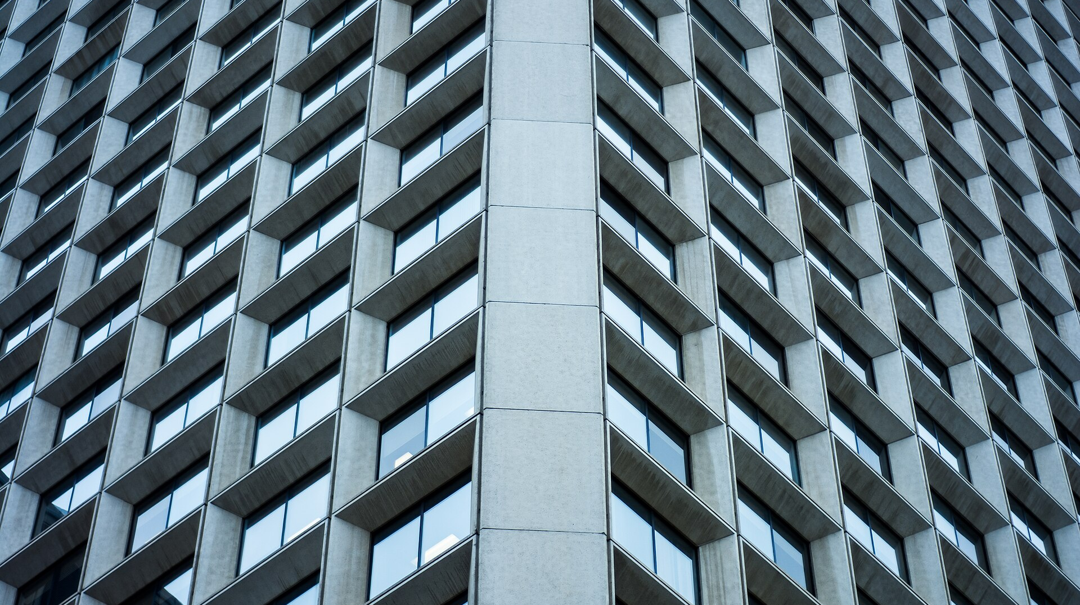
SLOP1512 / WEEK 4
04 / 11
Grid: two axes, defined together
grid-template-columns and grid-template-rows lay out both dimensions in one declaration.
.gallery {
display: grid;
grid-template-columns: 1fr 1fr 1fr;
grid-template-rows: 200px 200px;
gap: 1rem;
}
The fr unit divides remaining space into fractions after fixed-size tracks are subtracted — three equal 1fr columns share whatever width the container has.
SLOP1512 Web Design and Interactive Publishing
Notes:
Original explanation of explicit grid track definition and the fr unit. File:Reflective skyscraper windows (Unsplash).jpg — CC0 — Redd Angelo reddangelo16 — https://commons.wikimedia.org/wiki/File:Reflective_skyscraper_windows_(Unsplash).jpg — accessed 13 Sep 2026

Slide 12
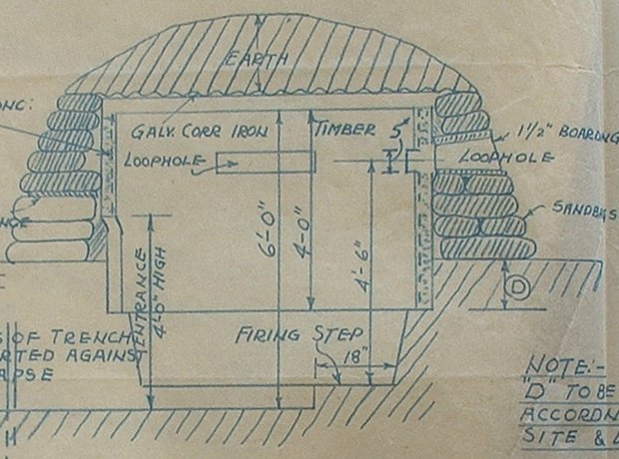
SLOP1512 / WEEK 4
04 / 12
Naming areas with grid-template-areas
A page layout described visually, in the stylesheet itself.
.page {
display: grid;
grid-template-columns: 220px 1fr;
grid-template-areas:
"sidebar header"
"sidebar main";
}
.sidebar { grid-area: sidebar; }
.header { grid-area: header; }
.main { grid-area: main; }
SLOP1512 Web Design and Interactive Publishing
Notes:
Original grid-template-areas example modelling a common sidebar/header/main page skeleton, chosen to parallel a blueprint's labelled sections. File:Norcon blueprint section.jpg — Public domain — HM Government — https://commons.wikimedia.org/wiki/File:Norcon_blueprint_section.jpg — accessed 13 Sep 2026

Slide 13

SLOP1512 / WEEK 4
04 / 13
Auto-fit, auto-fill and minmax: a self-sizing card grid
One line of CSS that adds and removes columns as the viewport changes — no breakpoints.
.gallery {
display: grid;
grid-template-columns:
repeat(auto-fit, minmax(220px, 1fr));
gap: 1rem;
}
minmax(220px, 1fr) tells the browser: never shrink a track below 220px, but let it grow to fill remaining space. auto-fit collapses empty tracks so the last row of cards stretches instead of leaving a gap.
SLOP1512 Web Design and Interactive Publishing
Notes:
Original explanation of repeat(auto-fit, minmax()) as the standard responsive card-grid pattern, chosen to parallel a city block grid. File:Aerial view of the Seattle Center, Seattle, Washington (4860575885).jpg — No restrictions — UW Digital Collections — https://commons.wikimedia.org/wiki/File:Aerial_view_of_the_Seattle_Center,_Seattle,_Washington_(4860575885).jpg — accessed 13 Sep 2026

Slide 14
SLOP1512 / WEEK 4
04 / 14
auto-fit vs auto-fill — the difference that trips people up
Both compute the same track count. They differ only when the grid has fewer items than tracks.
auto-fit
Collapses unused tracks to 0 width — existing items stretch to fill the row
auto-fill
Keeps unused tracks at their minmax minimum width, even if empty — items do not stretch
Test it: build a grid with 2 items and repeat(auto-fit/auto-fill, minmax(200px, 1fr)) inside a 900px container. auto-fit gives 2 wide items; auto-fill leaves visible empty tracks beside them.
SLOP1512 Web Design and Interactive Publishing
Notes:
Original disambiguation of a commonly confused CSS Grid pairing, with a browser-testable reproduction case.

Slide 15
SLOP1512 / WEEK 4
04 / 15
Flexbox or grid — a decision rule, not a preference
The choice follows from the content's dimensionality, not from habit.
Choose flexbox when
Choose grid when
You are arranging items along one dimension and want their size to respond to their content — a nav bar, a button group, a tag list.
You are arranging items along two dimensions at once, or need precise alignment between rows and columns — a page skeleton, a card gallery, a form.
Rule of thumb: if you find yourself nesting flex containers to fake rows and columns together, that is the signal to switch to grid.
SLOP1512 Web Design and Interactive Publishing
Notes:
Original decision framework directly answering webModules[3]'s comparison requirement; testable via the nested-flex smell test.

Slide 16
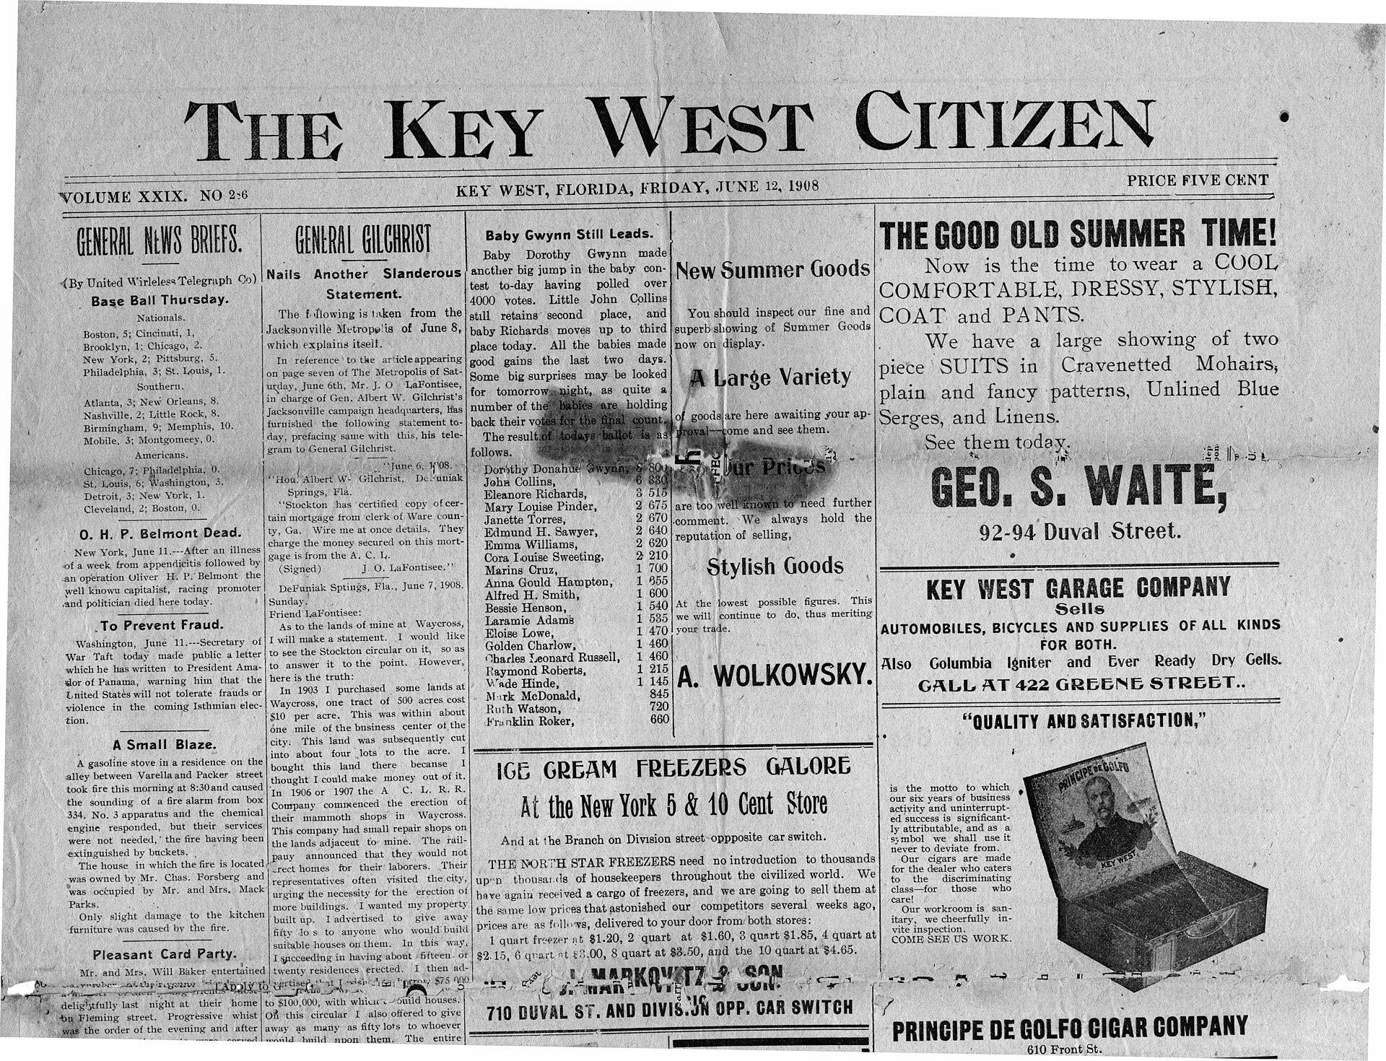
SLOP1512 / WEEK 4
04 / 16
The reading column: why measure matters
Line length, not font size, is the main lever for reading comfort in long-form text.
Typographic research puts comfortable measure (line length) around 45–75 characters, roughly 60ch in CSS. Below that, eyes jump lines too often; above it, they lose their place returning to the start of the next line.
.article p {
max-width: 60ch;
line-height: 1.6;
}
SLOP1512 Web Design and Interactive Publishing
Notes:
Original explanation of measure and readability, applied to the single narrow reading column. File:Key West Citizen newspaper front page 12 June 1908.jpg — Public domain — Florida Keys--Public Libraries — https://commons.wikimedia.org/wiki/File:Key_West_Citizen_newspaper_front_page_12_June_1908.jpg — accessed 13 Sep 2026

Slide 17
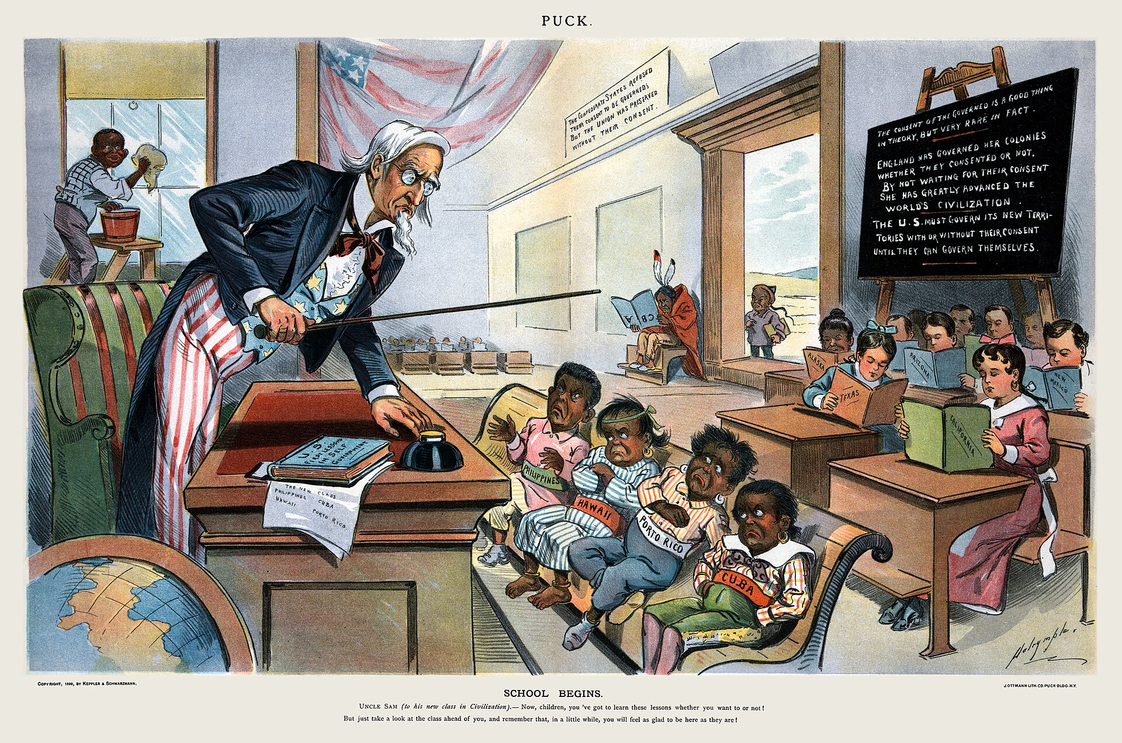
SLOP1512 / WEEK 4
04 / 17
Multi-column layout: column-count and column-width
CSS can lay one flow of text into newspaper-style columns without touching the HTML.
.brief {
column-width: 22ch;
column-gap: 2rem;
column-rule: 1px solid #d7d0c4;
}
column-width sets an ideal column size; the browser fits as many columns as fit, then shares leftover width between them — the same responsive logic as auto-fit grid tracks, applied to text flow.
SLOP1512 Web Design and Interactive Publishing
Notes:
Original explanation of CSS multi-column layout (column-width, column-gap, column-rule), paired with a period magazine layout for visual grounding. File:School Begins (Puck Magazine 1-25-1899).jpg — Public domain — Louis Dalrymple — https://commons.wikimedia.org/wiki/File:School_Begins_(Puck_Magazine_1-25-1899).jpg — accessed 13 Sep 2026

Slide 18
SLOP1512 / WEEK 4
04 / 18
Narrow column vs multi-column: the actual comparison
webModules[3] asks you to compare these directly — here is the testable difference.
Dimension
Single reading column
Multi-column info layout
Reading pattern
One continuous vertical scroll
Zig-zag: down one column, jump to the top of the next
Best for
Long-form narrative prose meant to be read start to finish
Reference or scannable content: glossaries, short news items, indexes
Failure mode if misused
Wastes width on a wide screen, feels empty
A reader loses their place jumping between columns of long paragraphs
SLOP1512 Web Design and Interactive Publishing
Notes:
Original comparison table directly answering the module's stated requirement: compare a narrow reading column with a multi-column information layout.

Slide 19
SLOP1512 / WEEK 4
04 / 19
Container queries: responding to the container, not the viewport
@container lets a component adapt to the space it actually has, wherever it is placed.
.card-wrapper { container-type: inline-size; }
@container (min-width: 380px) {
.card { display: grid; grid-template-columns: 120px 1fr; }
}
A media query asks “how wide is the browser window?”. A container query asks “how wide is my parent right now?” — the same .card component can sit in a 300px sidebar or a 900px main column and lay itself out correctly in each.
SLOP1512 Web Design and Interactive Publishing
Notes:
Original explanation of container queries as a component-level responsive mechanism, distinct from viewport-level media queries.

Slide 20
SLOP1512 / WEEK 4
04 / 20
Layout bug 1 — collapsing margins
Adjacent vertical margins between block siblings do not add; the larger one wins.
<div style="margin-bottom: 20px">First</div>
<div style="margin-top: 30px">Second</div>
<!-- gap between them is 30px, not 50px -->
The fix
Give the parent display: flex, display: grid, or a non-zero border/padding — any of these opts the parent out of margin collapsing entirely.
SLOP1512 Web Design and Interactive Publishing
Notes:
Original explanation of margin collapsing, a well-documented CSS box-model behaviour, with a concrete verifiable measurement and a flex/grid-based fix.

Slide 21
SLOP1512 / WEEK 4
04 / 21
Layout bug 2 — the flex item that will not shrink
Flex items default to min-width: auto, which can override flex-shrink entirely.
.row { display: flex; }
.row > pre { flex: 1; } /* long unbroken text still overflows */
.row > pre { flex: 1; min-width: 0; } /* fix: now it wraps/scrolls inside */
A flex or grid item's default min-width (and min-height, on the cross axis) is auto, meaning “never smaller than my content's intrinsic size.” A long unbroken string like a URL then forces the item wider than flex-shrink allows, and it overflows the row.
Test it: put min-width: 0 back on the item and the same content wraps inside its column instead of pushing the layout wider.
SLOP1512 Web Design and Interactive Publishing
Notes:
Original explanation of the classic flexbox min-width:auto overflow bug and its one-line fix, independently reproducible in DevTools.

Slide 22
SLOP1512 / WEEK 4
04 / 22
Layout bug 3 — grid blowout from implicit tracks
Content that does not fit an explicit grid creates new tracks the designer never sized.
.gallery { display: grid; grid-template-columns: repeat(3, 1fr); }
.gallery > .wide { grid-column: span 5; } /* only 3 columns exist! */
The fix
Constrain implicit tracks explicitly with grid-auto-columns, or clamp spans with min(5, 3) logic in code before the value reaches CSS, so a span can never exceed the defined column count.
SLOP1512 Web Design and Interactive Publishing
Notes:
Original explanation of implicit grid track creation causing layout blowout when a span exceeds the explicit column count.

Slide 23
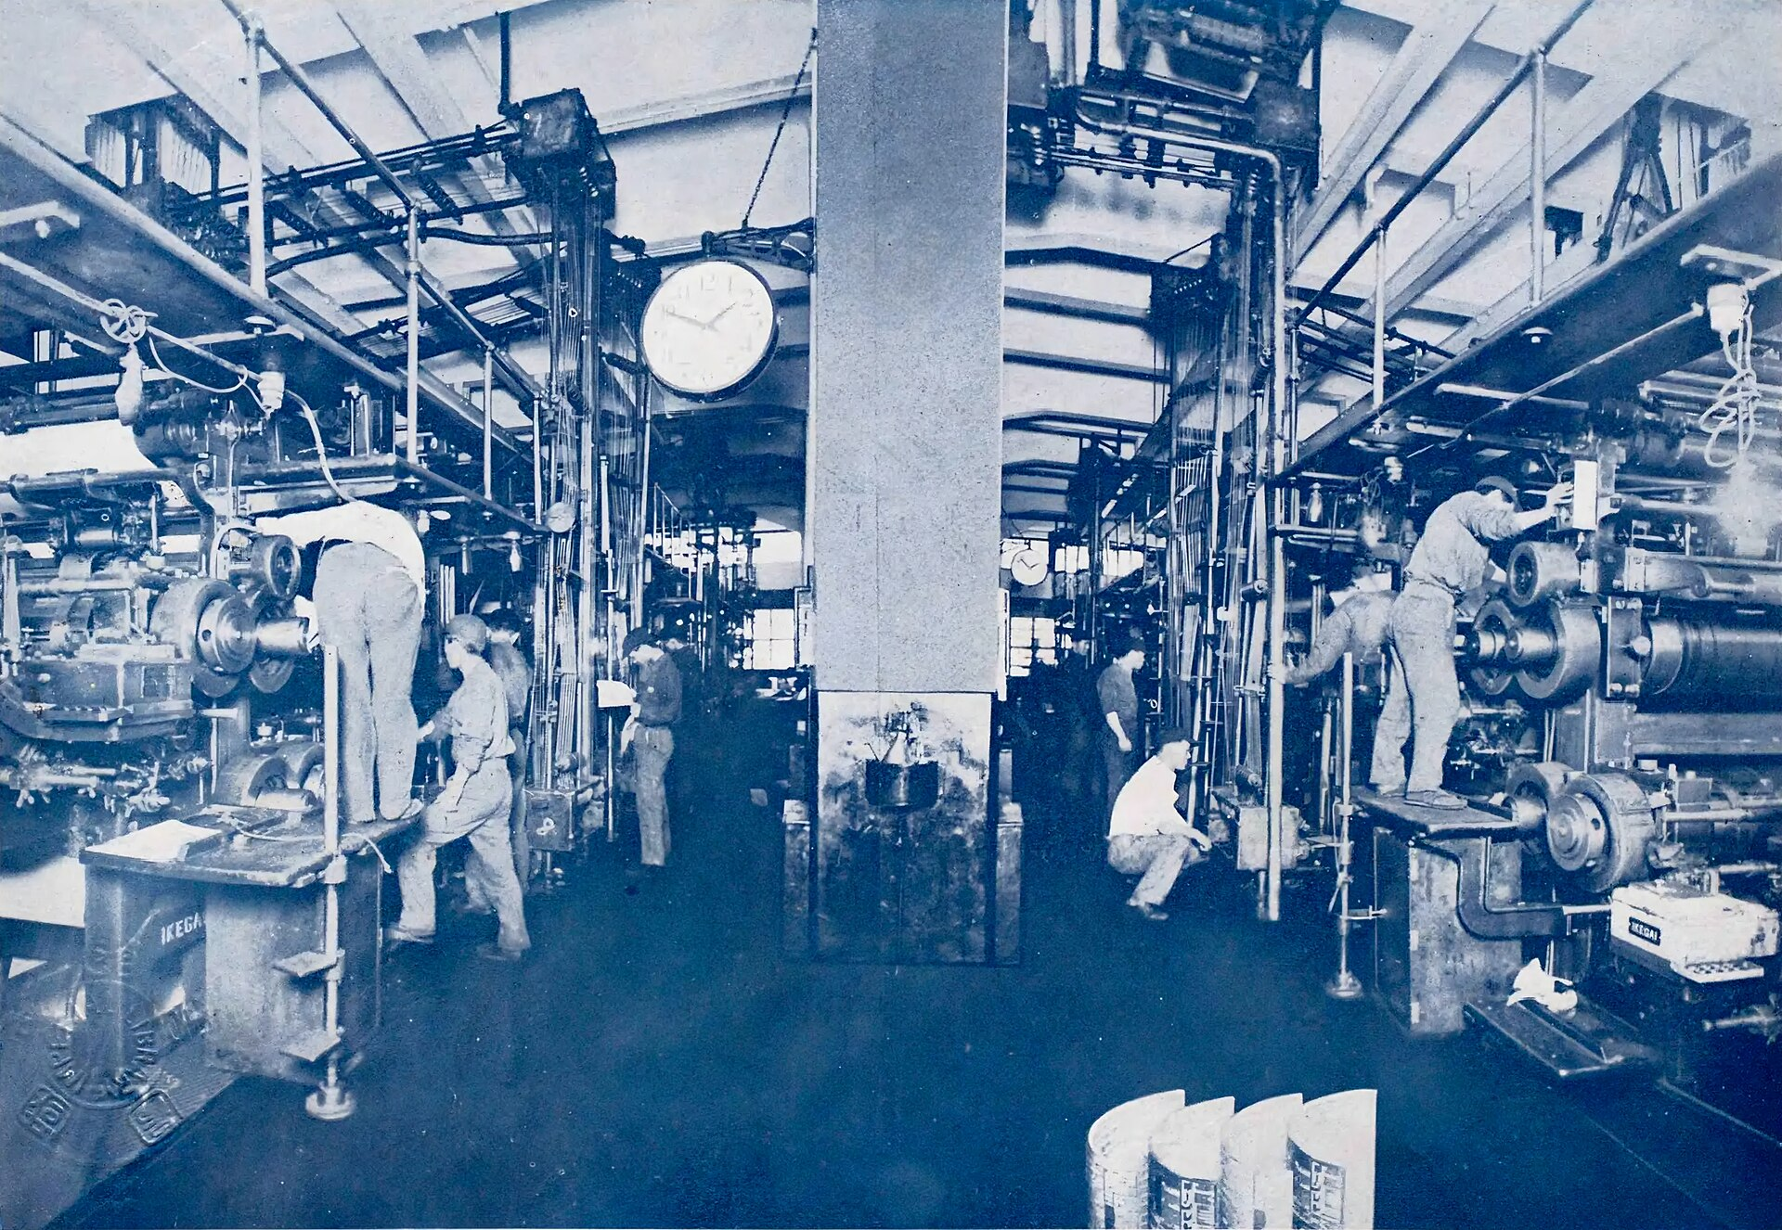
SLOP1512 / WEEK 4
04 / 23
Before / after: refactoring a float-based layout to grid
The historical technique this replaces, and why the replacement is more robust.
/* before: float + clearfix */
.sidebar { float: left; width: 220px; }
.main { margin-left: 240px; }
.row::after { content: ""; display: block; clear: both; }
SLOP1512 Web Design and Interactive Publishing
Notes:
Original before/after refactor exercise, framed against the print era's fixed physical page layout. File:Rotary printing press machine, Asahi-Shinbun, 1932.jpg — Public domain — Unknown authorUnknown author — https://commons.wikimedia.org/wiki/File:Rotary_printing_press_machine,_Asahi-Shinbun,_1932.jpg — accessed 13 Sep 2026

Slide 24
SLOP1512 / WEEK 4
04 / 24
The grid version — same result, no clearfix
grid-template-columns replaces float, width and the clearfix hack in one declaration.
/* after: grid */
.row {
display: grid;
grid-template-columns: 220px 1fr;
gap: 1.5rem;
}
.sidebar { /* no float, no width hack needed */ }
What improved
The main column's height is no longer independent of the sidebar's; both sit in one grid row and stay aligned even if either one's content changes length.
SLOP1512 Web Design and Interactive Publishing
Notes:
Original continuation of the refactor exercise, making the specific correctness improvement (row-height alignment) explicit and testable by changing content length in either column.

Slide 25
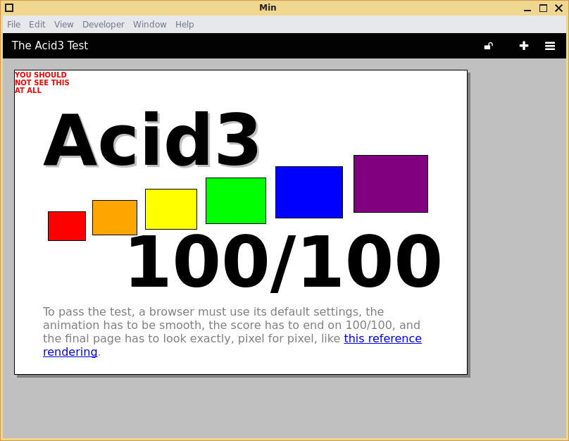
SLOP1512 / WEEK 4
04 / 25
Debugging layout in DevTools
Both flex and grid have dedicated, official inspector overlays — use them before guessing.
1
Select the container element, then click the flex or grid badge next to its display value.
2
Toggle the overlay to see track/line numbers and item boundaries drawn directly on the page.
3
Open the Layout or Flex panel to read each item's resolved size, not just its declared CSS.
SLOP1512 Web Design and Interactive Publishing
Notes:
Original DevTools workflow for verifying flex/grid layouts empirically rather than by visual inspection alone. File:Min (web browser) 1.5.1 tests Acid3 screenshot.png — Public domain — Jayvee Enaguas (HarvettFox96) — https://commons.wikimedia.org/wiki/File:Min_(web_browser)_1.5.1_tests_Acid3_screenshot.png — accessed 13 Sep 2026

Slide 26


SLOP1512 / WEEK 4
04 / 26
Image sources and licenses
Every photograph in this deck is CC0, public domain, or otherwise unrestricted, sourced from Wikimedia Commons.
File:Key West Citizen newspaper front page 12 June 1908.jpg — Public domain, Florida Keys--Public Libraries
File:Movie theater seats (Unsplash).jpg — CC0, Elijah Flores baesik
File:School Begins (Puck Magazine 1-25-1899).jpg — Public domain, Louis Dalrymple
File:Reflective skyscraper windows (Unsplash).jpg — CC0, Redd Angelo reddangelo16
File:Norcon blueprint section.jpg — Public domain, HM Government
File:CSS code on a screen (Unsplash).jpg — CC0, Sai Kiran Anagani _imkiran
File:Canadian law books on shelf (31089552820).jpg — CC0, David Whelan
File:Aerial view of the Seattle Center, Seattle, Washington (4860575885).jpg — No restrictions, UW Digital Collections
File:Rotary printing press machine, Asahi-Shinbun, 1932.jpg — Public domain, Unknown authorUnknown author
File:Man with smartphone and laptop (Unsplash).jpg — CC0, Alejandro Escamilla alejandroescamilla
File:Min (web browser) 1.5.1 tests Acid3 screenshot.png — Public domain, Jayvee Enaguas (HarvettFox96)
Full description-page URLs are recorded in each slide's speaker notes. All images accessed 13 September 2026.
SLOP1512 Web Design and Interactive Publishing
Notes:
01-newspaper-columns.jpg: File:Key West Citizen newspaper front page 12 June 1908.jpg — Public domain — Florida Keys--Public Libraries — https://commons.wikimedia.org/wiki/File:Key_West_Citizen_newspaper_front_page_12_June_1908.jpg
02-magazine-page.jpg: File:School Begins (Puck Magazine 1-25-1899).jpg — Public domain — Louis Dalrymple — https://commons.wikimedia.org/wiki/File:School_Begins_(Puck_Magazine_1-25-1899).jpg
03-architectural-blueprint.jpg: File:Norcon blueprint section.jpg — Public domain — HM Government — https://commons.wikimedia.org/wiki/File:Norcon_blueprint_section.jpg
04-bookshelf-row.jpg: File:Canadian law books on shelf (31089552820).jpg — CC0 — David Whelan — https://commons.wikimedia.org/wiki/File:Canadian_law_books_on_shelf_(31089552820).jpg
05-printing-press.jpg: File:Rotary printing press machine, Asahi-Shinbun, 1932.jpg — Public domain — Unknown authorUnknown author — https://commons.wikimedia.org/wiki/File:Rotary_printing_press_machine,_Asahi-Shinbun,_1932.jpg
06-browser-devtools.png: File:Min (web browser) 1.5.1 tests Acid3 screenshot.png — Public domain — Jayvee Enaguas (HarvettFox96) — https://commons.wikimedia.org/wiki/File:Min_(web_browser)_1.5.1_tests_Acid3_screenshot.png
07-theatre-seats-grid.jpg: File:Movie theater seats (Unsplash).jpg — CC0 — Elijah Flores baesik — https://commons.wikimedia.org/wiki/File:Movie_theater_seats_(Unsplash).jpg
08-window-panes-grid.jpg: File:Reflective skyscraper windows (Unsplash).jpg — CC0 — Redd Angelo reddangelo16 — https://commons.wikimedia.org/wiki/File:Reflective_skyscraper_windows_(Unsplash).jpg
09-css-code-screen.jpg: File:CSS code on a screen (Unsplash).jpg — CC0 — Sai Kiran Anagani _imkiran — https://commons.wikimedia.org/wiki/File:CSS_code_on_a_screen_(Unsplash).jpg
10-city-grid-aerial.jpg: File:Aerial view of the Seattle Center, Seattle, Washington (4860575885).jpg — No restrictions — UW Digital Collections — https://commons.wikimedia.org/wiki/File:Aerial_view_of_the_Seattle_Center,_Seattle,_Washington_(4860575885).jpg
11-devices-desk.jpg: File:Man with smartphone and laptop (Unsplash).jpg — CC0 — Alejandro Escamilla alejandroescamilla — https://commons.wikimedia.org/wiki/File:Man_with_smartphone_and_laptop_(Unsplash).jpg
All images accessed 13 September 2026.

Slide 27
SLOP1512 / WEEK 4
04 / 27
Studio task
Build both layout systems in the same page and justify each choice in writing.
Brief
Build a page with a flexbox navigation bar (logo left, links right, wraps below 600px) and a CSS Grid card gallery below it (auto-fit, minmax(220px, 1fr)).
Constraints
No fixed pixel widths on the cards. No media queries in the gallery. The nav must not overflow at 320px wide.
Evidence to submit
A screenshot at 375px and 1440px, your CSS, and 100 words justifying flexbox for the nav and grid for the gallery using this lecture's decision rule.
SLOP1512 Web Design and Interactive Publishing
Notes:
Original SLOP1512 Week 4 studio task, directly implementing webModules[3]'s flexbox/grid coverage and the flexbox-vs-grid decision rule taught earlier in the deck.

Slide 28
SLOP1512 / WEEK 4
04 / 28
Review checklist
How your studio submission is assessed.
Correctness
Layout matches the brief at both 375px and 1440px without horizontal overflow.
System choice
Flexbox used for the one-dimensional nav; grid used for the two-dimensional gallery.
Robustness
No fixed pixel widths on cards; the gallery re-flows correctly as items are added or removed.
Justification
Written explanation correctly applies the flexbox-vs-grid decision rule to this specific layout.
SLOP1512 Web Design and Interactive Publishing
Notes:
Original review rubric aligned to the studio task and the CSS layout criteria this course applies to layout work.

Slide 29
SLOP1512 / WEEK 4
04 / 29
Further practice and preparation
Before next session.
Flexbox reference
MDN, Basic concepts of flexbox: https://developer.mozilla.org/en-US/docs/Web/CSS/CSS_flexible_box_layout/Basic_concepts_of_flexbox
Grid reference
MDN, Basic concepts of grid layout: https://developer.mozilla.org/en-US/docs/Web/CSS/CSS_grid_layout/Basic_concepts_of_grid_layout
Container queries
MDN, CSS container queries: https://developer.mozilla.org/en-US/docs/Web/CSS/CSS_containment/Container_queries
Bring to Week 5
One page of your studio build printed or screenshotted, ready to critique in session.
SLOP1512 Web Design and Interactive Publishing
Notes:
External resources: MDN flexbox, grid, and container query references. Accessed 13 September 2026.

Slide 30
SLOP1512 / WEEK 4
04 / 30
Next week
From layout to typography and colour — making the page you can now build easy to read.
Week 4 gave you the structural tools: normal flow as the default, flexbox for one dimension, grid for two, and the reading-column vs multi-column decision for long-form and reference content.
Week 5 preview
Typography, colour and visual hierarchy — how type scale, contrast and whitespace make a correctly laid-out page comfortable to actually read.
SLOP1512 Web Design and Interactive Publishing
Notes:
Original closing slide bridging Week 4 (layout) to Week 5 (typography and visual hierarchy) per webModules ordering.

