Slide 1

SLOP1512 / WEEK 5
01
Colour, image
and identity
Building a restrained visual system, and preparing images with useful alternative text and appropriate crops.
Web Design and Interactive Publishing
Notes:
Cover: this week moves from taste to a defensible system — numeric contrast checks for colour, stated roles and crops for images.

Slide 2
SLOP1512 / WEEK 5
02
Technical outcomes
Colour, image and identity
Build a token system
Prepare real images
Write useful alt text
Define 5-7 semantic colour tokens in HSL, not scattered hex codes, and check every text/background pairing against WCAG contrast ratios.
Choose crops by role (hero, portrait, avatar, decorative) and reason about aspect-ratio, object-fit and Cumulative Layout Shift.
Classify an image as decorative, informative, functional or complex before writing its alternative text.
Web Design and Interactive Publishing
Notes:
Frame the week: a restrained visual system is a set of decisions you can justify with numbers, not a mood board.

Slide 3
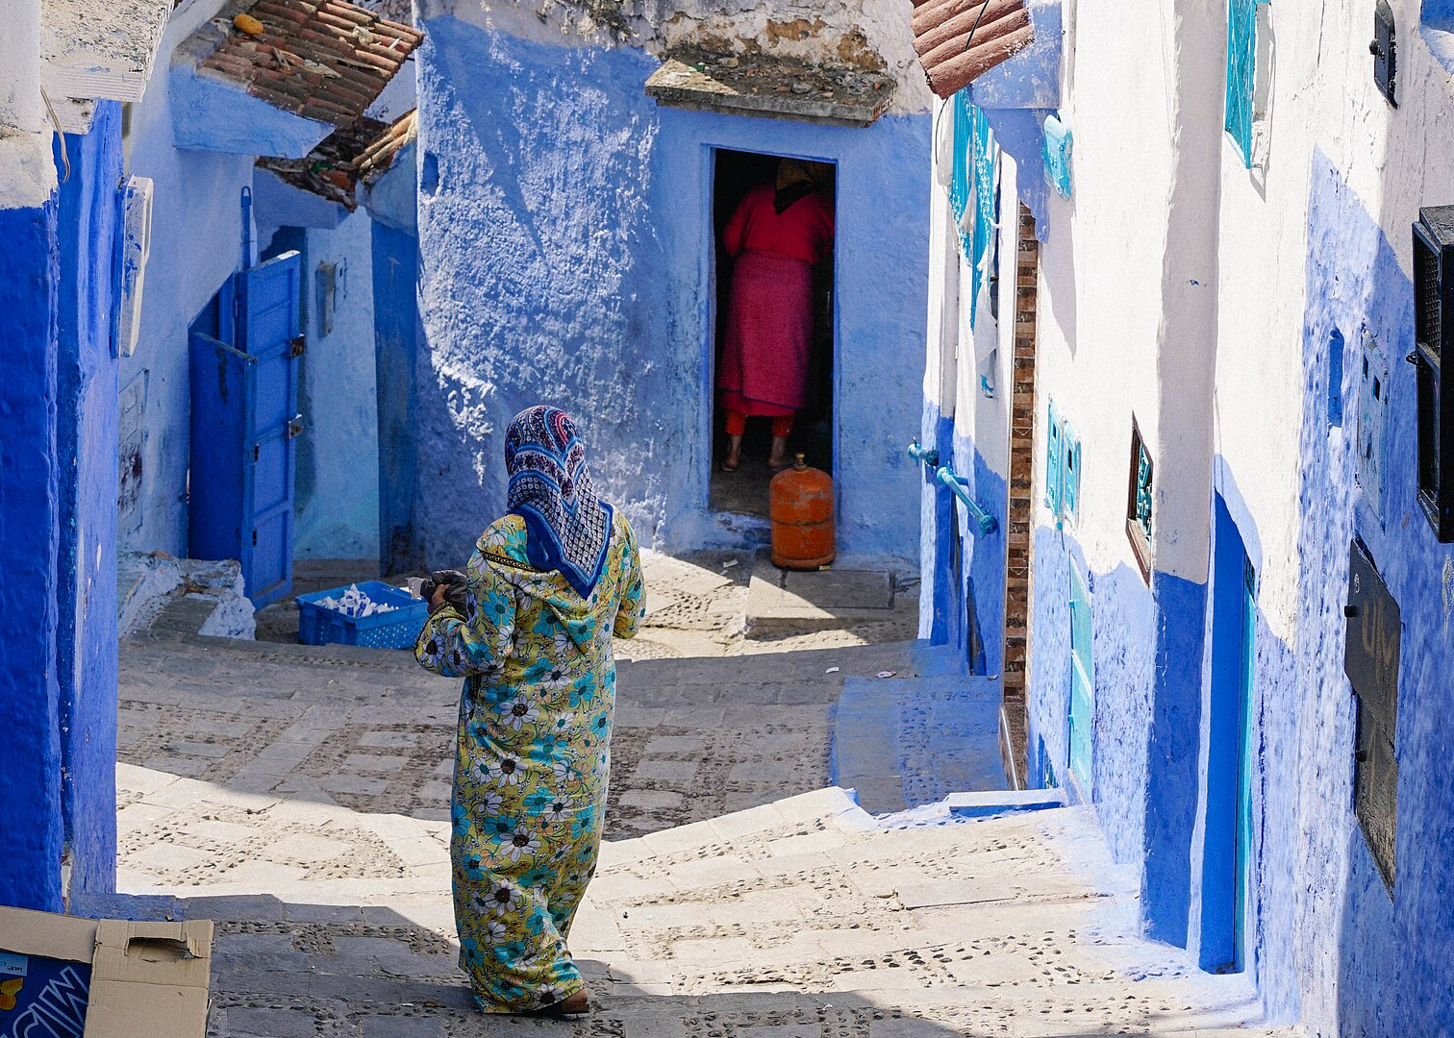
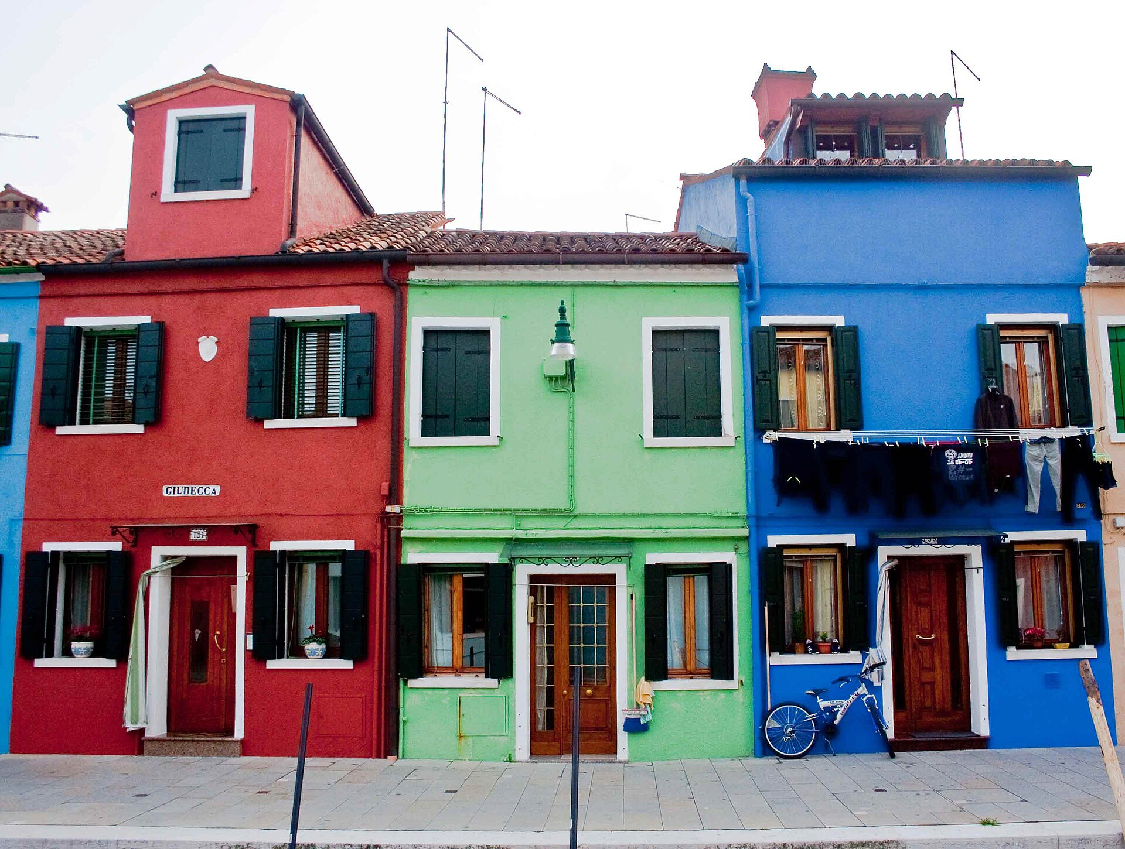
SLOP1512 / WEEK 5
03
From taste to a system
Two photographs, one idea
Chefchaouen restrains itself to one hue family. Burano allows many hues, but a local rule still constrains which colour a house may take. Both are systems: a small, explainable rule set governs every colour decision, rather than choice made independently, slide by slide.
Web Design and Interactive Publishing
Notes:
Both towns look intentional because a rule, not a preference, decided each colour. That is what a token system does for a website.

Slide 4
SLOP1512 / WEEK 5
04
Why tokens, not scattered hex
Name the role, not the colour
A hex code like #C7831A tells CSS what to paint. It says nothing about why. A design token adds a name for the role that colour plays: --color-accent, --color-text, --color-surface.
/* scattered */
h1 { color: #18212A; }
.btn { background: #C7831A; }
.card { border: 1px solid #D7D0C4; }
/* tokenised */
:root {
--color-text: #18212A;
--color-accent: #C7831A;
--color-border: #D7D0C4;
}
h1 { color: var(--color-text); }
.btn { background: var(--color-accent); }
.card { border: 1px solid var(--color-border); }
Web Design and Interactive Publishing
Notes:
Tokens make a rebrand, a dark mode, or a contrast fix a one-line change instead of a find-and-replace across every file.

Slide 5
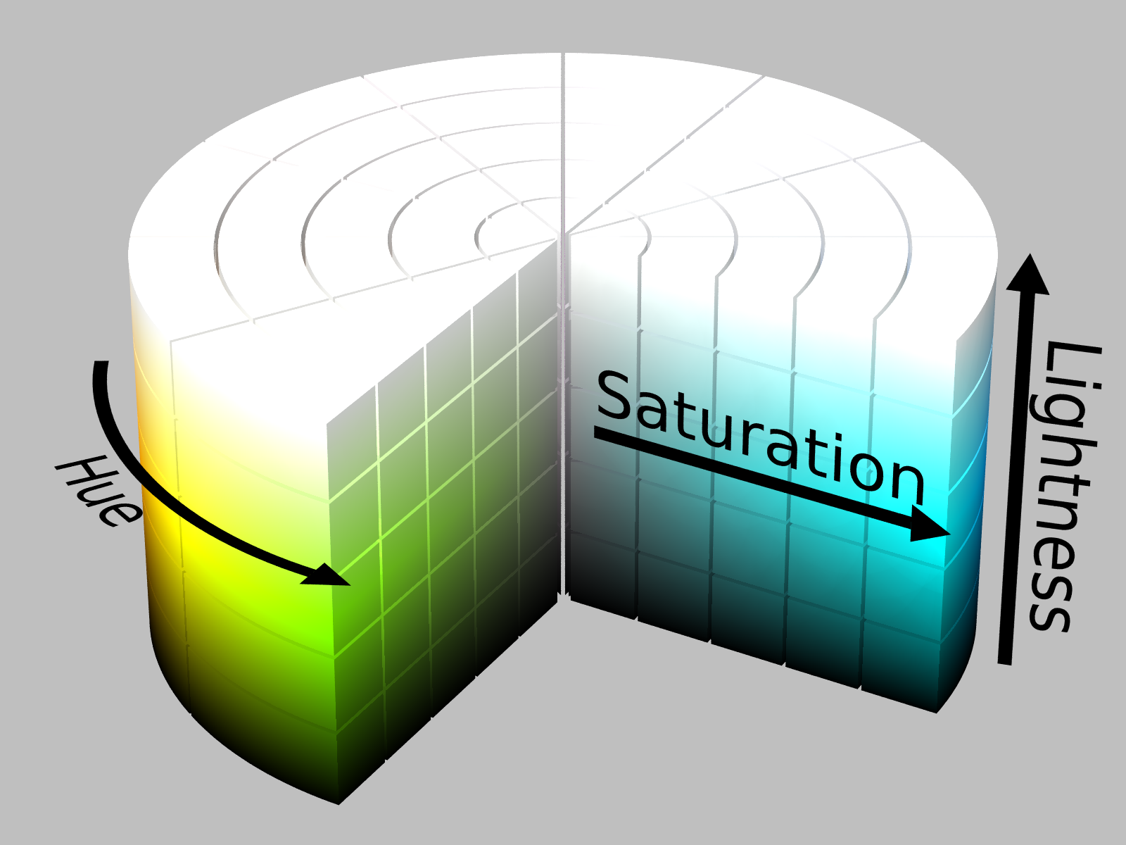
SLOP1512 / WEEK 5
05
HSL vs hex
The same colour, two notations
hsl(36, 77%, 44%) is the SLOP1512 gold token. Hex hides three separate decisions inside six characters; HSL exposes them.
Hue (36°)
Saturation (77%)
Position on the colour wheel. 36° sits between orange and amber.
Colourfulness. High saturation reads as vivid rather than muted.
Lightness (44%)
Why it matters
Distance from black to white. 44% is a mid-dark tone.
Need a lighter accent for dark mode? Raise lightness and keep hue and saturation fixed.
Web Design and Interactive Publishing
Notes:
HSL turns 'make this a bit lighter' from guesswork into a single number change: raise L, leave H and S alone.

Slide 6
SLOP1512 / WEEK 5
06
Design tokens
The SLOP1512 token set
Token
Hex
HSL
Role
--color-ink
#18212A
hsl(210, 27%, 13%)
Primary text, dark surfaces
--color-cream
#F8F5EF
hsl(40, 39%, 95%)
Page background (light)
--color-gold
#C7831A
hsl(36, 77%, 44%)
Accent — never as body text on cream
--color-slate
#43515D
hsl(208, 16%, 31%)
Secondary text, captions
--color-line
#D7D0C4
hsl(38, 19%, 81%)
Borders and rules only
--color-white
#FFFFFF
hsl(0, 0%, 100%)
Cards on dark surfaces
Web Design and Interactive Publishing
Notes:
Every hex value here is real, computed from the actual palette used across this deck's own chrome — nothing is illustrative.

Slide 7
SLOP1512 / WEEK 5
07
WCAG contrast
The maths behind 'readable'
Relative luminance (per sRGB channel c in [0,1]):
c_lin = c / 12.92 if c <= 0.03928
c_lin = ((c + 0.055) / 1.055) ^ 2.4 otherwise
L = 0.2126*R_lin + 0.7152*G_lin + 0.0722*B_lin
Contrast ratio between the lighter and darker of two colours:
contrast = (L_lighter + 0.05) / (L_darker + 0.05)
4.5 : 1
3 : 1
Minimum for normal body text (WCAG 2.1, SC 1.4.3).
Minimum for large text (18pt, or 14pt bold) and for UI components / graphical objects (SC 1.4.11).
Web Design and Interactive Publishing
Notes:
These are not approximations — this is the exact formula a browser's own accessibility tooling runs.

Slide 8
SLOP1512 / WEEK 5
08
Contrast, worked
Which token pairs actually pass?
Pairing
Ratio
4.5:1 text
3:1 large/UI
ink text / cream bg
14.96:1
PASS
PASS
slate text / cream bg
7.50:1
PASS
PASS
gold text / ink bg
5.19:1
PASS
PASS
gold text / cream bg
2.88:1
FAIL
FAIL
gold icon/border / white bg
3.14:1
FAIL
PASS
slate text / ink bg
2.00:1
FAIL
FAIL
Finding: gold must never carry body text on cream (2.88:1). It is safe as text on ink (5.19:1), and safe as a large graphic/UI accent on white (3.14:1) — but not as white-background text.
Web Design and Interactive Publishing
Notes:
This table is the deliverable of a real contrast audit against this course's own brand palette — the kind of check the studio task asks students to repeat on their own tokens.

Slide 9
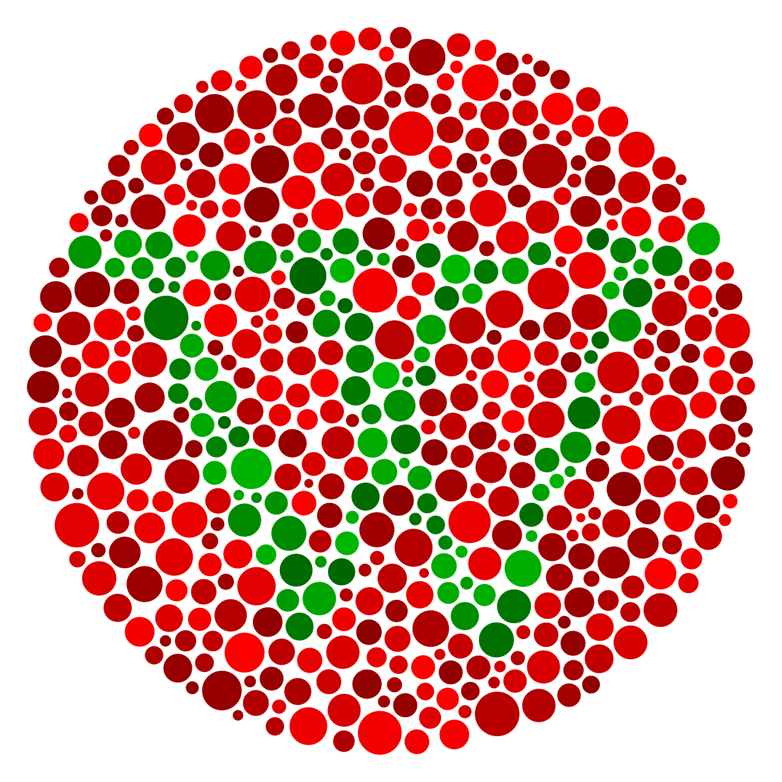
SLOP1512 / WEEK 5
09
Colour-blindness pitfalls
Contrast is not colour vision
Protanopia / deuteranopia
Roughly 1 in 12 men and 1 in 200 women have reduced sensitivity to red or green. Red/green status pairs (error/success) can become indistinguishable.
The trap
A high WCAG contrast ratio only measures lightness difference. Red #C0392B and green #27AE60 can both pass 4.5:1 against white and still look identical to a deuteranope.
The fix
Pair colour with a second channel: an icon, a pattern, an underline, or text ('Error:' / 'Saved') — never colour alone.
Web Design and Interactive Publishing
Notes:
Ask students to check their own studio palette against a colour-blindness simulator, not just a contrast calculator.

Slide 10
SLOP1512 / WEEK 5
10
Case study
Dark-mode tokens: same roles, re-checked
Dark mode is not 'invert everything' — it is re-pointing the same semantic roles at a palette that still passes contrast.
Light mode
Re-checked ratios
Light: text/bg = ink/cream = 14.96:1.
Dark: text/bg = cream/ink = 14.96:1 (same pair, reversed — ratio is symmetric).
Dark muted: line/ink = 10.63:1 — safe for secondary text on dark, unlike slate/ink at 2.00:1.
--color-bg
(cream)
--color-text
(ink)
--color-muted
(slate)
Dark mode
--color-bg
(ink)
--color-text
(cream)
--color-muted
(line)
Web Design and Interactive Publishing
Notes:
The muted token cannot just be reused verbatim between modes — slate looks fine on cream (7.50:1) but fails on ink (2.00:1), so dark mode swaps it for line instead.

Slide 11
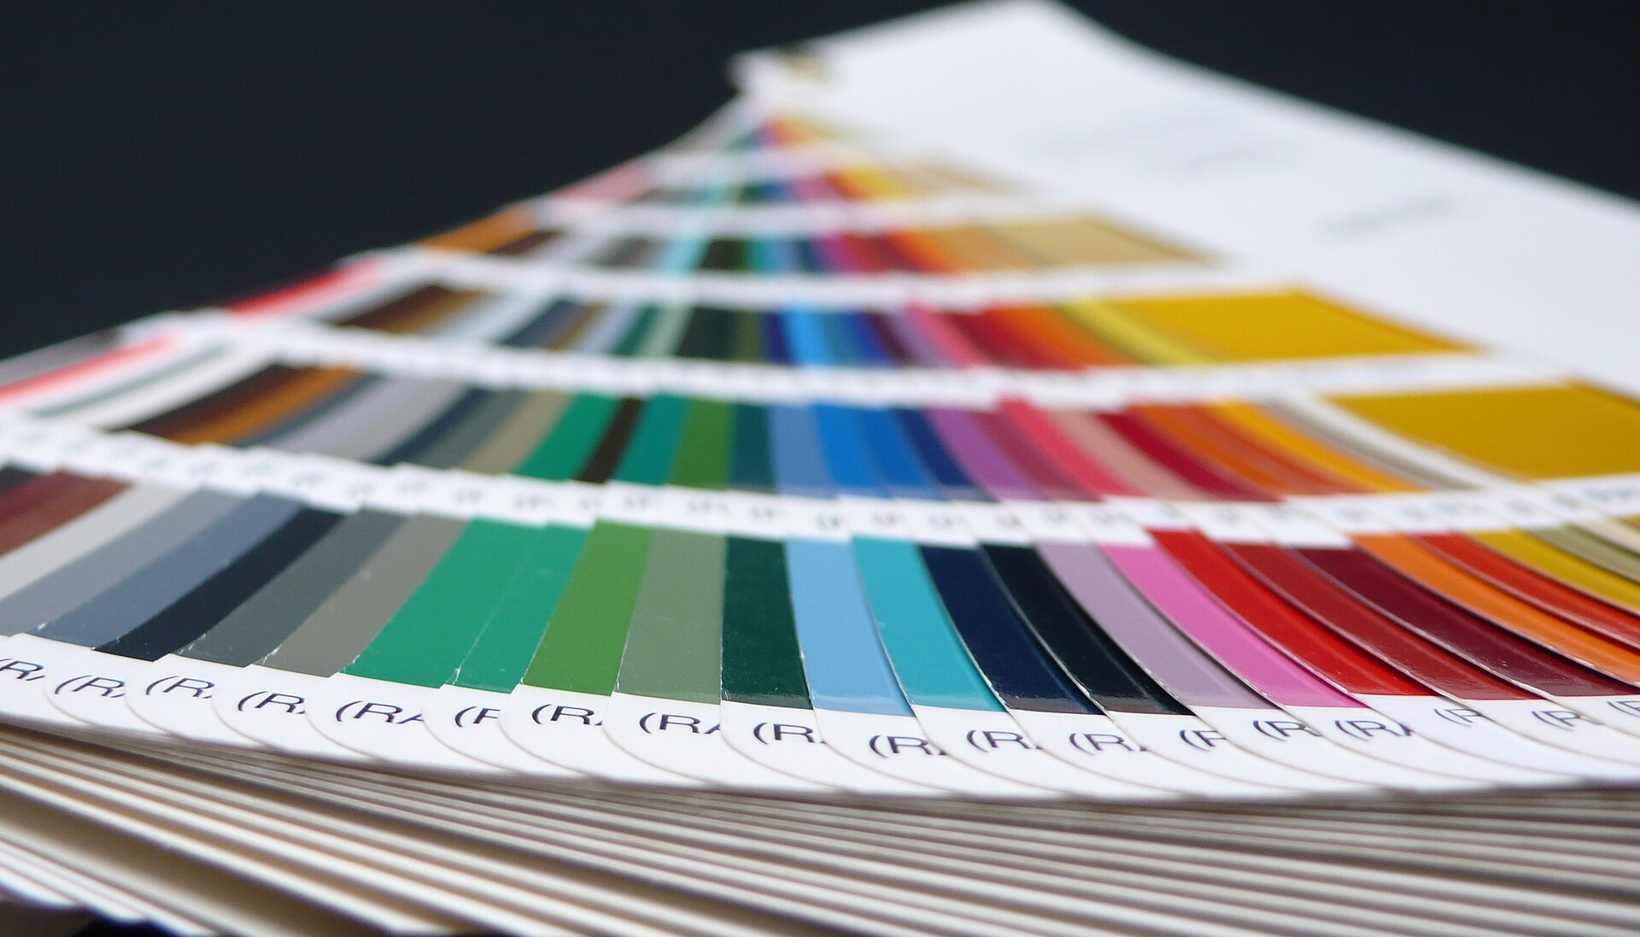
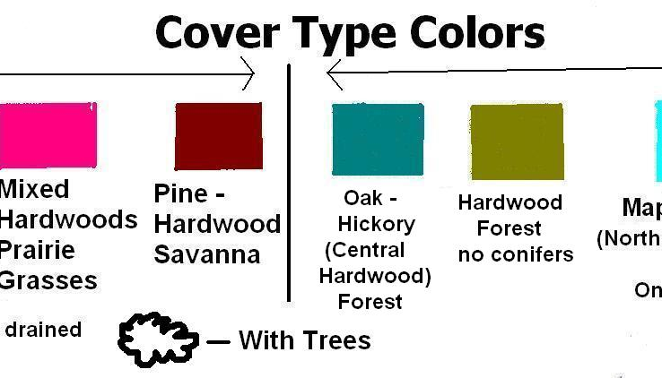
SLOP1512 / WEEK 5
11
Before / after
An unrestrained board vs a token system
Before: any of dozens of hues could appear anywhere, with no way to predict which pairing will occur next. After: exactly the tokens on the table three slides back, and nothing else — every colour decision traces back to one of six names.
Web Design and Interactive Publishing
Notes:
The 'after' image is a stand-in for a token set, not literally the SLOP1512 palette — the point is the discipline of a small, closed list.

Slide 12
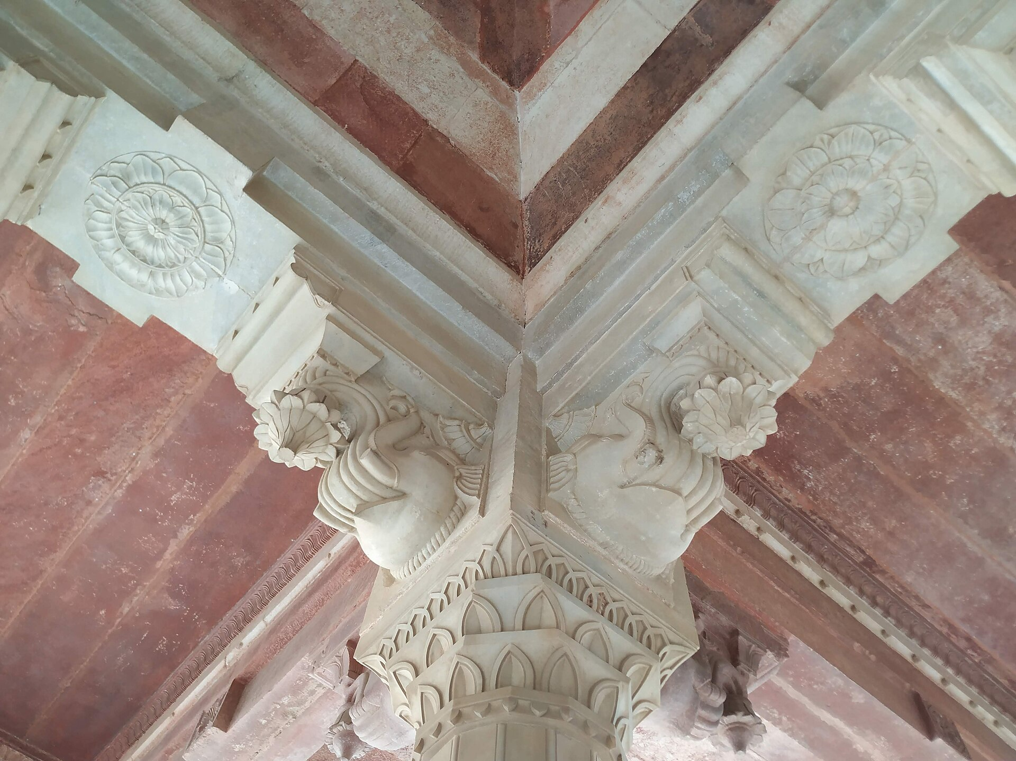
SLOP1512 / WEEK 5
12
Image roles, recapped
Decorative, informative, functional, complex
Decorative
The marble image above carries no information a reader needs — alt="" and it is skipped by assistive technology.
Informative
The HSL cylinder diagram earlier this deck communicates real content — its alt text described hue, saturation and lightness.
Functional images (icon-only buttons) describe the action they trigger. Complex images (charts, diagrams with detail) need a short alt plus a longer text description nearby.
Web Design and Interactive Publishing
Notes:
Marble here is a genuine decorative photograph — nothing on this slide requires knowing what the marble looks like.

Slide 13
SLOP1512 / WEEK 5
13
Crop and fit
object-fit and aspect-ratio
.card-media {
aspect-ratio: 16 / 9;
width: 100%;
object-fit: cover;
object-position: 50% 30%;
}
aspect-ratio
object-fit: cover
Reserves the box's shape before the image loads. Prevents the surrounding layout from resizing when the file arrives.
Fills the box, cropping overflow. object-position chooses which part of the image survives the crop.
Web Design and Interactive Publishing
Notes:
aspect-ratio and object-fit solve two different problems: one reserves space, the other decides what gets cropped once space is reserved.

Slide 14
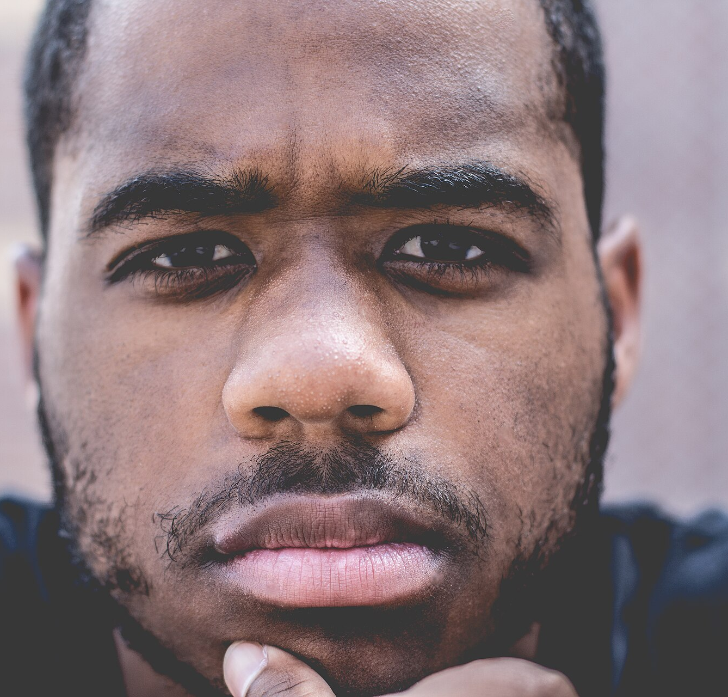
SLOP1512 / WEEK 5
14
Crop decisions
Portrait crop: keep the subject, lose the noise
The rule
Crop so the eyes sit on the upper third line, not the exact centre. A face-safe crop keeps eyes, not the chin or hairline, as the anchor point when the box is later resized.
img.avatar-wide {
aspect-ratio: 4 / 5;
object-fit: cover;
object-position: 50% 20%;
}
Web Design and Interactive Publishing
Notes:
object-position 50% 20% keeps the crop anchored near the top of the frame, which is where a face-safe crop usually needs it.

Slide 15
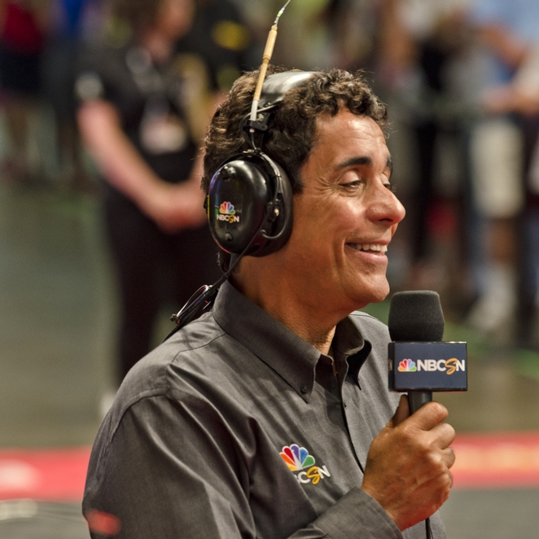
SLOP1512 / WEEK 5
15
Crop decisions
Square avatar: a tighter ratio, same logic
Why square is harder
A 1:1 crop leaves less room than 4:5 — the same face-safe rule now has to compete with cropping in from both sides, not just top and bottom.
img.avatar-square {
aspect-ratio: 1 / 1;
object-fit: cover;
object-position: 50% 25%;
}
Same object-position idea, moved slightly further up to compensate for the narrower box.
Web Design and Interactive Publishing
Notes:
Compare this slide to the previous one: the crop rule generalises, but the exact object-position number still needs to be tuned per aspect ratio.

Slide 16
SLOP1512 / WEEK 5
16
Responsive images
srcset and sizes
<img
src="hero-800.jpg"
srcset="hero-480.jpg 480w,
hero-800.jpg 800w,
hero-1600.jpg 1600w"
sizes="(min-width: 60em) 33vw, 100vw"
alt="…">
How the browser decides
srcset lists candidate files with their real pixel width (480w). sizes tells the browser how wide the image will actually be laid out at the current viewport, so it can pick the smallest file that is still sharp enough — before it knows the final layout.
Web Design and Interactive Publishing
Notes:
srcset offers choices; sizes tells the browser which choice it needs. Without sizes, the browser assumes 100vw and over-downloads on narrow layouts.

Slide 17
SLOP1512 / WEEK 5
17
Responsive images
picture/source: art direction and modern formats
<picture>
<source type="image/avif" srcset="hero.avif">
<source type="image/webp" srcset="hero.webp">
<img src="hero.jpg" alt="…" width="1600" height="900">
</picture>
Format fallback
Art direction
The browser picks the first <source> it can decode. AVIF and WebP are typically 25-50% smaller than JPEG at equal visual quality; the <img> is the guaranteed fallback.
picture/source can also swap to a different crop (not just a format) at a breakpoint — a portrait crop on mobile, a wide crop on desktop, from the same <img> alt text.
Web Design and Interactive Publishing
Notes:
srcset/sizes solves resolution switching for one image; picture/source solves format switching and art direction across genuinely different files.

Slide 18
SLOP1512 / WEEK 5
18
Cumulative Layout Shift
Reserve the space before the image loads
Layout shift score = impact fraction × distance fraction
Example: an image box covers 60% of the viewport.
It loads late and pushes content down by 180px in a 900px viewport.
impact fraction = 0.60
distance fraction = 180 / 900 = 0.20
layout shift score = 0.60 * 0.20 = 0.12
The fix
Give the <img> explicit width and height attributes (or a CSS aspect-ratio). The browser then reserves 180px of space immediately, so impact fraction on load becomes 0 and no shift occurs — a single score of 0.12 already exceeds the 0.1 'good' CLS threshold, so this is not a minor issue.
Web Design and Interactive Publishing
Notes:
This is the same aspect-ratio idea from the object-fit slide, now justified by an actual CLS score rather than just 'it looks nicer'.

Slide 19
SLOP1512 / WEEK 5
19
Alt text
A decision tree before you write anything
Role
Alt text rule
Example
Decorative
alt="" (empty, but present)
Background texture, marble photo
Informative
Describe what a sighted reader learns
"HSL colour model shown as a cylinder…"
Functional
Describe the action, not the picture
"Search" for a magnifying-glass icon button
Complex
Short alt + adjacent long description
A chart: alt names the trend, caption gives the data
Web Design and Interactive Publishing
Notes:
Decide the role first. The wrong alt text for the right role (or the right words for the wrong role) both fail users.

Slide 20
SLOP1512 / WEEK 5
20
Alt text, worked
Four of this deck's own images
Image
Role
Alt text used in this deck
Chefchaouen street
Informative
"Narrow street in Chefchaouen, Morocco, its walls and stairs painted in closely related shades of blue."
Ishihara plate
Informative
"Ishihara colour-vision test plate: a numeral formed from dots that share lightness but differ in hue…"
HSL cylinder diagram
Informative
"Diagram of the HSL colour model drawn as a cylinder: hue around the rim, saturation from centre outward, lightness bottom to top."
Marble close-up
Decorative
alt="" — the image is used only as visual texture on the image-roles slide
Web Design and Interactive Publishing
Notes:
Every alt text on this row is the literal string used earlier in this deck — not a hypothetical example.

Slide 21
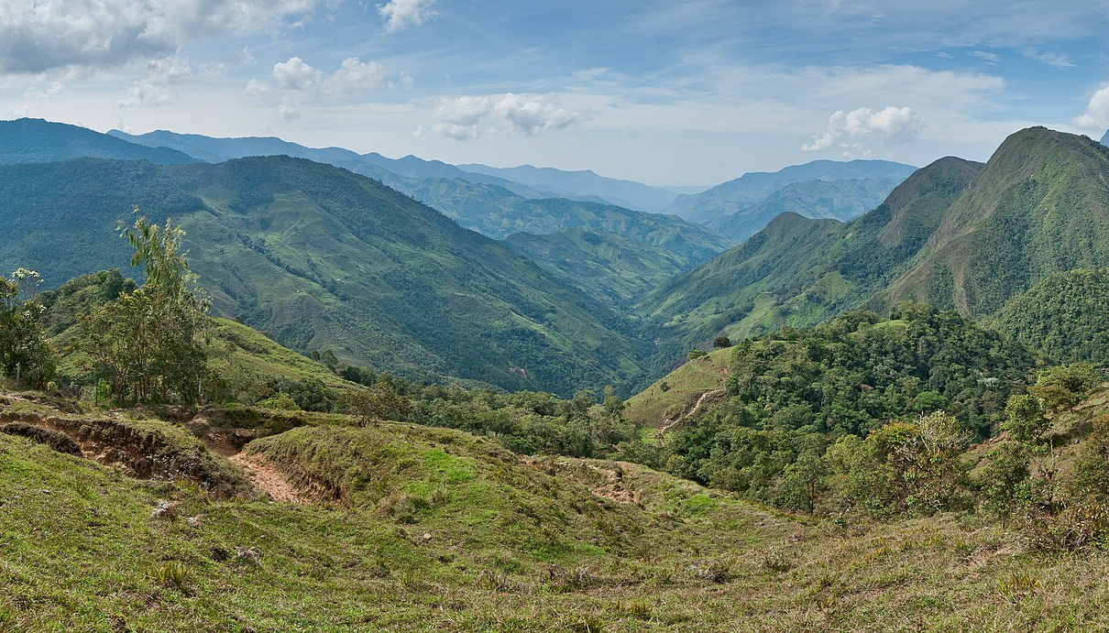
SLOP1512 / WEEK 5
21
Alt text for identity imagery
Hero and brand images are still informative
The temptation
Hero banners feel decorative, so it is tempting to leave alt="". But if the image sets the tone for the page (a course, a brand, a place), a screen-reader user loses that context entirely.
Write alt text that names the scene, the way a caption would — not a mood ('breathtaking view'), and not a repeat of the heading text next to it.
Web Design and Interactive Publishing
Notes:
The test: if you removed this image, would a sighted reader lose information the alt text should replace? For a true hero image, usually yes.

Slide 22
SLOP1512 / WEEK 5
22
Identity
Logo and brand-mark treatment rules
Clear space
Minimum size
Reserve a margin around the mark at least equal to the height of its own smallest element. Never let text or other graphics enter that margin.
Below a stated minimum width, fine details in a mark disappear or merge. State the minimum in the brand guide, not by trial and error each time.
Do not recolour
Contrast against backgrounds
A mark's colours are part of its identity. Recolouring it to 'match the page' undermines the one thing a logo is supposed to do: stay recognisable.
Provide light and dark variants of the mark rather than placing one variant on a background it was not designed for — apply the same 3:1 UI-component threshold from earlier.
Web Design and Interactive Publishing
Notes:
These four rules are why brand guides exist as documents, not folklore passed between designers.

Slide 23
SLOP1512 / WEEK 5
23
Studio task
Build your own restrained system
Part 1 — tokens
Define 5-7 semantic colour tokens (not raw hex scattered through your CSS). Check every text/background pairing you actually use against the correct WCAG threshold (4.5:1 body text, 3:1 large text/UI). Provide both a light and a dark variant.
Part 2 — images
Select two real images for your own page. For each: state its role (decorative/informative/functional/complex), choose a crop and aspect-ratio with a stated reason, and write alt text that matches its role.
Part 3 — evidence
Record: the token table with hex + HSL + contrast ratio; the source, licence and access date for each image; and the final alt text you chose, with one sentence justifying it.
Web Design and Interactive Publishing
Notes:
This mirrors exactly the two halves of this week's topic — a token system you can defend with numbers, and two images you can defend with a stated role.

Slide 24
SLOP1512 / WEEK 5
24
Studio task
Rubric
Criterion
What passes
Token discipline
5-7 named tokens used consistently; no stray hex values in the final CSS
Contrast evidence
Every real text/background pairing checked against the correct threshold, with the ratio shown
Crop justification
Aspect-ratio and object-position chosen for a stated reason, not left at defaults
Alt text fit
Alt text matches the declared role (decorative/informative/functional/complex)
Source record
Licence, author and access date recorded for every real image used
Web Design and Interactive Publishing
Notes:
Use this rubric literally when reviewing studio submissions this week.

Slide 25
SLOP1512 / WEEK 5
25
Source record
Images used in this deck (1 of 2)
File / local name
Wikimedia Commons source
Licence · author
w5-chefchaouen.jpg
Chefchaouen, Morocco (Unsplash).jpg
https://commons.wikimedia.org/wiki/File:Chefchaouen,_Morocco_(Unsplash).jpg
CC0 1.0 Universal · Azer Koçulu
w5-burano.jpg
Burano Houses (8492557865).jpg
https://commons.wikimedia.org/wiki/File:Burano_Houses_(8492557865).jpg
CC BY 2.0 · Paul VanDerWerf
w5-hsl-cylinder.png
HSL color solid cylinder saturation gray.png
https://commons.wikimedia.org/wiki/File:HSL_color_solid_cylinder_saturation_gray.png
CC BY-SA 3.0 · SharkD
w5-ishihara.png
Ishihara-Test.svg
https://commons.wikimedia.org/wiki/File:Ishihara-Test.svg
CC BY-SA 3.0 · Dan-yell
w5-face-portrait.jpg
Face portrait (Unsplash).jpg
https://commons.wikimedia.org/wiki/File:Face_portrait_(Unsplash).jpg
CC0 1.0 Universal · William Stitt
w5-headshot.jpg
Headshot.jpg
https://commons.wikimedia.org/wiki/File:Headshot.jpg
CC0 1.0 Universal · John A. Hollansworth Jr.
All images accessed 13 September 2026. Continued on next slide.
Web Design and Interactive Publishing
Notes:
First six of eleven sourced images, each independently verified against its Wikimedia Commons file page before download.

Slide 26
SLOP1512 / WEEK 5
26
Source record
Images used in this deck (2 of 2)
File / local name
Wikimedia Commons source
Licence · author
w5-rainbow-swatches.jpg
RAL Color Card (2354626166).jpg
https://commons.wikimedia.org/wiki/File:RAL_Color_Card_(2354626166).jpg
CC BY-SA 2.0 · CoCreatr
w5-farrowball-grey.jpg
Minnesota ten color palat september wiki version.jpeg
https://commons.wikimedia.org/wiki/File:Minnesota_ten_color_palat_september_wiki_version.jpeg
CC BY-SA 3.0 · Firry Floyd
w5-marble.jpg
A Close-Up of an Intricate Marble Pillar.jpg
https://commons.wikimedia.org/wiki/File:A_Close-Up_of_an_Intricate_Marble_Pillar.jpg
CC BY-SA 4.0 · Pim58
w5-andes-panorama.jpg
Andes mountains panoramic view.jpg
https://commons.wikimedia.org/wiki/File:Andes_mountains_panoramic_view.jpg
CC BY-SA 3.0 / GFDL · Paolo Costa Baldi
w5-workspace.jpg
Laptop and coffee on a desk.jpg
https://commons.wikimedia.org/wiki/File:Laptop_and_coffee_on_a_desk.jpg
CC0 1.0 Universal · Lauren Mancke
All images accessed 13 September 2026. 11 distinct images in total, all placed as slide images in this deck.
Web Design and Interactive Publishing
Notes:
Remaining five of eleven sourced images. Every file was independently verified against its Commons licence tag before use, mirroring the source-record discipline this course asks of students.

Slide 27
SLOP1512 / WEEK 5
27
Review
Checklist and next week
Before you ship
Next week
Every colour in your CSS traces to a named token.
Every text/background pairing you use passes 4.5:1 (or 3:1 for large text/UI).
No status or meaning relies on colour alone.
Every image has a stated role and alt text that matches it.
Every real photo has a recorded source, licence and access date.
Typography and layout rhythm: how type scale, spacing and grid extend the same token discipline from colour into every other visual decision on the page.
Web Design and Interactive Publishing
Notes:
Close by connecting back to Week 2's semantic-HTML foundation and forward to next week's type system — colour is one token category among several.

