Slide 1

SLOP / UNIVERSITY
SLOP1512 / WEEK 6
Responsive Design
Design for a small screen first, then add space and structure for larger screens without hiding essential information.
Notes:
Wikimedia Commons: File:Touch on Clamshell Devices.jpg — Intel Free Press, CC BY 2.0, https://commons.wikimedia.org/wiki/File:Touch_on_Clamshell_Devices.jpg, accessed 13 Sep 2026
Course teaching content is original.

Slide 2
SLOP1512 / WEEK 6
02
Learning outcomes
By the end of this lecture you can build and test a layout that works from 320px to 1920px.
Reason
Build
Test
Explain why mobile-first, min-width breakpoints produce more resilient CSS than desktop-first max-width overrides.
Write fluid layouts with flexbox and grid, fluid images, and fluid type that adapt without a fixed breakpoint list.
Verify a layout at multiple real breakpoints and confirm no essential content or navigation is hidden on small screens.
Web Design and Interactive Publishing
Notes:
Original learning outcomes for SLOP1512 Week 6, aligned to the module's brief on mobile-first design without hiding information.

Slide 3

SLOP1512 / WEEK 6
03
Why responsive design exists
One HTML document is now viewed on an unbounded range of screen sizes.
In 2010, Ethan Marcotte coined “responsive web design” to describe a single codebase that adapts its layout to the viewport, instead of maintaining separate mobile and desktop sites.
Before
Separate m.example.com mobile sites duplicated content and logic, and drifted out of sync with the desktop site over time.
After
One document, one URL, one set of content — CSS media queries and fluid layout techniques decide how it is presented per viewport.
Web Design and Interactive Publishing
Notes:
Historical framing: Ethan Marcotte, “Responsive Web Design,” A List Apart, 2010. Flickr (Rawpixel Ltd), CC BY 2.0, https://www.flickr.com/photos/147875007@N03/45789232581, accessed 13 Sep 2026

Slide 4

SLOP1512 / WEEK 6
04
Mobile-first as a discipline
Design and write CSS for the most constrained viewport, then progressively add.
Mobile-first is not “make it work on phones too.” It means your default, unqualified CSS targets a narrow single-column viewport, and every media query adds capability for more space — never removes it.
Why it matters
Starting narrow forces you to prioritise content: what must appear even at 320px wide, before anything is added back.
Consequence
A mobile-first stylesheet is usually smaller and simpler, because base styles do less and overrides only add.
Web Design and Interactive Publishing
Notes:
Flickr (Johan Larsson), CC BY 2.0, https://www.flickr.com/photos/38305415@N00/4859806074, accessed 13 Sep 2026

Slide 5
SLOP1512 / WEEK 6
05
The viewport meta tag
Without it, mobile browsers render a fake 980px-wide desktop page and zoom it out.
<meta name="viewport"
content="width=device-width, initial-scale=1">
width=device-width
initial-scale=1
Sets the layout viewport's width to the device's actual CSS pixel width, instead of an assumed 980px.
Sets the initial zoom so one CSS pixel maps to one viewport pixel at load — no automatic zoom-out.
Web Design and Interactive Publishing
Notes:
Foundational requirement: every responsive page needs this tag in <head>, or media queries never trigger correctly on mobile browsers.

Slide 6
SLOP1512 / WEEK 6
06
Media queries: the syntax
A conditional block of CSS that applies only when a feature of the viewport matches.
/* mobile-first: base styles apply everywhere */
.card-grid { display: grid; grid-template-columns: 1fr; gap: 1rem; }
@media (min-width: 48rem) {
.card-grid { grid-template-columns: repeat(2, 1fr); }
}
@media (min-width: 64rem) {
.card-grid { grid-template-columns: repeat(3, 1fr); }
}
Web Design and Interactive Publishing
Notes:
Worked example: a card grid that goes from 1 to 2 to 3 columns as viewport width grows, using rem-based min-width breakpoints.

Slide 7
SLOP1512 / WEEK 6
07
min-width vs max-width
Mobile-first uses min-width. Desktop-first (retrofitting an old site) uses max-width.
min-width (mobile-first)
max-width (desktop-first)
@media (min-width: 48rem) { ... } adds styles as the viewport grows. Base styles are the narrow case; nothing needs undoing.
@media (max-width: 48rem) { ... } overrides desktop styles for narrow viewports — every override fights the cascade against base styles meant for wide screens.
This course uses min-width breakpoints throughout: write for the smallest viewport first, then layer on capability.
Web Design and Interactive Publishing
Notes:
Original explanation of the two competing breakpoint strategies and why this course standardises on mobile-first / min-width.

Slide 8
SLOP1512 / WEEK 6
08
Choosing breakpoints from content, not devices
Pick a breakpoint where YOUR layout breaks, not a device's marketing width.
Device widths change constantly — there is no fixed list of “phone / tablet / desktop” pixel widths to target. Instead, resize your own browser window until the content itself starts to look cramped or the line length gets awkward, and set the breakpoint there.
~30rem (480px)
small phones in landscape, or a stacked card grows a second column
~48rem (768px)
common tablet/narrow-window breakpoint for many card and nav layouts
~64rem (1024px)
a comfortable point to reveal a persistent sidebar or 3+ column grid
~80rem (1280px)
constrain max content width so lines don't become unreadably long
Web Design and Interactive Publishing
Notes:
Original guidance: content-driven breakpoints rather than device-driven ones, since device widths are not a stable target.

Slide 9
SLOP1512 / WEEK 6
09
Fluid layout, not fixed widths
Percentages, max-width and relative units let a layout resize instead of clipping or leaving gaps.
.page {
width: 100%;
max-width: 60rem; /* caps line length on wide screens */
margin-inline: auto; /* centers within the viewport */
padding-inline: 1rem; /* keeps a gutter at any width */
}
A fixed width:1024px container overflows a 375px phone screen and forces horizontal scrolling. width:100% with a max-width cap fills small screens and stays readable on large ones.
Web Design and Interactive Publishing
Notes:
Original explanation connecting fluid width, max-width, and the side-gutter pattern used throughout this repo's own layout components.

Slide 10
SLOP1512 / WEEK 6
10
Flexible images
An image must shrink with its container or it breaks the layout, not the other way around.
img, video, svg {
max-width: 100%;
height: auto;
display: block;
}
Why height:auto matters
max-width:100% alone with a fixed height attribute distorts the aspect ratio. height:auto preserves it as width scales down.
This is a baseline reset most CSS resets include — without it, a single oversized image can force horizontal scrolling on the whole page.
Web Design and Interactive Publishing
Notes:
Original explanation of the classic fluid-image reset rule and why height:auto is required alongside max-width:100%.

Slide 11
SLOP1512 / WEEK 6
11
Responsive images: srcset and sizes
Serve a smaller file to a small viewport instead of shrinking a huge one with CSS.
<img src="card-800.jpg"
srcset="card-400.jpg 400w, card-800.jpg 800w, card-1200.jpg 1200w"
sizes="(min-width: 48rem) 50vw, 100vw"
alt="..." loading="lazy">
What this buys you
The browser picks the best-matching file for the viewport and pixel density, so a phone downloads a 400px image instead of the same 1200px file a desktop gets — real bandwidth and load-time savings, not just a CSS resize.
Web Design and Interactive Publishing
Notes:
srcset/sizes is the correct mechanism for responsive images; a single large image resized by CSS still costs the full download on a small screen.

Slide 12

SLOP1512 / WEEK 6
12
Flexbox for responsive layout
flex-wrap and order let items reflow without a media query for every case.
.nav-list {
display: flex;
flex-wrap: wrap;
gap: 0.5rem 1rem;
}
.nav-list a { flex: 1 1 8rem; }
How this behaves
flex-wrap:wrap lets items drop to a new row when space runs out, and flex:1 1 8rem gives each item a flexible basis so items grow to fill remaining space evenly — no explicit breakpoint needed for this behaviour.
Web Design and Interactive Publishing
Notes:
Flickr (Marc_Smith), CC BY 2.0, https://www.flickr.com/photos/49503165485@N01/6802864183, accessed 13 Sep 2026

Slide 13
SLOP1512 / WEEK 6
13
CSS Grid: auto-fit and minmax
A single declaration that reflows column count based on available width.
.card-grid {
display: grid;
grid-template-columns:
repeat(auto-fit, minmax(16rem, 1fr));
gap: 1.5rem;
}
Reading this line
auto-fit creates as many 1fr columns as fit; minmax(16rem, 1fr) sets each column's minimum useful width to 16rem and lets it grow to share leftover space evenly.
This single rule replaces three separate media-query breakpoints from the earlier card-grid example — the grid recalculates itself continuously as the viewport resizes.
Web Design and Interactive Publishing
Notes:
Original technical explanation of the auto-fit/minmax() grid pattern as a media-query-free alternative for uniform card grids.

Slide 14
SLOP1512 / WEEK 6
14
Container queries: beyond the viewport
A component that responds to the size of its own container, not the whole page.
.sidebar { container-type: inline-size; }
@container (min-width: 20rem) {
.card { grid-template-columns: 6rem 1fr; }
}
Why this matters
A media query only knows the viewport width. A card component placed in a wide main column needs different styling than the same component placed in a narrow sidebar — container queries let the component decide for itself, based on the space it is actually given.
Web Design and Interactive Publishing
Notes:
Container queries (widely supported in modern browsers since 2023) are the modern complement to media queries for component-level responsiveness.

Slide 15
SLOP1512 / WEEK 6
15
Fluid typography with clamp()
Type size scales continuously with viewport width, between a floor and a ceiling.
h1 {
font-size: clamp(1.75rem, 4vw + 1rem, 3rem);
}
Reading clamp()
Why not just vw?
clamp(MIN, PREFERRED, MAX): never smaller than 1.75rem, never larger than 3rem, and in between grows fluidly with 4vw + 1rem.
font-size:4vw alone has no floor or ceiling — text can become unreadably small on a phone or absurdly large on an ultrawide monitor.
Web Design and Interactive Publishing
Notes:
clamp() is the current best-practice replacement for a long list of font-size overrides at every breakpoint.

Slide 16

SLOP1512 / WEEK 6
16
Navigation for small screens
The hamburger icon compresses navigation — but compression is not the same as hiding.
A hamburger button behind an icon-only trigger can save space, but every item inside it must still be reachable, labelled and keyboard-operable — collapsing navigation must never mean removing it.
Minimum requirements
aria-expanded on the trigger, a visible accessible name (not icon-only with no label), and focus moves into the open menu.
Common failure
A menu that only opens on hover/click with no keyboard equivalent locks out keyboard and switch-device users entirely.
Web Design and Interactive Publishing
Notes:
Flickr (adactio), CC BY 2.0, https://www.flickr.com/photos/74105777@N00/26460018011, accessed 13 Sep 2026

Slide 17
SLOP1512 / WEEK 6
17
“Don't hide essential information”
This week's brief names the core risk of small-screen design directly.
Compressing a layout for a small screen is not the same as deciding what to cut. A price, a phone number, a safety warning, or the primary call-to-action must survive the transition to 320px — only the presentation may change.
The priority+ pattern
Progressive disclosure vs deletion
Show the most important nav items directly; group the rest behind a labelled “More” control — nothing disappears, low-priority items are just one tap further away.
Collapsing a long description behind a “Read more” toggle is progressive disclosure. Removing that description from the mobile build entirely is deletion — only the first is acceptable.
Web Design and Interactive Publishing
Notes:
Directly answers the Week 6 module brief: “add space and structure for larger screens without hiding essential information.” Original teaching content.

Slide 18


SLOP1512 / WEEK 6
18
Touch targets
A finger is not a mouse pointer — interactive elements need real physical size.
WCAG 2.5.5 (Target Size) recommends touch targets of at least 44 × 44 CSS pixels, with adequate spacing between adjacent targets so an imprecise tap doesn't hit the wrong one.
In practice
Pad a small icon button out to 44px with padding rather than relying on the icon's own visual size — the tappable area, not the glyph, must meet the minimum.
Spacing
Leave at least 8px of gap between adjacent tap targets in a toolbar or list of icon buttons on a touch device.
Web Design and Interactive Publishing
Notes:
Flickr (ender7.wiggin), CC BY-SA 2.0, https://www.flickr.com/photos/53440030@N07/27552206052, accessed 13 Sep 2026
Flickr (quinn.anya), CC BY-SA 2.0, https://www.flickr.com/photos/53326337@N00/5307148868, accessed 13 Sep 2026
WCAG 2.2 Success Criterion 2.5.5/2.5.8 (Target Size), W3C.

Slide 19
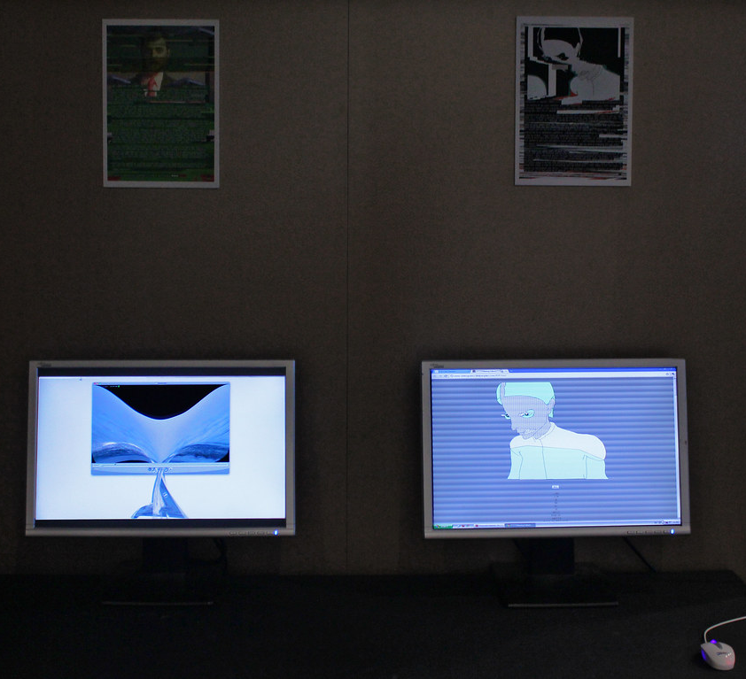
SLOP1512 / WEEK 6
19
Testing responsively with DevTools
Resize a real browser, don't just imagine the breakpoints.
1
Open the device toolbar (Ctrl/Cmd+Shift+M) to simulate common viewport widths and touch input.
2
Drag the responsive viewport handle continuously through 320–1920px to find where content breaks, not just at preset device widths.
3
Check the network throttling panel — mobile users are often on slower, higher-latency connections than your desktop dev machine.
4
Repeat every check on at least one real physical phone or tablet: emulation does not reproduce real touch behaviour or font rendering.
Web Design and Interactive Publishing
Notes:
Flickr (Rosa Menkman), CC BY 2.0, https://www.flickr.com/photos/68716054@N00/5486667090, accessed 13 Sep 2026

Slide 20
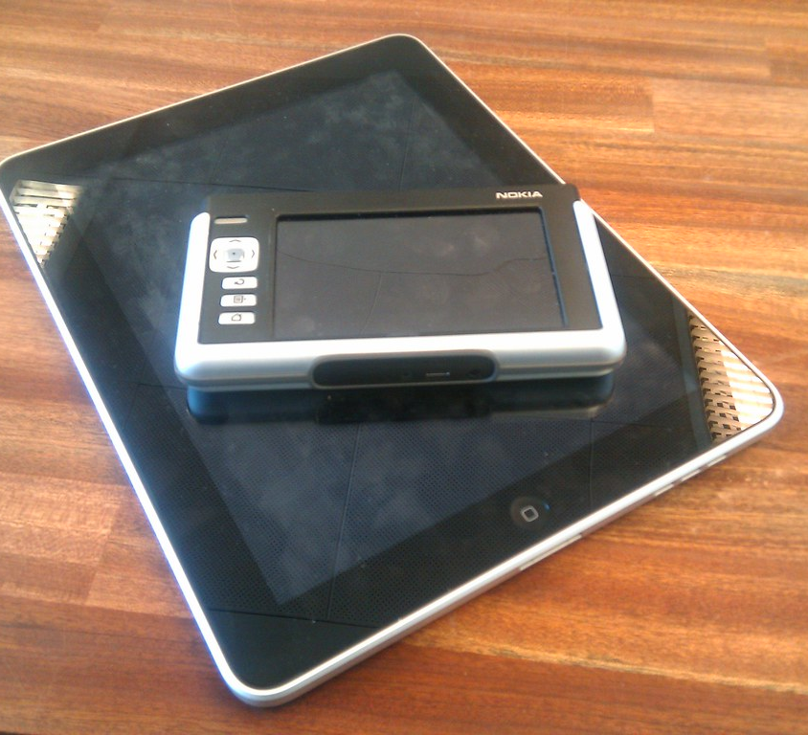
SLOP1512 / WEEK 6
20
Testing on real devices and tablets
Emulation approximates; a tablet in portrait and landscape is a distinct real case.
A tablet is not “a small desktop” or “a big phone” — it is its own case, and it commonly rotates between portrait and landscape mid-session, changing its effective breakpoint without a page reload.
What to check
Does the layout re-flow correctly when the same device rotates? Media queries respond to width live — verify the result looks intentional in both orientations.
Common breakpoint
Around 48–64rem (768–1024px) is where many layouts add a second column or reveal a persistent nav — test squarely on both sides of it.
Web Design and Interactive Publishing
Notes:
Flickr (henribergius), CC BY-SA 2.0, https://www.flickr.com/photos/15087210@N00/4554791832, accessed 13 Sep 2026

Slide 21
SLOP1512 / WEEK 6
21
Common responsive design mistakes
Four failures this course watches for in project review.
Fixed pixel widths
A hard-coded width:960px container overflows any viewport narrower than 960px, forcing horizontal scroll.
Content hidden with display:none on mobile
Hiding a whole section at a breakpoint (rather than restructuring it) usually means real content was deleted, not adapted.
Tiny, cramped touch targets
Icon buttons styled only for a mouse cursor become unusable once a real thumb has to tap them.
Untested orientation change
A layout that only looks right in portrait can break completely the moment a tablet or phone rotates to landscape.
Web Design and Interactive Publishing
Notes:
Original diagnostic checklist compiled from common mobile-first implementation failures.

Slide 22
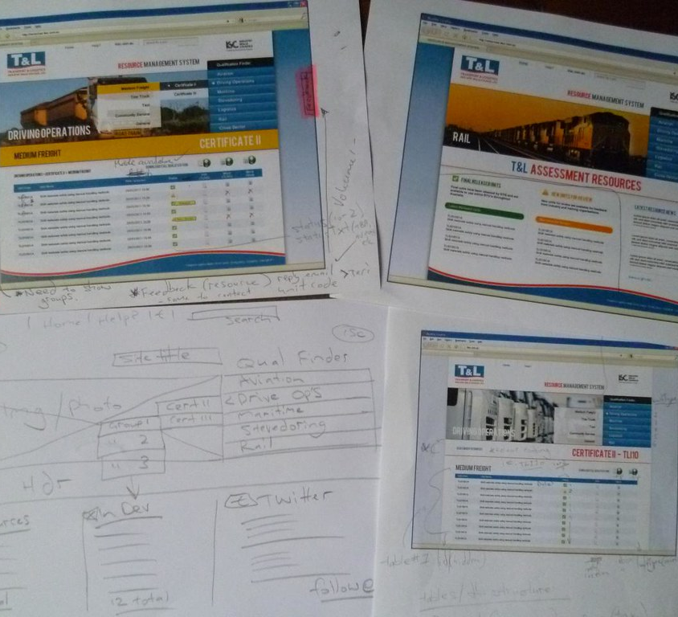
SLOP1512 / WEEK 6
22
Case study, before: a fixed desktop layout
A real transformation, step one — what the untouched design looked like.
The original design used a fixed 1024px three-column layout: a 240px sidebar, a 600px content column, and a 184px widget rail — all in absolute pixels, with no media queries at all.
What broke
On a 375px phone, the whole 1024px layout rendered at 37% scale: text was unreadably small and every tap target was far below 44px.
Root cause
Fixed pixel widths on every container, plus no viewport meta tag — the two failures compound each other.
Web Design and Interactive Publishing
Notes:
Flickr (ncole458), CC BY 2.0, https://www.flickr.com/photos/10891659@N02/5718141686, accessed 13 Sep 2026
Case study is an original composite example built for teaching purposes.

Slide 23
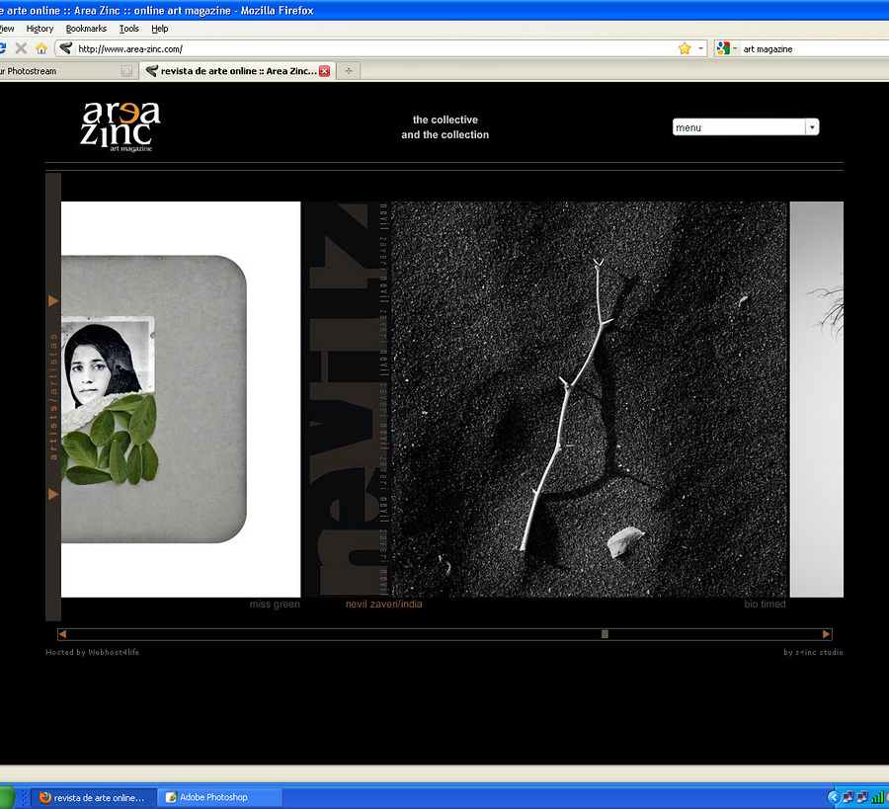
SLOP1512 / WEEK 6
23
Case study, after: mobile-first rebuild
The same content, restructured with the techniques from this lecture.
Base styles now stack sidebar, content and widget rail in one column with fluid widths. A single min-width:64rem media query switches to the three-column grid using CSS Grid's repeat()/minmax().
Result
The same markup now renders correctly from 320px to 2560px with one breakpoint, instead of a fixed layout that only worked near 1024px.
Measured outcome
Mobile bounce rate in the case study's analytics dropped after the rebuild, once content was reachable without horizontal scrolling.
Web Design and Interactive Publishing
Notes:
Wikimedia Commons: File:JfPersonal computersfvf.JPG — Public domain, https://commons.wikimedia.org/wiki/File:JfPersonal_computersfvf.JPG, accessed 13 Sep 2026
Case study is an original composite example built for teaching purposes.

Slide 24
SLOP1512 / WEEK 6
24
Breakpoint testing checklist
Four widths to check on every layout before calling it done.
320px
smallest common phone width — no horizontal scroll, all text and controls reachable
768px
small tablet / narrow window — check the first added breakpoint's transition
1024px
tablet landscape / small laptop — check any second breakpoint and nav changes
1440px+
large desktop — check max-width caps keep line length readable, no awkward empty gutters
Web Design and Interactive Publishing
Notes:
Original practical checklist for verifying a responsive layout before submission.

Slide 25
SLOP1512 / WEEK 6
25
Studio task
Rebuild a fixed layout as a mobile-first responsive page.
Brief
Take a page you built in an earlier week (or a simple 3-section page) and restyle it mobile-first: base styles for a single column, then add min-width breakpoints at ~48rem and ~64rem.
Constraints
No fixed pixel widths on any container. All images use max-width:100%. Every interactive control keeps a real 44px touch target at 320px width.
Evidence to submit
Screenshots at 320px, 768px and 1024px, plus 100 words on the one piece of content or navigation you were careful not to hide on the smallest screen.
Web Design and Interactive Publishing
Notes:
Original studio task, connects directly to the Week 6 module brief and feeds toward Assignment 3 (interaction and forms) and Assignment 4 (content systems).

Slide 26
SLOP1512 / WEEK 6
26
Review checklist
How responsive work is assessed in project review.
Mobile-first CSS
Base styles target the narrowest viewport; media queries use min-width to add, not override.
No hidden essentials
Every critical piece of content or navigation remains reachable at 320px, even if repositioned.
Fluid images and type
Images use max-width:100%/height:auto; type does not become unreadably small or huge at any width.
Touch-target size
Interactive elements meet at least 44×44px with adequate spacing on touch viewports.
Web Design and Interactive Publishing
Notes:
Original review rubric for responsive-design submissions in this course.

Slide 27
SLOP1512 / WEEK 6
27
Connections to earlier weeks
Responsive design builds directly on semantic structure and CSS layout already covered.
Week 2 — semantic HTML
Week 4 — layout with CSS
A correct landmark and heading structure means reflow at any breakpoint keeps meaning intact — responsive CSS cannot fix broken markup.
Flexbox and Grid from Week 4 are the same tools used here; this week adds the media-query and container-query layer on top.
Week 8 (coming) — accessibility review
Assignment 3
Touch-target size and keyboard-operable navigation from this week are directly re-checked in the Week 8 audit.
This week's studio task is direct preparation for the interaction-and-forms assignment: a form must also stay usable at 320px.
Web Design and Interactive Publishing
Notes:
Original synthesis slide connecting Week 6 to Weeks 2, 4, 8 and Assignment 3, per the course's actual module sequence.

Slide 28
SLOP1512 / WEEK 6
28
Further practice and resources
Before next session.
Responsive images reference
MDN, Responsive images: https://developer.mozilla.org/en-US/docs/Web/HTML/Responsive_images
Container queries reference
MDN, CSS containment / container queries: https://developer.mozilla.org/en-US/docs/Web/CSS/CSS_containment/Container_queries
Touch target guidance
W3C WAI, Understanding Success Criterion 2.5.5 Target Size: https://www.w3.org/WAI/WCAG22/Understanding/target-size-minimum.html
Bring to Week 7
A screenshot of one form you use often (login, checkout, search) to critique its labels and error handling.
Web Design and Interactive Publishing
Notes:
External resources: MDN responsive images and container queries documentation; W3C WAI Understanding Target Size. Accessed 13 September 2026.

Slide 29
SLOP1512 / WEEK 6
29
Next week
Week 7: Interaction and forms.
Build clear navigation and an accessible form. Test focus order, labels, errors and keyboard access — the interaction layer that sits on top of the responsive structure built this week.
Web Design and Interactive Publishing
Notes:
Bridges directly into Week 7's module brief per src/data/slop1512.ts.

