Slide 1
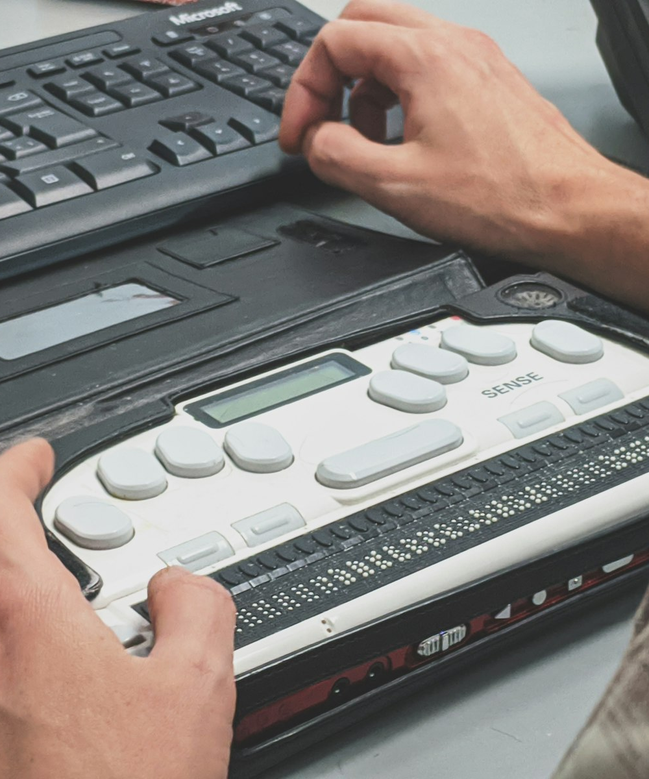
SLOP1512 / UNIVERSITY
SLOP1512 / WEEK 8
Accessibility Review
A practical, WCAG 2.2-referenced audit of headings, contrast, focus visibility, text alternatives and motion settings.
Notes:
Unsplash: https://unsplash.com/photos/4MoIpDcSlr4 — photographer Compagnons (@sigmund), “Blind man using a braille screen reader”, Québec, Canada, accessed 13 Sep 2026
Course teaching content is original.

Slide 2
SLOP1512 / WEEK 8
WCAG AUDIT / 02
Technical outcomes
By the end of this session you can run a structured accessibility audit, not just eyeball a page.
Audit
Cite
Fix
Run the five-part practical check against a real page: headings, contrast, focus, text alternatives, motion.
Attach the specific WCAG 2.2 success criterion to every finding — not just “this feels wrong”.
Propose one concrete, testable revision per finding and know how you would confirm it worked.
SLOP1512 Web Design and Interactive Publishing
Notes:
Original course learning outcomes, aligned to Week 8's accessibility-review brief.

Slide 3
SLOP1512 / WEEK 8
WCAG AUDIT / 03
Review is a different skill from building
A page can look finished and still fail people who don't browse the way you do.
Building teaches you to make something work for yourself, on your machine, with your mouse and your eyesight. Reviewing asks a harder question: does it work for someone who tabs through with a keyboard, listens with a screen reader, or needs 200% zoom?
Passive assumption
Active review
“It looks fine to me” treats one body and one set of tools as the default reader.
A structured audit checks the page against named criteria, using the tools an actual reader would use.
SLOP1512 Web Design and Interactive Publishing
Notes:
Original framing device opening the lecture.

Slide 4
SLOP1512 / WEEK 8
WCAG AUDIT / 04
WCAG in one slide
The Web Content Accessibility Guidelines give the audit its vocabulary and its pass/fail line.
Level
Meaning
Use in practice
A
Minimum
Absolute baseline; failing A blocks basic access for some users
AA
Course and industry target
The level this course, and most organisations, design and test to
AAA
Enhanced
Not achievable for all content types; used selectively
Reference: W3C, Web Content Accessibility Guidelines (WCAG) 2.2, October 2023.
SLOP1512 Web Design and Interactive Publishing
Notes:
Standard WCAG conformance-level reference (W3C WCAG 2.2, October 2023).

Slide 5
SLOP1512 / WEEK 8
WCAG AUDIT / 05
POUR — the four principles
Every WCAG success criterion sits under one of four principles.
Principle
Requirement
Audit example
Perceivable
Information must be presentable so users can perceive it
Alt text, captions, contrast
Operable
Interface and navigation must be operable
Keyboard access, focus order, no traps
Understandable
Information and operation must be understandable
Clear labels, predictable navigation
Robust
Content must work with current and future assistive tech
Valid markup, correct roles and names
SLOP1512 Web Design and Interactive Publishing
Notes:
Original synthesis of WCAG's POUR structure (Perceivable, Operable, Understandable, Robust).

Slide 6
SLOP1512 / WEEK 8
WCAG AUDIT / 06
The five-part practical audit
The checklist this session's studio audit works through, with the WCAG reference for each part.
Check
WCAG reference
Pass looks like
Headings
1.3.1 Info and Relationships
Logical order, no skipped levels
Contrast
1.4.3 / 1.4.11
4.5:1 text, 3:1 UI components and graphics
Focus visibility
2.4.7 / 2.4.11
Every interactive element shows a visible indicator
Text alternatives
1.1.1 Non-text Content
Every non-text item has a role-appropriate alt
Motion settings
2.2.2 / 2.3.3
Animation can be paused; no unconsented vestibular triggers
SLOP1512 Web Design and Interactive Publishing
Notes:
Original overview table mapping this session's five-part audit to specific WCAG 2.2 success criteria.

Slide 7
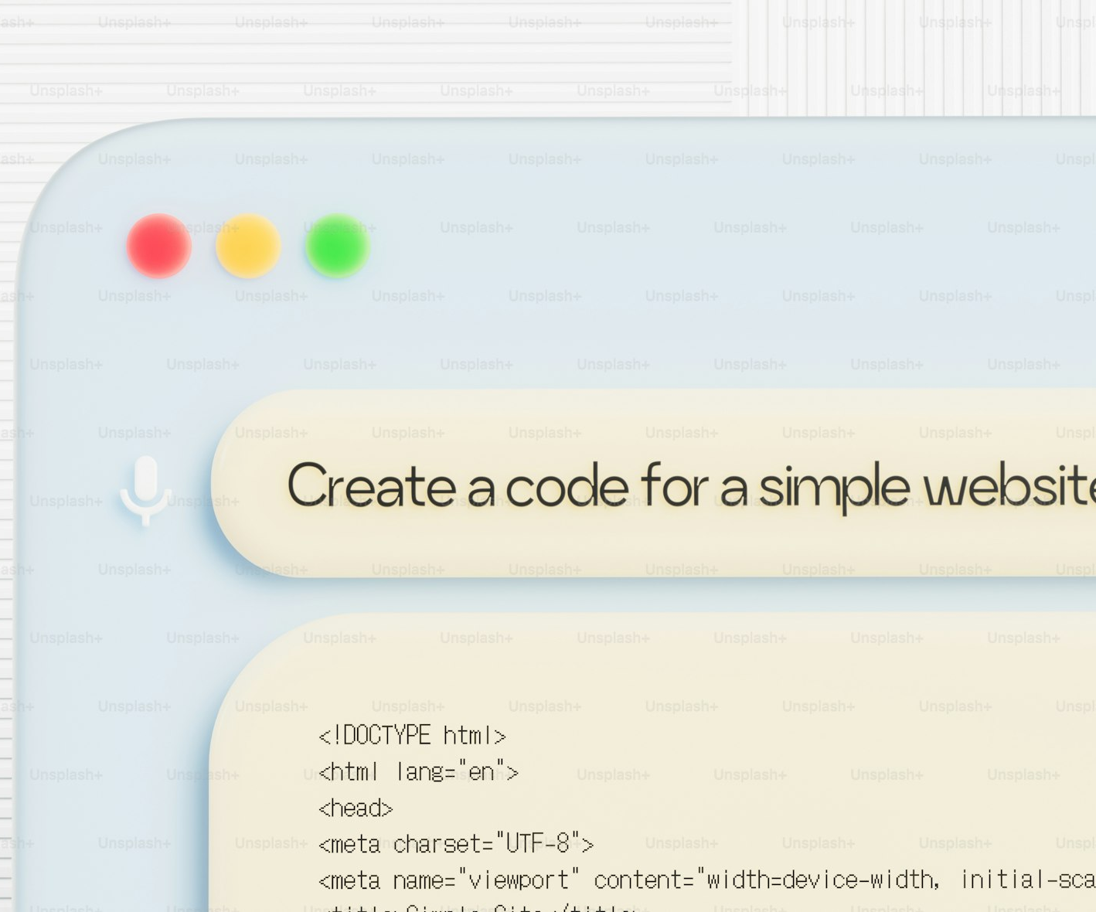
SLOP1512 / WEEK 8
WCAG AUDIT / 07
Check 1 / 5 — heading structure
A heading sequence is the outline a screen reader user hears before anything else.
WCAG 1.3.1 Info and Relationships requires that structure conveyed visually is also conveyed in markup. A heading skips from h2 straight to h4 breaks that relationship even if it still looks fine on screen.
Pass
One h1 per page; h2 for main sections; h3 only nested inside its h2; no level skipped.
Fail
Headings chosen for font size rather than structure; a visually “big” paragraph marked up as h2.
SLOP1512 Web Design and Interactive Publishing
Notes:
Original WCAG 1.3.1-based audit content. Unsplash+ (licensed): https://unsplash.com/photos/computer-screen-displaying-code-for-a-simple-website-TzoTtbgFOR8 — photographer Planet Volumes, accessed 13 Sep 2026

Slide 8
SLOP1512 / WEEK 8
WCAG AUDIT / 08
Heading audit method
A repeatable four-step check for any page.
1
List every heading on the page in order, ignoring the body text between them.
2
Read the list alone — does it form a coherent outline of the page?
3
Check that heading levels nest without skipping (h2 → h3, never h2 → h4).
4
Confirm each landmark region (nav, main, aside) has at most one heading naming it.
Run this with a browser's accessibility tree or headings-list extension, not just by eye.
SLOP1512 Web Design and Interactive Publishing
Notes:
Original repeatable heading-audit method, extending Week 2's semantic-structure content into a review procedure.

Slide 9

SLOP1512 / WEEK 8
WCAG AUDIT / 09
Check 2 / 5 — colour contrast
Contrast is measured as a ratio, not a subjective impression of legibility.
WCAG 1.4.3 sets a 4.5:1 minimum contrast ratio for normal text and 3:1 for large text (AA). WCAG 1.4.11 extends a 3:1 minimum to UI components and meaningful graphics, such as button borders and icons.
Pass
Body text measures at least 4.5:1 against its background; focus outlines and icons measure at least 3:1.
Fail
Light grey body text on white, or a brand-colour button whose border disappears against the page.
SLOP1512 Web Design and Interactive Publishing
Notes:
Original WCAG 1.4.3/1.4.11-based audit content. Unsplash: https://unsplash.com/photos/a-split-screen-displays-black-and-white-contrast-Cc5gk6_SUy4 — photographer Phil Desforges (@storybyphil), accessed 13 Sep 2026

Slide 10
SLOP1512 / WEEK 8
WCAG AUDIT / 10
Contrast audit method
A measured check, repeated for every distinct colour pairing on the page.
1
List every foreground/background colour pairing used for text, icons and borders.
2
Measure each pairing's ratio with a contrast-checking tool.
3
Record the ratio next to the required threshold for that pairing's role.
4
Flag any pairing under threshold and note the specific hex values involved.
Tool: WebAIM Contrast Checker or a browser DevTools contrast inspector; both report a numeric ratio.
SLOP1512 Web Design and Interactive Publishing
Notes:
Original repeatable contrast-audit method referencing WebAIM's Contrast Checker as the standard tool.

Slide 11

SLOP1512 / WEEK 8
WCAG AUDIT / 11
Check 3 / 5 — focus visibility
A keyboard user only knows where they are on a page from a visible focus indicator.
WCAG 2.4.7 Focus Visible requires a visible indicator on every focusable element. WCAG 2.4.11 Focus Not Obscured (new in 2.2) requires that indicator not be hidden behind a sticky header or overlay.
Pass
Tabbing through the page always shows a clear outline or highlight on the active element.
Fail
outline: none removed in CSS with nothing put in its place; a focused link hidden under a fixed nav bar.
SLOP1512 Web Design and Interactive Publishing
Notes:
Original WCAG 2.4.7/2.4.11-based audit content. Unsplash: https://unsplash.com/photos/close-up-of-a-hand-typing-on-a-computer-keyboard-Qh1degtlisQ — photographer Alicia Christin Gerald (@allysphotos), accessed 13 Sep 2026

Slide 12
SLOP1512 / WEEK 8
WCAG AUDIT / 12
Keyboard navigation audit method
Unplug the mouse and try to complete the page's core task.
1
Disconnect or ignore the mouse; use Tab, Shift+Tab, Enter and Space only.
2
Confirm the tab order matches the visual reading order (WCAG 2.4.3).
3
Check every menu, modal and form can be opened, used and closed by keyboard.
4
Confirm nothing traps focus so it cannot be tabbed back out (WCAG 2.1.2).
A keyboard trap inside a modal is one of the most common, and most severe, findings in a real audit.
SLOP1512 Web Design and Interactive Publishing
Notes:
Original keyboard-only audit method referencing WCAG 2.1.1 Keyboard, 2.1.2 No Keyboard Trap and 2.4.3 Focus Order.

Slide 13
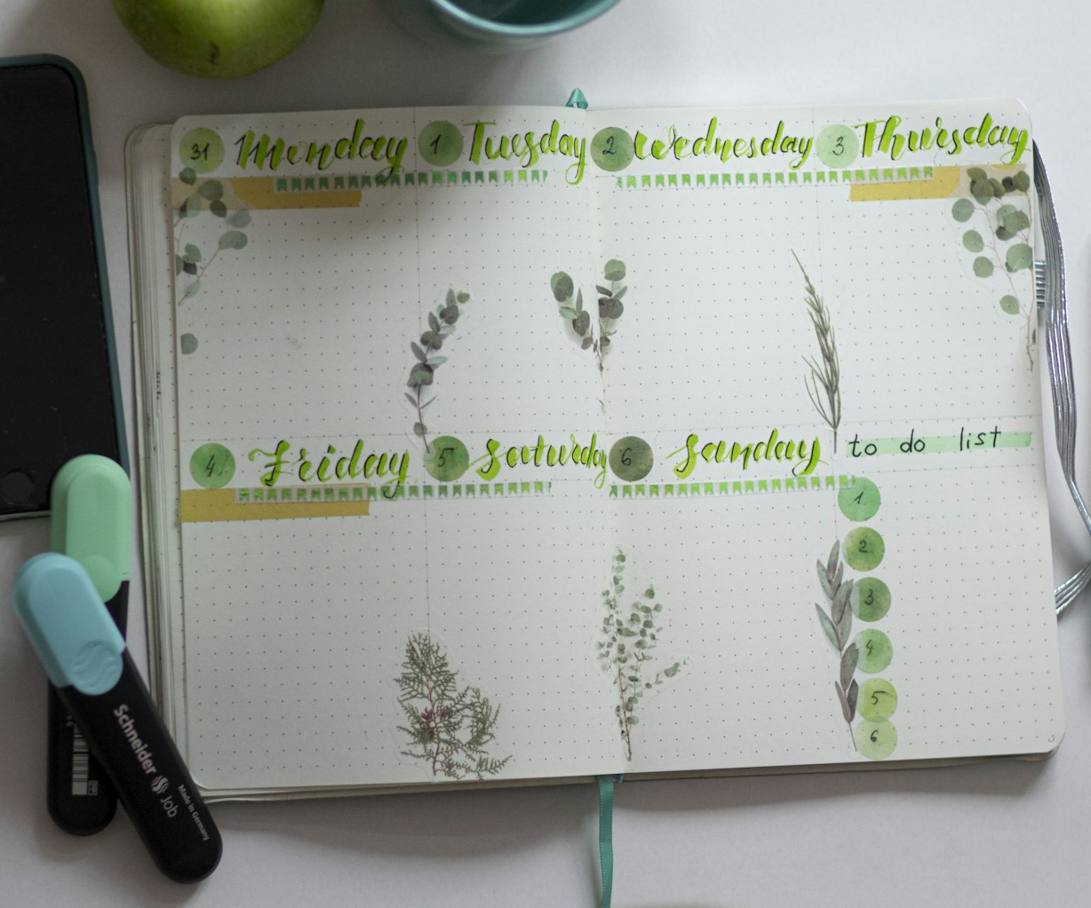
SLOP1512 / WEEK 8
WCAG AUDIT / 13
Check 4 / 5 — text alternatives
Every non-text item needs an alternative that matches its role, not a generic label.
WCAG 1.1.1 Non-text Content requires a text alternative that serves the same purpose. A decorative image gets an empty alt; an informative image gets a description; a functional icon gets the action it performs.
Pass
A chart's alt text states its conclusion; a search-icon button's alt or label reads “Search”.
Fail
alt="image123.jpg", a missing alt attribute entirely, or decorative alt text read aloud as noise.
SLOP1512 Web Design and Interactive Publishing
Notes:
Original WCAG 1.1.1-based audit content, extending Week 2's image-role framework into a review procedure. Unsplash: https://unsplash.com/photos/white-and-green-braille-paper-dCC7LtjU1WA — photographer Elena Mozhvilo (@miracleday), accessed 13 Sep 2026

Slide 14
SLOP1512 / WEEK 8
WCAG AUDIT / 14
Text alternative audit method
Classify before you write — the right alt text depends on the image's job.
1
List every image, icon and SVG on the page.
2
Classify each as decorative, informative, functional or complex.
3
Write or check alt text matched to that role (empty for decorative, descriptive for informative).
4
Turn off images in the browser and confirm the page still makes sense.
For a complex image such as a chart, put the full explanation in visible or linked text, not only in the alt attribute.
SLOP1512 Web Design and Interactive Publishing
Notes:
Original text-alternative audit method building on Week 2's image classification (decorative/informative/functional/complex).

Slide 15
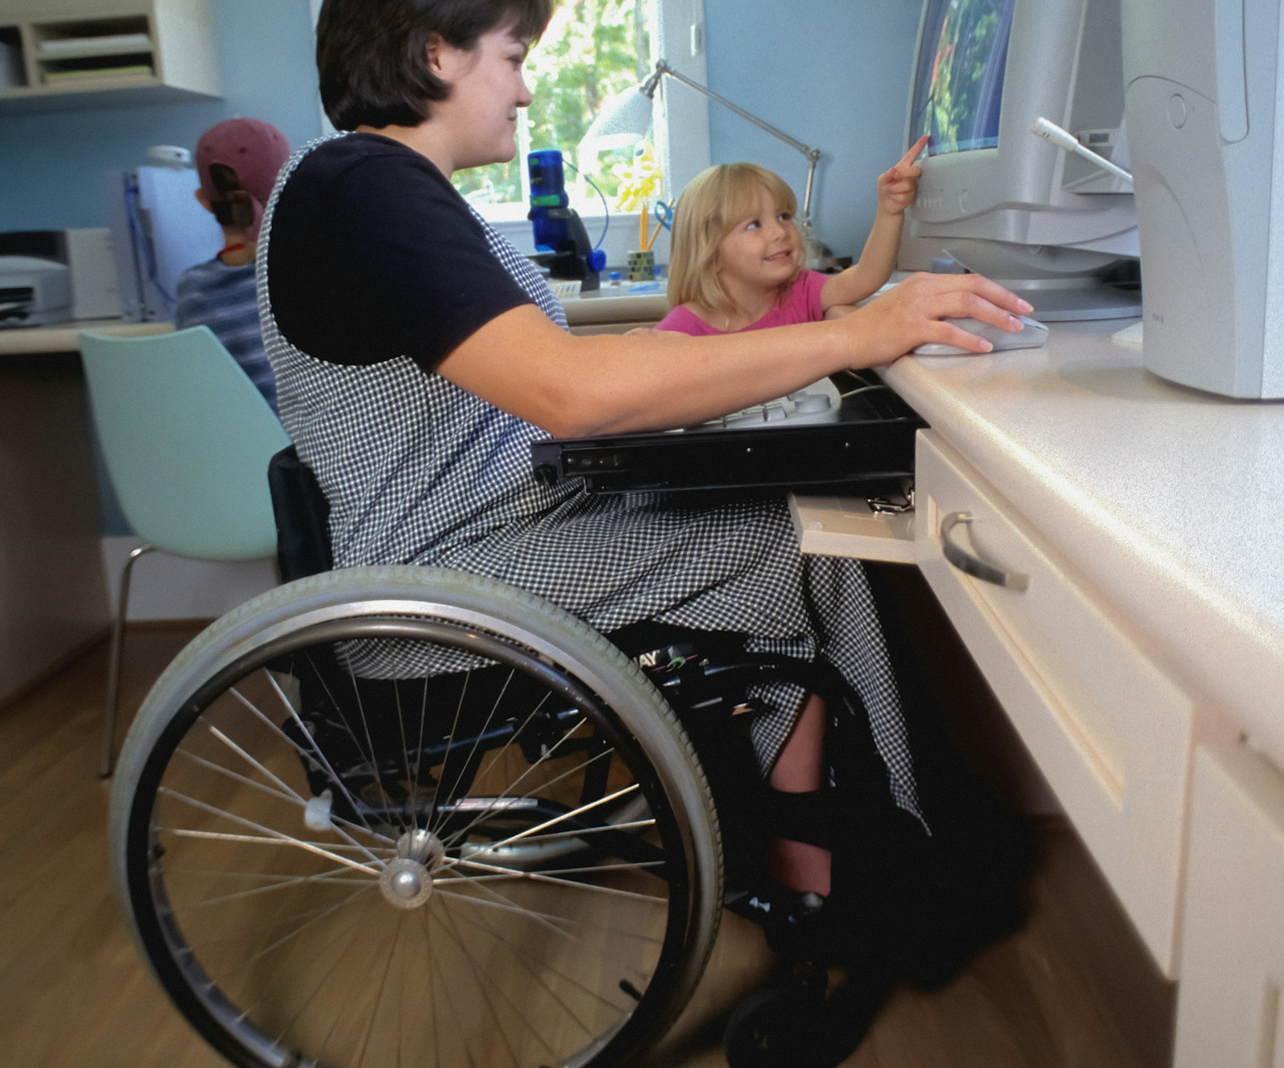
SLOP1512 / WEEK 8
WCAG AUDIT / 15
Assistive technology in practice
An automated scan cannot tell you what a real screen-reader pass reveals.
Automated tools check for missing attributes and structural errors, not for whether the experience actually makes sense read aloud, navigated by switch, or controlled by voice. A real audit runs the page with the tool a reader would use.
Screen readers
NVDA, JAWS or VoiceOver read the accessibility tree aloud, in document order.
Switch and voice control
A single-switch or voice-command user depends entirely on a correct, complete tab order.
SLOP1512 Web Design and Interactive Publishing
Notes:
Original bridge from automated checking to assistive-technology testing. Unsplash: https://unsplash.com/photos/a-woman-in-a-wheel-chair-working-on-a-computer-hqaeIsK3S2w — photographer CDC (@cdc), accessed 13 Sep 2026

Slide 16

SLOP1512 / WEEK 8
WCAG AUDIT / 16
Captions and media alternatives
Audio and video content need their own, separate accessible versions.
WCAG 1.2.2 requires captions for prerecorded audio in video; 1.2.4 extends this to live audio; 1.2.5 asks for audio description of important visual information a viewer would otherwise miss.
Pass
Accurate, synchronised captions cover dialogue and relevant sound effects; a transcript is available.
Fail
Auto-generated captions left uncorrected, or a video with no caption track at all.
SLOP1512 Web Design and Interactive Publishing
Notes:
Original WCAG 1.2.2/1.2.4/1.2.5-based content on captions and media alternatives. Unsplash: https://unsplash.com/photos/grayscale-photo-of-woman-doing-silent-hand-sign-BcjdbyKWquw — photographer Kristina Flour (@tinaflour), accessed 13 Sep 2026

Slide 17
SLOP1512 / WEEK 8
WCAG AUDIT / 17
Check 5 / 5 — motion and animation settings
Movement on screen can disorient or physically harm some readers.
WCAG 2.2.2 Pause, Stop, Hide requires a control for any moving, blinking or auto-updating content lasting more than five seconds. WCAG 2.3.3 (AAA) asks that motion triggered by interaction can be disabled entirely for readers who experience vestibular discomfort.
Pass
Fail
An auto-advancing carousel has a visible pause button; the page honours prefers-reduced-motion.
Background video autoplays with no pause control, or a parallax effect cannot be turned off.
SLOP1512 Web Design and Interactive Publishing
Notes:
Original WCAG 2.2.2/2.3.3-based audit content on motion, animation and vestibular safety.

Slide 18
SLOP1512 / WEEK 8
WCAG AUDIT / 18
Motion audit method
Check both the default experience and the reduced-motion experience.
1
List every animation, auto-playing carousel, video and auto-refreshing region on the page.
2
Confirm each one lasting over five seconds has a visible pause, stop or hide control.
3
Enable the OS or browser's reduced-motion setting and reload the page.
4
Confirm large parallax or zoom effects are removed or substantially reduced under that setting.
Test with prefers-reduced-motion: reduce active — this is a real, checkable browser setting, not a theoretical one.
SLOP1512 Web Design and Interactive Publishing
Notes:
Original motion-audit method referencing the prefers-reduced-motion media feature.

Slide 19
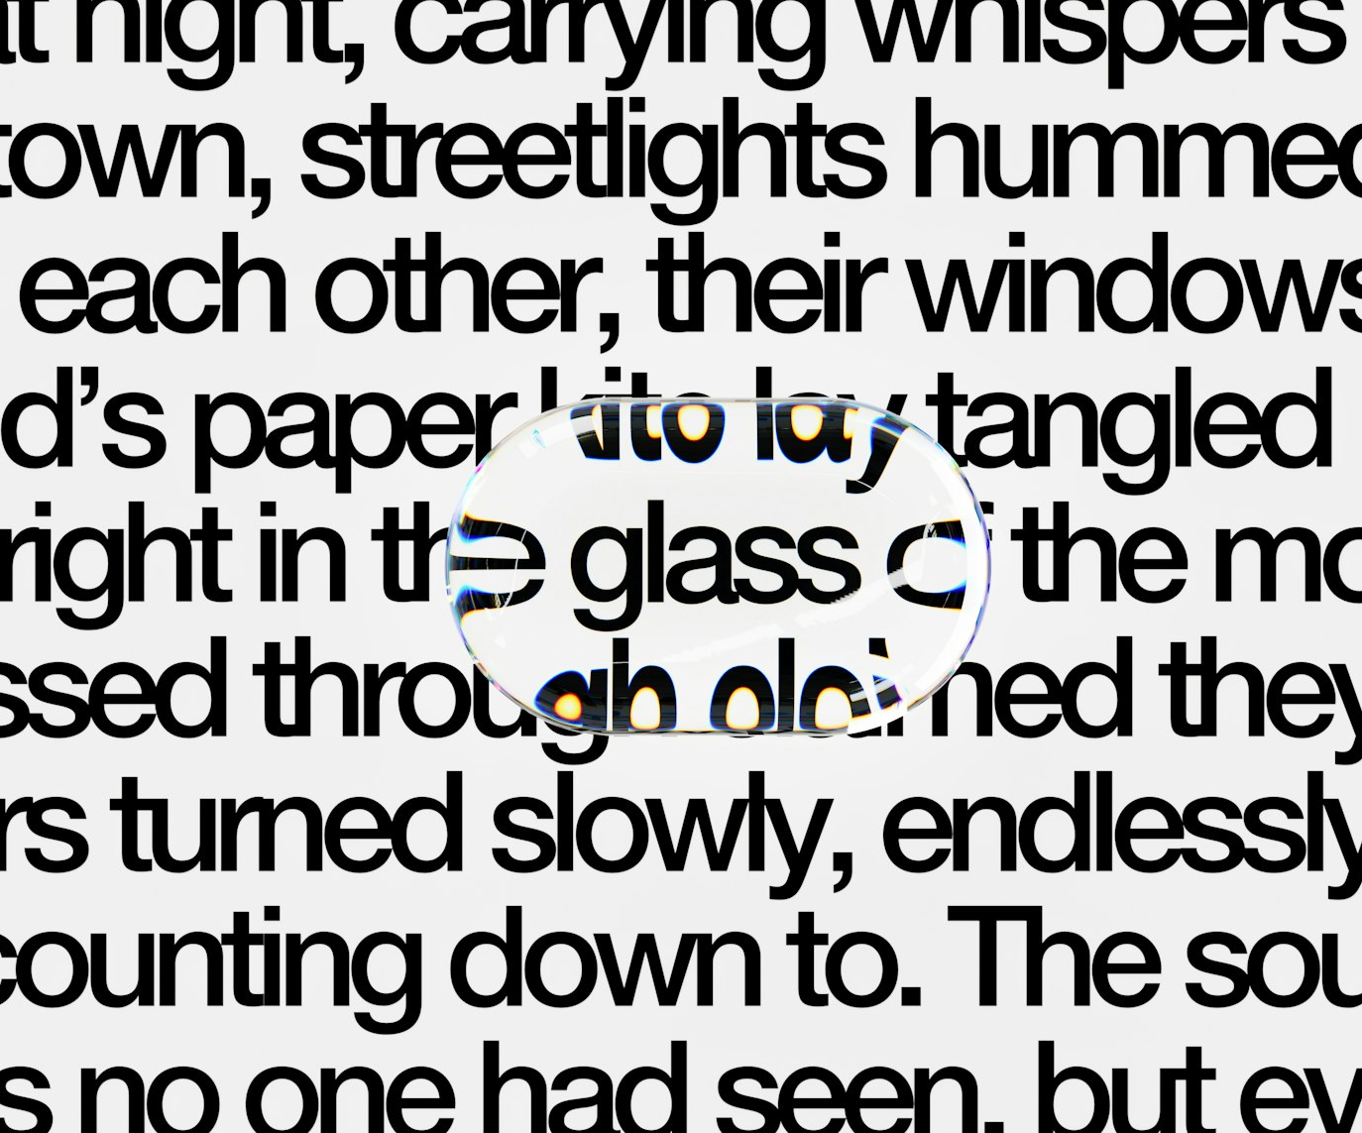
SLOP1512 / WEEK 8
WCAG AUDIT / 19
Zoom, reflow and text resize
Low vision is far more common than total blindness, and easier to test for.
WCAG 1.4.4 requires text to remain readable and functional at 200% zoom. WCAG 1.4.10 Reflow requires content to reflow into a single column at that zoom, without needing to scroll in two directions.
Pass
At 200% browser zoom, text reflows, nothing overlaps, and every control stays reachable.
Fail
Zooming causes horizontal scrolling, clipped text, or overlapping fixed-position elements.
SLOP1512 Web Design and Interactive Publishing
Notes:
Original WCAG 1.4.4/1.4.10-based audit content on zoom and reflow. Unsplash: https://unsplash.com/photos/a-text-snippet-focused-through-a-magnifying-glass-wgbZ4ZeJCV0 — photographer Planet Volumes, accessed 13 Sep 2026

Slide 20
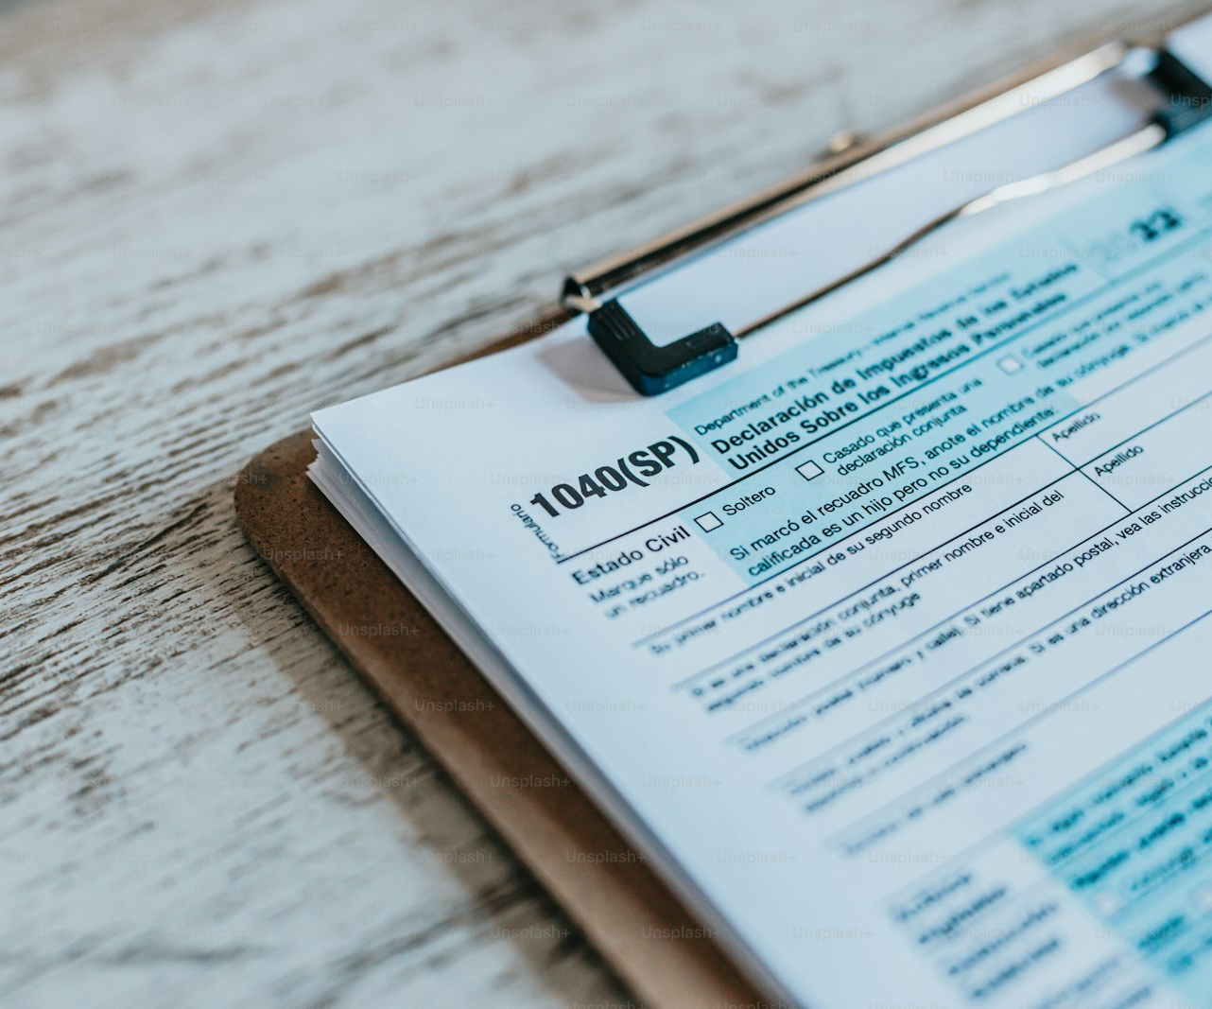
SLOP1512 / WEEK 8
WCAG AUDIT / 20
Audit tooling and process
Automated scanners are a fast first pass, never the whole review.
Automated tools such as axe DevTools, Lighthouse and WAVE reliably catch missing attributes and contrast failures. They cannot judge whether alt text is meaningful, whether a tab order makes sense, or whether captions are accurate.
Automated pass
Run a scanner first to catch structural errors quickly and cheaply.
Manual pass
Follow with keyboard-only and screen-reader passes for anything a scanner cannot judge.
SLOP1512 Web Design and Interactive Publishing
Notes:
Original process guidance on combining automated and manual accessibility testing. Unsplash+ (licensed): https://unsplash.com/photos/a-close-up-of-a-clipboard-with-a-checklist-on-it-o5D1-gQ1344 — photographer A. C. (@3tnik), accessed 13 Sep 2026

Slide 21
SLOP1512 / WEEK 8
WCAG AUDIT / 21
What automated tools miss vs. catch
Knowing the boundary tells you where to spend manual review time.
Finding
Detected by
Note
Missing alt attribute
Automated
Flags the absence, not whether text present is meaningful
Contrast ratio below threshold
Automated
Measures precisely against the numeric ratio
Alt text quality and relevance
Manual
Requires human judgement of purpose and context
Logical tab order
Manual
Requires an actual keyboard pass through the page
Caption accuracy
Manual
Requires watching with sound off, captions on
SLOP1512 Web Design and Interactive Publishing
Notes:
Original table distinguishing automated-detectable findings from manual-review-only findings.

Slide 22
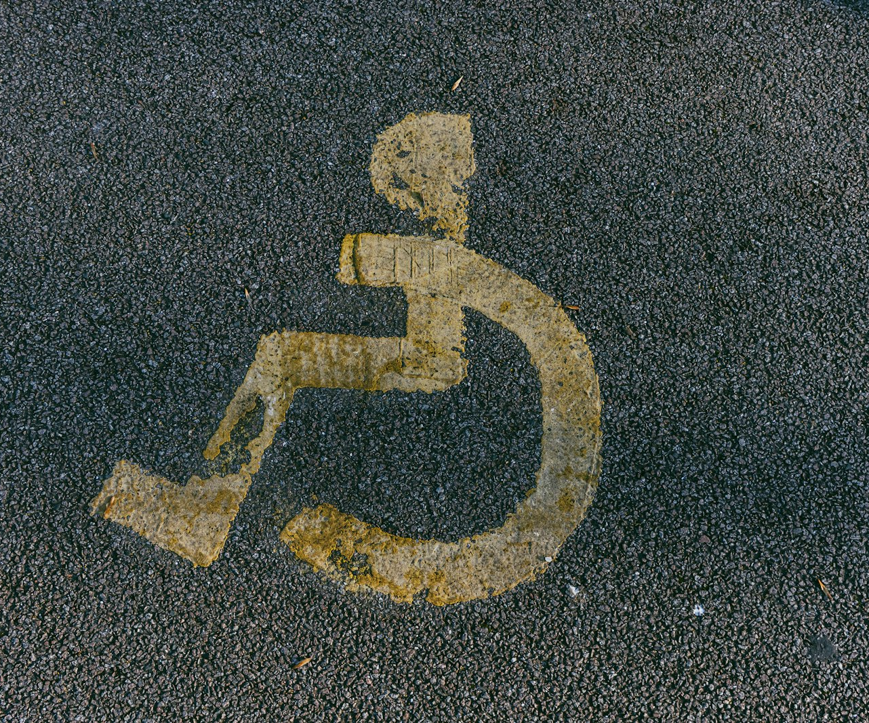
SLOP1512 / WEEK 8
WCAG AUDIT / 22
Universal design — the physical and digital parallel
Accessible features built for a specific need routinely help everyone.
An accessible parking space or a kerb cut was built for wheelchair users, but a parent with a stroller and a delivery worker with a trolley use it too. Digital accessibility features work the same way.
Captions
Built for deaf and hard-of-hearing users; used constantly in noisy rooms and silent offices.
High contrast
Built for low vision; makes every reader's page legible in direct sunlight.
SLOP1512 Web Design and Interactive Publishing
Notes:
Original universal-design framing, drawing the built-environment parallel explicit for a digital audience. Unsplash: https://unsplash.com/photos/a-handicapped-sign-is-painted-on-the-pavement-jt7WiIQOzPQ — photographer Jakub Pabis (@jakubpabis), Huntingdon, UK, accessed 13 Sep 2026

Slide 23
SLOP1512 / WEEK 8
WCAG AUDIT / 23
Severity and prioritisation
Not every finding blocks a task equally — triage before you fix.
Severity
Definition
Example
Critical
Blocks a core task entirely for some users
Keyboard trap in the checkout form
Serious
Makes a task very difficult but not impossible
Contrast failure on primary body text
Moderate
Adds friction without blocking the task
Inconsistent heading levels
Minor
Cosmetic or edge-case impact
Slightly imprecise alt text on a decorative image
SLOP1512 Web Design and Interactive Publishing
Notes:
Original severity-triage framework applied to accessibility-audit findings.

Slide 24
SLOP1512 / WEEK 8
WCAG AUDIT / 24
Writing up a finding
A finding is only useful to a developer if it is specific enough to act on.
1
Location: the exact page, component or element where the problem occurs.
2
Criterion: the specific WCAG success criterion it fails, by number.
3
Impact: which users are blocked, and how severely (see the previous slide).
4
Fix and retest: a concrete proposed change, and how you will confirm it worked.
A finding without a WCAG reference is an opinion; a finding with one is a testable claim.
SLOP1512 Web Design and Interactive Publishing
Notes:
Original finding-writeup template used across this session's studio audit.

Slide 25
SLOP1512 / WEEK 8
WCAG AUDIT / 25
Week 8 studio audit
What you produce and submit for this session.
Brief
Choose a page from your own project or a public site. Run the five-part audit: headings, contrast, focus visibility, text alternatives and motion settings.
Constraints
Every finding must name its WCAG 2.2 success criterion and a severity rating. Test at least one check with a real keyboard-only or screen-reader pass, not tooling alone.
Evidence to submit
A five-row findings table (check, WCAG reference, severity, evidence, proposed fix) and 100 words on the single highest-severity finding.
SLOP1512 Web Design and Interactive Publishing
Notes:
Original SLOP1512 Week 8 studio audit, directly implementing the session brief's five-part accessibility check.

Slide 26
SLOP1512 / WEEK 8
WCAG AUDIT / 26
Review rubric
How this audit is assessed, and how it feeds into Assignment 3.
Coverage
All five checks attempted, not just the easiest ones.
Accuracy
Each finding cites the correct WCAG 2.2 success criterion.
Evidence
Findings include what was tested and how, not just an assertion.
Actionability
Each finding pairs with one concrete, testable proposed fix.
SLOP1512 Web Design and Interactive Publishing
Notes:
Original review rubric, aligned to Assignment 3's ‘Accessible forms and keyboard use’ and ‘Testing evidence and revision’ criteria.

Slide 27
SLOP1512 / WEEK 8
WCAG AUDIT / 27
Common findings from real audits
The same handful of problems recur across almost every unreviewed site.
Structure
Interaction
Media and colour
Skipped heading levels; multiple h1s; landmark regions missing or duplicated.
Removed focus outlines; keyboard traps in modals and menus; unlabelled icon buttons.
Body text under 4.5:1 contrast; decorative alt text on informative images; uncaptioned video.
Recognising these patterns quickly is what turns a slow audit into a fast one.
SLOP1512 Web Design and Interactive Publishing
Notes:
Original summary of recurring accessibility-audit findings, consolidating the session's five checks.

Slide 28
SLOP1512 / WEEK 8
WCAG AUDIT / 28
Recommended practice and preparation
Before next session.
Standards reference
W3C, Web Content Accessibility Guidelines (WCAG) 2.2: https://www.w3.org/TR/WCAG22/
Tooling reference
WebAIM, Contrast Checker: https://webaim.org/resources/contrastchecker/ — W3C WAI, How to Meet WCAG (Quick Reference): https://www.w3.org/WAI/WCAG22/quickref/
Bring to Week 9
Your completed five-part audit findings table, ready to inform this week's content-system and navigation planning.
SLOP1512 Web Design and Interactive Publishing
Notes:
External resources: W3C WCAG 2.2 specification and quick reference; WebAIM Contrast Checker. Accessed 13 September 2026.

