Slide 1
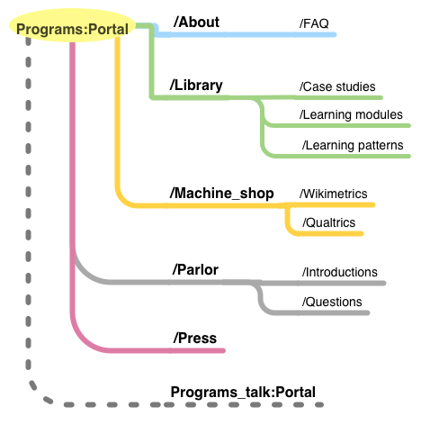
SLOP / UNIVERSITY
SLOP1512 / WEEK 9
Content Systems and
Multi-Page Sites
Planning an information architecture, a predictable navigation pattern, and shared page templates so a small site stays coherent as it grows from one page to many.
Notes:
Wikimedia Commons, File:Program evaluation portal sitemap draft1.png — author Jmorgan (WMF), CC BY-SA 3.0, https://commons.wikimedia.org/wiki/File:Program_evaluation_portal_sitemap_draft1.png, accessed 13 Sep 2026
Course teaching content is original, prepared for SLOP1512 Week 9.

Slide 2
SLOP1512 / WEEK 9
02
This week's outcomes
By the end of this session you can plan, structure and wire navigation for a small multi-page site.
Plan
Structure
Build
Turn a content inventory into a grouped information architecture using a real card-sorting method.
Choose a site-map topology and a URL scheme that stay predictable as pages are added.
Implement one shared navigation pattern across at least three real HTML pages using a page-shell template.
Web Design and Interactive Publishing
Notes:
Original learning outcomes for SLOP1512 session 9, aligned to the assignment 4 brief on information architecture.

Slide 3
SLOP1512 / WEEK 9
03
What information architecture actually is
IA is the structure a visitor infers before they read a single sentence.
Information architecture (IA) is the practice of deciding what content exists, how it is grouped, and how a visitor moves between groups — before any visual design happens.
The IA question
Why it matters here
For every page: what is this content, which group does it belong to, and what is one click away from it?
A site with a clean visual system but a confusing structure still fails — the reader can't find the page that answers their question.
Web Design and Interactive Publishing
Notes:
Original framing of IA for a small hand-built site, distinct from visual design (weeks 3-6).

Slide 4
SLOP1512 / WEEK 9
04
Step 1: content inventory
List every page and fragment the site needs before grouping anything.
1
List every planned page and any repeating content block (e.g. a testimonial, a contact block).
2
Note each item's purpose in one sentence — what task does this page complete for a visitor?
3
Flag near-duplicates: two pages answering the same question should usually merge into one.
4
Flag orphans-in-waiting: any item with no obvious page to link from yet.
A content inventory is a spreadsheet, not a design — rows are pages, columns are purpose, audience and status.
Web Design and Interactive Publishing
Notes:
Content inventory as the first concrete IA artefact; a real technique used before any grouping or navigation decision.

Slide 5
SLOP1512 / WEEK 9
05
Step 2: group by task, not by org chart
The most common IA mistake is grouping by who made the content, not what the visitor is trying to do.
Approach
Path shape
Consequence
Organisation-first grouping
“About → Departments → Marketing → Our team”
Matches how the organisation sees itself, not how a visitor searches
Task-first grouping
“Work → Case studies → [project]”
Matches the question a visitor actually arrived with
Rule of thumb: name each group after the question it answers, not after the team that owns it.
Web Design and Interactive Publishing
Notes:
Core IA heuristic: group by user task/question rather than internal organisational structure.

Slide 6
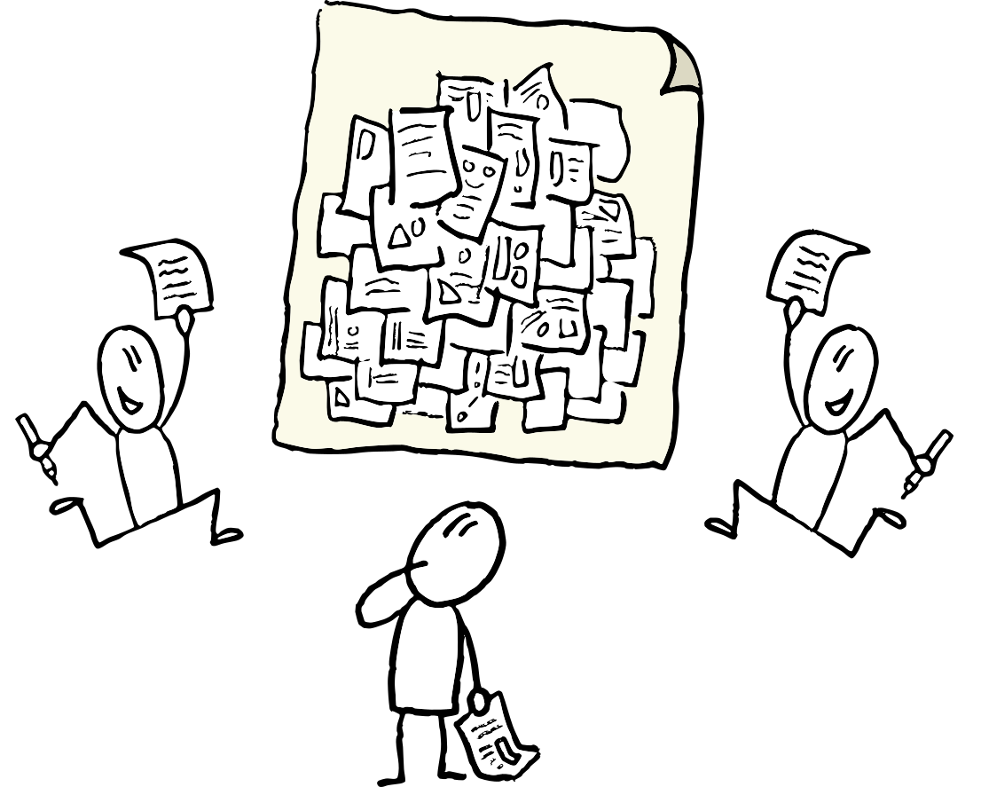
SLOP1512 / WEEK 9
06
Card sorting: a real technique, not a guess
Ask people to group your actual content — don't decide the grouping alone at a desk.
Write each planned page or content item on its own card. Ask 3-5 people, individually, to sort the cards into groups that make sense to them and name each group.
Open card sort
No group names are given up-front — reveals how people naturally expect content to be organised.
Closed card sort
Group names are fixed in advance — tests whether people can find items inside categories you've already chosen.
Web Design and Interactive Publishing
Notes:
Wikimedia Commons, File:Collecting ideas for brainstorming.png — photographer Frank Homp, CC BY 2.0, https://commons.wikimedia.org/wiki/File:Collecting_ideas_for_brainstorming.png, accessed 13 Sep 2026
Open vs closed card sorting is a standard, well-documented UX research technique for building an IA from real user input.

Slide 7
SLOP1512 / WEEK 9
07
Site-map topologies: three real shapes
Every small site's structure is one of these, or a deliberate mix.
Topology
Shape
Small-site example
Hierarchical
A trunk page branches into sections, each into sub-pages
A documentation site: Home → Guides → Setup → Install
Flat
Every page sits one click from every other, no sections
A 4-page portfolio: Home, About, Work, Contact
Hub-and-spoke
One hub page links out to many independent destinations, each returns to the hub
A directory site linking to member profile pages
Web Design and Interactive Publishing
Notes:
Standard IA vocabulary for site topology, illustrated with small-site examples matching the assignment scale.

Slide 8
SLOP1512 / WEEK 9
08
A worked site map: small business site
Home, about, work, contact, plus two secondary pages — a realistic Assignment 4 scale.
Home
├─ About
├─ Work (listing)
│ └─ Work / [project] (detail ×N)
├─ Contact
└─ Footer-only: Privacy, Credits
Every page above the footer row has an inbound link from the primary nav — nothing is reachable only by guessing a URL.
Web Design and Interactive Publishing
Notes:
Wikimedia Commons, File:Program evaluation portal sitemap draft1.png — author Jmorgan (WMF), CC BY-SA 3.0, https://commons.wikimedia.org/wiki/File:Program_evaluation_portal_sitemap_draft1.png, accessed 13 Sep 2026
Worked hierarchical site-map example scaled to a small multi-page project.

Slide 9
SLOP1512 / WEEK 9
09
Primary navigation: the contract with every page
The same links, in the same order, in the same place — on every single page.
<header>
<nav aria-label="Primary">
<ul>
<li><a href="/">Home</a></li>
<li><a href="/about/">About</a></li>
<li><a href="/work/" aria-current="page">Work</a></li>
<li><a href="/contact/">Contact</a></li>
</ul>
</nav>
</header>
Landmark role
A nav element identifies this as a navigation region — assistive tech can jump straight to it.
aria-current="page"
Marks which link matches the current page, so the active state is announced, not just coloured.
Web Design and Interactive Publishing
Notes:
Practical primary-nav markup connecting week 2's landmark roles to this week's IA/nav topic.

Slide 10
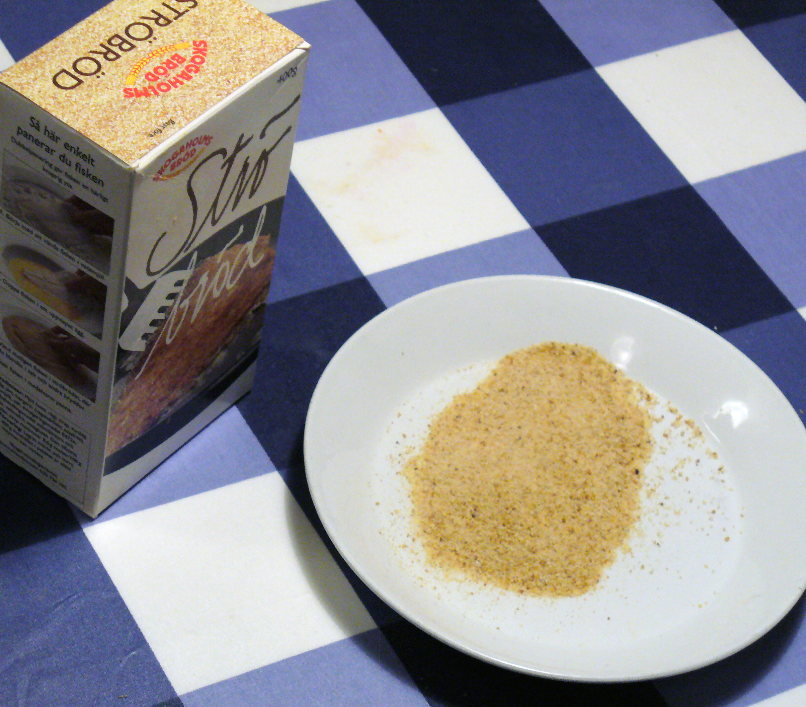
SLOP1512 / WEEK 9
10
Breadcrumbs: where am I, not where can I go
A breadcrumb trail names the path from home to the current page — it does not replace primary nav.
<nav aria-label="Breadcrumb">
<ol>
<li><a href="/work/">Work</a></li>
<li aria-current="page">Portfolio site</li>
</ol>
</nav>
Use breadcrumbs only once a site is at least two levels deep — on a flat 4-page site they add noise, not orientation.
Web Design and Interactive Publishing
Notes:
Wikimedia Commons, File:Breadcrumb.jpg — photographer Yvwv, CC BY-SA 3.0, https://commons.wikimedia.org/wiki/File:Breadcrumb.jpg, accessed 13 Sep 2026
The term "breadcrumb" comes directly from the Hansel and Gretel trail-of-crumbs image — the photo makes that literal origin explicit.

Slide 11
SLOP1512 / WEEK 9
11
Local nav and footer nav: the other two patterns
Primary nav is not the only navigation a page needs.
Pattern
Job
Typical use
Local / in-page nav
Move within one long page or one section (e.g. a table of contents)
A single, sectioned reference page
Footer nav
Catch secondary pages that don't belong in primary nav (legal, credits, sitemap link)
Privacy policy, source attribution page
Every page a footer links to must also be reachable another way — a footer-only page with no other inbound link is still an orphan.
Web Design and Interactive Publishing
Notes:
Distinguishes local/in-page nav and footer nav from primary nav, tying back to the orphan-page risk covered later.

Slide 12
SLOP1512 / WEEK 9
12
Consistent placement is an accessibility requirement
Predictable navigation location is not a style choice — it's tested behaviour (WCAG 3.2.3).
Consistent navigation
Skip link
Repeated navigation components must occur in the same relative order on every page they appear — a keyboard user builds a mental map of tab order.
A visually-hidden-until-focused link that jumps a keyboard user straight past repeated nav to <main>, so it isn't tabbed through on every page.
<a class="skip-link" href="#main">Skip to main content</a>
...
<main id="main">...</main>
Web Design and Interactive Publishing
Notes:
WCAG 2.4 Consistent Navigation and the skip-link pattern, connecting Week 8's accessibility audit to this week's nav design.

Slide 13
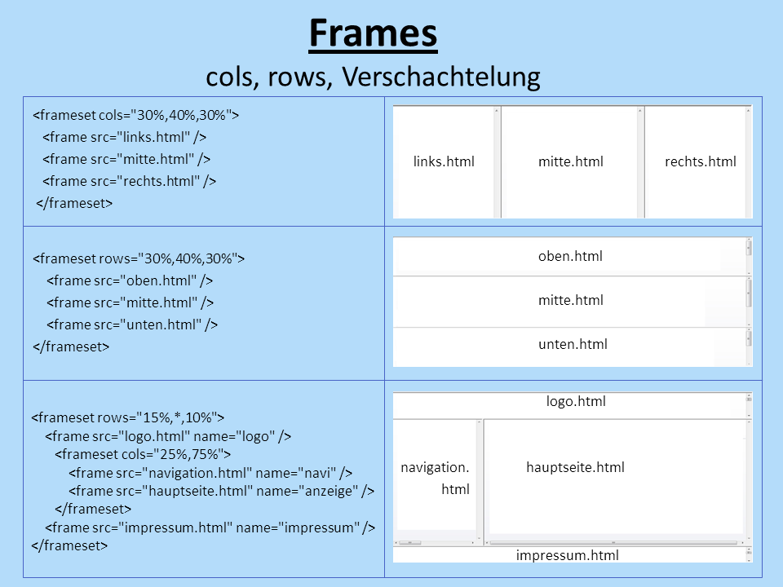
SLOP1512 / WEEK 9
13
The page shell: what repeats vs what's unique
Every page is one shared shell wrapped around one unique content region.
header + nav + footer are the shell — identical markup, identical classes, on every page. <main> holds the one thing that page is actually for.
The shell never changes
If the nav needs a new link, it changes once and every page picks it up — whether by copy-paste discipline or a build-time include.
Web Design and Interactive Publishing
Notes:
Wikimedia Commons, File:Website frames.png — author Bagok, CC BY-SA 3.0, https://commons.wikimedia.org/wiki/File:Website_frames.png, accessed 13 Sep 2026
The historical HTML frameset diagram is repurposed here purely as a visual of shell-vs-content regions, explained in the caption as such.

Slide 14
SLOP1512 / WEEK 9
14
Keeping the shell consistent by hand
Without a framework, discipline replaces automation — name the technique so it's checkable.
1
Write the header/nav/footer markup once, in one file, and treat it as the source of truth.
2
Copy that exact block into every page — never retype it from memory.
3
Give shell elements stable, descriptive classes (site-header, site-nav, site-footer) reused verbatim on every page.
4
After any shell edit, diff every page's shell markup against the source file before publishing.
This is a lightweight, hand-built version of what a templating system or static-site generator automates — same idea, manual enforcement.
Web Design and Interactive Publishing
Notes:
Practical technique for consistent shared layout without a framework, matching this course's hand-built HTML/CSS scope.

Slide 15
SLOP1512 / WEEK 9
15
Two reusable page patterns: listing and detail
Almost every content site reduces to these two page types, repeated.
Listing page
Detail page
Shows many items at a glance — a project gallery, a blog index, a product grid. Each entry links to its own detail page. The template is the same; only the item data changes per entry.
Shows one item in full — a single blog post, a single project. Every detail page follows the same section order so a returning visitor already knows where to look.
Web Design and Interactive Publishing
Notes:
Listing/detail as the two canonical reusable page patterns for a small multi-page site.

Slide 16
SLOP1512 / WEEK 9
16
A content model: the fields every detail page needs
Decide the fields before writing a single page — this is a hand-built version of a CMS content model.
Field
Type
Rule
title
Text
Becomes the h1 and the browser tab title
hero image
Image + alt text
One image, with alt text written for its role on this page
summary
1-2 sentences
Used on the listing page AND as the page's meta description
body
Structured HTML
Headings, paragraphs, lists — the unique content itself
link / call to action
URL + label
Where this item sends the visitor next
Web Design and Interactive Publishing
Notes:
A lightweight content model for a project/post detail page — the same fields every instance of that page type must supply.

Slide 17
SLOP1512 / WEEK 9
17
Why a content model prevents drift
Without an explicit model, each new page quietly reinvents its own structure.
Page 3 of a growing site is fine on instinct. Page 12 is where undocumented structure breaks — one project page has no image, another buries its link in a paragraph, a third has two headings labelled h1.
The fix
The test
Write the field list down once (a text file is enough) and check each new page against it before publishing.
Could you swap this page's body text into another page of the same type without touching the layout?
Web Design and Interactive Publishing
Notes:
Original argument connecting content-model discipline to scaling problems covered later in this lecture.

Slide 18
SLOP1512 / WEEK 9
18
URL structure: predictable and human-readable
A URL is part of the interface — a visitor reads it before the page even loads.
URL
Problem
Risk
/index.html?p=7&cat=3
Meaningless once shared; breaks if the numbering changes
High
/blog/post-7/
Readable but still arbitrary — tells you nothing about content
Medium
/work/portfolio-redesign/
Matches the nav label and the page's own heading exactly
Low
Keep the URL segment, the nav label, and the on-page <h1> in agreement — three different names for one page is a navigation bug.
Web Design and Interactive Publishing
Notes:
Predictable URL naming and the nav-label/heading/URL consistency rule, extending week 2's heading-hierarchy discipline.

Slide 19
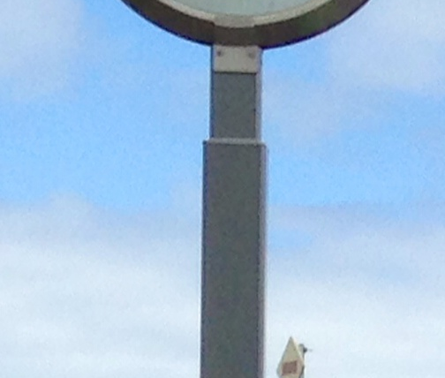
SLOP1512 / WEEK 9
19
The orphan page: reachable by URL, invisible in nav
The most common real defect a scaled-up hand-built site develops.
An orphan page loads fine if you type its exact URL — but no nav link, breadcrumb, or footer link points to it. A visitor, and a search engine, can never discover it.
How it happens
A page is built, tested by URL, and the developer forgets the one remaining step: link to it from somewhere.
The check
For every page in the content inventory, click through from the home page — if you can't arrive without typing the URL, it's an orphan.
Web Design and Interactive Publishing
Notes:
Wikimedia Commons, File:Wayfinding Signage.JPG — photographer BL2002, CC BY-SA 4.0, https://commons.wikimedia.org/wiki/File:Wayfinding_Signage.JPG, accessed 13 Sep 2026
Orphan-page defect defined and given a concrete detection method (click-through audit from the home page).

Slide 20
SLOP1512 / WEEK 9
20
What breaks first when a site scales past a handful of pages
The same three failures, in order, every time a site grows without a system.
Inconsistent navigation
Page 6 has a link the others don't; visitors lose the mental map week 8 taught you to protect
Duplicated header/footer code
A copy-pasted shell drifts — one page's markup silently diverges from the rest
Broken relative links
A page moved one folder deeper breaks every ../ link built for its old location
Web Design and Interactive Publishing
Notes:
Original scaling-failure sequence, motivating the systemic (shared partials/templates) approach in the next slide.

Slide 21
SLOP1512 / WEEK 9
21
The systemic fix: shared partials, one source of truth
Every failure on the previous slide is prevented the same way.
Shared shell file
Root-relative links
One header/nav/footer block, reused verbatim, so a nav change is a one-place edit even without a build tool.
Write links from the site root (/work/) instead of relative paths (../../work/) so moving a page can't silently break its links.
Neither fix requires a framework — both are decisions you make and apply consistently, by hand, across every page.
Web Design and Interactive Publishing
Notes:
Root-relative URLs and a shared shell file as the two concrete, framework-free fixes to the previous slide's failure modes.

Slide 22
SLOP1512 / WEEK 9
22
Before: ad-hoc navigation on a growing site
Three pages, three slightly different navs — a real and common starting state.
<!-- about.html -->
<a href="index.html">Home</a>
<a href="work.html">My Work</a>
<!-- work.html -->
<a href="/">Home</a>
<a href="about.html">About Me</a>
<a href="contact.html">Get in touch</a>
Three problems visible above: different link text for the same page (“My Work” vs “Work”), a missing Contact link on about.html, and a mixed root-relative/relative style.
Web Design and Interactive Publishing
Notes:
Worked ‘before’ example showing realistic ad-hoc navigation drift across three hand-built pages.

Slide 23
SLOP1512 / WEEK 9
23
After: one shared nav pattern, three pages
Identical markup, identical labels, identical order — pasted, not retyped.
<nav aria-label="Primary">
<ul>
<li><a href="/">Home</a></li>
<li><a href="/about/" aria-current="page">About</a></li>
<li><a href="/work/">Work</a></li>
<li><a href="/contact/">Contact</a></li>
</ul>
</nav>
This exact block appears on about.html, work.html and contact.html — only the aria-current value changes per page.
Web Design and Interactive Publishing
Notes:
Worked ‘after’ example restructuring the previous slide's ad-hoc nav into one shared, consistent pattern.

Slide 24

SLOP1512 / WEEK 9
24
Testing the IA: can a visitor find it in ≤ 2 clicks?
First-click and tree testing check the structure itself, separate from visual design.
First-click testing
Show a static page or wireframe, ask “where would you click to find X?” — the first click alone predicts most task success.
Tree testing
Show only the site's navigation labels as a text list (no visuals) and ask someone to find a target page — isolates the IA from the design entirely.
Web Design and Interactive Publishing
Notes:
Wikimedia Commons, File:Man at a laptop in an office (Unsplash).jpg — photographer Bench Accounting, CC0 1.0, https://commons.wikimedia.org/wiki/File:Man_at_a_laptop_in_an_office_(Unsplash).jpg, accessed 13 Sep 2026
First-click testing and tree testing as standard, distinct IA-validation methods, both usable before any visual build.

Slide 25
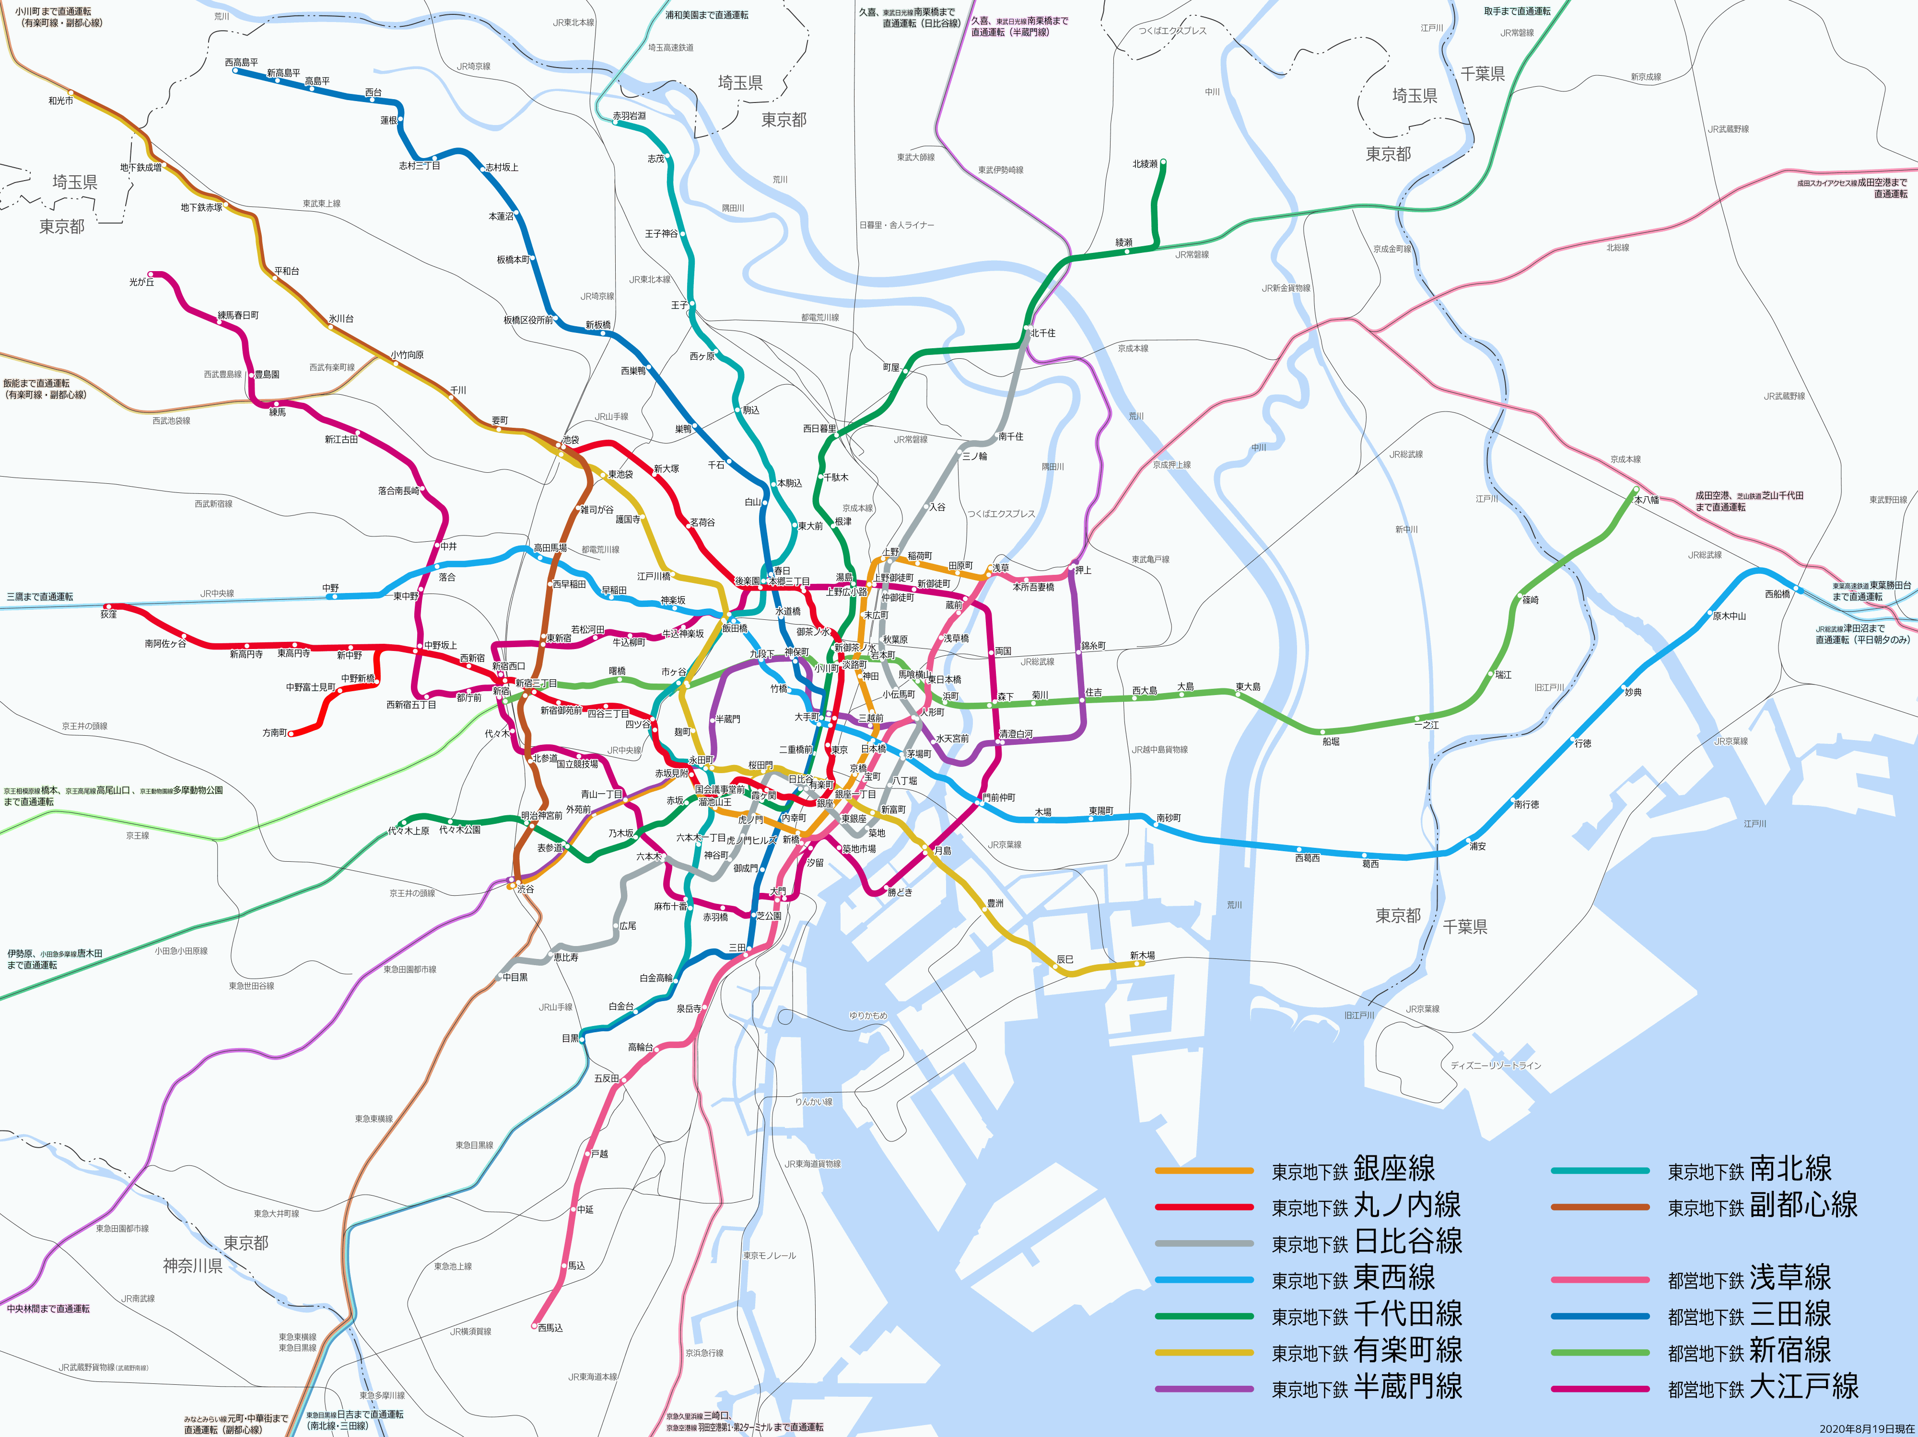
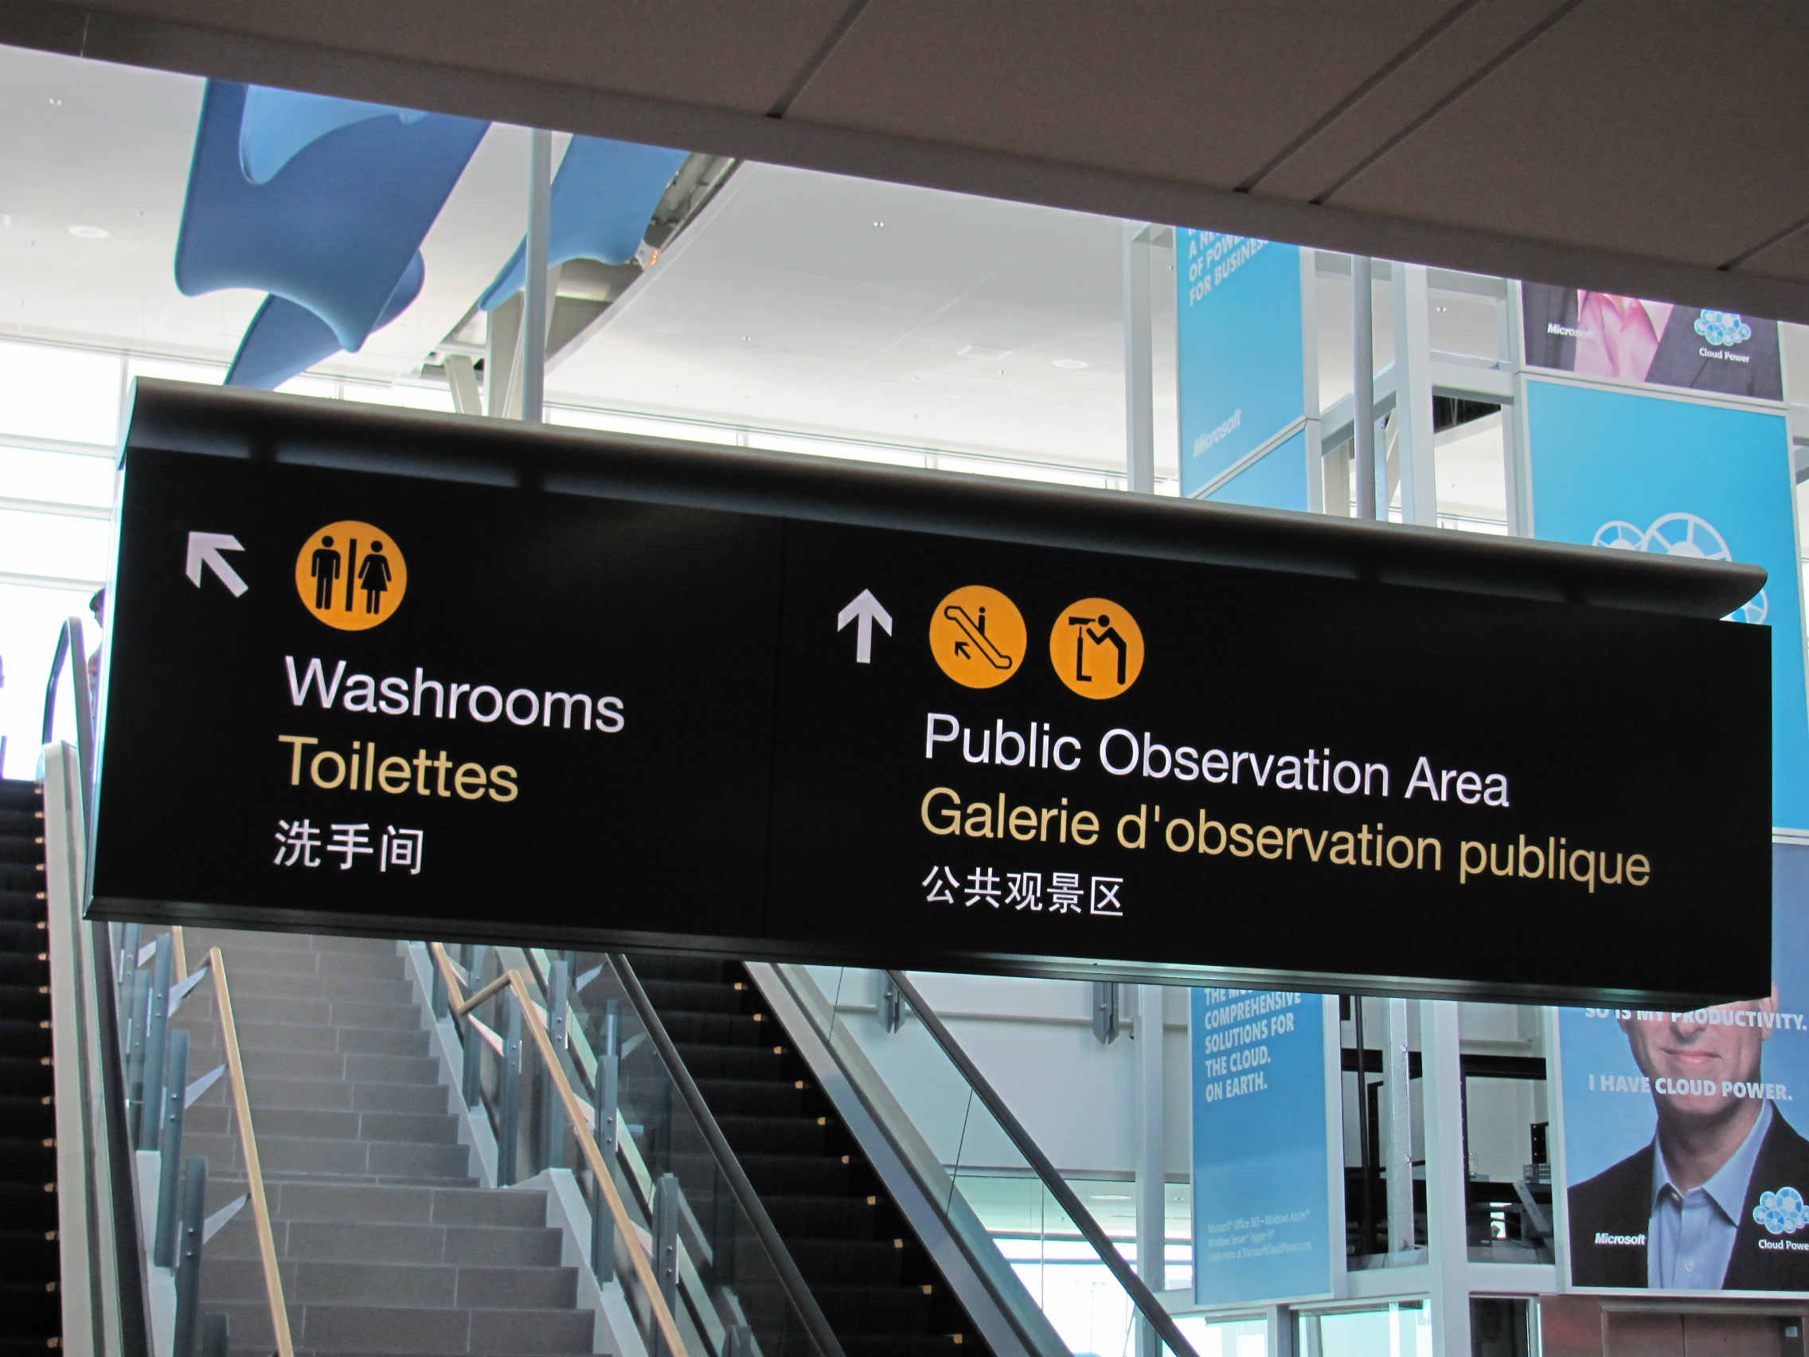
SLOP1512 / WEEK 9
25
Reading a real navigation system: two references
Two very different real systems solving the same underlying problem as your site map.
A transit map is a hub-and-spoke/interchange topology made legible at a glance; airport signage is consistent placement and label wording solved at very large scale — both are IA problems before they are visual ones.
Web Design and Interactive Publishing
Notes:
Wikimedia Commons, File:Tokyo metro map.png — author Hisagi, CC BY-SA 3.0, https://commons.wikimedia.org/wiki/File:Tokyo_metro_map.png, accessed 13 Sep 2026
Wikimedia Commons, File:Trilingual signage at YVR.jpg — photographer Mathew5000, CC BY-SA 3.0, https://commons.wikimedia.org/wiki/File:Trilingual_signage_at_YVR.jpg, accessed 13 Sep 2026

Slide 26
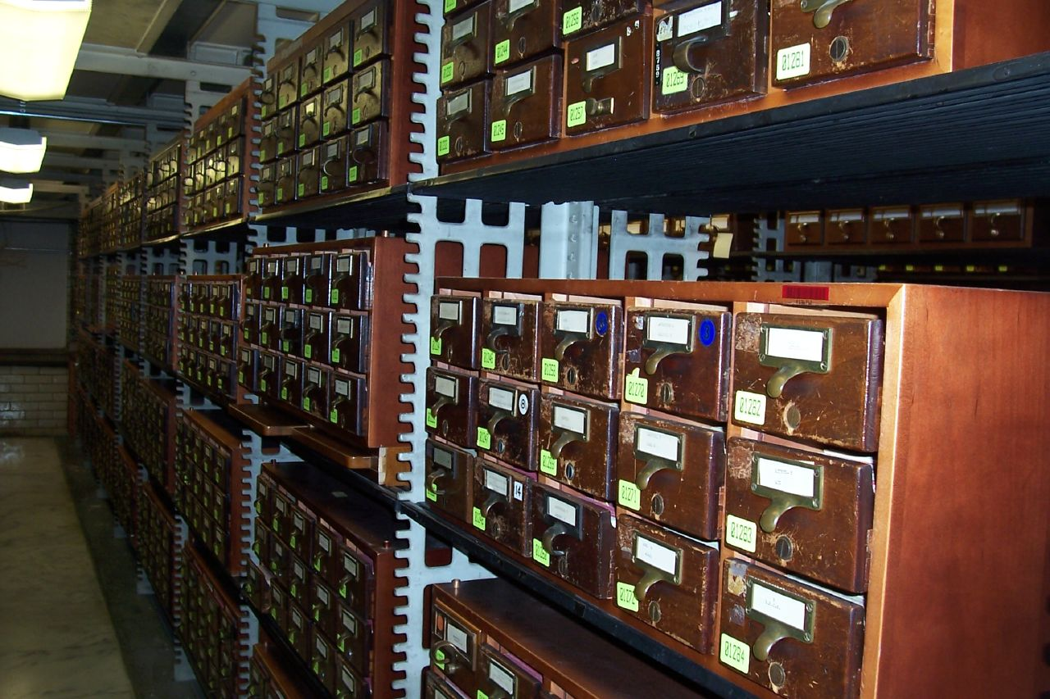
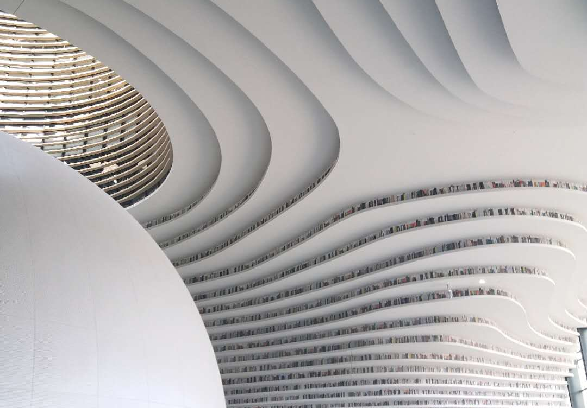
SLOP1512 / WEEK 9
26
Content organisation as a physical, pre-digital problem
IA did not start with the web — these two systems solved the same grouping problem.
A card catalog is a lookup index; the shelves are the grouped, browsable structure it points into — exactly the split between a site's nav (index) and its page groups (shelves).
Web Design and Interactive Publishing
Notes:
Wikimedia Commons, File:Library Of Congress Card Catalog.jpg — photographer rochelle hartman, CC BY 2.0, https://commons.wikimedia.org/wiki/File:Library_Of_Congress_Card_Catalog.jpg, accessed 13 Sep 2026
Wikimedia Commons, File:Binhai library bookshelves.jpg — photographer Muzzleflash, CC0 1.0, https://commons.wikimedia.org/wiki/File:Binhai_library_bookshelves.jpg, accessed 13 Sep 2026
Original analogy connecting physical library organisation systems to digital IA/navigation structure.

Slide 27
SLOP1512 / WEEK 9
27
Studio task: sketch, then build
Directly implements Assignment 4's information-architecture requirement.
Sketch
Draw a site map for your Assignment 4 project: choose a topology (hierarchical, flat or hub-and-spoke), list every page, and mark which nav item links to each.
Card-sort check
Ask one classmate to sort your page list into groups without seeing your sketch, then compare the two groupings.
Build
Implement one shared primary-nav pattern, identical in markup and label order, across at least three real HTML pages.
Evidence to submit
The site-map sketch, the three built pages, and a one-paragraph note on the topology you chose and why.
Web Design and Interactive Publishing
Notes:
Original SLOP1512 Week 9 studio task, mapped directly to Assignment 4's information-architecture and shared-navigation criteria.

Slide 28
SLOP1512 / WEEK 9
28
Common IA and navigation mistakes, and the fix
The defects a marker sees most often at this stage of a multi-page build.
Nav grouped by org chart, not by task
Rename groups after the visitor's question, not the team that owns the content
A page only reachable by typing its URL
Click through from home for every inventory item; link every orphan
Nav wording differs page to page
Copy the exact shell block; never retype navigation markup by hand
Detail pages missing a field others have
Check every new page against the written content model before publishing
Web Design and Interactive Publishing
Notes:
Original common-mistakes rubric for IA/navigation craft, aligned to Assignment 4's information-architecture criterion.

Slide 29
SLOP1512 / WEEK 9
29
Recap: this week builds on three earlier weeks
IA and navigation are not a new skill — they assemble three you already have.
Week 2 — HTML and semantic structure
Week 6 — Responsive design
Week 8 — Accessibility review
Landmarks (header, nav, main, footer) are the actual elements this week's shell and nav patterns are built from.
A shared shell has to keep working at every screen size — the nav pattern doesn't get a separate design per page.
Consistent navigation placement, skip links and aria-current are accessibility requirements this week puts into practice.
Web Design and Interactive Publishing
Notes:
Explicit recap connecting this week to Week 2 (semantic HTML), Week 6 (responsive design) and Week 8 (accessibility review), per the course's own module list.

Slide 30
SLOP1512 / WEEK 9
30
Recap checklist and what's next
Use this before calling any multi-page structure finished.
Content inventory lists every page and its purpose.
Groups are named after visitor tasks, not org structure.
Every page has at least one inbound nav/footer/breadcrumb link — no orphans.
Primary nav is identical, in markup and order, on every page.
URL, nav label and on-page heading agree for every page.
A tree test or first-click test on the sketch succeeded in ≤ 2 clicks.
Next week: user testing and revision — observing a classmate attempt a real task on the site you just structured.
Web Design and Interactive Publishing
Notes:
Closing checklist for the week 9 studio task, previewing week 10's user-testing session which will exercise this IA directly.

