Slide 1

SLOP / UNIVERSITY
SLOP1512 / WEEK 11
Publication and Performance
Check assets, metadata, source attribution and loading decisions before publishing a preview.
Notes:
Flickr (Hades2k), CC BY-SA 2.0, https://www.flickr.com/photos/24449221@N05/5871762782, accessed 13 Sep 2026
Course teaching content is original.

Slide 2
SLOP1512 / WEEK 11
02
Learning outcomes
By the end of this lecture you can audit a page and justify that it is ready to publish.
Audit
Describe
Measure
Inspect every asset a page ships — images, fonts, scripts — and identify what is unoptimised.
Write correct metadata, Open Graph tags and source attribution so the page describes itself accurately.
Read Core Web Vitals and a Lighthouse report, and act on what they say before publishing.
Web Design and Interactive Publishing
Notes:
Original learning outcomes for SLOP1512 Week 11, grounded in the module brief: check assets, metadata, source attribution and loading decisions before publishing a preview.

Slide 3
SLOP1512 / WEEK 11
03
“Done” is not the same as “ready to publish”
A page can render correctly on your machine and still fail its first real visitors.
Weeks 1–10 built structure, style, interaction, accessibility and tested revisions. This week adds the final gate: does the page perform, describe itself correctly, and credit its sources once it leaves your laptop?
What “done” checks
What “ready to publish” adds
Content is correct, layout works, links go where expected — all judged on your own fast machine and fast connection.
File sizes, metadata, attribution and load performance on a real network and a real device — conditions you cannot see from your editor.
Web Design and Interactive Publishing
Notes:
Original framing distinguishing feature-complete from publish-ready, opening the Week 11 module.

Slide 4
SLOP1512 / WEEK 11
04
The real asset audit
Every image, font, script and embed a page loads has a cost — list them before you ship.
Images
Often the largest share of page weight — check every image is sized and compressed for its actual display size.
Fonts
Each font file is a network request that can delay visible text — audit how many weights and styles are actually used.
Scripts
Third-party embeds (analytics, widgets, chat) each add their own request chain and can block rendering.
External embeds
Maps, videos and social embeds often load their own heavy sub-resources you did not directly write.
Web Design and Interactive Publishing
Notes:
Original content: a practical asset-audit checklist for what a page ships to a first-time visitor.

Slide 5
SLOP1512 / WEEK 11
05
Image formats: choosing the right one
JPEG, PNG, WebP and AVIF trade off compression, transparency and browser support differently.
JPEG
PNG
WebP
AVIF
Best for photographs: strong lossy compression, no transparency, universal support.
Best for graphics needing transparency or flat colour — much larger files for photographic content.
Smaller than JPEG/PNG at similar quality, supports transparency, supported by all modern browsers.
Often the smallest of all at equal quality, but slower to encode and still gaining full tooling support.
Web Design and Interactive Publishing
Notes:
Original comparison of raster image format trade-offs relevant to publication decisions.

Slide 6
SLOP1512 / WEEK 11
06
Responsive images, revisited
Week 6 introduced srcset/sizes — this week, verify it is actually wired correctly before publishing.
<img src="hero-800.jpg"
srcset="hero-400.jpg 400w, hero-800.jpg 800w, hero-1600.jpg 1600w"
sizes="(min-width: 48rem) 60vw, 100vw"
width="800" height="450"
alt="Team reviewing a printed page layout">
A publish-ready image also states width and height attributes — the browser reserves the correct space before the file even downloads, preventing layout shift.
Web Design and Interactive Publishing
Notes:
Ties directly back to Week 6's srcset/sizes content, adding width/height attributes as a Core Web Vitals concern.

Slide 7

SLOP1512 / WEEK 11
07
Compressing images without visible quality loss
A correctly-sized image can still be needlessly heavy if it isn't compressed.
Re-encoding a photo at roughly 70–80% JPEG quality is usually visually indistinguishable from the original, but can cut file size by half or more.
Practical rule
Compress before you publish, not after a complaint — check the largest 3–4 images on a page individually.
Common mistake
Uploading a camera-original file (often several megabytes) directly, with no resizing or re-encoding step at all.
Web Design and Interactive Publishing
Notes:
Flickr (Brokentaco), CC BY 2.0, https://www.flickr.com/photos/92024986@N00/2558749158, accessed 13 Sep 2026

Slide 8
SLOP1512 / WEEK 11
08
Loading strategy: eager, lazy and priority
Not every image needs to load immediately — but the first one usually does.
<!-- Hero image: load immediately, it's the first thing seen -->
<img src="hero.jpg" fetchpriority="high" alt="...">
<!-- Below-the-fold image: defer until near viewport -->
<img src="gallery-3.jpg" loading="lazy" alt="...">
loading="lazy" on off-screen images and fetchpriority="high" on the hero image both target the same goal: get the content the visitor sees first onto the screen first.
Web Design and Interactive Publishing
Notes:
Original explanation of native lazy loading and fetchpriority as complementary loading-order signals.

Slide 9
SLOP1512 / WEEK 11
09
Web fonts: display, subsetting, preloading
A font file that blocks text from appearing is one of the most common publish-day surprises.
<link rel="preload" href="/fonts/body.woff2"
as="font" type="font/woff2" crossorigin>
@font-face {
font-family: "Body";
src: url("/fonts/body.woff2") format("woff2");
font-display: swap;
}
font-display: swap shows fallback text immediately and swaps in the web font once it loads, instead of leaving text invisible while the font downloads.
Web Design and Interactive Publishing
Notes:
Original explanation of font-display and preload as they relate to text visibility and Core Web Vitals.

Slide 10
SLOP1512 / WEEK 11
10
Minification and removing dead code
Whitespace, comments and unused CSS/JS all cost bytes on every single page load.
Minification
Dead code
Build tools strip whitespace, comments and shorten variable names in CSS/JS — no behaviour change, smaller files.
Unused CSS rules and unused JavaScript functions still cost download and parse time even if they never run.
Astro's build step already minifies output automatically — the audit here is checking you have not hand-pasted a whole unused library or framework into a page for one small feature.
Web Design and Interactive Publishing
Notes:
Original content connecting general minification/dead-code principles to this course's own Astro build pipeline.

Slide 11
SLOP1512 / WEEK 11
11
Page metadata: title and description
The two lines a search result or shared link actually shows first.
<title>Portfolio site — Jordan Lee, web design</title>
<meta name="description"
content="A responsive, accessible portfolio built
for SLOP1512, showcasing three
interactive case studies.">
Each page needs its own distinct title and description — a template placeholder like “Untitled” or a copy-pasted description on every page is a genuine publish-readiness failure.
Web Design and Interactive Publishing
Notes:
Original explanation of title/meta description as the first thing a search engine or link preview reads.

Slide 12
SLOP1512 / WEEK 11
12
Open Graph tags: what a shared link shows
When a URL is pasted into chat or social media, these tags control the preview card.
<meta property="og:title" content="Portfolio site — Jordan Lee">
<meta property="og:description" content="A responsive, accessible portfolio.">
<meta property="og:image" content="https://example.edu/og-cover.jpg">
<meta property="og:url" content="https://example.edu/">
Without an og:image, most platforms show a blank or generic preview card — a working link that still looks broken the moment someone shares it.
Web Design and Interactive Publishing
Notes:
Original explanation of the Open Graph protocol's role in link previews, directly answering the module brief's “metadata” requirement.

Slide 13
SLOP1512 / WEEK 11
13
Favicons and touch icons
A small, unglamorous checklist that is easy to forget entirely.
favicon.ico / favicon.svg
shown in the browser tab and bookmarks
apple-touch-icon.png (180×180)
used when a visitor adds the page to an iOS home screen
site.webmanifest
names and icons the page if added to an Android home screen
Web Design and Interactive Publishing
Notes:
Original checklist of icon/manifest assets commonly missing at publish time.

Slide 14
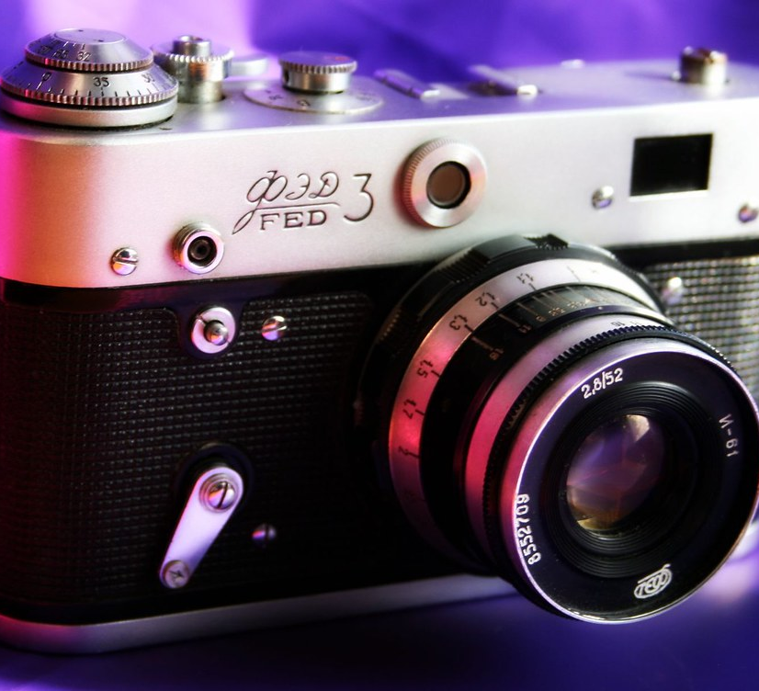
SLOP1512 / WEEK 11
14
Why source attribution matters
Every photograph, icon or quote used in this course's decks and sites is someone else's work.
A Creative Commons or public-domain licence permits reuse, but almost all of them still require crediting the creator — using an image without attribution can violate the very licence that made it usable.
Minimum credit
Creator name, licence, and a link back to the source — recorded somewhere a reader can actually find it.
Academic parallel
This is the same principle as citing a source in an essay: reuse is fine, silent reuse is not.
Web Design and Interactive Publishing
Notes:
Flickr (Annafur), CC BY 2.0, https://www.flickr.com/photos/13606906@N04/2923211110, accessed 13 Sep 2026
Directly answers the Week 11 module brief's “source attribution” requirement.

Slide 15
SLOP1512 / WEEK 11
15
A working attribution pattern
Record it once, in a predictable place, at the time you download the asset — not from memory later.
{
"file": "hero.jpg",
"title": "Team reviewing a printed layout",
"creator": "Jane Doe",
"license": "CC BY 2.0",
"source": "https://example.com/photos/12345",
"accessed": "2026-09-13"
}
Why this shape
Every field needed to satisfy a CC BY licence's attribution requirement is present, and the file lives alongside the assets it describes so it cannot go missing.
Web Design and Interactive Publishing
Notes:
Original recommended ATTRIBUTION.json pattern, matching the sourcing discipline used throughout this course's own image pipeline.

Slide 16

SLOP1512 / WEEK 11
16
Reading a Creative Commons licence correctly
Not all CC licences permit the same reuse — read the actual letters, not just the icon.
CC0 / Public domain
no attribution legally required (crediting anyway is still good practice)
CC BY
reuse and even modify freely, but attribution is required
CC BY-SA
attribution required, and anything you build with it must share alike under the same licence
Web Design and Interactive Publishing
Notes:
Flickr (twechy), CC BY 2.0, https://www.flickr.com/photos/77877011@N07/6830923298, accessed 13 Sep 2026

Slide 17
SLOP1512 / WEEK 11
17
Core Web Vitals: the three metrics that matter
Google's real-user metrics for loading, responsiveness and visual stability.
LCP
INP
CLS
Largest Contentful Paint: how long until the biggest visible element (often a hero image) finishes rendering. Target: under 2.5s.
Interaction to Next Paint: how quickly the page responds to a click, tap or keypress. Target: under 200ms.
Cumulative Layout Shift: how much visible content jumps around as the page loads. Target: under 0.1.
Web Design and Interactive Publishing
Notes:
Original summary of the three Core Web Vitals metrics as published by Google's web.dev, framed for a course audit context.

Slide 18
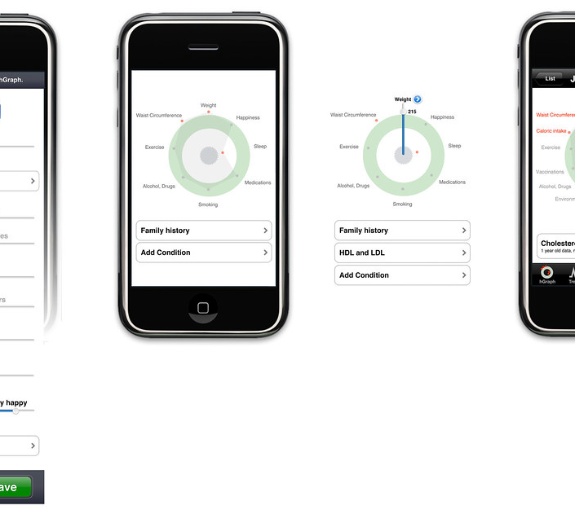
SLOP1512 / WEEK 11
18
Measuring LCP with real tooling
Do not guess — read what the browser itself measured.
Chrome DevTools' Performance panel and the Lighthouse panel both report a measured LCP time and identify exactly which element on the page was counted as the largest.
What to check
Is the LCP element the hero image or heading you intended? If it's an unrelated element, something is rendering unexpectedly late.
Field vs lab data
Lighthouse gives one lab measurement; PageSpeed Insights also reports real-user field data when enough visits exist.
Web Design and Interactive Publishing
Notes:
Flickr (juhansonin), CC BY 2.0, https://www.flickr.com/photos/38869431@N00/4731324232, accessed 13 Sep 2026

Slide 19
SLOP1512 / WEEK 11
19
Preventing layout shift
CLS is almost always caused by content whose final size isn't known until it loads.
img, video, iframe {
aspect-ratio: attr(width) / attr(height);
}
.ad-slot {
min-height: 250px; /* reserve space before the ad loads */
}
Explicit width/height on images (Week 6) and aspect-ratio reservation on embeds are the two most common fixes for a visible page-load jump.
Web Design and Interactive Publishing
Notes:
Original explanation connecting CLS causes to concrete fixes already established in earlier weeks.

Slide 20

SLOP1512 / WEEK 11
20
Testing on a throttled connection
Your dev machine's wifi is not representative of a real visitor's phone on the move.
DevTools' network throttling presets (“Slow 4G”, “Fast 3G”) simulate realistic latency and bandwidth, revealing loading problems a fast office connection completely hides.
What changes
A 3-second load on your machine can become 12+ seconds simulated on Slow 4G — test the experience that a real visitor gets.
CPU throttling too
Pair network throttling with CPU throttling (4–6x slowdown) to approximate an average mobile device, not a developer laptop.
Web Design and Interactive Publishing
Notes:
Flickr (audioreservoir), CC BY 2.0, https://www.flickr.com/photos/53515430@N06/9491861077, accessed 13 Sep 2026

Slide 21

SLOP1512 / WEEK 11
21
From files to a live URL: what hosting does
Publishing is not just “upload the folder” — a host serves, compresses and caches your files.
A static host (like the one this course's platform deploys to) serves pre-built files directly, applies HTTP compression (gzip/brotli) and sets caching headers so returning visitors re-download less.
Check before publishing
Confirm the deployed build actually matches your latest local build — a stale cached deploy is a common last-minute surprise.
Cache-Control headers
Long cache lifetimes for versioned assets (like hashed filenames) and short lifetimes for HTML keep updates visible quickly.
Web Design and Interactive Publishing
Notes:
Flickr (jurvetson), CC BY 2.0, https://www.flickr.com/photos/44124348109@N01/9848225175, accessed 13 Sep 2026

Slide 22

SLOP1512 / WEEK 11
22
CDNs and DNS: how bytes travel to a browser
A content delivery network puts copies of your files physically closer to each visitor.
Instead of every visitor's request travelling to one origin server, a CDN caches your published files at edge locations worldwide, cutting the physical distance data has to travel.
Why this matters here
A visitor far from your host's region can see a much slower LCP purely from network distance — a CDN is a real performance fix, not just an optimisation buzzword.
DNS resolution
Every new domain also costs a DNS lookup on first visit; browsers cache this, but it still adds to first-load latency.
Web Design and Interactive Publishing
Notes:
Flickr (twicepix), CC BY-SA 2.0, https://www.flickr.com/photos/30713600@N00/4333178624, accessed 13 Sep 2026

Slide 23
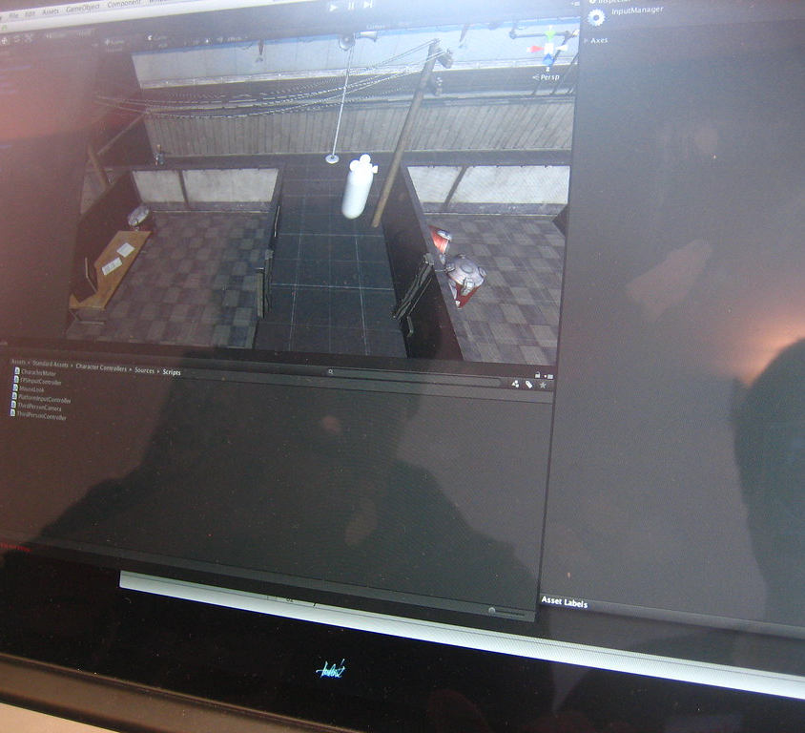
SLOP1512 / WEEK 11
23
Reading a Lighthouse / PageSpeed Insights report
One number is a summary; the audit list underneath is where the real work is.
The overall performance score (0–100) is useful for tracking trend over time, but the individual audits — “serve images in next-gen formats,” “eliminate render-blocking resources” — are the actionable checklist.
Prioritise by impact
Fix audits Lighthouse marks as high-impact on LCP/CLS first; a passed low-impact audit rarely changes the visitor's experience.
Re-run after every fix
Each fix can shift which audit is now the biggest remaining opportunity — treat this as an iterative loop, not a one-time report.
Web Design and Interactive Publishing
Notes:
Flickr (qubodup), CC BY 2.0, https://www.flickr.com/photos/21051491@N02/15204156909, accessed 13 Sep 2026

Slide 24

SLOP1512 / WEEK 11
24
Case study, before: an unaudited page
A real composite example — what the page looked like before this week's pass.
The original page shipped four camera-original JPEGs (avg. 3.2MB each), no width/height attributes, no meta description, and a font loaded with no font-display rule.
Measured before
LCP 4.8s on Slow 4G; CLS 0.34 from images popping in without reserved space; generic “Untitled” link preview.
Root cause
No publish-readiness pass had been run at all — every asset was still exactly as first authored.
Web Design and Interactive Publishing
Notes:
Flickr (Homedust), CC BY 2.0, https://www.flickr.com/photos/159630537@N08/41063797710, accessed 13 Sep 2026
Case study is an original composite example built for teaching purposes.

Slide 25

SLOP1512 / WEEK 11
25
Case study, after: the Week 11 pass applied
Same content, now measurably ready to publish.
Images resized and compressed to WebP (avg. 180KB), width/height attributes added, a written meta description and og:image added, font-display: swap applied.
Measured after
LCP 1.9s on Slow 4G; CLS 0.02; link previews now show the correct title, description and image.
Takeaway
None of these fixes changed the page's design — they changed only what it costs a real visitor to see it.
Web Design and Interactive Publishing
Notes:
Flickr (freestocks.org), CC0, https://www.flickr.com/photos/135396164@N05/24336063775, accessed 13 Sep 2026
Case study is an original composite example built for teaching purposes.

Slide 26

SLOP1512 / WEEK 11
26
Pre-publish checklist
Run this list before every submission or public deploy this course asks for.
Assets
Metadata
Performance
Every image sized, compressed and given width/height.
Unique title, meta description, Open Graph and favicon set.
LCP, INP and CLS measured with Lighthouse under throttled network and CPU conditions, and the top 2–3 audits acted on before submitting.
Attribution
Every reused image, icon or quote credited with licence and source link.
Web Design and Interactive Publishing
Notes:
Original consolidated pre-publish checklist tying together every subtopic covered this week.

Slide 27
SLOP1512 / WEEK 11
27
Studio task
Audit and fix one page from an earlier week's work.
Brief
Take a page you built earlier in this course. Run Lighthouse, record the LCP/INP/CLS scores, then fix the two highest-impact audits it lists.
Constraints
Add a correct title, meta description and at least one Open Graph tag. Add an ATTRIBUTION.json entry for every non-original image on the page.
Evidence to submit
Before/after Lighthouse scores, the two audits you fixed and how, and your completed ATTRIBUTION.json for that page.
Web Design and Interactive Publishing
Notes:
Original studio task, feeds directly into Assignment 4's process dossier and the Week 12 portfolio review.

Slide 28
SLOP1512 / WEEK 11
28
Review checklist
How publication-readiness is assessed in project review.
Assets are optimised
Images correctly sized, compressed and given width/height; unused code removed.
Metadata is accurate
Unique title, meta description and working Open Graph tags for every page.
Sources are credited
Every reused image, icon or quote has a recorded creator, licence and link.
Core Web Vitals measured
LCP, INP and CLS reported from a throttled test, not just a fast local connection.
Web Design and Interactive Publishing
Notes:
Original review rubric for publication-readiness submissions in this course.

Slide 29
SLOP1512 / WEEK 11
29
Connections to earlier weeks
Publication and performance closes the loop on decisions made since Week 1.
Week 6 — responsive images
Week 8 — accessibility review
srcset/sizes and width/height attributes from Week 6 are exactly what CLS and LCP measure here.
Alt text audited in Week 8 lives in the same asset-audit pass as file size and format checked this week.
Week 10 — user testing
Week 12 (next)
A blocker found by a real user is worthless if the page that fixes it never actually loads for them in time.
The portfolio review presents the finished, published site — this week is the last gate before that becomes public.
Web Design and Interactive Publishing
Notes:
Original synthesis slide connecting Week 11 to Weeks 6, 8, 10 and 12, per the course's actual module sequence.

Slide 30
SLOP1512 / WEEK 11
30
Next week
Week 12: Portfolio review.
Present the final site, explain the design system behind it, and reflect on the testing and revision evidence gathered across the course — including the publish-readiness pass completed this week.
Web Design and Interactive Publishing
Notes:
Bridges directly into Week 12's module brief per src/data/slop1512.ts.

