Slide 1
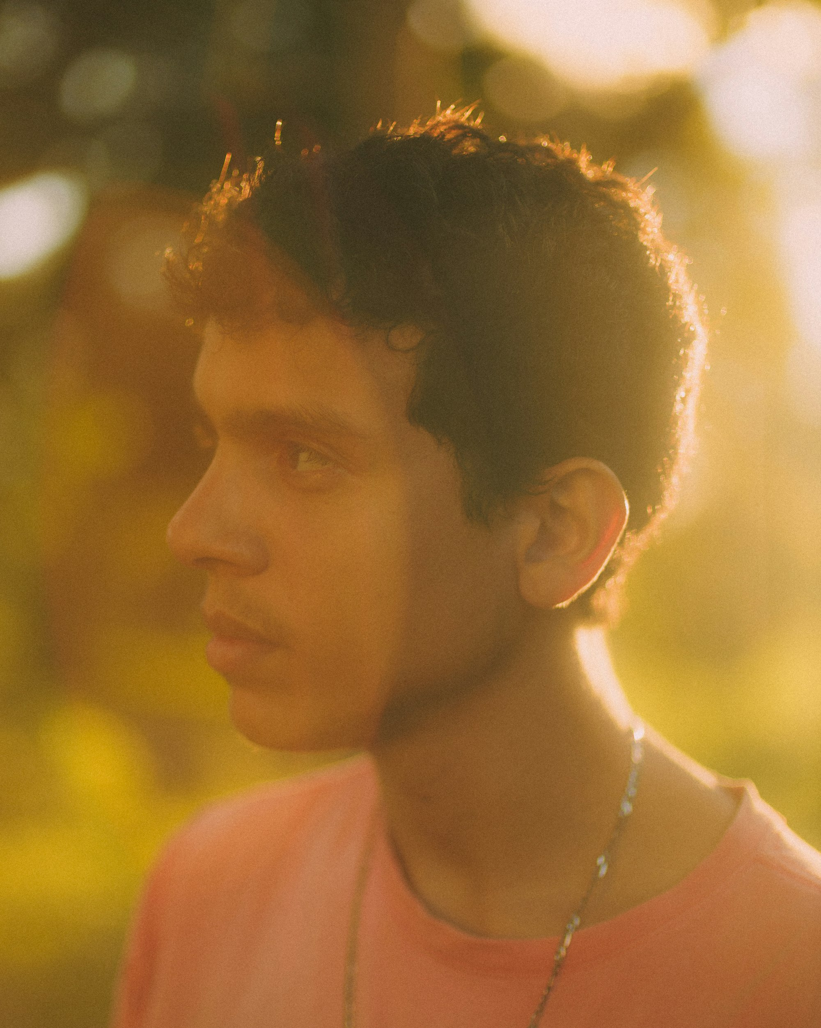
SLOP / UNIVERSITY
SLOP1416 / WEEK 3
Light and Colour
Reading and shaping light as an authorial decision: direction, quality and colour temperature, and what each one tells a viewer.
Notes:
Unsplash: https://images.unsplash.com/photo-1779497056472-2fa5e883dd36 — photographer Alef Morais (@alef_visuals), accessed 13 Sep 2026
Course teaching content is original.

Slide 2
SLOP / UNIVERSITY
WEEK 3 / 02
Technical outcomes
By the end of this lecture you can name, choose and plan light — not just notice it.
Read
Shape
Plan
Name the direction, quality and colour temperature of any light source in a shot or a location.
Choose a direction, quality and colour deliberately to set mood, direct attention and keep a subject readable.
Scout a location and time of day in advance and carry a backup light plan for Assignment 1.
SLOP1416 Visual Storytelling for Short-Form Media
Notes:
Original course learning outcomes, aligned to session 3's brief.

Slide 3
SLOP / UNIVERSITY
WEEK 3 / 03
Light is authored, not found
“Natural light” and “available light” describe a source, not a decision.
A camera does not perceive light neutrally. Two people photographing the same window at the same minute make different pictures because they choose where the subject stands relative to that light.
Passive framing
Authored framing
“The light was what it was” treats direction, quality and colour as fixed conditions to record.
The same source is selected, angled or filtered against a subject to produce a specific, repeatable read.
This lecture gives you the three variables that make that selection deliberate instead of accidental.
SLOP1416 Visual Storytelling for Short-Form Media
Notes:
Original framing device opening the lecture.

Slide 4
SLOP / UNIVERSITY
WEEK 3 / 04
Three variables describe any light
Direction, quality and colour temperature — used together for the rest of this lecture.
Variable
What it describes
Range
Direction
Where the source sits relative to the subject and the lens
front / side / back
Quality
How gradually the light falls off from lit to shadow
hard ↔ soft
Colour temperature
The hue of the source, measured in kelvin
warm ↔ cool
SLOP1416 Visual Storytelling for Short-Form Media
Notes:
Original analytic framework for the lecture.

Slide 5
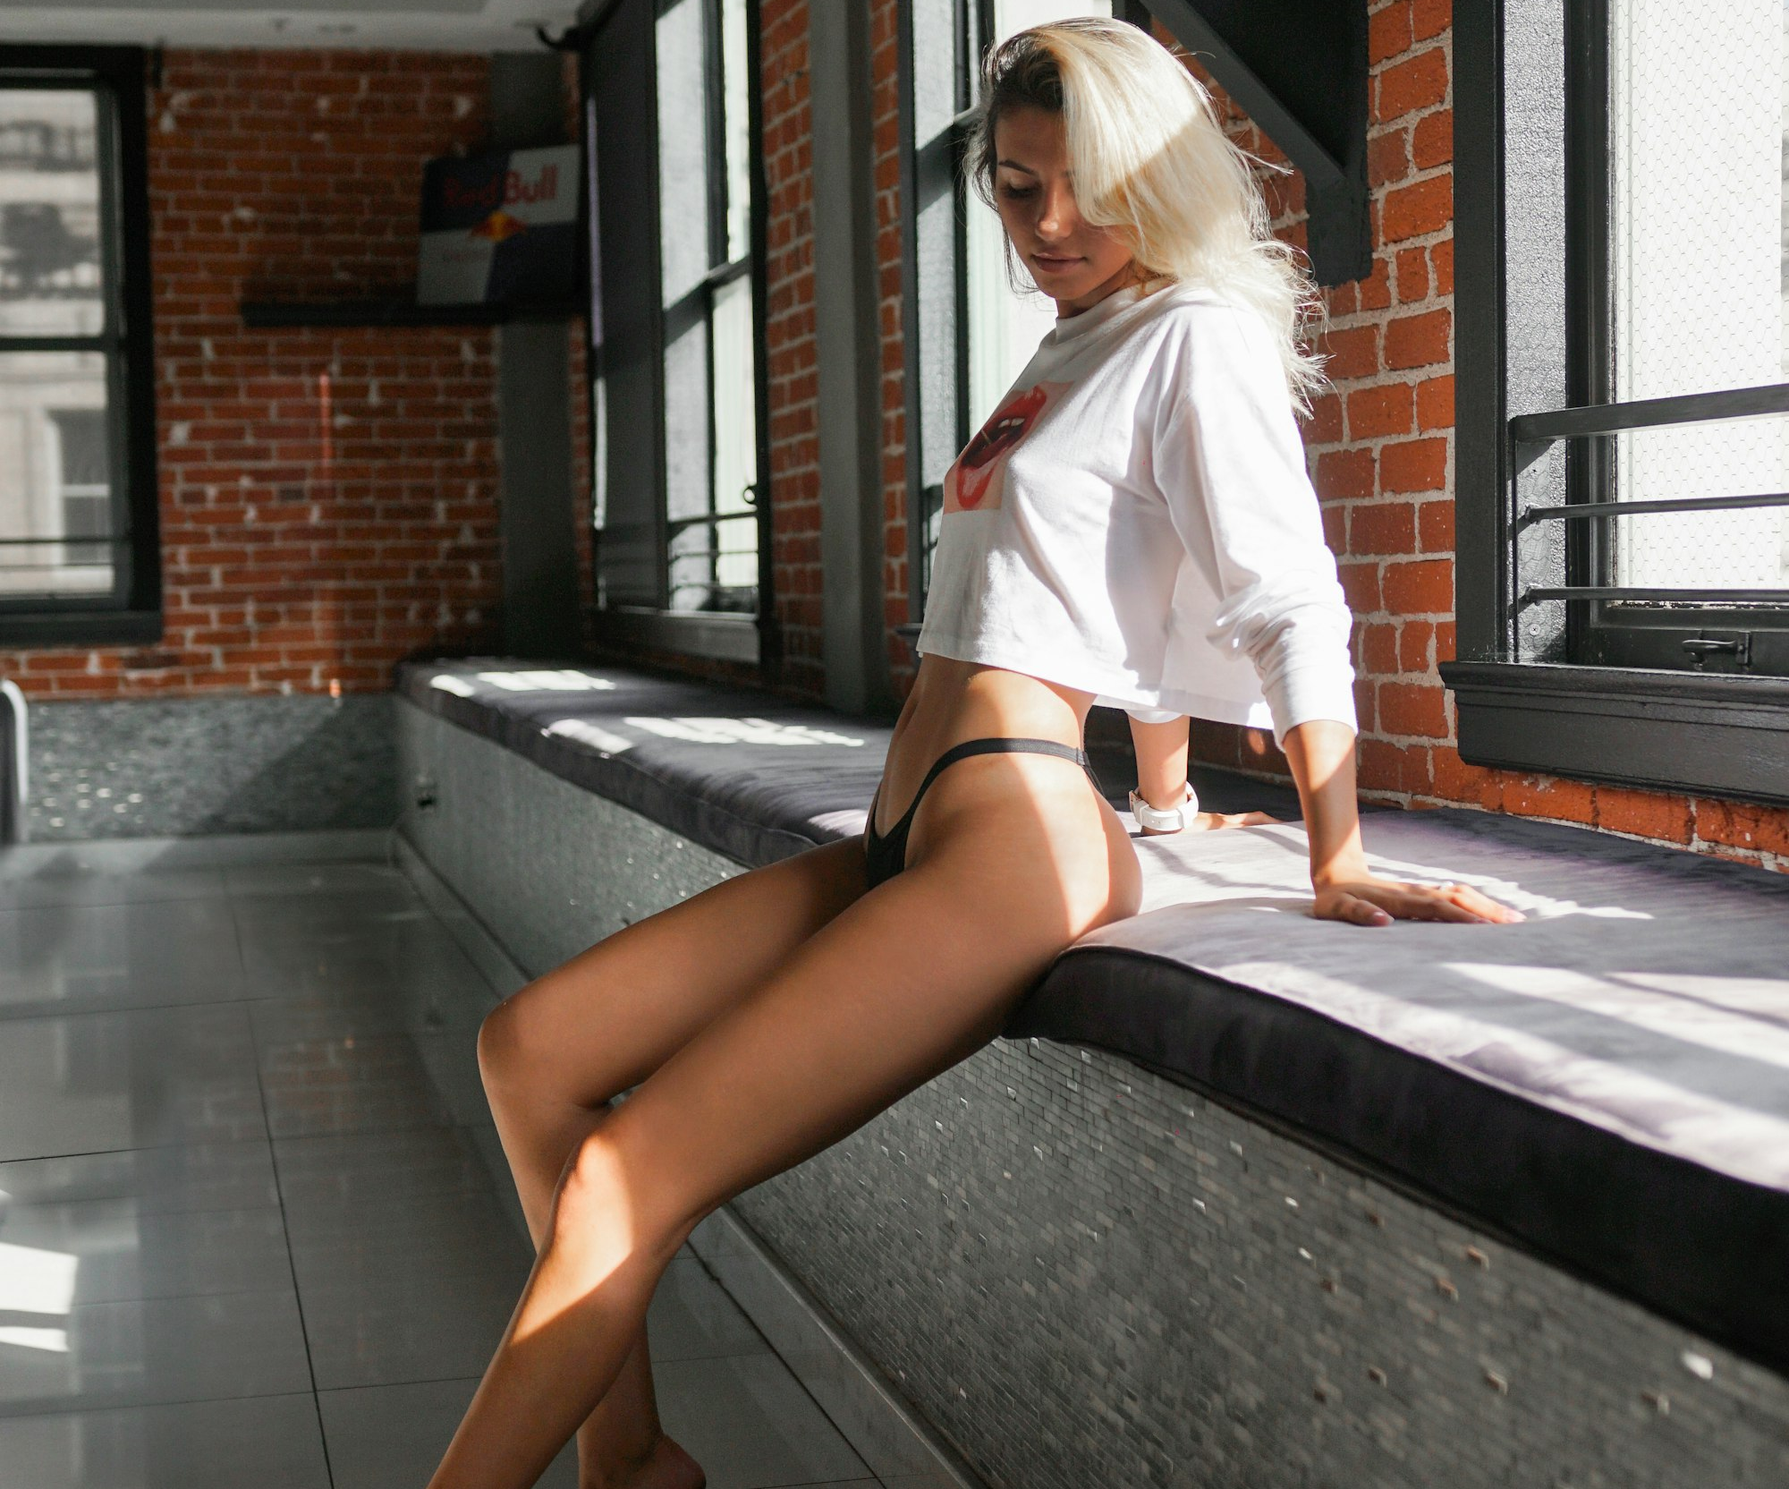
SLOP / UNIVERSITY
WEEK 3 / 05
Direction 1 / 3 — front light
Source close to the camera-subject axis.
Shadows fall directly behind the subject and are mostly hidden from the lens. Skin and surface texture read as smooth; the face reads as flat and low-drama.
Reads as
Neutral, approachable, informational — the register of an interview or a product shot.
Costs you
Little sense of volume or texture; a flat face can look generic on screen.
SLOP1416 Visual Storytelling for Short-Form Media
Notes:
Unsplash: https://images.unsplash.com/photo-1567894086133-49b03b2735e4 — photographer Garin Chadwick, accessed 13 Sep 2026

Slide 6
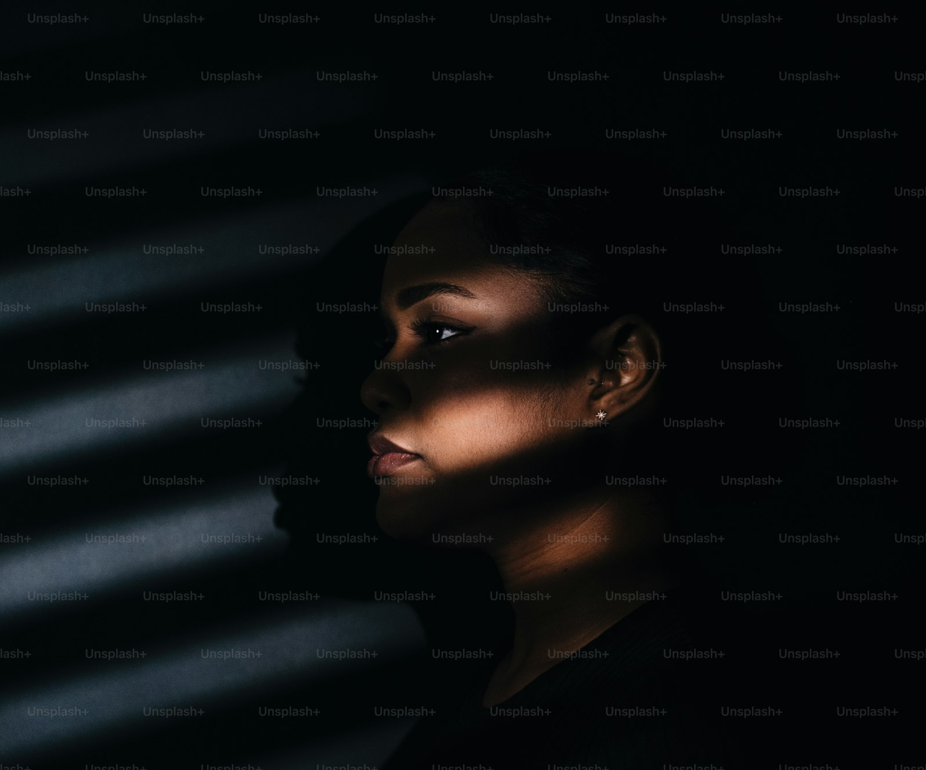
SLOP / UNIVERSITY
WEEK 3 / 06
Direction 2 / 3 — side light
Source roughly 90° from the lens axis.
Half the face lights, half falls into shadow. The classic “Rembrandt” placement leaves a small triangle of light on the shadow-side cheek.
Reads as
Tension, character, effort — texture and bone structure become visible.
Costs you
Half the face can lose detail entirely if nothing fills the shadow side.
SLOP1416 Visual Storytelling for Short-Form Media
Notes:
Unsplash (Unsplash+): https://plus.unsplash.com/premium_photo-1741884923786-6508e5206f6e — photographer Dmitrii Shirnin (@shirnind), accessed 13 Sep 2026

Slide 7
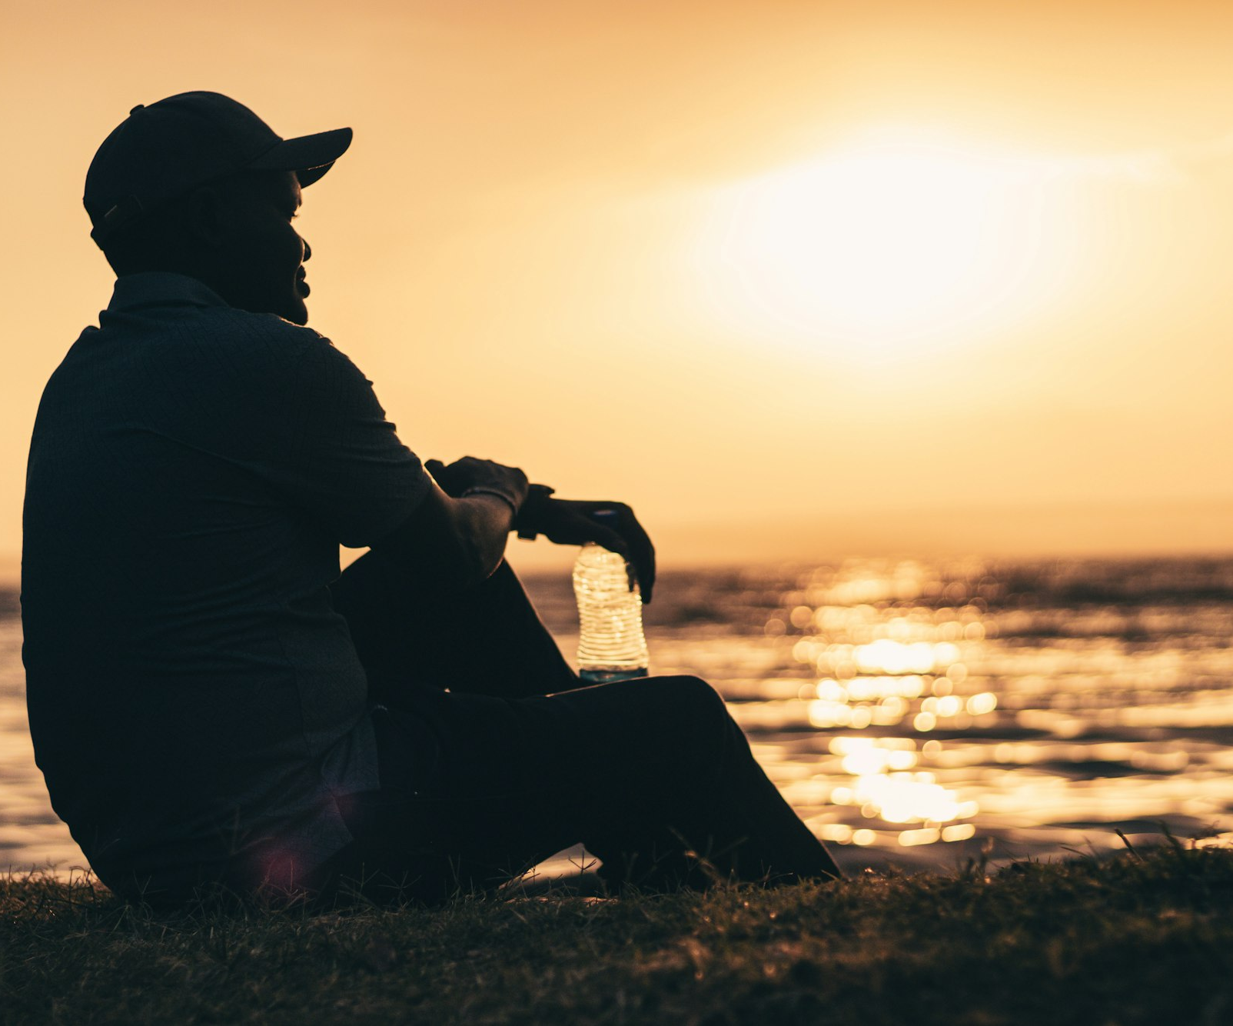
SLOP / UNIVERSITY
WEEK 3 / 07
Direction 3 / 3 — back light
Source behind the subject, aimed toward the lens.
With no light reaching the camera side of the subject, the outline separates from the background but the subject reads as a silhouette.
Reads as
Mystery, anonymity, scale — identity is withheld, shape is emphasised.
Costs you
No facial detail at all unless a fill source is added to lift the front.
SLOP1416 Visual Storytelling for Short-Form Media
Notes:
Unsplash: https://images.unsplash.com/photo-1752520835778-0063b1435f8a — photographer Brian Kungu (@oldceltic), accessed 13 Sep 2026

Slide 8
SLOP / UNIVERSITY
WEEK 3 / 08
Quality of light — hard vs soft
Quality is set by the source's apparent size relative to the subject, not by its brightness.
Hard light
Soft light
A small source, or a large source far away, casts a shadow with a sharp, defined edge. A clear midday sun is physically enormous but so distant it behaves like a point.
A large source close to the subject — an overcast sky, a diffusion panel, a window — casts a shadow whose edge fades gradually.
Rule: move a source closer, or make it physically larger, and its light gets softer — without changing its direction or its colour.
SLOP1416 Visual Storytelling for Short-Form Media
Notes:
Original explanation of the geometric basis of hard/soft light (apparent source size, not intensity).

Slide 9
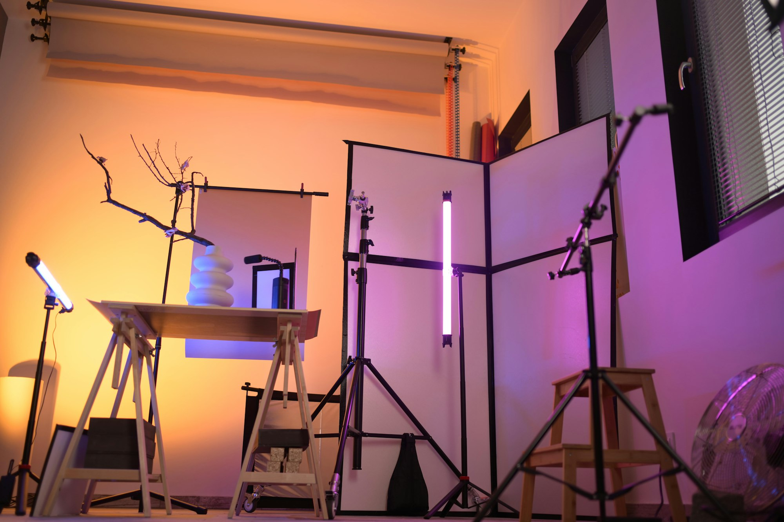
SLOP / UNIVERSITY
WEEK 3 / 09
Three-point lighting and ratio
The three roles, and the stop-based maths that sets contrast.
Key
Fill
Primary source. Sets exposure and the direction decided on the previous slides.
Raises shadow-side brightness. Placed opposite the key, always weaker than it.
Key : fill ratio
Difference
Effect
1:1
0 stops
flat, no shadow read
2:1
1 stop
moderate, most faces
4:1
2 stops
dramatic, defined shadow
8:1+
3+ stops
near-silhouette
SLOP1416 Visual Storytelling for Short-Form Media
Notes:
Original three-point lighting and ratio explanation. Unsplash: https://images.unsplash.com/photo-1767130298927-2df12c33e5d6 — photographer Sofia Lasheva (@sofizz), accessed 13 Sep 2026

Slide 10
SLOP / UNIVERSITY
WEEK 3 / 10
The kelvin scale
Colour temperature is measured against a theoretical heated black body: lower kelvin looks warmer, higher looks cooler.
~1,900 K
~3,200 K
~5,600 K
~7,500 K
10,000 K+
candle flame
tungsten / quartz film light
midday daylight
open shade, overcast sky
blue hour, deep shade
A camera's white balance setting tells it which kelvin value should render as neutral grey/white in the recorded image.
SLOP1416 Visual Storytelling for Short-Form Media
Notes:
Standard colour-temperature reference values used across cinematography and lighting texts (approximate, source-dependent).

Slide 11
SLOP / UNIVERSITY
WEEK 3 / 11
The warm end — golden hour
Low sun angle changes both colour and direction at once.
When the sun sits low, its light travels a longer path through the atmosphere. Shorter, blue wavelengths scatter out of that path; the light that reaches the subject is disproportionately red and orange.
See the cover photograph: a single low, warm source explains both its colour and its strong side-lit modelling.
Free side/back light
The same low angle that warms the colour also puts the sun to the side or behind most subjects — golden hour bundles colour and direction together.
Planning cost
It lasts roughly 30–60 minutes and moves — arrive with the shot already planned.
SLOP1416 Visual Storytelling for Short-Form Media
Notes:
Original explanation of Rayleigh scattering's effect on low-sun colour temperature. Cover image referenced rather than repeated.

Slide 12
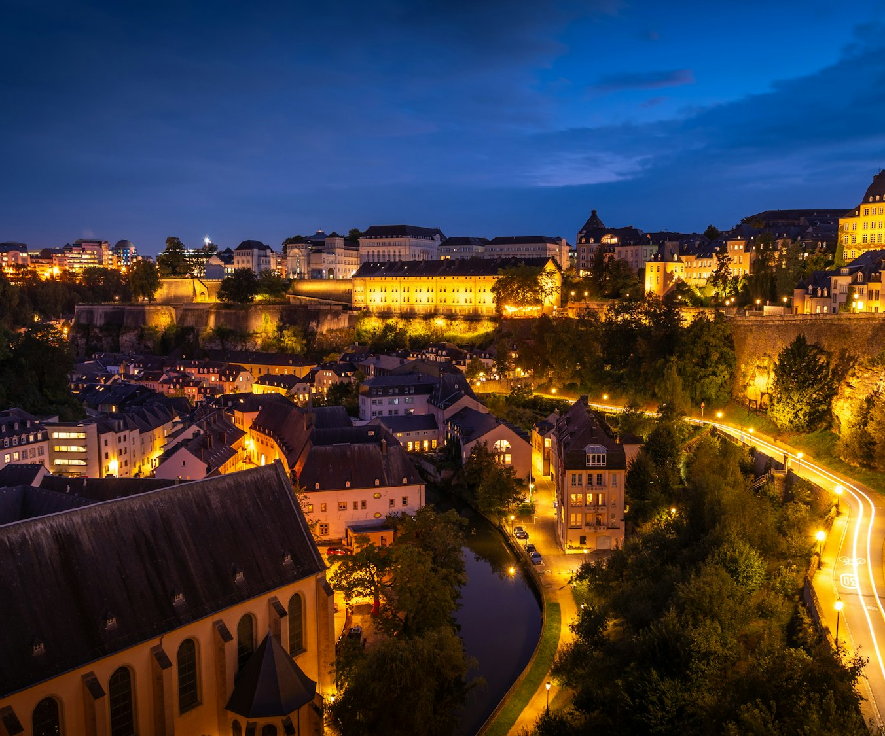
SLOP / UNIVERSITY
WEEK 3 / 12
The cool end — blue hour
After sunset, only scattered skylight remains — and it reads blue.
Once the sun drops below the horizon, direct sunlight is gone. The only light left is indirect, scattered skylight, which is rich in blue wavelengths and low in intensity.
Reads as
Calm, melancholy, or unease — blue hour is a common choice for a scene that needs to feel suspended.
Watch for
Tungsten windows and streetlights (~3,200 K) sit inside the same frame as ~10,000 K ambient sky — see the next slide.
SLOP1416 Visual Storytelling for Short-Form Media
Notes:
Unsplash: https://images.unsplash.com/photo-1748030278234-5c1e9f155c1a — photographer Pierre Blaché (@pierre9x6), accessed 13 Sep 2026

Slide 13
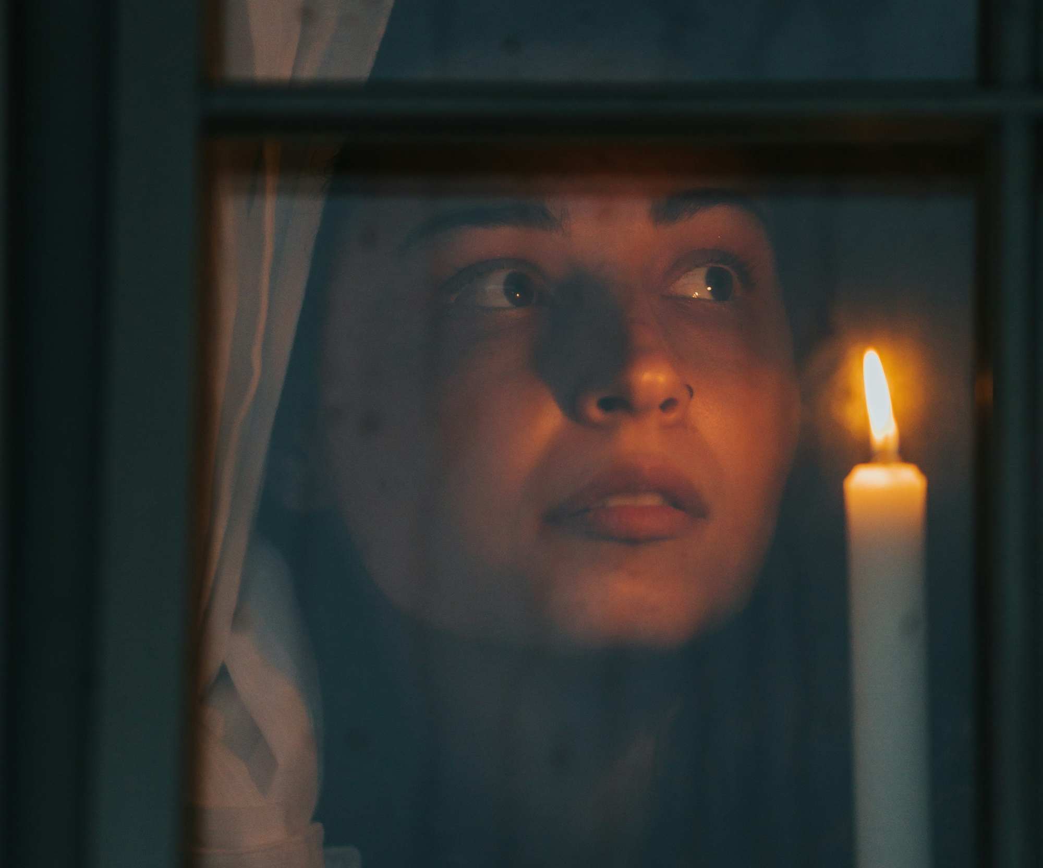
SLOP / UNIVERSITY
WEEK 3 / 13
Mixed colour temperature
A white-balance setting can only make one dominant source look neutral.
Set white balance for the blue-hour sky and every tungsten window turns orange. Set it for the tungsten and the sky turns deep blue. There is no setting that neutralises both.
The practical choice
Decide which source is the “truth” of the scene and white-balance for that one; let the other cast stay and read as mood.
Practical light
A single close, warm source like a candle behaves the same way: intensity falls off fast (inverse-square), so exposure is set for the lit side of the face only.
SLOP1416 Visual Storytelling for Short-Form Media
Notes:
Unsplash: https://images.unsplash.com/photo-1666964487789-56cb7242ae06 — photographer Roxana Zerni (@roxette12), accessed 13 Sep 2026

Slide 14
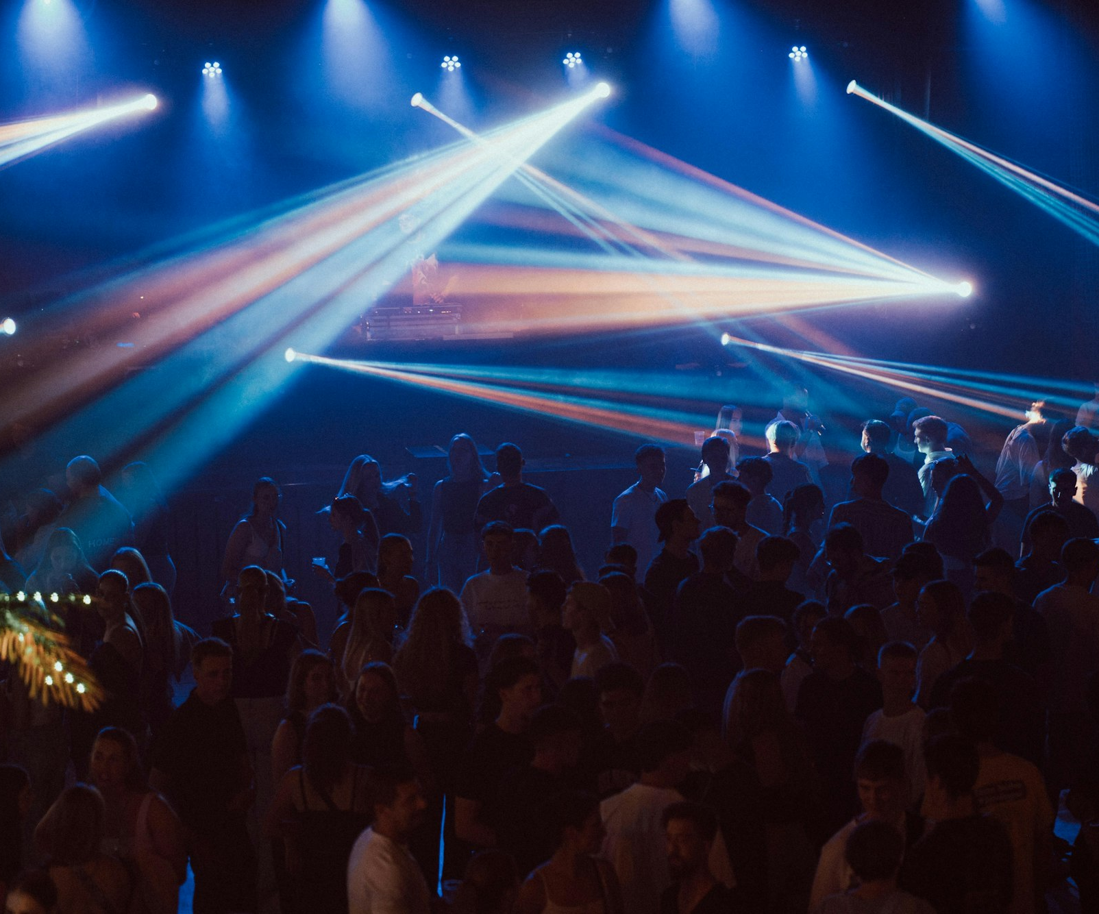
SLOP / UNIVERSITY
WEEK 3 / 14
Colour as meaning
Coloured light is a deliberate narrative signal, not decoration.
A gel changes the hue of a source outright. Two near-complementary hues — orange and teal, red and blue — placed in the same frame separate strongly because they sit opposite each other on the colour wheel.
Common pairing
Warm skin-tone light in the foreground against a cooler background keeps a subject readable even in a single wide shot.
Caution
Colour used everywhere reads as nothing; reserve strong hues for the moment that needs them.
SLOP1416 Visual Storytelling for Short-Form Media
Notes:
Unsplash: https://images.unsplash.com/photo-1758550445980-4d099c6de8d8 — photographer Marcel Strauß (@martzzl), accessed 13 Sep 2026

Slide 15
SLOP / UNIVERSITY
WEEK 3 / 15
Direction × quality × colour → meaning
The three variables combine; none of them works alone.
Combination
Typical read
Soft + front + neutral
Approachable, informational, low drama
Hard + side + warm
Textured, effortful, present-tense
Any + back + cool
Distant, withheld, uncertain
Soft + side + warm
Intimate, reflective, safe
Use this table to predict a read before you shoot — then check the result against what you intended.
SLOP1416 Visual Storytelling for Short-Form Media
Notes:
Original synthesis table connecting direction, quality and colour to the session brief's “shape mood, direct attention, keep a subject readable”.

Slide 16
SLOP / UNIVERSITY
WEEK 3 / 16
Subject readability
A viewer needs the subject to separate from everything behind it.
Luminance gap
Edge light
Hue contrast
Keep at least roughly one stop of brightness difference between subject and background.
A rim or back light traces the subject's outline against a background of similar tone.
A colour difference (warm subject, cool background) separates even at matched brightness.
If a subject disappears into the background in a still frame, no amount of good performance saves the shot in the edit.
SLOP1416 Visual Storytelling for Short-Form Media
Notes:
Original craft rules for subject/background separation.

Slide 17
SLOP / UNIVERSITY
WEEK 3 / 17
Directing attention with light
In a static frame, the eye moves first to the brightest, highest-contrast point.
Composition tells a viewer where to look. Light decides which part of that composition they see first — luminance hierarchy works before the viewer consciously reads the frame.
Deliberate hierarchy
Accidental hierarchy
One clearly brightest point — usually the subject's eyes or a key action — with everything else a step or more darker.
A bright window, sky or lamp behind a dim subject wins the eye by default and away from the story.
SLOP1416 Visual Storytelling for Short-Form Media
Notes:
Original explanation of luminance-driven attention, applied to lighting design rather than composition alone.

Slide 18
SLOP / UNIVERSITY
WEEK 3 / 18
Continuity of light across a cut
Light has its own version of the 180-degree line.
Two shots the viewer reads as “the same moment” need the same dominant direction and the same colour temperature. A cut from warm side light to flat blue light reads as a jump in time or place, intended or not.
Check before cutting
Match key direction, key:fill ratio and white balance across every shot meant to sit in the same scene.
Deliberate break
A real light change (a door opens, a lamp switches on) earns a visible shift — an unexplained one does not.
SLOP1416 Visual Storytelling for Short-Form Media
Notes:
Original continuity principle, extending Week 2's screen-direction rule to lighting.

Slide 19
SLOP / UNIVERSITY
WEEK 3 / 19
The three-shot exercise, deconstructed
Same routine, three light plans, three different meanings.
Shot 1 — hard, flat, midday
Shot 2 — warm side light
Shot 3 — cool back light
Overhead or front light, neutral colour. The routine reads as ordinary, unremarkable.
Late-afternoon or golden-hour side light. The same action now reads as significant, worth noticing.
Blue hour or silhouette. The action reads as solitary or uncertain.
The subject and the action do not change between shots — only the light plan does. That is the proof that light, not content, carried the meaning.
SLOP1416 Visual Storytelling for Short-Form Media
Notes:
Direct expansion of session 3's brief: “a three-shot exercise that uses changing light to alter the meaning of a routine.” Original teaching content.

Slide 20
SLOP / UNIVERSITY
WEEK 3 / 20
Reading light in reference footage
A repeatable four-step method for the session's reference-viewing task.
1
Name the direction: front, side or back, relative to the lens.
2
Name the quality: hard-edged or soft-edged shadow.
3
Name the colour: warm, neutral or cool, and note any mixed sources.
4
Describe the effect: what mood or emphasis that combination produces for this subject.
Apply this to the two shots from this week's reference-viewing task before judging whether the choice worked.
SLOP1416 Visual Storytelling for Short-Form Media
Notes:
Directly answers session 3's reference-viewing prompt: “Find two shots of one subject in different light. How does each lighting choice change the subject's mood or emphasis?”

Slide 21
SLOP / UNIVERSITY
WEEK 3 / 21
Planning your location and time
For the Assignment 1 light study: two contrasting conditions of the same subject.
1
Scout the location at the actual hour you plan to shoot, not a convenient one.
2
For outdoor light, note the sun's direction and how it will move during your window.
3
Identify one backup: an indoor room, a practical lamp, or a later/earlier time.
4
Write both the light you need and the backup directly into your Assignment 1 plan.
This is exactly the note session 3 asks you to add: a location, a time of day, the light you need, and a backup option.
SLOP1416 Visual Storytelling for Short-Form Media
Notes:
Directly answers session 3's “Afterwards” instruction and feeds Assignment 1's Light study exercise (two contrasting lighting conditions + 100-word comparison).

Slide 22
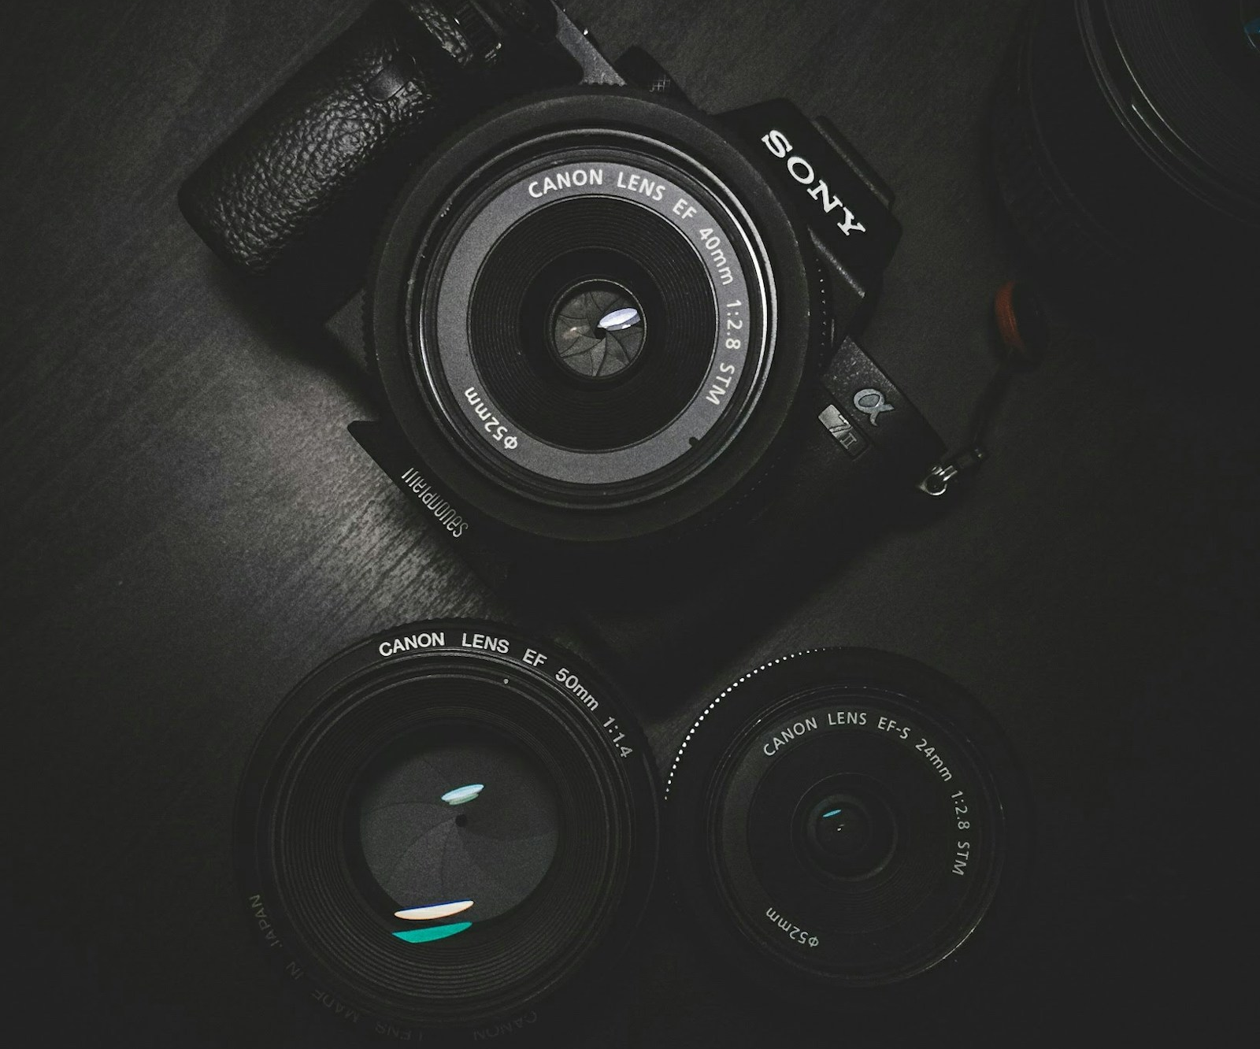
SLOP / UNIVERSITY
WEEK 3 / 22
From light plan to camera settings
A light plan only survives contact with a scene through the exposure controls from Week 2.
Two lighting conditions rarely share one exposure. Revisit shutter, aperture, ISO and white balance for each condition rather than reusing yesterday's settings.
Lower light
Slower shutter risks blur; wider aperture narrows focus; higher ISO adds noise — pick which cost you can accept.
Colour shift
Re-check or re-lock white balance every time the dominant source changes, even mid-location.
SLOP1416 Visual Storytelling for Short-Form Media
Notes:
Original bridge between this week's lighting theory and Week 2's exposure controls. Unsplash image asset: https://images.unsplash.com/photo-1485846234645-a62644f84728 (accessed 13 Sep 2026); reused from the Week 1 asset set.

Slide 23

SLOP / UNIVERSITY
WEEK 3 / 23
Colour in the edit
Correcting colour and grading colour are different decisions.
Correction neutralises an unwanted cast so footage matches what the scene actually looked like. Grading then pushes colour deliberately, for mood, on top of a corrected base.
Decide early
A grade that depends on “fixing it later” is a plan, not an accident — decide the intended look before you shoot.
Shot-to-shot match
Grade the whole scene together so a corrected clip does not sit next to an ungraded one.
SLOP1416 Visual Storytelling for Short-Form Media
Notes:
Unsplash (Unsplash+): https://plus.unsplash.com/premium_photo-1663040316559-8684ca45d7e9 — contributor Getty Images (@gettyimages), accessed 13 Sep 2026

Slide 24
SLOP / UNIVERSITY
WEEK 3 / 24
Week 3 in-session exercise
What you produce and submit for this session.
Brief
Compare front, side and back light on one subject, then shoot a three-shot exercise using changing light to alter the meaning of one routine.
Constraints
Keep the subject and action identical across the three shots. Only the light plan (direction, quality, colour, time of day) may change.
Evidence to submit
Three shots, a one-line light plan per shot (direction / quality / colour), and 100 words on which shot changed the routine's meaning most and why.
SLOP1416 Visual Storytelling for Short-Form Media
Notes:
Original SLOP1416 Week 3 in-session exercise, directly implementing the session brief.

Slide 25
SLOP / UNIVERSITY
WEEK 3 / 25
Technical review rubric
How light and colour choices are assessed in your submitted work.
Direction
The chosen direction is identifiable and matches the intended read.
Quality
Hard or soft edge is consistent with the stated intention, not accidental.
Colour
Colour temperature is controlled; any mixed cast reads as a choice.
Readability
The subject separates clearly from the background in every shot.
SLOP1416 Visual Storytelling for Short-Form Media
Notes:
Original review rubric, aligned to Assignment 1's ‘Image, light and sound choices’ criterion (30% weight).

Slide 26
SLOP / UNIVERSITY
WEEK 3 / 26
Recommended practice and preparation
Before next session.
Lighting reference
Blackmagic Design, Lighting for the DaVinci Resolve colourist workflow: https://www.blackmagicdesign.com/au/products/davinciresolve/training
Colour temperature reference
Adobe, Understanding colour temperature and white balance: https://helpx.adobe.com/premiere/using/color-workflow.html
Bring to Week 4
Two examples of the same place photographed or filmed at different times of day, ready to compare in session.
SLOP1416 Visual Storytelling for Short-Form Media
Notes:
External resources: Blackmagic Design DaVinci Resolve training; Adobe colour-workflow reference. Accessed 13 September 2026.

