Slide 1
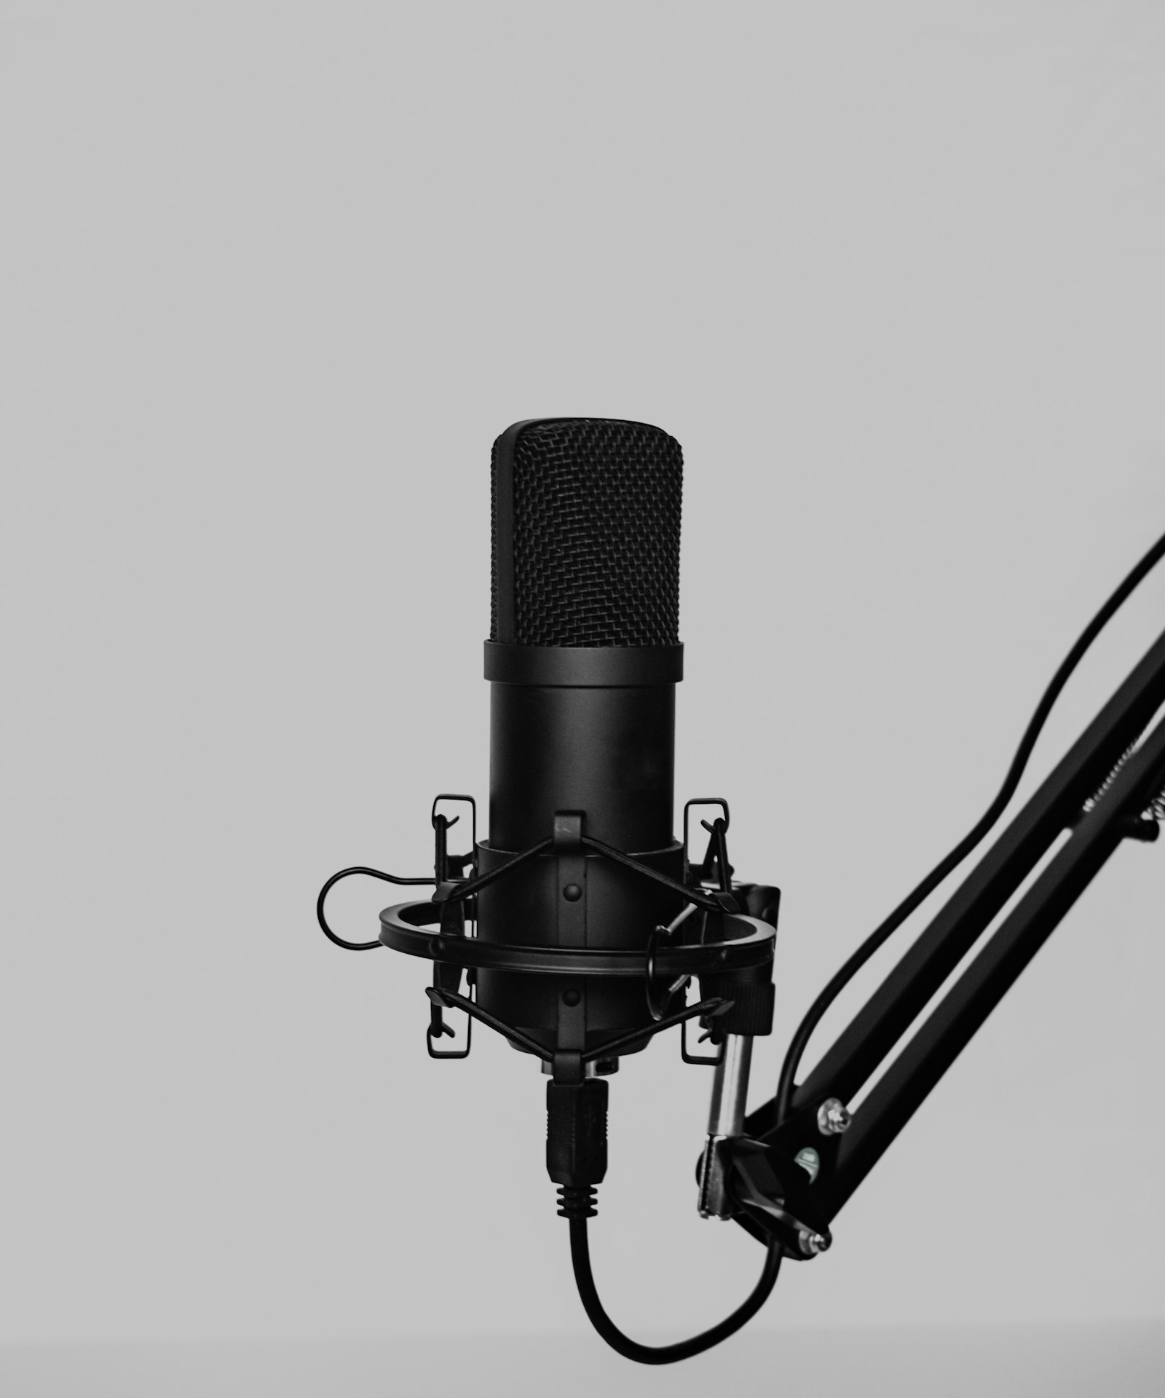
SLOP / UNIVERSITY
SLOP1416 / WEEK 4
Recording Sound
Capturing voice and ambient sound so a viewer understands where they are and what matters — the recording chain, mic choice, and listening while you shoot.
Notes:
Unsplash: https://images.unsplash.com/photo-1660631228116-b3643559f611 — photographer Klim Musalimov (@klim11), accessed 13 Sep 2026
Course teaching content is original.

Slide 2
SLOP / UNIVERSITY
WEEK 4 / 02
Technical outcomes
By the end of this lecture you can choose a microphone, protect a recording, and plan sound like a shot list.
Capture
Listen
Plan
Choose a microphone and placement that matches the scale of a shot, and gain-stage a recording so it survives the edit.
Monitor on headphones during the take, not just after, to catch clipping, wind and hum while they can still be fixed.
Treat sound as a planned element of a production — beginning, middle and end — not something recorded by accident.
SLOP1416 Visual Storytelling for Short-Form Media
Notes:
Original course learning outcomes, aligned to session 4's brief.

Slide 3
SLOP / UNIVERSITY
WEEK 4 / 03
Sound is captured, not caught
An on-camera mic records whatever is loudest nearest the lens — a chosen mic records what the story needs.
A camera's built-in microphone treats the whole space as equally worth recording: traffic, air-conditioning and the speaker's voice arrive at similar levels. A viewer's ear does the opposite — it follows attention.
Uncaptured sound
Captured sound
Whatever the on-board mic happens to pick up: distant, thin, and mixed with everything else in the room.
A mic chosen and placed for one source, monitored while recording, so the important sound is close and clear.
This lecture gives you the chain and the choices that turn accidental audio into a deliberate soundtrack.
SLOP1416 Visual Storytelling for Short-Form Media
Notes:
Original framing device opening the lecture, mirroring Week 3's authored-light framing.

Slide 4
SLOP / UNIVERSITY
WEEK 4 / 04
The recording chain
Every sound travels through four stages before it becomes a file — and can be lost at any one of them.
Stage
What happens there
Risk
Source
The voice, action or ambience actually making the sound
Wrong source recorded
Microphone
Converts air pressure into an electrical signal — pattern and placement decide what it hears
Wrong pattern picks up the wrong thing
Preamp / gain
Boosts that signal to a usable level before it is stored
Too little gain buries it in noise
Recorder
Converts the boosted signal into a digital file at a set sample rate and bit depth
Clipping destroys the file
SLOP1416 Visual Storytelling for Short-Form Media
Notes:
Original signal-chain framework for the lecture: source, mic, preamp/gain, recorder.

Slide 5
SLOP / UNIVERSITY
WEEK 4 / 05
Gain staging: headroom vs noise floor
Every recorder has a ceiling and a floor — your job is to sit between them.
Set gain too low
Set gain too high
The signal sits close to the recorder's noise floor. You can raise the level later, but you raise the hiss with it — noise cannot be edited back out.
Peaks exceed 0 dBFS and clip: the waveform is cut flat and the digital distortion is permanent, unlike an overexposed frame.
Rule: aim for peaks around ‒12 to –6 dBFS, leaving headroom for the loudest moment you have not heard yet — a shout, a slammed door, a laugh.
SLOP1416 Visual Storytelling for Short-Form Media
Notes:
Original explanation of gain staging: headroom, noise floor, and why clipping is unrecoverable while low gain is merely lossy.

Slide 6
SLOP / UNIVERSITY
WEEK 4 / 06
Microphone polar patterns
A polar pattern describes which directions a microphone is sensitive to — it decides what gets recorded as much as where you point it.
Pattern
Sensitivity
Best use
Omnidirectional
Equally sensitive all around
room tone, ambience, group scenes
Cardioid
Sensitive to the front, rejects the rear
single speaker, general dialogue
Hypercardioid / shotgun
Narrow front lobe, longer reach
boom-mounted dialogue, isolating one source
Lavalier (omni, worn close)
Small omni capsule worn on the body
consistent level regardless of camera distance
SLOP1416 Visual Storytelling for Short-Form Media
Notes:
Original overview table of microphone polar patterns, expanded in the following three slides.

Slide 7
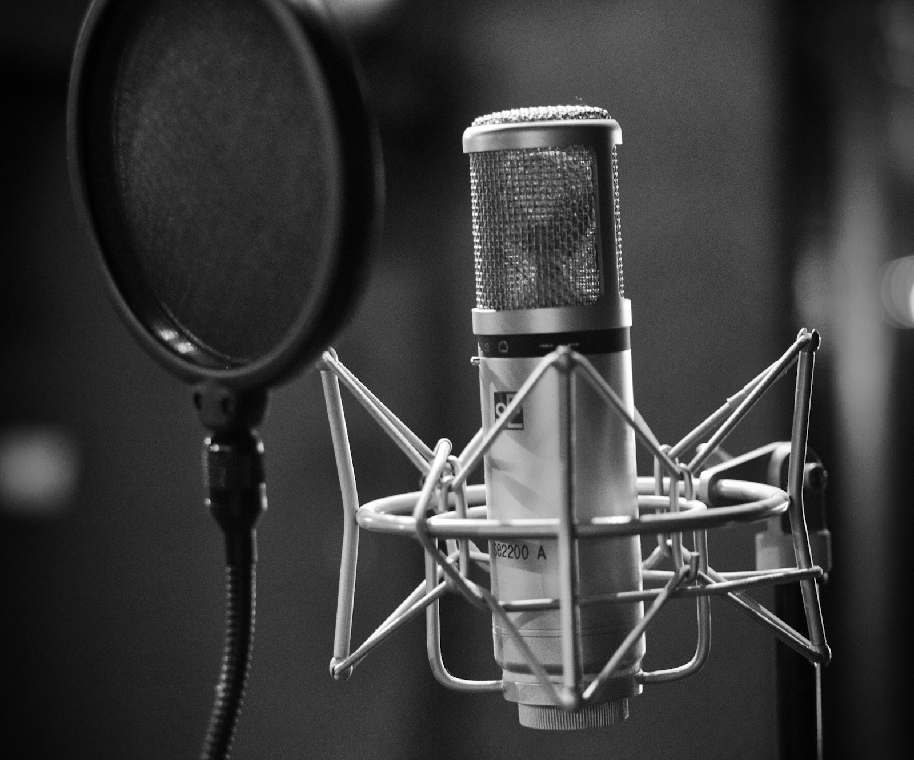
SLOP / UNIVERSITY
WEEK 4 / 07
Pattern 1 / 3 — cardioid and proximity
The default studio and interview pattern — sensitive to the front, deaf to the rear.
A cardioid capsule rejects sound from behind it, which is why it is the standard choice for a single voice with a room behind the camera.
Proximity effect
Move a directional mic closer and low frequencies boost disproportionately — the voice gets warmer and fuller.
Pop filter
A screen between mouth and capsule breaks up the fast air bursts of “p” and “b” sounds before they hit the diaphragm.
SLOP1416 Visual Storytelling for Short-Form Media
Notes:
Unsplash: https://images.unsplash.com/photo-1531651008558-ed1740375b39 — photographer Leo Wieling, accessed 13 Sep 2026

Slide 8
SLOP / UNIVERSITY
WEEK 4 / 08
Pattern 2 / 3 — hypercardioid and shotgun
A narrow front lobe reaches further into a scene without moving the mic into frame.
A shotgun's interference tube cancels off-axis sound so effectively that it can isolate a speaker from traffic or wind several metres away — at the cost of being unforgiving about aim.
Boom operating
Held just outside frame, angled down at the mouth, tracking the speaker's head as they move or turn.
Off-axis colouration
Sound that is not directly on-axis is not just quieter — it is tonally duller, which is audible if the boom drifts mid-line.
SLOP1416 Visual Storytelling for Short-Form Media
Notes:
Original explanation of interference-tube shotgun design and boom operating practice. Unsplash: https://images.unsplash.com/photo-1660631228116-b3643559f611 — photographer Klim Musalimov (@klim11), accessed 13 Sep 2026

Slide 9
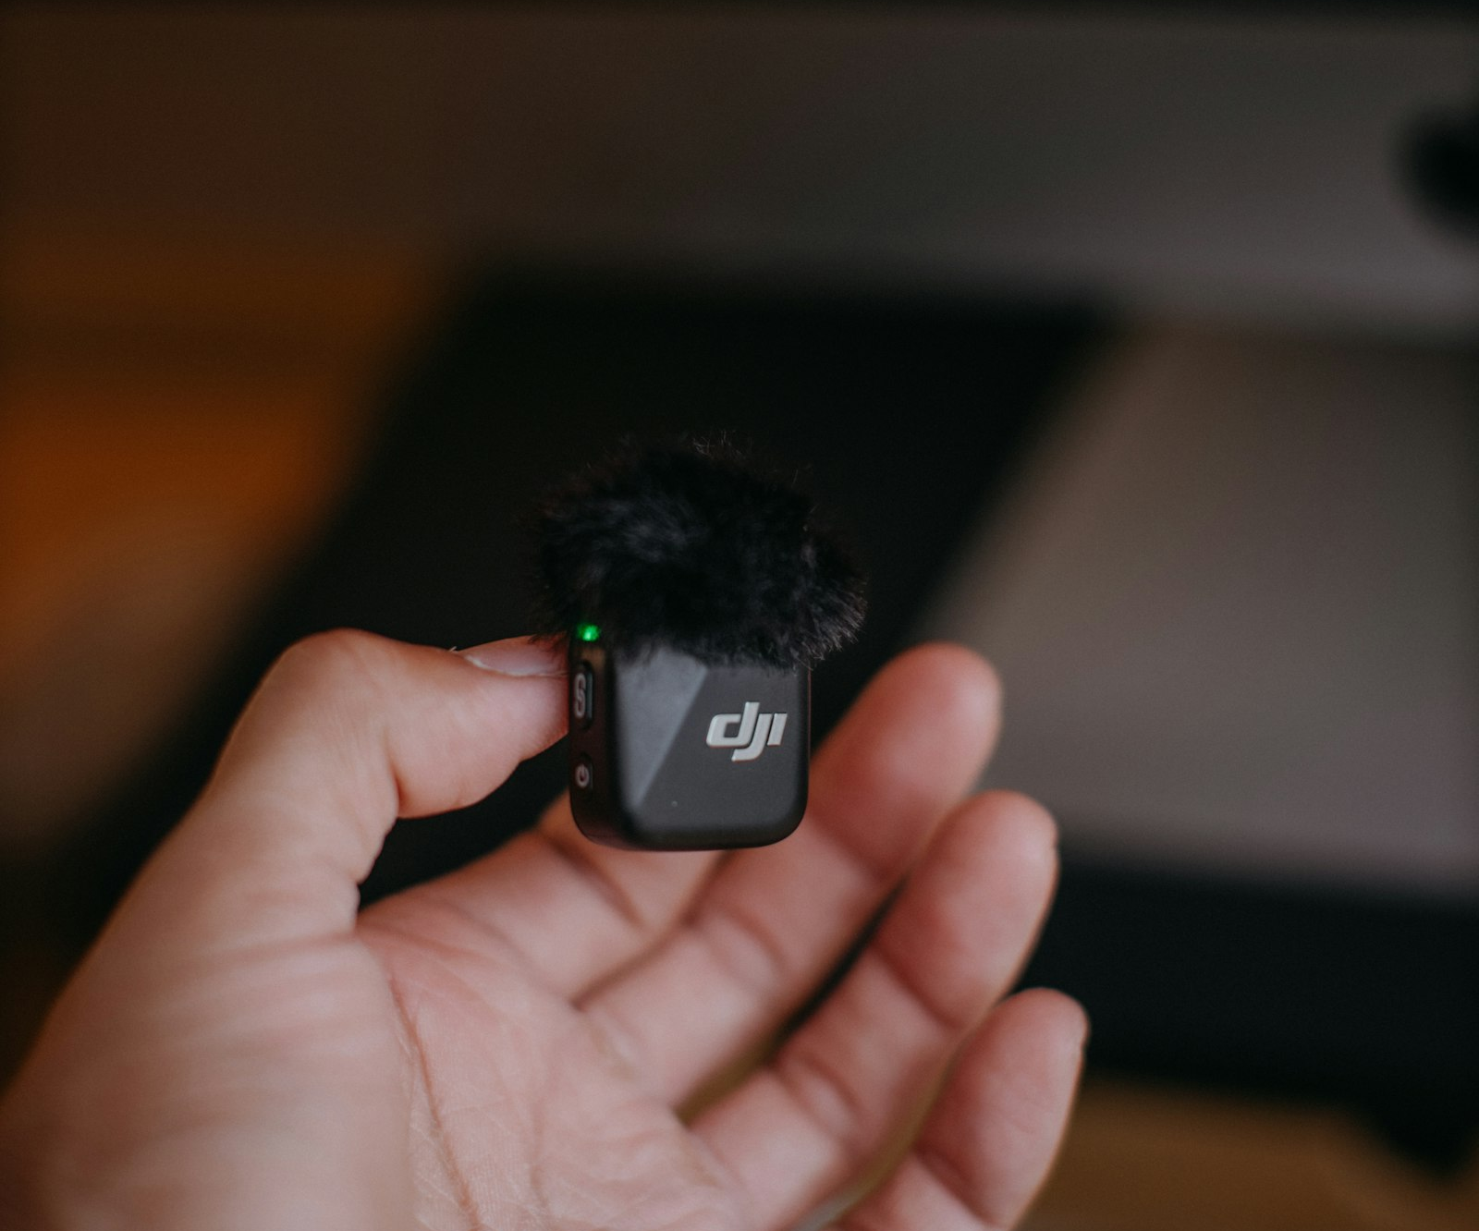
SLOP / UNIVERSITY
WEEK 4 / 09
Pattern 3 / 3 — lavalier mics
A small omni capsule worn on the body trades polar precision for consistent distance.
Clipped 10–15 cm below the chin, a lav stays the same distance from the mouth no matter how the speaker turns or how far they are from camera — a boom cannot guarantee that.
Placement risk
Too close to fabric and every movement becomes a rustle; too low and consonants lose clarity.
When to choose it
Multi-camera interviews, moving subjects, or any shot where a boom cannot stay out of frame.
SLOP1416 Visual Storytelling for Short-Form Media
Notes:
Unsplash: https://images.unsplash.com/photo-1764557206181-0c64c56be486 — photographer JJ ROCHA (@that_person), accessed 13 Sep 2026

Slide 10
SLOP / UNIVERSITY
WEEK 4 / 10
Direct-to-reverberant ratio
The balance between a source's direct sound and the room's reflections tells a listener how large and how close a space is.
Every recorded sound is a mix of the direct wave from the source and reflected copies bouncing off walls, floors and ceilings a fraction of a second later. Moving the mic changes that ratio without changing the room.
Close mic, high direct ratio
Reads as intimate and dry — the room disappears, which can feel disconnected from a wide establishing shot.
Distant mic, high reverberant ratio
Reads as spacious or cavernous — useful for establishing scale, wrong for a close confessional line.
SLOP1416 Visual Storytelling for Short-Form Media
Notes:
Original explanation of direct-to-reverberant ratio and its perceptual effect on sense of space.

Slide 11
SLOP / UNIVERSITY
WEEK 4 / 11
Room tone and the ambient bed
Thirty to sixty seconds of “silence” recorded in every location is not optional.
No real location is silent — a room has its own constant hiss of HVAC, traffic, wind or hum. An editor needs a clean sample of that exact tone to smooth over cuts, cover a removed line, or fill a gap left by an edit.
Record it every location
Before or after the take, ask everyone to stay still and quiet for 30–60 seconds while the room's own sound is captured alone.
Why it matters
Without matching room tone, a silent gap in the edit reads as an unnatural, artificial silence rather than the room simply pausing.
SLOP1416 Visual Storytelling for Short-Form Media
Notes:
Original explanation of room tone / ambient bed capture, directly answering session 4's “collect ten seconds of ambient sound” preparation task.

Slide 12
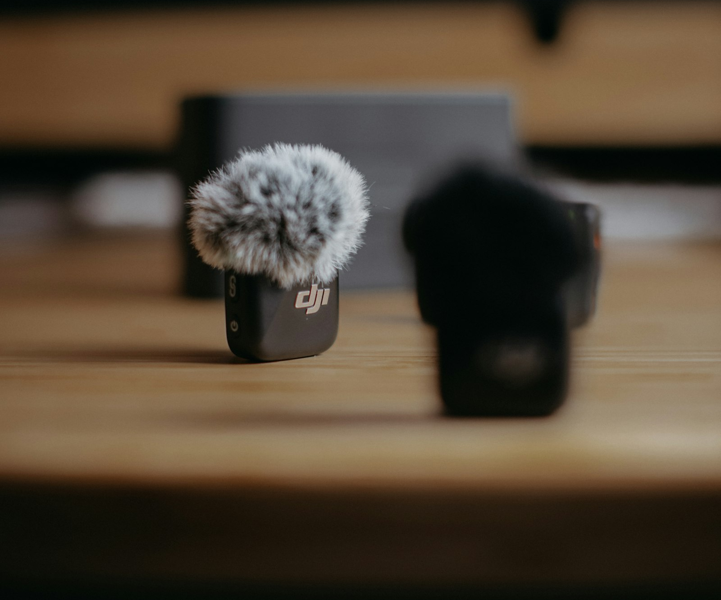
SLOP / UNIVERSITY
WEEK 4 / 12
Wind noise
Wind is not loud in the air — it becomes loud the moment it hits a microphone capsule.
Moving air across an unprotected capsule creates turbulence directly on the diaphragm, producing a low rumble that has nothing to do with the actual scene — foam alone stops only light breeze.
Foam windscreen
Cuts breath blasts and gentle air movement indoors; largely ineffective outdoors above a light breeze.
Deadcat / blimp
A furry cover over a rigid basket traps a layer of still air around the capsule — the only reliable outdoor defence.
SLOP1416 Visual Storytelling for Short-Form Media
Notes:
Original explanation of wind-turbulence physics and windscreen design. Unsplash: https://images.unsplash.com/photo-1764557207194-c6b27d50945b — photographer JJ ROCHA (@that_person), accessed 13 Sep 2026

Slide 13
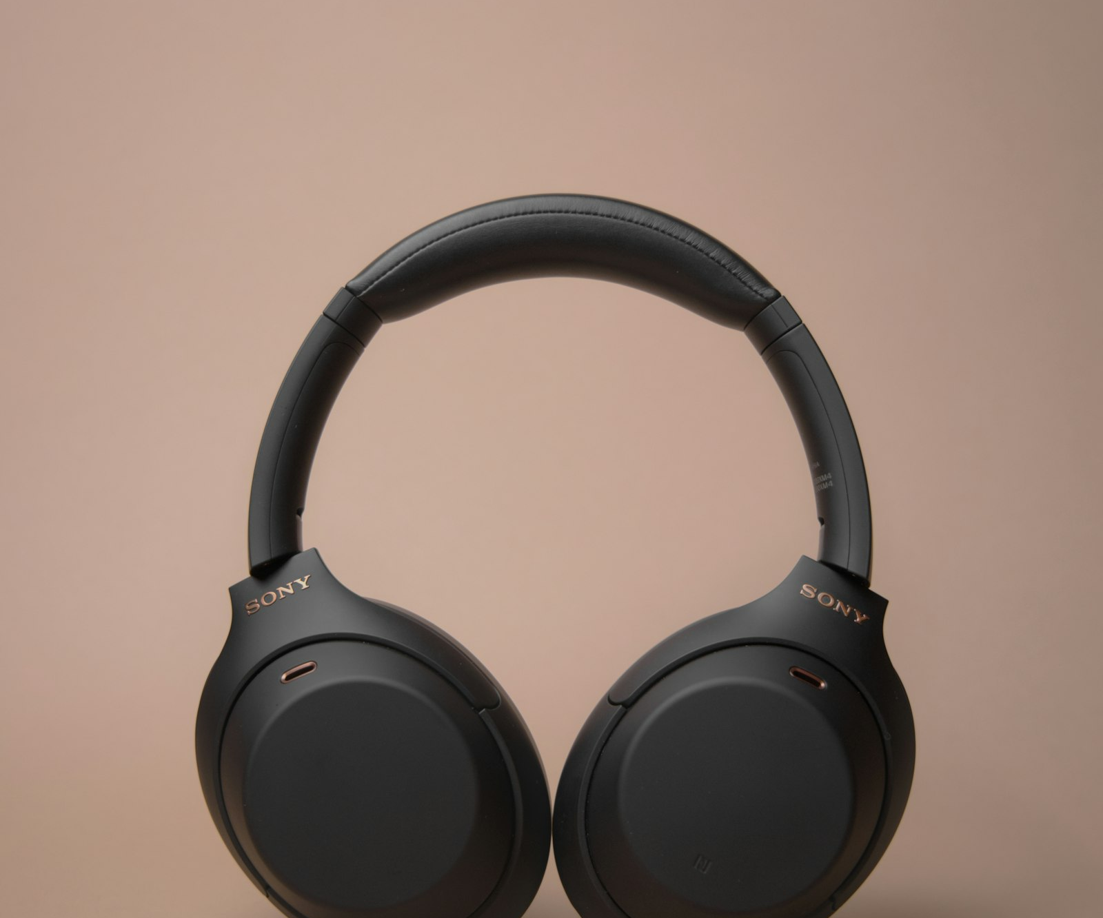
SLOP / UNIVERSITY
WEEK 4 / 13
Monitoring while you record
Closed-back headphones are the only reliable way to hear what the microphone actually hears.
Your ears in the room automatically filter out a hum, a rattle or a distant siren that the microphone records without judgement. Only monitoring reveals what was actually captured.
Closed-back, not open
Closed cups seal out the room so you hear the feed, not the room bleeding around the earcup.
Check every take
Clipping, wind rumble, dropouts and unexpected hum are all audible immediately — and unfixable once the crew has left.
SLOP1416 Visual Storytelling for Short-Form Media
Notes:
Unsplash: https://images.unsplash.com/photo-1618366712010-f4ae9c647dcb — photographer Luke Peterson (@ldpeterson11), accessed 13 Sep 2026

Slide 14
SLOP / UNIVERSITY
WEEK 4 / 14
Frequency basics
The human voice and most unwanted noise do not occupy the same part of the spectrum equally.
~85–255 Hz
~300 Hz–3 kHz
~20–200 Hz
4 kHz+
voice fundamental (pitch)
speech intelligibility / formants
HVAC hum, traffic rumble, handling noise
sibilance, air, high-frequency hiss
Placement that keeps a mic close to the mouth favours the intelligibility band; distance lets low-frequency room noise dominate instead.
SLOP1416 Visual Storytelling for Short-Form Media
Notes:
Standard voice-frequency and noise-band reference ranges used across audio-engineering and post-production texts (approximate, source-dependent).

Slide 15
SLOP / UNIVERSITY
WEEK 4 / 15
Sound perspective matches shot scale
A wide shot with dry, close audio breaks the same illusion a close-up with a distant, roomy voice does.
Wide shot
Close shot
The audience expects more room tone and reverberation — the subject is far from an implied listener, so the sound should feel far too.
The audience expects direct, present sound with little room — mismatch here (thin, roomy audio on a tight close-up) reads as wrong immediately.
This is sound's version of Week 3's light continuity: what the ear expects has to agree with what the eye is shown in the same moment.
SLOP1416 Visual Storytelling for Short-Form Media
Notes:
Original explanation of sound-perspective matching, explicitly bridging to Week 3's continuity concept as requested by session 4's brief.

Slide 16
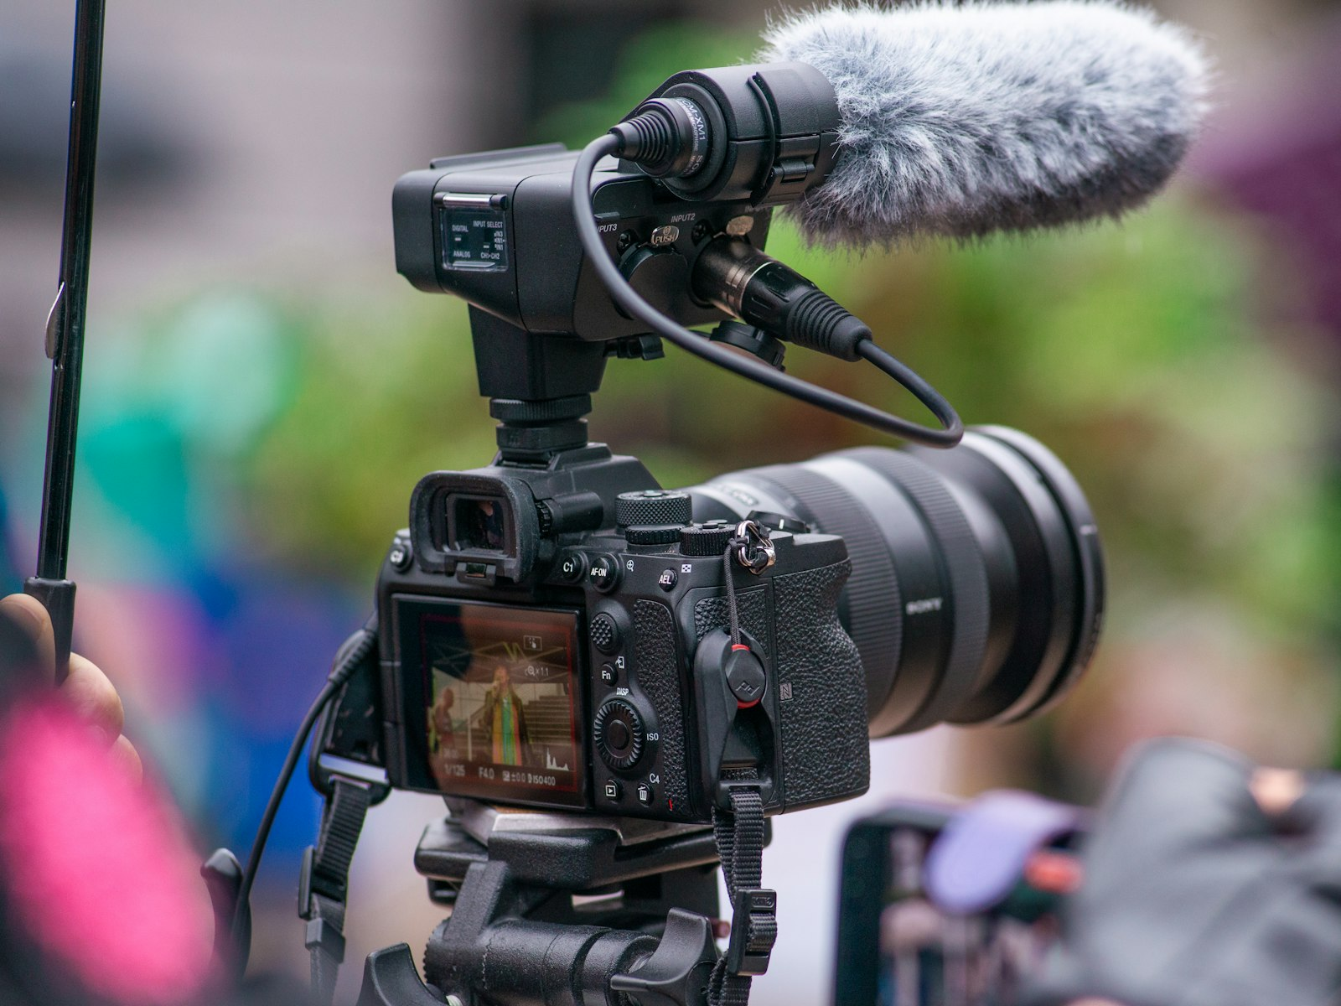
SLOP / UNIVERSITY
WEEK 4 / 16
On-camera mic vs external mic
The built-in microphone is a safety net, not a plan.
A camera's on-board capsule sits several centimetres from the lens, aimed at the whole scene, often picking up the camera's own handling noise and autofocus motor.
Always run a backup
Record the on-camera mic alongside an external one — a reference track that syncs even if the main mic fails.
External is the plan
A shotgun on the hot shoe, a boom, or a lavalier is the intended source; the built-in mic is the fallback, not the first choice.
SLOP1416 Visual Storytelling for Short-Form Media
Notes:
Unsplash: https://images.unsplash.com/photo-1698199071311-bd5fe0e37449 — photographer Albert Stoynov, accessed 13 Sep 2026

Slide 17
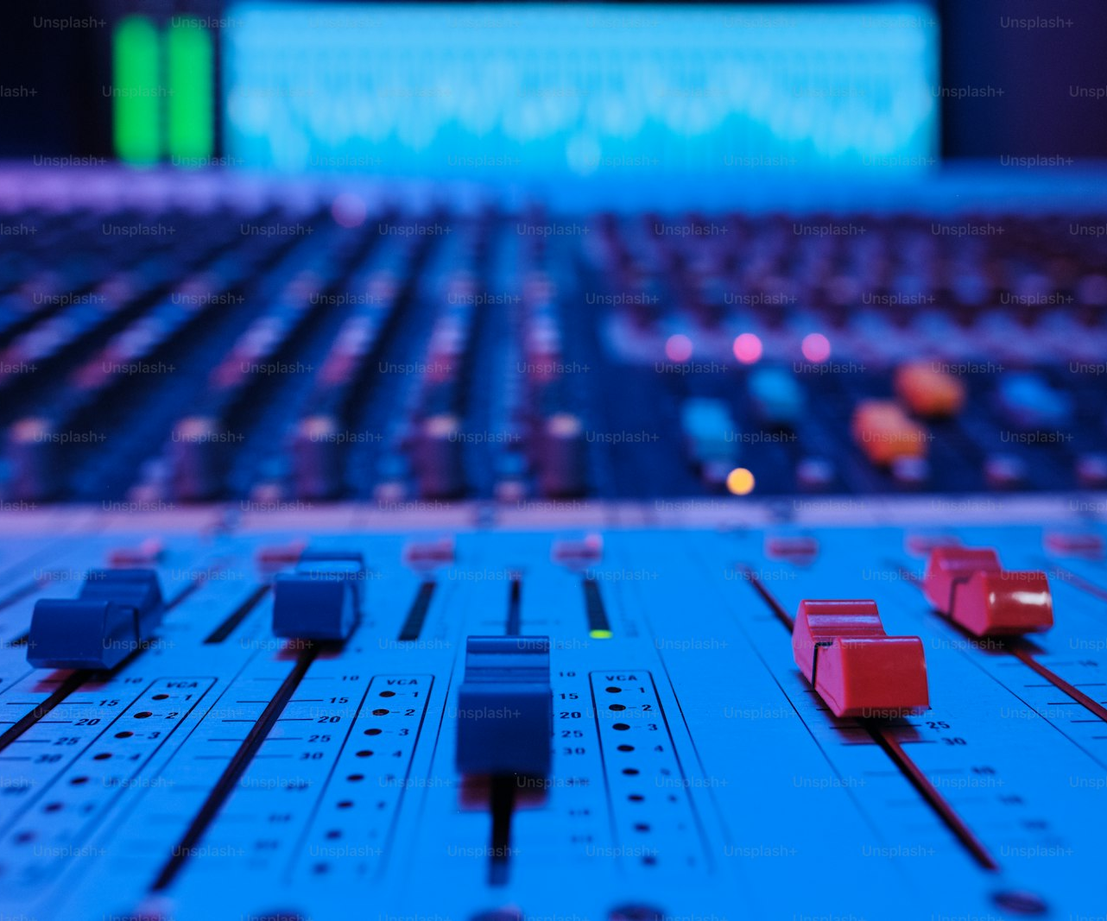
SLOP / UNIVERSITY
WEEK 4 / 17
Gain staging in practice
A field mixer or recorder gives you a meter — read it, don't guess.
Set input gain during a rehearsal at the loudest expected level, watch the meter peak below clipping, then leave it alone — riding gain live risks audible level jumps.
Rehearse at full volume
Ask the speaker to deliver their loudest line before recording, not their normal conversational level.
Limiters are a safety net
A recorder's built-in limiter can catch an unexpected peak, but it is a last resort, not a substitute for correct gain.
SLOP1416 Visual Storytelling for Short-Form Media
Notes:
Unsplash (Unsplash+): https://plus.unsplash.com/premium_photo-1682124293900-54bea8ca7e9f — contributor Getty Images (@gettyimages), accessed 13 Sep 2026

Slide 18

SLOP / UNIVERSITY
WEEK 4 / 18
Sample rate, bit depth and sync
Two numbers describe every digital recording — and a clap describes how it lines up with picture.
48 kHz / 24-bit is the standard for video production: 48,000 samples per second gives clean sync with common frame rates, and 24-bit gives headroom to correct level in post without adding noise.
Match your camera
Record audio and video at the same sample rate; mismatched rates cause the two to drift out of sync over a long take.
Slate or clap
A visible, audible clap gives the edit a single shared frame to align a separate audio recorder with the picture.
SLOP1416 Visual Storytelling for Short-Form Media
Notes:
Unsplash (Unsplash+): https://plus.unsplash.com/premium_photo-1664303403877-7f079e34aec9 — contributor Getty Images (@gettyimages), accessed 13 Sep 2026

Slide 19
SLOP / UNIVERSITY
WEEK 4 / 19
Diegetic vs non-diegetic sound
Whether a sound's source exists inside the world of the scene changes what it can be used to say.
Diegetic
Non-diegetic
A sound whose source is present in the scene: dialogue, footsteps, a radio playing in the room. The subject could, in principle, hear it too.
A sound added for the audience only: narration, a music score, a sound effect layered over picture. The subject cannot hear it.
A sound portrait built entirely from diegetic ambience and voice earns its claim to document a real place; added music undercuts that claim.
SLOP1416 Visual Storytelling for Short-Form Media
Notes:
Original explanation of the diegetic/non-diegetic distinction, applied to the documentary-style honesty expected of a sound portrait.

Slide 20
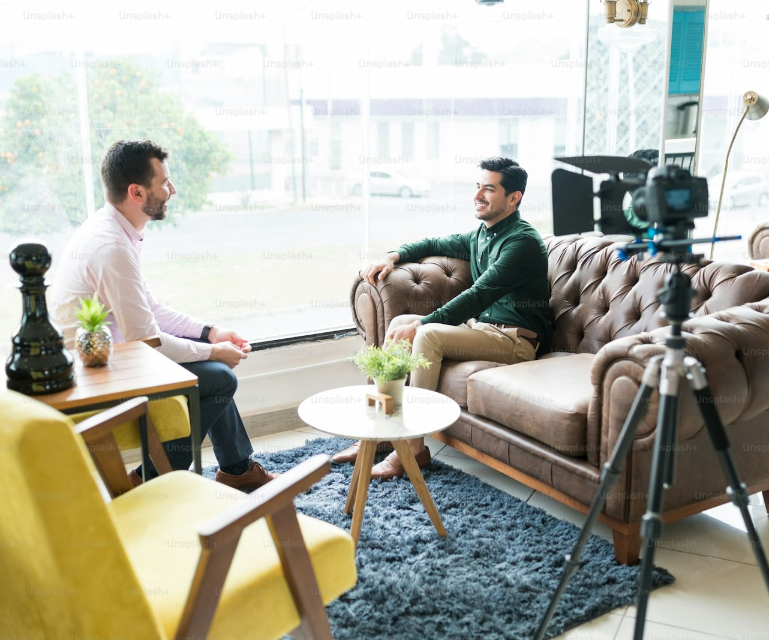
SLOP / UNIVERSITY
WEEK 4 / 20
Your field kit
A minimum viable sound kit for the sound-portrait exercise and Assignment 1.
You do not need a full mixer to record usable sound — you need a mic matched to the source, a windscreen, headphones, and the discipline to monitor every take.
Minimum kit
One directional or lavalier mic, a foam or fur windscreen, closed-back headphones, and spare batteries or charge.
Test before the shoot
Record ten seconds in the actual location beforehand and listen back on headphones — fix problems before the take that matters.
SLOP1416 Visual Storytelling for Short-Form Media
Notes:
Unsplash (Unsplash+): https://plus.unsplash.com/premium_photo-1682089018098-e616e4e065e2 — contributor Getty Images (@gettyimages), accessed 13 Sep 2026

Slide 21
SLOP / UNIVERSITY
WEEK 4 / 21
The sound portrait, deconstructed
Three moves build a thirty-second sequence led by sound rather than image.
1 — Establish place
2 — Foreground the subject
3 — Resolve
Open on the ambient bed alone — the room tone or environment sound that tells a listener where they are before anything else happens.
Bring in the significant voice or sound — speech, a distinct action — closer and clearer than the bed around it.
Let the foregrounded sound finish or fade, returning attention to the ambient bed — a deliberate, not accidental, ending.
This is the direct structure behind Assignment 1's sound-portrait exercise: a 30-second sequence led by ambient sound or clear voice.
SLOP1416 Visual Storytelling for Short-Form Media
Notes:
Direct expansion of Assignment 1's “Sound portrait” exercise (30-second sequence led by ambient sound or clear voice). Unsplash: https://images.unsplash.com/photo-1764557207162-e98edb2457e8 — photographer JJ ROCHA (@that_person), accessed 13 Sep 2026

Slide 22
SLOP / UNIVERSITY
WEEK 4 / 22
Continuity of sound across a cut
Sound has its own version of Week 3's light-continuity rule.
Two shots the viewer reads as “the same moment” need a matching room tone and a consistent sound perspective. A cut from close, dry dialogue to distant, roomy dialogue reads as a jump in space or time, intended or not.
Check before cutting
Match room tone, perspective and mic type across every shot meant to sit in the same scene or location.
Deliberate break
A real change (stepping outside, a door closing) earns a visible sound shift — an unexplained one does not.
SLOP1416 Visual Storytelling for Short-Form Media
Notes:
Original continuity principle, directly extending Week 3's light-continuity rule to sound as session 4 requests.

Slide 23
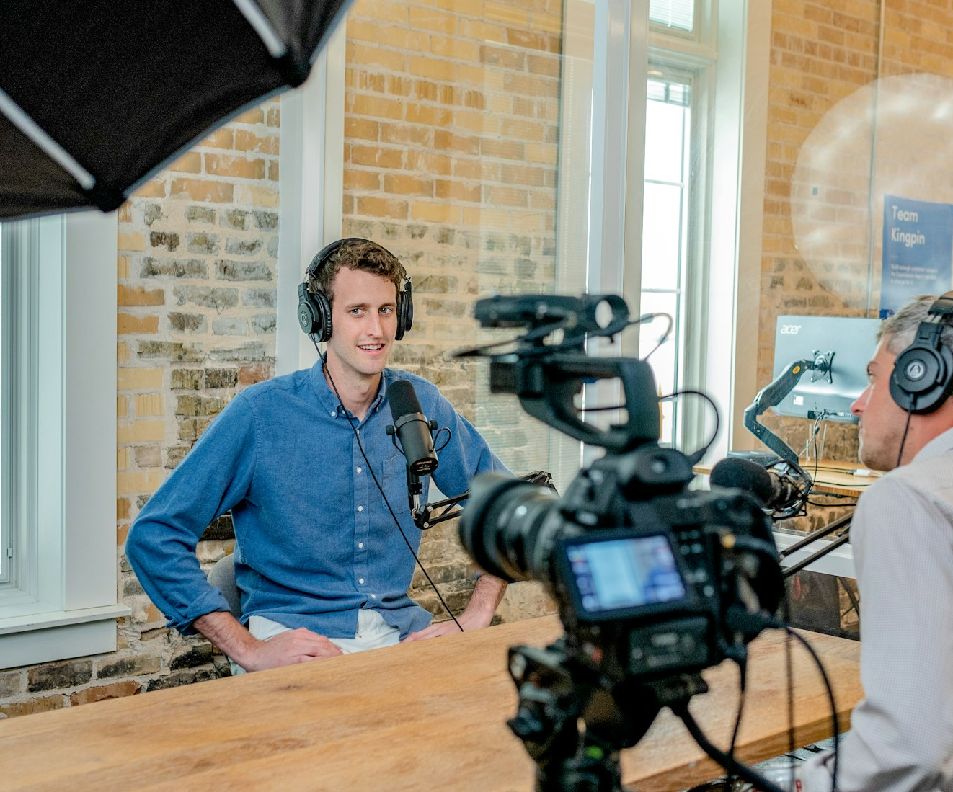
SLOP / UNIVERSITY
WEEK 4 / 23
Reading sound in reference footage
A repeatable method for the session's “watch with your eyes closed” task.
1
Close your eyes for one scene and listen only.
2
Name what sound alone tells you: place, time, distance, mood.
3
Open your eyes and compare — what did the image add that sound could not?
4
Note anything sound revealed that the image alone would have missed.
SLOP1416 Visual Storytelling for Short-Form Media
Notes:
Directly answers session 4's reference-viewing prompt: watch a scene with eyes closed and note what sound alone communicates. Unsplash: https://images.unsplash.com/photo-1557804506-e969d7b32a4b — photographer Austin Distel (@austindistel), accessed 13 Sep 2026

Slide 24
SLOP / UNIVERSITY
WEEK 4 / 24
Planning sound for your production
Sound belongs in a production plan at the beginning, middle and end — not as an afterthought on set.
1
Beginning: what does the opening ambient bed need to establish about place?
2
Middle: which voice or sound is the scene's foreground — and what mic will capture it cleanly?
3
End: how does the sequence resolve — does the sound fade, cut, or hand off to silence?
4
Write the mic, placement and backup plan into your production plan alongside the shot list.
This directly answers session 4's “Afterwards” instruction: revise your production plan to include sound at the beginning, middle and end.
SLOP1416 Visual Storytelling for Short-Form Media
Notes:
Directly answers session 4's afterwards task and feeds Assignment 1's Sound portrait exercise and media/consent record.

Slide 25
SLOP / UNIVERSITY
WEEK 4 / 25
Week 4 in-session exercise
What you produce and submit for this session.
Brief
Record a short sound portrait of one place: an ambient bed, a foregrounded voice or sound, and a resolution — no picture required.
Constraints
Monitor on headphones throughout. Test mic distance, check for wind and room hum, and record ten seconds of room tone at the same location.
Evidence to submit
The sound portrait file, a one-line note on the mic and placement used, and the separate room-tone clip.
SLOP1416 Visual Storytelling for Short-Form Media
Notes:
Original SLOP1416 Week 4 in-session exercise, directly implementing the session brief's sound-portrait and comparison tasks.

Slide 26
SLOP / UNIVERSITY
WEEK 4 / 26
Technical review rubric
How sound choices are assessed in your submitted work.
Gain staging
Levels sit within usable headroom; no clipping on any peak.
Mic choice
Pattern and placement suit the source and the shot's scale.
Room tone
A matching ambient bed is present and usable for edit cover.
Clarity
Dialogue or foregrounded sound is intelligible against the background.
SLOP1416 Visual Storytelling for Short-Form Media
Notes:
Original review rubric, aligned to Assignment 1's ‘Image, light and sound choices’ criterion (30% weight).

Slide 27
SLOP / UNIVERSITY
WEEK 4 / 27
Recommended practice and preparation
Before next session.
Sound reference
Sound Devices, Gain staging and levels for field recording: https://www.sounddevices.com/learn/
Microphone technique reference
Rode, Microphone polar patterns explained: https://rode.com/en/about/news-articles/polar-patterns-explained
Bring to Week 5
A draft consent conversation and three open questions, or an observational plan that does not require an interview.
SLOP1416 Visual Storytelling for Short-Form Media
Notes:
External resources: Sound Devices field-recording guidance; Rode polar-pattern reference. Accessed 13 September 2026.

