Slide 1
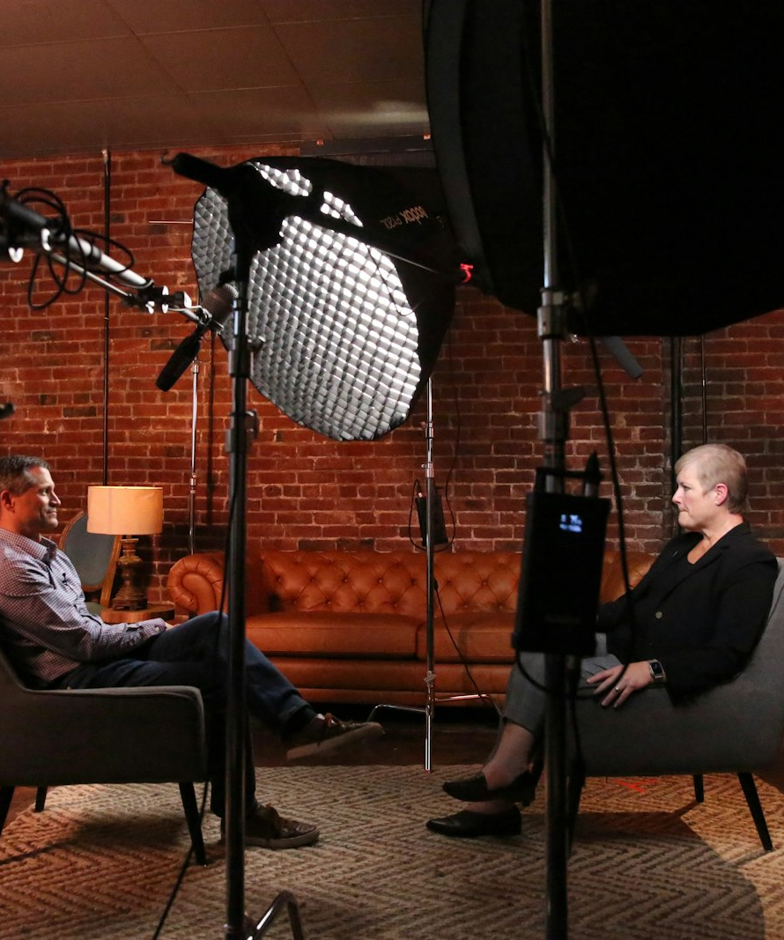
SLOP / UNIVERSITY
SLOP1416 / WEEK 5
Interview and Observation
Two ways to get a true story on camera: asking, and watching. Consent, technique and the ethics of both.
Notes:
Unsplash: https://images.unsplash.com/photo-1602743297108-4c9061884285 — photographer Jonah De Oliveira (@jecd), accessed 13 Sep 2026
Course teaching content is original.

Slide 2
SLOP / UNIVERSITY
WEEK 5 / 02
Technical outcomes
By the end of this lecture you can choose, run and defend either mode of documentary production.
Choose
Run
Defend
Decide whether an interview or an observational approach will actually get you the truer version of a story.
Practise an interview or an observational shoot with correct consent, technique and framing.
Write a consent record and justify every cutaway and edit you make against the person's own words.
SLOP1416 Visual Storytelling for Short-Form Media
Notes:
Original course learning outcomes, aligned to session 5's brief.

Slide 3
SLOP / UNIVERSITY
WEEK 5 / 03
Two modes of getting to the truth
Interview-led and observational production are different bets on how truth appears on camera.
Interview-led
Observational
The subject is asked directly and answers in their own words. The camera records a reflection, spoken after the fact, about what happened or what it meant.
The camera simply stays present while something happens, unprompted and unstaged. The behaviour itself is the evidence, not a description of it.
Most documentary work blends both — but every scene starts as a choice between asking and watching, and that choice changes what consent, technique and editing all need to do.
SLOP1416 Visual Storytelling for Short-Form Media
Notes:
Original framing device opening the lecture, setting up the interview vs observation distinction used throughout.

Slide 4

SLOP / UNIVERSITY
WEEK 5 / 04
Consent is a conversation, not a form
A signature at the start does not cover everything a shoot day can turn into.
A consent form signed before filming establishes permission for what you described in advance. It does not automatically cover a follow-up question that goes somewhere unexpected, a cutaway of someone's home, or footage used in a different edit than the one you pitched.
Treat consent as ongoing
Check in before anything not already agreed: a sensitive follow-up, a new location, a different final use.
Right to withdraw
A subject can withdraw consent for a specific answer or the whole recording — build in a real chance to do that, not just a formality.
SLOP1416 Visual Storytelling for Short-Form Media
Notes:
Original ethics framing directly answering session 5's consent-conversation task. Unsplash: https://images.unsplash.com/photo-1681505531034-8d67054e07f6 — photographer Amina Atar (@minaslens), accessed 13 Sep 2026

Slide 5
SLOP / UNIVERSITY
WEEK 5 / 05
Two lineages: vérité and direct cinema
Interview-led and observational method both trace back to a 1960s split in documentary practice.
Cinéma vérité
Direct cinema
The filmmaker's presence is part of the film: they ask, provoke, and appear in the encounter, treating the interview itself as the event worth recording.
The filmmaker aims to disappear: a fly-on-the-wall camera records events as they would have unfolded without it, and never asks a question on screen.
Neither claims to be unfiltered. Every camera position, every cut and every choice of what to keep rolling is already an author's decision.
SLOP1416 Visual Storytelling for Short-Form Media
Notes:
Original historical framing: cinéma vérité (Rouch, Morin) vs direct cinema (Maysles, Wiseman, Pennebaker) as the lineage behind interview-led vs observational modes.

Slide 6
SLOP / UNIVERSITY
WEEK 5 / 06
Interview technique — open and closed questions
The kind of question you ask sets the kind of answer you can use.
Type
Example
What it produces
Closed question
“Were you scared?”
Invites a short yes/no answer that repeats your framing back to you
Open question
“What did that feel like?”
Invites the subject to build the answer in their own words and images
Default to open questions; use a closed question only to confirm a fact you already need to state precisely.
SLOP1416 Visual Storytelling for Short-Form Media
Notes:
Original interview-technique content: open vs closed questions and the type of answer each produces.

Slide 7

SLOP / UNIVERSITY
WEEK 5 / 07
Sequencing questions and using silence
The order you ask in, and what you don't say, both shape the answer.
Start with easy, factual questions to build comfort, move toward the harder or more reflective ones once trust is established, and hold your own silence after an answer — a pause often pulls out the more honest continuation.
Silence as a tool
Resist the urge to fill a pause with your next question. Many of the strongest answers arrive after the subject fills the silence themselves.
Prepare, don't script
Bring open questions in a rough order, but be ready to abandon that order to follow what the subject actually says.
SLOP1416 Visual Storytelling for Short-Form Media
Notes:
Original interview-technique content: question sequencing and silence as an interviewing tool. Unsplash: https://images.unsplash.com/photo-1521791055366-0d553872125f — photographer Cytonn Photography (@cytonn_photography), accessed 13 Sep 2026

Slide 8
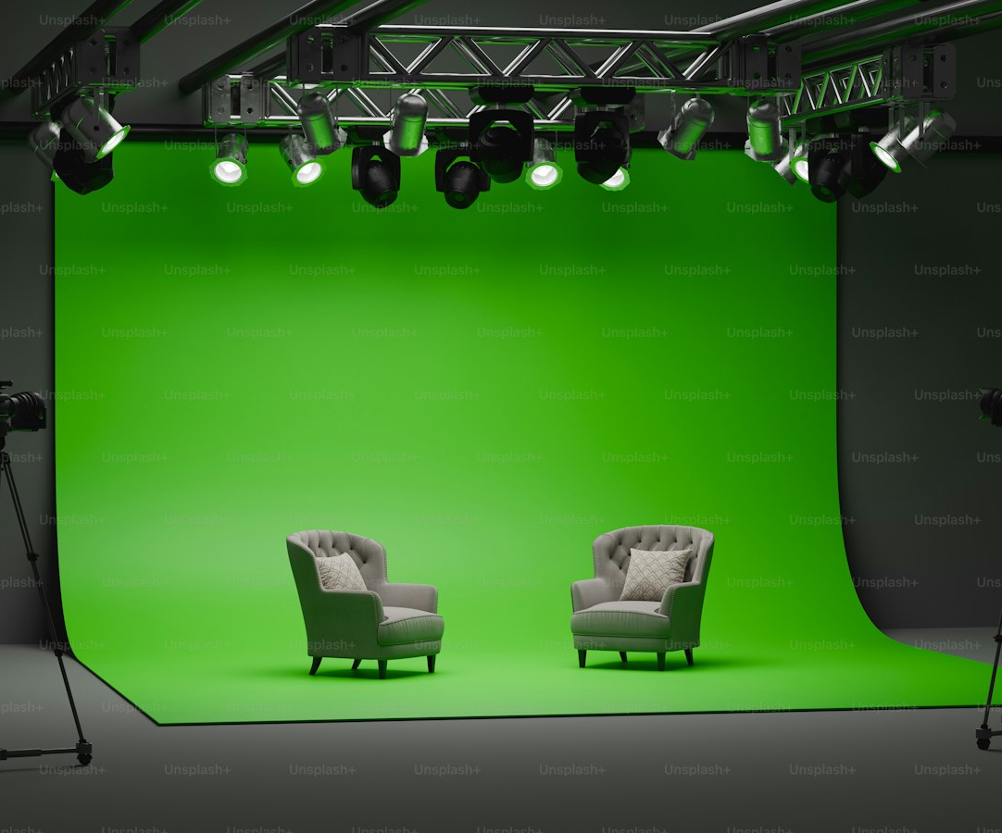
SLOP / UNIVERSITY
WEEK 5 / 08
The off-camera interviewer
Where the interviewer sits changes where the subject looks, and what that look means.
Position yourself just beside the lens, close enough that the subject's eyeline reads as natural conversation but off the camera axis. The subject speaks to a person, not to the audience.
Consistent axis
Keep your position fixed for the whole interview so every answer cuts together on a matching eyeline.
To-camera is a different choice
A subject looking straight into the lens directly addresses the viewer — decide which register the piece needs before you sit down.
SLOP1416 Visual Storytelling for Short-Form Media
Notes:
Original explanation of off-camera interviewer positioning, eyeline and camera axis, directly extending session 5's practice item on “practising introductions, permissions and cutaway shots”. Unsplash (Unsplash+): https://plus.unsplash.com/premium_photo-1711061959382-0de7a4bddccf — photographer Mohamed Nohassi (@coopery), accessed 13 Sep 2026

Slide 9
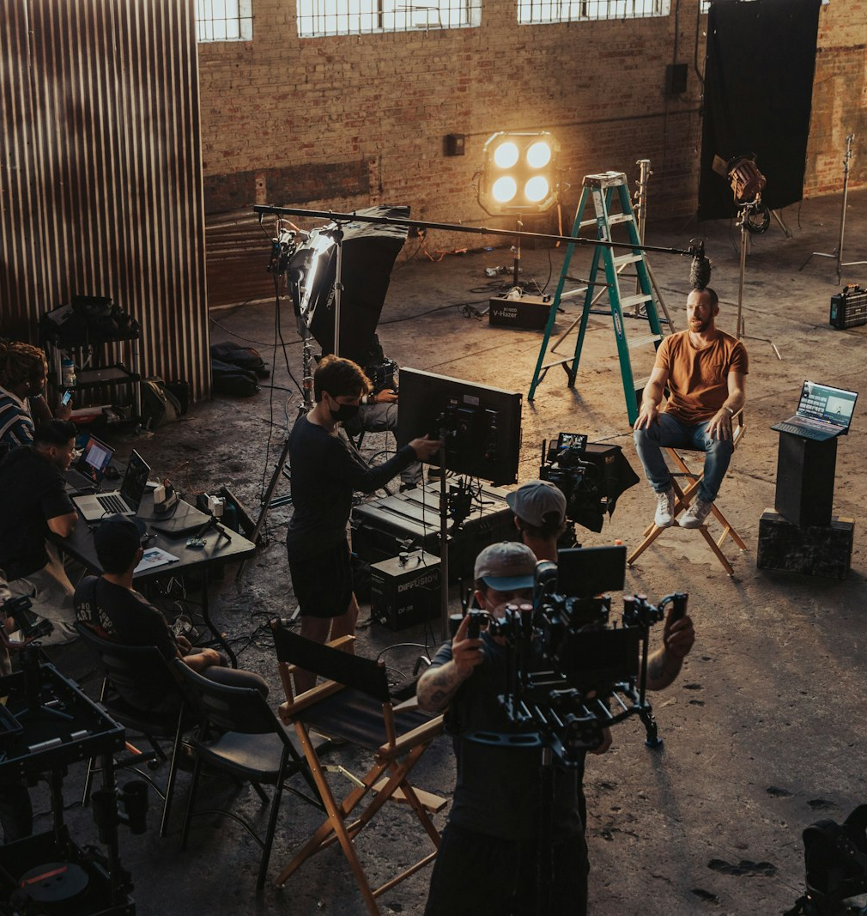
SLOP / UNIVERSITY
WEEK 5 / 09
Practising the setup before you roll
Rehearsing the introduction, the permissions and the physical setup protects the real take.
1
Introduce yourself and the project again on camera, even if you already spoke off camera.
2
State out loud what you will and will not use the footage for, and confirm the subject agrees.
3
Check eyeline, framing and audio with a throwaway question before the real interview starts.
4
Agree a simple signal the subject can use at any point to pause or stop.
SLOP1416 Visual Storytelling for Short-Form Media
Notes:
Direct answer to session 5's in-session practice item: introductions, permissions and setup rehearsal before an interview.

Slide 10
SLOP / UNIVERSITY
WEEK 5 / 10
Cutaways — two jobs at once
A cutaway can hide an edit and support what someone just said, and it is easy to blur those jobs.
Covering a jump cut
Evidentiary support
Trimming an answer creates a jump in the subject's position. Cutting briefly to something else hides that jump so the edit reads as continuous.
A cutaway can also show the thing the subject is describing — their hands, an object, the place — backing up their words with a second source.
The audience reads both uses the same way: as proof. That is exactly why the difference between them is an ethical line, not just a technical one.
SLOP1416 Visual Storytelling for Short-Form Media
Notes:
Original explanation of cutaways' dual function, distinguishing the technical (covering a jump cut) from the evidentiary (supporting testimony) use.

Slide 11
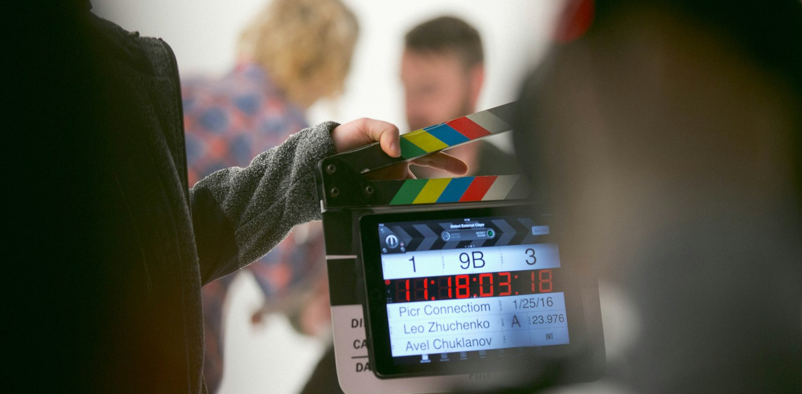
SLOP / UNIVERSITY
WEEK 5 / 11
The risk of false correspondence
A cutaway implies the shown thing relates to the spoken thing — even when it was shot elsewhere, elsewhen.
Cutting to a hand, an object or a location while someone speaks tells the audience “this is what they mean.” If that shot was filmed at a different time, in a different context, the audience is drawing a connection you invented, not one the subject made.
Rule of thumb
Only use a cutaway as evidence for a claim if it genuinely shows that claim — otherwise use it purely to bridge a cut, and keep it visually neutral.
Disclose reconstruction
If a cutaway restages something rather than documenting it live, that is a reconstruction — say so, don't let it pass as observed fact.
SLOP1416 Visual Storytelling for Short-Form Media
Notes:
Original ethics content on false correspondence between cutaway imagery and interview claims — the central risk flagged in session 5's reference-viewing prompt. Unsplash: https://images.unsplash.com/photo-1515634928627-2a4e0dae3ddf — photographer Avel Chuklanov (@chuklanov), accessed 13 Sep 2026

Slide 12
SLOP / UNIVERSITY
WEEK 5 / 12
B-roll and the interview audio
B-roll can illustrate what a voice says — or quietly contradict it.
Illustrative B-roll
Contradictory B-roll
Footage that shows the described activity, place or object, laid under the interview audio to keep the screen active while someone talks.
Footage that visibly disagrees with the claim being made — used deliberately, this exposes a gap between what is said and what is shown.
Know which one you are building before you cut. An accidental contradiction reads as an editing mistake; a deliberate one is a legitimate, but visible, authorial choice.
SLOP1416 Visual Storytelling for Short-Form Media
Notes:
Original explanation of B-roll's illustrative vs contradictory relationship to interview audio.

Slide 13
SLOP / UNIVERSITY
WEEK 5 / 13
The ethics of trimming an answer
Every cut inside a spoken answer is an edit of someone's own words.
Removing a pause, a stumble or a tangent can make an answer clearer without changing its meaning. Removing a qualifier, a hedge or the second half of a sentence can change what the person actually said.
Ask: does the meaning survive?
If a neutral listener would summarise the trimmed answer differently than the full one, the trim has changed the claim, not just the pacing.
When in doubt, go back
Play the trimmed version to the subject if the meaning is at all borderline, especially for anything sensitive or personal.
SLOP1416 Visual Storytelling for Short-Form Media
Notes:
Original ethics content on trimming interview answers without misrepresenting meaning, directly relevant to Assignment 1's reflection-and-consent criterion.

Slide 14
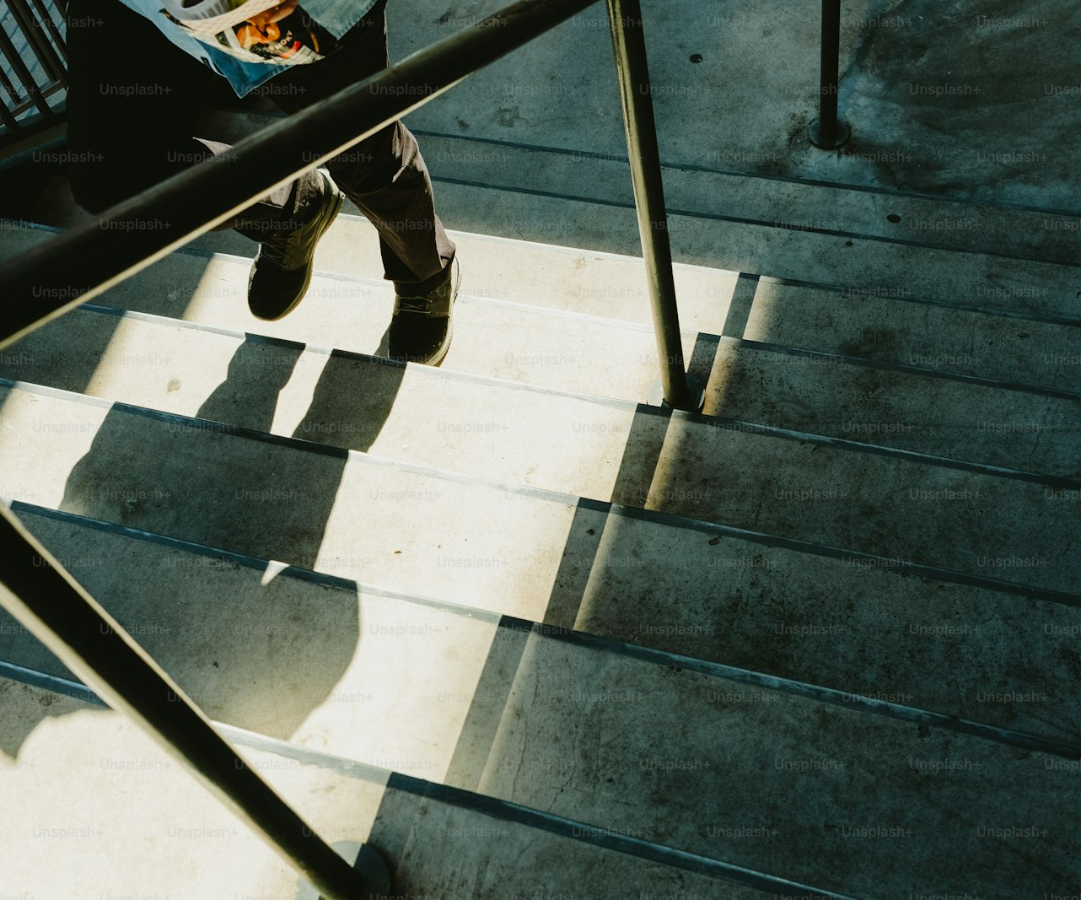
SLOP / UNIVERSITY
WEEK 5 / 14
Power and representation
Whoever holds the camera and the edit decides whose story gets told, and how.
The subject speaks; you choose what stays in, what leaves out, and what order it plays in. That asymmetry is real even when your intentions are good, and it is sharper when the subject has less power than you do.
Show them the cut
Where possible, let a subject see how they are represented before you publish, especially on anything vulnerable.
Protect where needed
Anonymity, obscured faces or reframed footage protect a subject without erasing their story — use them where the sensitivity calls for it.
SLOP1416 Visual Storytelling for Short-Form Media
Notes:
Original ethics content on power and representation in documentary editing, connecting to the instruction to favour anonymous or non-identifying framing for sensitive subject matter. Unsplash (Unsplash+): https://plus.unsplash.com/premium_photo-1749157886266-673cb7c73508 — photographer Fujiphilm (@fujiphilm), accessed 13 Sep 2026

Slide 15
SLOP / UNIVERSITY
WEEK 5 / 15
What a consent record actually contains
Assignment 1 requires a media/consent record — here is what belongs in it.
Field
Must state
Who
Full name and role of each person recorded, including anyone visible but not interviewed
What
What footage and audio they agreed to, in plain language, not just “yes to filming”
Where it goes
Where the finished piece will be shown or submitted, and for how long it is kept
Withdrawal
How and until when the person can withdraw consent for their part
SLOP1416 Visual Storytelling for Short-Form Media
Notes:
Directly answers Assignment 1's media/consent record requirement and its 'Reflection, consent and media record' marking criterion (20% weight).

Slide 16

SLOP / UNIVERSITY
WEEK 5 / 16
Seeking permission for your Assignment 1 subject
The exact conversation to have once you have confirmed who you are filming.
Explain the exercise, show them roughly what kind of shots you plan to take, and ask directly whether they are comfortable being filmed for coursework that may be shown to a marker or the class.
Confirm before you shoot
Get a clear yes on subject, use and audience before the camera comes out — not partway through.
Write it down
Even an informal agreement needs a short written record for your media/consent record.
SLOP1416 Visual Storytelling for Short-Form Media
Notes:
Directly answers session 5's “Afterwards” instruction: confirm the Assignment 1 subject and seek their permission. Unsplash: https://images.unsplash.com/photo-1664463760781-f159dfe3af30 — photographer Annika Wischnewsky (@wischn), accessed 13 Sep 2026

Slide 17
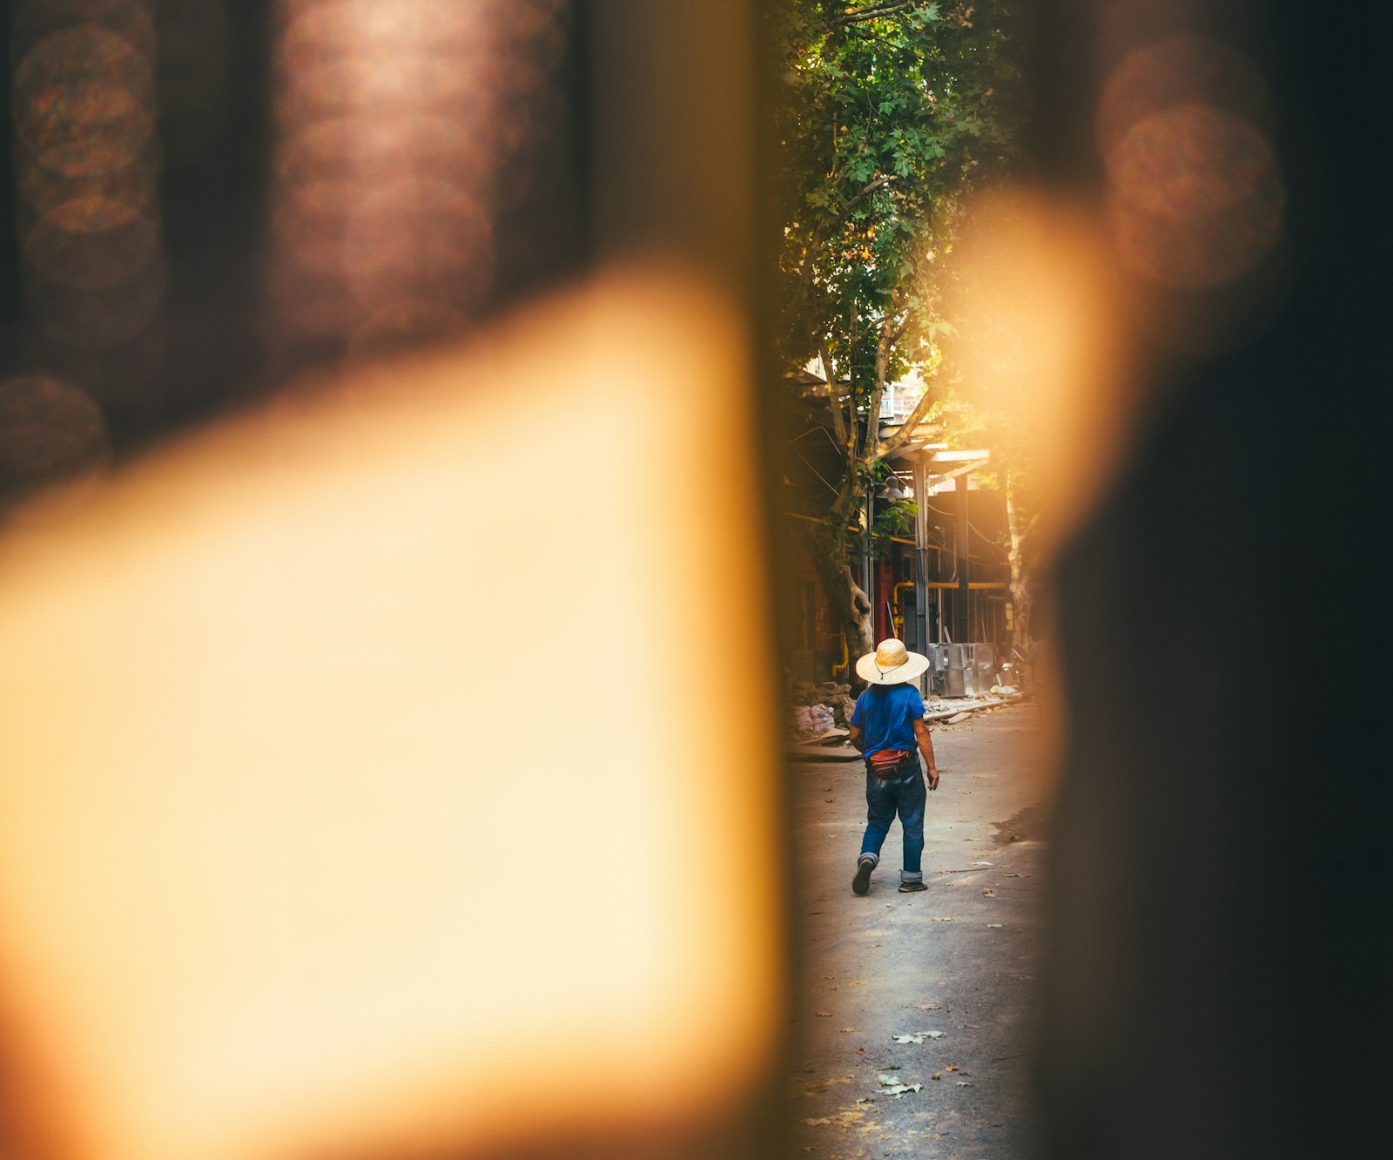
SLOP / UNIVERSITY
WEEK 5 / 17
Observational method — patience over prompting
Observation asks you to wait for something true to happen, rather than asking someone to describe it.
You are not directing the moment. You arrive early, stay longer than feels necessary, and let ordinary time pass until something worth keeping happens in front of the lens.
Long takes
Keep rolling well past the point where you think the interesting part is over — the real moment is often what comes after.
No staging
Do not ask a subject to “do that again for the camera” — a repeated action is a re-enactment, not an observation.
SLOP1416 Visual Storytelling for Short-Form Media
Notes:
Original explanation of observational method: patience, long takes, and the discipline of not staging or re-prompting an action. Unsplash: https://images.unsplash.com/photo-1693858323643-b61be7341e6f — photographer Xingchen Yan (@xingchenyan), accessed 13 Sep 2026

Slide 18
SLOP / UNIVERSITY
WEEK 5 / 18
The observer effect
A camera changes behaviour just by being present — pretending otherwise is its own kind of dishonesty.
People act differently when they know they are being filmed. The observational discipline is not to eliminate that effect — you can't — but to give it time to fade, and to be honest about what a camera's presence may have changed.
Let it settle
The first minutes of any observational shoot usually show a subject performing for the lens; keep rolling until that eases.
Name it if it doesn't
If a subject visibly never stops performing, that is worth noting honestly rather than presenting the footage as unaffected fact.
SLOP1416 Visual Storytelling for Short-Form Media
Notes:
Original explanation of the observer effect in observational documentary, and the honesty required when it cannot be fully removed.

Slide 19
SLOP / UNIVERSITY
WEEK 5 / 19
When observation says more than an interview can
Some truths a subject cannot, or will not, put into words.
A subject may not know
A subject may not say
People are often poor narrators of their own habits, tics and relationships — behaviour shows what self-report misses.
Some things are too private, too embarrassing, or too politically risky to state on camera, but visible in how someone acts anyway.
This is not a reason to avoid asking — it's a reason to know which questions only watching, not asking, can answer.
SLOP1416 Visual Storytelling for Short-Form Media
Notes:
Original synthesis on the specific evidentiary value of observational footage over self-reported interview testimony.

Slide 20
SLOP / UNIVERSITY
WEEK 5 / 20
Reading cutaways in reference footage
A repeatable method for this session's reference-viewing task.
1
Note every question you can hear the interviewer ask, and every one you can only infer from the answer.
2
List each cutaway and what it shows while the subject speaks.
3
For each cutaway, decide: does it support the claim being made, or only bridge a cut?
4
Judge whether any cutaway changes how much you trust the speaker, and why.
Apply this to the interview-led short work you watch for this week's reference-viewing task.
SLOP1416 Visual Storytelling for Short-Form Media
Notes:
Directly answers session 5's reference-viewing prompt: watch an interview-led short work, note unheard questions and how cutaways affect trust in the speaker.

Slide 21
SLOP / UNIVERSITY
WEEK 5 / 21
Role-play review — interview or observation?
For each scenario, decide which mode gets closer to the truth.
Scenario
Better mode, and why
A subject explains why they made a hard decision
Interview — reasoning behind a choice is rarely visible in behaviour alone
A subject navigates a stressful, repeated daily task
Observation — the behaviour itself is the evidence, description would flatten it
A subject reflects on an event from years ago
Interview — the meaning made of a memory only exists in how they tell it now
A group interacts without being asked to perform
Observation — asking would replace the real dynamic with a described one
SLOP1416 Visual Storytelling for Short-Form Media
Notes:
Direct expansion of session 5's role-play review of when an interview or an observation is more useful, worked through four concrete scenarios.

Slide 22
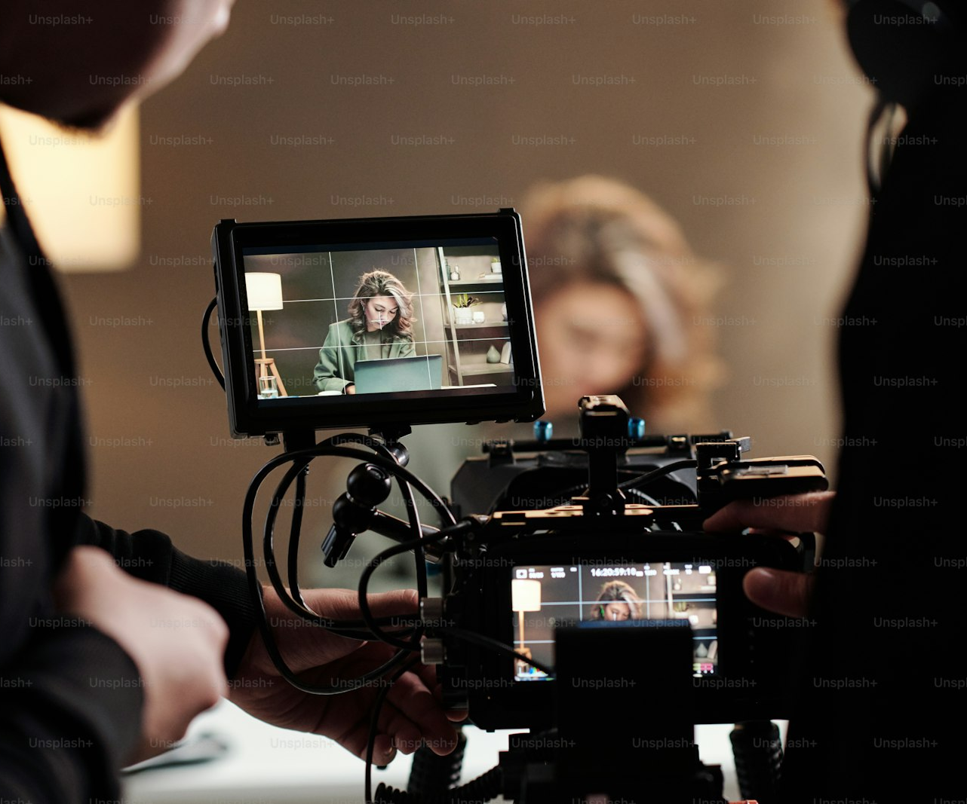
SLOP / UNIVERSITY
WEEK 5 / 22
Editing what you gathered
Reviewing footage is where the ethics of cutaways and trims actually get decided.
Log every cutaway against the claim it sits beside before you commit to a cut. If you can't say what a cutaway is evidence for, it belongs in the bridging category, not the supporting one.
Build a simple log
One line per cutaway: what it shows, what claim it sits next to, and whether it was filmed at the same time as that claim.
Revisit trims against the raw
Compare a trimmed answer back to the untrimmed recording before it goes in the final cut.
SLOP1416 Visual Storytelling for Short-Form Media
Notes:
Original bridge from shoot-day ethics to the edit suite, connecting cutaway logging and trim-checking directly to Assignment 1's consent and reflection criterion. Unsplash (Unsplash+): https://plus.unsplash.com/premium_photo-1682146717223-874ac7dcc607 — contributor Getty Images (@gettyimages), accessed 13 Sep 2026

Slide 23
SLOP / UNIVERSITY
WEEK 5 / 23
Week 5 in-session exercise
What you produce and submit for this session.
Brief
Role-play a short interview and a short observational scene with a partner, then swap and repeat the other mode.
Constraints
Practise the introduction and permission check on camera, and record at least one cutaway you can justify as either bridging or evidentiary.
Evidence to submit
Both short clips, a one-line note on which cutaway you used and why, and a draft consent line for your role-play partner.
SLOP1416 Visual Storytelling for Short-Form Media
Notes:
Original SLOP1416 Week 5 in-session exercise, directly implementing the session brief's practice of introductions, permissions, cutaways and a role-play review.

Slide 24
SLOP / UNIVERSITY
WEEK 5 / 24
Technical review rubric
How consent, technique and editing choices are assessed in your submitted work.
Consent
A written media/consent record exists, is specific, and states how to withdraw.
Technique
Interview eyeline, or observational patience and non-staging, is evident in the footage.
Cutaways
Every cutaway is either clearly evidentiary or clearly a bridge, never presented as both.
Reflection
The submission names any trims made and why they do not change the subject's meaning.
SLOP1416 Visual Storytelling for Short-Form Media
Notes:
Original review rubric, aligned to Assignment 1's 'Reflection, consent and media record' criterion (20% weight).

Slide 25
SLOP / UNIVERSITY
WEEK 5 / 25
Recommended practice and preparation
Before next session.
Interview technique reference
BBC Academy, Interview technique for journalists: https://www.bbc.co.uk/academy/en/articles/art20130702112133480
Documentary ethics reference
Doc Society, Documentary ethics and consent guidance: https://impact.docsociety.org/resources
Bring to Week 6
Your confirmed Assignment 1 subject, their signed consent line, and a rough shot list ready to storyboard.
SLOP1416 Visual Storytelling for Short-Form Media
Notes:
External resources: BBC Academy interview-technique guidance; Doc Society documentary ethics and consent resources. Accessed 13 September 2026.

