Slide 1

SLOP / UNIVERSITY
SLOP1416 / WEEK 8
Continuity and Rhythm
Screen direction, action matching and shot duration: the systems a viewer relies on without noticing, and what happens when they break.
Notes:
Unsplash (Unsplash+): https://plus.unsplash.com/premium_photo-1753737685500-1fc5f0b3c19c — photographer Renato Leal (@renatoaleal), accessed 13 Sep 2026
Course teaching content is original.

Slide 2
SLOP / UNIVERSITY
WEEK 8 / 02
Technical outcomes
By the end of this lecture you can diagnose a continuity break and choose a cutting rhythm on purpose.
Diagnose
Re-cut
Scope
Name a screen-direction, action-match or duration problem in a cut and explain why it disorients a viewer.
Take one shared sequence and produce a different, defensible rhythm and continuity reading of it.
Stress-test a final-project premise for what footage, access and permission it actually requires.
SLOP1416 Visual Storytelling for Short-Form Media
Notes:
Original course learning outcomes, aligned to session 8's brief.

Slide 3
SLOP / UNIVERSITY
WEEK 8 / 03
Three invisible continuity systems
A viewer tracks space, action and time without being told to — until a cut breaks the tracking.
Week 3 showed that light has its own continuity rule: two shots read as one scene only if their key direction and colour temperature agree. Screen direction is the same kind of rule, applied to space and movement instead of light.
What light continuity tracks
What this week adds
Direction, quality and colour temperature must agree across a scene, or the cut reads as a time or place jump (Week 3).
Screen direction, physical action and shot duration must also agree, or the cut reads as spatially or temporally broken.
Three separate systems, one shared failure mode: they work by being invisible, and fail by suddenly becoming visible.
SLOP1416 Visual Storytelling for Short-Form Media
Notes:
Original framing device connecting Week 3's light-continuity principle to this week's spatial/temporal continuity systems.

Slide 4
SLOP / UNIVERSITY
WEEK 8 / 04
The axis of action, in full
An imaginary line drawn through the scene that fixes which side the camera is allowed to work from.
Draw a line through the two things a shot is about — two people talking, or one person and the direction they are moving. Every camera position used to cover that moment must stay on one side of that line.
Why it matters
What crossing does
Staying on one side keeps each subject's left/right position and gaze direction consistent shot to shot, so the audience's mental map of the space never has to reset.
A camera that jumps to the other side without warning flips the subjects' apparent positions — a person who was screen-left is suddenly screen-right for no diegetic reason.
SLOP1416 Visual Storytelling for Short-Form Media
Notes:
Original detailed explanation of the 180-degree line / axis of action, expanding the session's screen-direction brief.

Slide 5
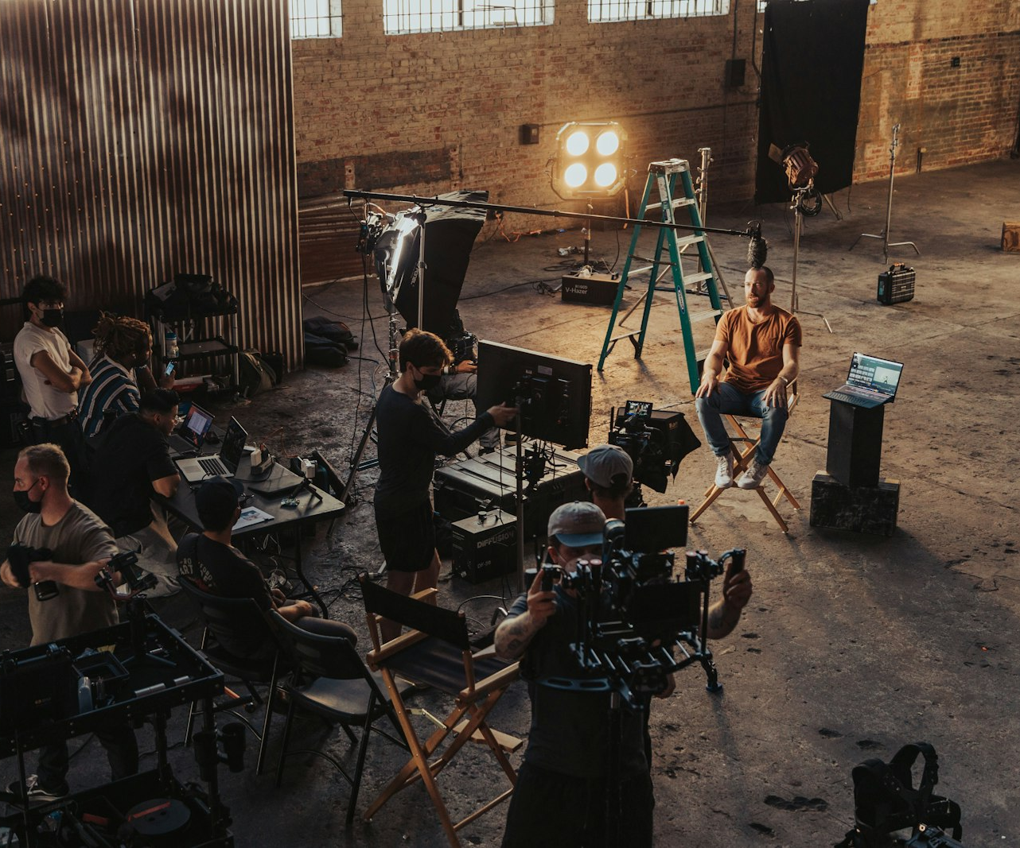
SLOP / UNIVERSITY
WEEK 8 / 05
Legitimately resetting the line
The line is a tool for the editor, not a law of physics — it can be moved on purpose.
A hard cut across the axis disorients. But two techniques let you move the camera to the other side and keep the viewer oriented.
The cutaway reset
Cut briefly to a neutral shot — a reaction, a detail, an establishing angle — then return from the new side. The break gives the viewer's spatial model a moment to update.
The re-establishing shot
A wide shot from the new position rebuilds the spatial map explicitly, so the next close shot from the far side reads as continuous rather than reversed.
SLOP1416 Visual Storytelling for Short-Form Media
Notes:
Original explanation of legitimate line-crossing techniques (cutaway reset, re-establishing shot). Unsplash: https://images.unsplash.com/photo-1632187981988-40f3cbaeef5e — photographer Jakob Owens (@jakobowens1), accessed 13 Sep 2026

Slide 6
SLOP / UNIVERSITY
WEEK 8 / 06
Action matching / the match cut
Physical continuity of position, direction and speed across the cut point.
Cut in the middle of a movement, not before or after it. If a hand is reaching for a door in shot A, the second shot should pick up that same hand at the same point in the same reach — not a beat earlier or later.
What reads as continuous
What breaks it
Matching body position, direction of travel and apparent speed at the cut frame, so the eye perceives one action rather than two separate ones.
A mismatch in any one of position, direction or speed — the viewer perceives a stutter or a restart, even if they cannot say exactly why.
SLOP1416 Visual Storytelling for Short-Form Media
Notes:
Original explanation of action matching / match cuts as a distinct continuity discipline from screen direction.

Slide 7

SLOP / UNIVERSITY
WEEK 8 / 07
Eyeline match and shot / reverse-shot geometry
Two shots, filmed separately, can still imply one shared space.
Subject A looks slightly off-frame right; subject B, filmed later, looks slightly off-frame left. Cut together, their eyelines imply they are looking at each other — even though neither shot contains both people.
The geometry rule
Both eyelines must point toward the same imagined point across the axis of action, and both must stay on their own side of that axis.
Common failure
Both subjects looking the same direction reads as two people facing the same way, not facing each other.
SLOP1416 Visual Storytelling for Short-Form Media
Notes:
Unsplash: https://images.unsplash.com/photo-1513470270416-d3ff6f16b22f — photographer Christin Hume (@christinhumephoto), accessed 13 Sep 2026

Slide 8

SLOP / UNIVERSITY
WEEK 8 / 08
Shot duration as a rhythm tool
Average shot length (ASL) is a stylistic signature, not an accident of coverage.
ASL is the running time of a piece divided by its number of shots. A contemplative observational piece might sit at 8–15 seconds per shot; an action sequence might sit under 2 seconds. Neither is correct — each is a choice about how much time a viewer needs per idea.
The real rule
Duration should track the information density and emotional weight of the shot, not a fixed metronome.
Diagnostic
If you cannot say why a shot is exactly as long as it is, its duration is probably accidental.
SLOP1416 Visual Storytelling for Short-Form Media
Notes:
Unsplash: https://images.unsplash.com/photo-1574717024653-61fd2cf4d44d — photographer Peter Stumpf (@peter_s), accessed 13 Sep 2026

Slide 9
SLOP / UNIVERSITY
WEEK 8 / 09
Cutting-rate changes build and release tension
Rhythm is not fixed across a whole piece — it accelerates and decelerates on purpose.
Pattern
Effect on the viewer
Accelerating rhythm
Progressively shorter shots raise urgency, panic or excitement toward a peak.
Decelerating rhythm
Progressively longer shots let a moment land, settle or be absorbed after a peak.
Held long take
One uncut shot signals importance by refusing to let the edit interrupt it.
Sudden single short cut
A single fast cut inside a slow sequence functions like a shock or a jolt.
SLOP1416 Visual Storytelling for Short-Form Media
Notes:
Original synthesis of cutting-rate rhythm patterns, extending the session brief's 'shot duration' theme.

Slide 10
SLOP / UNIVERSITY
WEEK 8 / 10
Diagnosing continuity errors, precisely
Four named failure modes, so a critique can point at something specific.
Jump cut
Near-identical framing of the same subject cut together — a small, disorienting hop rather than a clean cut or a real change.
30-degree violation
Camera angle changes by less than roughly 30° between two shots of the same subject, reading as a jump cut even with a angle change.
Screen-direction flip
A subject or motion reverses left/right across a cut with no cutaway or re-establishing shot to justify it.
Prop/position mismatch
An object, costume detail or body position changes between takes of the same continuous moment.
SLOP1416 Visual Storytelling for Short-Form Media
Notes:
Original diagnostic vocabulary: jump cut, the 30-degree rule, screen-direction flip, prop/position continuity — the session's 'diagnose continuity problems' brief made specific and nameable.

Slide 11
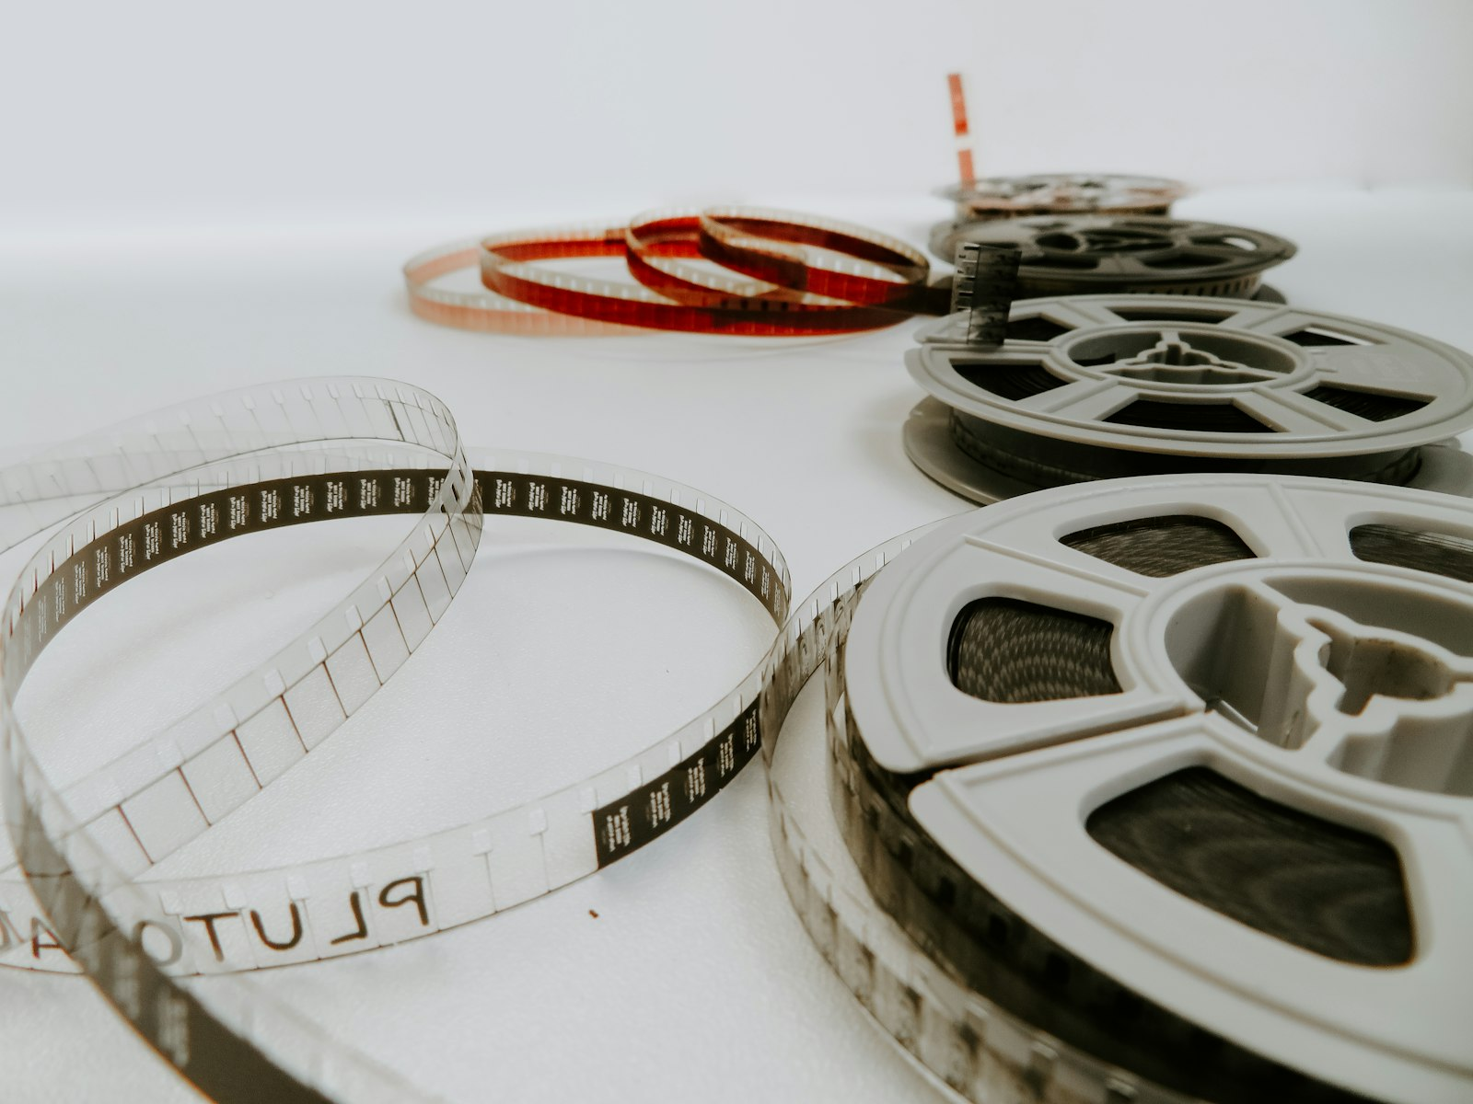
SLOP / UNIVERSITY
WEEK 8 / 11
The deliberate jump cut
Naming the error also lets you use it on purpose.
A jump cut used deliberately — compressing time, signalling instability, or making a documentary subject's edited-ness visible — is a style choice. The same cut, unnoticed and unintended, is an error.
The test
Ask whether the break serves the scene's meaning. If removing it would improve clarity with no expressive loss, it was an accident.
Where it shows up
Interview footage trimmed for time is the most common deliberate jump cut in short-form nonfiction work.
SLOP1416 Visual Storytelling for Short-Form Media
Notes:
Unsplash: https://images.unsplash.com/photo-1542204165-65bf26472b9b — photographer Denise Jans (@dmjdenise), accessed 13 Sep 2026

Slide 12

SLOP / UNIVERSITY
WEEK 8 / 12
The re-cutting exercise, as a method
One shared source sequence, tested against different rhythm and continuity choices.
The same raw footage can be cut to mean several different things. Re-cutting a shared sequence is the fastest way to observe that directly, because the variable under test is only the edit — nothing was reshot.
What to vary
Try one pass preserving strict screen direction and a measured ASL, then a second pass with faster cuts and a deliberate line-cross.
What to observe
Which pass feels more urgent, more confusing, more controlled — and whether that matches what you intended.
SLOP1416 Visual Storytelling for Short-Form Media
Notes:
Original explanation of the re-cutting exercise as an epistemic method for the session's 're-cut a shared sequence' brief. Unsplash (Unsplash+): https://plus.unsplash.com/premium_photo-1724634778253-f4a6390656c8 — photographer Yianni Mathioudakis (@yiannifive), accessed 13 Sep 2026

Slide 13
SLOP / UNIVERSITY
WEEK 8 / 13
Reading rhythm and continuity together
A four-step method for the session's reference-viewing task.
1
Pick one scene with a single, clear physical action.
2
Track the axis of action: note when the camera stays on one side and when it crosses.
3
Time three consecutive shots and estimate the sequence's local ASL.
4
Judge whether any line-cross or duration change is earned by the scene, or accidental.
Directly answers session 8's reference-viewing prompt: track screen direction across a scene with a clear action.
SLOP1416 Visual Storytelling for Short-Form Media
Notes:
Directly answers session 8's reference-viewing task: 'Choose a scene with a clear action. Track screen direction: when does the editor preserve orientation, and when do they disrupt it?'

Slide 14
SLOP / UNIVERSITY
WEEK 8 / 14
Continuity systems compared
Three systems, one shared diagnostic question.
System
What must agree
The diagnostic question
Light (Week 3)
Direction, quality, colour temperature
Does every shot in the scene share the same key?
Sound (Week 4)
Room tone, ambient level, mic distance
Does the audio bed match across the cut?
Space (this week)
Screen direction, eyeline, physical action
Does the axis of action hold, or is a break earned?
SLOP1416 Visual Storytelling for Short-Form Media
Notes:
Original synthesis table connecting light continuity (Week 3), sound continuity (Week 4) and spatial continuity (this week) as one shared discipline.

Slide 15
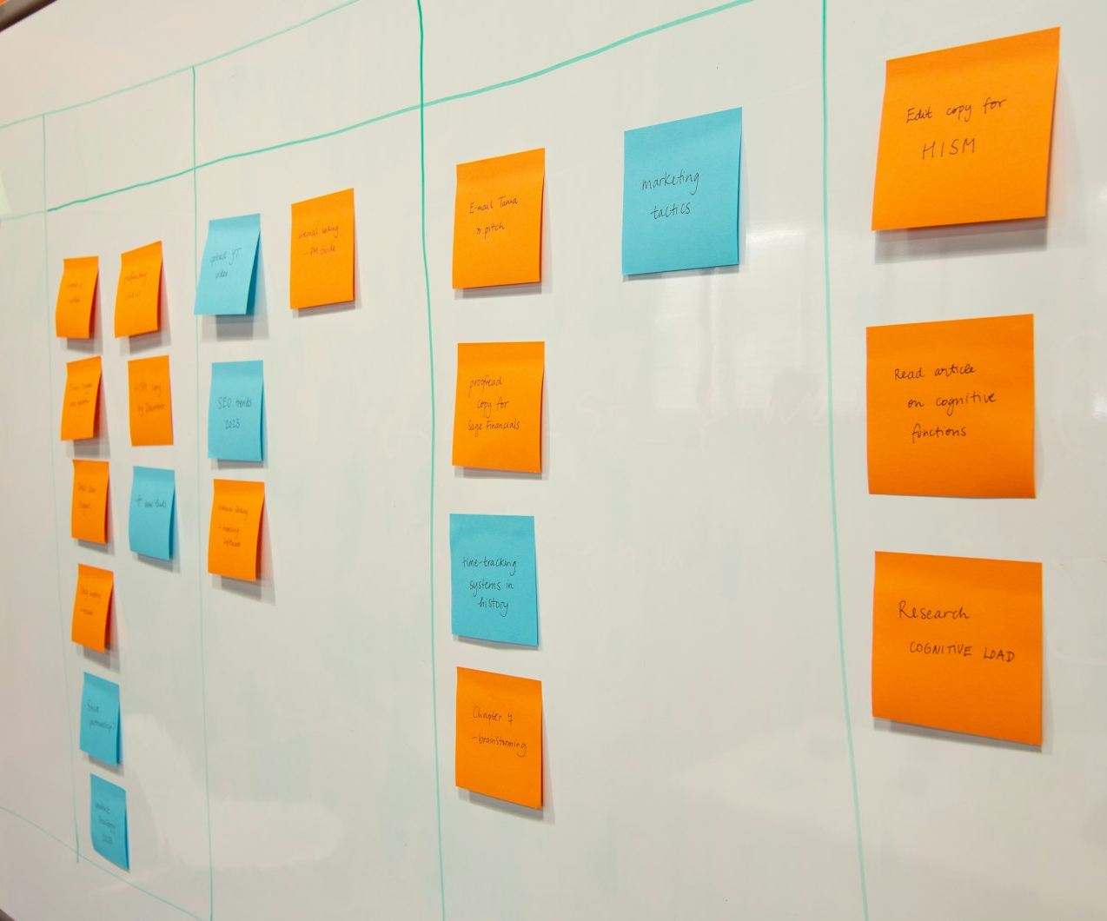
SLOP / UNIVERSITY
WEEK 8 / 15
From premise to production plan
A one-sentence premise is a starting point, not a finished scope.
“A short film about my grandmother's garden” says nothing about what you can actually film, when, or with whose permission. Workshopping a premise means stress-testing it against real constraints before you commit weeks to it.
Too broad
A premise requiring access you don't yet have, a subject who hasn't agreed, or a process that runs longer than your shoot window.
Workshop-ready
A premise you can name the location, subject, and access plan for, in one more sentence.
SLOP1416 Visual Storytelling for Short-Form Media
Notes:
Original explanation of premise-scoping for the final project, directly implementing session 8's 'workshop final-project premises for scope and access' brief. Unsplash: https://images.unsplash.com/photo-1677506048148-0c914dd8197b — photographer Paymo, accessed 13 Sep 2026

Slide 16
SLOP / UNIVERSITY
WEEK 8 / 16
The scope-and-access stress test
Four questions a workshop should force on every premise.
1
Footage: can this actually be filmed in the time you have, more than once if a shot fails?
2
Access: do you already have permission from every person, place or institution the premise depends on?
3
Consent: has every identifiable person agreed to appear, and do you have a record of that agreement?
4
Fallback: if the access falls through in week 10, is there a smaller version of this premise you can still shoot?
SLOP1416 Visual Storytelling for Short-Form Media
Notes:
Original scope-and-access checklist, directly answering session 8's premise-workshop brief and anticipating final-project.md's consent/media-record dossier requirement.

Slide 17
SLOP / UNIVERSITY
WEEK 8 / 17
Writing the logline
One or two sentences that survive contact with an audience who knows nothing about the project.
What a logline contains
What it leaves out
Who the subject is, what specific question or change the film follows, and why it matters to someone who isn't you.
Your production process, your equipment, your personal connection to the subject — none of that belongs in the sentence the audience reads.
Test: read the logline to someone who has never heard about the project. If they can't say what the film is about, the logline isn't done.
SLOP1416 Visual Storytelling for Short-Form Media
Notes:
Original guidance on logline-writing, directly answering session 8's 'Afterwards' instruction to write a final-project logline.

Slide 18
SLOP / UNIVERSITY
WEEK 8 / 18
Writing the audience statement
Naming who the film is for changes almost every craft decision downstream.
Someone unfamiliar with the subject
Needs more context, explanation and orientation inside the edit.
Someone who already knows the subject
Can be shown more implication, less exposition — trust the cut.
A general public audience
Needs a clear point of entry in the first 15 seconds or they leave.
A specific community the subject belongs to
Carries the highest ethical weight — they will notice a misrepresentation fastest.
SLOP1416 Visual Storytelling for Short-Form Media
Notes:
Original guidance on audience-statement writing, directly answering session 8's 'Afterwards' instruction and anticipating final-project.md's 'Story, structure and audience' criterion (30% weight).

Slide 19
SLOP / UNIVERSITY
WEEK 8 / 19
The first production plan
What the plan needs to answer before you shoot a single frame.
Subject and consent
Who appears, and what have they agreed to — in writing where possible.
Location and access
Where you will film, and what permission that location requires.
Shot list
The specific shots this premise needs — not everything you could film.
Contingency
What happens if a location, a subject, or a day of weather falls through.
SLOP1416 Visual Storytelling for Short-Form Media
Notes:
Original production-plan checklist, directly answering session 8's 'first production plan' brief.

Slide 20
SLOP / UNIVERSITY
WEEK 8 / 20
Where continuity discipline pays off later
Every choice this week is graded, later, against final-project.md's criteria.
Editing and revision (25%)
Story, structure, audience (30%)
Dossier, ethics, attribution (20%)
Continuity and rhythm discipline is exactly what this criterion assesses in the finished cut.
A scoped premise with a clear logline and audience statement is the foundation this criterion is built on.
The consent/media record you start this week becomes required dossier evidence in Week 12.
SLOP1416 Visual Storytelling for Short-Form Media
Notes:
Ties this week's craft and premise-scoping work directly to final-project.md's weighted marking criteria (Story/structure/audience 30%, Editing/revision 25%, Dossier/ethics/attribution 20%).

Slide 21

SLOP / UNIVERSITY
WEEK 8 / 21
Case study: reading a scene for its axis
Walking through the reference-viewing task on a two-person exchange.
Watch the exchange once for content, then a second time only for geometry: where is the axis drawn, does every shot stay on one side of it, and if it crosses, what earns that crossing?
What holds attention
A held axis lets the viewer stop thinking about space and start thinking about what's being said.
What breaks it
An uncut crossing mid-conversation forces the viewer to briefly re-locate both speakers before they can listen again.
SLOP1416 Visual Storytelling for Short-Form Media
Notes:
Unsplash: https://images.unsplash.com/photo-1573497491208-6b1acb260507 — photographer wocintechchat.com, accessed 13 Sep 2026

Slide 22
SLOP / UNIVERSITY
WEEK 8 / 22
Common mistakes at this stage
What tends to go wrong between diagnosing continuity and applying it.
Treating the 180 rule as absolute
It is a default, not a law — legitimate resets exist and are common in professional work.
Cutting on rhythm alone
A fast cut with a broken action match still reads as an error, however energetic it feels.
Premise too personal to scope
“I'll figure out access once I start filming” is not a production plan.
Skipping the consent record
An undocumented verbal agreement will not satisfy the Week 12 dossier requirement.
SLOP1416 Visual Storytelling for Short-Form Media
Notes:
Original error patterns observed at the assembly-to-premise-workshop stage.

Slide 23
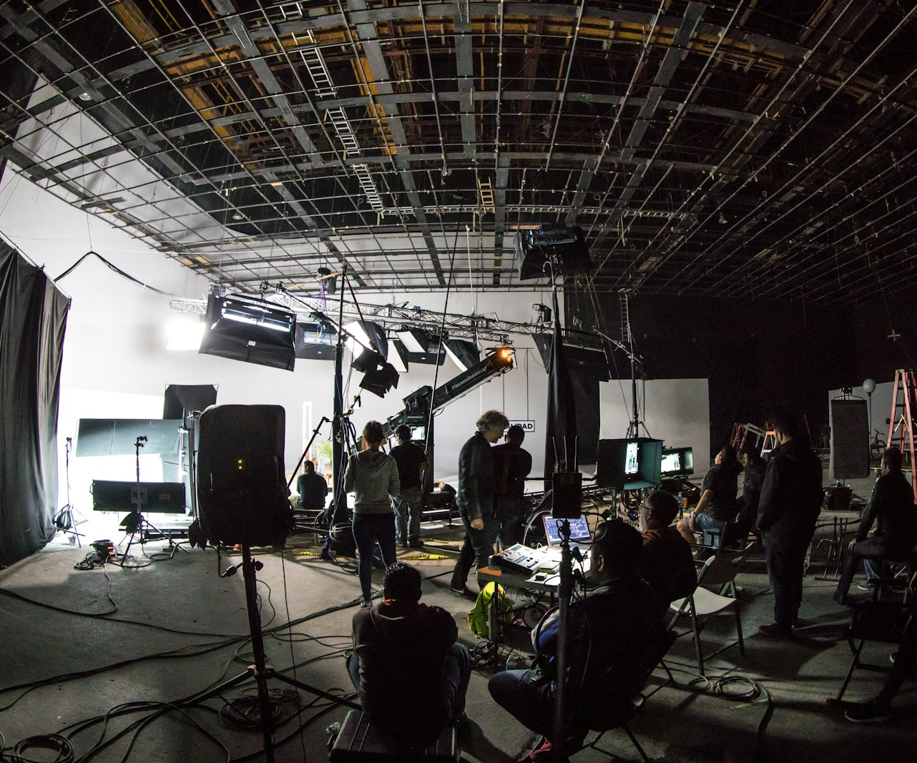
SLOP / UNIVERSITY
WEEK 8 / 23
On set: capturing coverage that survives the edit
Continuity discipline starts at the shoot, not the timeline.
An editor cannot invent a matching action or a legal line-cross from footage that was never shot. Note the axis and the action's start/end point on set, before the crew moves on.
On-set habit
Call out the axis position out loud before every setup change, so everyone on set tracks it, not just the director.
Coverage insurance
Shoot one clean cutaway per scene even if you don't think you'll need it — it is the cheapest continuity fix available in the edit.
SLOP1416 Visual Storytelling for Short-Form Media
Notes:
Unsplash: https://images.unsplash.com/photo-1612544409025-e1f6a56c1152 — photographer Brands&People (@brandsandpeople), accessed 13 Sep 2026

Slide 24
SLOP / UNIVERSITY
WEEK 8 / 24
Week 8 in-session exercise
What you produce and submit for this session.
Brief
Diagnose two continuity problems in a shared sequence, then re-cut it to fix or deliberately re-interpret them.
Constraints
Use only the provided footage — no reshoots. Name each continuity choice you changed and why.
Evidence to submit
The re-cut sequence, a one-sentence final-project premise, and your first production plan draft.
SLOP1416 Visual Storytelling for Short-Form Media
Notes:
Original SLOP1416 Week 8 in-session exercise, directly implementing the session brief's 're-cut a shared sequence' and 'workshop final-project premises' tasks.

Slide 25
SLOP / UNIVERSITY
WEEK 8 / 25
Technical review rubric
How continuity and rhythm choices are assessed in your re-cut and premise work.
Screen direction
The axis of action is held, or any crossing is earned by a cutaway or re-establishing shot.
Action matching
Cuts inside a physical action preserve position, direction and speed.
Rhythm
Shot duration tracks the content and emotional weight of each shot, not a fixed pace.
Premise scope
The one-sentence premise names a subject, access plan and fallback that are all realistic.
SLOP1416 Visual Storytelling for Short-Form Media
Notes:
Original review rubric, aligned to final-project.md's 'Editing and revision' (25%) and 'Story, structure and audience' (30%) criteria.

Slide 26
SLOP / UNIVERSITY
WEEK 8 / 26
Recommended practice and preparation
Before next session.
Continuity reference
No Film School, Understanding the 180-degree rule and axis of action: https://nofilmschool.com/180-degree-rule
Editing rhythm reference
Walter Murch, In the Blink of an Eye (on rhythm and the rule of six): referenced via course reading list.
Bring to Week 9
Your re-cut sequence and production plan draft, ready to workshop against caption and music choices.
SLOP1416 Visual Storytelling for Short-Form Media
Notes:
External resources: No Film School's 180-degree-rule explainer; Walter Murch's In the Blink of an Eye as a course reading-list reference. Accessed 13 September 2026.

