Slide 1

SLOP / UNIVERSITY
SLOP1416 / WEEK 9
Captions, Music and Audience
Making a video accessible and intentional: caption craft, music versus ambient sound, and how aspect ratio and platform shape what an audience actually reads.
Notes:
Unsplash: https://images.unsplash.com/photo-1764664281859-36f1b637b6a8 — photographer Detail .co (@detailvideo), accessed 13 Sep 2026
Course teaching content is original.

Slide 2
SLOP / UNIVERSITY
WEEK 9 / 02
Technical outcomes
By the end of this lecture you can caption, mix and format a cut for the audience actually receiving it.
Caption
Balance
Format
Time and place captions so they read as information, not decoration — serving both deaf/hard-of-hearing viewers and sound-off scrollers.
Choose music and ambient sound deliberately, understanding what each one is telling the audience to believe.
Plan aspect ratio and duration for the platform and context the work will actually be watched in.
SLOP1416 Visual Storytelling for Short-Form Media
Notes:
Original learning outcomes, aligned to session 9's brief.

Slide 3
SLOP / UNIVERSITY
WEEK 9 / 03
Captions are not subtitles
The two solve different problems, and a documentary short needs the first one.
Subtitles
Captions
Assume the audience can hear the audio track. They exist to translate or transcribe speech for a viewer in a different language — nothing else is described.
Assume the audience may not hear anything at all. They transcribe speech AND describe meaningful non-speech audio: [wind gusting], [phone buzzing], [music swells].
Rule of thumb: if a sound carries story information — a door slam, a ringtone, a shift in music — a caption has to say so; a subtitle never does.
SLOP1416 Visual Storytelling for Short-Form Media
Notes:
Standard accessibility distinction between subtitles (speech-only, hearing-audience assumed) and captions (full audio description, deaf/hard-of-hearing audience assumed).

Slide 4
SLOP / UNIVERSITY
WEEK 9 / 04
Open captions vs closed captions
The choice is about who controls whether they appear.
Type
What it is
Trade-off
Open captions
Burned permanently into the video image
Guaranteed visible everywhere; cannot be muted by mistake; cannot be styled per-platform
Closed captions
A separate track the player can toggle on or off
Respects viewer choice; can be re-styled per platform; depends on the platform actually supporting the track
For a short-form deliverable submitted as a single MP4, open captions are the safer default — nothing depends on the playback platform.
SLOP1416 Visual Storytelling for Short-Form Media
Notes:
Practical craft guidance for the final-project MP4 deliverable, which must arrive captioned regardless of playback platform.

Slide 5
SLOP / UNIVERSITY
WEEK 9 / 05
Caption timing craft, rule 1 — reading speed
A caption that outruns the eye fails even if the words are correct.
A widely used accessibility benchmark: roughly 15–20 characters per second, or about 3 spoken words per second, is the fastest most viewers can read comfortably while also watching the image.
Practical check
Read the caption aloud at a measured pace — if you can't finish before the clip cuts, shorten the line or hold the shot.
Common failure
Dense narration compressed to fit a fast cut; the fix is almost always to trim the sentence, not shrink the type.
SLOP1416 Visual Storytelling for Short-Form Media
Notes:
Standard caption-timing guideline used across accessibility standards (approx. 15-20 characters/second reading speed).

Slide 6
SLOP / UNIVERSITY
WEEK 9 / 06
Caption timing craft, rule 2 — minimum duration and line breaks
Two more rules that keep captions readable under real viewing conditions.
Minimum on-screen time
Break at phrase boundaries
Even a very short line needs a floor duration — roughly one second minimum — so a caption is not flashed and gone before a viewer's eye arrives.
Split a two-line caption where a listener would naturally pause — after a clause, not at an arbitrary character count that cuts a phrase in half.
Both rules exist for the same reason: captions are read, and reading has its own pace independent of how fast the edit cuts.
SLOP1416 Visual Storytelling for Short-Form Media
Notes:
Standard caption craft: minimum duration floors and phrase-based line breaks, used to keep captions legible rather than technically present.

Slide 7
SLOP / UNIVERSITY
WEEK 9 / 07
Caption placement and safe areas
A caption has to survive every aspect ratio the video might be viewed in.
Keep captions inside a safe area clear of platform UI — like buttons, usernames, progress bars — and clear of any other on-screen text or logo the shot already carries.
The risk
The practice
A caption positioned for 16:9 can sit under a mobile app's comment bar or share icons once the same file is viewed in a 9:16 feed.
Preview captions in every export ratio you plan to publish, not just the ratio you edited in.
SLOP1416 Visual Storytelling for Short-Form Media
Notes:
Original craft guidance connecting caption placement to the aspect-ratio discussion later in this lecture.

Slide 8
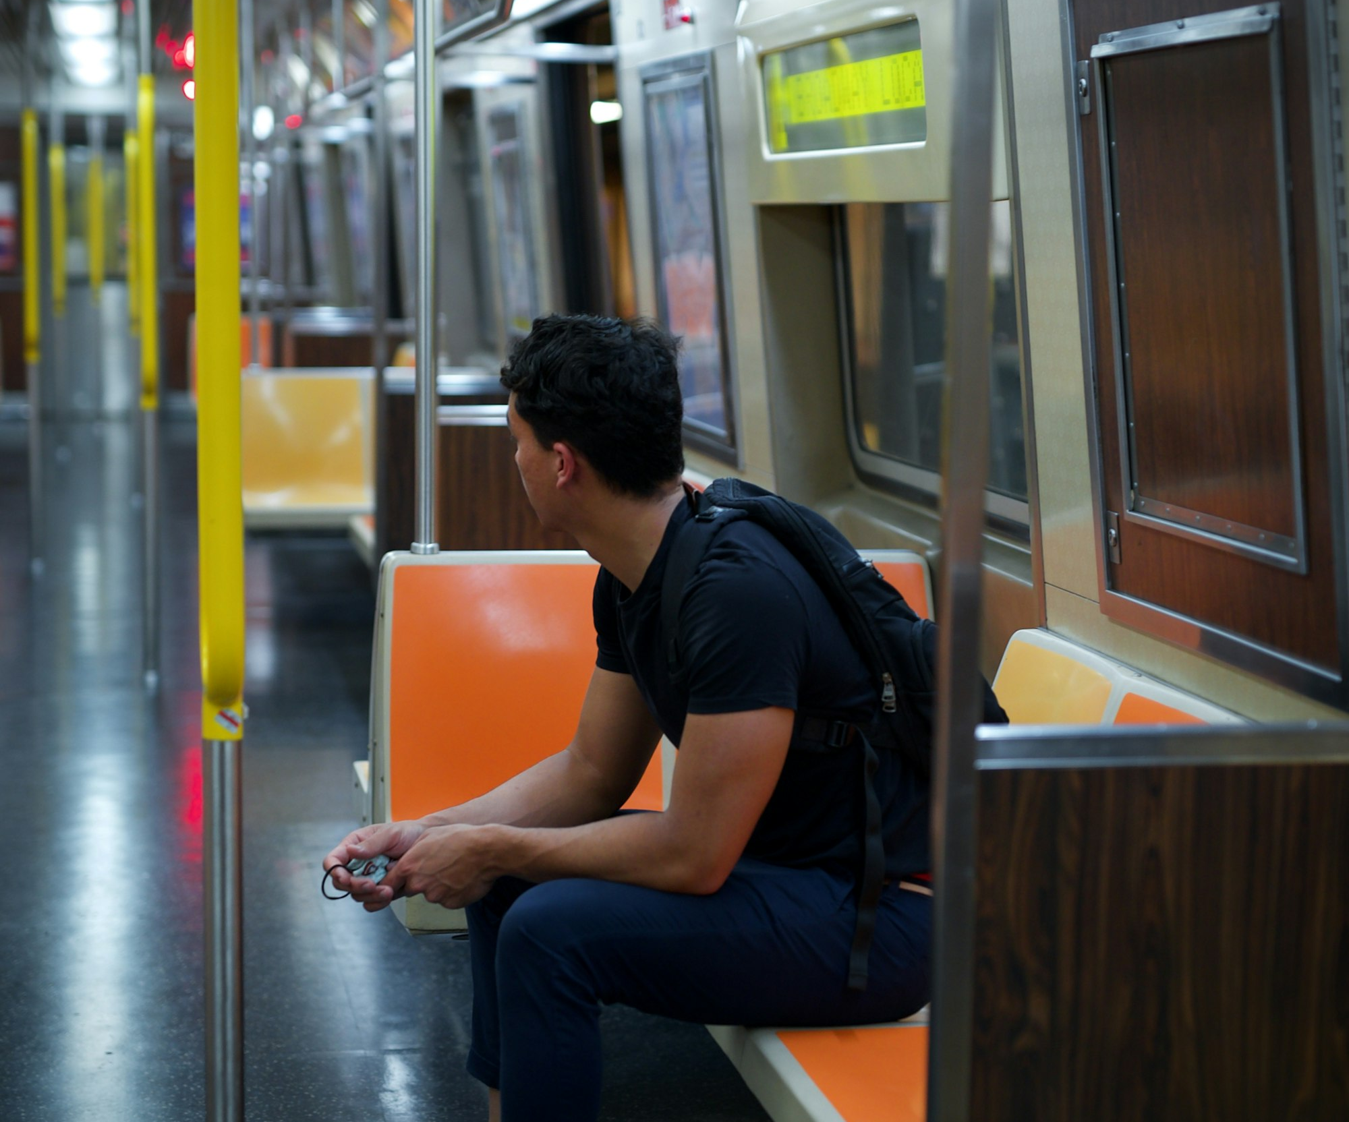
SLOP / UNIVERSITY
WEEK 9 / 08
One solution, two real audiences
Captions are not a compliance checkbox — they serve two overlapping, very large groups of viewers.
Deaf and hard-of-hearing viewers
For this audience, captions are not optional — they are the only access to spoken and audio content at all.
Sound-off viewers
Most social video is watched muted by default — on a train, in an office, in bed next to someone asleep. Captions are how the story survives that context.
SLOP1416 Visual Storytelling for Short-Form Media
Notes:
Unsplash: https://images.unsplash.com/photo-1635873977302-aa1c16d70f55 — photographer Fabian Centeno (@real_chance12), accessed 13 Sep 2026

Slide 9
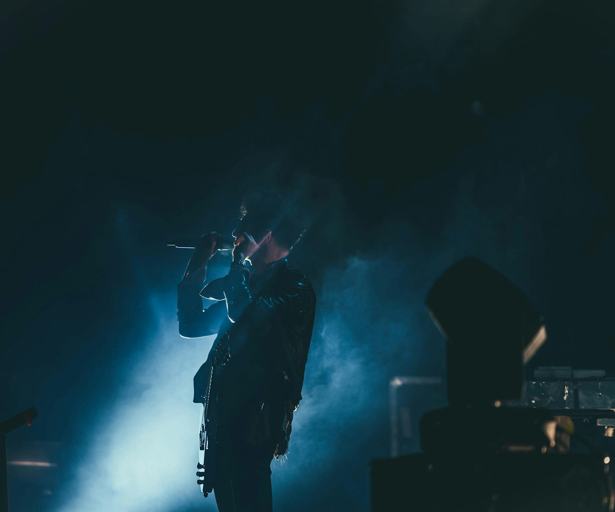
SLOP / UNIVERSITY
WEEK 9 / 09
Music and ambient sound do different jobs
They are not interchangeable — they signal different kinds of truth.
Music: connotative
Music tells the audience how to feel. A minor key, a swelling string, a driving beat — all instruct the viewer's emotional read of the image.
Ambient sound: evidentiary
Room tone, traffic, wind, footsteps — ambient sound proves “you are here.” It is part of the documentary's truth-claim, not decoration.
SLOP1416 Visual Storytelling for Short-Form Media
Notes:
Unsplash: https://images.unsplash.com/photo-1487954277007-8c2d6710c312 — photographer Austin Neill (@arstyy), accessed 13 Sep 2026

Slide 10
SLOP / UNIVERSITY
WEEK 9 / 10
The risk of letting music override the image
In non-fiction work, music can actively contradict what the picture is showing.
A triumphant score over a subject who is visibly struggling tells the audience to feel triumph anyway — overriding, not supporting, the documentary evidence in front of them.
Credibility cost
An audience that senses music is steering their feelings past what the footage supports starts to distrust the whole piece, not just that scene.
Practical check
Watch the scene with music muted, then with only music — if the two tell different stories, the mix is the problem.
SLOP1416 Visual Storytelling for Short-Form Media
Notes:
Original craft argument extending session 9's music-vs-ambient comparison to non-fiction credibility.

Slide 11
SLOP / UNIVERSITY
WEEK 9 / 11
Music rights: a real risk, not a formality
Unlicensed commercial tracks are one of the most common ways a student project gets blocked at submission.
Choice
Risk
Why
Unlicensed commercial track
High risk
Platform takedown, muted audio on export, or a rejected submission
Properly licensed library music
Low risk
Cleared for the specific use; keep the licence record for the dossier
Original composition
Low risk
Full control, but budget the time to make or commission it
Ambient/room-tone-led sequence
Low risk
No licence needed; also reinforces the documentary truth-claim
SLOP1416 Visual Storytelling for Short-Form Media
Notes:
Original rights/licensing awareness guidance for a student non-fiction submission context.

Slide 12

SLOP / UNIVERSITY
WEEK 9 / 12
Waveform literacy: reading a mix visually
The waveform is where music-vs-ambient balance decisions actually get made.
A dense, tall waveform under dialogue usually means music or ambient sound is loud enough to compete with speech — the first thing to check when a cut “feels muddy.”
Quick check
Dialogue should visibly sit above the music/ambient bed in the waveform, not be buried inside it.
Duck, don't delete
Lower music under a line rather than cutting it out entirely — abrupt silence draws as much attention as being too loud.
SLOP1416 Visual Storytelling for Short-Form Media
Notes:
Unsplash: https://images.unsplash.com/photo-1692838952665-a7a9577fde9e — photographer Yassine Ait Tahit (@unclearvision), accessed 13 Sep 2026

Slide 13
SLOP / UNIVERSITY
WEEK 9 / 13
Aspect ratio is an audience decision, not a technical afterthought
Each ratio corresponds to a real viewing context that has to be planned for at the shoot.
Ratio
Context
Framing consequence
16:9
TV, desktop, YouTube
Wide establishing shots and side-by-side framing read comfortably
9:16
Vertical mobile feed
Subject fills a tall, narrow frame; wide shots lose most of their information
1:1
Square feed post
Centred framing with headroom on both sides; least common but most format-flexible
SLOP1416 Visual Storytelling for Short-Form Media
Notes:
Original comparison table on aspect ratio as an audience-context decision, extending session 9's brief.

Slide 14

SLOP / UNIVERSITY
WEEK 9 / 14
Plan the ratio at the shoot, not in the export
Cropping after the fact loses composition control that framing never gets back.
A 16:9 wide shot cropped to 9:16 after editing either loses the subject's edges or leaves empty space where the original composition wasn't built for a tall frame.
The fix
Decide the target ratio before the shoot and frame for it directly — recompose in the viewfinder, not in the timeline.
Mixed delivery
If a project truly needs both a 16:9 and a 9:16 cut, plan two takes of the key shots rather than one crop.
SLOP1416 Visual Storytelling for Short-Form Media
Notes:
Unsplash: https://images.unsplash.com/photo-1758599879065-46fd59235166 — photographer Vitaly Gariev (@silverkblack), accessed 13 Sep 2026

Slide 15
SLOP / UNIVERSITY
WEEK 9 / 15
Duration and platform attention norms
How long an audience gives an edit before deciding whether to keep watching differs by context.
Short-form feeds
Longer-form / assignment context
Completion and re-watch rates are the currency; the first 1-3 seconds have to establish the hook or the viewer scrolls past.
A 2-3 minute short can earn patience a 15-second clip cannot — but only if the opening promises a specific, followable premise.
Pacing and the opening-hook decision should follow the platform's actual attention norm, not a generic “grab them fast” rule applied everywhere identically.
SLOP1416 Visual Storytelling for Short-Form Media
Notes:
Original discussion of duration/attention norms varying by publication context, connecting to the final project's 2-3 minute constraint.

Slide 16
SLOP / UNIVERSITY
WEEK 9 / 16
The same edit, two real viewing conditions
A responsible cut has to hold up in both, because you don't control which one your audience is in.
Condition
What the audience actually receives
Muted, captions on, phone, public
Story must be legible from image + captions alone; sound design is a bonus
Full volume, headphones or speakers, private
Music, ambient sound and mix decisions are fully perceptible and open to scrutiny
Test cut: play it once fully muted with captions, then once at full volume alone — both should tell a complete story.
SLOP1416 Visual Storytelling for Short-Form Media
Notes:
Original two-condition testing method, synthesising the captions and sound sections of this lecture into one practical check.

Slide 17

SLOP / UNIVERSITY
WEEK 9 / 17
This week's shoot schedule milestone
Permissions are revisited here, not confirmed once and forgotten.
Every time the shoot plan changes — a new location, a new interview subject, a new public space — the permission question has to be asked again, not assumed still valid.
Shoot schedule
List each planned shoot with date, location, subjects and the specific permission each one still needs.
Consent is not one-time
A subject who agreed to Week 5's plan has not automatically agreed to a changed scope in Week 9.
SLOP1416 Visual Storytelling for Short-Form Media
Notes:
Unsplash (Unsplash+): https://plus.unsplash.com/premium_photo-1705583863541-9ff1b2206f5e — photographer Olivie Strauss (@olivie_strauss), accessed 13 Sep 2026

Slide 18

SLOP / UNIVERSITY
WEEK 9 / 18
Confirming permissions in practice
What “confirmed” actually needs to mean before a shoot happens.
A verbal “sure, that's fine” from weeks ago is not a confirmed permission. Confirming means checking, in writing, against the actual current shoot plan.
Minimum record
Who agreed, to what specifically, and when — kept alongside the production dossier's consent/media record.
Location permissions
Public space filming, private property, and any workplace or institution each carry a different permission path — confirm the right one.
SLOP1416 Visual Storytelling for Short-Form Media
Notes:
Unsplash: https://images.unsplash.com/photo-1763729805496-b5dbf7f00c79 — photographer Jakub Żerdzicki (@jakubzerdzicki), accessed 13 Sep 2026

Slide 19
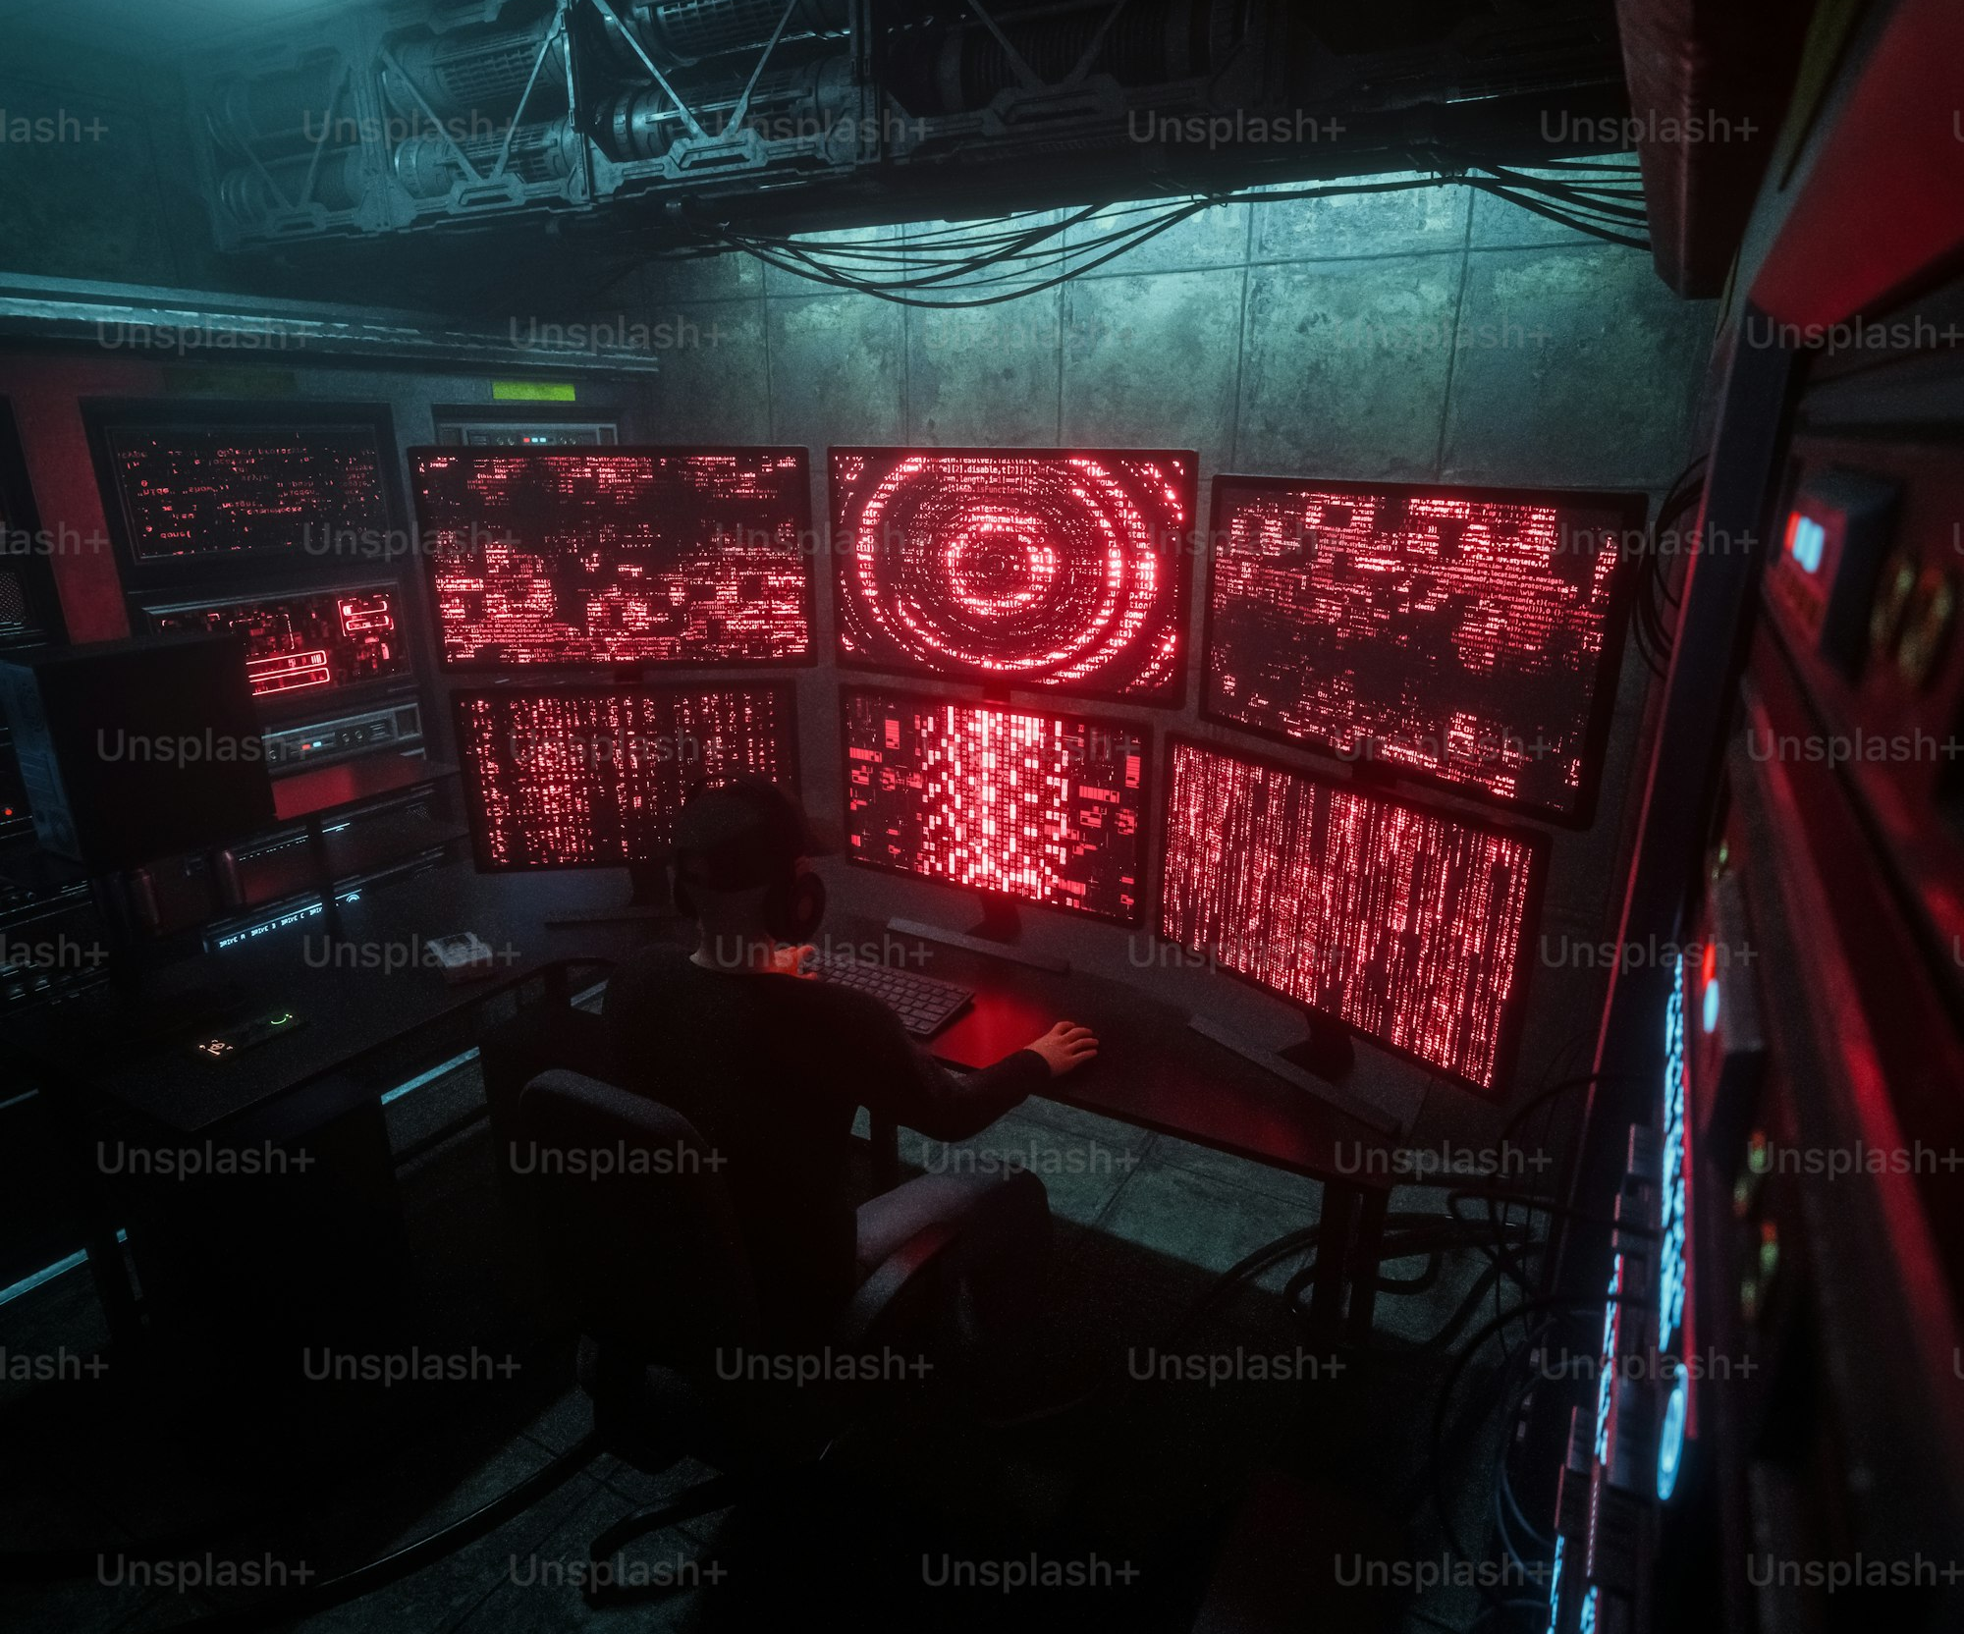
SLOP / UNIVERSITY
WEEK 9 / 19
Editing captions on the timeline
Where caption timing craft actually gets executed.
1
Transcribe dialogue and mark every meaningful non-speech sound.
2
Set in/out points so each line clears the reading-speed and minimum-duration checks.
3
Break lines at phrase boundaries and confirm placement inside the safe area.
4
Preview the full sequence muted, on the smallest screen you expect it viewed on.
SLOP1416 Visual Storytelling for Short-Form Media
Notes:
Unsplash (Unsplash+): https://plus.unsplash.com/premium_photo-1767857307085-093bac0df927 — photographer A Chosen Soul (@a_chosensoul), accessed 13 Sep 2026

Slide 20

SLOP / UNIVERSITY
WEEK 9 / 20
Reviewing the cut with someone else present
A video call review catches what a solo edit session misses.
Watching alongside someone — in person or on a call — surfaces caption errors, confusing pacing, and mix problems that a familiar editor stops noticing after the tenth pass.
What to ask
“Could you follow that muted?” and “Did the music tell you something the picture didn't?” — both point straight at this week's material.
Feed forward
Note what changes; this becomes input for Week 10's structured peer-feedback session.
SLOP1416 Visual Storytelling for Short-Form Media
Notes:
Unsplash: https://images.unsplash.com/photo-1752650733337-cb0189176fb9 — photographer Vitaly Gariev (@silverkblack), accessed 13 Sep 2026

Slide 21
SLOP / UNIVERSITY
WEEK 9 / 21
Reference-viewing task, worked through
Compare a captioned and uncaptioned version of the same short work.
1
Watch the uncaptioned version once, sound on — note what you understand.
2
Watch the captioned version muted — note what changes in what you understand.
3
Identify any moment where the caption adds information the image alone did not carry.
4
Identify any moment where caption placement or timing got in the way of reading the image.
The gap between those two viewings is exactly what captions are for — not redundancy, but access to the same story.
SLOP1416 Visual Storytelling for Short-Form Media
Notes:
Directly answers session 9's reference-viewing prompt: comparing a captioned and uncaptioned short work.

Slide 22
SLOP / UNIVERSITY
WEEK 9 / 22
Common caption mistakes, and the fix
The failures a marker sees most often, and what actually corrects each one.
Auto-generated captions left unedited
Re-check every line against the audio; auto-captions mishear names and technical terms
Speaker not identified in overlapping dialogue
Add a name or descriptor when it isn't visually obvious who is speaking
Music/sound description skipped entirely
Add bracketed non-speech cues wherever the sound carries story information
Captions cropped by an aspect-ratio export
Preview in the actual export ratio, not the edit-timeline ratio
SLOP1416 Visual Storytelling for Short-Form Media
Notes:
Original common-mistakes rubric for caption craft, aligned to the final project's captioned-MP4 submission requirement.

Slide 23
SLOP / UNIVERSITY
WEEK 9 / 23
Sound and captions rubric
How this week's craft is assessed in your final project submission.
Captions
Present, accurately timed, correctly broken, and describing meaningful non-speech sound.
Music vs ambient balance
The mix supports rather than overrides what the image documents.
Format planning
Aspect ratio and duration match the stated viewing context, decided before the shoot.
Rights and permissions
Music is cleared or original; permissions match the shoot as actually executed.
SLOP1416 Visual Storytelling for Short-Form Media
Notes:
Original review rubric, aligned to the final project's 'Cinematography and sound' (25%) and 'Dossier, ethics and attribution' (20%) criteria.

Slide 24
SLOP / UNIVERSITY
WEEK 9 / 24
Week 9 in-session exercise
What you produce and submit for this session.
Brief
Bring a 30-second test sequence from the final project with its current caption draft; check timing, mix and format together.
Constraints
Apply the reading-speed and minimum-duration rules exactly; identify at least one place music or ambient sound could contradict the image.
Evidence to submit
A shoot schedule with confirmed permissions per shoot, and a one-paragraph note on the target aspect ratio and why.
SLOP1416 Visual Storytelling for Short-Form Media
Notes:
Original SLOP1416 Week 9 in-session exercise, directly implementing the session brief.

Slide 25
SLOP / UNIVERSITY
WEEK 9 / 25
Recommended practice and preparation
Before next session.
Caption standards reference
W3C Web Accessibility Initiative, Captions/Subtitles: https://www.w3.org/WAI/media/av/captions/
Rights and licensing reference
Australian Copyright Council, Music: https://www.copyright.org.au/
Bring to Week 10
A rough cut of the final project, ready to screen once without interruption for structured peer feedback.
SLOP1416 Visual Storytelling for Short-Form Media
Notes:
External resources: W3C WAI captioning guidance; Australian Copyright Council music-rights reference. Accessed 13 September 2026.

