Slide 1

SLOP / UNIVERSITY
SLOP1416 / WEEK 10
Rough-Cut Clinic
Structured peer feedback that tells you what a cut needs next — and the discipline to tell useful revision from a request to make it look like mine.
Notes:
Unsplash: https://images.unsplash.com/photo-1758270705518-b61b40527e76 — photographer Vitaly Gariev (@silverkblack), accessed 13 Sep 2026
Course teaching content is original.

Slide 2
SLOP / UNIVERSITY
WEEK 10 / 02
Technical outcomes
By the end of this clinic you can run, receive and act on a structured rough-cut review.
Run
Receive
Act
Structure a single uninterrupted screening and a feedback round that surfaces observable problems, not preferences.
Log feedback without defending the cut, and separate a pattern across viewers from one person's taste.
Choose two feedback changes, write the reasoning that connects observation to edit decision, and record it in the dossier.
SLOP1416 Visual Storytelling for Short-Form Media
Notes:
Original course learning outcomes, aligned to session 10's brief.

Slide 3
SLOP / UNIVERSITY
WEEK 10 / 03
What a rough cut is for at this stage
Substantially assembled, deliberately unpolished.
A rough cut has most of its shots in place and its structure decided — but sound levels, colour and pacing details are still open. Screening it now tests the story and structure decision before you spend time on polish that a structural change would waste.
Ready to screen
Not yet ready
Scenes are ordered, the throughline is legible in a single pass, and you can already answer “what is this cut currently about?”
You are still deciding which footage exists to use — screen a structural placeholder assembly, not raw dailies.
SLOP1416 Visual Storytelling for Short-Form Media
Notes:
Original explanation of the rough-cut stage's purpose, distinguishing it from a fine cut or an assembly of raw footage.

Slide 4

SLOP / UNIVERSITY
WEEK 10 / 04
The single rule: watch once, uninterrupted
A first-time, unbriefed reaction is the only data point you cannot get any other way.
The moment you explain a shot, pause to justify a choice, or answer a question mid-screening, you destroy the one thing a first viewing could tell you: how a real audience experiences the cut without you in the room.
Why it matters
Every future viewer of the finished work will also watch it once, unbriefed, with no director present to explain.
Discipline
Save every question and comment until the viewing ends — including your own urge to narrate.
SLOP1416 Visual Storytelling for Short-Form Media
Notes:
Direct expansion of session 10's brief: "small groups watch work once without interruption". Unsplash: https://images.unsplash.com/photo-1758613656682-b15a221eb3dd — photographer Vitaly Gariev (@silverkblack), accessed 13 Sep 2026

Slide 5
SLOP / UNIVERSITY
WEEK 10 / 05
Observable choice vs stated preference
The single most important distinction in this clinic.
What was said
Why it is or isn't useful
“At 0:42, the cut to the wide shot made me lose track of who was talking.”
Names a timecode, a specific edit, and a specific effect on the viewer — actionable.
“I would have used more close-ups.”
Names a stylistic preference with no diagnosed problem — not actionable as stated.
“I didn't understand why the second scene started until it was almost over.”
Describes confusion at a moment — actionable, points at the second scene's opening.
“It just didn't feel very cinematic.”
A vague aesthetic judgement with nothing to revise against — ask a follow-up before logging it.
SLOP1416 Visual Storytelling for Short-Form Media
Notes:
Original teaching device contrasting useful, observation-anchored feedback with unusable preference statements, per session 10's brief.

Slide 6
SLOP / UNIVERSITY
WEEK 10 / 06
Eliciting feedback in the right order
Description before prescription — a four-question structure.
1
What did you think was happening, scene by scene, in your own words?
2
Where did you get confused, bored or lost — name the moment, not just the feeling?
3
What did you think would happen next, and were you right?
4
Only now: what would you change, and why, based on what you just described?
Asking for description first stops a viewer jumping straight to a fix that doesn't address the real problem — the confusion they describe may not be where they think the fix belongs.
SLOP1416 Visual Storytelling for Short-Form Media
Notes:
Original feedback-elicitation structure, built directly from session 10's brief on separating description from prescription.

Slide 7
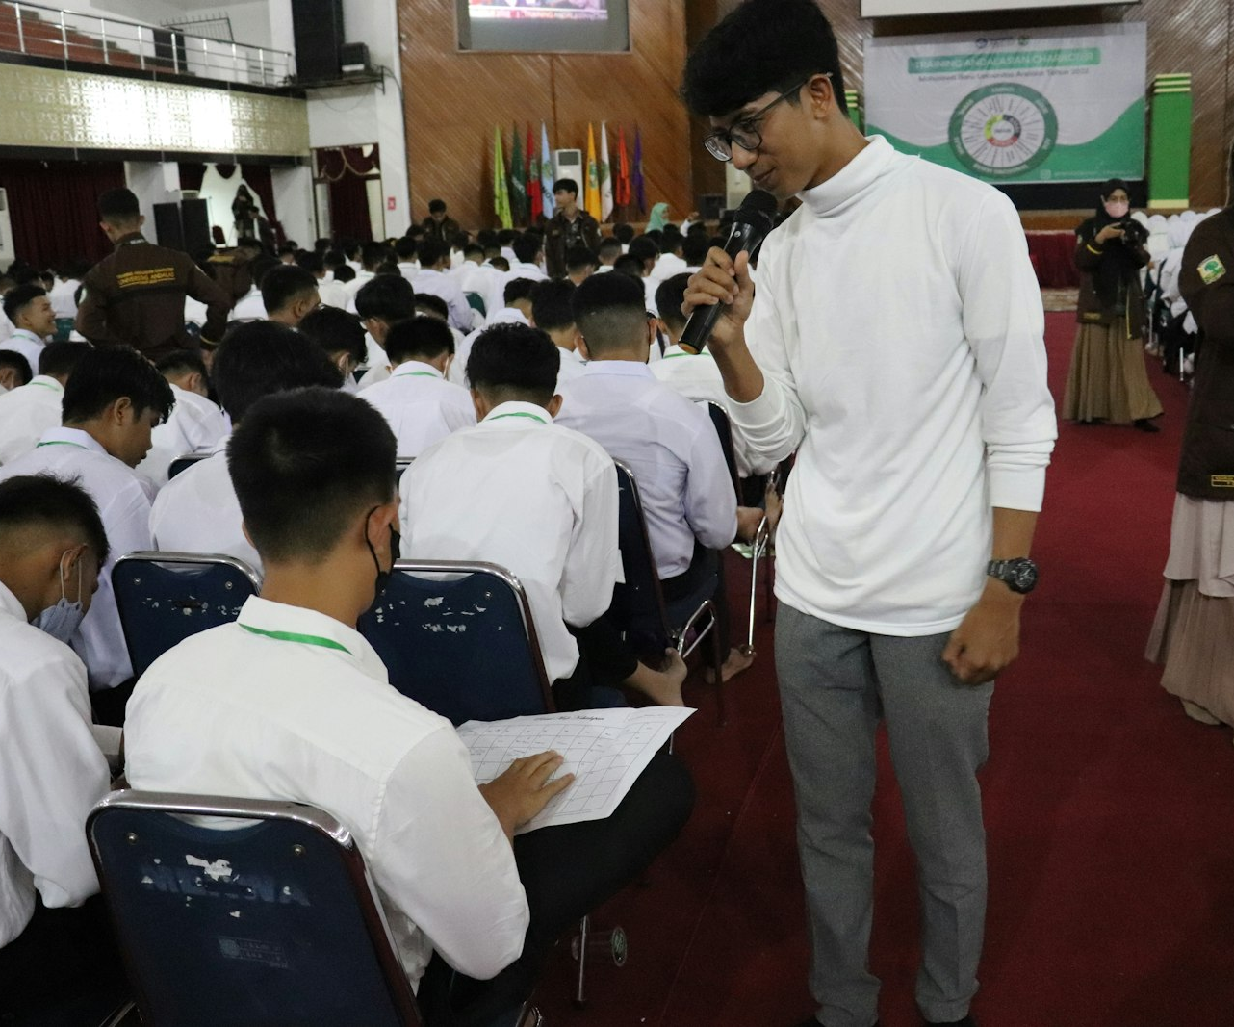
SLOP / UNIVERSITY
WEEK 10 / 07
The maker's job while listening
Log, don't defend — the work has to speak for itself.
“That shot means X” is not useful information if a viewer without your explanation was confused — the confusion is the finding, not a misunderstanding to correct in the room.
Do
Write down the observation and the timecode, and ask a clarifying question only about what they experienced.
Don't
Explain intent, argue the point, or talk a viewer out of a reaction — you won't be in the room for the real audience.
SLOP1416 Visual Storytelling for Short-Form Media
Notes:
Unsplash: https://images.unsplash.com/photo-1660796047018-c4ad402639e5 — photographer Herlambang Tinasih Gusti (@tinasihgusti), accessed 13 Sep 2026

Slide 8
SLOP / UNIVERSITY
WEEK 10 / 08
Revision vs “make it look like mine”
The specific risk this clinic has to guard against.
Peer feedback can drift from diagnosing a problem in your cut to prescribing a different cut entirely — one that resembles the reviewer's own taste or approach rather than fixing what confused them.
Needs revision
Not how I'd have cut it
Multiple independent viewers raise the same confusion or drop-off point without prompting each other — that convergence is signal.
One viewer's account of how they personally would have made the film — a preference, not a diagnosis; note it, don't chase it.
SLOP1416 Visual Storytelling for Short-Form Media
Notes:
Direct expansion of session 10's brief: “we separate a useful revision from a request to make every project look alike.”

Slide 9
SLOP / UNIVERSITY
WEEK 10 / 09
Triage: pattern beats single reaction
Prioritising feedback when your remaining time is limited.
Feedback pattern
Priority this week
Confusion about story or structure, raised by 2+ viewers independently
High — revise before this week ends
A single viewer's structural confusion, not repeated by others
Medium — note it, watch for it again next screening
Stylistic preference (“more close-ups”, “different music”) from any viewer
Low — log but do not action without a second, independent signal
Technical polish notes (levels, colour, minor pacing)
Deferred — this is rough-cut stage; polish comes after structure is locked
SLOP1416 Visual Storytelling for Short-Form Media
Notes:
Original triage framework for prioritising rough-cut clinic feedback, built from session 10's brief.

Slide 10
SLOP / UNIVERSITY
WEEK 10 / 10
Clinic logistics that make the method work
The structure around the viewing matters as much as the questions.
Timebox each cut
One notetaker per cut
Rotate honestly
Fix a screening time and a feedback-round length in advance so every project gets an equal, uninterrupted hearing.
Someone other than the maker logs timecoded observations during the single viewing — the maker is listening, not writing.
Every project gets watched by the same small group so patterns across viewers are comparable cut to cut.
SLOP1416 Visual Storytelling for Short-Form Media
Notes:
Direct expansion of session 10's “before the session” brief: bring a rough cut, questions for viewers, and the media record.

Slide 11
SLOP / UNIVERSITY
WEEK 10 / 11
The media record re-enters the room
A rough cut is the first place an unreleased shot becomes visible to someone other than you.
Check your media record against what actually made the cut, not just what you shot — a shot with no consent or an unreleased piece of external media does not belong in a rough cut you're screening to other people.
Before this clinic
Cross off every shot in the timeline against your consent and media record from earlier weeks.
If something is missing
Cut it or blur/replace it before screening — don't wait for a viewer to ask.
SLOP1416 Visual Storytelling for Short-Form Media
Notes:
Original tie-back connecting the media record established in Week 4/5 to this week's rough-cut screening obligation.

Slide 12
SLOP / UNIVERSITY
WEEK 10 / 12
Test both a sound-on and a sound-off pass
Week 9's reading-context lesson applies to this clinic too.
The rough cut you screen with sound on for a small group is not the only way this project will eventually be watched. If time allows, run a second, silent pass with captions to see whether the story still holds without the audio track carrying it.
Sound-on pass
Tests whether ambient sound, dialogue and music are doing the job you intend at this stage.
Muted / captioned pass
Tests whether the edit's structure and framing alone still communicate the story — the true test of the cut, not the mix.
SLOP1416 Visual Storytelling for Short-Form Media
Notes:
Original tie-back to session 9's captions/music/audience content, applied as a second-pass testing method for the rough-cut clinic.

Slide 13

SLOP / UNIVERSITY
WEEK 10 / 13
Reading the timeline like a viewer, not a maker
What to look at on your own timeline before you screen it.
You already know what every cut means because you made it. Before the clinic, try to watch your own rough cut once as if seeing it for the first time — it will not fully work, but it surfaces the most obvious problems before a peer has to name them.
A useful self-check
Cover the picture and listen only to sound, then cover the sound and watch only picture — note where either alone confuses you.
SLOP1416 Visual Storytelling for Short-Form Media
Notes:
Unsplash: https://images.unsplash.com/photo-1574717024653-61fd2cf4d44d — photographer Peter Stumpf (@peter_s), accessed 13 Sep 2026

Slide 14
SLOP / UNIVERSITY
WEEK 10 / 14
Continuity and rhythm problems surface here first
This clinic is where Week 8's editing craft gets tested against a real, unbriefed viewer.
Symptom in feedback
Likely editing-craft cause
Screen-direction break
A viewer reports losing track of who is where or who is speaking to whom
Pacing drag
A viewer names a specific stretch as “slow” or their attention drifting
Unclear point of view
A viewer can't say whose experience the cut is following
Jump-cut confusion
A viewer reads an intended time-compression cut as a mistake
SLOP1416 Visual Storytelling for Short-Form Media
Notes:
Original diagnostic table connecting rough-cut clinic feedback symptoms back to Week 8's continuity/rhythm vocabulary.

Slide 15
SLOP / UNIVERSITY
WEEK 10 / 15
The “two changes and why” deliverable
A rehearsal for professional practice: dailies review, editor's cut notes.
What professionals do
What you write down
In a dailies review or a cut screening, an editor doesn't just list what changed — they connect each change to a specific viewer or producer observation.
For each of your two chosen changes: the observation that triggered it, which viewer(s) raised it, and the edit decision you made in response.
This reasoning — not just the list of changes — is exactly what the dossier records and what “revision through feedback” means as a marking criterion.
SLOP1416 Visual Storytelling for Short-Form Media
Notes:
Direct expansion of session 10's “afterwards” instruction: choose two feedback changes and document why you will make them.

Slide 16

SLOP / UNIVERSITY
WEEK 10 / 16
Documenting the sticky-note pile
Turning a room full of scattered observations into two decisions.
Whatever format your notes take — sticky notes, a shared doc, timecoded comments — the same triage applies: cluster by moment in the cut, count how many independent viewers hit the same moment, then rank.
Cluster first
Group notes by timecode/moment before judging any single note in isolation.
Rank second
The moment with the most independent hits becomes your first change; the second-most, your second.
SLOP1416 Visual Storytelling for Short-Form Media
Notes:
Unsplash: https://images.unsplash.com/photo-1735639013995-086e648eaa38 — photographer Jakub Żerdzicki (@jakubzerdzicki), accessed 13 Sep 2026

Slide 17

SLOP / UNIVERSITY
WEEK 10 / 17
Timeboxing the clinic itself
Structure protects every project's chance at an equal, useful hearing.
A clinic with no time limits collapses into the loudest or most talkative project getting the most attention. Fix a screening length and a feedback-round length before you start, and hold to it.
A workable split
Roughly: 1x the cut's own runtime to watch, then 2–3x that runtime for structured feedback per project.
Enforce it kindly
A visible timer (not a person interrupting the discussion) keeps the group on schedule without adding friction.
SLOP1416 Visual Storytelling for Short-Form Media
Notes:
Unsplash: https://images.unsplash.com/photo-1704265586142-db3e17d0dea0 — photographer William Warby (@wwarby), accessed 13 Sep 2026

Slide 18
SLOP / UNIVERSITY
WEEK 10 / 18
When the group disagrees with itself
Contradictory feedback is data too, not a deadlock.
Two viewers sometimes give opposite notes about the same moment. That contradiction usually means the moment is genuinely ambiguous — which is itself useful information, distinct from either viewer simply being wrong.
If the ambiguity is intentional
If the ambiguity is accidental
Good — you've confirmed the moment reads as open, which may be exactly your intended effect. Leave it.
The moment needs a clearer signal (a shot choice, a sound cue, a line of dialogue) to resolve it in the direction you intend.
SLOP1416 Visual Storytelling for Short-Form Media
Notes:
Original guidance for handling contradictory peer feedback, extending the triage method to the harder real-world case.

Slide 19
SLOP / UNIVERSITY
WEEK 10 / 19
What not to change this week
Rough-cut stage has a scope boundary.
In scope now
Defer to fine cut
Watch for scope creep
Scene order, shot selection for structure, trims that fix confusion about who/what/when.
Audio levels, colour, music choice, precise cut-point timing — these depend on a locked structure.
“While I'm in here” changes unrelated to a logged piece of feedback — resist unless it's fast and free.
SLOP1416 Visual Storytelling for Short-Form Media
Notes:
Original scope-discipline guidance, protecting the rough-cut clinic's structural focus from premature polish work.

Slide 20
SLOP / UNIVERSITY
WEEK 10 / 20
Reference-viewing task, answered
Session 10's prompt: read comments on a short work critically.
Before this clinic, you were asked to read feedback on a short work and judge which comments identify an observable choice and which merely state a preference.
1
Underline any comment that names a timecode, a specific shot, or a specific viewer reaction.
2
Cross out any comment that only states what the commenter personally prefers.
3
For each underlined comment, write the one-sentence problem it points to.
4
Bring your marked-up example to compare with a partner's before your own clinic round.
SLOP1416 Visual Storytelling for Short-Form Media
Notes:
Directly answers session 10's reference-viewing prompt about reading feedback critically.

Slide 21

SLOP / UNIVERSITY
WEEK 10 / 21
Applying this to your own final project
How this session's method plugs into your production dossier.
The dossier due at submission asks for your production log, two feedback changes and the reasoning behind them — this clinic is where you generate that exact evidence, not an afterthought written later from memory.
Capture it live
Write the observation → change → reasoning chain during or immediately after this clinic, while it's accurate.
Keep the raw notes
Retain the timecoded feedback log itself as evidence behind your two-change summary.
SLOP1416 Visual Storytelling for Short-Form Media
Notes:
Unsplash: https://images.unsplash.com/photo-1690378820474-b468b8ee64d3 — photographer Lyubomyr Reverchuk (@lreverchuk), accessed 13 Sep 2026

Slide 22
SLOP / UNIVERSITY
WEEK 10 / 22
From this clinic to Week 11's peer review
This is a rehearsal, not the final gate.
The rough-cut clinic tests structure while there's still time to fix it. Week 11's peer review comes later, on a revised cut, and asks a stricter question: does the fix actually work, and is the cut ready to lock?
This week (Week 10)
Next milestone (Week 11)
Structural triage on a rough, unpolished assembly — expect real problems and expect to find several.
A revised cut is tested again, this time checking whether Week 10's fixes actually resolved what viewers reported.
SLOP1416 Visual Storytelling for Short-Form Media
Notes:
Original bridge connecting this week's rough-cut clinic to Week 11's revision and peer review session.

Slide 23

SLOP / UNIVERSITY
WEEK 10 / 23
Hands-on notes: writing the feedback log during a clinic
What a usable, timecoded note actually looks like on paper.
A fast, legible template beats a perfect one you can't keep up with during a live screening: timecode, one line of what happened, one line of the viewer's reaction.
Minimum viable note
0:42 — cut to wide — “lost track of who was talking”. Three fields, every time.
After the screening
Rewrite messy live notes into the clustered/ranked format from the triage slide within the same day, while memory is fresh.
SLOP1416 Visual Storytelling for Short-Form Media
Notes:
Unsplash: https://images.unsplash.com/photo-1667489023374-ea7bf696829d — photographer Peter Olexa (@deeezyfree), accessed 13 Sep 2026

Slide 24

SLOP / UNIVERSITY
WEEK 10 / 24
Reviewing an edit on a plain monitor before the clinic
Check the technical basics before you ask people's time for content feedback.
A clinic slot is for content and structure feedback, not for someone spotting a file that won't play or audio that's silent — confirm the cut exports and plays correctly on a machine other than your own before you screen it.
Quick pre-clinic check
Play the exported file start to finish on a different device; confirm picture and sound both run for the full length.
SLOP1416 Visual Storytelling for Short-Form Media
Notes:
Unsplash: https://images.unsplash.com/photo-1551302175-952301267d19 — photographer Skye Studios (@skyestudios), accessed 13 Sep 2026

Slide 25
SLOP / UNIVERSITY
WEEK 10 / 25
Clinic session checklist
What you produce and submit for this session.
Brief
Bring a 90-second to 3-minute rough cut, a short list of questions for viewers, and your media record.
In session
Watch each cut once without interruption; give and receive feedback anchored to observable moments, not preferences.
Evidence to submit
A timecoded feedback log, two chosen changes, and one sentence each on why you are making them — feeding directly into your dossier.
SLOP1416 Visual Storytelling for Short-Form Media
Notes:
Original SLOP1416 Week 10 in-session checklist, directly implementing the session brief.

Slide 26
SLOP / UNIVERSITY
WEEK 10 / 26
Technical review rubric
How your rough-cut clinic evidence is assessed.
Observable feedback
Feedback given and received is anchored to specific moments, not general taste.
Triage discipline
Chosen changes reflect patterns across viewers, not a single idiosyncratic note.
Reasoning recorded
Each change is paired with the observation and reasoning that produced it.
Consent/media check
The rough cut screened is confirmed consistent with the media record.
SLOP1416 Visual Storytelling for Short-Form Media
Notes:
Original review rubric, aligned to the final project's ‘Editing and revision’ criterion (25% weight).

Slide 27
SLOP / UNIVERSITY
WEEK 10 / 27
Recommended practice and preparation
Before next session.
Feedback methodology reference
Pixar/Ed Catmull, on candour and the ‘Braintrust’ review process: https://hbr.org/2008/09/how-pixar-fosters-collective-creativity
Editing reference
Walter Murch, In the Blink of an Eye (on rhythm and story-first revision): general reference, no single URL.
Bring to Week 11
A revised cut responding to your two logged changes, updated captions, and a draft dossier.
SLOP1416 Visual Storytelling for Short-Form Media
Notes:
External resources: Harvard Business Review on Pixar's Braintrust review process; Walter Murch, In the Blink of an Eye. Accessed 13 September 2026.

