Slide 1

SLOP / UNIVERSITY
SLOP1416 / WEEK 11
Revision and Peer Review
The last review before picture lock: testing a revised cut against an audience, auditing consent and captions, and closing the dossier that argues for the cut you chose.
Notes:
Unsplash (Unsplash+): https://plus.unsplash.com/premium_photo-1663050729728-2ae12822fe59 — photographer Getty Images (@gettyimages), accessed 13 Sep 2026
Course teaching content is original.

Slide 2
SLOP / UNIVERSITY
WEEK 11 / 02
Technical outcomes
By the end of this session you can run a compliance-grade final review and lock with discipline.
Test
Audit
Lock
Run a final peer review that checks execution, not structure — captions, credits, continuity, levels.
Verify consent and external-media records match the film you actually made, before you lock anything.
Watch the literal export on the literal device it will be judged on, then lock picture and sound.
SLOP1416 Visual Storytelling for Short-Form Media
Notes:
Original session learning outcomes, aligned to session 11's brief.

Slide 3
SLOP / UNIVERSITY
WEEK 11 / 03
Two kinds of review, two different jobs
Week 10's rough-cut clinic and Week 11's peer review are not the same exercise.
Week 10 — structural review
Week 11 — finishing review
“Is this the right story, told in the right order?” Feedback here can still reshuffle scenes, cut a whole thread, or change the premise's emphasis.
“Does this now execute cleanly?” The story is settled; this pass checks captions, credits, continuity errors and audio levels — not structure.
Running Week 11's checklist on a structurally unsettled cut wastes it: fix the story first, then finish it.
SLOP1416 Visual Storytelling for Short-Form Media
Notes:
Original framing distinguishing the rough-cut clinic (session 10) from the final peer review (session 11).

Slide 4
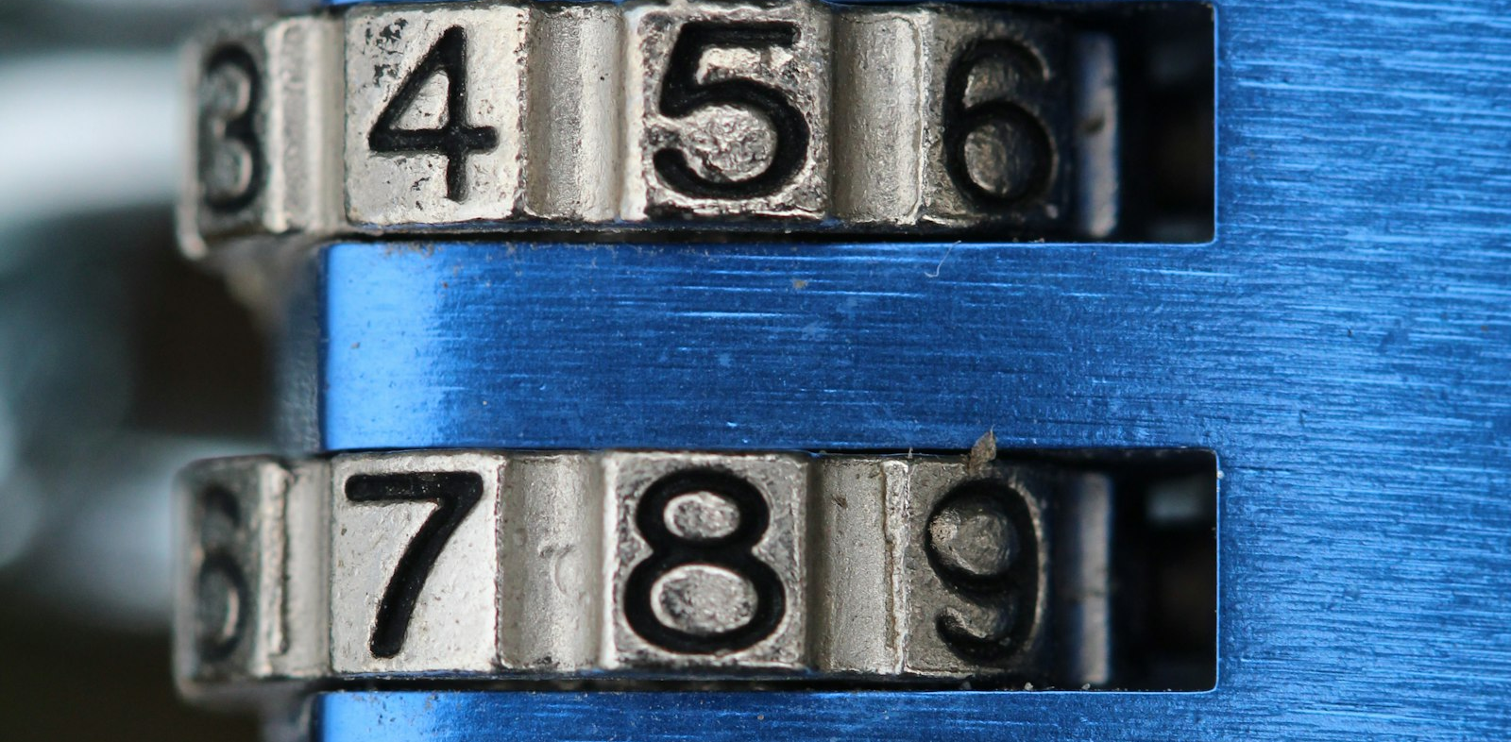
SLOP / UNIVERSITY
WEEK 11 / 04
What “picture lock” actually means
A declared point after which shot selection, trims and sequence order stop changing.
Locking is not a vague sense of “done.” It is a specific commitment: from this point forward, no cut, trim, reorder or re-timing of the picture track happens — only work that depends on picture being fixed.
Why it exists
Sound design, colour, captions and titles are all built against exact timecodes on the locked track — lock is what makes that downstream work possible.
Who declares it
You do, deliberately — after the checklist on this deck's later slide, not by simply running out of time.
SLOP1416 Visual Storytelling for Short-Form Media
Notes:
Original explanation of picture-lock discipline in post-production workflow.

Slide 5
SLOP / UNIVERSITY
WEEK 11 / 05
The avalanche a late change causes
Why editors treat lock as a hard line, not a suggestion.
Late picture change...
...forces this rework
Change after captions timed
Every caption after that point drifts out of sync with the speech it labels
Change after audio sweetened
Sound cues, music hits and ambience built to specific frames land on the wrong frame
Change after colour graded
Grading decisions made per-shot no longer match the new shot boundaries
Change after credits/titles set
Title durations and positions were timed to the old cut length
SLOP1416 Visual Storytelling for Short-Form Media
Notes:
Original explanation of the specific downstream resync costs of skipping picture-lock discipline.

Slide 6
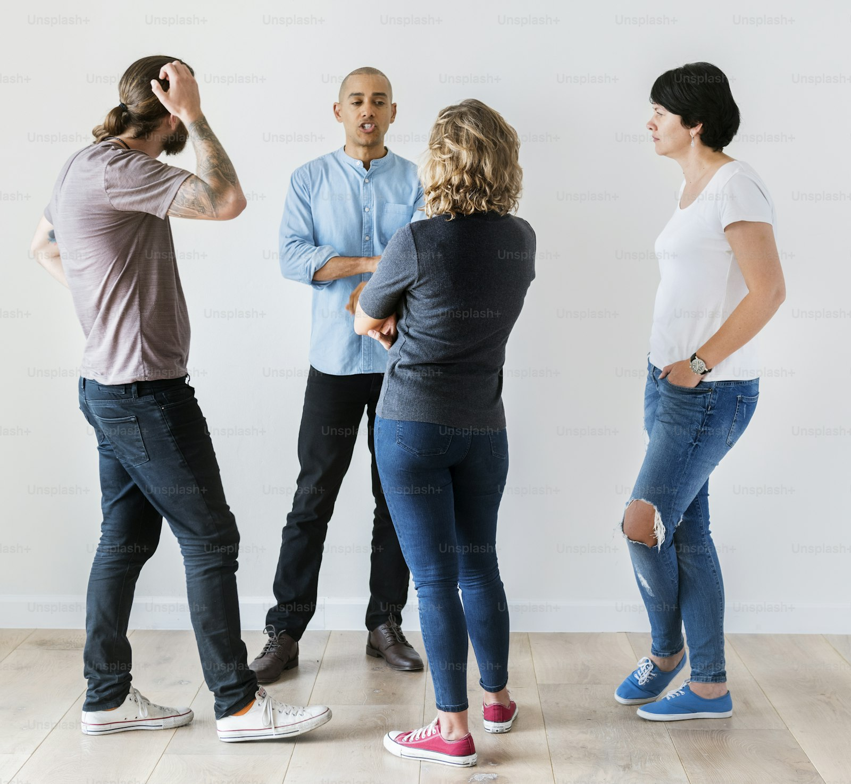
SLOP / UNIVERSITY
WEEK 11 / 06
The final peer review, run properly
A compliance pass with real viewers, not a solo checklist.
Bring your revised cut, captions and draft dossier. Reviewers watch once, then work through captions, credits, continuity and audio — the same categories as the checklist on this deck.
What reviewers are for
A second and third set of eyes catches a caption typo, a missed credit or a stray audio pop you have watched past a dozen times.
What this pass is not
Not the moment to relitigate the story — that was Week 10. Redirect structural notes to “noted for future work.”
SLOP1416 Visual Storytelling for Short-Form Media
Notes:
Unsplash (Unsplash+): https://plus.unsplash.com/premium_photo-1770660130643-728f9c9f7eff — photographer Curated Lifestyle (@curatedlifestyle), accessed 13 Sep 2026

Slide 7

SLOP / UNIVERSITY
WEEK 11 / 07
Auditing consent before you lock
A consent given during production may not automatically cover the final publication context.
If the shoot plan, distribution context or edited framing of someone's appearance changed since they agreed to be filmed, their original consent may no longer match what you are about to publish.
Check
Every person on screen has consent that matches how they actually appear and where the film will actually be seen.
If it doesn't match
Re-confirm consent for the new context, reframe the shot to remove them, or cut the material — in that order of preference.
SLOP1416 Visual Storytelling for Short-Form Media
Notes:
Unsplash: https://images.unsplash.com/photo-1750277120336-ca98ec2e2f90 — photographer Haim Charbit (@haim_charbit18), accessed 13 Sep 2026

Slide 8
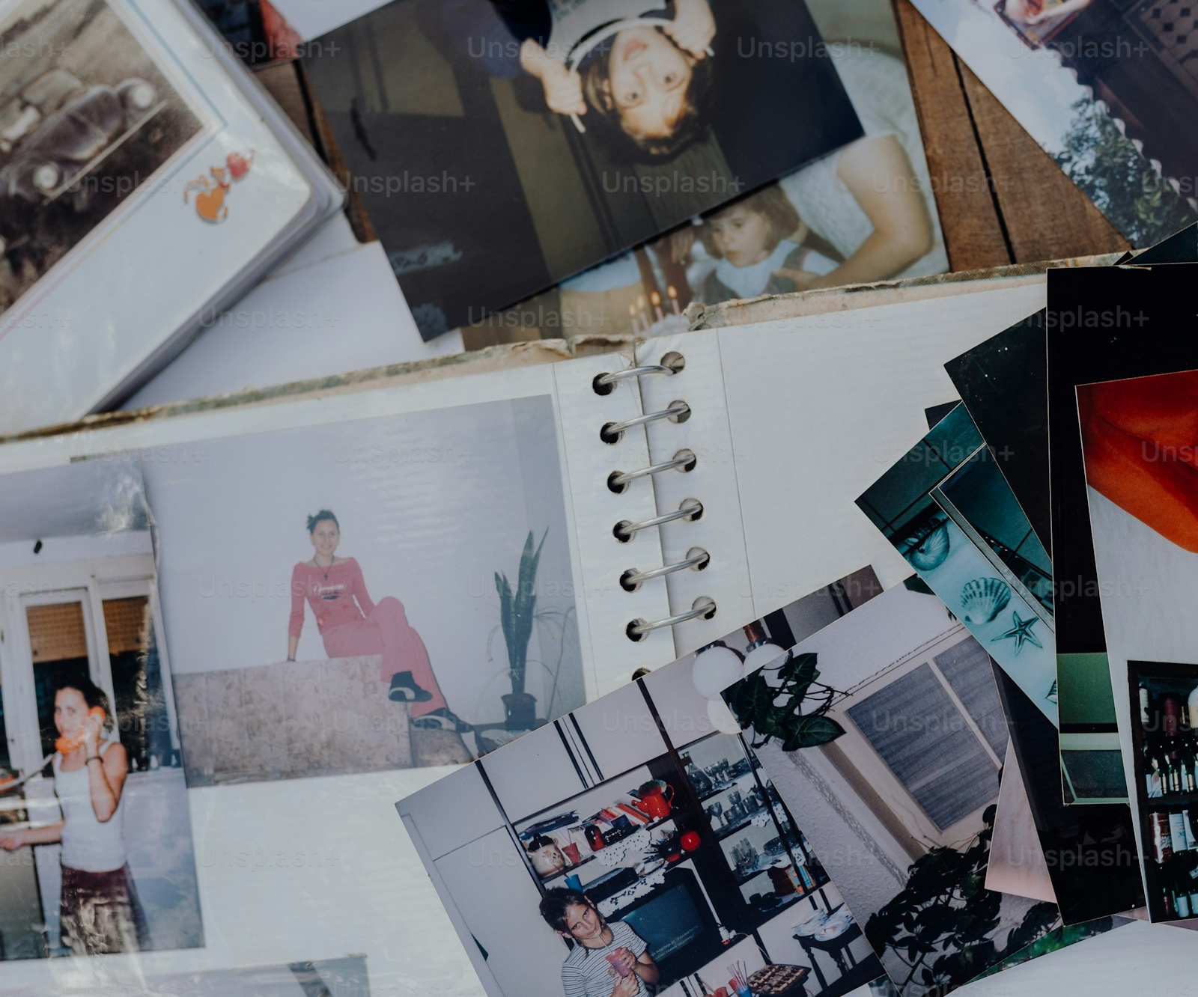
SLOP / UNIVERSITY
WEEK 11 / 08
Auditing external media before you lock
Music, archival footage and stock images each carry their own licence terms.
A licence or attribution obtained for one use does not automatically cover a different use — check that what you have permission for matches exactly how the material appears in your final cut.
Music
Confirm the licence covers this specific distribution context, not just “non-commercial student use” in general.
Archival material
Attribution text in your credits must match the source's required wording exactly, not a paraphrase.
SLOP1416 Visual Storytelling for Short-Form Media
Notes:
Unsplash (Unsplash+): https://plus.unsplash.com/premium_photo-1698007827258-98ad4b822c41 — photographer Drazen Nesic (@ohanzee), accessed 13 Sep 2026

Slide 9
SLOP / UNIVERSITY
WEEK 11 / 09
Captions: the final-pass check
A caption pass done in Week 9 can silently go stale by Week 11.
1
Re-check timing against the picture you are locking now, not the draft you timed captions against earlier.
2
Spell-check every proper noun: names, places, titles — these are the errors viewers notice first.
3
Confirm credits are complete: every contributor, every piece of external media, correctly attributed.
4
Confirm caption placement still clears the frame at the export resolution you are actually using.
Any picture edit after Week 9's caption pass is exactly the kind of late change the previous slide warned about — this is where you catch it.
SLOP1416 Visual Storytelling for Short-Form Media
Notes:
Original final-pass caption checklist connecting back to session 9's caption-timing work.

Slide 10
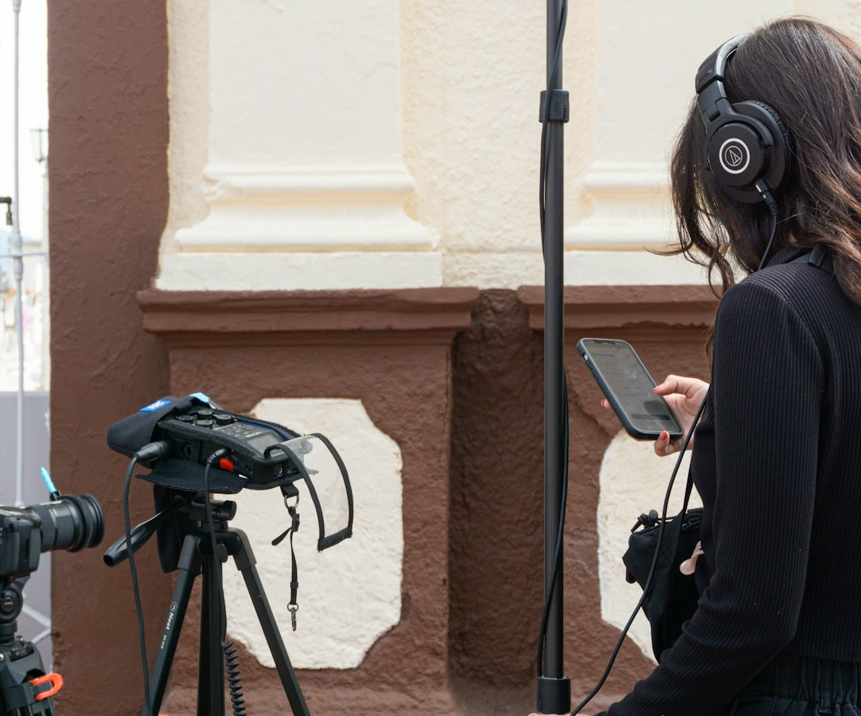
SLOP / UNIVERSITY
WEEK 11 / 10
Watch it on the device that judges it
The edit workstation is the least representative viewing context you have.
Your calibrated monitor and studio speakers are built to reveal problems, not hide them. The device your work is judged on is built for convenience — and hides different problems entirely.
What this catches
Audio inaudible on a laptop speaker, captions unreadable at compressed export resolution, colour crushing on a phone screen.
How to do it
Export the actual deliverable file and play it back on the actual device, in the actual room, before you declare lock.
SLOP1416 Visual Storytelling for Short-Form Media
Notes:
Unsplash: https://images.unsplash.com/photo-1701817321684-41d5cc37d5af — photographer Ricardo Loaiza (@rickpekar), accessed 13 Sep 2026

Slide 11

SLOP / UNIVERSITY
WEEK 11 / 11
Audio levels: what the workstation hides
Studio monitors are more forgiving than the speaker your audience actually has.
A mix that sits comfortably through calibrated studio monitors can vanish through a laptop's small speaker or a phone held at arm's length — dialogue is usually the first thing lost.
Practical check
Play the export through the smallest, cheapest speaker you have access to — if dialogue survives that, it will survive most contexts.
Do not chase peaks alone
A level that looks fine on a meter can still be masked by a competing music or ambience track — listen, don't just watch the meter.
SLOP1416 Visual Storytelling for Short-Form Media
Notes:
Unsplash: https://images.unsplash.com/photo-1535406208535-1429839cfd13 — photographer Adi Goldstein (@adigold1), "The Mixer", accessed 13 Sep 2026

Slide 12
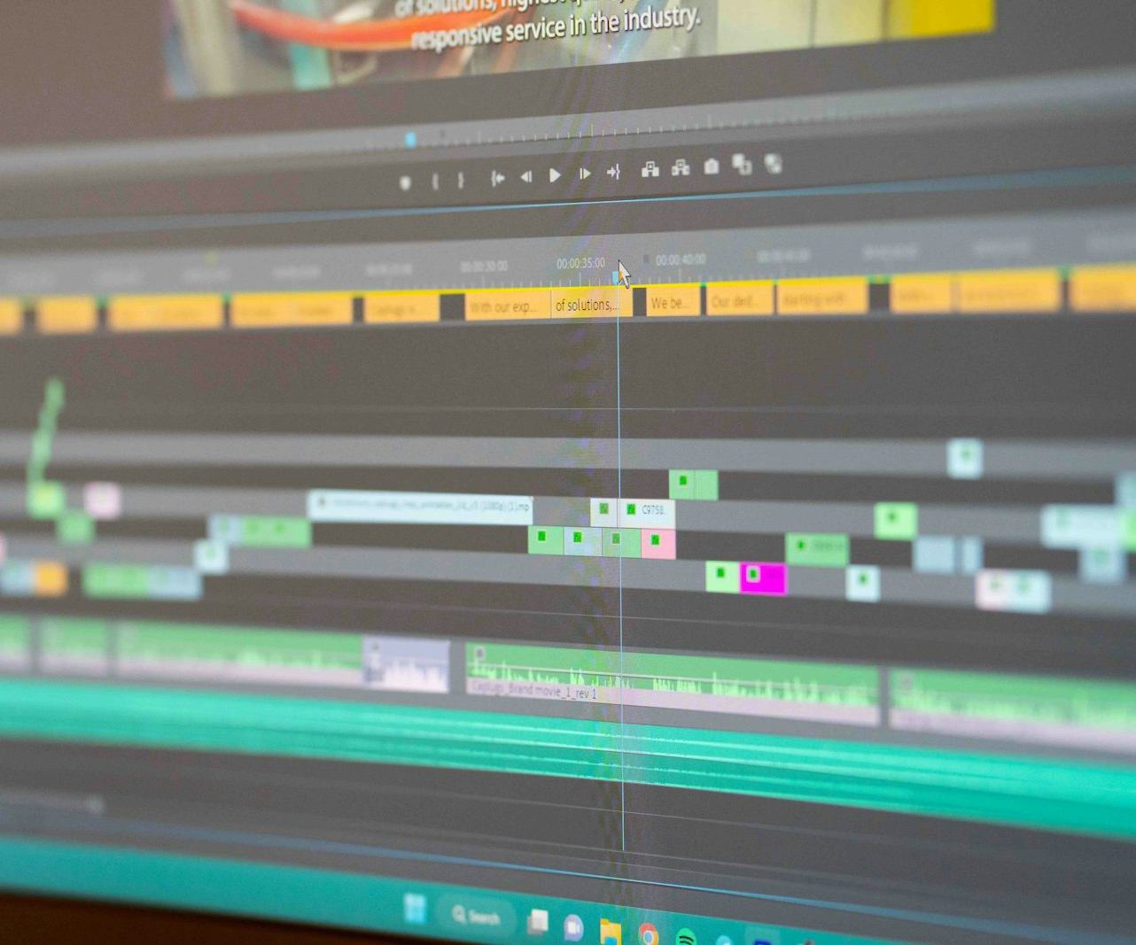
SLOP / UNIVERSITY
WEEK 11 / 12
Editing timeline discipline at lock
What actually happens to your project file the moment you declare lock.
Duplicate the project file and label the copy “locked.” Every subsequent pass — sound, colour, captions, titles — works from that copy, never from a timeline that can still drift.
One exception
A genuine error — a frozen frame, a corrupt clip — can still be fixed after lock. A preference change cannot.
Version discipline
Keep the pre-lock and locked versions both, named clearly — you may need to prove what changed and when.
SLOP1416 Visual Storytelling for Short-Form Media
Notes:
Unsplash: https://images.unsplash.com/photo-1695218716405-5b813000e994 — photographer Bas Peperzak (@bastroloog), accessed 13 Sep 2026

Slide 13
SLOP / UNIVERSITY
WEEK 11 / 13
The lock checklist
Run this in order. Only lock once every row is checked.
1
Captions timed against the final picture and spell-checked.
2
Credits complete: every contributor and external source correctly attributed.
3
Consent audit complete for every person appearing in the final context.
4
External-media licence audit complete for every piece of music, archive or stock material.
5
Final viewing done on the actual export device, in the actual playback context.
Only after all five rows are checked do you duplicate the project file and declare picture and sound locked.
SLOP1416 Visual Storytelling for Short-Form Media
Notes:
Original synthesis checklist, directly implementing session 11's brief: lock only after captions/credits, consent/media audit, and a final device viewing.

Slide 14
SLOP / UNIVERSITY
WEEK 11 / 14
The dossier as an argument, not a checklist
Each dossier component earns the cut you made, rather than merely documenting it.
Component
The argument it makes
Logline + audience statement
Argue why this story, for this audience, deserved this form
Storyboard / edit map
Show the structure was planned, not stumbled into
Production log
Show the shoot matched or deliberately departed from the plan
Two feedback changes (Week 10)
Show you could hear a note and act on it
Consent / media record
Show the finished film is one you had the right to make
SLOP1416 Visual Storytelling for Short-Form Media
Notes:
Original reframing of the final-project dossier requirements (final-project.md) as an evidentiary argument rather than a compliance list.

Slide 15
SLOP / UNIVERSITY
WEEK 11 / 15
Writing a substantive 400-word reflection
The difference between narrating and reflecting is one specific link.
Descriptive (weak)
Substantive (strong)
“I shot the interview, then edited it, then added music and captions.” This narrates process without showing judgement.
“After Week 10 feedback that the opening buried my subject's voice, I moved the interview's clearest sentence to the first 8 seconds.” Names the constraint, the feedback, and the decision.
Pick two or three decisions like the right-hand example — specific enough that only your project could have produced them.
SLOP1416 Visual Storytelling for Short-Form Media
Notes:
Original guidance on writing the final-project's 400-word critical reflection, distinguishing description from substantive reflection.

Slide 16
SLOP / UNIVERSITY
WEEK 11 / 16
Common lock-review failure modes
The errors a final peer review most often catches.
Caption drift
Captions timed against an earlier cut no longer match the locked picture
Silent consent gap
A bystander or contributor's appearance was never explicitly cleared for this use
Orphaned credit
A piece of music or footage used in the final cut is missing from the credits
Untested playback
The film was never watched on anything but the edit workstation
SLOP1416 Visual Storytelling for Short-Form Media
Notes:
Original failure-mode catalogue synthesising the audits described earlier in the deck, framed as what a peer reviewer should actively look for.

Slide 17
SLOP / UNIVERSITY
WEEK 11 / 17
Feedback you keep vs. feedback you park
Not every note from the final review belongs in this cut.
Keep now
Park for later
Anything that is factually wrong or broken: a misspelled name, a missing credit, an inaudible line, drifted captions. These are compliance errors, not opinions.
A reviewer's preference for a different structural choice. Note it as “considered, not adopted” in the dossier rather than reopening the edit.
The test: would leaving it unfixed make a claim about your film that isn't true? If yes, keep it. If it's just a different taste, park it.
SLOP1416 Visual Storytelling for Short-Form Media
Notes:
Original decision rule for triaging late-stage feedback without reopening structural decisions already settled in Week 10.

Slide 18
SLOP / UNIVERSITY
WEEK 11 / 18
Revisiting the reference-viewing task
Watch a finished film twice, as this week's reference-viewing prompt asks.
1
First viewing: watch straight through, no notes, as an ordinary audience member would.
2
Second viewing: identify one specific revision you believe improved the audience's understanding.
3
Ask what evidence in the finished film tells you that revision worked — not just that a change was made.
4
Compare that reasoning against your own two feedback changes from Week 10 — is your logic the same kind?
This exercise is a rehearsal for writing your own dossier's account of why your feedback changes worked.
SLOP1416 Visual Storytelling for Short-Form Media
Notes:
Directly answers session 11's reference-viewing prompt: watch a final film twice and identify a revision that improved audience understanding.

Slide 19
SLOP / UNIVERSITY
WEEK 11 / 19
From Week 11 to Week 12
What carries forward into the screening and submission.
You leave this session with
Week 12 will ask
A locked (or lock-ready) cut, an audited consent and media record, and a dossier draft that argues for the choices in your film.
To screen the locked film for a real audience, complete the submission and backup checklist, and hand in the film and dossier together.
Nothing about the film should change between now and the Week 12 screening — that is what “locked” means in practice.
SLOP1416 Visual Storytelling for Short-Form Media
Notes:
Original bridge from session 11's lock discipline into session 12's screening and submission requirements.

Slide 20
SLOP / UNIVERSITY
WEEK 11 / 20
Week 11 in-session exercise
What you bring and what you leave with.
Bring
A revised final-project cut, timed captions, and a draft dossier (logline, audience statement, edit map, production log, two feedback changes, consent/media record).
In session
Run a final peer review against the lock checklist; audit consent and external-media records as a group exercise.
Afterwards
Complete any outstanding checklist rows, do a final viewing on your actual export device, then lock picture and sound.
SLOP1416 Visual Storytelling for Short-Form Media
Notes:
Original SLOP1416 Week 11 in-session exercise, directly implementing the session brief.

Slide 21
SLOP / UNIVERSITY
WEEK 11 / 21
Technical review rubric
How this stage of your work is assessed against the final-project marking criteria.
Editing and revision (25%)
Evidence that peer feedback was heard, triaged and acted on with clear reasoning.
Dossier, ethics and attribution (20%)
Consent and external-media records are complete and match the final cut exactly.
Story, structure and audience (30%)
Unaffected by this week's finishing work — should already be settled from Week 10.
Cinematography and sound (25%)
Audio levels and continuity checked against the real playback context, not just the workstation.
SLOP1416 Visual Storytelling for Short-Form Media
Notes:
Original mapping of session 11's work onto the four weighted marking criteria in final-project.md.

Slide 22
SLOP / UNIVERSITY
WEEK 11 / 22
Recommended practice and preparation
Before Week 12.
Captioning reference
W3C Web Accessibility Initiative, Captions/Subtitles: https://www.w3.org/WAI/media/av/captions/
Post-production workflow reference
Blackmagic Design, DaVinci Resolve project and version management: https://www.blackmagicdesign.com/au/products/davinciresolve/training
Bring to Week 12
Your current locked export, completed dossier, and one question you want the audience's reaction to answer.
SLOP1416 Visual Storytelling for Short-Form Media
Notes:
External resources: W3C WAI captions guidance; Blackmagic Design DaVinci Resolve training. Accessed 13 September 2026.

Slide 23
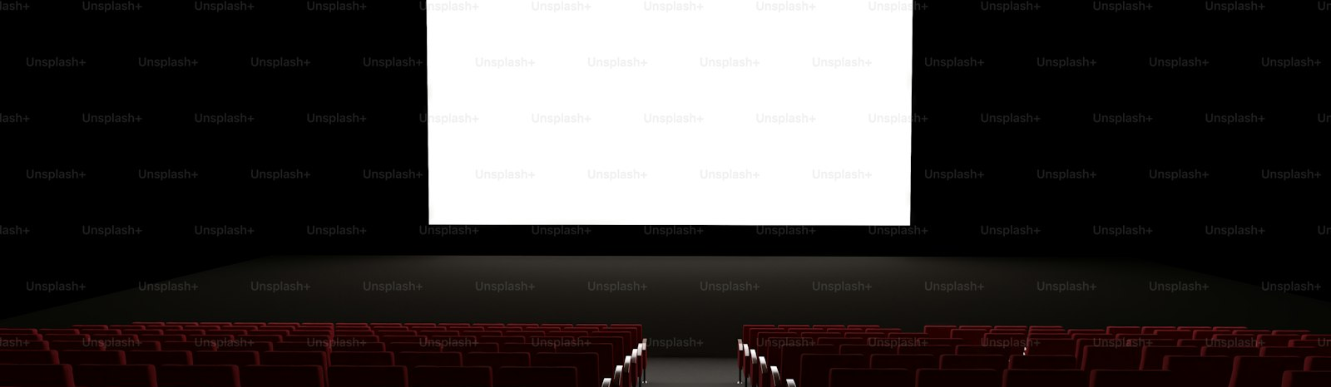
SLOP / UNIVERSITY
WEEK 11 / 23
Closing image — an empty house before the audience arrives
The locked film, waiting for the viewing it was made for.
Everything in this session exists to make sure that when an audience finally sits down, the film in front of them is the one you actually meant to make.
SLOP1416 Visual Storytelling for Short-Form Media
Notes:
Unsplash (Unsplash+): https://plus.unsplash.com/premium_photo-1710374596703-c9e53fe3fa29 — photographer Alexander Mils (@alexandermils), accessed 13 Sep 2026

