Slide 1

SLOP1512 / WEEK 1
Web Design and
Interactive Publishing
The web as a publishing medium
Notes:
Image: Unsplash photo-1498050108023-c5249f4df085. Original course content.

Slide 2

SLOP1512 / WEEK 1
02
What this course builds
A semester of deliberate web publishing
Semantic HTML, visual hierarchy, responsive CSS, accessible interaction, testing and revision.
Observe the visual, then connect it to the principle on this slide.
Web Design and Interactive Publishing
Notes:
Original SLOP1512 Week 1 teaching content.

Slide 3
SLOP1512 / WEEK 1
03
Assessment map
Four connected projects, 100% total
A1 · 15%
A2 · 20%
A3 · 25%
A4 · 40%
Structured reading page
Responsive visual system
Accessible interaction
Interactive publishing site
Web Design and Interactive Publishing
Notes:
Original SLOP1512 Week 1 teaching content.

Slide 4
SLOP1512 / WEEK 1
04
Assignment 1
Structured reading page · 15%
Build a semantic one-page reading experience. Show heading hierarchy, meaningful links and text alternatives.
Web Design and Interactive Publishing
Notes:
Original SLOP1512 Week 1 teaching content.

Slide 5

SLOP1512 / WEEK 1
05
Assignment 2
Responsive visual system · 20%
Turn content into a type, spacing, colour and layout system that works at narrow and wide sizes.
Observe the visual, then connect it to the principle on this slide.
Web Design and Interactive Publishing
Notes:
Original SLOP1512 Week 1 teaching content.

Slide 6
SLOP1512 / WEEK 1
06
Assignment 3
Accessible interaction prototype · 25%
Build a focused task flow with keyboard access, labels, errors and visible feedback.
Web Design and Interactive Publishing
Notes:
Original SLOP1512 Week 1 teaching content.

Slide 7
SLOP1512 / WEEK 1
07
Assignment 4
Interactive publishing site · 40%
Create a small multi-page site with information architecture, shared navigation, testing evidence and a process dossier.
Web Design and Interactive Publishing
Notes:
Original SLOP1512 Week 1 teaching content.

Slide 8
SLOP1512 / WEEK 1
08
Week 1 outcomes
What you should be able to do today
Describe the difference between content, structure, presentation and behaviour. Inspect a page before changing it.
Question
Evidence
What evidence would let you judge this page?
Name a specific heading, control, label or reading path.
Web Design and Interactive Publishing
Notes:
Original SLOP1512 Week 1 teaching content.

Slide 9

SLOP1512 / WEEK 1
09
A webpage is a document
The browser needs structure before it can render design
HTML expresses what each part means. CSS controls how it looks. JavaScript changes behaviour when a task needs it.
Observe the visual, then connect it to the principle on this slide.
Web Design and Interactive Publishing
Notes:
Original SLOP1512 Week 1 teaching content.

Slide 10
SLOP1512 / WEEK 1
10
The publishing question
Who needs this page, and what should they understand or do?
A page with no clear audience often accumulates features. A page with a task can make choices about hierarchy.
Web Design and Interactive Publishing
Notes:
Original SLOP1512 Week 1 teaching content.

Slide 11
SLOP1512 / WEEK 1
11
Reading paths
A visitor rarely reads from top to bottom
They scan headings, links, images and the first line of paragraphs. Design should support a useful path, not demand attention.
Web Design and Interactive Publishing
Notes:
Original SLOP1512 Week 1 teaching content.

Slide 12
SLOP1512 / WEEK 1
12
Content before components
Start with the material
Write a title, summary, sections, evidence, next action and source information before choosing a card, carousel or animation.
Web Design and Interactive Publishing
Notes:
Original SLOP1512 Week 1 teaching content.

Slide 13
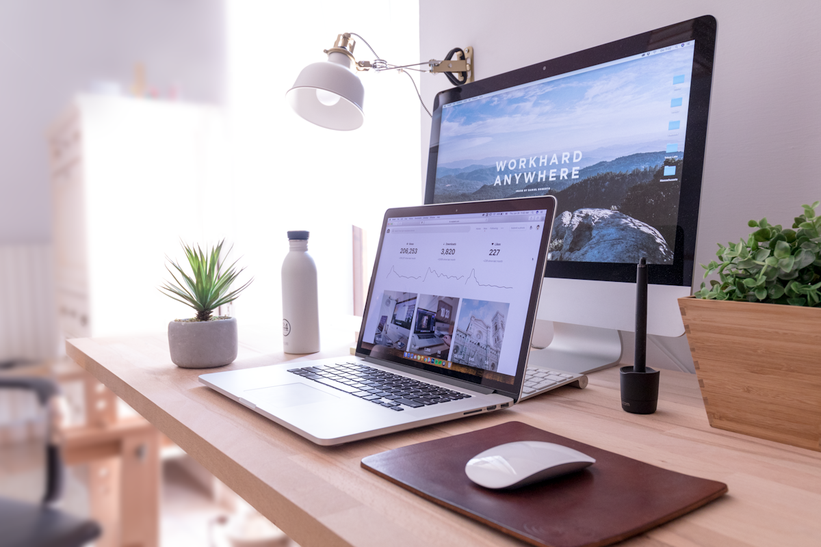
SLOP1512 / WEEK 1
13
Semantic HTML
Elements carry meaning
Use headings for hierarchy, paragraphs for prose, lists for groups, nav for navigation and buttons for actions.
Observe the visual, then connect it to the principle on this slide.
Web Design and Interactive Publishing
Notes:
Original SLOP1512 Week 1 teaching content.

Slide 14
SLOP1512 / WEEK 1
14
HTML anatomy
A minimal, meaningful document
<main>
<article>
<h1>How to repair a bicycle light</h1>
<p>A practical guide for first-time riders.</p>
</article>
</main>
Read code aloud: element, content, relationship and purpose.
Web Design and Interactive Publishing
Notes:
Original SLOP1512 Week 1 teaching content.

Slide 15
SLOP1512 / WEEK 1
15
Heading hierarchy
Headings form an outline, not a font-size menu
One page normally has one h1. Use h2 for major sections and h3 only inside an h2 section.
Web Design and Interactive Publishing
Notes:
Original SLOP1512 Week 1 teaching content.

Slide 16
SLOP1512 / WEEK 1
16
A useful outline
Structure makes the page navigable
h1: Community garden guide
h2: Before you visit
h2: What to bring
h2: Find a plot
h3: Weekday access
h3: Weekend access
Web Design and Interactive Publishing
Notes:
Original SLOP1512 Week 1 teaching content.

Slide 17
SLOP1512 / WEEK 1
17
Landmarks
Landmarks let assistive technology jump through a page
header, nav, main, aside and footer describe regions. They also help developers review the page's information architecture.
Web Design and Interactive Publishing
Notes:
Original SLOP1512 Week 1 teaching content.

Slide 18
SLOP1512 / WEEK 1
18
Links and buttons
Different elements, different promises
A link takes the visitor somewhere. A button performs an action on the current page. Styling does not change their meaning.
Web Design and Interactive Publishing
Notes:
Original SLOP1512 Week 1 teaching content.

Slide 19
SLOP1512 / WEEK 1
19
Link text
Make the destination clear out of context
Avoid: Click here.
Better: Read the accessibility review checklist.
The visible words should tell a reader where the link goes.
Web Design and Interactive Publishing
Notes:
Original SLOP1512 Week 1 teaching content.

Slide 20

SLOP1512 / WEEK 1
20
Images as information
Every image needs a role
Decorative images can be ignored. Informative images need alternative text that communicates their purpose in the surrounding context.
Observe the visual, then connect it to the principle on this slide.
Web Design and Interactive Publishing
Notes:
Original SLOP1512 Week 1 teaching content.

Slide 21
SLOP1512 / WEEK 1
21
Alternative text
Describe the information, not every pixel
Weak: Image of a person.
Useful: Student tests a website with keyboard navigation on a laptop.
If the caption already says it, alt text can be shorter.
Web Design and Interactive Publishing
Notes:
Original SLOP1512 Week 1 teaching content.

Slide 22
SLOP1512 / WEEK 1
22
Lists and data
Choose the element that matches the relationship
Use ul for an unordered group, ol for a sequence and table for data with row and column relationships.
Web Design and Interactive Publishing
Notes:
Original SLOP1512 Week 1 teaching content.

Slide 23
SLOP1512 / WEEK 1
23
A table needs headers
Headers connect values to meaning
<table>
<thead><tr><th>Week</th><th>Topic</th></tr></thead>
<tbody><tr><td>1</td><td>HTML</td></tr></tbody>
</table>
Read code aloud: element, content, relationship and purpose.
Web Design and Interactive Publishing
Notes:
Original SLOP1512 Week 1 teaching content.

Slide 24
SLOP1512 / WEEK 1
24
Structure before style
CSS should reveal a good document, not rescue a confused one
If removing CSS makes the page impossible to understand, revisit the HTML outline first.
Web Design and Interactive Publishing
Notes:
Original SLOP1512 Week 1 teaching content.

Slide 25

SLOP1512 / WEEK 1
25
Design tokens
Small decisions become a system
Choose a limited type scale, spacing scale and colour palette. Reuse them consistently so a reader can recognise hierarchy.
Observe the visual, then connect it to the principle on this slide.
Web Design and Interactive Publishing
Notes:
Original SLOP1512 Week 1 teaching content.

Slide 26
SLOP1512 / WEEK 1
26
Responsive thinking
One document, changing constraints
A narrow screen changes line length, reading order and touch targets. It does not reduce the reader's need for complete information.
Web Design and Interactive Publishing
Notes:
Original SLOP1512 Week 1 teaching content.

Slide 27
SLOP1512 / WEEK 1
27
A responsive rule
Use CSS to adapt layout, not duplicate content
@media (min-width: 48rem) {
.feature-list {
display: grid;
grid-template-columns: repeat(3, 1fr);
}
}
Web Design and Interactive Publishing
Notes:
Original SLOP1512 Week 1 teaching content.

Slide 28
SLOP1512 / WEEK 1
28
Keyboard access
A page should work without a pointer
Press Tab. Can you see where focus is? Can you reach every control? Can you activate it and understand the result?
Web Design and Interactive Publishing
Notes:
Original SLOP1512 Week 1 teaching content.

Slide 29

SLOP1512 / WEEK 1
29
Contrast and hierarchy
Colour alone cannot carry meaning
Use labels, text, position and shape alongside colour. Check contrast in the actual context, including hover and focus states.
Observe the visual, then connect it to the principle on this slide.
Web Design and Interactive Publishing
Notes:
Original SLOP1512 Week 1 teaching content.

Slide 30
SLOP1512 / WEEK 1
30
Page inspection
Read the browser's structure
Use browser developer tools to inspect headings, landmarks, link text, image alternatives and the box model.
Question
Evidence
What evidence would let you judge this page?
Name a specific heading, control, label or reading path.
Web Design and Interactive Publishing
Notes:
Original SLOP1512 Week 1 teaching content.

Slide 31
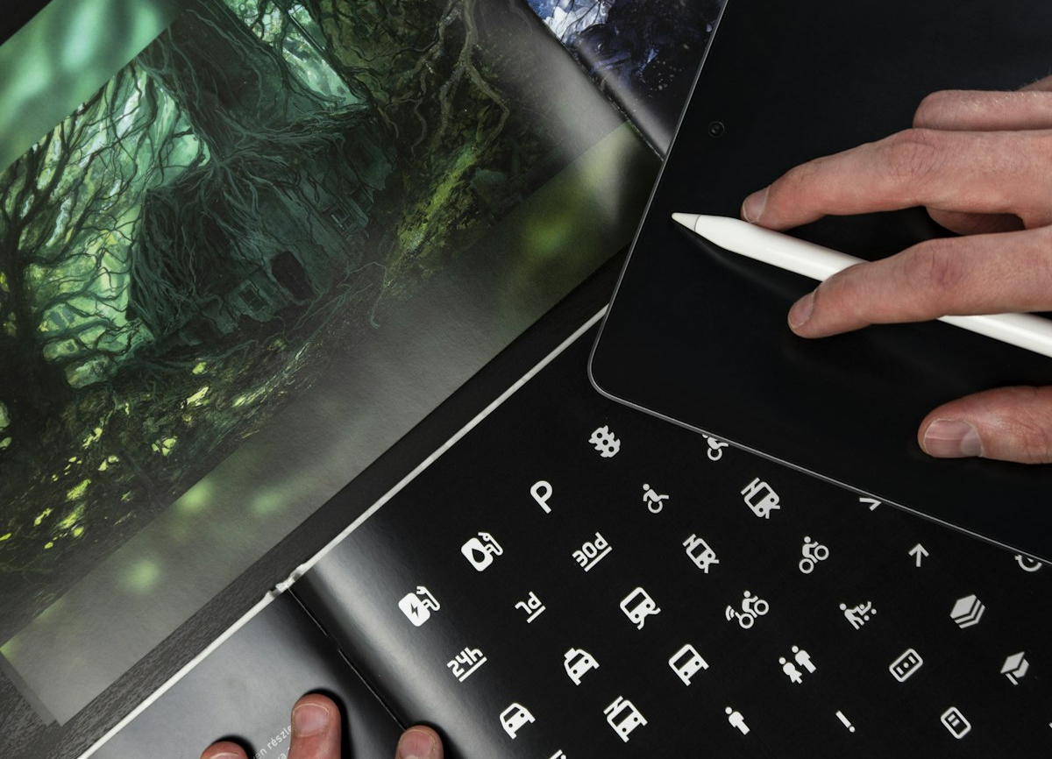
SLOP1512 / WEEK 1
31
Critical reading exercise
What does this page ask the reader to trust?
Identify the author, purpose, evidence, call to action and missing context. Then describe how the page's structure supports or weakens that trust.
Observe the visual, then connect it to the principle on this slide.
Web Design and Interactive Publishing
Notes:
Original SLOP1512 Week 1 teaching content.

Slide 32
SLOP1512 / WEEK 1
32
Studio exercise
Build a reading profile
Choose a useful web page. Recreate its content outline in plain HTML. Do not copy its visual styling. Explain one structural improvement.
Question
Evidence
What evidence would let you judge this page?
Name a specific heading, control, label or reading path.
Web Design and Interactive Publishing
Notes:
Original SLOP1512 Week 1 teaching content.

Slide 33
SLOP1512 / WEEK 1
33
Quality check
Before you leave today
One h1. Logical h2 sections. Useful links. Images have a role. Keyboard focus is visible. The page still makes sense without CSS.
Question
Evidence
What evidence would let you judge this page?
Name a specific heading, control, label or reading path.
Web Design and Interactive Publishing
Notes:
Original SLOP1512 Week 1 teaching content.

Slide 34
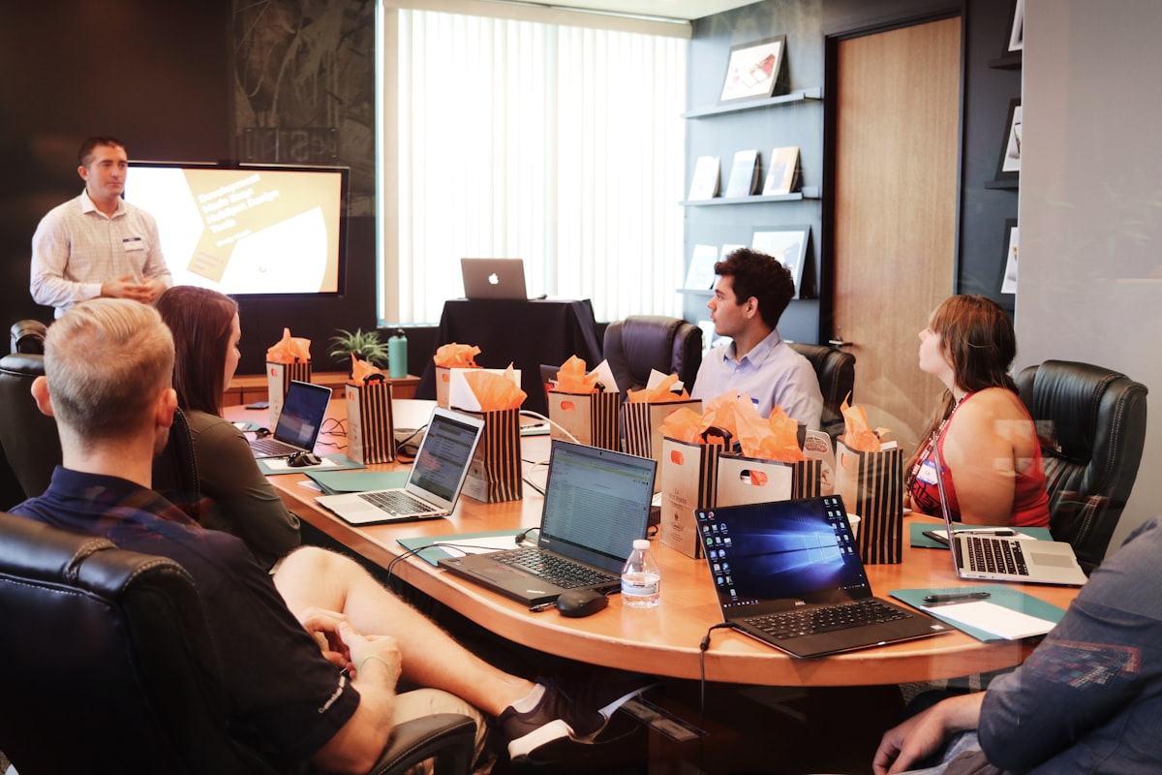
SLOP1512 / WEEK 1
34
Recommended practice
Continue after class
MDN Learn HTML · W3C WAI accessibility guidance · WebAIM keyboard accessibility · Inspect three sites you use weekly.
Observe the visual, then connect it to the principle on this slide.
Web Design and Interactive Publishing
Notes:
Original SLOP1512 Week 1 teaching content.

Slide 35
SLOP1512 / WEEK 1
35
Next week
Semantic HTML in depth
Bring a page you use often and a short written answer: what does the page want you to notice first, and why?
Web Design and Interactive Publishing
Notes:
Original SLOP1512 Week 1 teaching content.

Slide 36
SLOP1512 / WEEK 1
36
Closing prompt
A web page is an argument about attention
Structure decides what can be found. Design decides what can be noticed. Interaction decides what a visitor can do.
Web Design and Interactive Publishing
Notes:
Original SLOP1512 Week 1 teaching content.

