Slide 1

SLOP1512 / WEEK 10
User Testing
and Revision
Watch someone else use it, then prove your fix worked
Notes:
Cover image: Wikimedia Commons, 'Petra, People in conversation, Jordan', CC BY 4.0. Full attribution list in images-slop1512-week10/ATTRIBUTION.json. Original SLOP1512 Week 10 teaching content.

Slide 2
SLOP1512 / WEEK 10
02
The Week 10 question
Your interaction worked in Week 7. Your accessibility audit passed in Week 8. So why does a real person still get stuck?
This week trades your own judgement for observed evidence: watch a real person try to use what you built, then justify a change with what you actually saw.
Web Design and Interactive Publishing
Notes:
Original SLOP1512 Week 10 teaching content.

Slide 3
SLOP1512 / WEEK 10
03
From self-review to observed evidence
The self-review problem
Why it happens
Weeks 1-9 built structure, hierarchy, layout, colour, response, interaction and access on your own judgement. That judgement cannot see this week's failures.
You already know where every link goes and what every label means. That knowledge makes you the worst possible judge of whether a stranger can find them.
Web Design and Interactive Publishing
Notes:
Original SLOP1512 Week 10 teaching content.

Slide 4
SLOP1512 / WEEK 10
04
Learning outcomes
Run a lightweight usability test.
Record what actually blocks a participant, in their words and actions, not your interpretation of their competence.
Distinguish a blocker from a preference, and triage findings by severity.
Write a revision justified by a specific observed moment, then retest to confirm it worked.
Web Design and Interactive Publishing
Notes:
Original SLOP1512 Week 10 teaching content.

Slide 5
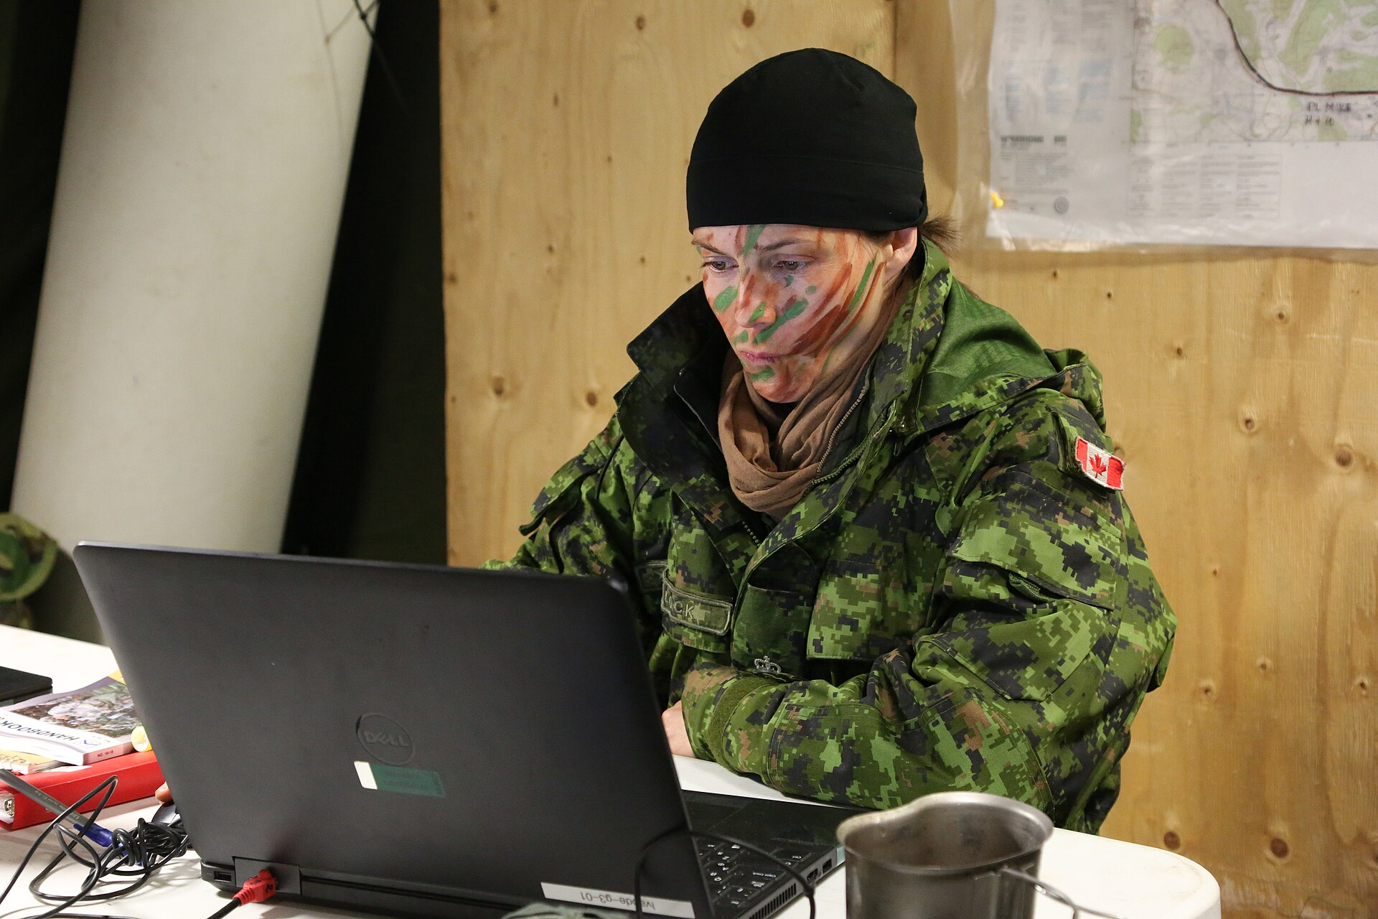
SLOP1512 / WEEK 10
05
The five-second test
Show the page for five seconds, then hide it and ask what the participant remembers and what they think the page is for.
Reveals whether the top of the page communicates its purpose at all, before a participant reads a single word of body text.
Sourced photograph (Wikimedia Commons, CC-licensed) — full attribution in ATTRIBUTION.json.
Web Design and Interactive Publishing
Notes:
Photo sourced from Wikimedia Commons under a CC/public-domain licence; see images-slop1512-week10/ATTRIBUTION.json for title, author and licence. Original SLOP1512 Week 10 teaching content.

Slide 6
SLOP1512 / WEEK 10
06
The first-click test
Give one task, watch only the first click. If the first click is wrong, everything after it is a recovery from a bad start, not a real reading of the design.
Best suited to navigation and information-architecture questions: does the label a participant expects actually exist, in the place they expect it?
Web Design and Interactive Publishing
Notes:
Original SLOP1512 Week 10 teaching content.

Slide 7

SLOP1512 / WEEK 10
07
The think-aloud protocol
Think-aloud protocol
Ask the participant to speak their thoughts continuously while attempting a task: what they see, what they expect, what confuses them, before they act.
Choosing a method for what you have
Five-second suits a landing page's clarity. First-click suits navigation. Think-aloud suits a full task flow with forms or multiple steps.
Web Design and Interactive Publishing
Notes:
Photo sourced from Wikimedia Commons under a CC/public-domain licence; see images-slop1512-week10/ATTRIBUTION.json for title, author and licence. Original SLOP1512 Week 10 teaching content.

Slide 8
SLOP1512 / WEEK 10
08
Writing a task scenario: a bad example
<p>
Click the "Subscribe" button in the
top navigation bar to sign up for
our newsletter.
</p>
Read this as a task scenario: does it state a goal, or does it name a click path?
Web Design and Interactive Publishing
Notes:
Original SLOP1512 Week 10 teaching content.

Slide 9
SLOP1512 / WEEK 10
09
Why it fails, and a better version
Why that scenario fails
A better version
It names the exact button and its exact location. The participant is now testing whether they can follow directions, not whether they can find the feature on their own.
“You want to be told by email whenever this site publishes something new. Show me how you would do that.” States a goal in the participant's own words and lets the interface prove or fail to prove itself.
Web Design and Interactive Publishing
Notes:
Original SLOP1512 Week 10 teaching content.

Slide 10

SLOP1512 / WEEK 10
10
What the better scenario tests
A goal-based scenario lets any hesitation, wrong click, or giving up stand as real evidence, not a scripted result.
If the participant succeeds without help, the interface itself communicated the path. If they don't, that failure belongs to the design, not to unclear instructions.
Sourced photograph (Wikimedia Commons, CC-licensed) — full attribution in ATTRIBUTION.json.
Web Design and Interactive Publishing
Notes:
Photo sourced from Wikimedia Commons under a CC/public-domain licence; see images-slop1512-week10/ATTRIBUTION.json for title, author and licence. Original SLOP1512 Week 10 teaching content.

Slide 11
SLOP1512 / WEEK 10
11
Recruiting a participant
A classmate who has not seen your site is enough for this course. Recruit someone unfamiliar with your specific design decisions, not someone who already knows your intentions.
Someone who has watched you build it, or discussed the brief with you, will fill gaps with knowledge a real visitor won't have.
Web Design and Interactive Publishing
Notes:
Original SLOP1512 Week 10 teaching content.

Slide 12
SLOP1512 / WEEK 10
12
The moderator's role
The moderator's role
Common moderator mistakes
Stay quiet during the task. Do not explain, hint, or rescue. Note the moment you feel the urge to help; that urge marks exactly where the design failed.
Leading questions (“you'd click here, right?”), explaining before the participant tries, and treating a hard task as a test of the participant instead of the design.
Web Design and Interactive Publishing
Notes:
Original SLOP1512 Week 10 teaching content.

Slide 13
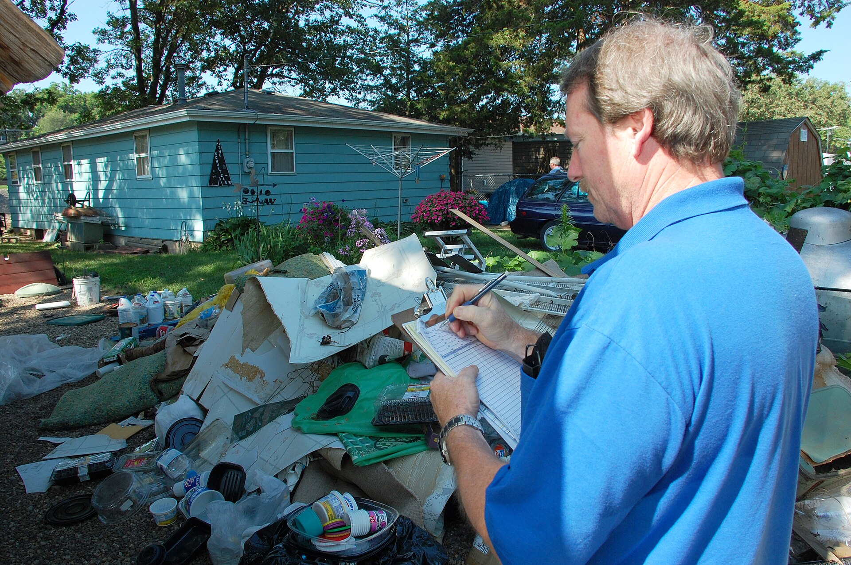
SLOP1512 / WEEK 10
13
An observation template
Columns: step, participant action, direct quote, elapsed time, blocker severity.
Fill it in live during the session, not from memory afterwards — memory smooths over exactly the hesitations and wrong turns that are the evidence you need.
Sourced photograph (Wikimedia Commons, CC-licensed) — full attribution in ATTRIBUTION.json.
Web Design and Interactive Publishing
Notes:
Photo sourced from Wikimedia Commons under a CC/public-domain licence; see images-slop1512-week10/ATTRIBUTION.json for title, author and licence. Original SLOP1512 Week 10 teaching content.

Slide 14
SLOP1512 / WEEK 10
14
Worked observation example
Step + action
Direct quote
What the participant did, in their own path through the interface.
Their exact words, not a paraphrase.
Elapsed time
Blocker severity
How long the step took, from task start.
Blocker, friction, or polish — assigned live.
Web Design and Interactive Publishing
Notes:
Original SLOP1512 Week 10 teaching content.

Slide 15

SLOP1512 / WEEK 10
15
Blocker vs. preference
A blocker stops the task or forces the participant to give up and restart. A preference is a completed task with a complaint. Fix blockers first; preferences are a lower-priority backlog.
Reading hesitation as data: a long pause, re-reading a label twice, or scrolling back up are signs the interface failed to confirm the participant's guess quickly enough, even when the task eventually succeeds.
Sourced photograph (Wikimedia Commons, CC-licensed) — full attribution in ATTRIBUTION.json.
Web Design and Interactive Publishing
Notes:
Photo sourced from Wikimedia Commons under a CC/public-domain licence; see images-slop1512-week10/ATTRIBUTION.json for title, author and licence. Original SLOP1512 Week 10 teaching content.

Slide 16
SLOP1512 / WEEK 10
16
Severity triage: three levels
Blocker
Friction
Polish
Task fails, or the participant gives up and restarts.
Task succeeds with a visible struggle or wrong turn.
Task succeeds smoothly; only a stated preference remains.
Web Design and Interactive Publishing
Notes:
Original SLOP1512 Week 10 teaching content.

Slide 17
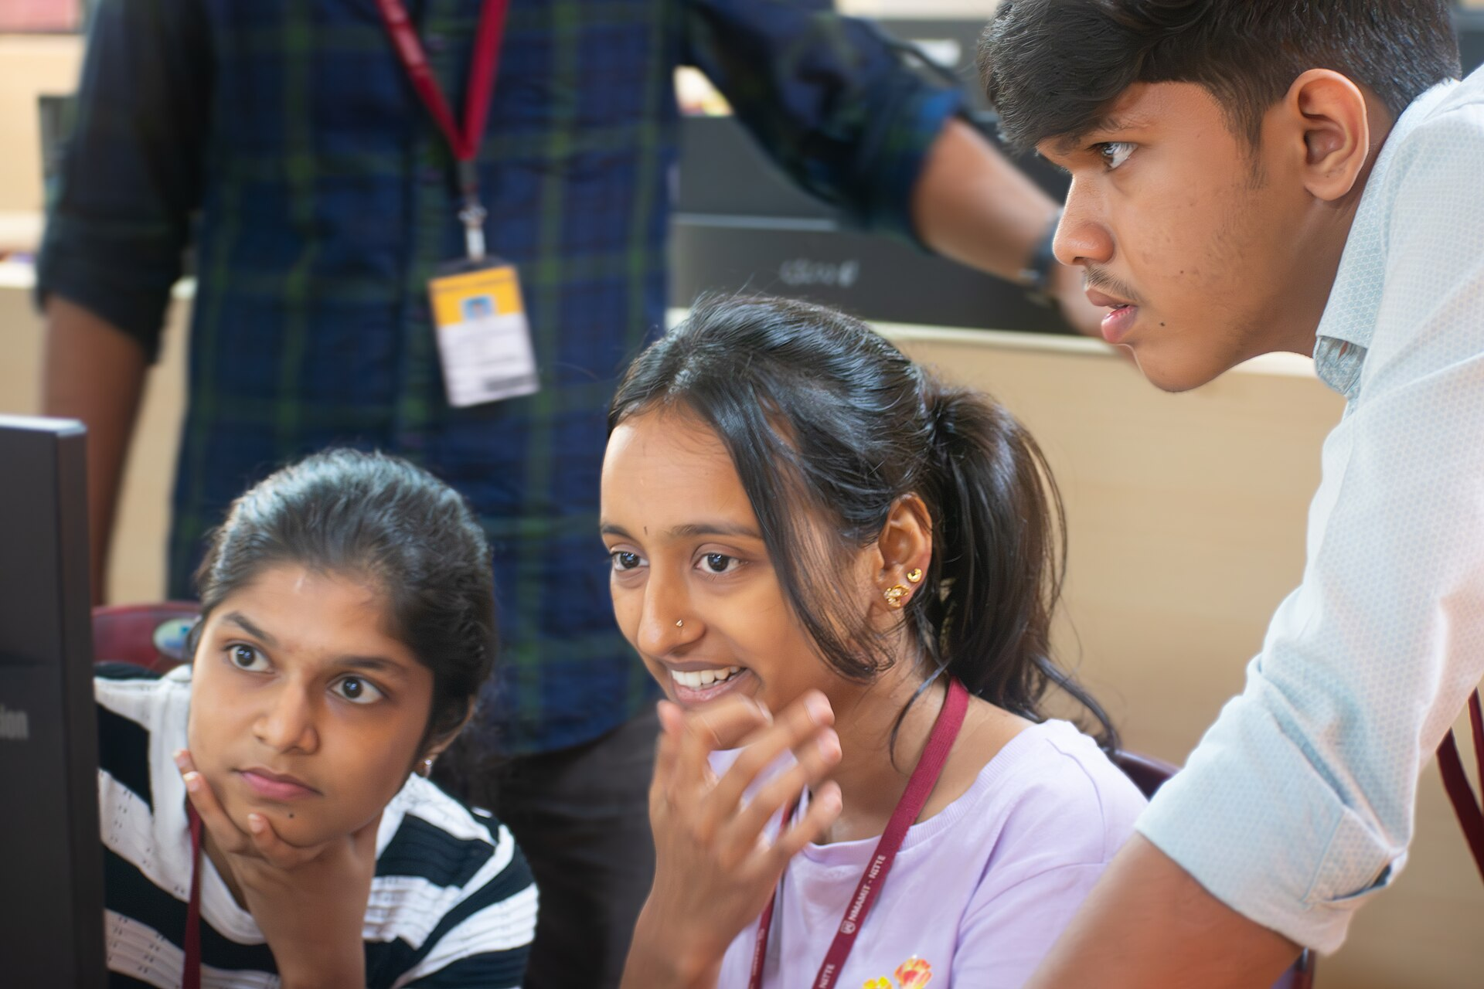
SLOP1512 / WEEK 10
17
Triage worked example
A confusing label that costs 5 extra seconds is friction, not a blocker.
A submit button with no visible focus state that a keyboard user cannot find at all is a blocker, even if a mouse user never notices it — severity depends on whether the task fails, not on how many participants hit it.
Sourced photograph (Wikimedia Commons, CC-licensed) — full attribution in ATTRIBUTION.json.
Web Design and Interactive Publishing
Notes:
Photo sourced from Wikimedia Commons under a CC/public-domain licence; see images-slop1512-week10/ATTRIBUTION.json for title, author and licence. Original SLOP1512 Week 10 teaching content.

Slide 18
SLOP1512 / WEEK 10
18
From observation to root cause: five whys
Problem: participant missed the contact link. Why? It was in the footer. Why is that a problem? They expected primary navigation to hold it. Why? The nav pattern on similar sites places contact there. Why does that matter? Convention sets expectation before your labelling does.
Stop once the answer names a design decision you can actually change.
Web Design and Interactive Publishing
Notes:
Original SLOP1512 Week 10 teaching content.

Slide 19
SLOP1512 / WEEK 10
19
Writing a revision justification
Cite the specific observed moment (quote, timestamp, task), name the exact change, and state the predicted effect.
A justification without an observed moment is a guess wearing a research citation — examiners and real teams both discount it the same way.
Web Design and Interactive Publishing
Notes:
Original SLOP1512 Week 10 teaching content.

Slide 20
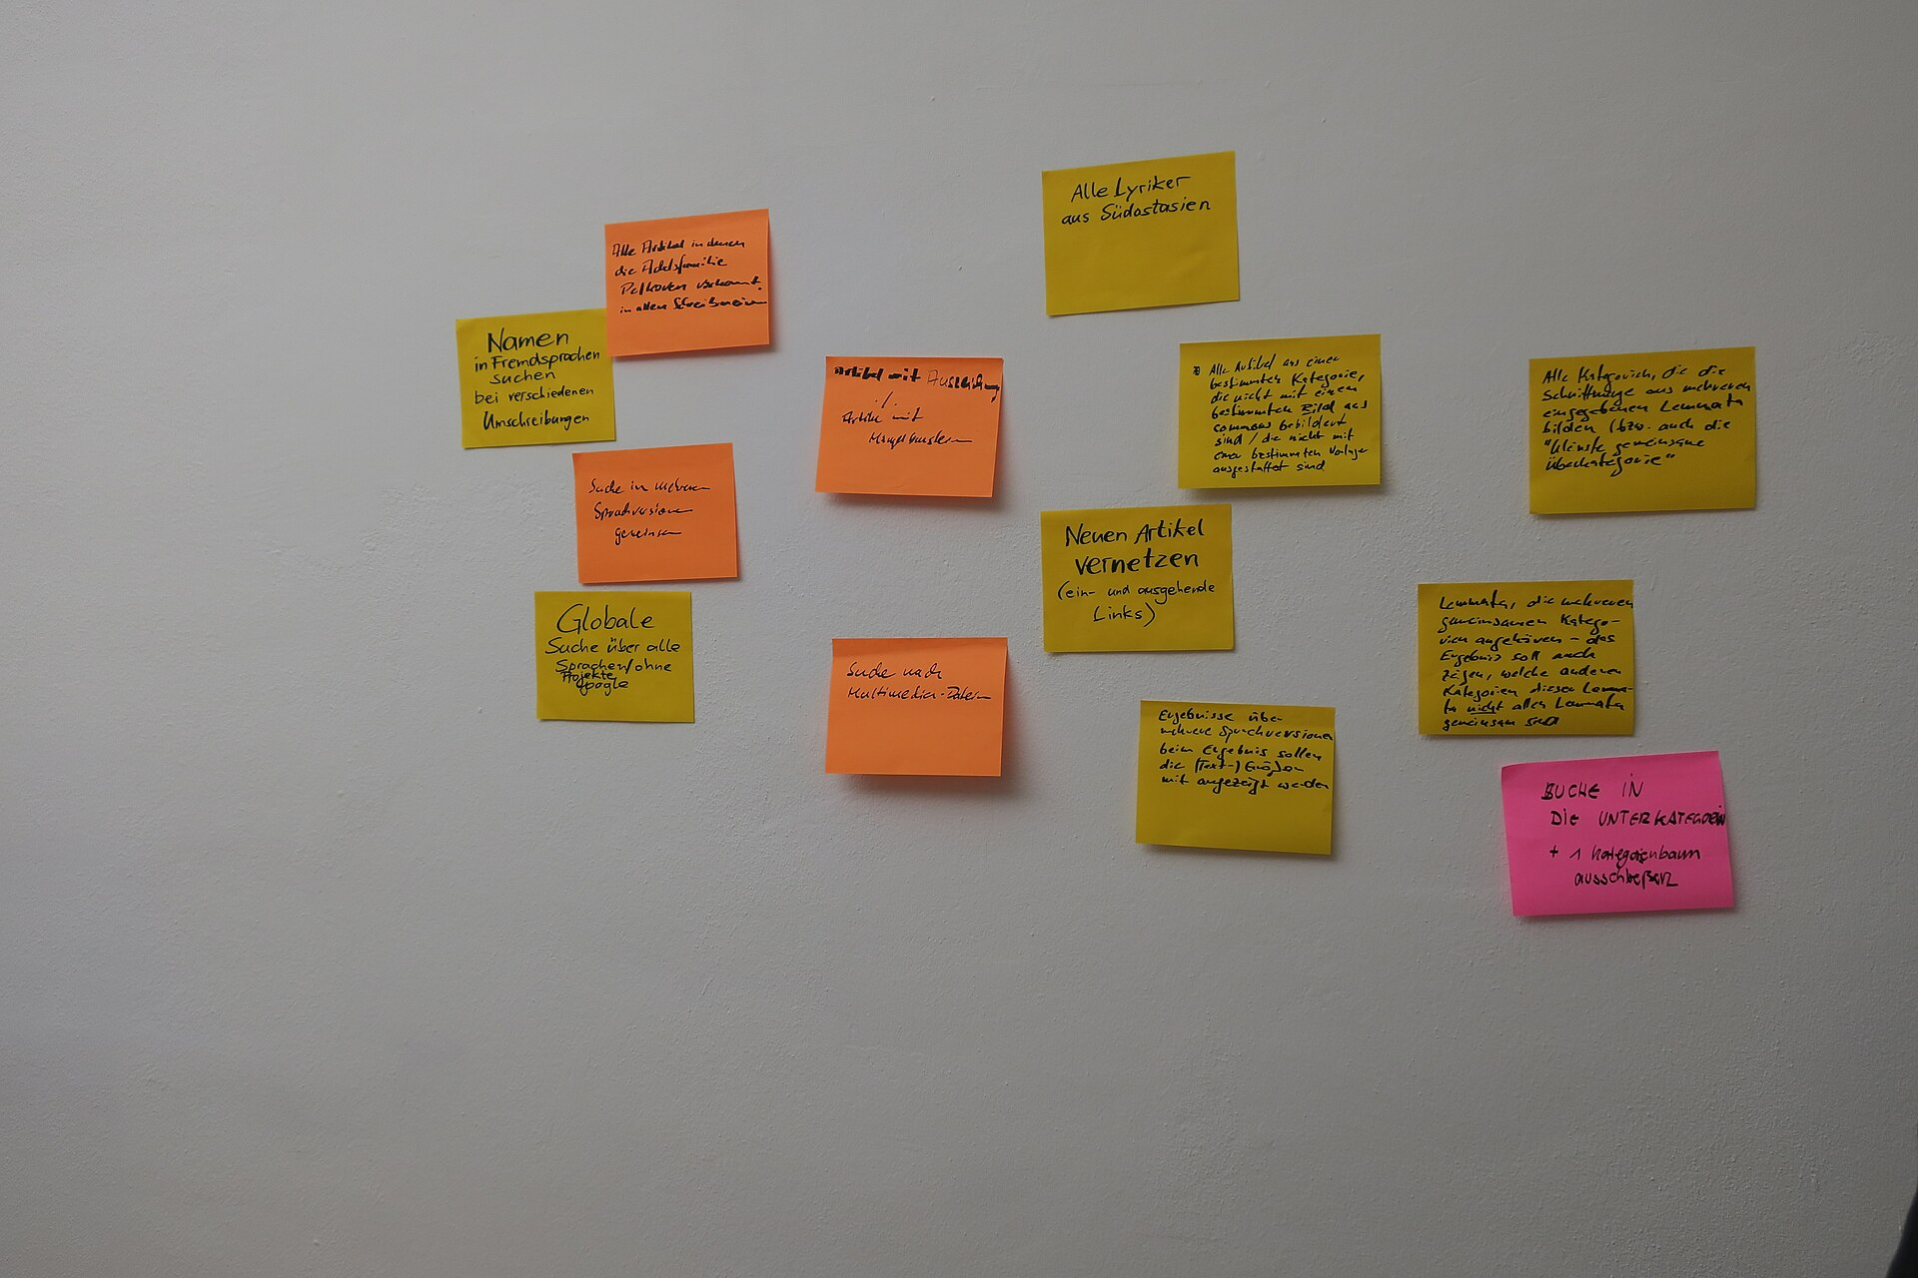
SLOP1512 / WEEK 10
20
Two worked case studies
Case study 1: navigation failure
Observed: participant scanned top nav twice, said “I don't see contact anywhere,” then opened the hamburger menu after 40s. Revision: add a persistent Contact link to the top nav, not just the footer.
Case study 2: form error clarity
Observed: participant submitted an empty required field, said “did that work?”, clicked submit twice more. Revision: inline error text plus colour, with focus moved to the invalid field.
Web Design and Interactive Publishing
Notes:
Photo sourced from Wikimedia Commons under a CC/public-domain licence; see images-slop1512-week10/ATTRIBUTION.json for title, author and licence. Original SLOP1512 Week 10 teaching content.

Slide 21
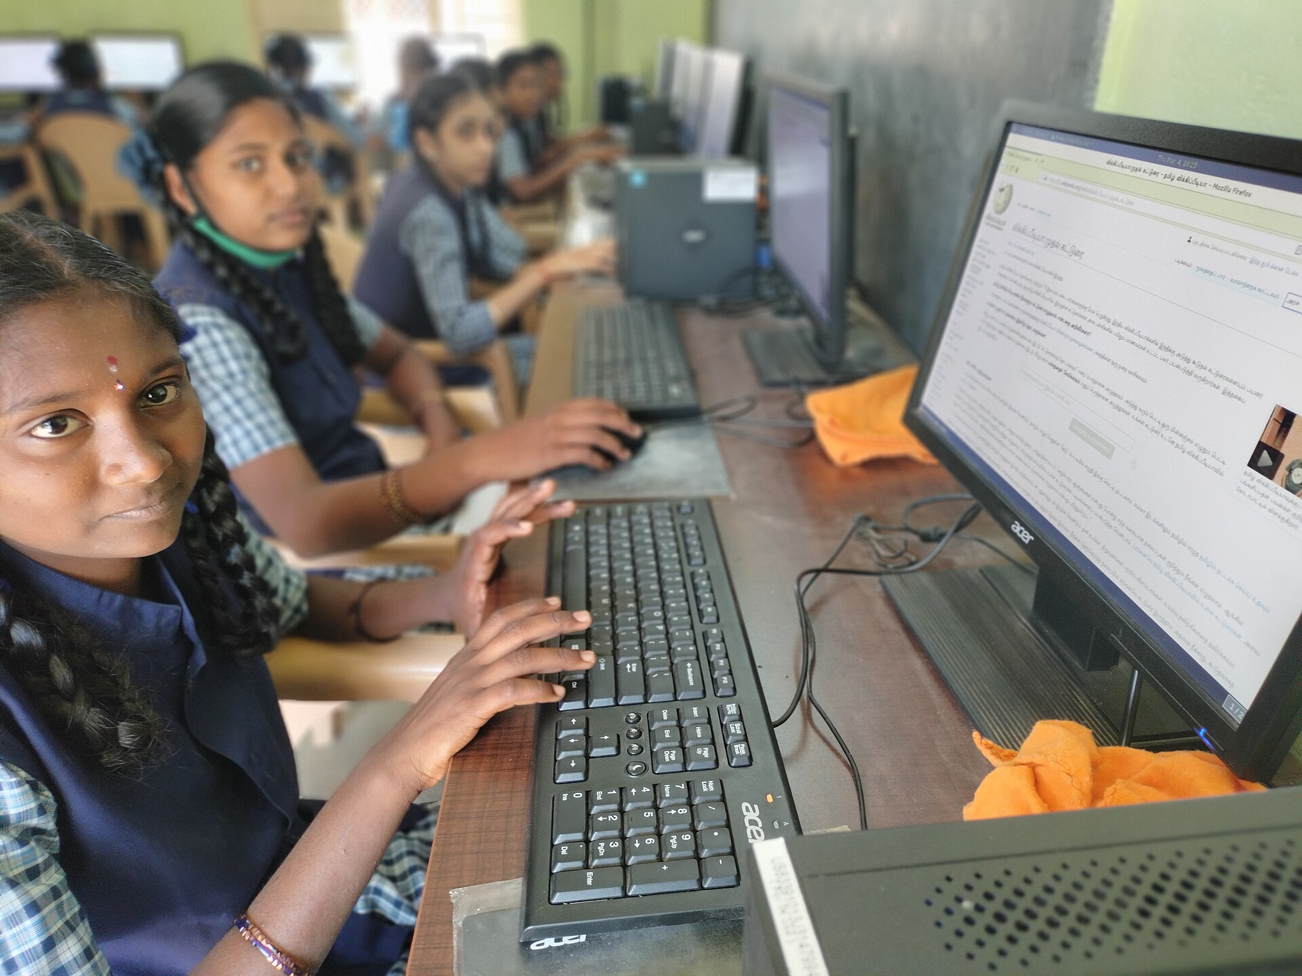
SLOP1512 / WEEK 10
21
What counts as evidence after one test
What NOT to change
One participant's dislike of a font size or a colour they find “boring” is a preference, not a pattern. A single opinion should not override a decision made with evidence in Weeks 3-6.
When n=1 is still trustworthy
A hard blocker — task fails, participant gives up, or a keyboard/screen-reader path is impossible — is trustworthy from a single test, because the interface objectively failed regardless of who tried it.
Web Design and Interactive Publishing
Notes:
Photo sourced from Wikimedia Commons under a CC/public-domain licence; see images-slop1512-week10/ATTRIBUTION.json for title, author and licence. Original SLOP1512 Week 10 teaching content.

Slide 22
SLOP1512 / WEEK 10
22
Retesting after a revision
Retesting after a revision
When a revision fails on retest
Run the same task again, ideally with a different participant, after making the change. Confirm the specific blocker is gone, not just that something looks different.
If the retest participant still misses the fixed element, the diagnosis was wrong, not just the first attempt at a fix. Go back to the five-whys step rather than patching the same visual change again.
Web Design and Interactive Publishing
Notes:
Original SLOP1512 Week 10 teaching content.

Slide 23
SLOP1512 / WEEK 10
23
Ethics and common pitfalls
Documenting a session ethically
Common pitfalls
Ask consent before recording notes or screens. Record what the participant did and said, not judgements about their competence. “Did not find the link in 40 seconds” is data; “user was confused” is an opinion.
Testing your own site, testing too late to act on findings, and recruiting an overly helpful participant who explains your interface back to you instead of struggling with it honestly.
Web Design and Interactive Publishing
Notes:
Original SLOP1512 Week 10 teaching content.

Slide 24
SLOP1512 / WEEK 10
24
Bridging to Assignment 3 and 4
Bridging to Assignment 3 and 4
Assignment 3 asks for a completed keyboard test and a 300-word account of two revisions. Assignment 4's process dossier needs testing evidence and a change log.
Writing the testing-evidence section
State the method, the task scenario, one direct observed quote or moment, the specific revision, and the predicted or confirmed effect. Four short paragraphs beat a page of general impressions.
Web Design and Interactive Publishing
Notes:
Photo sourced from Wikimedia Commons under a CC/public-domain licence; see images-slop1512-week10/ATTRIBUTION.json for title, author and licence. Original SLOP1512 Week 10 teaching content.

Slide 25
SLOP1512 / WEEK 10
25
Studio task
Run one 5-minute think-aloud test on a partner's site from an earlier week.
Fill in the observation template live.
Produce two justified revisions, citing the specific observed moment for each.
Web Design and Interactive Publishing
Notes:
Original SLOP1512 Week 10 teaching content.

Slide 26

SLOP1512 / WEEK 10
26
Testable review checklist
Task scenario states a goal, not a click path.
Observation template is filled in live with quotes and timing.
Each revision cites a specific moment.
A retest confirms the fix, not just a visual change.
Sourced photograph (Wikimedia Commons, CC-licensed) — full attribution in ATTRIBUTION.json.
Web Design and Interactive Publishing
Notes:
Photo sourced from Wikimedia Commons under a CC/public-domain licence; see images-slop1512-week10/ATTRIBUTION.json for title, author and licence. Original SLOP1512 Week 10 teaching content.

Slide 27
SLOP1512 / WEEK 10
27
Further practice and next week
Further practice
Next week
Steve Krug's “Rocket Surgery Made Easy” and the Nielsen Norman Group's articles on think-aloud protocols and severity ratings both extend this week's method for future projects.
Publication and performance: checking assets, metadata, source attribution and loading decisions before the whole site goes live.
Web Design and Interactive Publishing
Notes:
Original SLOP1512 Week 10 teaching content.

