Slide 1
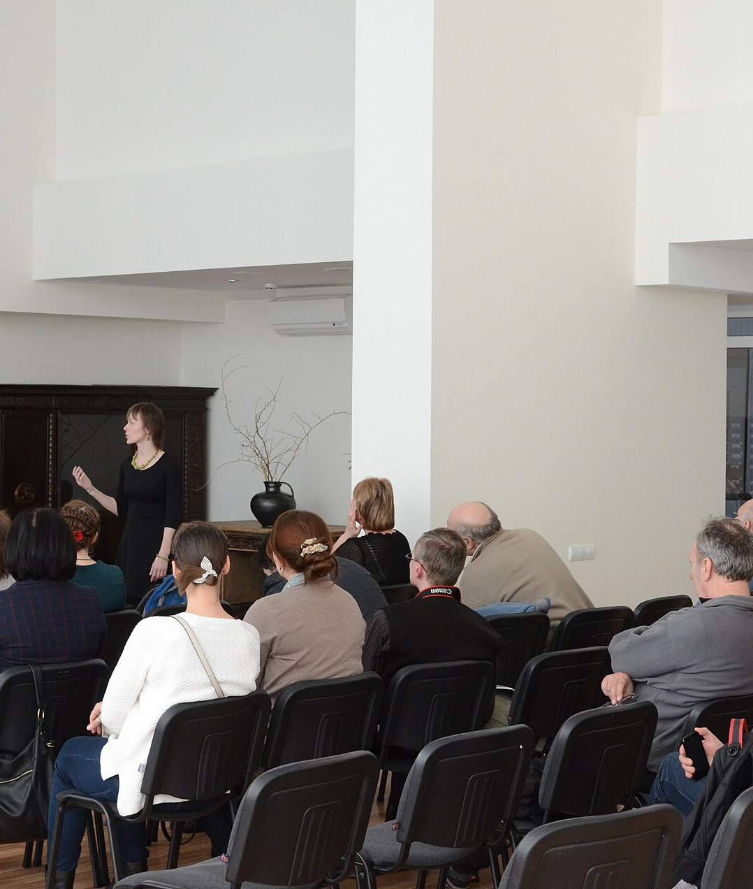
SLOP1512 / WEEK 12
Portfolio Review
Presenting the finished site, the design system, and the evidence behind it
Notes:
Image source: Audience seated at a conference presentation — see .codex-ppt-build/images-slop1512-week12/sources.txt for full attribution. Original SLOP1512 Week 12 teaching content.

Slide 2
SLOP1512 / WEEK 12
02
The Week 12 question
You have built and revised a site for eleven weeks. Can you show, not just tell, what you decided and why?
Why it matters: a portfolio review rewards evidence over description. Every claim on screen should be checkable against the live site.
Verification: before presenting, test each claim yourself — open the live site and confirm it still holds.
Evidence to record: claim made, site checked, and what you found.
Web Design and Interactive Publishing
Notes:
Original SLOP1512 Week 12 teaching content.

Slide 3
SLOP1512 / WEEK 12
03
From building to presenting
Weeks 1 to 11 built the site. Week 12 is the last skill: turning that work into a legible, evidenced account of it.
Why it matters: a portfolio review rewards evidence over description. Every claim on screen should be checkable against the live site.
Verification: before presenting, test each claim yourself — open the live site and confirm it still holds.
Evidence to record: claim made, site checked, and what you found.
Web Design and Interactive Publishing
Notes:
Original SLOP1512 Week 12 teaching content.

Slide 4
SLOP1512 / WEEK 12
04
Learning outcomes
Present a site's purpose and structure, show its design system as artefacts, present evidence of testing and revision, and receive critique without becoming defensive.
Why it matters: a portfolio review rewards evidence over description. Every claim on screen should be checkable against the live site.
Verification: before presenting, test each claim yourself — open the live site and confirm it still holds.
Evidence to record: claim made, site checked, and what you found.
Web Design and Interactive Publishing
Notes:
Original SLOP1512 Week 12 teaching content.

Slide 5
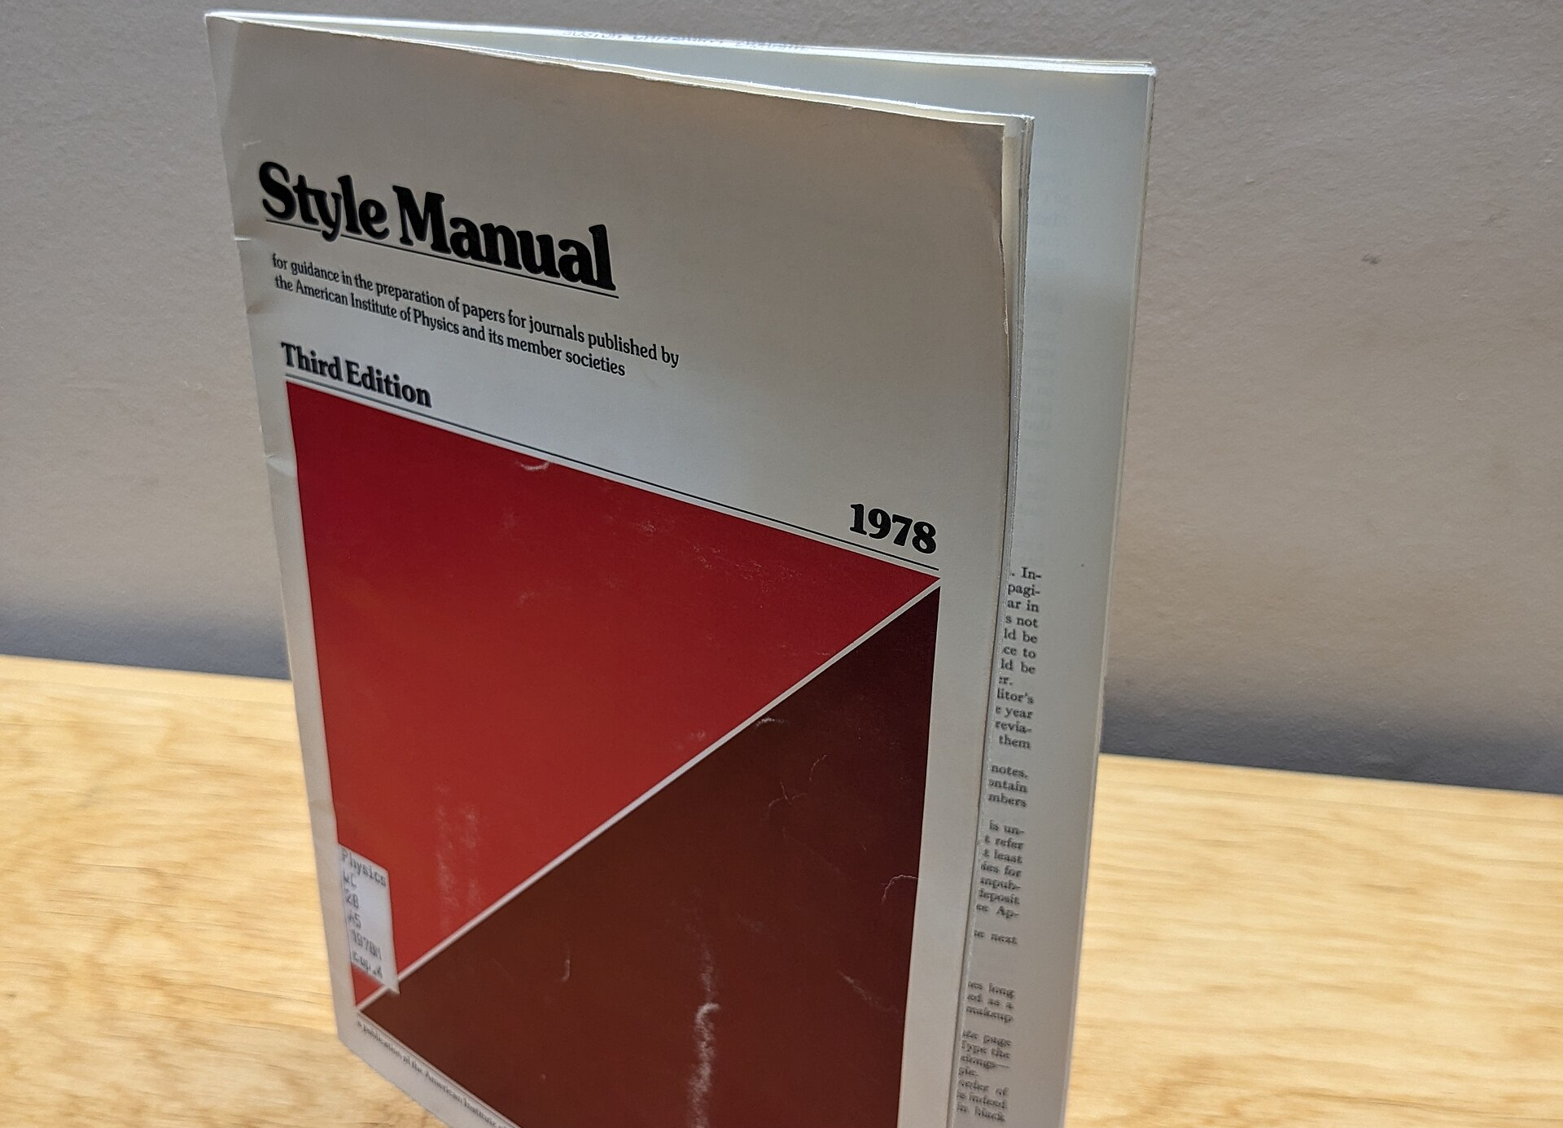
SLOP1512 / WEEK 12
05
Recap: Assignment 4
The process dossier asks for an information map, a design system reference, testing evidence, a change log and a critical reflection — this week rehearses presenting all five out loud.
Observe the visual, then connect it to the principle on this slide.
Web Design and Interactive Publishing
Notes:
Image source: Reference style guide manual standing upright — see .codex-ppt-build/images-slop1512-week12/sources.txt for full attribution. Original SLOP1512 Week 12 teaching content.

Slide 6
SLOP1512 / WEEK 12
06
What a portfolio review actually assesses
Purpose, audience, IA
Visual system, responsive
Who is this for, and what task does the sitemap support?
Tokens shown as a sheet; behaviour shown by resizing live.
Accessibility, technical care
Testing and revision
Keyboard task and one real DevTools fix, not a compliance claim.
One obstacle named, one revision shown, with evidence.
Web Design and Interactive Publishing
Notes:
Original SLOP1512 Week 12 teaching content.

Slide 7
SLOP1512 / WEEK 12
07
Criterion 1: purpose, audience, IA
Can you say who the site is for, what task they come to do, and show the sitemap that supports that task in two clicks or fewer?
Why it matters: a portfolio review rewards evidence over description. Every claim on screen should be checkable against the live site.
Verification: before presenting, test each claim yourself — open the live site and confirm it still holds.
Evidence to record: claim made, site checked, and what you found.
Web Design and Interactive Publishing
Notes:
Original SLOP1512 Week 12 teaching content.

Slide 8
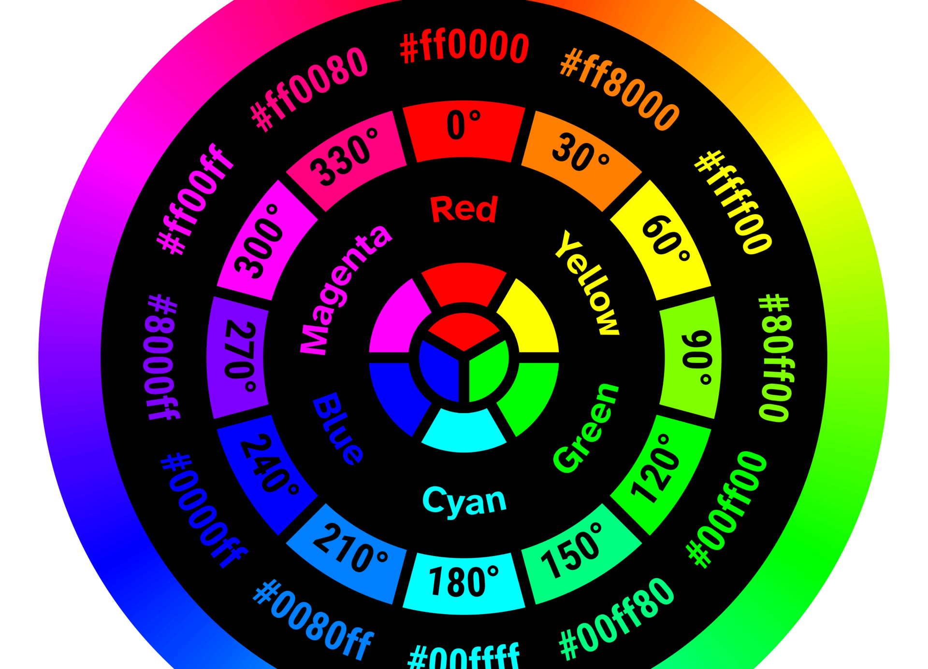
SLOP1512 / WEEK 12
08
Criterion 2: visual system, responsive
Can you show the type scale and colour tokens as a reference sheet, then resize the browser live and explain what changes and why?
Observe the visual, then connect it to the principle on this slide.
Web Design and Interactive Publishing
Notes:
Image source: RGB colour wheel diagram with labelled hues — see .codex-ppt-build/images-slop1512-week12/sources.txt for full attribution. Original SLOP1512 Week 12 teaching content.

Slide 9
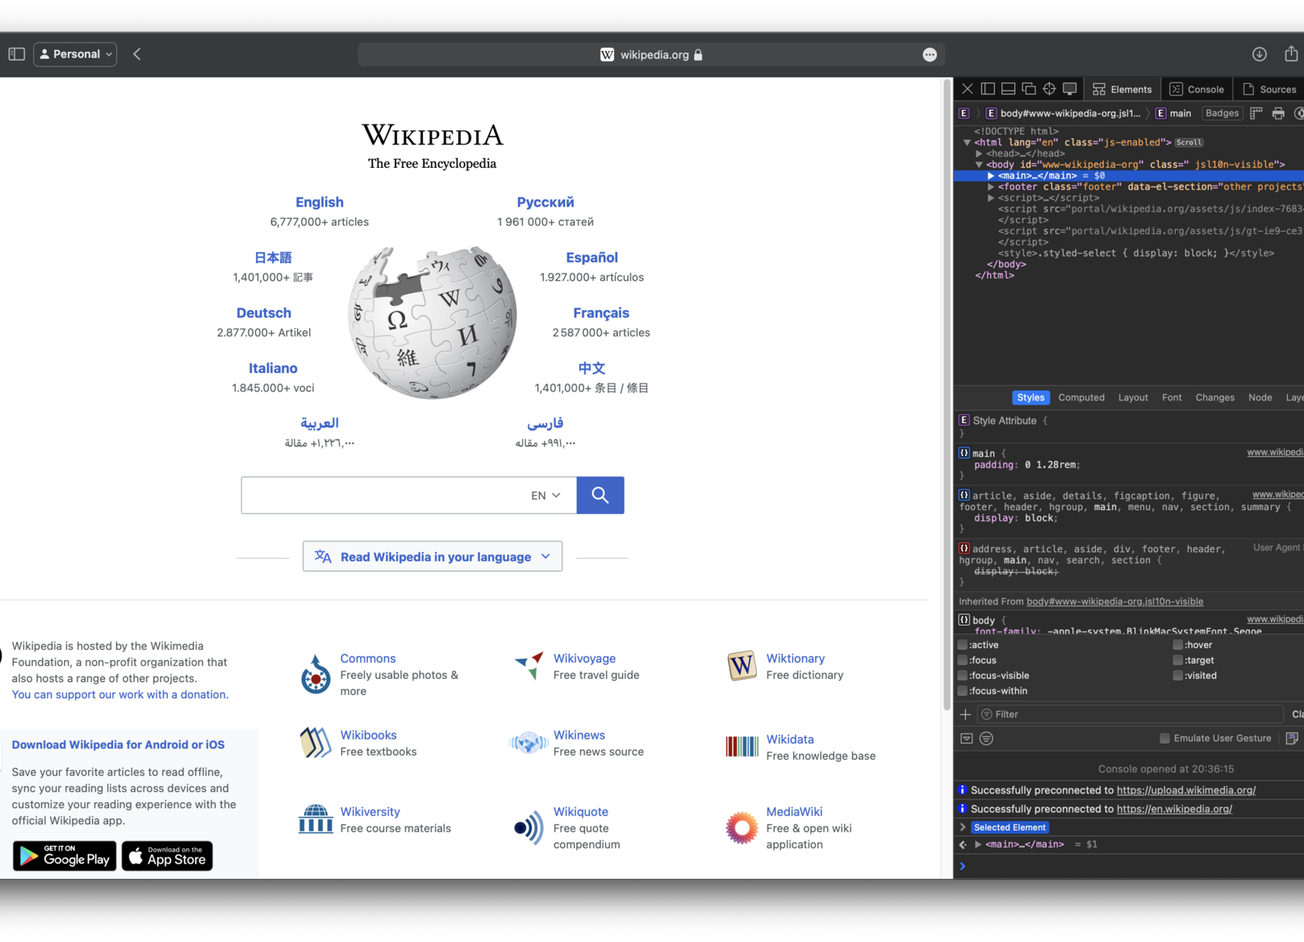
SLOP1512 / WEEK 12
09
Criterion 3: accessibility and technical care
Can you tab through a key task with a keyboard only, and show one real accessibility fix you made in DevTools, not just claim WCAG compliance?
Observe the visual, then connect it to the principle on this slide.
Web Design and Interactive Publishing
Notes:
Image source: Browser developer tools inspector panel open on a webpage — see .codex-ppt-build/images-slop1512-week12/sources.txt for full attribution. Original SLOP1512 Week 12 teaching content.

Slide 10
SLOP1512 / WEEK 12
10
Criterion 4: testing and revision
Can you name one thing a real user got stuck on, and show the specific change you made in response, with a before-and-after?
Why it matters: a portfolio review rewards evidence over description. Every claim on screen should be checkable against the live site.
Verification: before presenting, test each claim yourself — open the live site and confirm it still holds.
Evidence to record: claim made, site checked, and what you found.
Web Design and Interactive Publishing
Notes:
Original SLOP1512 Week 12 teaching content.

Slide 11
SLOP1512 / WEEK 12
11
Structuring a design walkthrough
1. Problem, audience
2. IA
3. Visual system
4. Live demo, evidence
Open with who and why, not the homepage.
Sitemap or content model, visible next.
Tokens as a reference sheet.
One task, one obstacle, one fix.
Web Design and Interactive Publishing
Notes:
Original SLOP1512 Week 12 teaching content.

Slide 12
SLOP1512 / WEEK 12
12
Step 1: problem and audience first
Recap Week 1: content before interface. Open with who the site serves and what they need, not with the homepage screenshot.
Why it matters: a portfolio review rewards evidence over description. Every claim on screen should be checkable against the live site.
Verification: before presenting, test each claim yourself — open the live site and confirm it still holds.
Evidence to record: claim made, site checked, and what you found.
Web Design and Interactive Publishing
Notes:
Original SLOP1512 Week 12 teaching content.

Slide 13
SLOP1512 / WEEK 12
13
Step 2: information architecture
Recap Week 9: show the sitemap or content model next. A visitor's mental map should be visible before any visual design appears.
Why it matters: a portfolio review rewards evidence over description. Every claim on screen should be checkable against the live site.
Verification: before presenting, test each claim yourself — open the live site and confirm it still holds.
Evidence to record: claim made, site checked, and what you found.
Web Design and Interactive Publishing
Notes:
Original SLOP1512 Week 12 teaching content.

Slide 14
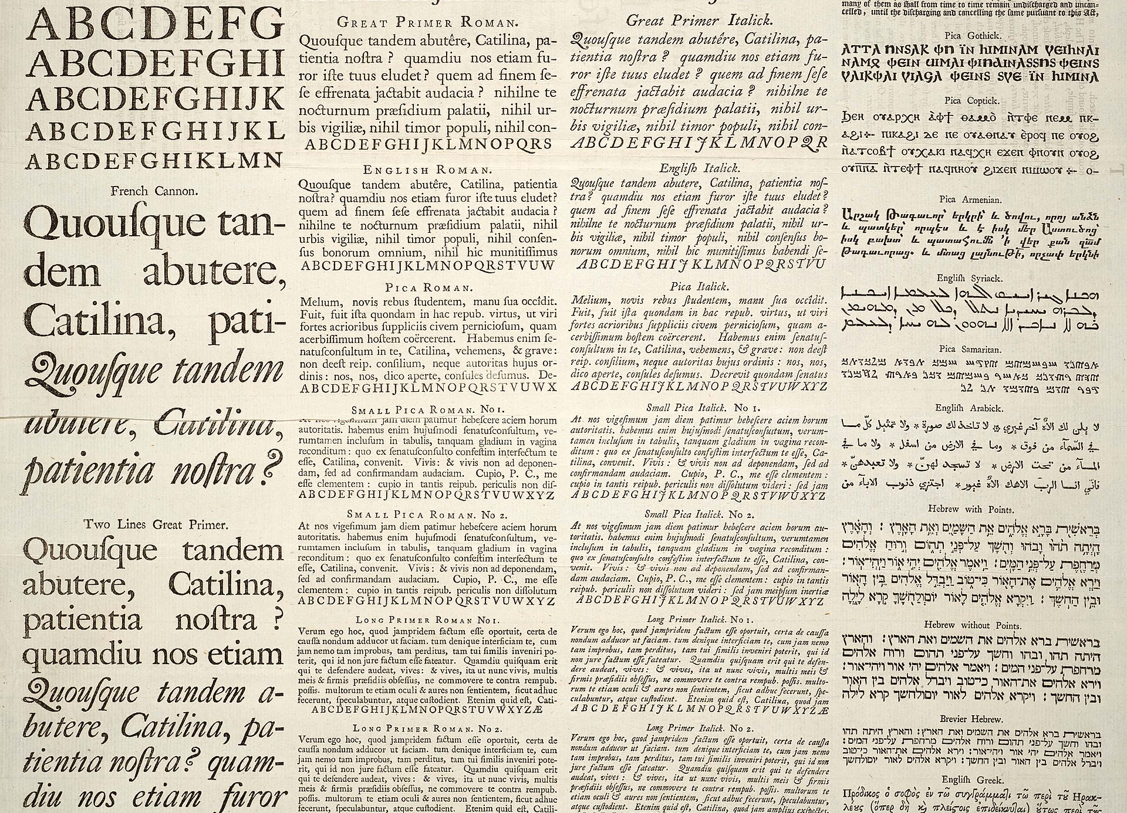
SLOP1512 / WEEK 12
14
Step 3: the visual system
Recap Week 3 (type scale) and Week 5 (colour and image system). Show the actual tokens, not adjectives like "modern" — a swatch grid, a type-scale ladder and a spacing ramp are checkable against the live site; a description is not.
Observe the visual, then connect it to the principle on this slide.
Web Design and Interactive Publishing
Notes:
Image source: Historic typography specimen sheet with multiple typefaces — see .codex-ppt-build/images-slop1512-week12/sources.txt for full attribution. Original SLOP1512 Week 12 teaching content.

Slide 15
SLOP1512 / WEEK 12
15
A design system slide, concretely
<style>
:root {
--step-0: 1rem;
--step-1: 1.25rem;
--step-2: 1.563rem;
--brand-ink: #18212A;
--brand-accent: #C7831A;
--space-3: 1.5rem;
}
</style>
Read this as a rule for what a review must show, not as markup to memorise.
Web Design and Interactive Publishing
Notes:
Original SLOP1512 Week 12 teaching content.

Slide 16

SLOP1512 / WEEK 12
16
Step 4: a live interaction demo
Recap Week 7. Do not describe the contact form — open it live, submit an empty field, and show the real error message and focus behaviour.
Observe the visual, then connect it to the principle on this slide.
Web Design and Interactive Publishing
Notes:
Image source: Close-up of hands typing on a backlit laptop keyboard — see .codex-ppt-build/images-slop1512-week12/sources.txt for full attribution. Original SLOP1512 Week 12 teaching content.

Slide 17
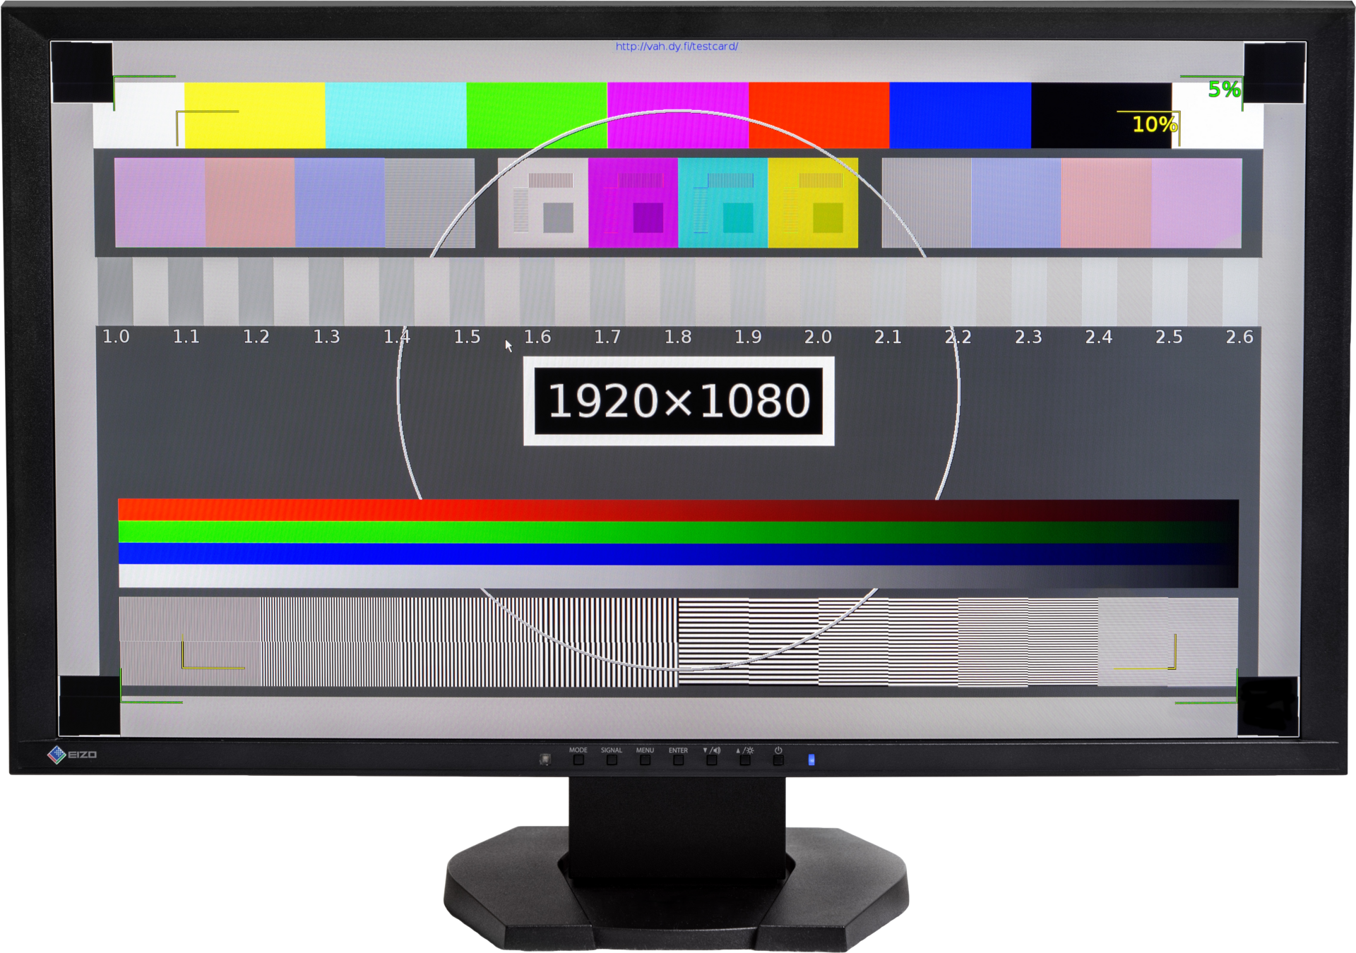
SLOP1512 / WEEK 12
17
Step 5: evidence, not claims
Recap Week 1 (reflection and evidence) and Week 10 (user testing). "It went well" is a claim. An observed blocker plus the fix that followed is evidence.
Observe the visual, then connect it to the principle on this slide.
Web Design and Interactive Publishing
Notes:
Image source: Computer monitor displaying a calibration test pattern — see .codex-ppt-build/images-slop1512-week12/sources.txt for full attribution. Original SLOP1512 Week 12 teaching content.

Slide 18
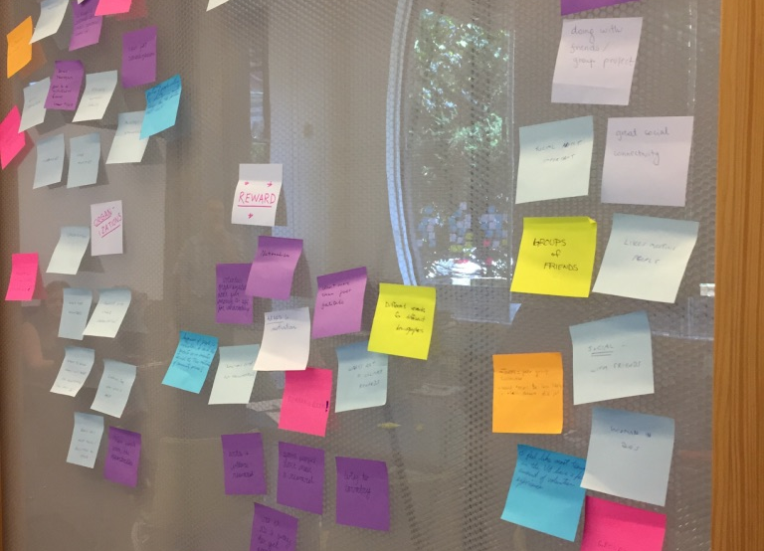
SLOP1512 / WEEK 12
18
Worked example: blocker to revision
Observed: a tester tried to tap a 20px icon-only nav link and missed twice. Revision: enlarged the tap target to 44px and added a visible text label. Recap Week 10's method: group raw session notes into named obstacles before the review, not during it.
Observe the visual, then connect it to the principle on this slide.
Web Design and Interactive Publishing
Notes:
Image source: Wall covered in sticky notes from a feedback session — see .codex-ppt-build/images-slop1512-week12/sources.txt for full attribution. Original SLOP1512 Week 12 teaching content.

Slide 19
SLOP1512 / WEEK 12
19
The change log as a presentable artefact
A dated table turns a semester of small decisions into a legible record a reviewer can scan in under a minute.
Why it matters: a portfolio review rewards evidence over description. Every claim on screen should be checkable against the live site.
Verification: before presenting, test each claim yourself — open the live site and confirm it still holds.
Evidence to record: claim made, site checked, and what you found.
Web Design and Interactive Publishing
Notes:
Original SLOP1512 Week 12 teaching content.

Slide 20
SLOP1512 / WEEK 12
20
Change log worked example
<table>
<tr><th>Date</th><th>Change</th><th>Why</th><th>Evidence</th></tr>
<tr><td>Wk 6</td><td>Added breakpoint</td><td>Nav overlapped at 375px</td><td>Screenshot, device test</td></tr>
<tr><td>Wk 10</td><td>Enlarged tap target</td><td>User missed nav link twice</td><td>Session recording</td></tr>
</table>
Read this as a rule for what a review must show, not as markup to memorise.
Web Design and Interactive Publishing
Notes:
Original SLOP1512 Week 12 teaching content.

Slide 21
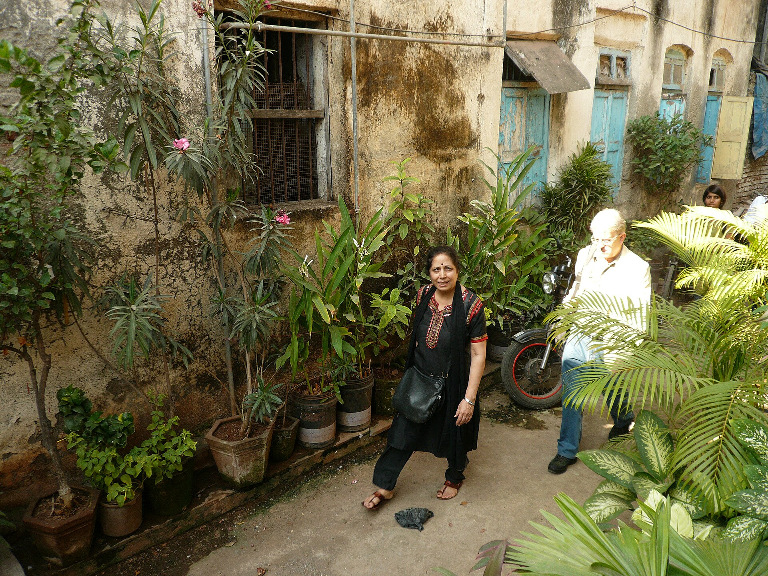
SLOP1512 / WEEK 12
21
Handling critique in the room
Recap Week 1's critique method: evidence before preference. A reviewer's opinion is a starting point, not a verdict, until tested against a task. Write the comment down before responding, and ask what task or expectation produced it before explaining your reasoning.
Observe the visual, then connect it to the principle on this slide.
Web Design and Interactive Publishing
Notes:
Image source: Design studio critique session with students around a table — see .codex-ppt-build/images-slop1512-week12/sources.txt for full attribution. Original SLOP1512 Week 12 teaching content.

Slide 22
SLOP1512 / WEEK 12
22
A clarifying question to keep ready
"What were you trying to do when that happened?" turns a vague complaint into a specific, checkable usability observation.
Why it matters: a portfolio review rewards evidence over description. Every claim on screen should be checkable against the live site.
Verification: before presenting, test each claim yourself — open the live site and confirm it still holds.
Evidence to record: claim made, site checked, and what you found.
Web Design and Interactive Publishing
Notes:
Original SLOP1512 Week 12 teaching content.

Slide 23

SLOP1512 / WEEK 12
23
Live and technical walkthrough checklist
Some things must be shown live. Others can be described. Confusing the two is the most common portfolio-review mistake.
Observe the visual, then connect it to the principle on this slide.
Web Design and Interactive Publishing
Notes:
Image source: Checklist icon on a clipboard — see .codex-ppt-build/images-slop1512-week12/sources.txt for full attribution. Original SLOP1512 Week 12 teaching content.

Slide 24
SLOP1512 / WEEK 12
24
Demonstrate live vs describe
Show live: keyboard-only navigation of one task, a resize across a breakpoint, one DevTools accessibility fix. Describe: hosting choices, asset pipeline, file naming.
Why it matters: a portfolio review rewards evidence over description. Every claim on screen should be checkable against the live site.
Verification: before presenting, test each claim yourself — open the live site and confirm it still holds.
Evidence to record: claim made, site checked, and what you found.
Web Design and Interactive Publishing
Notes:
Original SLOP1512 Week 12 teaching content.

Slide 25
SLOP1512 / WEEK 12
25
Common failure modes
All screenshots, no site
Vague reflection
A review that never opens the live URL invites doubt about what actually works.
"I learned a lot" is not evidence. Name the obstacle and the specific change.
Design system not in the site
Critique met with defence
Tokens on a slide that don't match the shipped CSS undercut the whole walkthrough.
Arguing with feedback instead of testing it reads as unprepared, not confident.
Web Design and Interactive Publishing
Notes:
Original SLOP1512 Week 12 teaching content.

Slide 26
SLOP1512 / WEEK 12
26
Self-assessment against the rubric
Score your own project against all four criteria before presenting. A worked example, scored honestly, with the evidence for each score.
Why it matters: a portfolio review rewards evidence over description. Every claim on screen should be checkable against the live site.
Verification: before presenting, test each claim yourself — open the live site and confirm it still holds.
Evidence to record: claim made, site checked, and what you found.
Web Design and Interactive Publishing
Notes:
Original SLOP1512 Week 12 teaching content.

Slide 27
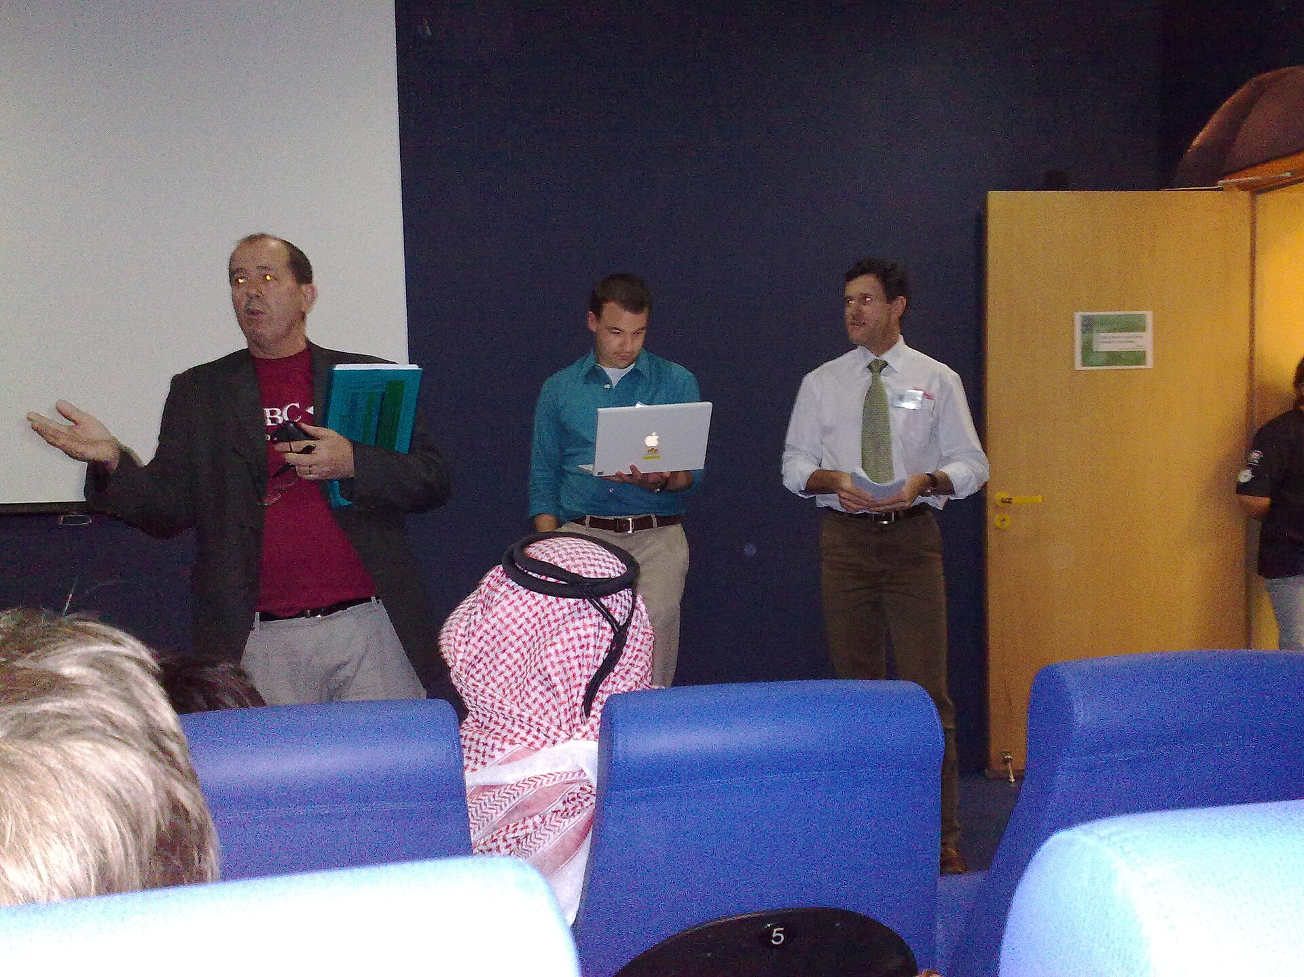
SLOP1512 / WEEK 12
27
Worked self-assessment example
IA: strong, sitemap tested with two users. Visual system: solid, tokens documented. Accessibility: partial, colour contrast unchecked on one page. Testing: strong, three sessions logged. A gap you find yourself is a fixable footnote; a gap a reviewer finds first is a credibility problem — score honestly, then patch the weakest area.
Observe the visual, then connect it to the principle on this slide.
Web Design and Interactive Publishing
Notes:
Image source: Student presenting a project to classmates — see .codex-ppt-build/images-slop1512-week12/sources.txt for full attribution. Original SLOP1512 Week 12 teaching content.

Slide 28
SLOP1512 / WEEK 12
28
Testable review checklist
Purpose and audience stated first. IA shown before visuals. Design system shown as a reference sheet. One live interaction demonstrated. One observed blocker paired with its fix. Change log dated. Self-assessed against all four criteria.
Why it matters: a portfolio review rewards evidence over description. Every claim on screen should be checkable against the live site.
Verification: before presenting, test each claim yourself — open the live site and confirm it still holds.
Evidence to record: claim made, site checked, and what you found.
Web Design and Interactive Publishing
Notes:
Original SLOP1512 Week 12 teaching content.

Slide 29
SLOP1512 / WEEK 12
29
Further practice
Nielsen Norman Group's articles on portfolio and design critique, and the course's own Assignment 4 brief and rubric, support continued preparation.
Web Design and Interactive Publishing
Notes:
Original SLOP1512 Week 12 teaching content.

Slide 30
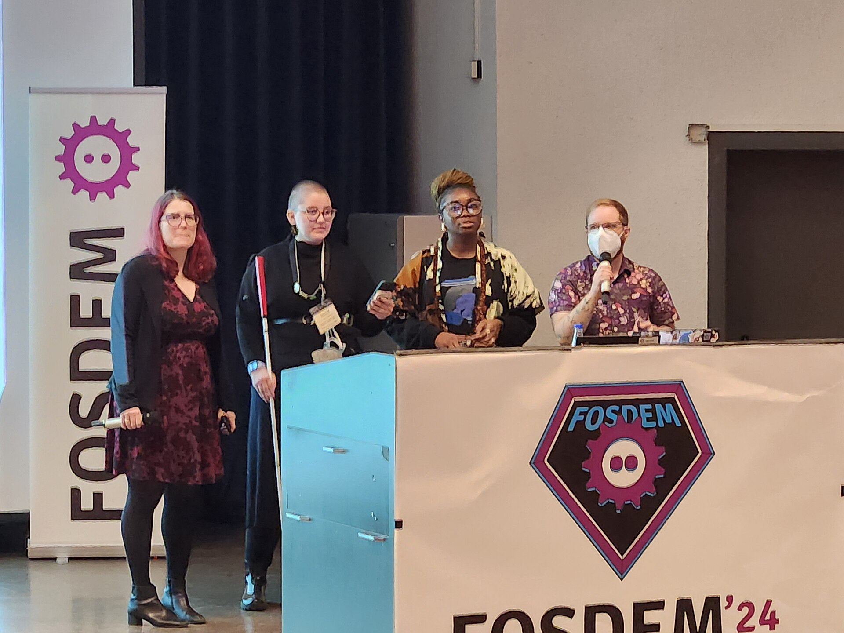
SLOP1512 / WEEK 12
30
Closing studio task
Prepare a five-minute walkthrough of a work-in-progress project: problem and audience, IA, visual system, one live interaction, one piece of testing evidence, and a one-sentence reflection. Deliver it in the final session.
Observe the visual, then connect it to the principle on this slide.
Web Design and Interactive Publishing
Notes:
Image source: Presenters speaking to an audience at a technology conference — see .codex-ppt-build/images-slop1512-week12/sources.txt for full attribution. Original SLOP1512 Week 12 teaching content.

