Slide 1

ROS Overview
COMP 417 – Tutorial 1
September 19, 2019

Slide 2
What is ROS?
ROS is an open-source, meta-operating system for your robot. It provides the services you would expect from an operating system, including:
message-passing between processes
hardware abstraction
low-level device control
implementation of commonly-used functionality
package management
Source: http://wiki.ros.org/ROS/Introduction

Slide 3
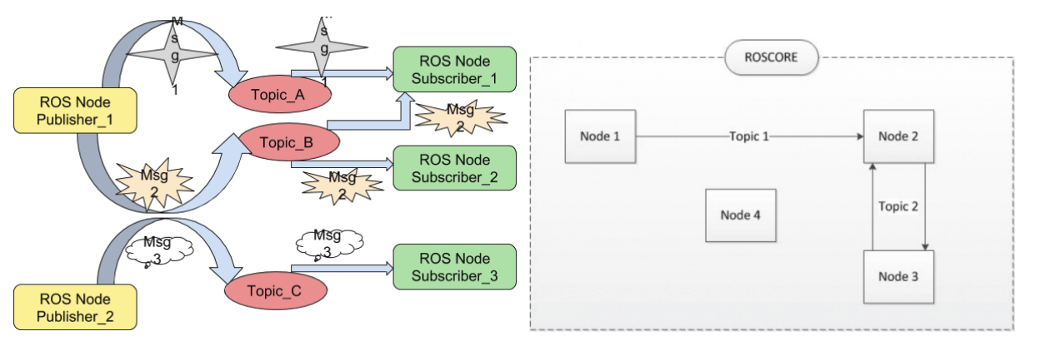
Message Passing and Node Graph
ROS application made up of collection of nodes.
Nodes exchange messages in doucupled fashion via message constracts

Slide 4
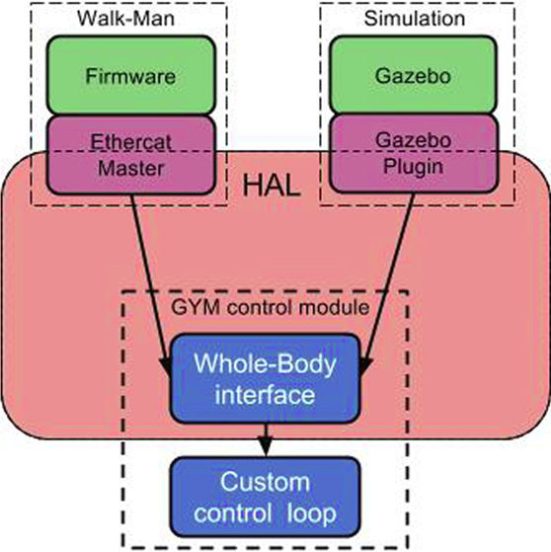
Hardware Abstraction
Goal:
User code should not change between simulation and real hardware.
Because working off common message types, interface remains unchanged

Slide 5
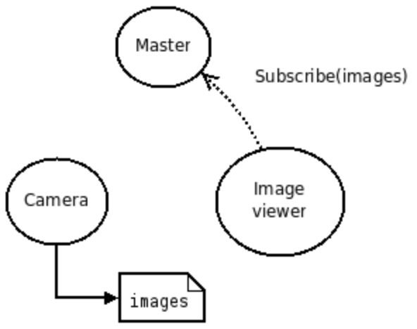
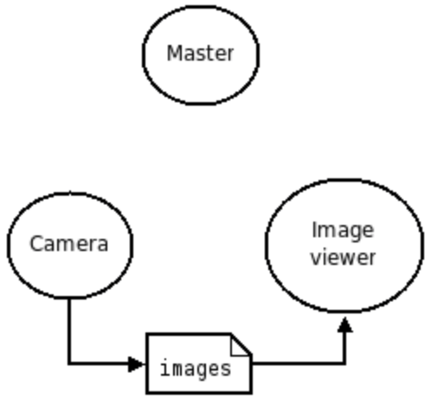
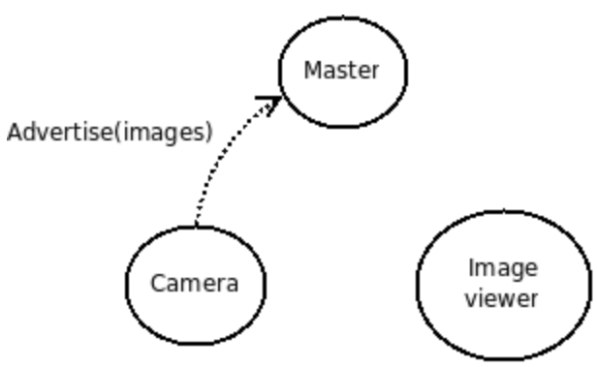
Master Node
Master node responsible for registry and lookup of other nodes
Enables other ROS nodes to locate eachother
Once nodes have located eachother, communiate peer-to-peer
roscore command starts master node
Source: http://wiki.ros.org/Master

Slide 6
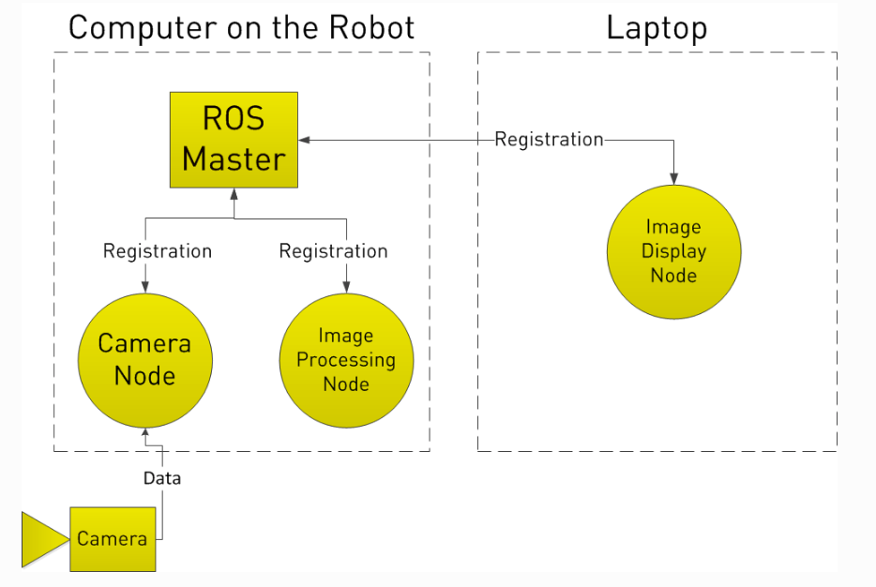
Nodes on Multiple Computers
Nodes can exist on multiple machines
But only 1 master node manages entire environment

Slide 7
Node Components + Communication Paradigms
Node is the base processing unit in ROS
Internally, node can host 1) topics 2) services 3) action client/server
Communication Type | Description | Typical Usage
1) Topic | Publisher-Subscriber | Constant streams of data.
2) Service | Blocking Request-Response | One-off short-running tasks
3) Action Client/Server | Async Request-Response | One-off long running tasks

Slide 8
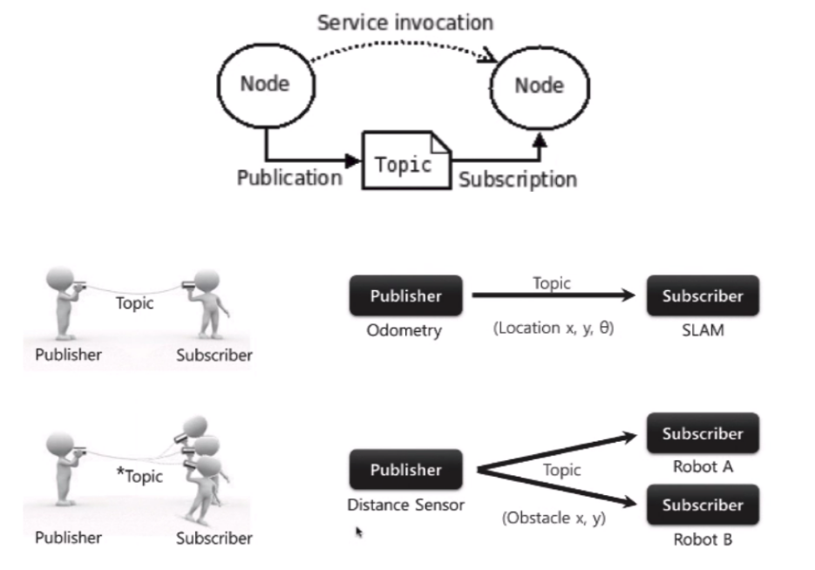
Topics
Publisher / Subscriber communication paradigm
Topic forms a pipe between publishers and subscribers
Multiple subscribers possible

Slide 9
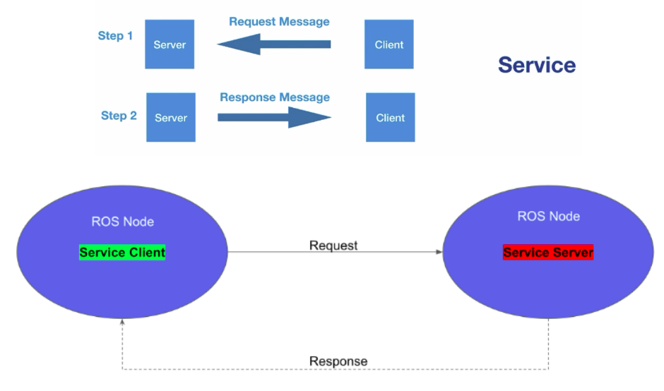
Services
Request / Response communication paradigm
Request will block will response is received

Slide 10
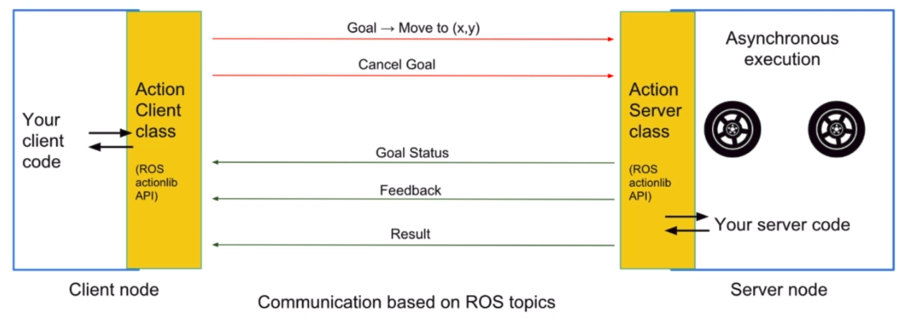
Action Clients/Servers
Actions trigger asynchronous tasks
Client code receives async, non-blocking callbacks with status updates.

Slide 11
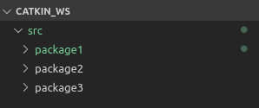
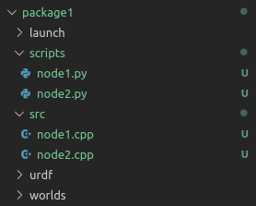
Anatony of a ROS Project
Workspace folder
catkin_ws: Workspace folder where packages
(projects) are stored
Similar to Eclipse Workspace
Packages can be implemented in Python or C++
Folder | Description
scripts or python | Stores python scripts and nodes
src | Stores c++ files and nodes
urdf | Markup for graphical models
worlds | Markup for simulation worlds
launch | Stores launch files for running nodes (more later)
Package folders

Slide 12
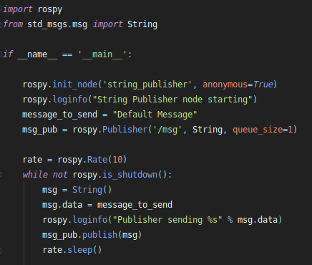
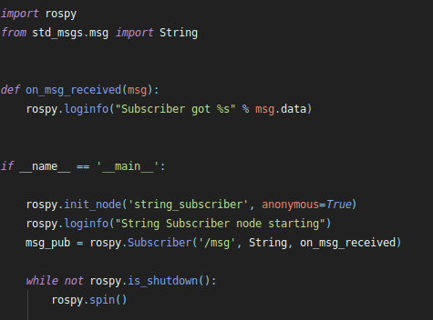
Subscriber / Publisher Example
Publisher Node
Subscriber Node

Slide 13
Rosrun
Used to run individual nodes
rosrun <package> <node>
Example: run 1) master node, 2) publisher node, 3) subscriber node
roscore
rosrun ros_tutorial publisher.py
rosrun ros_tutorial subscriber.py

Slide 14
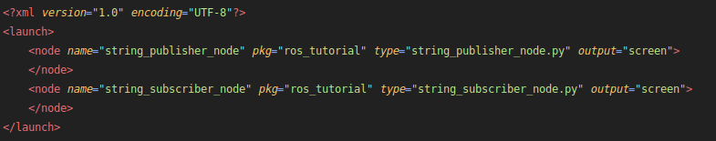
Roslaunch
Motivation:
Running nodes 1-by-1 cumbersome
Can run many nodes in batch using launch files
roslaunch <package> <file.launch>
Ex: roslaunch ros_tutorial pub_sub.launch
File path: /launch/pub_sub.launch

Slide 15
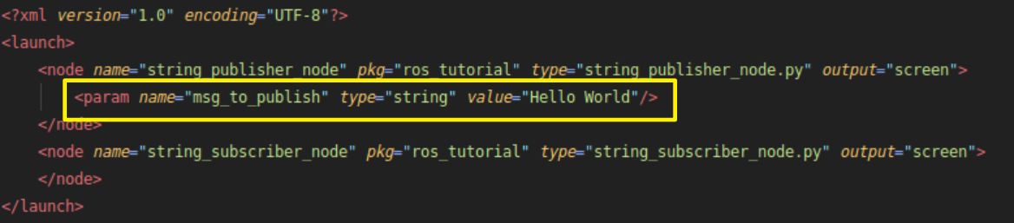

Roslaunch with Parameters
Can run parameters to launch files
Read in code with get_param

Slide 16
Tools for Debugging and Data Analysis
rqt_image_view
rqt_graph
rqt_plot
RVIZ

Slide 17
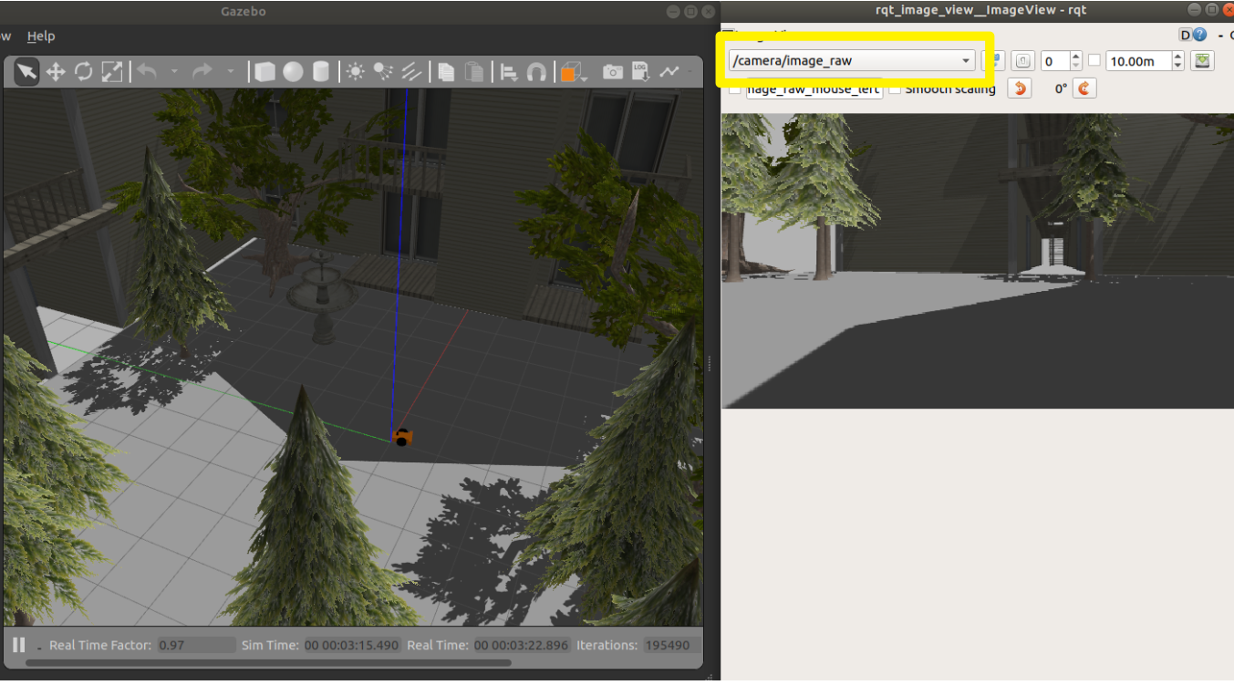
rqt_image_view
Visualize image topics.

Slide 18
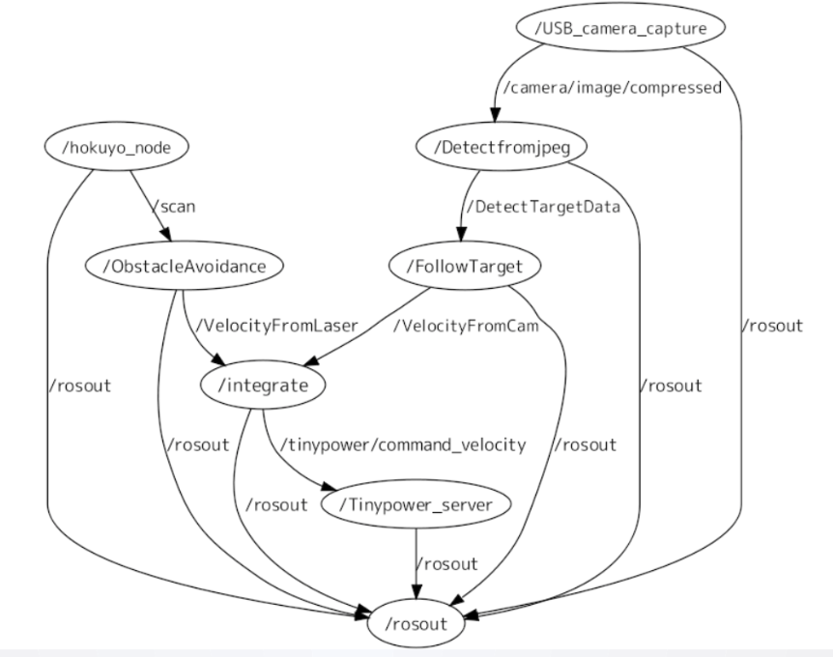
rqt_graph
Shows list of nodes and their connections

Slide 19
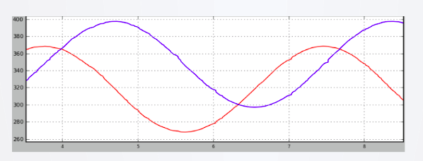
rqt_plot
Graphs data from one or more topic fields
Example: Graph x,y fields of trutle1/pose topic over time.
rqt_plot turtle1/pose/x, turtle1/pose/y

Slide 20
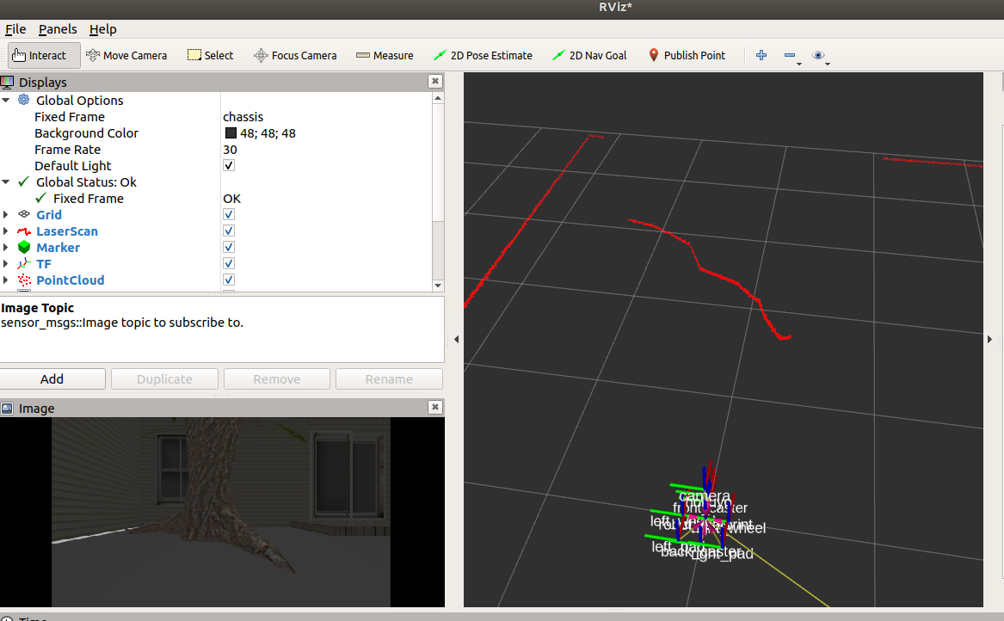
RVIZ (ROS Visualization)
General purpose 3D visualization for ROS
Can visualize lidar scans, coordinate frames, point clouds, etc.

Slide 21
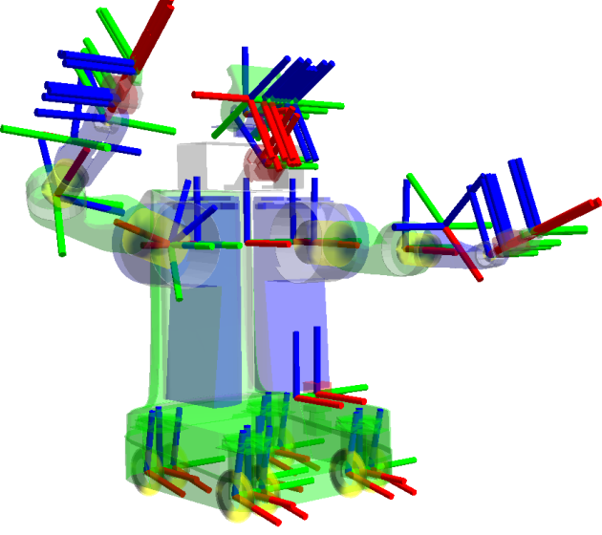
TF Package for Coordinate Frame Transforms
TF package handles transforms between coordinate frames over time
tf_echo: Prints updated transforms in console
Example:
rosrun tf tf_echo [reference_frame] [target_frame]
Source: http://wiki.ros.org/tf

Slide 22
Rosbag
Motivation:
Real-world robotics experiments subject to high amounts of variability
Want re-run (replay) experiments deterministically
Record all topics | rosbag record -a
Record topics to output file | rosbag record [topics] -o <output_file.bag>
Play back recorded data | rosbag play <input_file.bag>

Slide 23
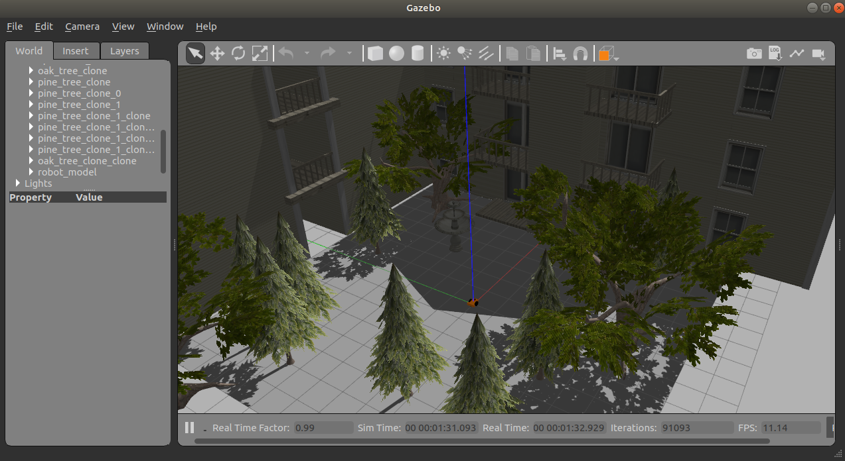

Gazebo Simulator
ROS alone does not do physics-based simulation
ROS often used in conjuction with Gazebo for simulation
Run empty gazebo world with command: gazebo

Slide 24
Definining Graphical Models
Graphical models defined in xml style format
Commonly found in urdf/ (for robot models) or world/ (for environments) project folders.
Format | Description
urdf | Unified Robot Definiton Format Typically only used to represent robot models (not environments).
sdf | Simulation Definition Format Can represent robot models and environments.

Slide 25
Additional Tutorials
Resource | Link
ROS Wiki | http://wiki.ros.org/ROS/Tutorials
ClearPath Tutorials | http://www.clearpathrobotics.com/assets/guides/ros/
Husarion Tutorials | https://husarion.com/tutorials/ros-tutorials/1-ros-introduction/
Ohio State Nodes (See ROS Tutorial Section) | http://www2.ece.ohio-state.edu/~zhang/RoboticsClass/
Github Repos for Udacity Robotics Nanodegree | https://github.com/topics/udacity-robotics-nanodegree
Udemy Courses | https://www.udemy.com/courses/search/?src=ukw&q=ros

