Slide 1
project1
File created on: 6/2/2022 8:44:24 PM

Slide 2
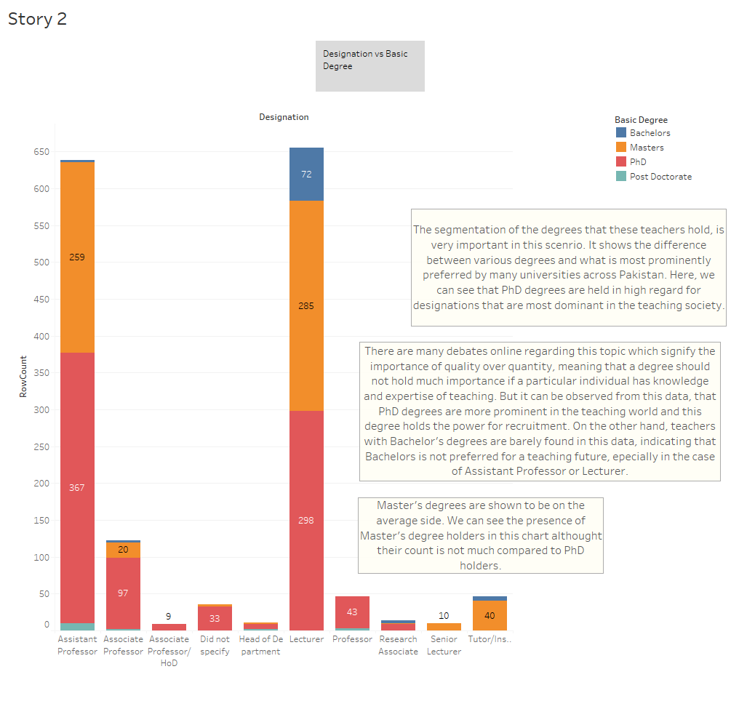

Slide 3
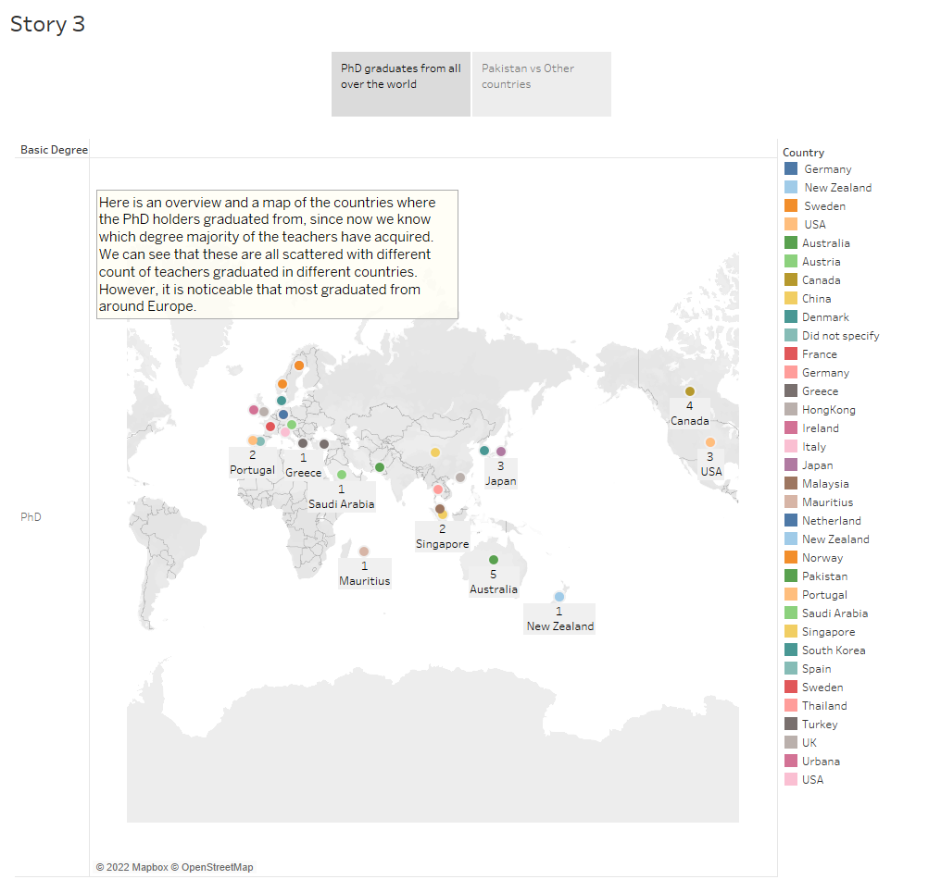

Slide 4
