Slide 1
BIG DATA ANALYTICS
PROJECT
HADOOP-BIOPYTHON
By Namra Aziz
ERP:09590

Slide 2
Dataset Information:
Dataset: GRCh38_latest_genomic.fna
Format: FASTA
Details: Reference Genomic Sequencing of Human being chromosome 1 which contains the longest sequence of human DNA.
Size: 3.11 GB

Slide 3
Dockerfile Information:
Downloaded Github code from Big Data Europe.
File name: “docker-hadoop-spark-workbench-master”
Services include:
Hadoop Name Node
Hadoop Data Node
Spark Master
Spark Worker
Spark Notebook
Jupyter/pyspark-notebook
Hue-hdfs file browser

Slide 4
Versions:
Hadoop: 2.8.0
Spark: 2.1.0
Py-spark jupyter notebook: latest version pulled from docker hub
Hue (hdfs file browser): 3.11

Slide 5
Libraries used:
pip install Bio
import Bio
from Bio import SeqIO
import pyspark
import pandas as pd
import numpy as np
import pyspark.pandas as ps
from pyspark.sql import SparkSession
from pyspark.sql.dataframe import DataFrame
pip install matplotlib
import pandas as pd
from pyspark.sql import SQLContext, DataFrameWriter
from pyspark.sql.types import *
from pyspark import SparkContext
from Bio.SeqUtils import molecular_weight
from Bio.SeqUtils import GC
import matplotlib.pyplot as plt
from collections import Counter

Slide 6
Steps followed:
Copied the data to Hadoop name node container
Copied data into spark master container
Enable Spark Session
Connected Spark master and Hadoop name node through bridge network in view of the idea if I could transfer data from Hadoop name node to spark master but couldn’t dig it up
Transferred data to hdfs using –put command

Slide 7
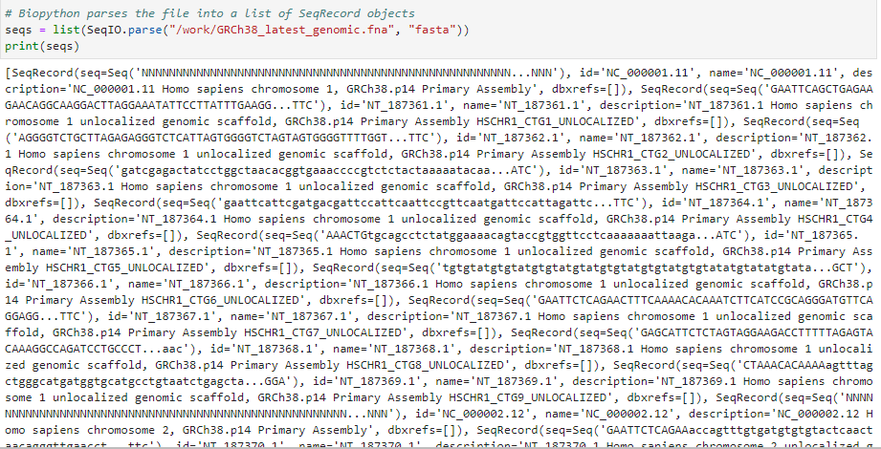
Loading the dataset in jupyter notebook container:
Loaded data using SeqIO module of Biopython package
SeqIO module is used to parse and read fasta files in python
No other method was available to read fasta format file in python
I converted the dataset into a list to do my analysis

Slide 8
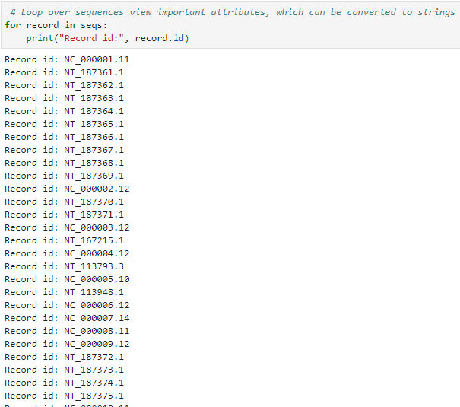
Printed ‘id’ of all sequences:

Slide 9
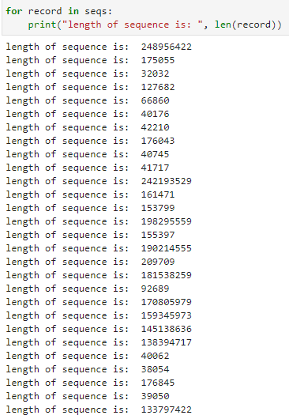
Printed length of all sequences:

Slide 10
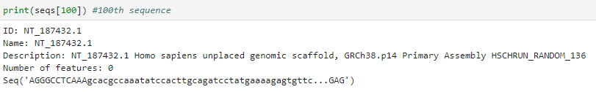
Printing 100th sequence:

Slide 11
Data Frame-challenges:
I was trying to convert my data set into a data frame so that spark sql could be run on it
But despite multiple tries, I couldn’t convert
This happened because of working with Biopython package which did not have dataframe flexibility
And when I tried doing it without using Biopython, it gave memory error since the data set was huge and I was working inside a container
Moreover, I tried to make a data frame using spark, but I couldn’t figure out how to load a ‘fasta’ file from spark. There were no sources available on the internet

Slide 12
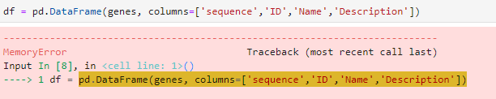

Tried making data frame but encountered memory error:
Tried using spark sql data frame but it kept restarting kernel so I wasn’t able to run this command:

Slide 13
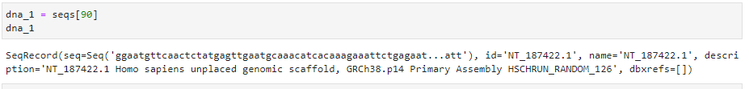
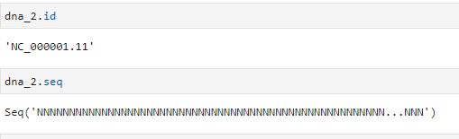
Genome Sequence Analysis:
Printing a sequence
Getting sequence or id from a particular record:

Slide 14
Converting to a Protein sequence using .translate() method
Printing length of sequence to get count of nucleotides in a sequence
Plotted bar graph of nucleotides against their frequency
Calculate molecular weight of a gene sequence
Calculated GC Content: higher GC Content implies more stable molecule due to G and C forming triple hydrogen bonds
Calculated count of amino acids in a particular protein sequence
Plotted bar chart of amino acid count in a particular protein sequence
Calculated count of amino acids in a particular protein sequence

Slide 15
That’s it
Thank you ☺

