Slide 1
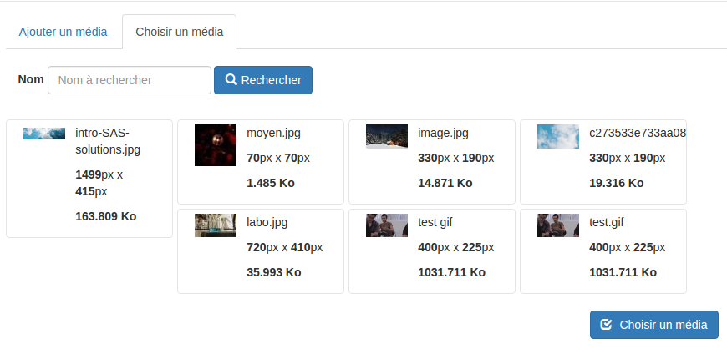
getSearchFields
getThumbnail
getListItem

