Slide 1

Dr Andrew Liew
Block Research Group
compas_fea

Slide 2
compas_fea > Introduction
Finite Element Analysis (FEA) Python package.
FEA software is not well suited for complex geometry.
Need a smooth interface between CAD and FEA.
Some FEA solvers have no GUI, for example OpenSees.
Architects: make FEA accessable for meaningful designs.
Engineers: make complex structures easier to model.
Integrate with compas, e.g datastructures, geometry, viewers.
Enable parametric studies: geometry > analysis > results.
Make FEA fun to use while retaining full functionality.
Non-linear geometry, material and complex analyses.

Slide 3
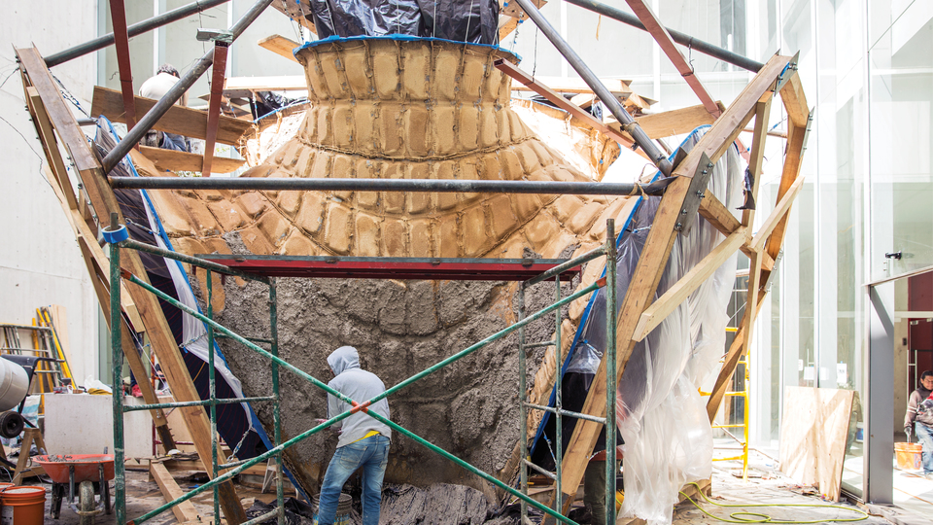
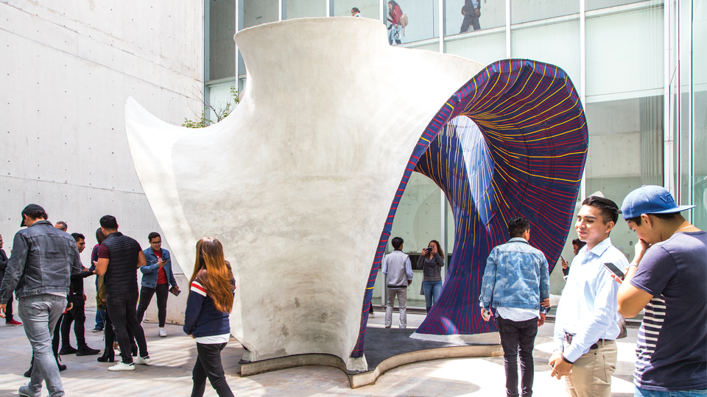
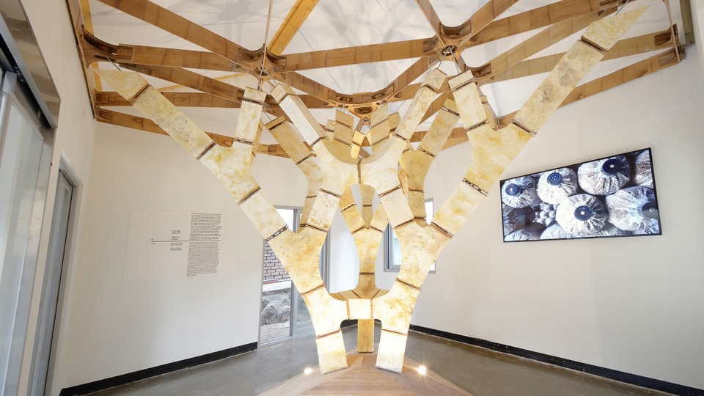
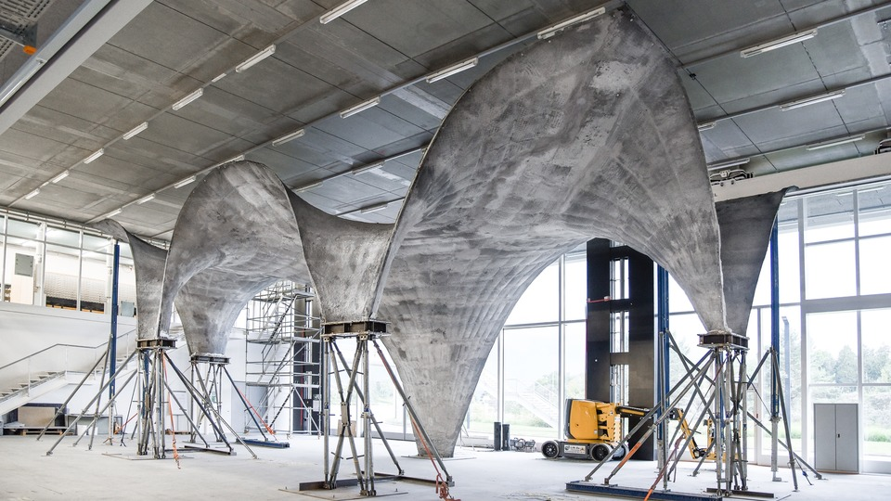
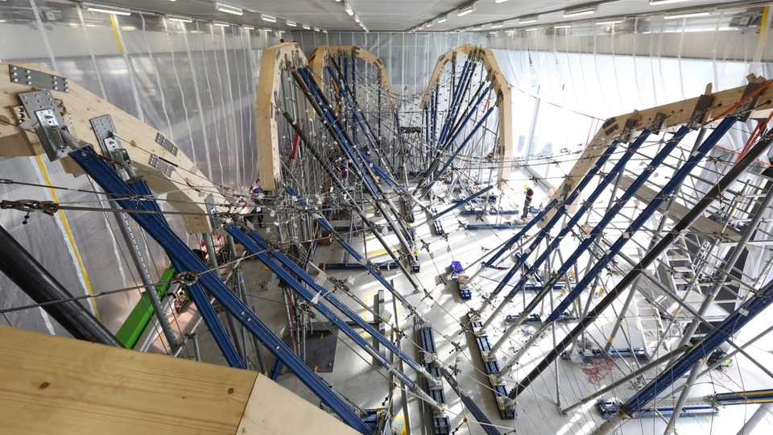
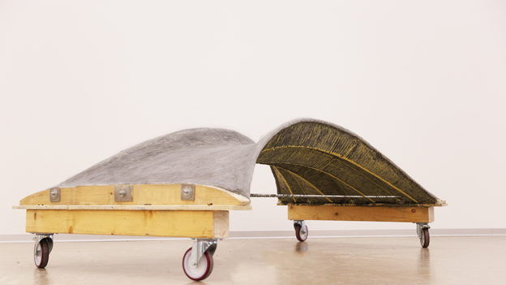
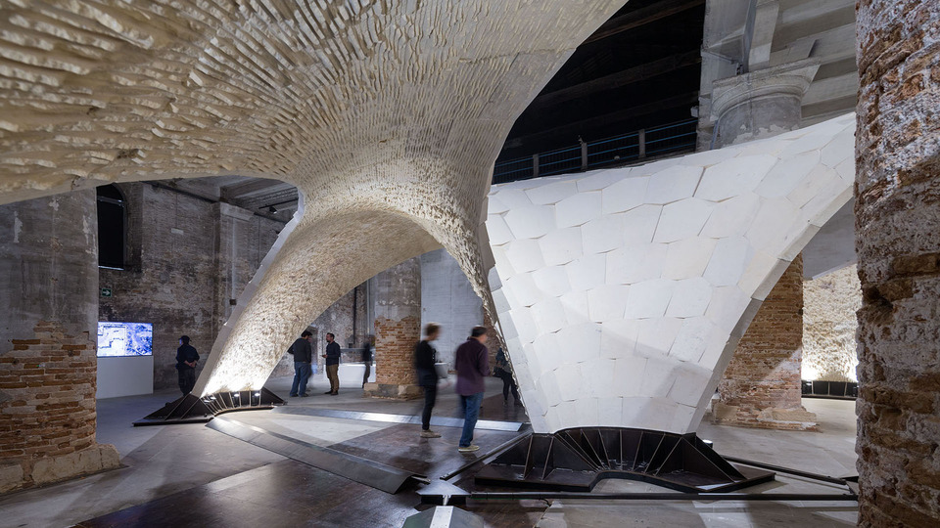
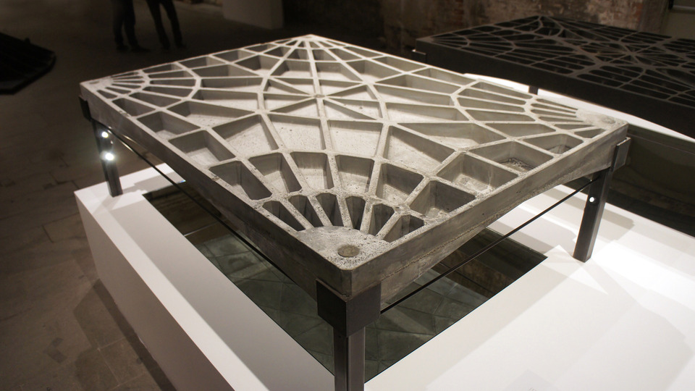
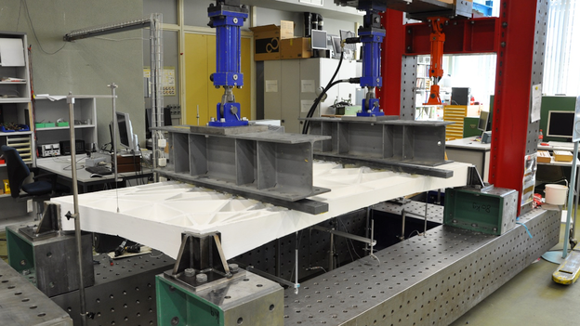
compas_fea > Projects

Slide 4
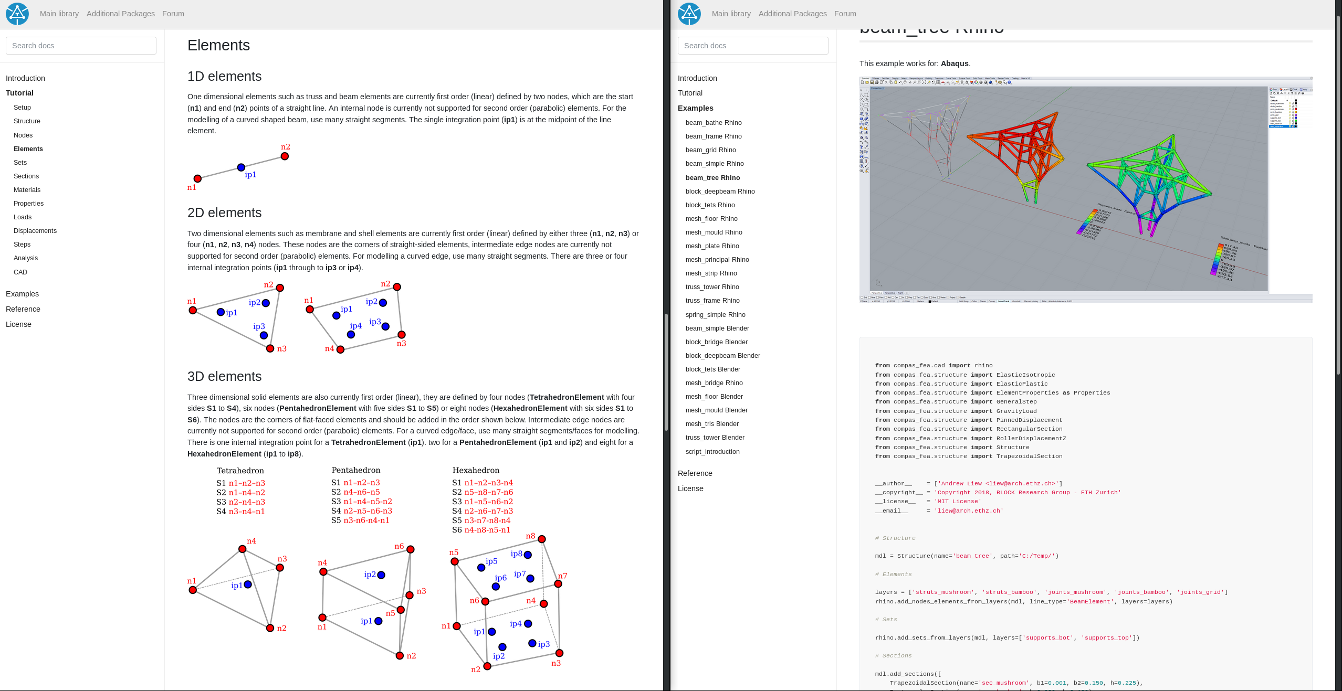
compas_fea > documentation

Slide 5












compas_fea > pipeline
Structure.obj
.constraints
.displacements
.elements
.element_properties
.interactions
.loads
.materials
.misc
.nodes
.results
.sections
.sets
.steps
Plot results
Results
Geometry
Input file
.inp
.txt
.tcl

Slide 6
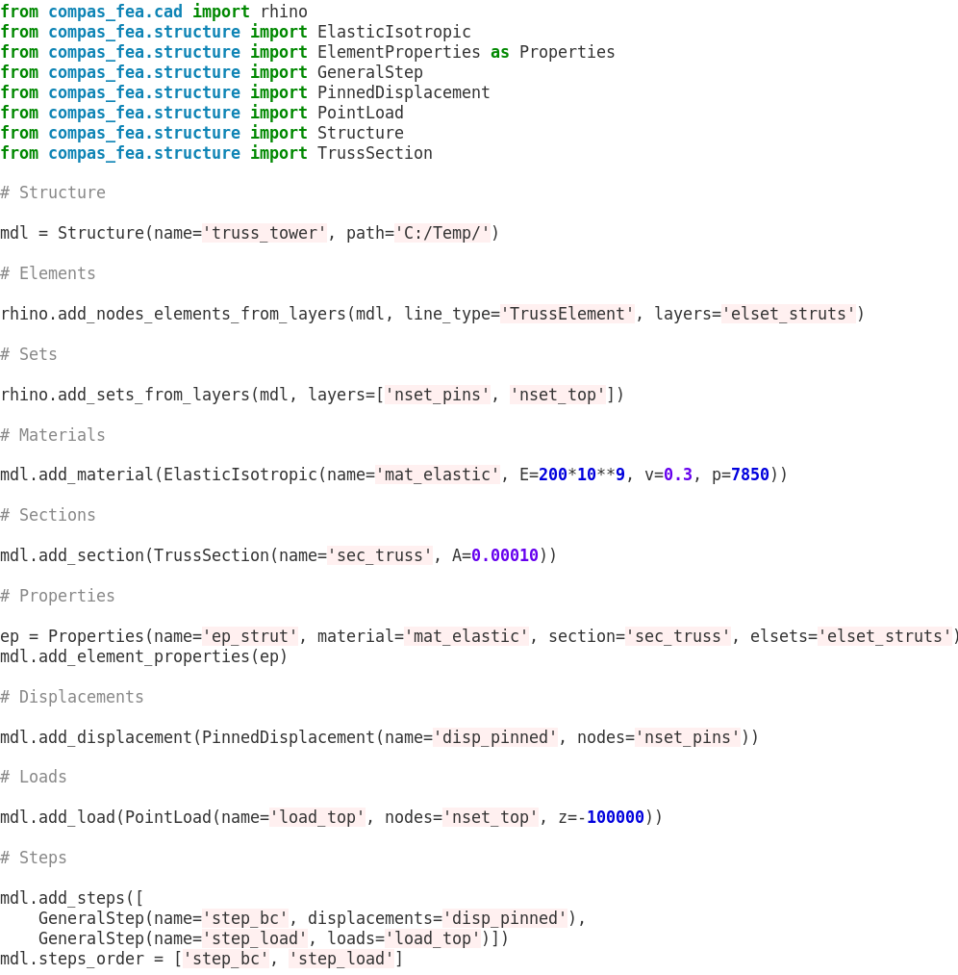
compas_fea > Structure
Structure.obj
.constraints
.displacements
.elements
.element_properties
.interactions
.loads
.materials
.misc
.nodes
.results
.sections
.sets
.steps

Slide 7
compas_fea > example

