Slide 1

CS6290 Course Project
Wallet RPC Privacy
Leakage Measurement System
Quantifying Privacy Risks in Blockchain Communication
Privacy Protection
Risk Quantification
Real-time Measurement

Slide 2
PROJECT OVERVIEW
Project Overview
Core Objectives
Target Audience
Quantify privacy leakage risks in blockchain wallet-RPC node communication, establish standardized measurement methodology. Through real-time traffic capture, rule-based detection, and risk assessment, transform abstract privacy threats into quantifiable, actionable insights.
Wallet developers, RPC providers, end users, academic researchers, regulatory agencies. Provide targeted privacy protection recommendations and assessment tools for different roles.
10
4
5000+
Weeks
People
Samples
Project Timeline
Team Size
Target Samples
Core Highlights
Empirical Method
Rule Detection
Real network traffic measurement
Comprehensive pattern recognition
Quantitative Metrics
Actionable Advice
Multi-dimensional scoring system
Evidence-based recommendations

Slide 3
CORE PROBLEM
Core Problem Statement
Privacy Risk Sources
Research Gaps
Even with encryption protection intact, RPC providers can infer user behavior and identity through metadata:
1
Lack of Standardized Methods
Different studies use different metrics, difficult to compare horizontally
Query Patterns
Temporal Features
Call frequency, method types expose user activity intensity
Time patterns can identify users across sessions
2
Lack of Empirical Analysis
More theoretical assumptions, less real data validation
Address Association
Network Identity
Multiple addresses belong to same user
IP address, session ID infer location
3
No Actionable Assessment
Research results difficult to translate into actual improvement measures
4
Lack of Real Environment Validation
Threat Model
Insufficient controlled experiments, difficult to reproduce
Honest-but-curious RPC provider: Correctly executes all RPC requests and returns valid responses, but passively observes and records communication metadata for analysis. Can link user addresses, infer behavior patterns, conduct long-term tracking.
Our Solution: Complete measurement, detection, and assessment system

Slide 4
SYSTEM ARCHITECTURE
System Architecture
Frontend Layer
Business Logic
API Gateway
Data Layer
React + TypeScript
Core Services
FastAPI - Python
Storage & Engines
Traffic Capture
Real-time Dashboard
Configure capture, parse packets, extract JSON-RPC, standardize data
RESTful Endpoints
MySQL
Structured Storage
Privacy Detection
Analysis Panel
Apply rules, classify leakage, calculate confidence, real-time & batch
Request Validation
File Storage
PCAP Files
Risk Assessment
Risk Assessment UI
Multi-dimensional metrics, aggregate scores, generate reports
Response Formatting
Rule Engine
YAML Rules
Analysis Service
Report Export
Statistical analysis, trend detection, visualization datasets
Rate Limiting
Metrics Engine
Scoring Algorithms
Clear Responsibilities
Loose Coupling
High Scalability
Standardized Interfaces

Slide 5
TRAFFIC CAPTURE
Traffic Capture Module
Technical Implementation
1000+
<100ms
P95<500ms
Capture Rate
Detection Latency
API Response
packets/second
real-time processing
high performance
Python 3.10+
mitmproxy
Privacy Protection Mechanisms
scapy
MySQL 8.0+
Address Hashing
IP Anonymization
Transaction Hash
SHA-256 hash then take first 16 characters
Hash processing, do not store original IP
Hash sensitive parameters before storage
Core Functions
HTTPS/TLS Decryption
Use mitmproxy as man-in-the-middle proxy to intercept and decrypt TLS encrypted traffic
Data Processing Flow
WebSocket Support
Capture WebSocket real-time communication, support multi-protocol identification
1
2
3
4
JSON-RPC Parsing
Traffic Capture
Protocol Parsing
Anonymization
Storage
Extract method names, parameters, timestamps and other key metadata
Structured Storage
Packet parsing and organized data persistence

Slide 6
PRIVACY DETECTION
Privacy Detection Module
Rule-based Detection Engine
Priority System
Uses YAML format to define detection rules, supports flexible configuration and runtime dynamic adjustment. Rule engine analyzes traffic patterns in real-time, identifies four types of privacy leakage events.
CRITICAL
HIGH
Severe
High
MEDIUM
LOW
12
4
4
Medium
Low
Total Rules
Categories
Priorities
Confidence Assessment Algorithm
Rule Categories
Base Confidence
Based on rule weight
IDENTITY
ASSET
Frequency Factor
Address, account information
Balance, transaction info
High frequency increases confidence
Temporal Consistency
BEHAVIOR
LOCATION
Consistent behavior increases confidence
Usage patterns, habits
Timezone, network fingerprint
Confidence Interval
95% CI upper and lower bounds
Real-time Detection
Batch Detection
Event Aggregation

Slide 7
RISK ASSESSMENT
Actionable Recommendations Generation
Risk Assessment Module
Based on risk level and dominant contributing indicators, automatically generate targeted privacy protection recommendations, each assessment provides at least 3 actionable recommendations.
Multi-dimensional Risk Quantification
Establish four core dimension privacy risk quantification indicator system, enhance assessment through statistical methods and machine learning, generate comprehensive risk score from 0-100.
Low Entropy Risk
Increase request method diversity, explore multiple DApps to disperse behavior characteristics
Information Entropy
Uniqueness
High Correlation Risk
Measure information predictability
Measure user distinguishability
Use address rotation, generate new addresses for different sessions, separate activity types
Higher entropy = better privacy
Lower uniqueness = harder to identify
High Temporal Risk
Correlation
Temporal
Add random time jitter, batch requests to reduce time granularity
Cross-session consistency
Time pattern value
Higher correlation = easier to track
Higher temporal = greater leakage risk
Baseline Comparison Analysis
Risk Level Classification
Ideal Privacy Baseline
0-30
31-50
51-70
71-100
Theoretical optimal value
LOW
MEDIUM
HIGH
CRITICAL
Worst Privacy Baseline
Low
Medium
High
Critical
Theoretical worst value
Trend Analysis
Cross-session risk changes

Slide 8
DETECTION RULES
Detection Rule System
Identity Rules (3)
Behavior Rules (3)
DR-ID-1
HIGH
DR-BE-1
HIGH
Address Reuse Detection: frequent cross-session queries for same address balance
DApp Usage Patterns: detect DApp characteristic call sequences
DR-ID-2
HIGH
DR-BE-2
HIGH
Address Association: correlated behavior of multiple addresses in same session
Bot Behavior: identify automation characteristics of fixed intervals and burst patterns
DR-ID-3
MEDIUM
DR-BE-3
MEDIUM
Account Discovery: enumeration of account index patterns
Active Session Inference: detect active periods based on request frequency threshold
Asset Rules (2)
Location Rules (2)
DR-AS-1
HIGH
DR-LO-1
MEDIUM
Asset Holding Inference: infer holdings from repeated asset metadata queries
Timezone Inference: infer user timezone from request time patterns
DR-AS-2
MEDIUM
DR-LO-2
MEDIUM
Transaction Signature: identify transfers from nonce sequence and gas price patterns
Network Fingerprint: detect TLS handshake time signature

Slide 9
ASSESSMENT ALGORITHM
Four-Dimensional Assessment Algorithm
Entropy Score
Correlation Score
H = -Σ(pi × log2(pi)) / log2(n)
ρ = |Ai ∩ Aj| / |Ai ∪ Aj|
Measures randomness of request method distribution. Higher entropy indicates more diverse request patterns, harder for attackers to predict user behavior, better privacy protection.
Uses Jaccard similarity to measure behavior consistency between multiple addresses. Higher correlation indicates more similar behavior between addresses, easier to infer as same user.
Calculation Steps:
Calculation Steps:
Count RPC method frequencies f[1..n]
Normalize probabilities p[i] = f[i] / Σf
Calculate Shannon entropy H = -Σ(p[i] × log₂(p[i]))
Normalize to [0,1] range
Get method sets of all addresses in session
Calculate Jaccard similarity for all address pairs
Take maximum similarity as correlation score
Range [0,1], higher = easier to associate
Comprehensive Score Formula
wentropy = 25%
wuniqueness = 25%
Score = Σ(wi × Scorei) × 100
wcorrelation = 25%
wtemporal = 25%
Uniqueness Score
Temporal Score
U = 1 - max(cos(vT, vRi))
T = CV / threshold
Measures similarity between user behavior pattern and reference group. Lower uniqueness indicates more ordinary user behavior, harder to distinguish from group.
Analyzes coefficient of variation (CV) of request intervals. Higher temporal score indicates more characteristic time patterns, easier to identify user through time fingerprint.
Calculation Steps:
Calculation Steps:
Extract target session feature vector v_T
Calculate cosine similarity with reference sessions
Take maximum similarity value
Uniqueness = 1 - maximum similarity
Extract request interval sequence
Calculate CV = std / mean
Normalize to [0,1] range
Higher value = more obvious temporal characteristics

Slide 10
TECH STACK
Technical Implementation
Backend Tech Stack
Frontend Tech Stack
Performance Metrics
Python 3.10+
React 19 + Vite
1000+
P95<500ms
Async programming, type hints
Modern UI framework
Capture Rate
API Response
packets/second
milliseconds
FastAPI 0.104+
TypeScript 5.9+
High-performance async web framework
Type safety
>99%
>70%
MySQL 8.0+
ECharts + Axios
System Availability
Test Coverage
uptime
code coverage
Structured data storage
Visualization and API requests
SQLAlchemy 2.0
TailwindCSS
Security Requirements
Async ORM and model layer
Utility-first CSS
mitmproxy + scapy
React Router
AES-256 encrypted storage
Traffic capture and parsing
Routing and page navigation
TLS database connection
scikit-learn
Machine learning enhancement
Rate limiting 100req/min
Input validation and sanitization
Git + GitHub
Docker + Compose
GitHub Actions
Sphinx Documentation

Slide 11
VALUE PROPOSITION
Project Value Proposition
Wallet Developers
End Users
RPC Providers
Privacy Benchmarking
Privacy Awareness Enhancement
Privacy Audit
Quantitatively evaluate wallet privacy protection level, identify improvement space
Understand privacy risks in wallet-RPC communication
Evaluate service privacy protection capability, establish user trust
Wallet Selection Guidance
Transparency Enhancement
Vulnerability Identification
Choose more secure tools based on privacy assessment
Publicize privacy practices, enhance service differentiation competitiveness
Discover potential privacy leakage patterns and security weaknesses
Configuration Recommendations
Implementation Guide
Obtain personalized privacy protection configuration solutions
Provide specific privacy enhancement implementation recommendations
Academic Research
Regulatory Agencies
Methodology Establishment
Provide privacy standard evidence and compliance assessment tools, promote establishment of industry privacy protection standards. Enable evidence-based policy making and regulatory oversight in the blockchain ecosystem.
Blockchain privacy leakage quantitative assessment methodology
Dataset Contribution
Provide real privacy leakage datasets for research
Publishable Results
Generate high-quality academic papers and research reports

Slide 12
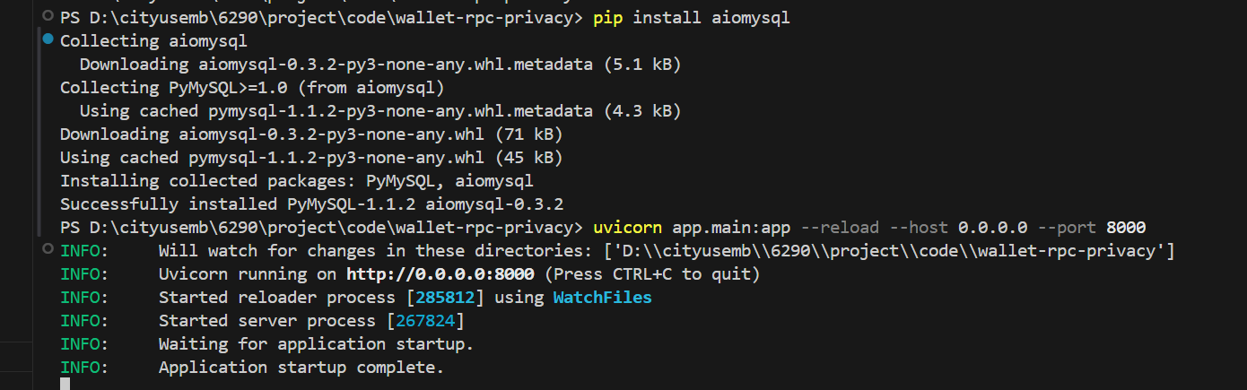
IMPLEMENTATION STATUS
Implementation Status & Demo Environment
Local end-to-end deployment is already running for the presentation demo.
What is already running
• Backend API: FastAPI service at http://localhost:8000
• Frontend dashboard: React + Vite UI at http://localhost:5173
• Database: MySQL 8.0 with async SQLAlchemy / aiomysql
• API testing surface: Swagger /docs is accessible in browser
Why this slide matters
• Confirms that the project is executable rather than only conceptual
• Proves backend / frontend connectivity before live explanation
• Provides the environment needed for later API and dashboard screenshots
Backend service started successfully with FastAPI + Uvicorn on localhost:8000
Backend Port
8000
Frontend Port
5173
Database
MySQL 8.0
Docs Endpoint
/docs
Demo Mode
Mock + Live UI
12

Slide 13
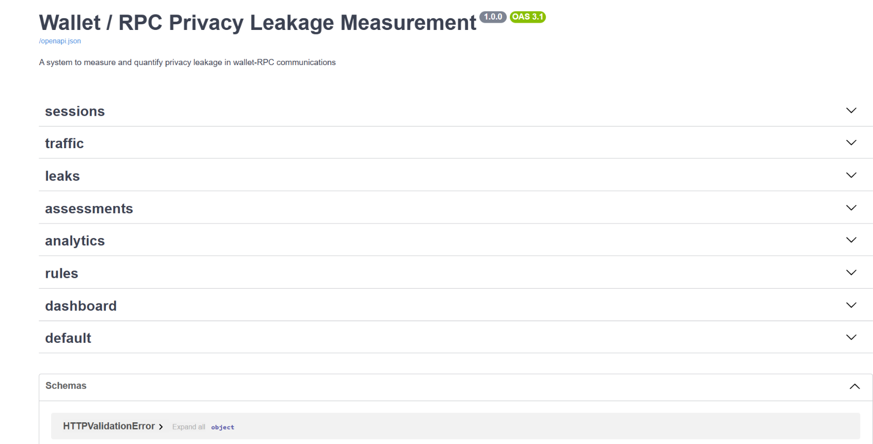
BACKEND API DEMO
FastAPI / Swagger Interface
The API layer exposes modular endpoints for session management, traffic analysis, and dashboard reporting.
Available API groups
• sessions – create, list, and inspect monitoring sessions
• traffic – query captured traffic metadata and packet records
• leaks – retrieve leak events and leakage categories
• assessments / analytics – compute risk scores and summaries
• rules / dashboard – inspection rules and visualization endpoints
What this validates
• API-first architecture, not a dashboard-only mockup
• Independent debugging of each module in front of the audience
• Clean separation between monitoring logic and presentation layer
Style
RESTful
Validation
Pydantic
Docs
OpenAPI 3.1
Swagger groups show that the backend service is registered and callable through OpenAPI.
13

Slide 14
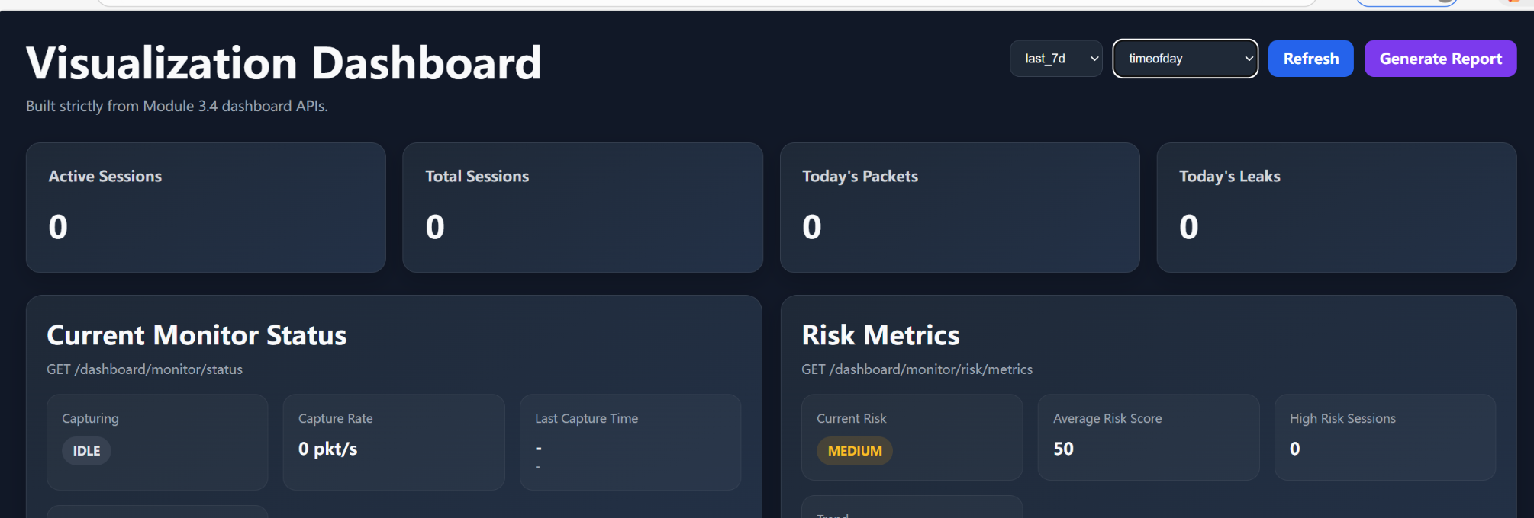
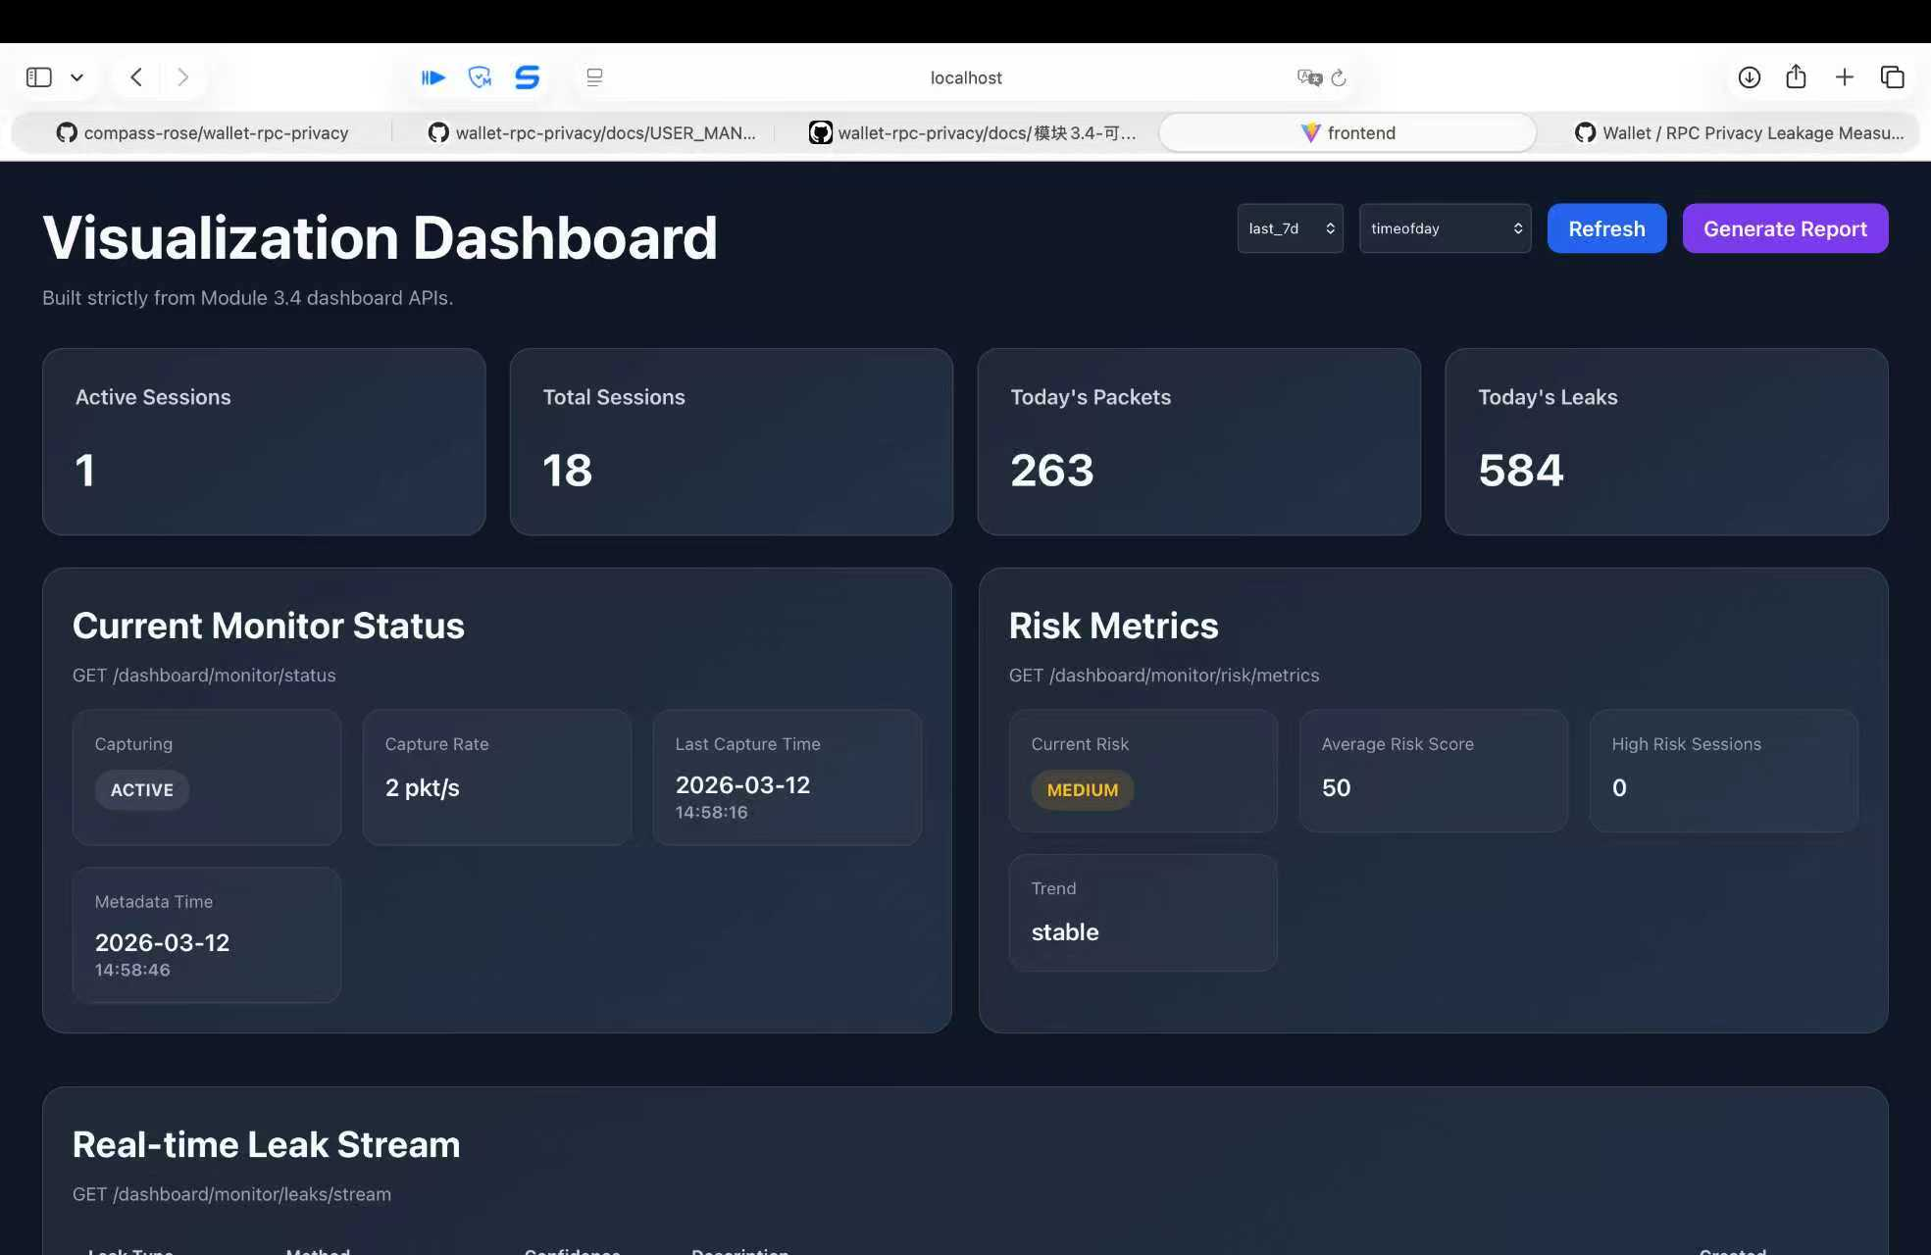
FRONTEND DASHBOARD DEMO
Visualization Dashboard Connected to the Backend
The browser dashboard is already consuming dashboard APIs and rendering monitor / risk panels.
What is visible now
• The dashboard now shows an active session, 18 total sessions, and 263 packets from the connected demo environment
• Leak monitoring is no longer empty: today's leak count reaches 584 and the real-time stream is populated
Current demo observation
• The monitor status is ACTIVE with a non-zero capture rate, updated timestamps, and synchronized dashboard counters
• This is stronger evidence than a basic connectivity screen because it reflects running backend state and stored records
Presentation significance
• The frontend is clearly driven by backend APIs, database-backed data, and reporting endpoints rather than static placeholders
• This screenshot is a stronger live-demo artifact because it shows multiple metrics updating together
14

Slide 15
LIVE DEMO WORKFLOW
End-to-End Pipeline for the Presentation
A clear execution order helps the audience understand how the modules interact in a real run.
1
Start services
Backend API + MySQL
2
Verify /docs
Swagger endpoint groups
3
Open dashboard
Frontend connectivity
4
Create session
Session object to analyze
5
Run assessment
Traffic / leak / risk logic
6
Refresh report
Visual outputs & summary
Execution pipeline
Input: wallet–RPC communication metadata, timestamps, methods, and session context
Processing: parsing → anonymization → rule matching → confidence scoring → risk assessment
Output: sessions, leak events, risk labels, dashboard panels, and report-ready summaries
Suggested presenter order
1. Show backend startup success and the Swagger home page
2. Point to session / traffic / leaks / dashboard endpoint groups
3. Switch to the frontend and show monitor status + risk metrics
4. Explain that later data population will drive charts and report generation
15

Slide 16
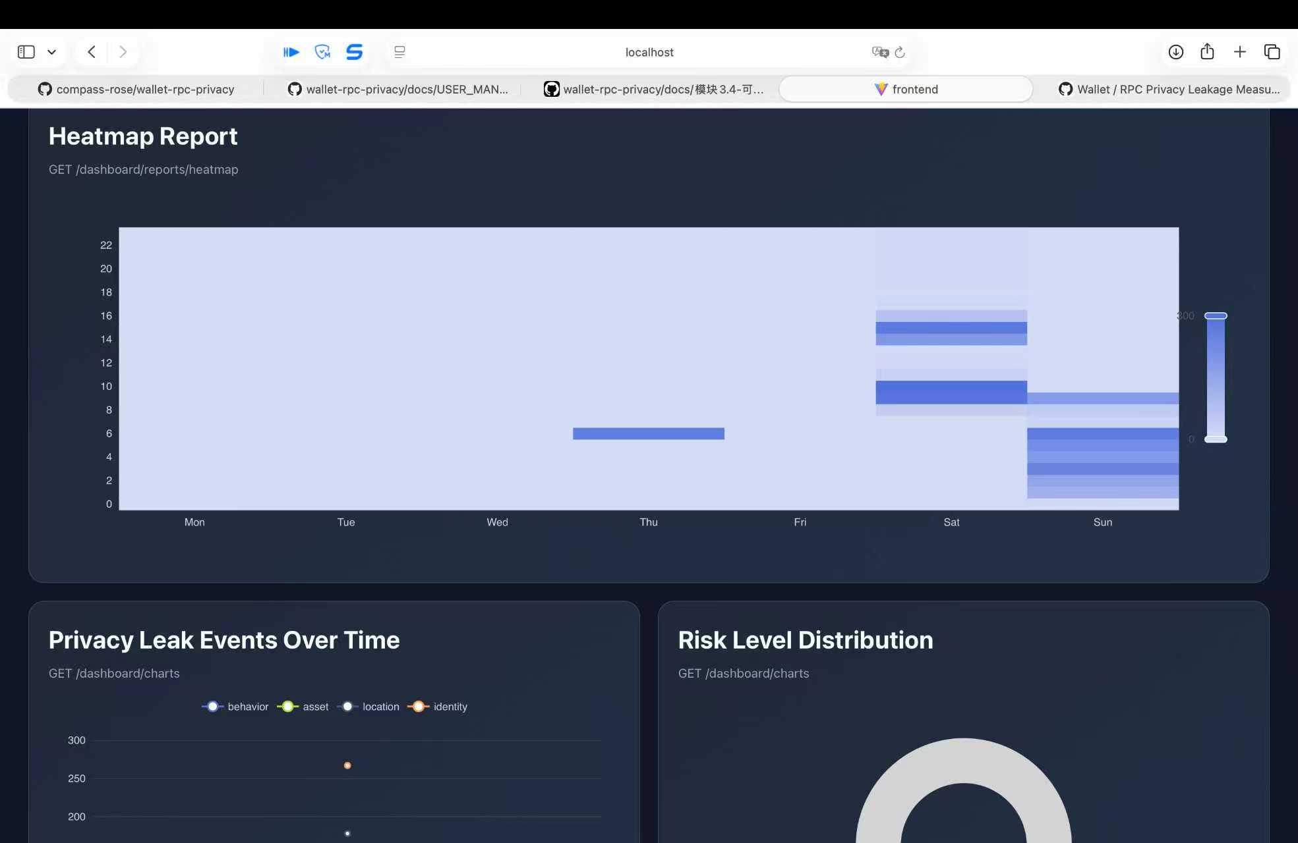
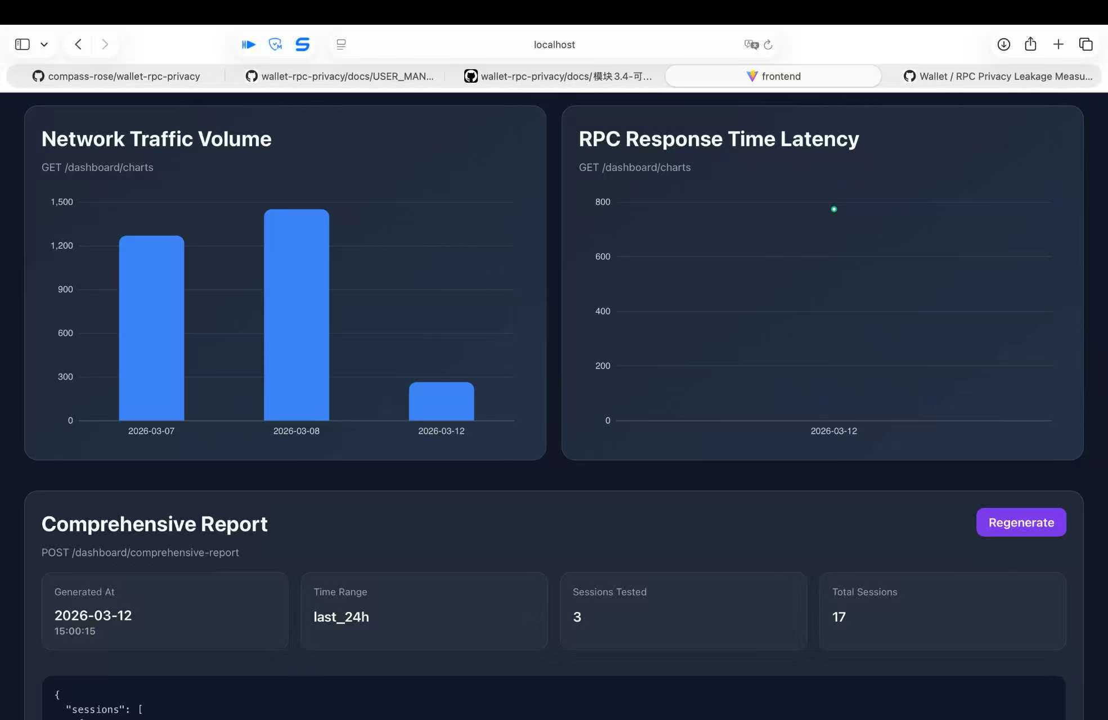
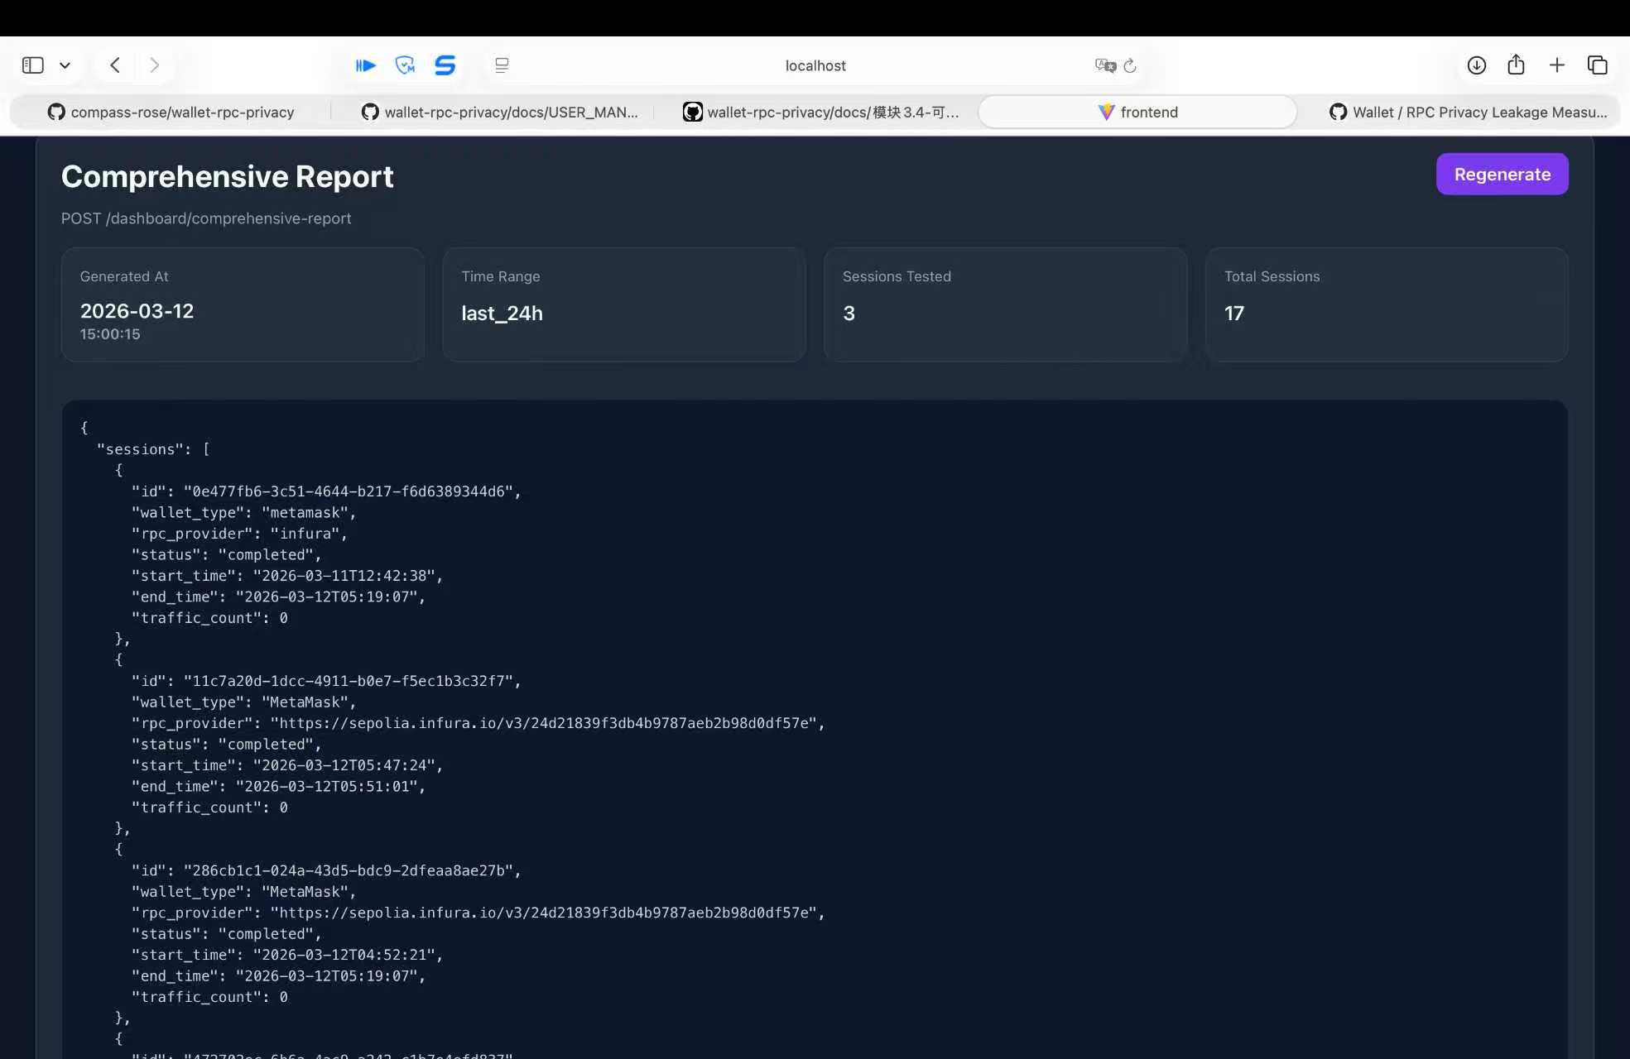
DASHBOARD API DETAIL
Representative Endpoints and Returned Data
These endpoints bridge the backend monitoring logic and the browser visualization layer.
Representative dashboard endpoints
GET /api/v1/dashboard/monitor/status
Current capture state, rate, and timestamps
GET /api/v1/dashboard/monitor/leaks/stream
Real-time leak table for live dashboard updates
GET /api/v1/dashboard/reports/timeline
Session / leak event timeline summaries
GET /api/v1/dashboard/reports/heatmap
Time-pattern heatmap for activity distribution
GET /api/v1/dashboard/charts
Visualization data for trend and risk charts
POST /api/v1/dashboard/comprehensive-report
Aggregated report-ready session output
What the frontend receives
• Monitor and leak stream data: active capture state, timestamps, leak type, method, confidence, and description
• Report views: timeline summaries, heatmap patterns, chart panels, and risk distribution visualizations
• Aggregated reporting: a comprehensive report can be generated with session-level records and summary fields
16

Slide 17
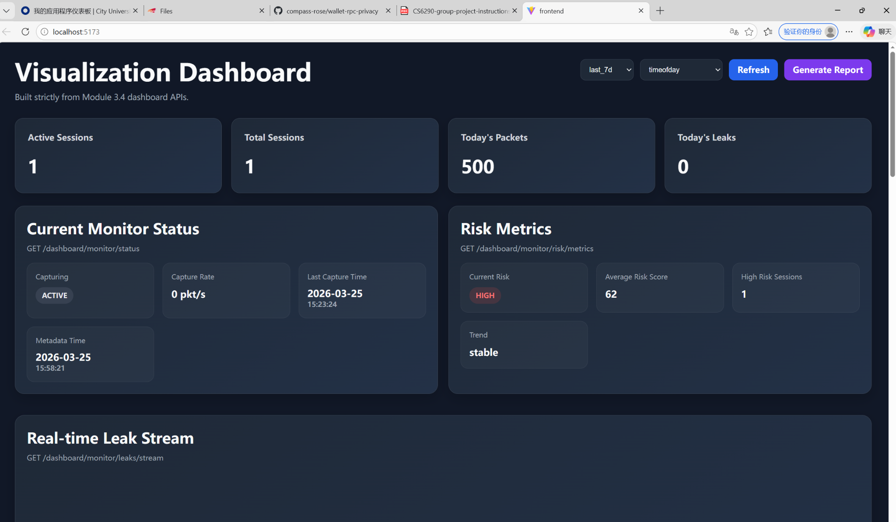

LIVE DEMO EVIDENCE
What the Running System Already Proves
Three complementary views show that the project has moved from design into implementation.
Service startup completed
Backend API groups exposed
Dashboard reports and analytics generated
End-to-end feasibility
Backend, database, and frontend can all run together in one local environment.
API-driven design
Dashboard values come from backend routes instead of hardcoded slide mockups.
Practical quantification
The running UI now surfaces packet counts, leak tables, timeline reports, heatmaps, and report outputs from actual backend responses.
Extensible experiment base
The prototype now demonstrates connected monitoring plus reporting views, which makes later real-capture experiments easier to explain.
17

Slide 18
LIMITATIONS & NEXT STEPS
From Local Validation to Richer Real-World Evaluation
The current prototype is already functional, but the next stage is broader experimental depth.
Current limitations
• The dashboard now shows connected monitoring, leak-stream, and reporting views, but the dataset is still limited in scale.
• Real wallet traffic capture has been prepared, but not yet demonstrated with a larger controlled sample.
• Cross-wallet / cross-provider comparisons still need more systematic experimental runs.
• Some assessment outputs remain less complete than the monitoring and reporting modules.
Next steps
• Run MetaMask / wallet proxy capture through rpc_proxy.py and the real-traffic pipeline.
• Populate sessions, leaks, and assessment tables with larger experimental data.
• Compare multiple wallets / RPC providers under the same measurement methodology.
• Expand comprehensive report exports for reproducible course-demo evidence.
Current prototype
Real capture
Larger dataset
Benchmarking
Publishable study
Roadmap message: the project is already runnable today, and the next improvement is to scale the amount and realism of evidence rather than redesign the entire architecture.
18

