Slide 1
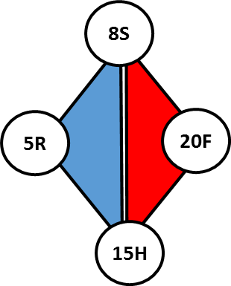
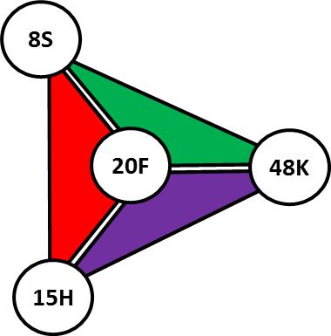
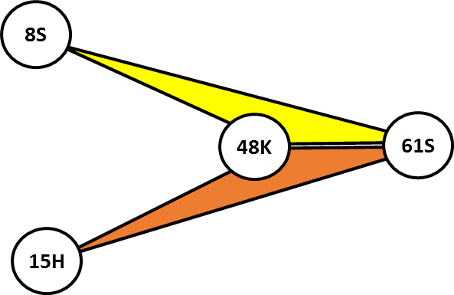
Step 1: Construct epistatic network
5R
Linked SNV pair
8S
SAV graph
8S
5R
20F
48K
61S
Aligned sequences
15H
Step 2: Generate candidate dense subgraphs
Step 3: Build an intersection graph of dense subgraphs
8S
5R
20F
48K
61S
15H
Step 4: Decompose the intersection graph into k-connected components and embedding –based clusters
Step 5: Identify a haplotype for each cluster
Components and clusters
15H
20F
5R
8S
8S
15H
20F
48K
8S
15H
48K
61S
Intersection graph embedding

