Slide 1
INTRODUCTION TO COMPUTATIONAL BIOLOGY
Resources used: Lecture slides from Steven Skiena’s Computational Biology class and Daisuke Kihara’s Protein Bioinformatics class

Slide 2
YOUTUBE VIDEO ON CELL STRUCTURE
Biology: Cell Structure Nucleus Medical Media
https://www.youtube.com/watch?v=URUJD5NEXC8
10

Slide 3
WHY COMPUTATIONAL BIOLOGY?
 Computational biology is particularly exciting today because:
 the problems are large enough to motivate efficient algorithms,
 the problems are accessible, fresh and interesting,
 biology is increasing becoming a computational science
 Computational biology is increasing of interest in both life science and computational science departments (Physics, Engineering, CSE, Math..).
 Source of complex questions and real-life data.
 Many problem ideas go from biology to CS: e.g. fragment assembly, sequence analysis, algorithms for phylogenic trees.
 Many problem ideas go from CS to biology: e.g. sequencing by hybridization, DNA computing.

Slide 4


COMPUTER SCIENTIST VS BIOLOGIST
 Similarity:
 There are many different types of life scientists (biologists, ecologists, medical doctors, etc.), just as there are many different types of computational scientists (algorists, software engineers, statisticians, etc.).
 Many cultural differences
 Nothing is ever completely true or false in biology, where everything is either true or false in computer science / mathematics.
 Biologists are comfortable with the idea that all data has errors; computer scientists are not.
 Biologists strive to understand the very complicated, very messy natural world; computer scientists seek to build their own clean and organized virtual worlds.
5

Slide 5
 Biologists are data driven; while computer scientists are algorithm driven. Although nowadays CS are becoming more data driven.
 Biotechnology/drug companies are largely science driven, while the computer industry is more engineering/marketing driven.
 The Platonic ideal of a biologist runs a big laboratories with many people. The Platonic ideal of a computer scientists is a hacker in garage.
 Biologists are much more obsessed with being the first to discover something; computer scientists invent more than discover.
 Biologists can get/spend infinitely more research money than computational scientists.
 Biologists seek to publish in prestigious journals like Science and Nature. Computer scientists seek to publish in prestigious refereed conference proceedings.
 One consequence is life science journals get refereed faster than computational science journals.

Slide 6
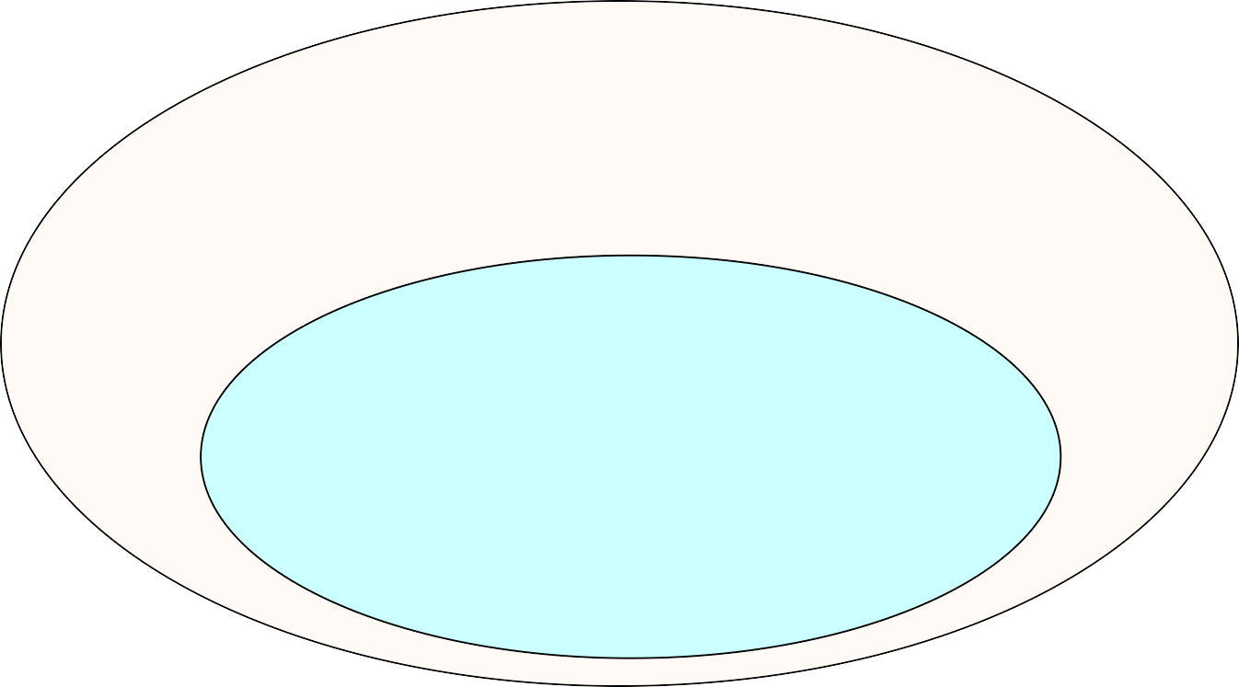



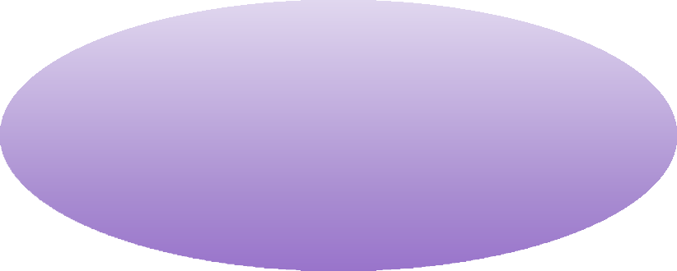
Bioinformatics/Computational Biology
(the application of a core technology of computer science,
e.g. algorithms, artificial intelligence, data bases, to problems arising from biology.)
Computational Biology
Molecular dynamics (MD) simulation Simulation of population
Theory of Protein folding
Bioinformatics
Biological image (2D/3D) processing
Systems Biology
(massive data analysis, database)
(looking at biology as a system often using network structures)
Translational Bioinformatics
(additional uses of clinical info to improve medicine)
In this course, Bioinformatics ≈ Computational Biology
9

Slide 7

WATCH A VIDEO
Cellular Vision: The Inner Life of a Cell [8.5 min]
TED talk: David Bolinsky: Visualizing the wonder of a living cell
“The Inner Life of the Cell is an 8.5-minute 3D computer graphics animation illustrating the molecular mechanisms that occur when a white blood cell in the blood vessels of the human body is activated by inflammation (Leukocyte extravasation). It shows how a white blood cell rolls along the inner surface of the capillary, flattens out, and squeezes through the cells of the capillary wall to the site of inflammation where it contributes to the immune reaction.”[ wikipedia, Wired News. March 14, 2007]

Slide 8

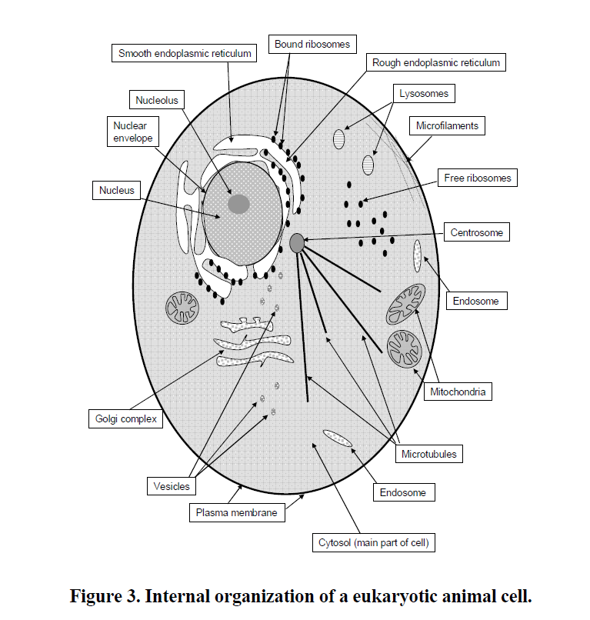


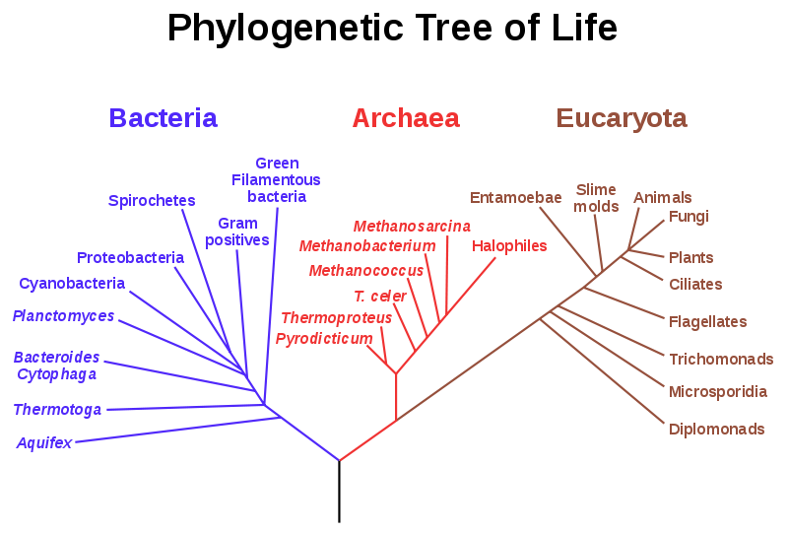
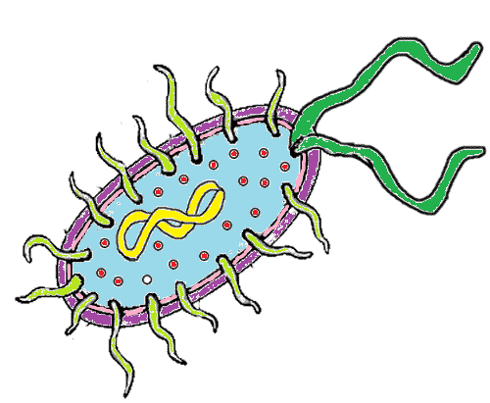
PROKARYOTIC VS EUKARYOTIC
In prokaryotes, DNA is stored in what is essentially a single long loop.
In eukaryotes, DNA is stored in complexes called chromosomes, wrapped around protein complexes called nucleosomes.
W.W. Cohen, “A Computer Scientist’s Guide to Cell Biology”
11

Slide 9


PROKARYOTIC VS EUKARYOTIC CHROMOSOMES
CS 549 Spring - Computational Biology
PROKARYOTIC CHROMOSOMES EUKARYOTIC CHROMOSOMES
 Many contain a single circular chromosome.
 Chromosomes are condensed in the nucleoid via DNA supercoiling and the binding of various architectural proteins.
 DNA can interact with cytoplasm, so transcription and translation occur simultaneously.
 Most prokaryotes contain only one copy of each gene (i.e., they are haploid).
 Genomes are efficient and compact, containing little repetitive DNA.
 Eukaryotes contain
multiple linear chromosomes.
 Chromosomes are condensed in a membrane-
bound nucleus via histones.
 Transcription occurs in the nucleus, and translation occurs in the cytoplasm.
 Most contain two copies of each gene (i.e., they
are diploid).
 Contain large amounts of noncoding and repetitive DNA.
A. Criswold, “Genome Packaging in Prokaryotes: the Circular Chromosome of E. coli”, 2008 Nature Educatio1n2

Slide 10
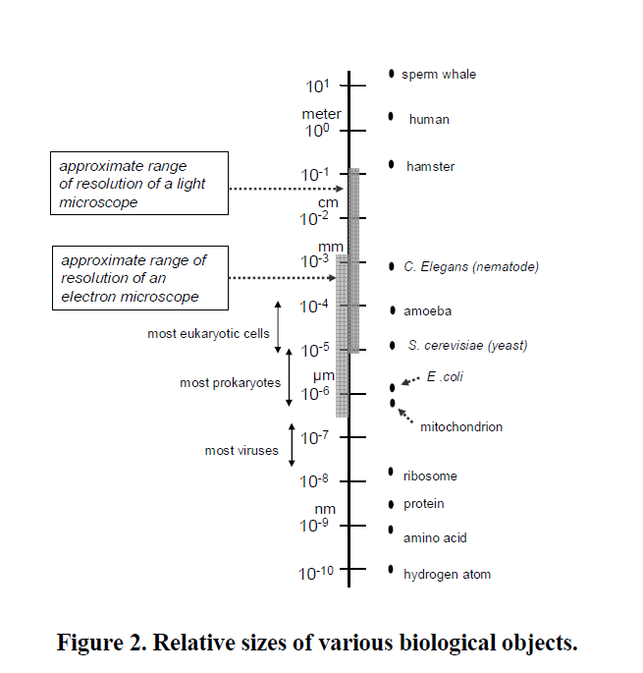
From W. Cohen, “A Computer Scientist’s Guide to Cell Biology”
13

Slide 11
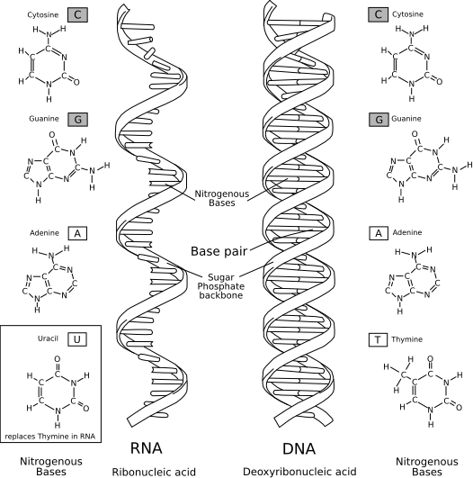

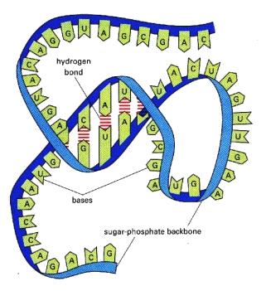
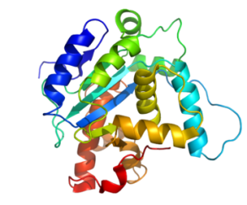
INFORMATION CONTENT IN BIOLOGY
DNA
DNA sequences can be thought of as strings of bases on a four-letter alphabet, {A,C,G,T}, called nucleic acids.
Binding: A=T; C-G
Stable structural form : double helix
RNA
RNA sequences can also be thought of as strings of bases on a four-letter alphabet, {A,C,G,U}.
Binding: A=U; C-G
Stable structural form:
Proteins
Proteins sequence can be thought of as string of 21-letter alphabet
Binding: covalent bonding, van der Waals force, hydrophobicity, etc.
Stable structural form:
http://en.wikipedia.org/wiki/Nucleic_acids
A LQNHTFLHTVYCQDGSPSVGLSEA … DIFSCIVTHEPDRYTAIAYWVPRNALPS
14

Slide 12
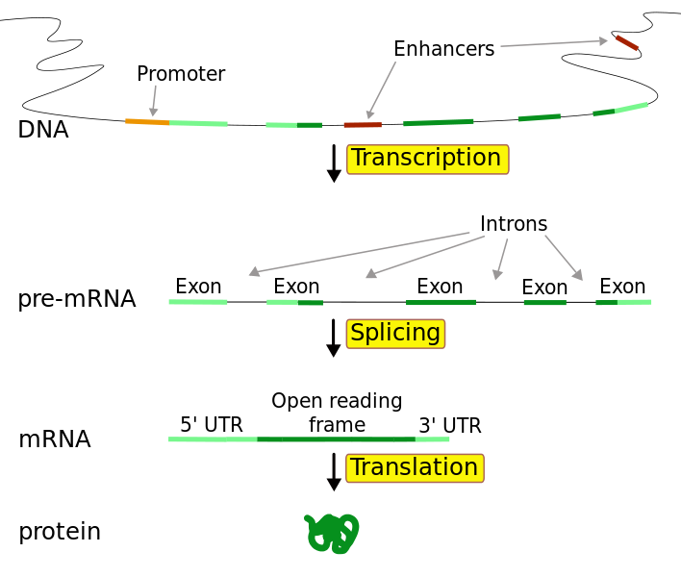
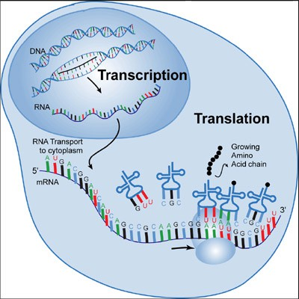




CENTRAL DOGMA OF BIOLOGY
Many other gene expression factors
http://www.tokresource.org/tok_classes/biobiobio/biomenu/trans cription_translation/transcription_2.jpg
Common Abbreviations
DNA: Deoxyribonucleic acid
RNA: Ribonucleic acid
mRNA: messenger RNA
tRNA: transfer RNA
rRNA: ribosomal RNA
siRNA: Small interfering RNA₁₇
Youtube: From DNA to protein - 3D [3min]

Slide 13
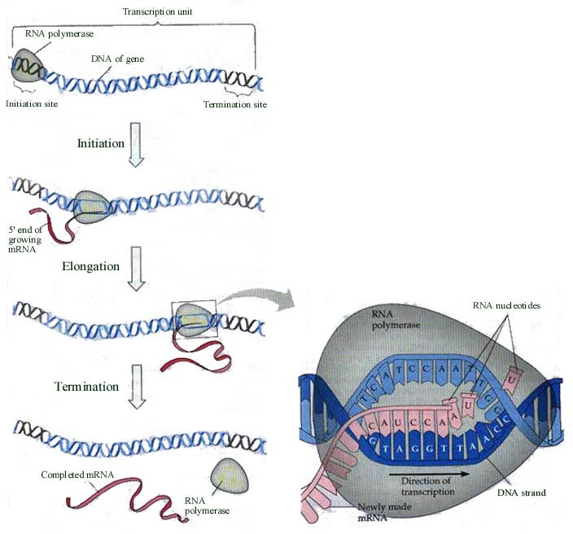
TRANSCRIPTION PROCESS
RNA polymerase ‘unzips’ the DNA from initiation site.
Elongation: create a RNA strand by coping DNA strand
Stops at termination site
Posttranslational modification
http://biology12- lum.wikispaces.com/file/view/transcription,nbk.jpg/177394793/transcription,nbk.jp g
18

Slide 14
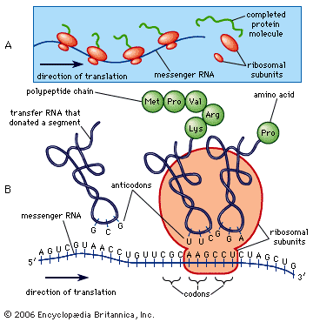
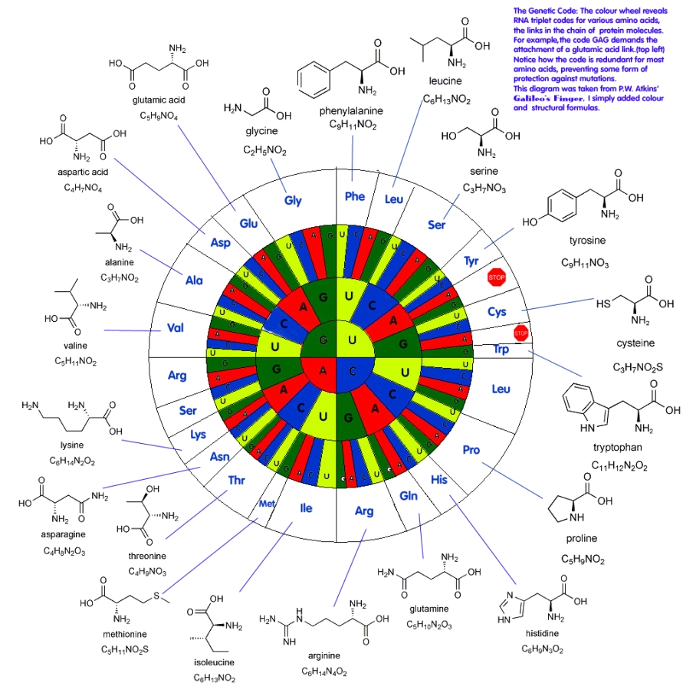

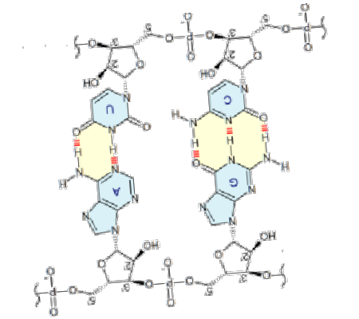
TRANSLATION PROCESS
Codon: Three nucleic acid coding one of 20 amino acid (alphabet of 20 size) + START & STOP CODEN
CCC: Proline
(Pro, P)
http://content.answcdn.com/main/content/img/Britannic aConcise/images/780.gif
Start codon: AUG ( also Methionine (Met, M)) Stop codon: UAA, UAG, UGA
19

Slide 15
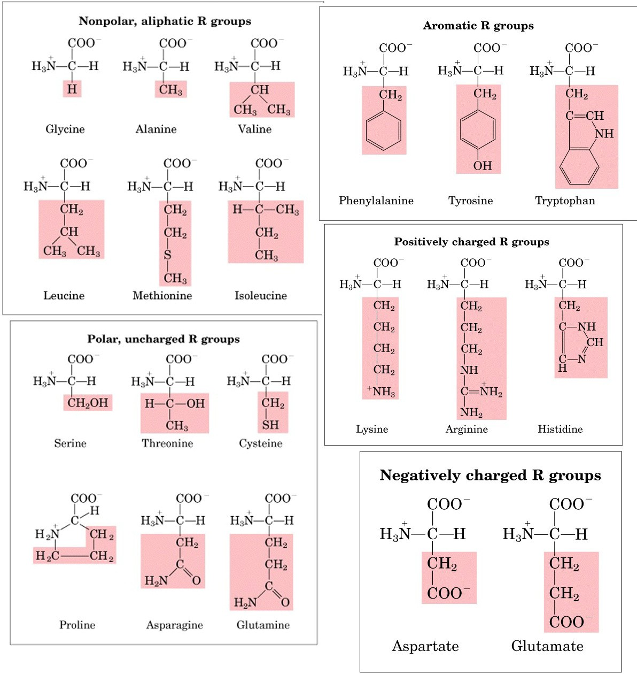
20 AMINO ACIDS FORM ALL
NATURAL PROTEINS

Slide 16
PROTEIN FUNCTIONS
 Signaling
 Interact to send signal to other proteins
 Involved in molecular recognition
 Recognize and bind to specific molecules (DNA, RNA, proteins).
 In the case of DNA they may recognize a specific sequence of nucleotides, or even a specific pattern
 Their function depends on the 3D structure
 May be turned active and inactive
 Protein conformation may change after binding to other molecules
 Molecular motors
 Proteins may act as molecular motors through repeated changes in their 3D structure
 Used for particle transportation or for cell locomotion
 Self-assembly
 By binding to another protein, some new binding sites may be unveiled, for other proteins to bind, etc.

Slide 17
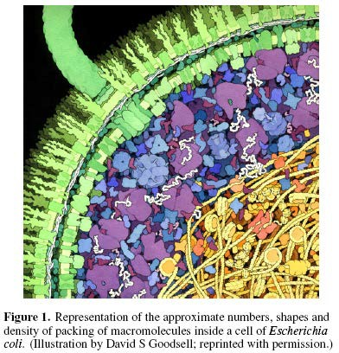
MOLECULES INTERACT WITH OTHER MOLECULES IN THE CELL
 Protein Interactions
 Biological macromol ecules occur at conc entration of 300-40 0g/liter
 20-30% of the total volume

Slide 18
FUNCTIONAL BASICS
 Function by molecular interaction or binding
 Classify by duration
 Transient binding
 Obligate binding
 Classify by components
 Protein-protein binding
 Protein-ligand binding
 Protein-ion binding
 Protein-DNA/RNA binding
 Etc.
 Classify by function
 Signaling
 Structure forming
 etc

Slide 19

ANIMATIONS
https://www.youtube.com/watch?v=wJyUtbn0O5Y
https://xvivo.com/harvard-protein-packing/
27

