Slide 1
Fun time – let’s play with drugs!
Amitava Roy

Slide 2
Today’s Instructor
Amitava Roy, PhD
Faculty affiliate at the Department Of Biomedical And Pharmaceutical Sciences, University of Montana
CEO, Geval Inc
Research interest: Computational Structural Biology and Drug Development
Email: amitava.roy@umontana.edu

Slide 3
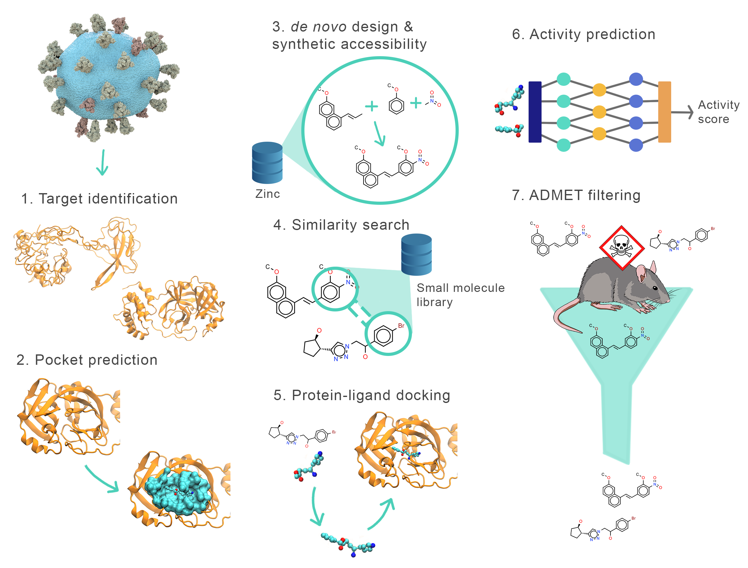

Slide 4
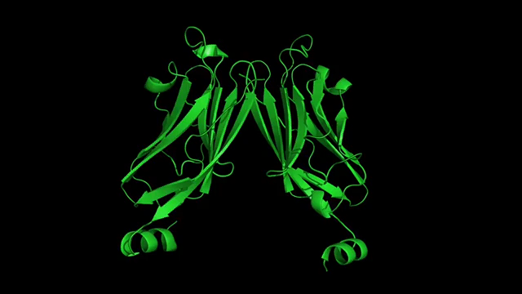

Slide 5
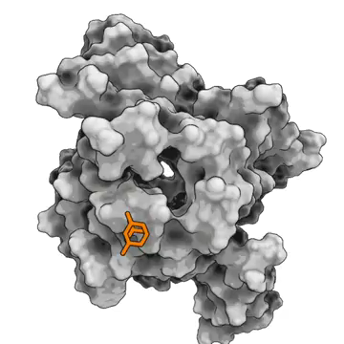
Notes:
First, we needed to select drug targets.
There’s nothing magical about this – we want proteins that are fairly straightforward to model, and that don’t have mammalian homologs - (avoid cross-reactivity)
Nsp12 is part of the RNA-dependent RNA polymerase complex

Slide 6
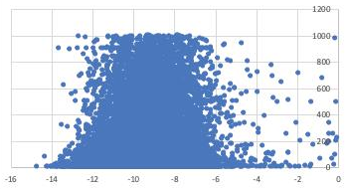
Computational Hit Identification
 | Performance | Required time for 3.7 billion molecules and 22 pockets
Quantum Mech | ~ 1000 atoms ~100 CPU hours
Molecular Mech | No limit ~10 CPU hours | 1200 years with 5000 CPUs
Docking | No limit ~0.1 CPU hours | 154 months with 5000 CPUs
Accuracy
Entropy
Notes:
First, we needed to select drug targets.
There’s nothing magical about this – we want proteins that are fairly straightforward to model, and that don’t have mammalian homologs - (avoid cross-reactivity)
Nsp12 is part of the RNA-dependent RNA polymerase complex

Slide 7
Physical High-throughput Screening
- Construct a molecule to match the pocket
- not a solved problem
- Scan a large collection of synthesizable molecules
- predict binding affinity
Database | Ligands
Sweetlead | ~4K
Drugbank | ~10K
CAS Antivirals | ~50K
Merck | ~5.0M
MOLPORT | ~7.6M
PUBCHEM | ~103M
ZINC15 | ~417M
GDB | ~1.03B
SAVI | ~1.09B
ENAMINE | ~1.2 B
Total | ~3.7B unique
Notes:
Here’s what you’re hoping to do
- explore a wider diversity of scaffolds, for less cost and time

Slide 8
Which protein does the drug target to?
Identify the PDB ID associated with the protein.
Take an image of the pocket (where a drug or ligand can bind).
Are there any other drugs available targeting the same protein?
What other protein is interacting with the identified protein?
What other possible diseases can this drug be effective against?
Are there any mutations in the pocket region that can potentially make a drug ineffective?
Create an ML model to screen possible drug candidates against the protein.
How does your model work against another protein in the list?

Slide 9
Pentostatin
Pentostatin (or deoxycoformycin, trade name Nipent, manufactured by SuperGen) is an anticancer chemotherapeutic drug.^{[2]}

Slide 10
Ipatasertib
Ipatasertib (RG7440) is an experimental cancer drug in development by Roche. It is a small molecule inhibitor of AKT, which is a key component of the PI3K/AKT pathway. Ipatasertib was discovered by Genentech in collaboration with Array Biopharma and is currently in phase III trials for treatment of breast cancer.^{[1]}

Slide 11
Avibactam
Avibactam is a non-β-lactam β-lactamase inhibitor^{[2]} developed by Actavis (now Teva) jointly with AstraZeneca. A new drug application for avibactam in combination with ceftazidime was approved by the FDA in 2015 for treating complicated urinary tract (cUTI) and complicated intra-abdominal infections (cIAI) caused by antibiotic-resistant pathogens, including those caused by multidrug resistant Gram-negative bacterial pathogens.^{[3][4][5]}

Slide 12
NSAID against Caspase-3
Non-steroidal anti-inflammatory drugs^{[1][3]} (NSAID)^{[1]} are members of a therapeutic drug class which reduces pain,^{[4]} decreases inflammation, decreases fever,^{[1]} and prevents blood clots. Side effects depend on the specific drug, its dose and duration of use, but largely include an increased risk of gastrointestinal ulcers and bleeds, heart attack, and kidney disease.^{[5][6]}

Slide 13
Ritonavir
Ritonavir, sold under the brand name Norvir, is an antiretroviral medication used along with other medications to treat HIV/AIDS.[4][5][8] This combination treatment is known as highly active antiretroviral therapy (HAART).[8] Ritonavir is a protease inhibitor, though it now mainly serves to boost the potency of other protease inhibitors.[8][9] It may also be used in combination with other medications to treat hepatitis C and COVID-19.[10][11] It is taken by mouth.[8]

Slide 14
Plerixafor
Plerixafor, sold under the brand name Mozobil, is an immunostimulant used to mobilize hematopoietic stem cells in cancer patients into the bloodstream. The stem cells are then extracted from the blood and transplanted back to the patient. The drug was developed by AnorMED, which was subsequently bought by Genzyme.

Slide 15
Varespladib
Varespladib is an inhibitor of the IIa, V, and X isoforms of secretory phospholipase A2 (sPLA2).^{[1][2][3]} The molecule acts as an anti-inflammatory agent by disrupting the first step of the arachidonic acid pathway of inflammation.^{[4]} From 2006 to 2012, varespladib was under active investigation by Anthera Pharmaceuticals as a potential therapy for several inflammatory diseases, including acute coronary syndrome and acute chest syndrome.^{[5][6]} The trial was halted in March 2012 due to inadequate efficacy.^{[7]} The selective sPLA2 inhibitor varespladib (IC50 value 0.009 μM in chromogenic assay, mole fraction 7.3X10-6)^{[8]} was studied in the VISTA-16 randomized clinical trial (clinicaltrials.gov Identifier: NCT01130246) and the results were published in 2014.^{[8]} The sPLA2 inhibition by varespladib in this setting seemed to be potentially harmful, and thus not a useful strategy for reducing adverse cardiovascular outcomes from acute coronary syndrome. Since 2016, scientific research has focused on the use of Varespladib as an inhibitor of snake venom toxins^{[9][10][11][12][13]} using various types of in vitro and in vivo models. Varespladib showed a significant inhibitory effect to snake venom PLA₂ which makes it a potential first-line drug candidate in snakebite envenomation therapy. In 2019, the U.S. Food and Drug Administration (FDA) granted varespladib orphan drug status for its potential to treat snakebite.

Slide 16
Adavosertib
Adavosertib (development codes AZD1775, MK-1775) is an experimental anti-cancer drug candidate. It is a small molecule inhibitor of the tyrosine kinase WEE1 with potential antineoplastic sensitizing activity.^{[1]} It is being developed by AstraZeneca.^{[2]} It is being investigated as a treatment for pancreatic cancer with a phase 1 trial (University of Michigan researchers are as of 2019 planning a phase 2 study.^{[3]}), and ovarian cancer, in combination with another anti-cancer drug, gemcitabine, as a phase 2 trial.

