Slide 1
Nonadiabatic EXcited state Molecular Dynamics (NEXMD) code
CyberTraining 2021 Workshop
Walter Malone
Los Alamos National Laboratory

Slide 2
Outline
Introduction and Compilation
Base Functions
SCF convergence
Geometry optimization
Excited state structure
CIS vs RPA
Excited state optimization
Adiabatic dynamics in ground and S1 state
Newtonian Dynamics vs Langevin Dynamics
Dynamics in the present of solvent
Linear response vs Vertical excitation vs State-specific
Nonadiabatic Dynamics
Single Trajectory
Decoherence, surface hopping dynamics
Ground State Trajectory
Single Point Calculation Setup
Generating an Optical Spectrum
Setting Up and Running a Swarm of Trajectories
Analysis
Bonus Development Features

Slide 3
Outline
Introduction and Compilation
Base Functions
SCF convergence
Geometry optimization
Excited state structure
CIS vs RPA
Excited state optimization
Adiabatic dynamics in ground and S1 state
Newtonian Dynamics vs Langevin Dynamics.
Dynamics in the present of solvent
Linear response vs Vertical excitation vs State-specific
Nonadiabatic Dynamics
Single Trajectory
Decoherence, surface hopping dynamics
Ground State Trajectory
Single Point Calculation Setup
Generating an Optical Spectrum
Setting Up and Running a Swarm of Trajectories
Analysis
Bonus Development Features

Slide 4
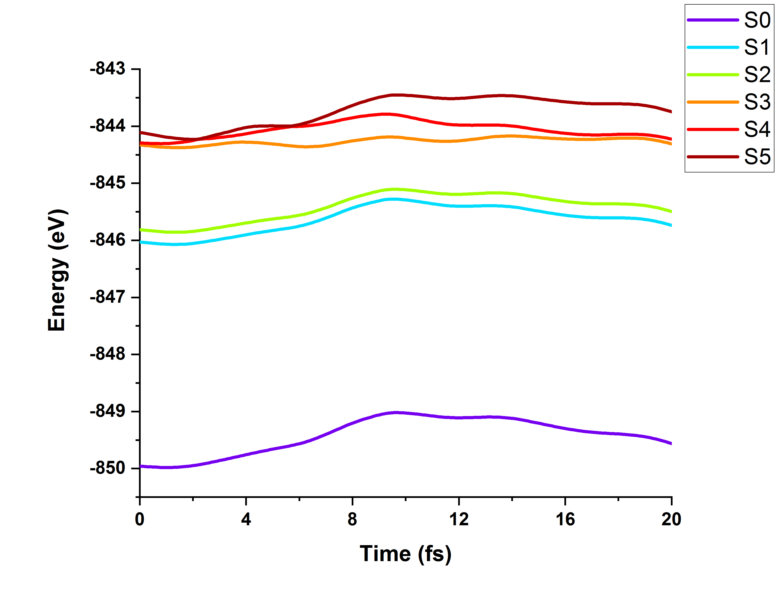
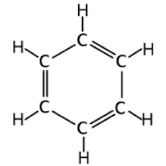
Trivial Crossing
Benzene: PES
Hop

Slide 5
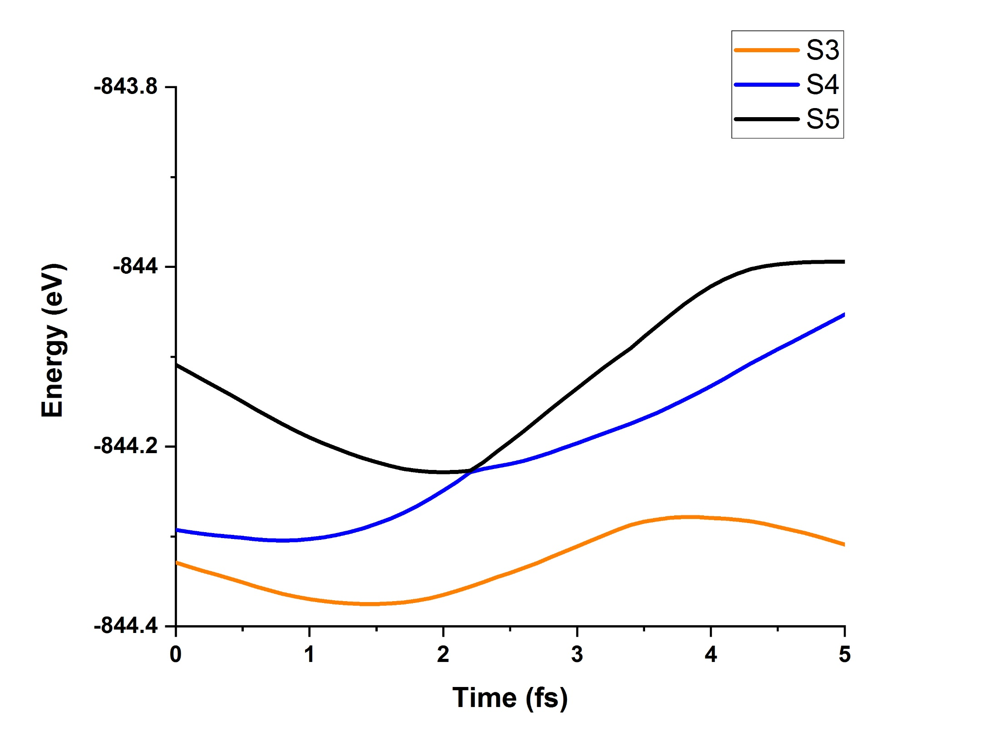
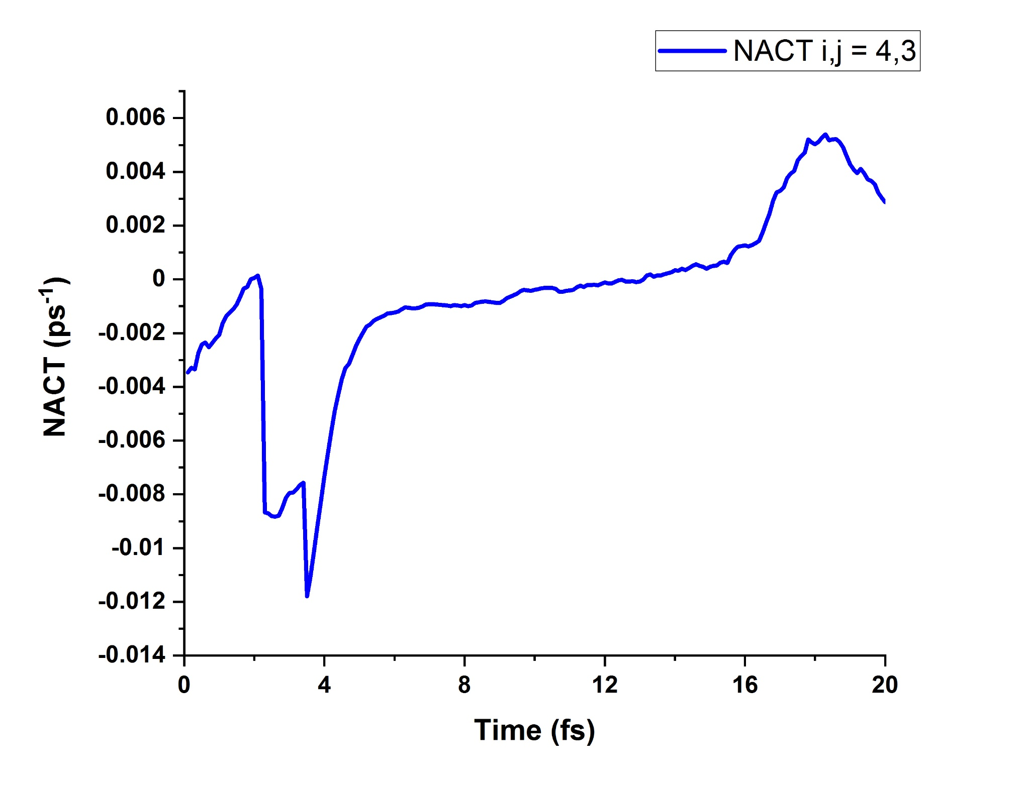
NACT
2 Hops.out
Trivial Crossing
0 Hops.out
Hop
PES
Hop

Slide 6
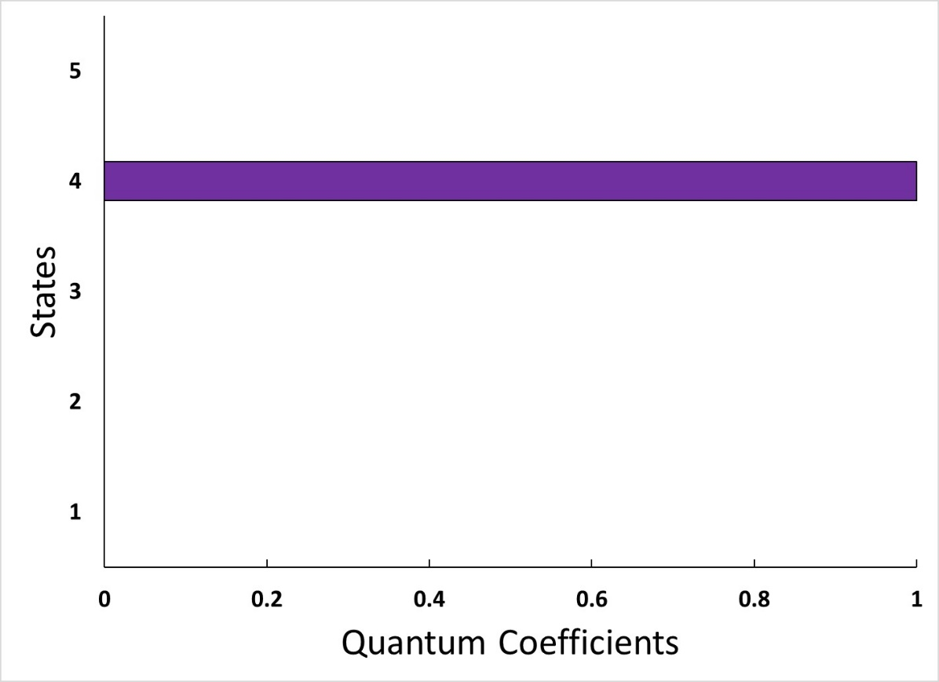
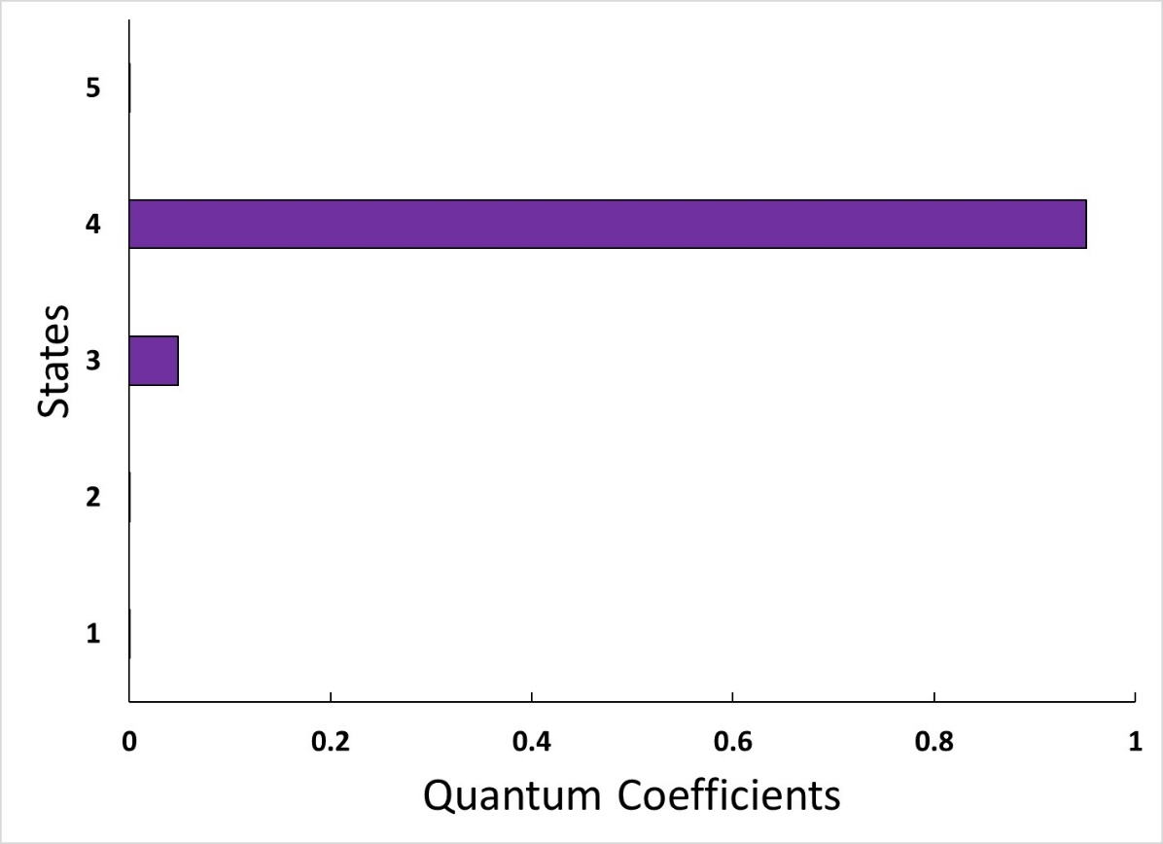
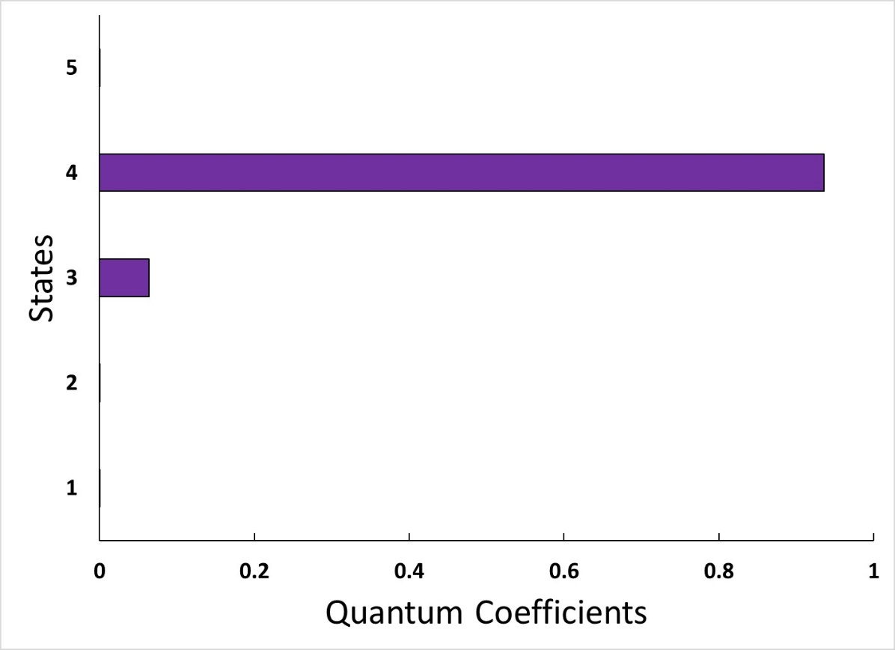
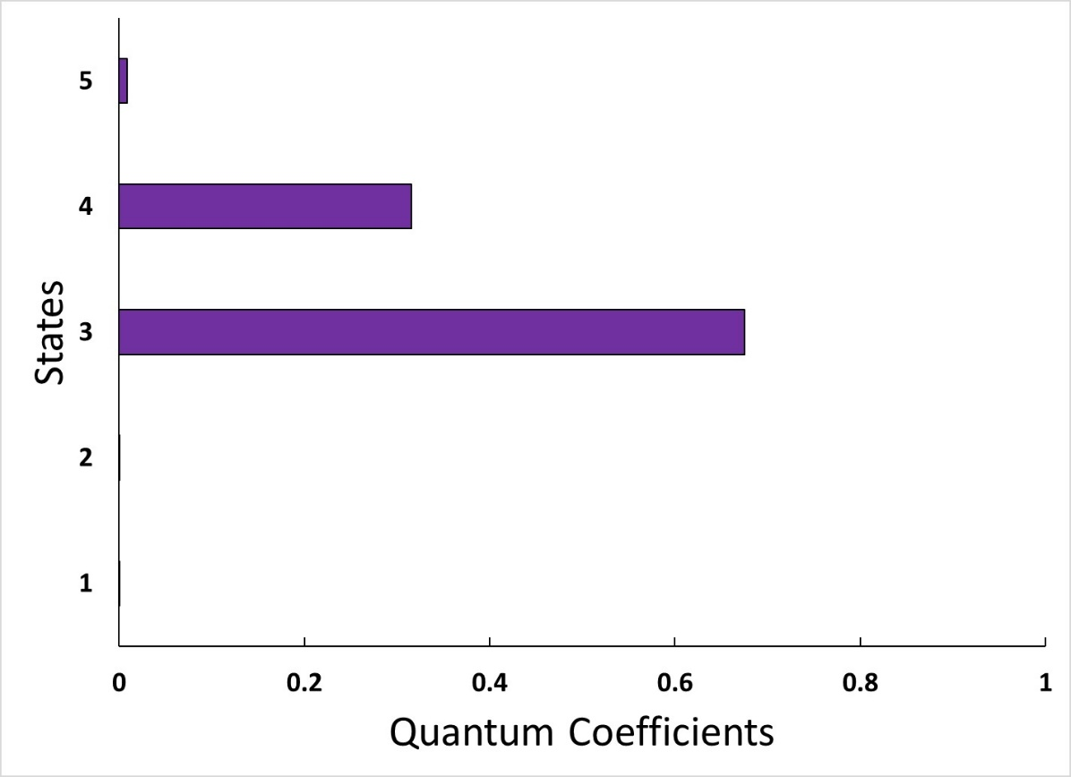
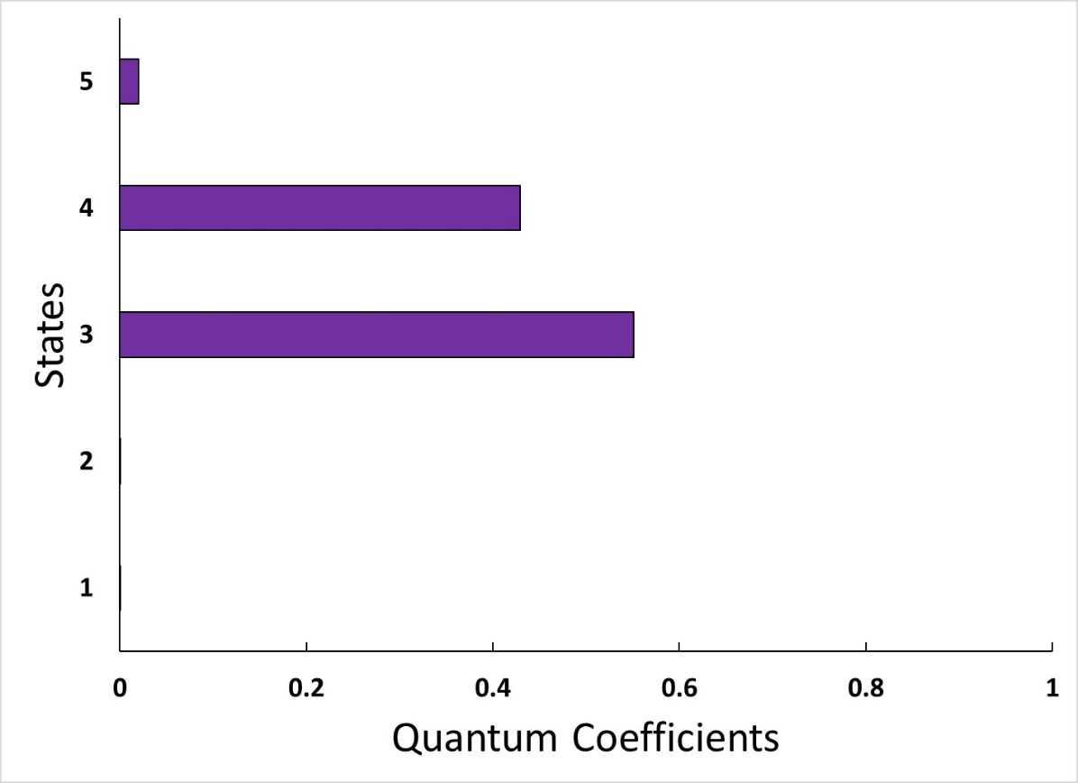
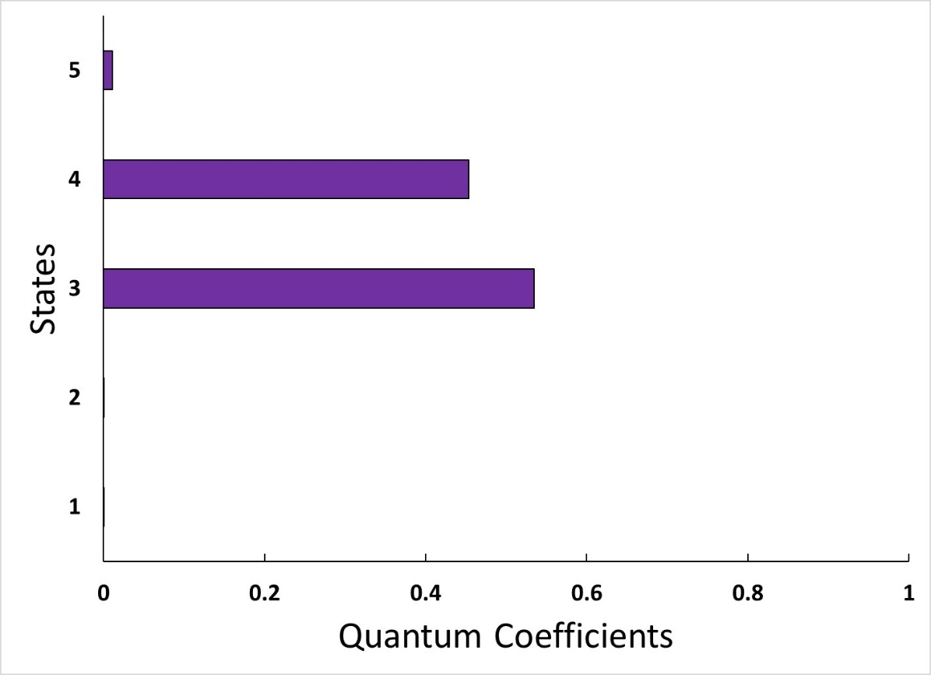
Quantum Coefficients
At Hop
t = 2 fs
t = 4 fs
Reinitialized
Never
Reinitialized

Slide 7
Outline
Introduction and Compilation
Base Functions
SCF convergence
Geometry optimization
Excited state structure
CIS vs RPA
Excited state optimization
Adiabatic dynamics in ground and S1 state
Newtonian Dynamics vs Langevin Dynamics.
Dynamics in the present of solvent
Linear response vs Vertical excitation vs State-specific
Nonadiabatic Dynamics
Single Trajectory
Decoherence, surface hopping dynamics
Ground State Trajectory
Single Point Calculation Setup
Generating an Optical Spectrum
Setting Up and Running a Swarm of Trajectories
Analysis
Swarms of Trajectories
Bonus Development Features

Slide 8
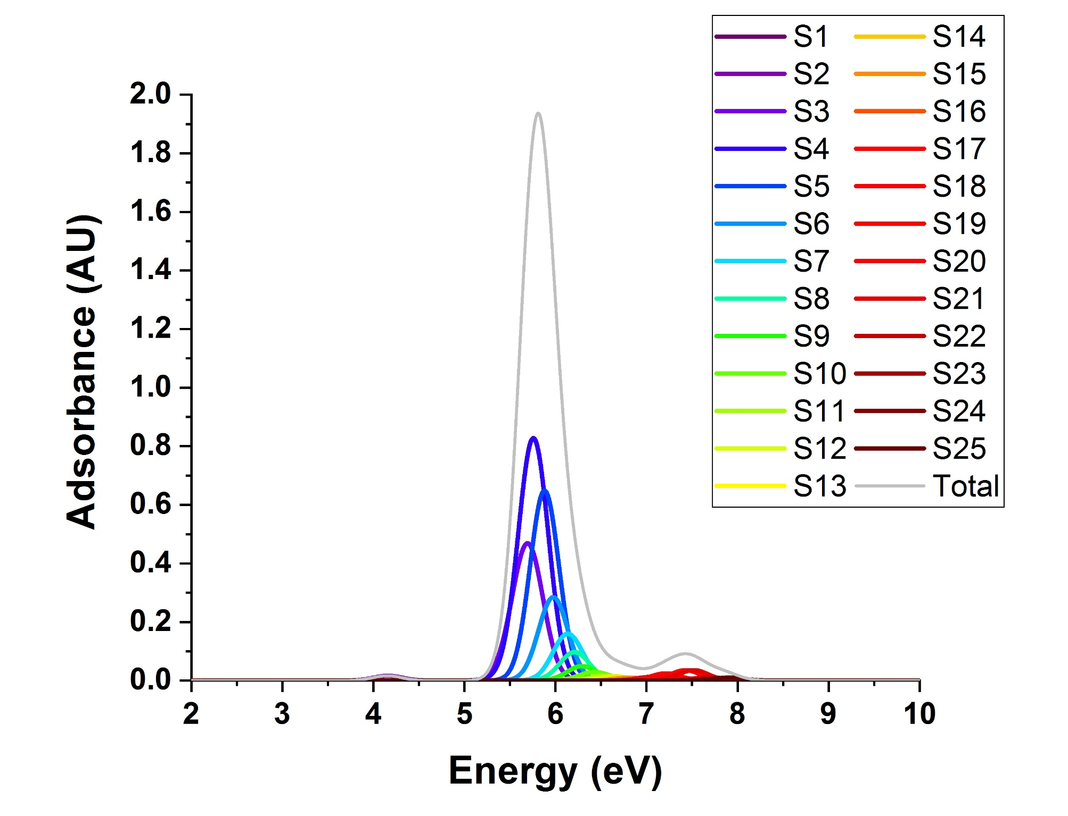
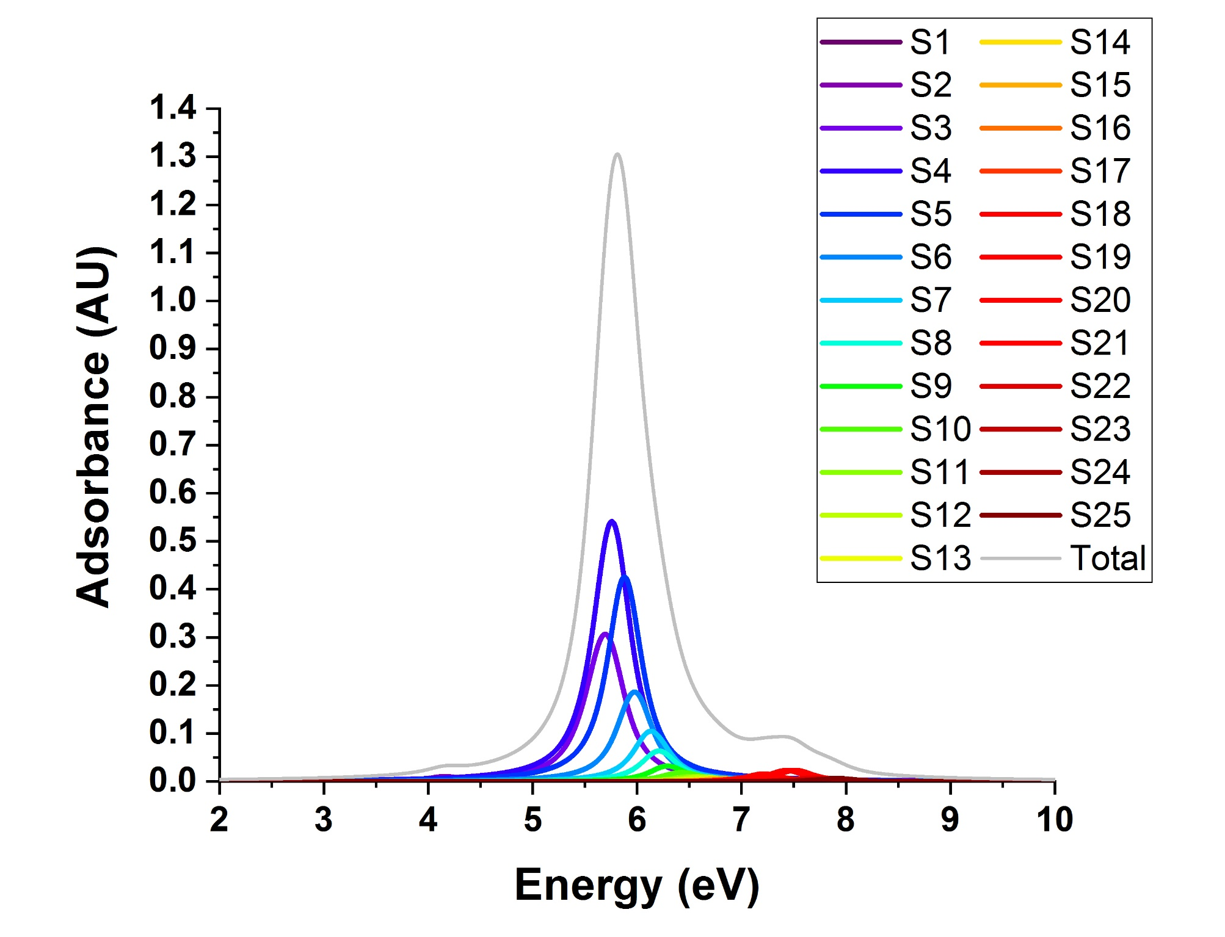
Benzene:Spectrum
Gaussian Fit
Lorentzian Fit

Slide 9
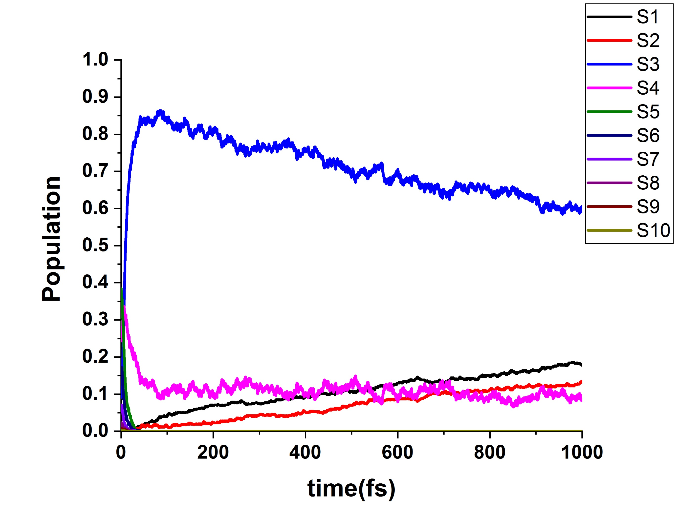
Populations
Benzene

Slide 10
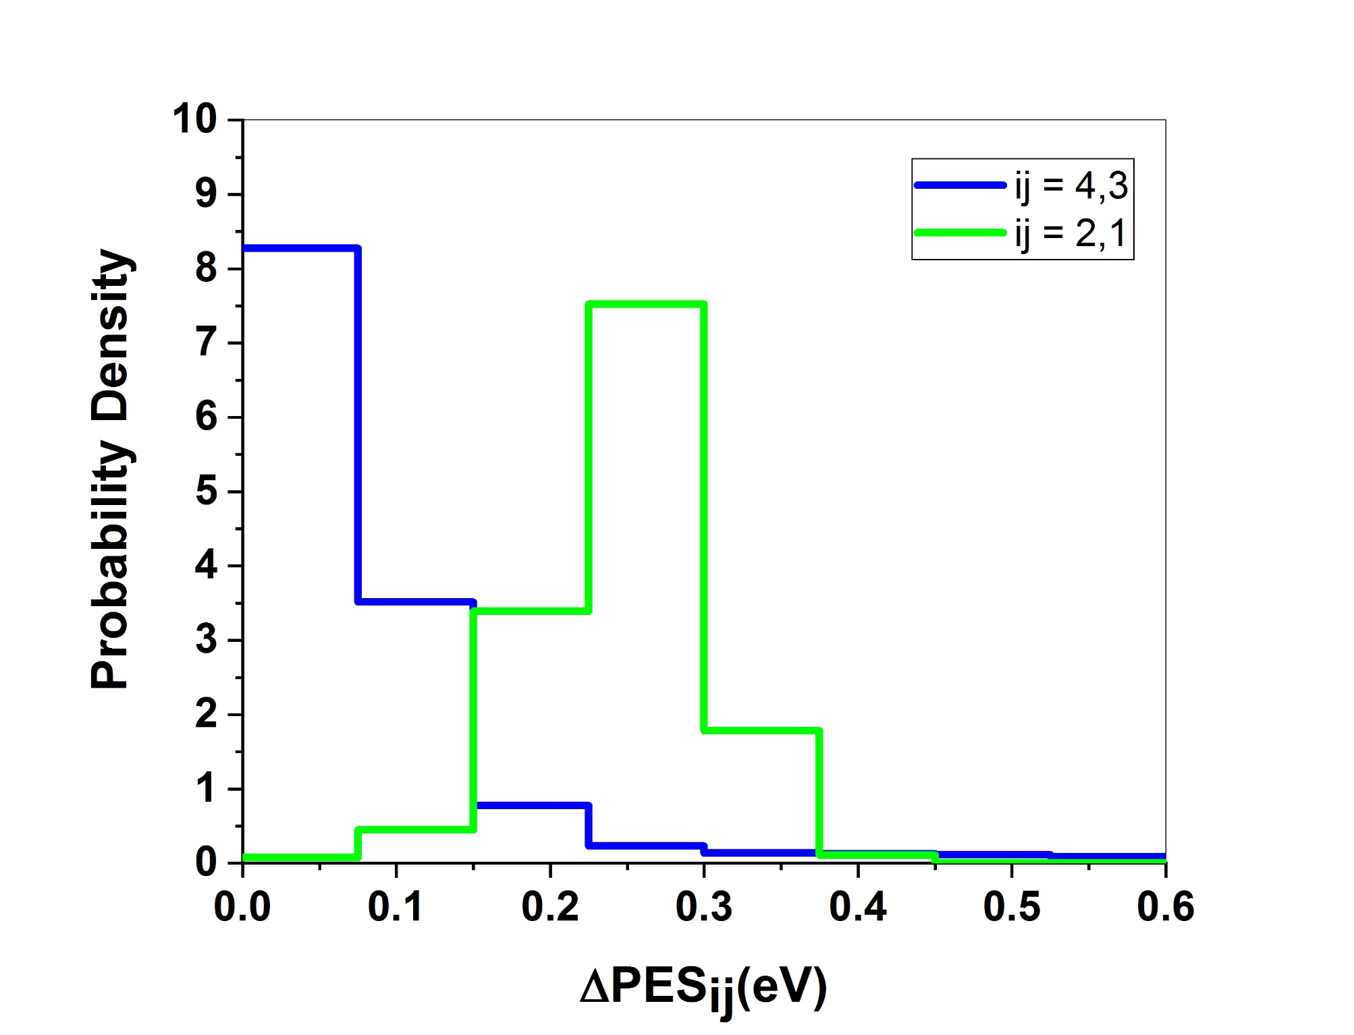
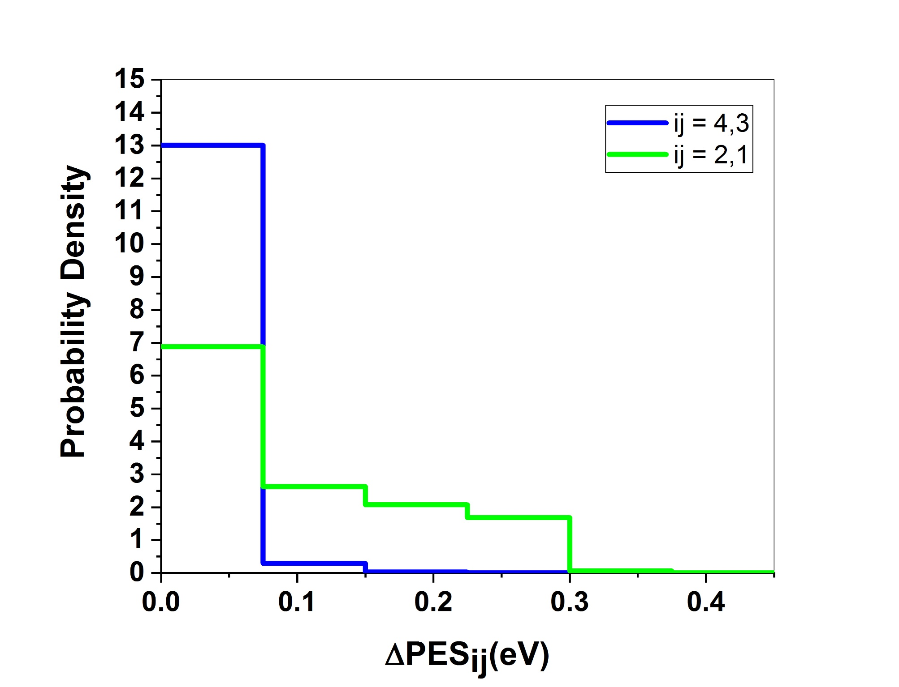
PES:Benzene
Total
At Hop

Slide 11
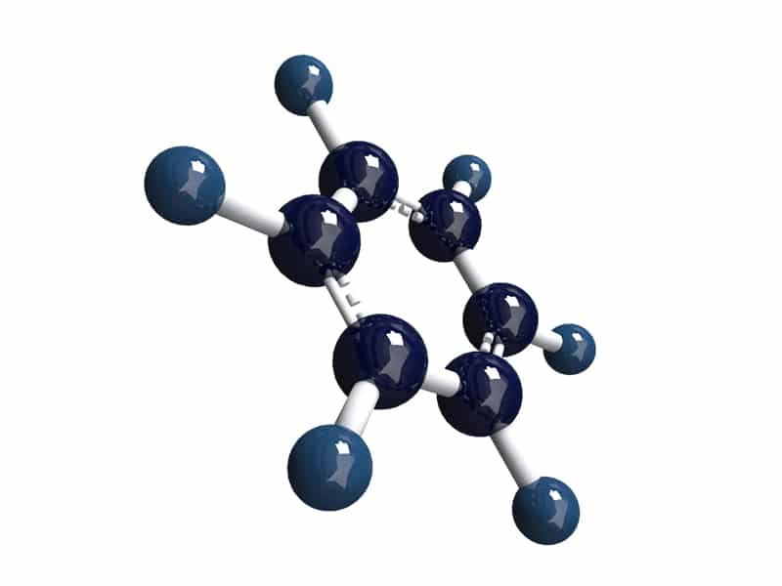
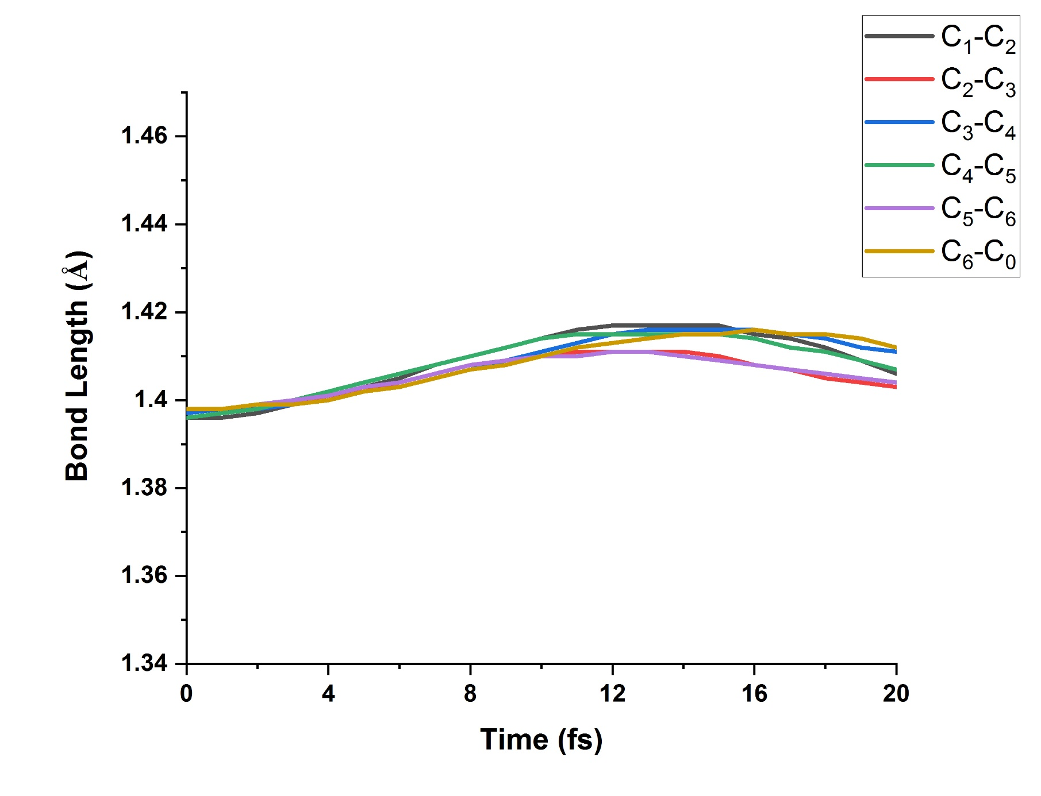
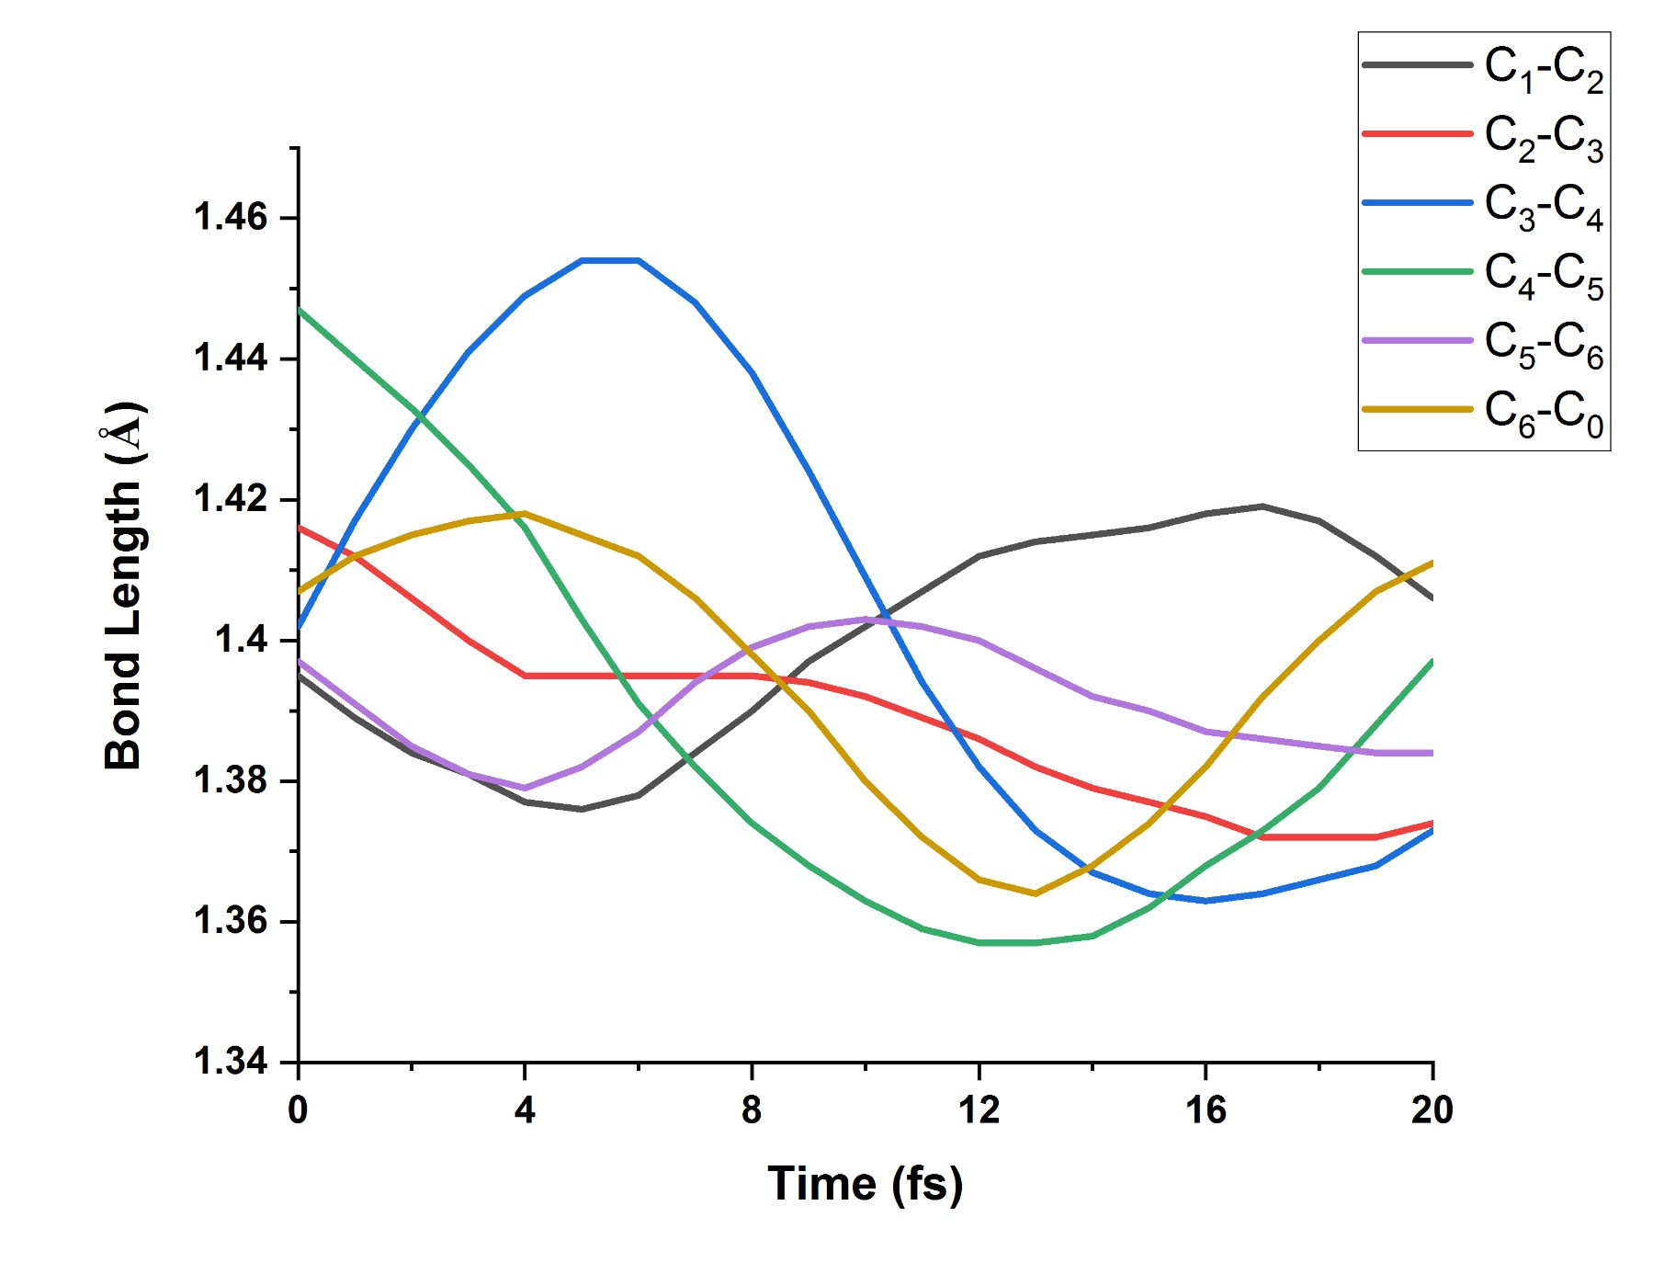
Benzene
GST
Ensemble

Slide 12
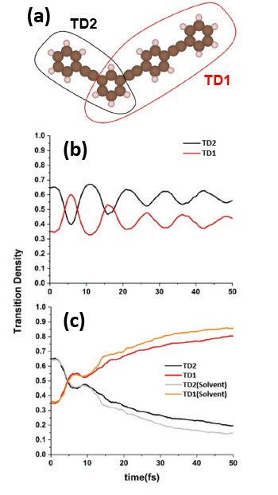
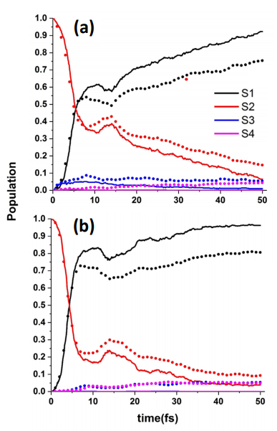
polyphenylene ethynylene dendrimer: Populations and Transition Densities

Slide 13
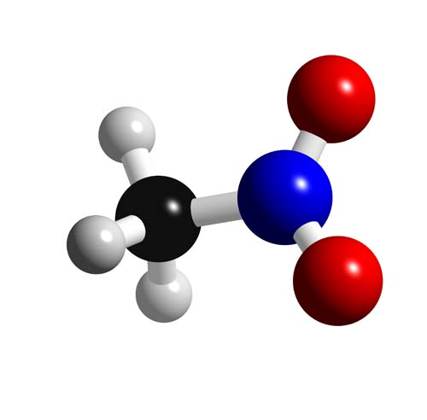
Nitromethane

