Slide 1
An Introduction into Multireference Theory
Hans Lischka
Texas Tech University, USA

Slide 2
Why do we need Multireference Methods?
Density functional theory (DFT)
Møller-Plesset perturbation theory (MP2)
Coupled cluster theory (CCSD(T))
Semiempirical methods
Why more???

Slide 3
Simple Example: Bond Dissociation of H₂
σ_{u}
σ_{u}
R→∞
+
σ_{u}
σ_{g}
σ_{g}
σ_{g}
Occupied and virtual orbitals are well separated
Occupied and virtual orbitals are quasi-degenerate

Slide 4
Generalization to Many Electrons
“Excitations” into virtual orbitals
“Dynamic electron correlation”
“Excitations” into virtual orbitals
“Dynamic electron correlation”
Virtual orbitals
Virtual orbitals
LUMO
Active orbitals
Four electrons
HOMO
MANY reference configurations
Static (nondynamic) electron correlation
Occupied orbitals
Closed shell
ONE reference configuration
Occupied orbitals
Internal orbitals
Closed shell
Automatic assignment of orbitals possible
Automatic assignment of orbitals NOT generally possible

Slide 5
Single Reference Configuration Interaction (SRCI)
Excitation (substitution) of occupied orbitals by virtual ones
Closed shell determinant
Excitation (or substitution) of occupied orbital Φ_{i} by virtual orbital Φ_{a}
Singly excited configuration Ψ_{i}ª
Single-, double-, triple- … m-tuple excitations
Method of configuration interaction (CI):
Variation principle (Ritz) is used to determine the coefficients and the energy
Note: Orbitals are usually taken from SCF calculation

Slide 6
Multireference Configuration Interaction (MRCI)
Orbital scheme
Reference wave function Ψ₀:
m-tuple excitations from
into the virtual orbitals creates a set of
configurations {Ψ_{I}}
Application of the Ritz variation principle leads to the MR-CI method.
Standard approach: inclusion of single (S) and double (D) excitations
Virtual orbitals
Active orbitals
Closed shell

Slide 7
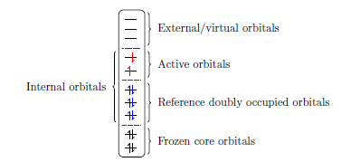
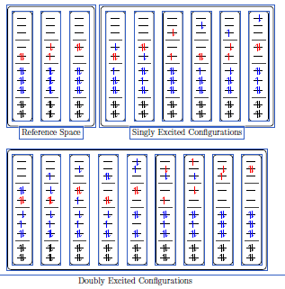
Excitation scheme:
refdocc →active
active → virtual
refdocc → virtual
active → active

Slide 8
Multiconfiguration SCF (MCSCF)
Approach used to compute molecular orbitals (MOs) for MRCI
Independent calculations
Wavefunction as in MRCI:
In many cases the MCSCF expansion will be identical to the reference space of MRCI
Important: the configurations are constructed from MOs, the MOs are expanded in a basis set (like SCF MOs)
Simultaneous optimization of the wavefunction expansion coefficients and MO coefficients

Slide 9
Reference space
MRCI
Energy, CI coefficents
MO integrals
AO→MO transformation
MO coeff.
Active space
MCSCF
AO integrals
Molecular geometry, basis set
Compute AO integrals

Slide 10
Types of MRCI: uncontracted or contracted
Free variation, more flexible, more expensive
Contraction, computationally faster
Truncation of MRCI leads to size extensivity errors: correlation energy does not scale correctly with size of the system
MR averaged quadratic coupled cluster MR-AQCC) method: size extensivity corrections

Slide 11
Ritz Variational Principle
Schrödinger equation
CI expansion
Multiply from the left with ψ_{l} and integrate
using
and

Slide 12
Strategy for Multibillion CI calculations
Solving for individual eigenstates: “Davidson subspace method”¹⁾
Projection of the Hamiltonian matrix H into a set of an increasing number of subspace expansion vectors v_{i} leading to smaller matrices and solve the smaller eigenvalue problems until convergence is achieved.
The main computational step is the matrix-vector product w_{j} = Hv_{j.}
Direct CI (Roos): “on-the-fly” calculation of the contributions to the matrix-vector product
¹⁾ E. R. Davidson, J. Comp. Physics 17, 87, 1975

Slide 13
Classification and Organization of Different Terms
Indices i,j,k,l run over the number of orbitals.
The matrix-vector product can be written as

Slide 14
Calculation of coupling coefficient using the Graphical Unitary Group Approach (GUGA)^{1,2)}
Graphical representation of a Distinct Row Table (DRT)
Reference configurations in red
Inactive (reference doubly occupied)
Active (variable occupation in the reference)
External (virtual) orbitals: only singles and doubles
¹⁾Paldus, J., J. Chem. Phys. 61, 5321-5330, 1974
Shavitt, I., in: The Unitary Group for the Evaluation of Electronic Energy
²⁾Matrix Elements, Lecture Notes in Chemistry, vol. 22 (ed. J. Hinze), 51–99. Berlin: Springer, 1981

Slide 15
Step Vector
d_{i} = 0 ⇒ orbital i is unoccupied (uo)
d_{i} = 1,2 ⇒ orbital i is singly occupied (so)
d_{i} = 3 ⇒ orbital i is doubly occupied (do)
Example:
Orbital 1 2 3 4 5 6
Step vector 1 0 3 1 0 2
so uo do so uo so

Slide 16
The internal (active + closed shell) part of the graph is complicated, but relatively small in comparison to the virtual (external) space.
The graph for the external is space is very simple due to the fact that we allow only double excitations. Moreover, its structure is independent of the internal part. Respective loops (coupling elements) can be computed once and for all.
The interface between internal and external space is given by the vertices Z (0-excitations), Y (single-excitations), X (double excitations, triplet coupling) and W (double excitations, singlet coupling)

Slide 17
The loops are split into an internal part and into an external one. The internal part is computed explicitly and either stored on a file (formula file) or recomputed every Davidson iteration. The external part is added “on-the-fly” when the total coupling elements are computed.
The two-electron integrals are sorted according to the number of internal indices: all (four)-internal, three-internal, two-internal, one internal and all-external.

Slide 18
Analytic MRCI energy Gradients
Basic formalism:
R. Shepard, H. Lischka, P. G. Szalay, T. Kovar and M. Ernzerhof, J. Chem. Phys. 96, 2085, 1992
Applicable to general MR wavefunctions
Extension to excited states
H. Lischka, M. Dallos and R. Shepard
Mol. Phys. 100, 1647, 2002
Based on state-averaged MCSCF calculation

Slide 19
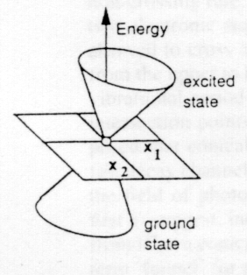
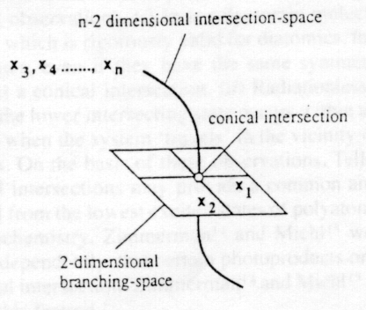
Conical Intersection of Energy Surfaces
Conical intersection
Branching space
Intersection space
Example: Ethylene dimerization
Search for minima on the crossing seam (MXS)
Conical Intersections, Electronic Structure, Dynamics & Spectroscopy
W. Domcke, D. R. Yarkony and H. Köppel, World Scientific 2004
D. R. Yarkony, J. Phys. Chem. A 101, 4263, 1997

Slide 20
References
P. G. Szalay, Th. Müller, G. Gidofalvi, H. Lischka and R. Shepard Multiconfiguration Self-Consistent Field and Multireference Configuration Interaction Methods and Applications Chem. Rev. 112 (2012) 108-181
H. Lischka, D. Nachtigallová, A. J. A. Aquino, P. G. Szalay, F. Plasser, F. B. C. Machado, and M. Barbatti Multireference Approaches for Excited States of Molecules Chem. Rev. 118 (2018) 7293-7361
R. Lindh, L. Gonzalez Quantum Chemistry and Dynamics of Excited States: Methods and Applications, John Wiley&Sons Ltd, Hoboken, NJ, USA, 2021: F. Plasser, H. Lischka Multireference Configuration Interaction, p. 277-297

