Slide 1

Excited States and Nonadiabatic Dynamics
CyberTraining School/Workshop 2022
Alexey Akimov
University at Buffalo, SUNY
July 14, 2022

Slide 2
Fundamentals of ML with Libra

Slide 3
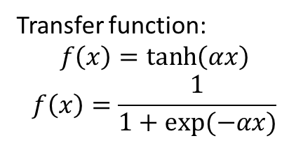
Basics of the ANN
The expected output should be scaled
The inputs should be close to 0.0, where the transfer function slope is large
Transfer function:
$$f\left(x\right)=\tanh\left(αx\right)$$
$$f\left(x\right)=\frac{1}{1+exp⁡(−αx)}$$

Slide 4
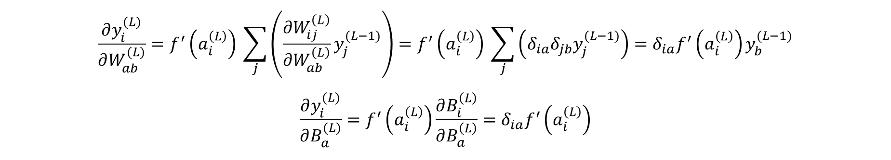
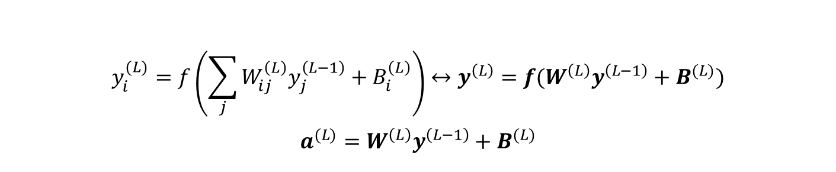
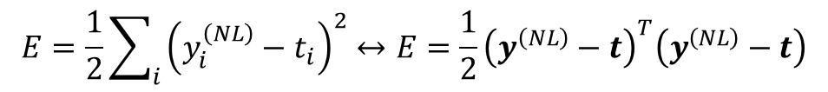
Function back-propagation
$$y_{i}^{(L)}=f\left(\sum_{j}{W_{ij}^{\left(L\right)}y_{j}^{\left(L−1\right)}+B_{i}^{\left(L\right)}}\right)↔y^{\left(L\right)}=f(W^{\left(L\right)}y^{\left(L−1\right)}+B^{(L)})$$
$$a^{(L)}=W^{\left(L\right)}y^{\left(L−1\right)}+B^{(L)}$$
$$\frac{∂y_{i}^{(L)}}{∂W_{ab}^{(L)}}=f^{′}\left(a_{i}^{\left(L\right)}\right) \sum_{j}{\left(\frac{∂W_{ij}^{\left(L\right)}}{∂W_{ab}^{\left(L\right)}}y_{j}^{(L−1)}\right)}=f^{′}\left(a_{i}^{\left(L\right)}\right) \sum_{j}{\left(δ_{ia}δ_{jb}y_{j}^{(L−1)}\right)}=δ_{ia}f^{′}\left(a_{i}^{\left(L\right)}\right)y_{b}^{(L−1)}$$
$$\frac{∂y_{i}^{(L)}}{∂B_{a}^{(L)}}=f^{′}\left(a_{i}^{\left(L\right)}\right)\frac{∂B_{i}^{\left(L\right)}}{∂B_{a}^{\left(L\right)}}=δ_{ia}f^{′}\left(a_{i}^{\left(L\right)}\right)$$
$$E=\frac{1}{2}\sum_{i}{{\left(y_{i}^{\left(NL\right)}−t_{i}\right)}^{2}}↔E=\frac{1}{2}{\left(y^{\left(NL\right)}−t\right)}^{T}\left(y^{\left(NL\right)}−t\right)$$

Slide 5
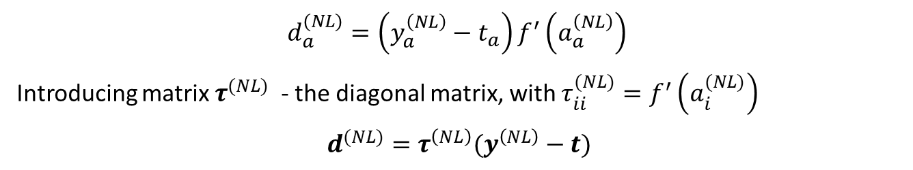
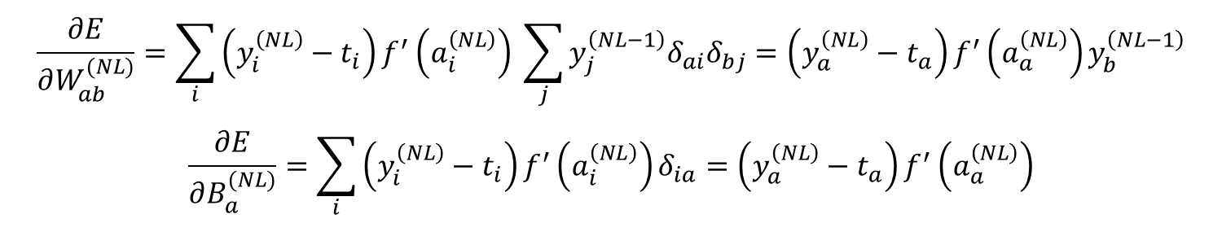
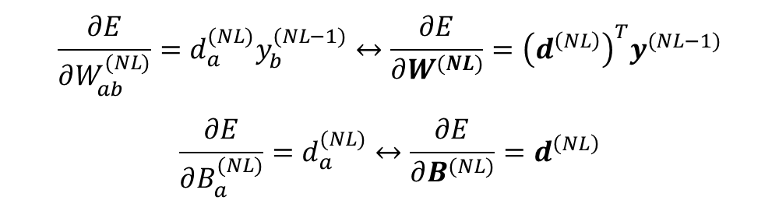
Gradients w.r.t the weights and biases of the layer NL
$$\frac{∂E}{∂W_{ab}^{(NL)}}=\sum_{i}{\left(y_{i}^{\left(NL\right)}−t_{i}\right)}f^{′}\left(a_{i}^{\left(NL\right)}\right) \sum_{j}{y_{j}^{\left(NL−1\right)}δ_{ai}δ_{bj}}=\left(y_{a}^{\left(NL\right)}−t_{a}\right)f^{′}\left(a_{a}^{\left(NL\right)}\right)y_{b}^{\left(NL−1\right)}$$
$$\frac{∂E}{∂B_{a}^{(NL)}}=\sum_{i}{\left(y_{i}^{\left(NL\right)}−t_{i}\right)}f^{′}\left(a_{i}^{\left(NL\right)}\right)δ_{ia}=\left(y_{a}^{\left(NL\right)}−t_{a}\right)f^{′}\left(a_{a}^{\left(NL\right)}\right)$$
$$d_{a}^{(NL)}=\left(y_{a}^{\left(NL\right)}−t_{a}\right)f^{′}\left(a_{a}^{\left(NL\right)}\right)$$
Introducing matrix $τ^{(NL)}$ - the diagonal matrix, with $τ_{ii}^{(NL)}=f^{′}\left(a_{i}^{(NL)}\right)$
$d^{(NL)}=τ^{\left(NL\right)}(y^{\left(NL\right)}−t)$
$$\frac{∂E}{∂W_{ab}^{(NL)}}=d_{a}^{(NL)}y_{b}^{(NL−1)}↔\frac{∂E}{∂W^{(NL)}}={\left(d^{\left(NL\right)}\right)}^{T}y^{(NL−1)}$$
$$\frac{∂E}{∂B_{a}^{(NL)}}=d_{a}^{(NL)}↔\frac{∂E}{∂B^{(NL)}}=d^{\left(NL\right)}$$

Slide 6
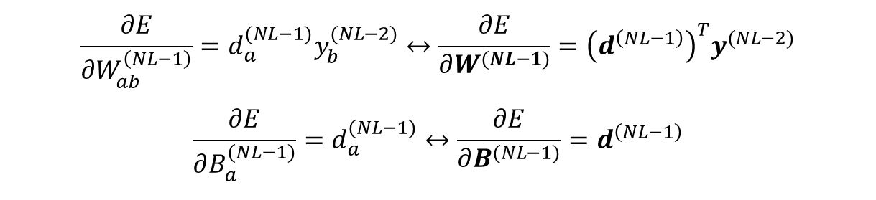
In general
$$\frac{∂E}{∂W_{ab}^{\left(NL−1\right)}}=d_{a}^{(NL−1)}y_{b}^{(NL−2)}↔\frac{∂E}{∂W^{(NL−1)}}={\left(d^{\left(NL−1\right)}\right)}^{T}y^{(NL−2)}$$
$$\frac{∂E}{∂B_{a}^{(NL−1)}}=d_{a}^{(NL−1)}↔\frac{∂E}{∂B^{(NL−1)}}=d^{\left(NL−1\right)}$$

Slide 7
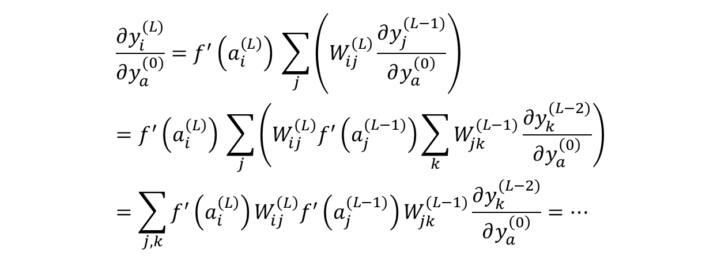
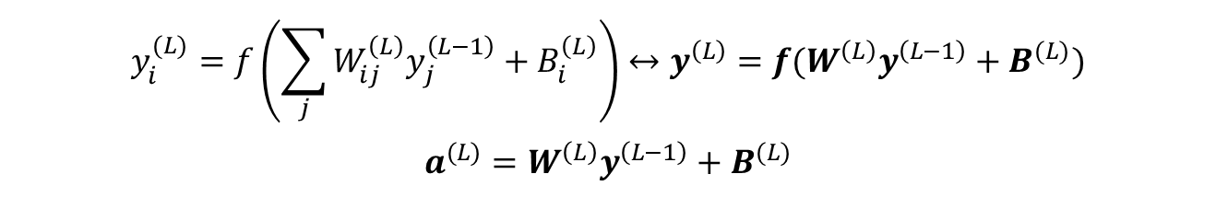
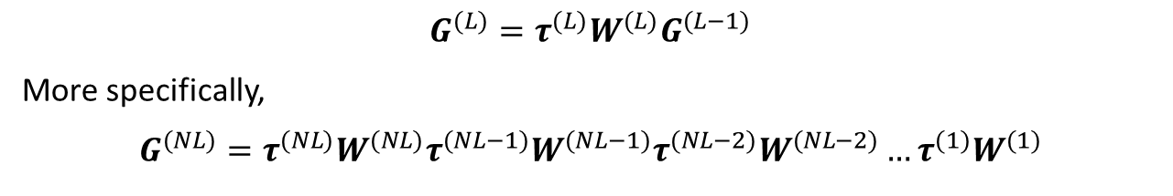
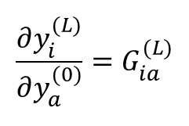
Derivatives of the ANN w.r.t. Inputs
$$y_{i}^{(L)}=f\left(\sum_{j}{W_{ij}^{\left(L\right)}y_{j}^{\left(L−1\right)}+B_{i}^{\left(L\right)}}\right)↔y^{\left(L\right)}=f(W^{\left(L\right)}y^{\left(L−1\right)}+B^{(L)})$$
$$a^{(L)}=W^{\left(L\right)}y^{\left(L−1\right)}+B^{(L)}$$
$$\frac{∂y_{i}^{(L)}}{∂y_{a}^{(0)}}=f^{′}\left(a_{i}^{\left(L\right)}\right) \sum_{j}{\left(W_{ij}^{\left(L\right)}\frac{∂y_{j}^{(L−1)}}{∂y_{a}^{\left(0\right)}}\right)}=f^{′}\left(a_{i}^{\left(L\right)}\right) \sum_{j}{\left(W_{ij}^{\left(L\right)}f^{′}\left(a_{j}^{(L−1)}\right)\sum_{k}{W_{jk}^{(L−1)}\frac{∂y_{k}^{(L−2)}}{∂y_{a}^{\left(0\right)}}}\right)}=\sum_{j,k}{f^{′}\left(a_{i}^{\left(L\right)}\right)W_{ij}^{\left(L\right)}f^{′}\left(a_{j}^{(L−1)}\right)W_{jk}^{(L−1)}\frac{∂y_{k}^{(L−2)}}{∂y_{a}^{\left(0\right)}}=…}$$
$$\frac{∂y_{i}^{(L)}}{∂y_{a}^{(0)}}=G_{ia}^{(L)}$$
$$G^{(L)}=τ^{(L)}W^{(L)}G^{(L−1)}$$
More specifically,
$$G^{(NL)}=τ^{(NL)}W^{(NL)}τ^{(NL−1)}W^{(NL−1)}τ^{(NL−2)}W^{(NL−2)}…τ^{(1)}W^{(1)}$$

Slide 8

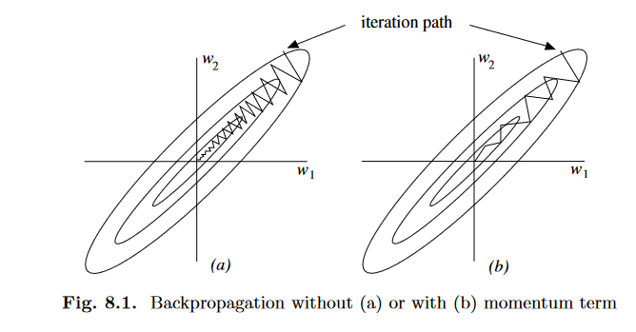
Back-prop with momentum
http://page.mi.fu-berlin.de/rojas/neural/chapter/K8.pdf
https://arxiv.org/pdf/1711.05101.pdf
http://citeseerx.ist.psu.edu/viewdoc/summary?doi=10.1.1.17.1332

Slide 9
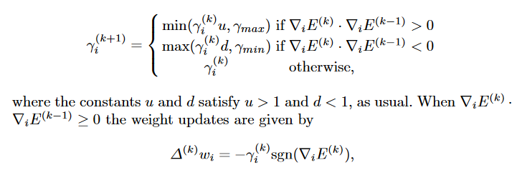
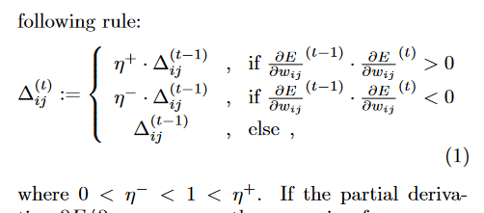
Rprop

Slide 10
Time-domain Machine Learning (TD-ML) with Libra

Slide 11
Neural network architecture
???
X(t)
t
Can not use time as the input directly
Need to use the periodicity of the functions
Non-linear transformation of time

Slide 12



Determining frequencies
$$δX\left(t\right)=X\left(t\right)−\left\langle X\right\rangle$$
$$ACF\left[X\right]\left(τ\right)=\left\langle δX\left(0\right)δX(τ)\right\rangle$$
$$J\left(ω\right)=DFT\left[ACF\left(t\right)\right]$$

Slide 13
Training in the time and “modes” spaces
Energies
NACs

Slide 14
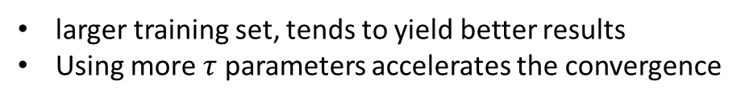

Choice of the $τ$ and training size
Direct reference: 1.7 ps
larger training set, tends to yield better results
Using more $τ$ parameters accelerates the convergence

Slide 15
Choice of the ANN architecture and training size
More complex architecture is not necessarily the best
Need more training data for more complex ANNs to work

