Slide 1
TDDFT
Daniel Mejia-Rodriguez,
Edoardo Aprà & Niri Govind
2023 CyberWorkshop

Slide 2
Casida Formulation
Perturbed density → first-order correction
Linear response approach → frequency domain
Time-Dependent DFT
Cannot be used to describe
excitations in intense fields
Time-Dependent Density Functional Theory, Marques et al, Springer 2006
2

Slide 3
Optical properties (UV/Vis)
Pre- and near-edge X-ray absorption (XANES)
TDDFT Gradients/Optimization
Excited State Calculations with TDDFT

Slide 4
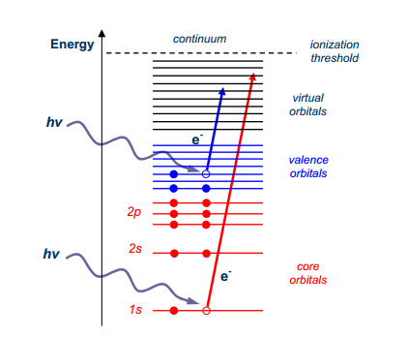
UV/Vis
UV/Vis & X-ray Spectroscopy
X-ray

Slide 5
Basic UV/Vis Input
geometry
O 0.00000000 0.00000000 0.12982363
H 0.75933475 0.00000000 -0.46621158
H -0.75933475 0.00000000 -0.46621158
end
basis
O library 6-31G**
H library 6-31G**
end
dft
xc b3lyp
end
tddft
nroots 10
end
task tddft energy

Slide 6
Sample UV/Vis Output
----------------------------------------------------------------------------
Root 1 singlet b2 0.294221368 a.u. 8.0062 eV
----------------------------------------------------------------------------
Transition Moments X -0.00000 Y 0.26890 Z 0.00000
Transition Moments XX -0.00000 XY 0.00000 XZ 0.00000
Transition Moments YY -0.00000 YZ -0.08066 ZZ -0.00000
Dipole Oscillator Strength 0.0141833591
Electric Quadrupole 0.0000000009
Magnetic Dipole 0.0000001219
Total Oscillator Strength 0.0141834819
Occ. 5 b2 --- Virt. 6 a1 1.00002 X
----------------------------------------------------------------------------
Root 2 singlet a2 0.369097480 a.u. 10.0437 eV
----------------------------------------------------------------------------
Transition Moments X -0.00000 Y 0.00000 Z -0.00000
Transition Moments XX -0.00000 XY 0.24936 XZ 0.00000
Transition Moments YY 0.00000 YZ -0.00000 ZZ -0.00000
Dipole Oscillator Strength 0.0000000000
Electric Quadrupole 0.0000000166
Magnetic Dipole 0.0000003348
Total Oscillator Strength 0.0000003515
Occ. 5 b2 --- Virt. 7 b1 -0.99936 X
----------------------------------------------------------------------------
Root 3 singlet a1 0.387064731 a.u. 10.5326 eV
----------------------------------------------------------------------------
Transition Moments X -0.00000 Y -0.00000 Z 0.60463
Transition Moments XX -0.62351 XY 0.00000 XZ 0.00000

Slide 7
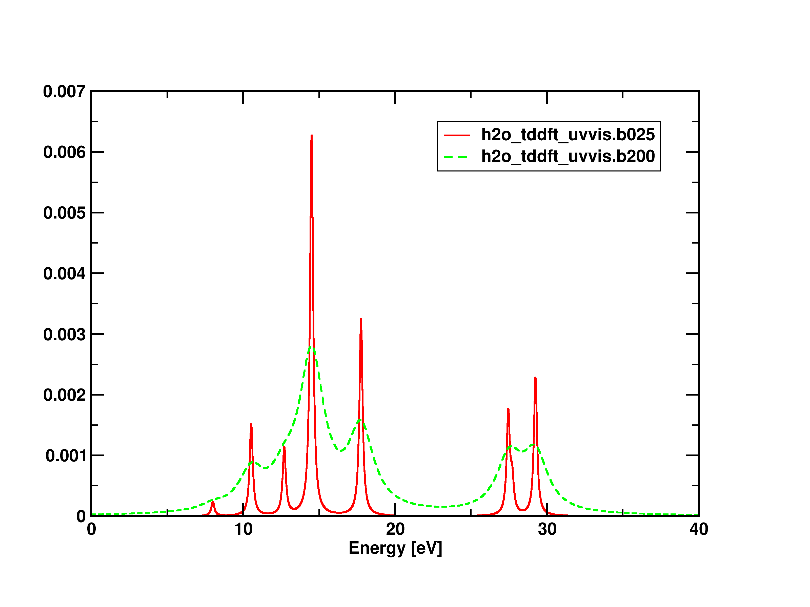
UV/Vis Spectrum (different broadenings)
python3 nw_spectrum.py -b0.25 -p5000 < h2o_tddft_uvvis.out>h2o_tddft_uvvis.data.b025
python3 nw_spectrum.py -b2.00 -p5000 < h2o_tddft_uvvis.out>h2o_tddft_uvvis.data.b200

Slide 8
Basic XANES Input
geometry units angstrom noautosym nocenter
O 0 0 0
C 0 0.00 1.15
end
basis
* library aug-cc-pvtz
end
dft
xc b3lyp
end
task dft optimize
dft
xc beckehandh
end
tddft
cis
ecut -15
nroots 30
notriplet
thresh 1e-04
end
task tddft
Defines the initial state(s)
All (core) states below energy of -15 au are taken as initial states. No restriction on final states

Slide 9
Alternate input for XANES
geometry units angstrom noautosym nocenter
O 0 0 0
C 0 0.00 1.15
end
basis
* library aug-cc-pvtz
end
dft
xc b3lyp
end
task dft optimize
dft
xc beckehandh
end
tddft
cis
ewin -20.0 -10.0
nroots 30
notriplet
thresh 1e-04
end
task tddft
Defines the initial state(s) with energy windows

Slide 10
Sample XANES Output
----------------------------------------------------------------------------
Root 1 singlet a 19.467775490 a.u. 529.7454 eV
----------------------------------------------------------------------------
Transition Moments X -0.05038 Y 0.00001 Z 0.00000
Transition Moments XX 0.00000 XY -0.00000 XZ 0.00222
Transition Moments YY 0.00000 YZ -0.00000 ZZ 0.00000
Dipole Oscillator Strength 0.0329382748
Electric Quadrupole 0.0000001929
Magnetic Dipole 0.0000000133
Total Oscillator Strength 0.0329384810
Occ. 1 a --- Virt. 8 a -0.98992
Occ. 1 a --- Virt. 16 a -0.12916
----------------------------------------------------------------------------
Root 2 singlet a 19.467775490 a.u. 529.7454 eV
----------------------------------------------------------------------------
Transition Moments X -0.00001 Y -0.05038 Z -0.00000
Transition Moments XX -0.00000 XY -0.00000 XZ 0.00000
Transition Moments YY -0.00000 YZ 0.00222 ZZ 0.00000
Dipole Oscillator Strength 0.0329382748
Electric Quadrupole 0.0000001929
Magnetic Dipole 0.0000000133
Total Oscillator Strength 0.0329384810
Occ. 1 a --- Virt. 9 a -0.98992
Occ. 1 a --- Virt. 17 a -0.12916
----------------------------------------------------------------------------
Root 3 singlet a 19.835495901 a.u. 539.7515 eV
….

Slide 11
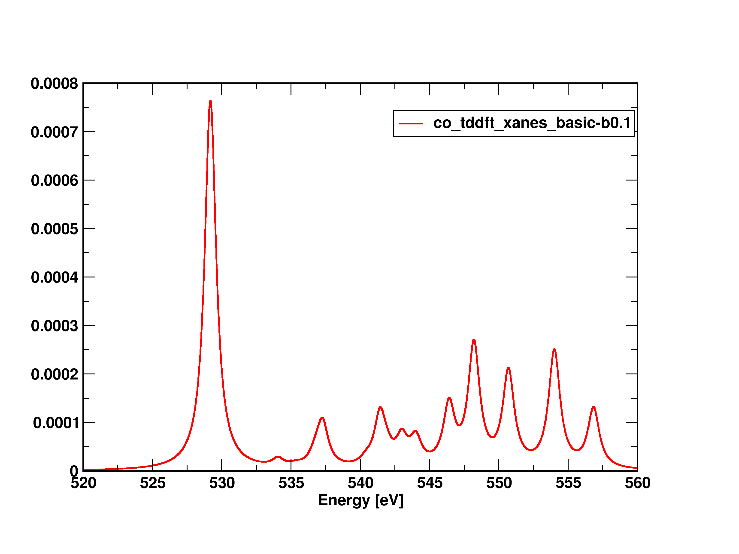
Pre- & Near-Edge X-ray Spectrum
python3 nw_spectrum.py -b0.1 -p5000 <co_tddft_xanes_basic.out>co_tddft_xanes_basic-b0.1

Slide 12
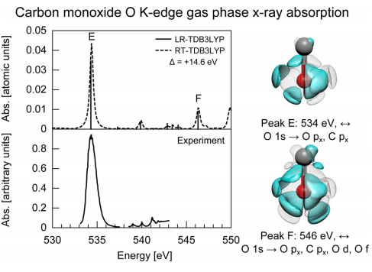
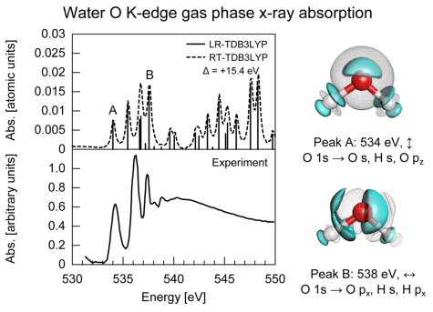
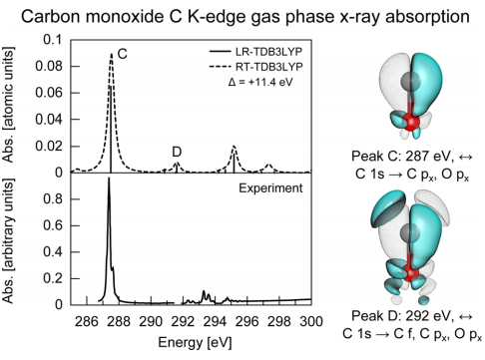
Other Examples: O K-edge in Water and
O, C K-edges in CO
Details: JCTC, 8, 3284 (2012)

Slide 13
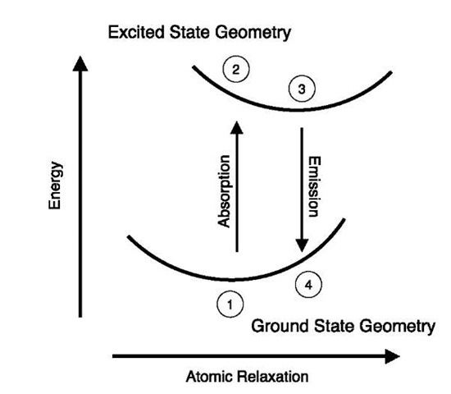
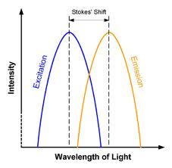
Optimization on the excited state
Excited-State Optimization

Slide 14
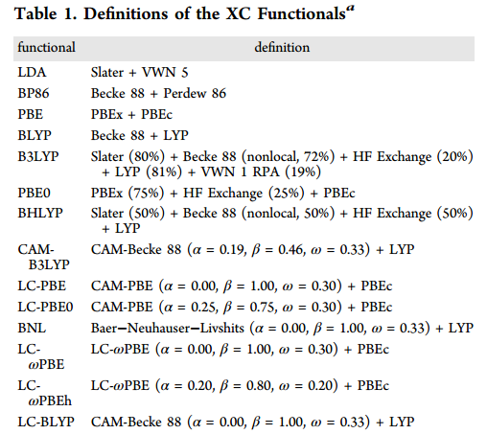
Available functionals for TDDFT gradients/optimization/dynamics
Analytic TDDFT Gradients/Opt in NWChem
Details: J. Chem. Theory Comput., 2013, 9 (12), pp 5490–5503

Slide 15
Basic TDDFT Optimization Input
geometry units angstrom noautosym nocenter
O 0 0 0
C 0 0.00 1.15
end
basis
* library 6-31G*
end
dft
xc pbe0
end
task dft optimize
tddft
nroots 2
notriplet
civecs
grad
root 1
end
end
task tddft optimize
Defines root on which the excited state gradient/optimization is performed

Slide 16
Casida Formulation
Cannot be used to describe
excitations in intense fields
Perturbed density → first-order correction
Linear response approach → frequency domain
Linear-Response Time-Dependent DFT
Time-Dependent Density Functional Theory, Marques et al, Springer 2006
16

Slide 17
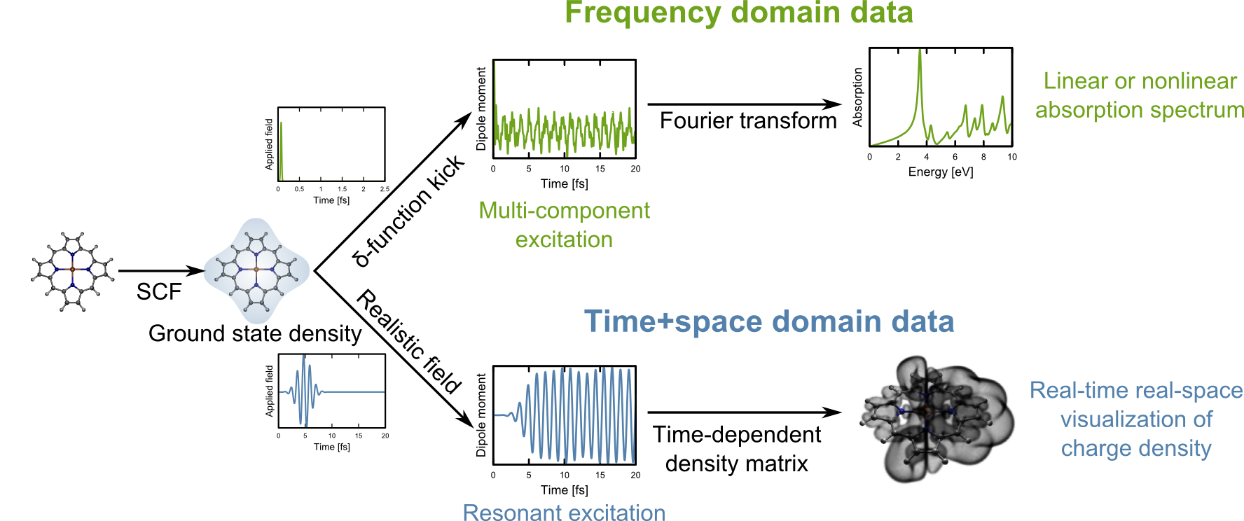

Real-Time TDDFT
Response beyond perturbation limit, anharmonic effects
Depends only on the XC potential
Real-time, real-space → full dynamical information
Insight into ultrafast and nonlinear processes
JCTC 7, 1344 (2011)

Slide 18
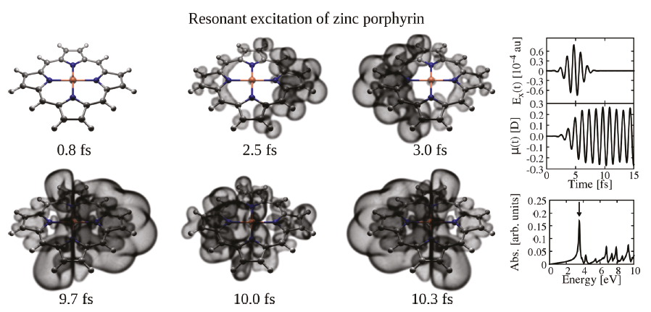
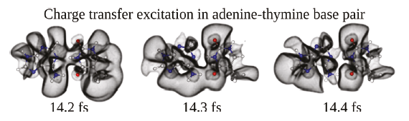
Ultrafast Electron Dynamics
K.Lopata
N. Govind
JCTC 7, 1344 (2011)

Slide 19
Questions?

Slide 20
Thank you

