Slide 1
Gaussian Basis AIMD
Daniel Mejia-Rodriguez,
Edoardo Aprà & Niri Govind
2023 CyberWorkshop​

Slide 2





Finite Cluster Molecular Dynamics
Compatible with all Gaussian basis function based electronic structure methods in NWChem
DFT, LR-TDDFT, MP2
Will switch to numerical gradients if analytical gradients are absent
Velocity Verlet
Constant Energy & Constant Temperature Ensembles
Berendsen, Langevin, and Stochastic Velocity Rescaling
https://nwchemgit.github.io/Gaussian-Basis-AIMD.html
Details: Journal of Physical Chemistry B, 120(8), 1429 (2015)
Gaussian Basis AIMD: QMD Module

Slide 3
geometry noautosym noautoz
O 0.00000000 -0.01681748 0.11334792
H 0.00000000 0.81325914 -0.34310308
H 0.00000000 -0.67863597 -0.56441201
end
dft; xc hfexch; end
basis; * library 6-31g* ;end
qmd
nstep_nucl 200
dt_nucl 10.d0
targ_temp 200.d0
com_step 10
rand_seed 12345
thermostat svr
print_xyz 5
end
task dft qmd
#
# water - S0 HF/6-31G* geometry
# ground state HF/6-31G* MD
# time step = 10 a.u.
# number of steps = 200
# SVR thermostat, default tau
# 200 K
# translations and rotations every 10 steps
# print trajectory every 5 steps
# random seed set to 12345
#
QMD:
Sample Input

Slide 4
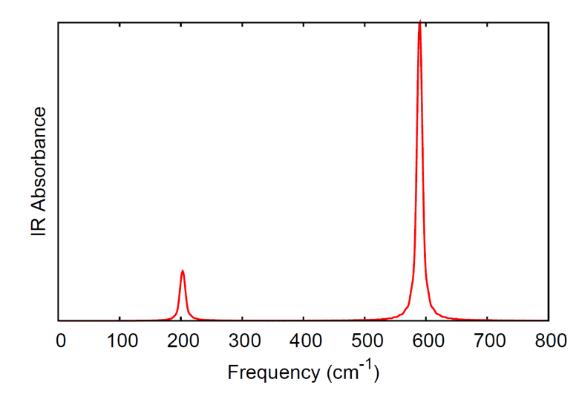
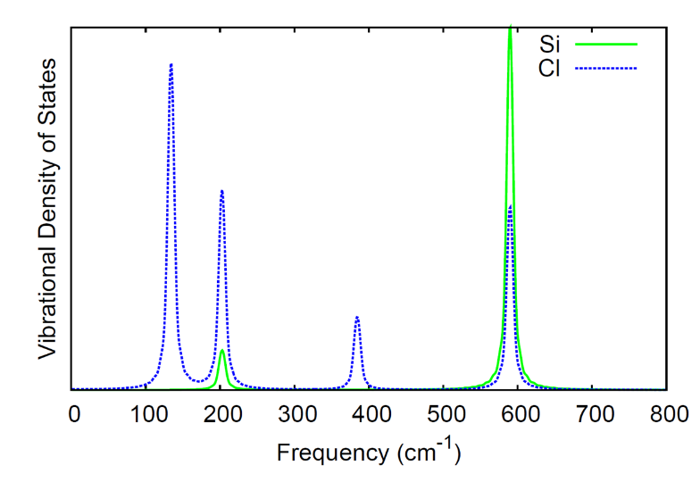
geometry noautosym noautoz
Si -0.00007905 0.00044148 0.00000001
Cl 0.71289590 1.00767685 1.74385011
Cl -2.13658008 -0.00149375 -0.00000001
Cl 0.71086735 -2.01430142 -0.00000001
Cl 0.71289588 1.00767684 -1.74385011
end
basis
* library 6-31G
end
dft
xc hfexch 1.0
end
qmd
nstep_nucl 20000
dt_nucl 10.0
targ_temp 20.0
com_step 10
rand_seed 12345
thermostat none
end
task dft qmd
QMD Detailed Example: SiCl₄
See Documentation & Analysis:
https://nwchemgit.github.io/Gaussian-Basis-AIMD.html

Slide 5
start qmd_props
…
qmd
nstep_nucl 200
dt_nucl 10.d0
targ_temp 200.d0
com_step 10
rand_seed 12345
thermostat berendsen
# calculate properties as defined in
# the properties block every 5 steps
property 5
end
property
dipole
aoresponse 1 .0911267060
velocity
damping 0.007
shielding 1 1
end
task dft qmd
Combining QMD with Properties
NOTE: The choice of property can slow down the QMD depending on how oftern you want to calculate it

Slide 6
…
qmd
nstep_nucl 200
dt_nucl 10.d0
targ_temp 200.d0
com_step 10
rand_seed 12345
thermostat berendsen
# calculate TDDFT every 3 steps
tddft 3
end
tddft
nroots 2
notriplet
end
task dft qmd
Combining QMD with TDDFT
NOTE: The choice of property/response can slow down the QMD depending on how often you want to calculate it

Slide 7
Questions?

Slide 8
Thank you

