Slide 1

CyberTraining: Modeling Quantum Dynamics of Excited States in Materials in the Era of Machine Learning, 2026
Alexey Akimov
University at Buffalo, SUNY
July 6, 2026
https://compchem-cybertraining.github.io/Cyber_Training_Workshop_2026/

Slide 2
General Workshop Goals
and
Overview of the CyberTraining Infrastructure

Slide 3

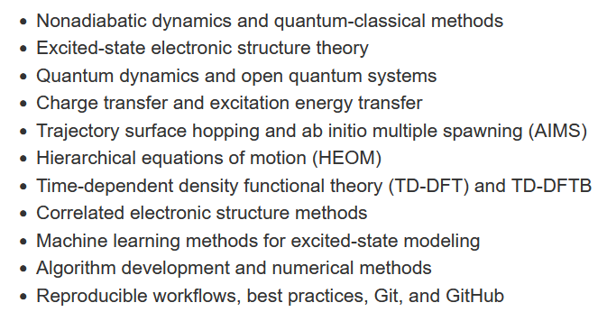
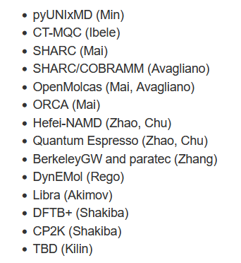
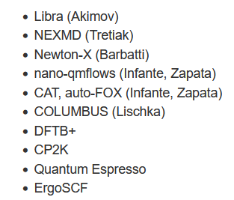
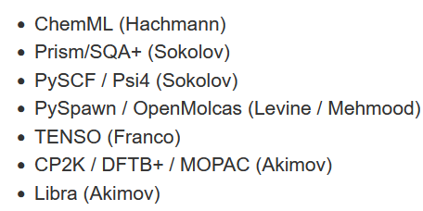
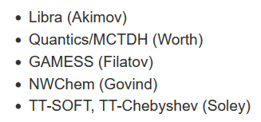
Objectives and Scope
Workshop Objectives
Get familiar with a variety of software packages relevant to modeling of excited states and nonadiabatic dynamics
Get an overview of theoretical background for corresponding computational methods
Get experience using machine learning tool and applying them to modeling excited states or nonadiabatic dynamics
Get a practical experience with these tools and packages
2026 (this year!)
2023 (in person/virtual)
2022 (in person/virtual)
2021 (virtual)
CyberTraining: Implementation: Small: Modeling Quantum Dynamics of Excited States in Materials in the Era of Machine Learning
CyberTraining: Pilot: Modeling Excited State Dynamics in Solar Energy Materials

Slide 4
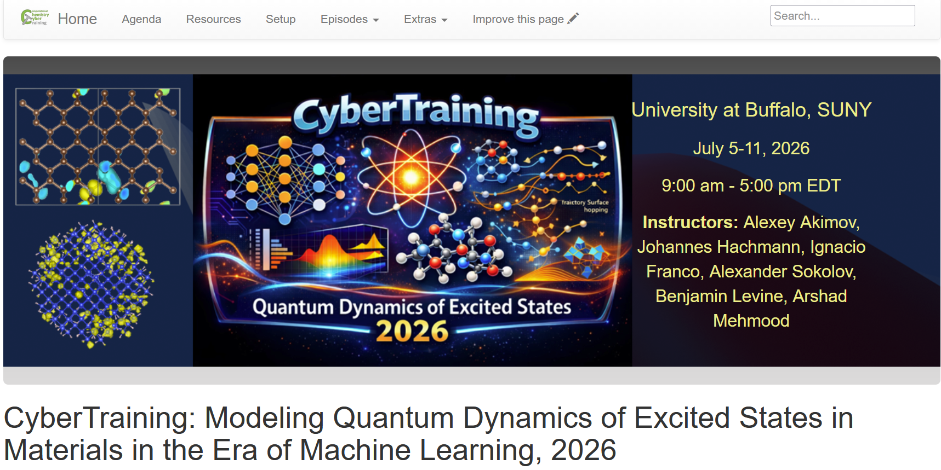
The Plan & Resources
All the details are here:
https://compchem-cybertraining.github.io/Cyber_Training_Workshop_2026/
Join Slack:
Members can invite new members
Private and public channels, direct (private) messages, conversations
Any time, no strings attached
https://join.slack.com/t/quantumdynamicshub/shared_invite/zt-mjbhjssx-GGhsbYHxeBMvhmumK_j7LA
VPN and Accounts:
2-factor authentication
ccr-help@buffalo.edu

Slide 5
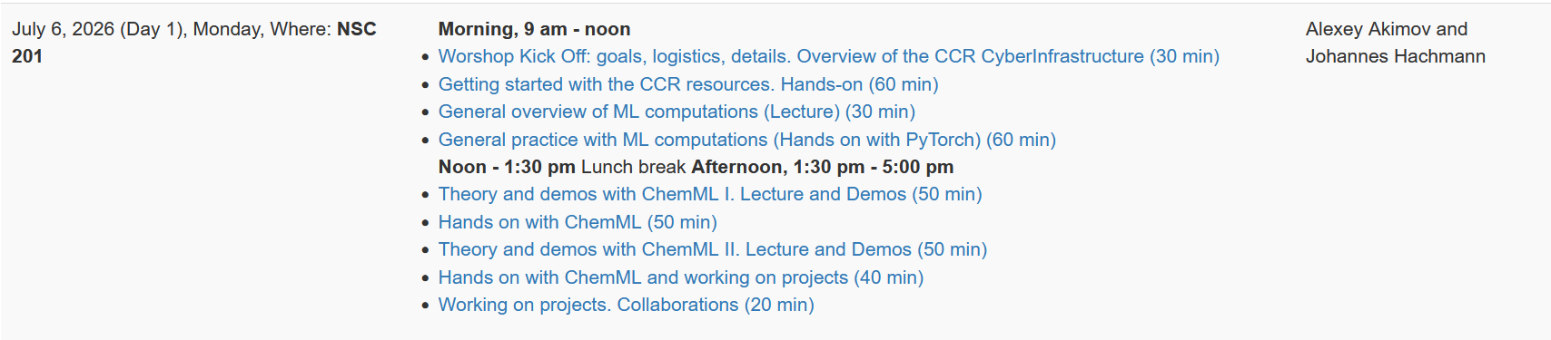
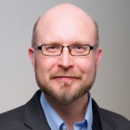

Topics and Instructors
https://hachmannlab.github.io/chemml/
Prof. Johannes Hachmann (SUNY UB)
https://hachmannlab.cbe.buffalo.edu/

Slide 6
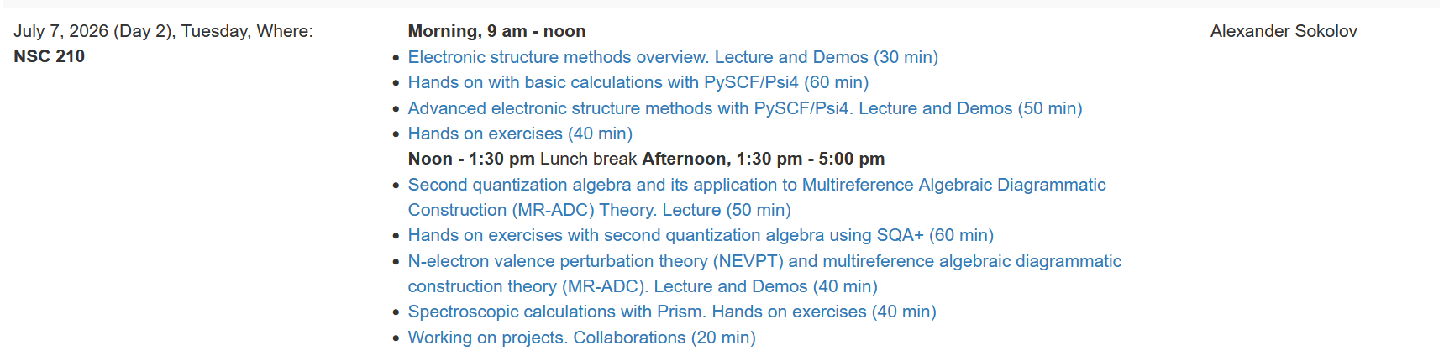
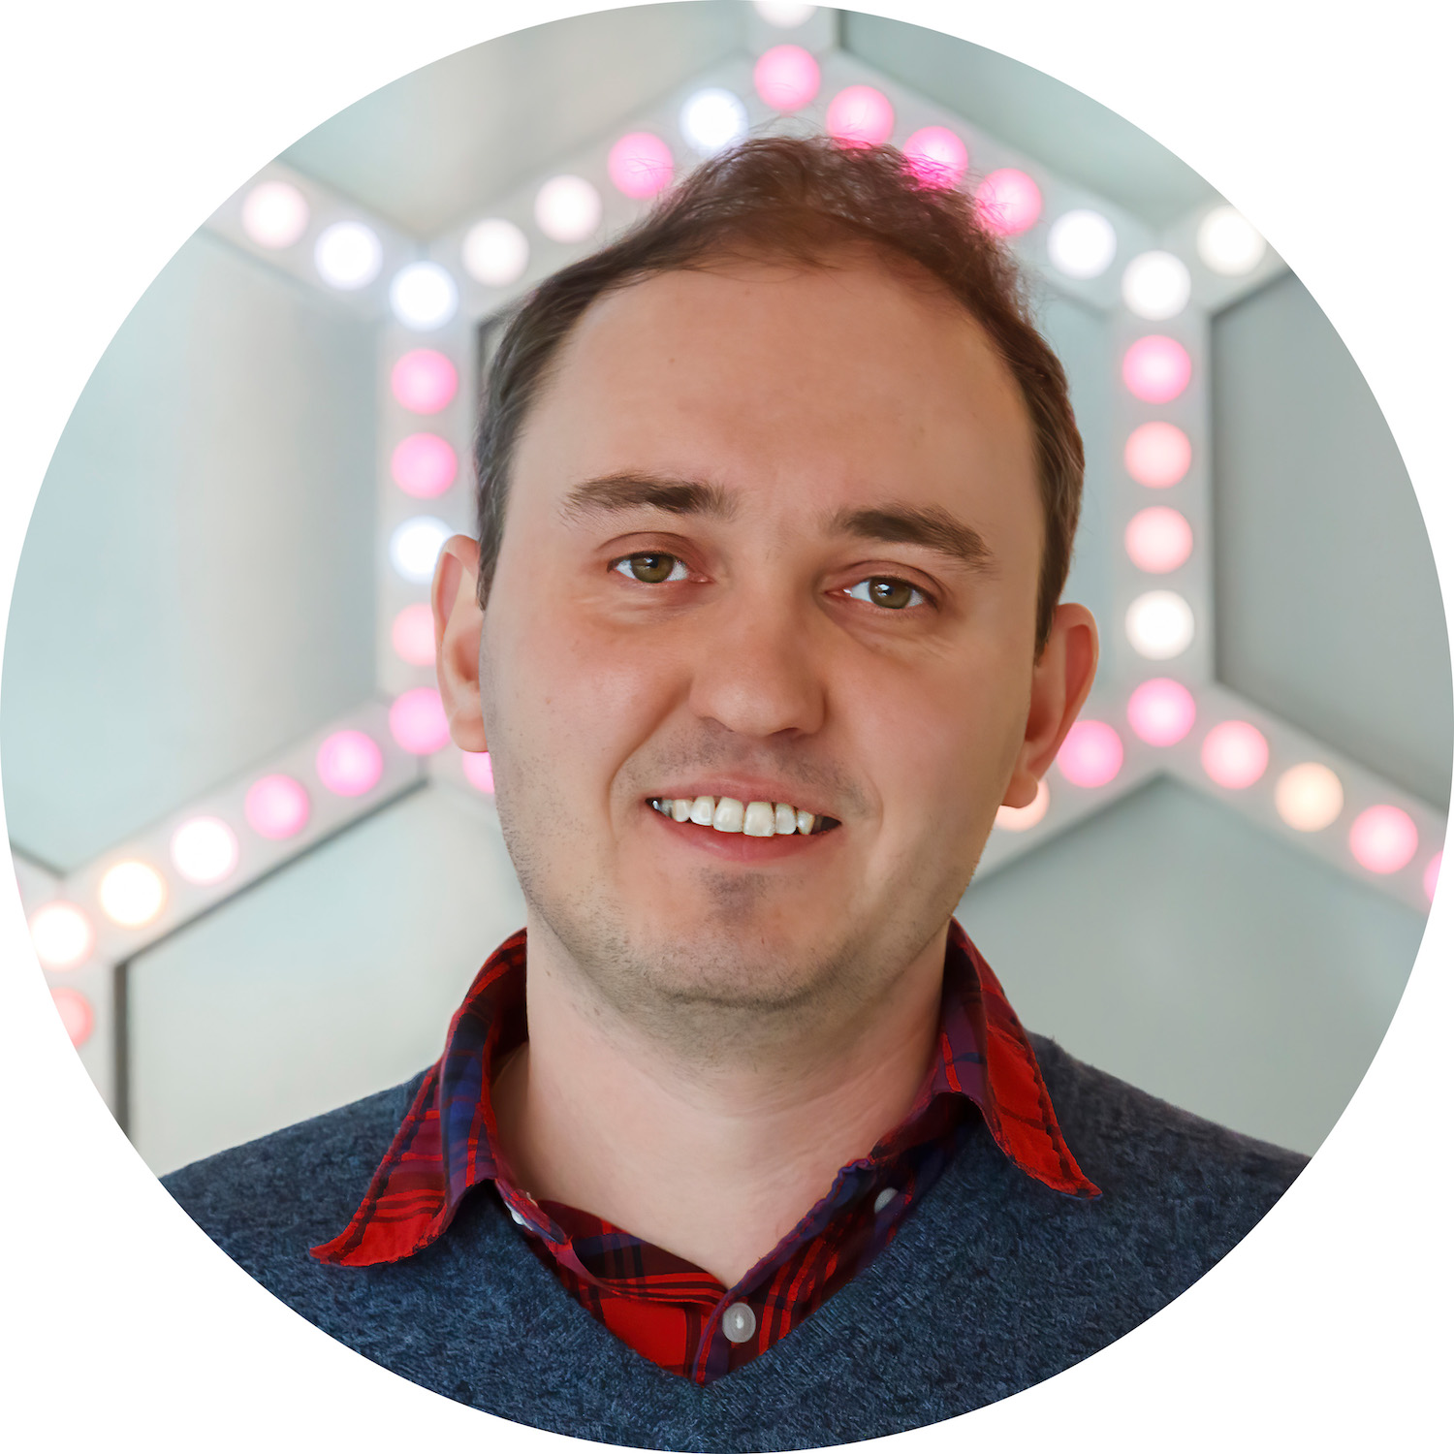
Topics and Instructors
PySCF https://pyscf.org/
Psi4 https://psicode.org/
SQA+ https://github.com/sokolov-group/sqa_plus
PRISM https://github.com/sokolov-group/prism/
Prof. Alexander Sokolov (Ohio State U)
https://research.cbc.osu.edu/sokolov.8/

Slide 7
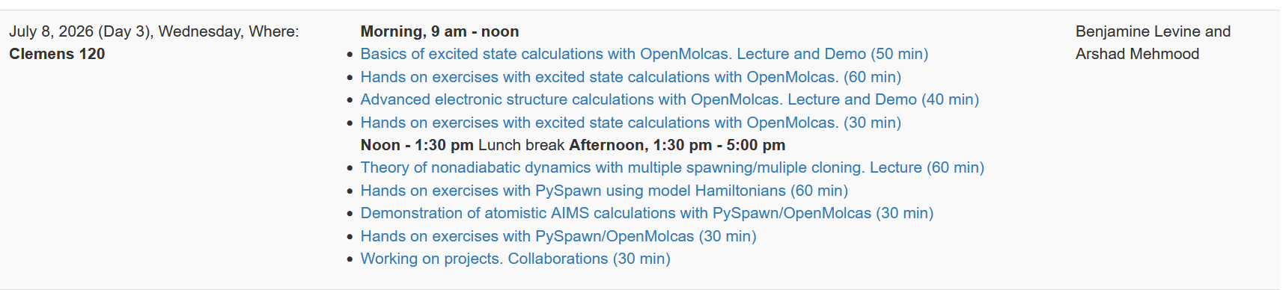
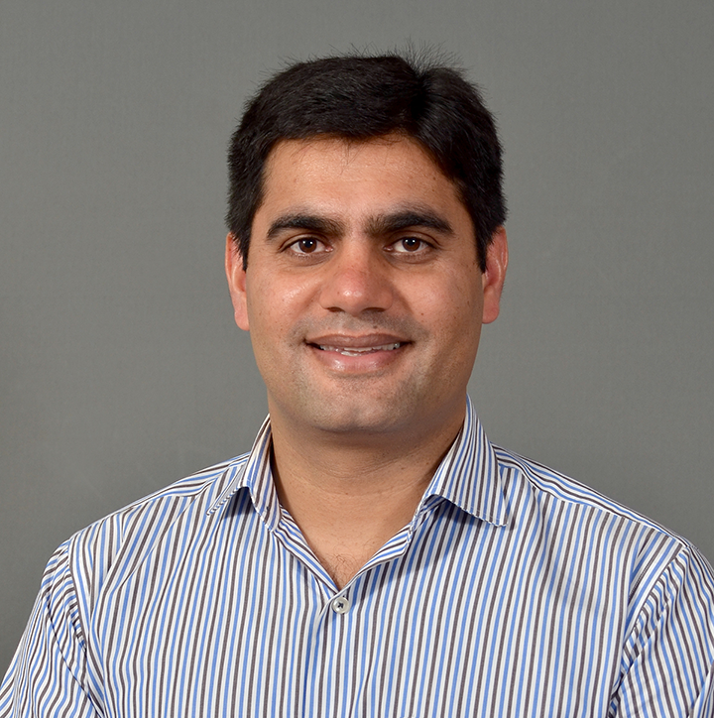
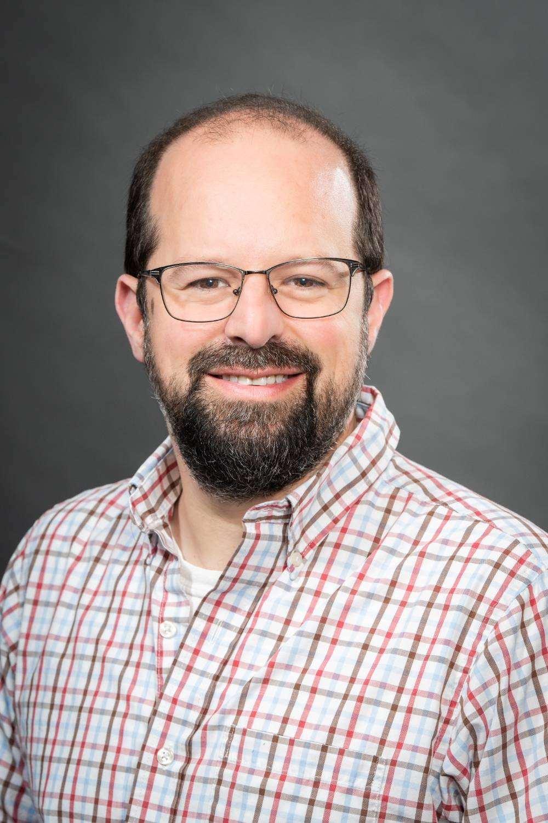

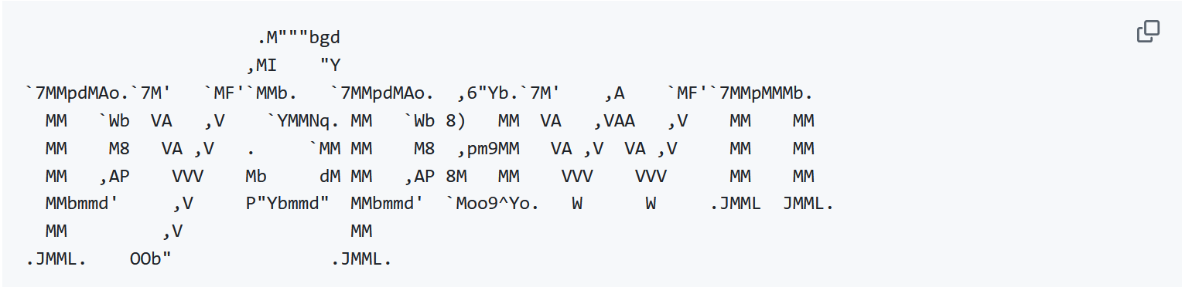
Topics and Instructors
OpenMolcas https://gitlab.com/Molcas/OpenMolcas
https://github.com/compchem-cybertraining/Tutorials_OpenMolcas
https://github.com/compchem-cybertraining/Tutorials_PySpawn
Dr. Arshad Mehmood (Stony Brook U)
Prof. Benjamin Levine (Stony Brook U)
pySpawn17 https://github.com/blevine37/pySpawn17
https://levinegroup.org/
https://arshadmehmood118.github.io/

Slide 8
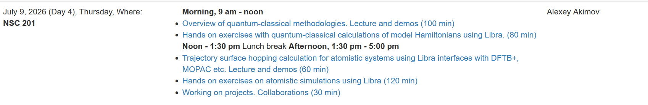
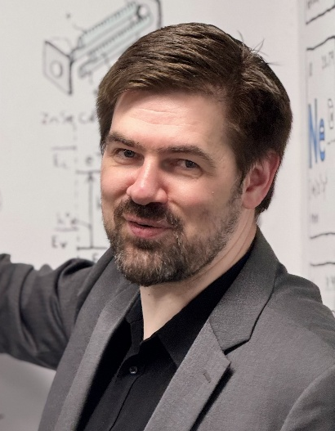
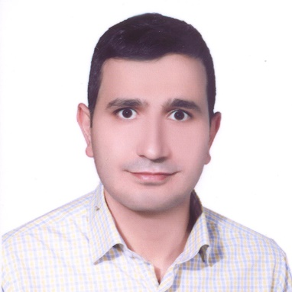

Topics and Instructors
Libra
https://github.com/Quantum-Dynamics-Hub/libra-code
https://github.com/compchem-cybertraining/Tutorials_Libra
https://github.com/compchem-cybertraining/Tutorials_DFTB_plus
Dr. Mohammad Shakiba
(UC Merced)
https://github.com/compchem-cybertraining/Tutorials_CP2K
Prof. Alexey Akimov
(UB, SUNY)
https://akimovlab.github.io/
https://mohammadshakiba.github.io/

Slide 9
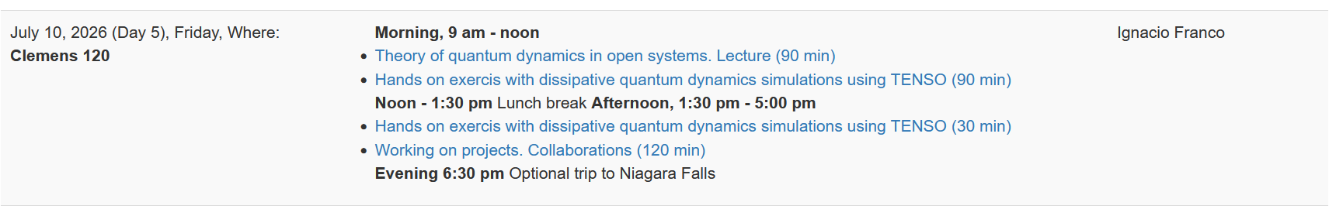
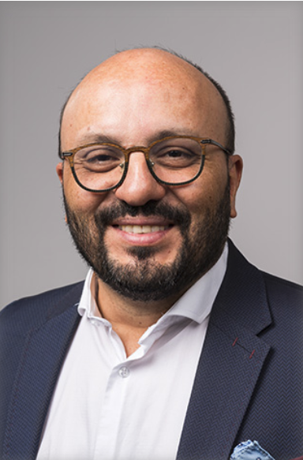
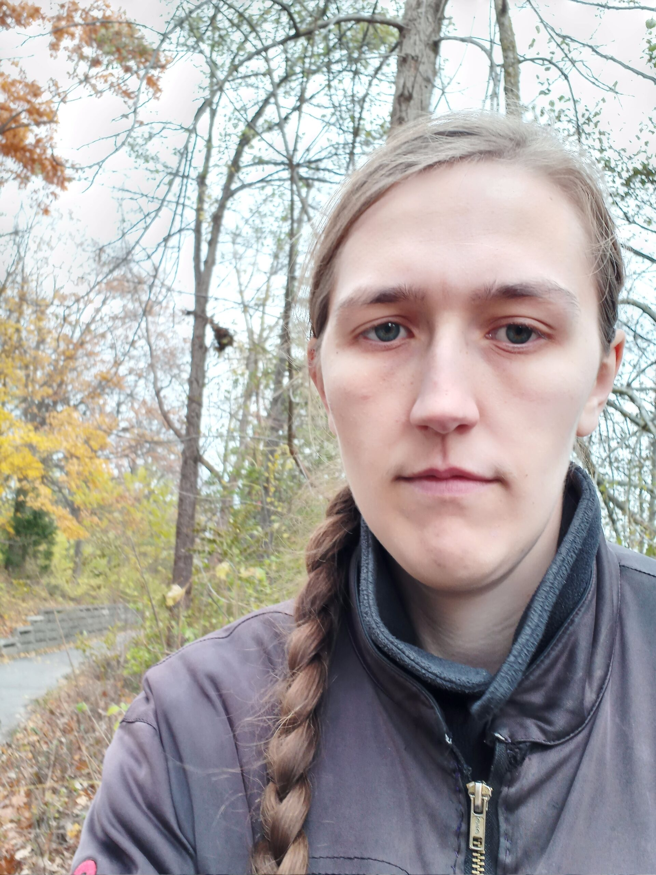
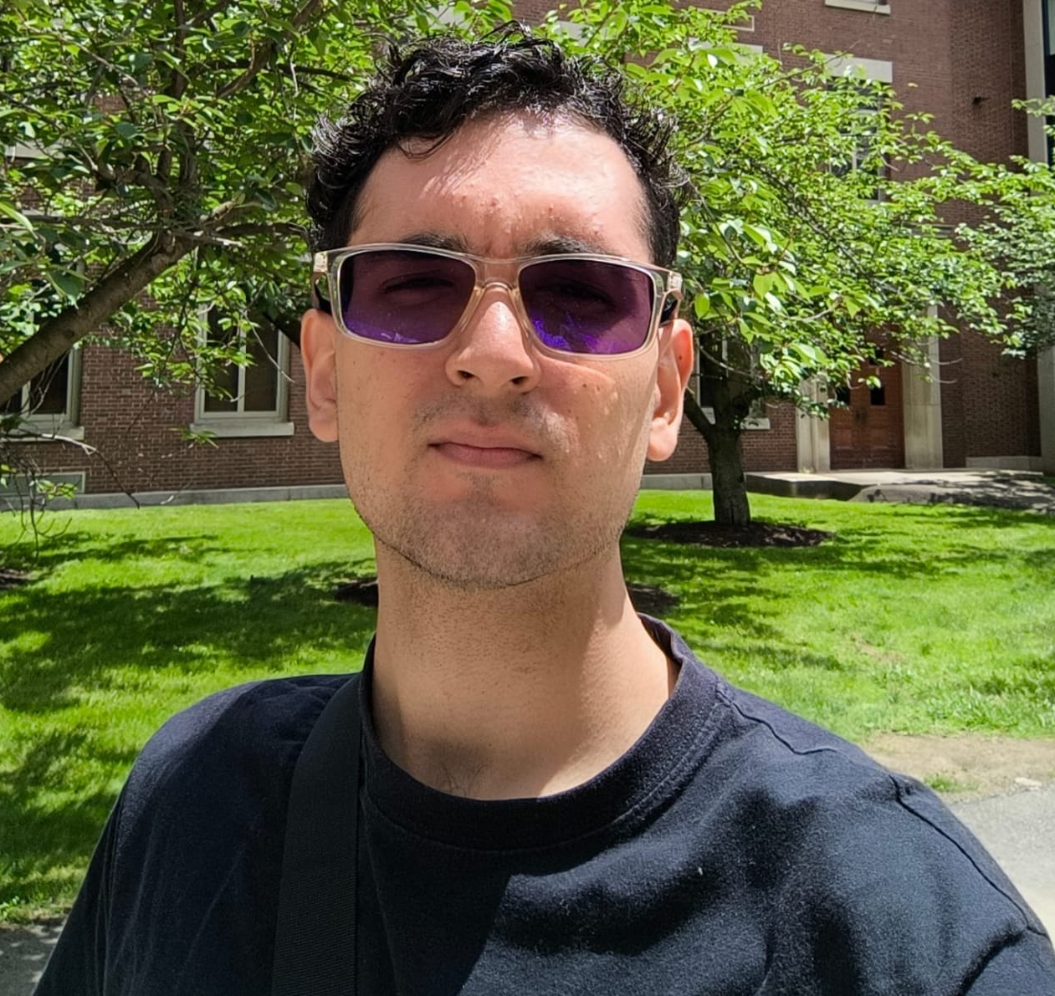
Topics and Instructors
PyTENSO https://github.com/ifgroup/pytenso
Prof. Ignacio Franco
(U of Rochester)
Mr. Juan, Camilo Rodríguez Betancourt
(U of Rochester)
Dr. Michelle Anderson
(U of Rochester)
https://sas.rochester.edu/chm/groups/franco/

Slide 10
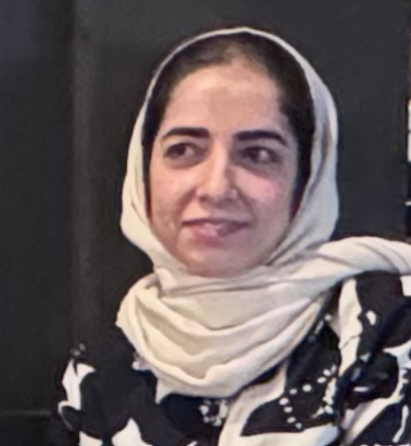
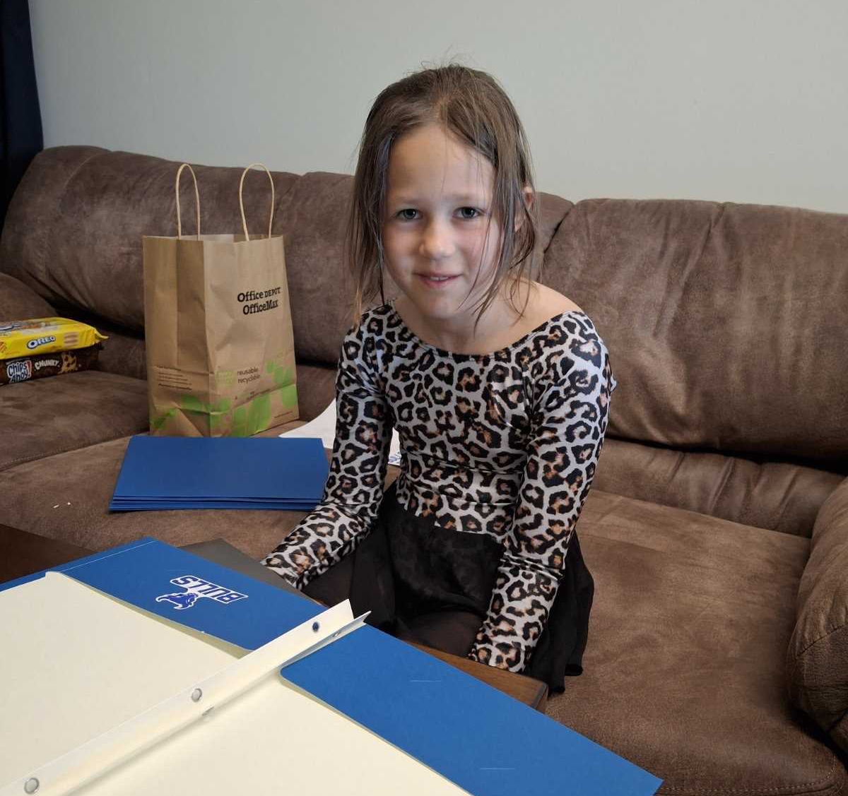
Organizational and Preparatory
Prof. Alexey Akimov
(UB, SUNY)
Ms. Layla Heydarizadeh
(UB, SUNY)
paperwork
Ms. Anna Akimova
- inspirational

Slide 11
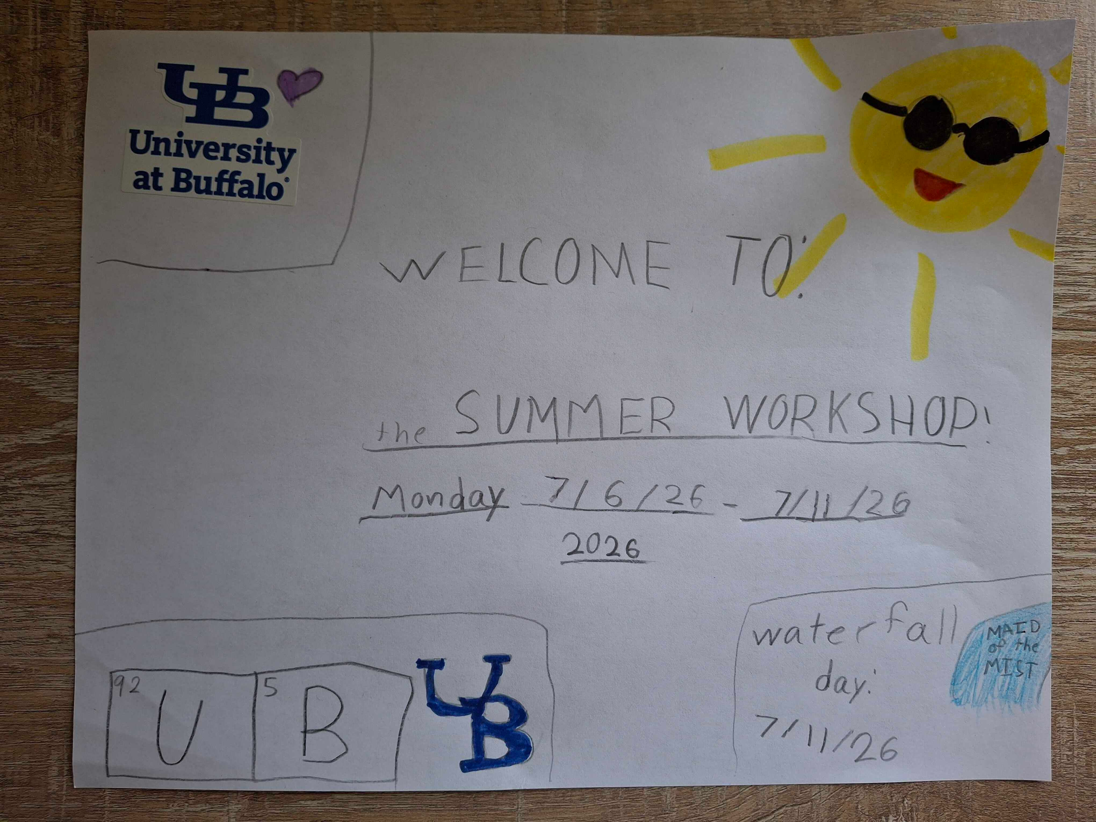

Slide 12
Please Introduce Yourself
Name, position, affiliation, research group
Research interests and expertise
Anything else you would like to share with us

Slide 13
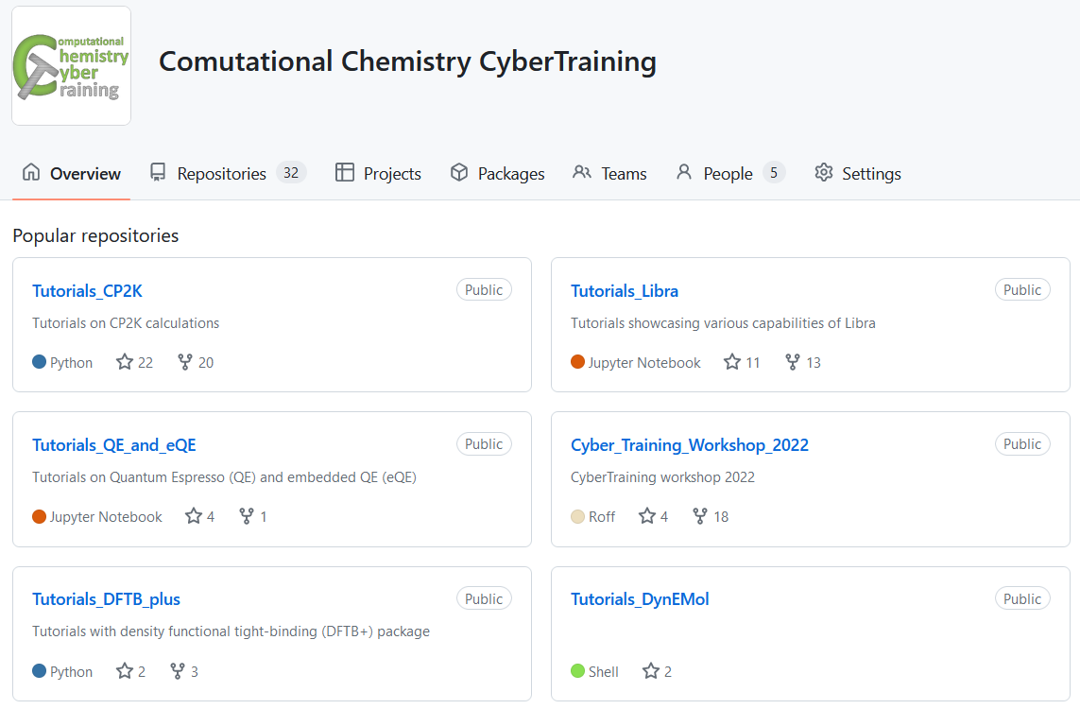
More Resources
Codes: https://github.com/Quantum-Dynamics-Hub
Training: https://github.com/compchem-cybertraining
Quantum Dynamics Hub: https://quantum-dynamics-hub.github.io/
Summer 2021 workshop: https://compchem-cybertraining.github.io/Cyber_Training_Workshop_2021/
Libra Winter school: https://compchem-cybertraining.github.io/Libra_Winter_School_2022/
Summer 2022 workshop: https://compchem-cybertraining.github.io/Cyber_Training_Workshop_2022/
Summer 2023 workshop: https://compchem-cybertraining.github.io/Cyber_Training_Workshop_2023/
Summer 2026 workshop (this!) https://compchem-cybertraining.github.io/Cyber_Training_Workshop_2026/

Slide 14
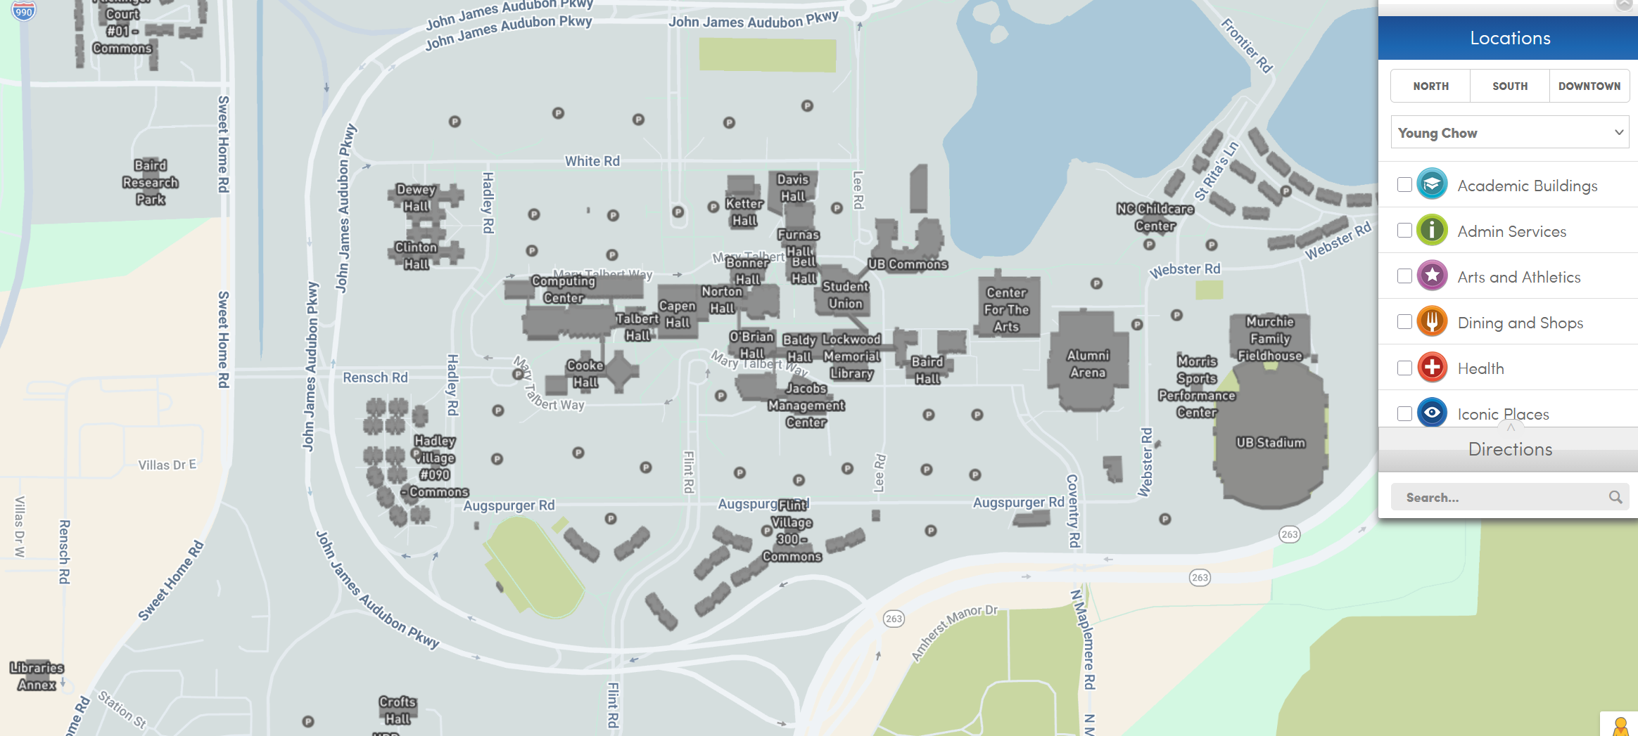
Daily Schedule
Daily
Breakfast = hotel
9:00 am – 12:00 pm: Morning session (Recording)
12:00 – 1:30 pm Working lunch/rest – on your own at “Commons”, rest, discuss, collaborate
1:30 pm – 5:00 pm: Afternoon session (Recording)
After 5:00 pm: collaborations/on your own, dinner on your own
Location
Classes are @:
Monday, Thursday: NSC 201
Tuesday: NSC 210
Wednesday, Friday: Clemens 120
Lunch
Your Hotels
Classes
Campus Map: https://www.buffalo.edu/home/visiting-ub/map.html

Slide 15
Logistic
We cover your hotel stay (except for the local folks). Stipends also cover the rest of expenses, please keep your receipts just in case. Let me know your flight expenses via the Google form provided on Slack channel.
Travel for the US participants to a reasonable amount, partially the international participants (as the funds allow), except for local/UB-affiliated folks.
Paperwork: All trainees will need to fill in the RF Participation Stipend form and one of the other two forms: W-9 - for the US residents and W-8BEN for the non-residents. The forms are distributed to you via Slack – please DON’t send them back via e-mail – upload to the form provided or via Slack.
A lot of paperwork later – likely it’ll be just me handling most of the stuff
Prizes: $300 (1 first prize), $200 (3 second prizes), $100 (5 first prizes) – the project competition. Online and in-person participants are eligible. UB-affiliated participants are eligible too.
Reimbursement/honoraria to the instructors – a separate paperwork. Will send you instructions via the Instructors Channel on Slack.

Slide 16
Course Project
https://compchem-cybertraining.github.io/Cyber_Training_Workshop_2026/CODE_OF_CONDUCT.html
Project rules
Consist of: a) short written report, b) presentation at the last day of workshop; c) set of input/output files deposited on the GitHub repository
Should actively involve one of the packages discussed over the workshop period
Preferably not something you have an extensive experience with
Doesn’t have to be a full-scale research project, but can be a step towards this direction
Projects completed using local or home institution resources are eligible
Can be an application or a coding project
The consistency in your course work during this school will contribute to your chances to win the awards
The awards decisions will be made based on the committee evaluation. The awards will be: 1 first prize ($300), 3 second, and 5 third prizes.
Project Timeline: https://compchem-cybertraining.github.io/Cyber_Training_Workshop_2026/_episodes/07-project
Have your work accepted to the GitHub repo by July 18 (Saturday), 5 pm Buffalo time
First stage winners are selected by July 22
Zoom oral presentations - July 24-26 (the exact dates are to be determined)
Check out the past years’ projects:
https://github.com/compchem-cybertraining/Cyber_Training_Workshop_2021/tree/gh-pages/course_work
https://compchem-cybertraining.github.io/Cyber_Training_Workshop_2021/_episodes/13-projects
https://github.com/compchem-cybertraining/Cyber_Training_Workshop_2022/tree/gh-pages/course_work
https://compchem-cybertraining.github.io/Cyber_Training_Workshop_2022/_episodes/15-projects
https://github.com/compchem-cybertraining/Cyber_Training_Workshop2023_course_projects
https://compchem-cybertraining.github.io/Cyber_Training_Workshop_2023/_episodes/08-projects

Slide 17
Getting Started on UB CCR

Slide 18
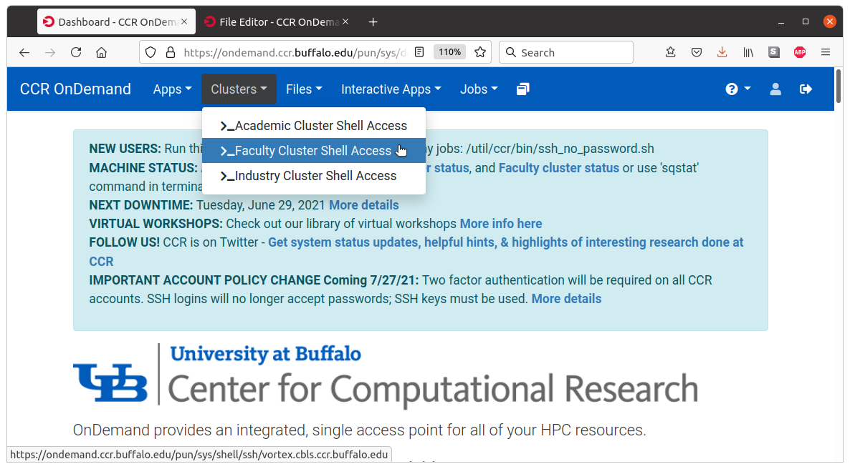
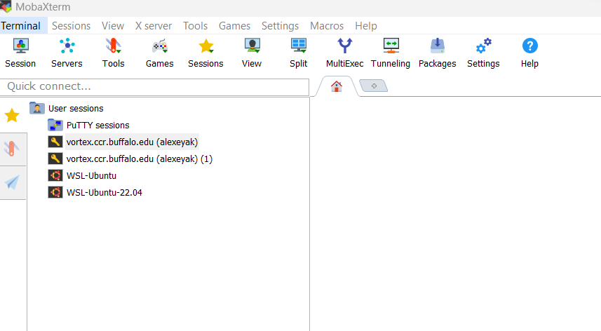
Accessing UB Computing Resources
Before the Workshop
https://compchem-cybertraining.github.io/Cyber_Training_Workshop_2026/setup.html
OnDemand (not Firefox, use Chrome)
On campus – nothing special;
Off-campus – use UB VPN
https://ondemand.ccr.buffalo.edu/
Moba Xterm
Generate the SSH public/private key.
Use Moba Tools -> MobaKeyGen
Coordinate it with your UB credentials
https://docs.ccr.buffalo.edu/en/latest/portals/idm/

Slide 19
Accessing UB Computing Resources
Your .bashrc file (in your home directory)
# .bashrc
# User specific aliases and functions
# Source global definitions
if [ -f /etc/bashrc ]; then
. /etc/bashrc
fi
module use /projects/academic/cyberwksp21/MODULES
module load libra_ava/devel
Restart terminal or `source .bashrc`
For terminal-based operations: Activate conda environment: `conda activate libra2`
For Jupyter – just launch it
Projects directory: /projects/academic/cyberwksp21 - slower, smaller, but permanent, limited space!
Scratch space: /vscratch/grp-cyberwksp21 - faster, larger, but temporary; content will be purged in 60 days
Home directory: convenient to use, but others can not access it in case you need them check something

Slide 20
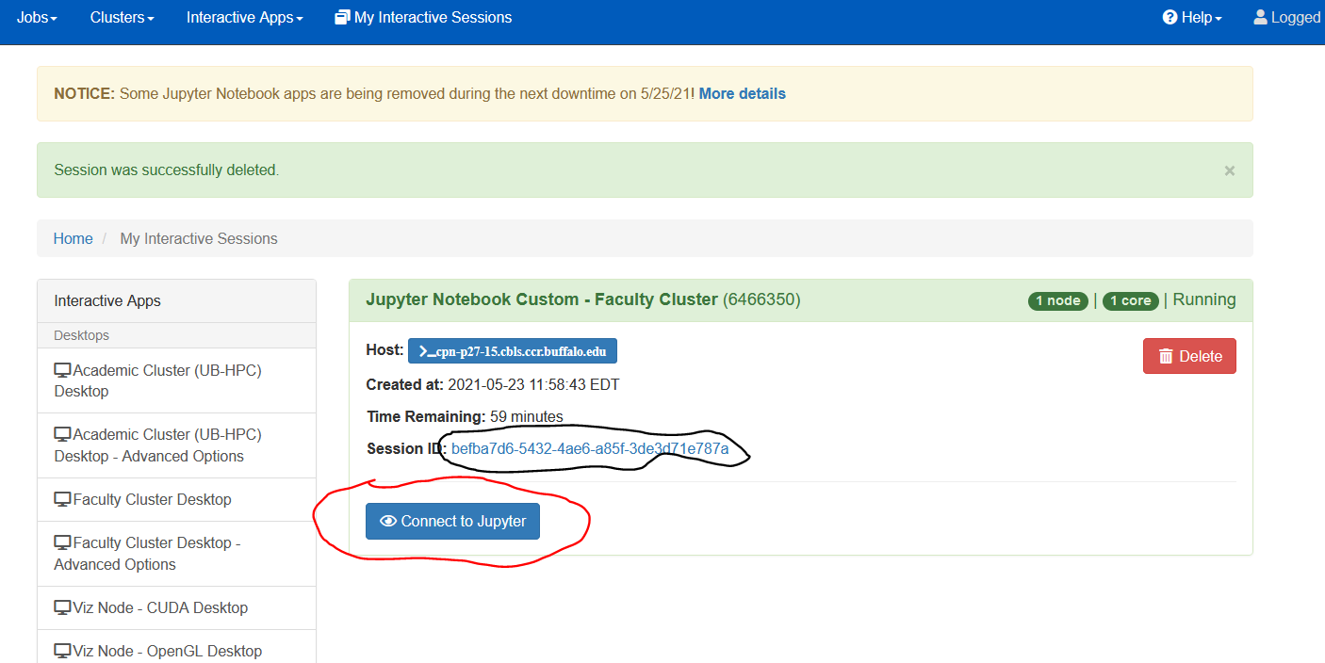
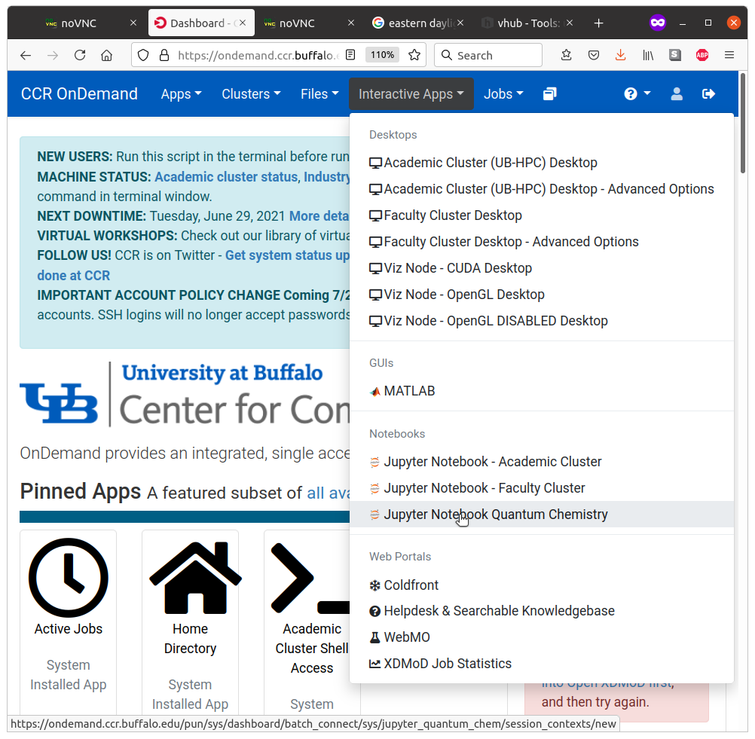
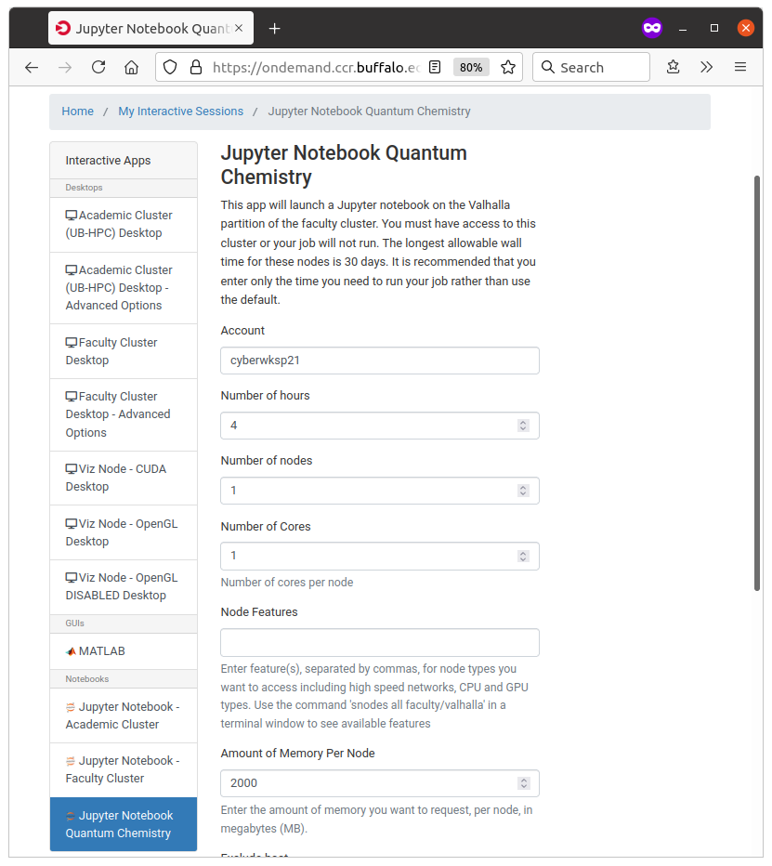
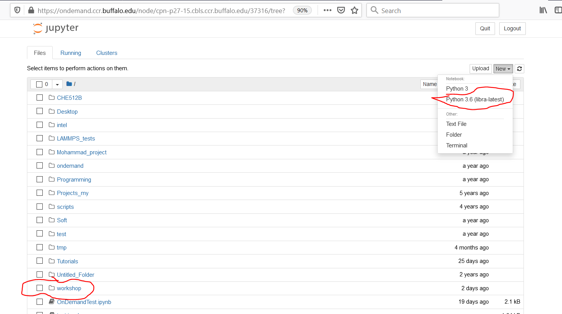
Using Jupyter Notebooks
https://compchem-cybertraining.github.io/Cyber_Training_Workshop_2026/_episodes/04-tsh

