Slide 1

CyberTraining: Modeling Quantum Dynamics of Excited States in Materials in the Era of Machine Learning, 2026
Alexey Akimov
University at Buffalo, SUNY
July 9, 2026
https://compchem-cybertraining.github.io/Cyber_Training_Workshop_2026/

Slide 2
Part 4: Algorithms and Methods for NA-MD

Slide 3
The general NA-MD workflow
Initialization
Nuclear dynamics
$\dot{p_{i}}=−\frac{∂H}{∂r_{i}}$ $\dot{r_{i}}=\frac{∂H}{∂p_{i}}$
analytical models or electronic structure codes
Stationary adiabatic states
$${\hat{H}}_{el}ψ_{i}=E_{i}ψ_{i}$$
NAC: Hammes-Schiffer, S.; Tully, J. C. JCP 1994, 101, 4657
Non-adiabatic Couplings
$$d_{ij}=\frac{\left\langle ψ_{i}(t) | ψ_{j}(t+dt)\right\rangle −\left\langle ψ_{i}(t+dt) | ψ_{j}(t)\right\rangle }{2dt}$$
Phase tracking: Akimov, A. V. JPCL 2018 9, 6096
Local Diabatization: Granucci, G.; Persico, M.; Toniolo, A. JCP 2001, 114, 10608; Plasser, F.; Granucci, G.; Pittner, J. et al. JCP 2012, 137, 22A514; Shakiba, M.; Akimov, A. V. TCA 2023, 142, 68
Integrate Coherent Electronic Dynamics
$$Ψ\left(r,R,t\right)=\sum_{i}{c_{i}\left(t\right)ψ_{i}(r;R(t))}$$
$$iℏ\frac{∂c_{i}(t)}{∂t}=\sum_{j}{\left(E_{i}δ_{ij}−iℏd_{ij}\right)}c_{j}$$
NBRA
SDM: Granucci, G.; Persico, M. JCP 2007, 126, 134114; mSDM: Smith, B. A.; Akimov, A. V. JCP, 2019, 151, 124107; IDA: Nelson, T.; Fernandez-Alberti, S.; Roitberg, A. E.; Tretiak, S. JCP 2013, 138, 224111.
Decoherence 1
$$c_{i}→c_{i}\exp\left(−\frac{Δt}{τ_{ij}}\right), ∀i≠j$$
as in SDM
Proposed Hops
Decoherence 2
$$P_{i→j}=Δt∗Re\left(\frac{2{\frac{p}{m}d}_{ij}c_{i}^{∗}c_{j}}{c_{i}^{∗}c_{i}}\right)$$
or as in DISH
FSSH: Tully, J. C. JCP, 1990, 93, 1061
Accept Hops
based on energy conservation or
$$P_{i→f}^{A}=\min\left(1, \exp\left(−\frac{ΔE}{k_{B}T}\right)\right)$$
NBRA: Prezhdo, O. V.; Duncan, W. R.; Prezhdo, V. V. Prog. Surf. Sci. 2009, 84, 30
Change of state/Velocity rescaling
change active electronic state, rescale velocity

Slide 4
Part 4.1: Integrating Nuclear EOM
Initialization
Nuclear dynamics
$\dot{p_{i}}=−\frac{∂H}{∂r_{i}}$ $\dot{r_{i}}=\frac{∂H}{∂p_{i}}$
analytical models or electronic structure codes
Stationary adiabatic states
$${\hat{H}}_{el}ψ_{i}=E_{i}ψ_{i}$$
NAC: Hammes-Schiffer, S.; Tully, J. C. JCP 1994, 101, 4657
Non-adiabatic Couplings
$$d_{ij}=\frac{\left\langle ψ_{i}(t) | ψ_{j}(t+dt)\right\rangle −\left\langle ψ_{i}(t+dt) | ψ_{j}(t)\right\rangle }{2dt}$$
Phase tracking: Akimov, A. V. JPCL 2018 9, 6096
Local Diabatization: Granucci, G.; Persico, M.; Toniolo, A. JCP 2001, 114, 10608; Plasser, F.; Granucci, G.; Pittner, J. et al. JCP 2012, 137, 22A514; Shakiba, M.; Akimov, A. V. TCA 2023, 142, 68
Integrate Coherent Electronic Dynamics
$$Ψ\left(r,R,t\right)=\sum_{i}{c_{i}\left(t\right)ψ_{i}(r;R(t))}$$
$$iℏ\frac{∂c_{i}(t)}{∂t}=\sum_{j}{\left(E_{i}δ_{ij}−iℏd_{ij}\right)}c_{j}$$
NBRA
SDM: Granucci, G.; Persico, M. JCP 2007, 126, 134114; mSDM: Smith, B. A.; Akimov, A. V. JCP, 2019, 151, 124107; IDA: Nelson, T.; Fernandez-Alberti, S.; Roitberg, A. E.; Tretiak, S. JCP 2013, 138, 224111.
Decoherence 1
$$c_{i}→c_{i}\exp\left(−\frac{Δt}{τ_{ij}}\right), ∀i≠j$$
as in SDM
Proposed Hops
Decoherence 2
$$P_{i→j}=Δt∗Re\left(\frac{2{\frac{p}{m}d}_{ij}c_{i}^{∗}c_{j}}{c_{i}^{∗}c_{i}}\right)$$
or as in DISH
FSSH: Tully, J. C. JCP, 1990, 93, 1061
Accept Hops
based on energy conservation or
$$P_{i→f}^{A}=\min\left(1, \exp\left(−\frac{ΔE}{k_{B}T}\right)\right)$$
NBRA: Prezhdo, O. V.; Duncan, W. R.; Prezhdo, V. V. Prog. Surf. Sci. 2009, 84, 30
Change of state/Velocity rescaling
change active electronic state, rescale velocity

Slide 5
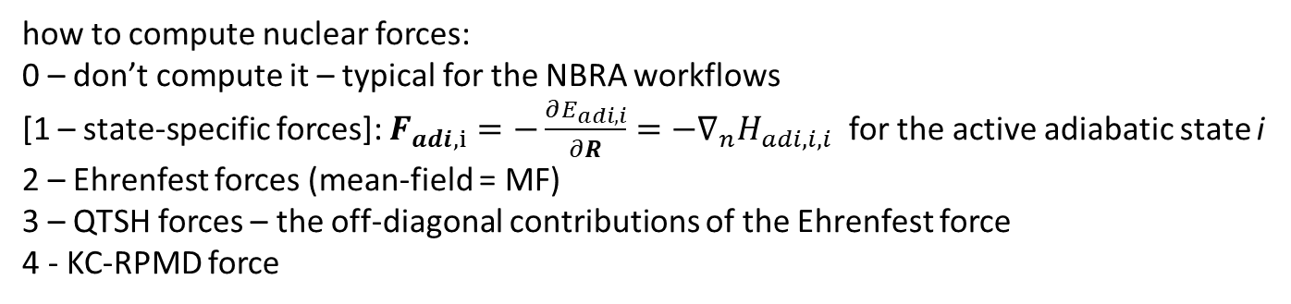
Options for the Dynamics: Forces
dyn_control_params
force_method
rep_force
how to compute nuclear forces:
0 – don’t compute it – typical for the NBRA workflows
[1 – state-specific forces]: $F_{adi,i}=−\frac{∂E_{adi, i}}{∂R}=−∇_{n}H_{adi,i,i}$ for the active adiabatic state i
2 – Ehrenfest forces (mean-field = MF)
3 – QTSH forces – the off-diagonal contributions of the Ehrenfest force
4 - KC-RPMD force
$$f_{adi, n}^{QTSH}≡\frac{1}{C_{adi}^{+}C_{adi}}C_{adi}^{+}F_{adi,n}^{QTSH}C_{adi}$$
0 – using only diabatic properties; [1 – using adiabatic properties]
$$f_{n}^{MF}≡f_{n,dia}^{MF}=\frac{1}{C_{dia}^{+}SC_{dia}}C_{dia}^{+}F_{dia,n}^{HF}C_{dia}=f_{n,adi}^{MF}=\frac{1}{C_{adi}^{+}C_{adi}}C_{adi}^{+}F_{adi,n}^{HF}C_{adi}$$
nHamiltonian
Ehrenfest_forces_dia
Ehrenfest_forces_adi
Ehrenfest_forces_tens_dia
Ehrenfest_forces_tens_adi
$$F_{dia,n}^{MF}=−\left\langle ψ_{dia} | ∇_{n}H | ψ_{dia}\right\rangle =\left[−∇_{n}H_{dia}+D_{dia,n}^{+}S^{−1}H_{dia}+H_{dia}S^{−1}D_{dia,n}\right]$$
$$F_{adi,n}^{MF}=−\left\langle ψ_{adi} | ∇_{n}H | ψ_{adi}\right\rangle =\left[−∇_{n}H_{adi}+D_{adi,n}^{+}H_{adi}+H_{adi}D_{adi,n}\right]$$
$$F_{adi,n}^{QTSH}=−\left\langle ψ_{adi} | ∇_{n}H | ψ_{adi}\right\rangle =\left[D_{adi,n}^{+}H_{adi}+H_{adi}D_{adi,n}\right]$$

Slide 6
Options for the Dynamics: Forces
Note on the Ehrenfest force calculations:
In the normal approach, when we rely on the TD-SE integrator that uses NACs, the force tensor is computed as:
$$F_{adi,n}^{MF}=−\left\langle ψ_{adi} | ∇_{n}H | ψ_{adi}\right\rangle =\left[−∇_{n}H_{adi}+D_{adi,n}^{+}H_{adi}+H_{adi}D_{adi,n}\right]$$
However, when the local diabatization integrators are used, the NACs vanish,$D_{adi}≈0$, so the force tensor becomes just:
$$F_{adi,n}^{MF, LD}=−\left\langle ψ_{adi} | ∇_{n}H | ψ_{adi}\right\rangle ≈−∇_{n}H_{adi}$$
dyn_control_params
enforce_state_following
enforced_state_index
Whether we want to enforce nuclear dynamics to be on a given state, regardless of the TSH transitions: [0 – no]; 1 – yes (the dynamics is governed by the given PES, but the hopping may still be happening). The option 1 can be used for NBRA for the excited-state surfaces.
If we enforce the nuclear dynamics to be on a given state, what is the index of that state [any integer > 0, default = 0 ]
The default value of 0 enforces the nuclear dynamics to be on the ground state.

Slide 7
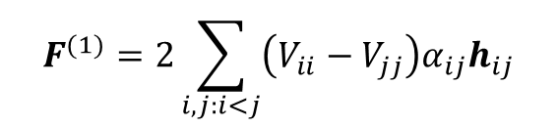

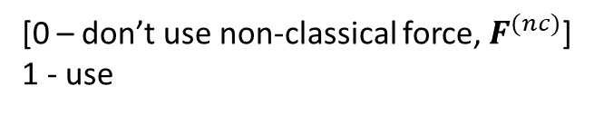

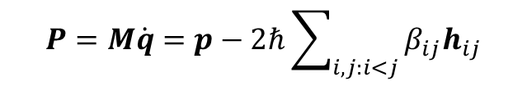



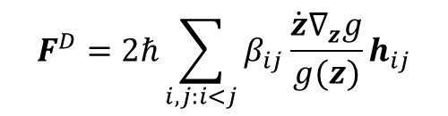
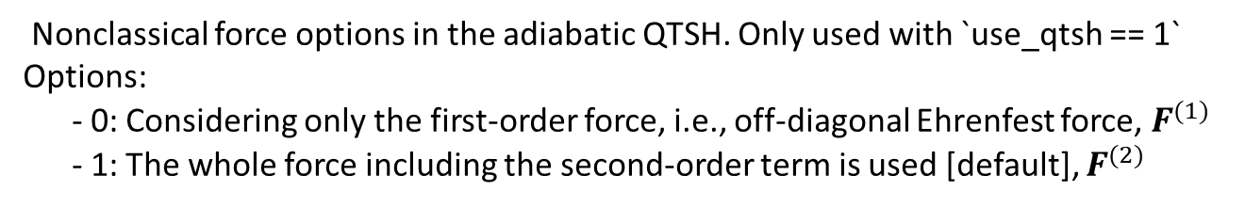
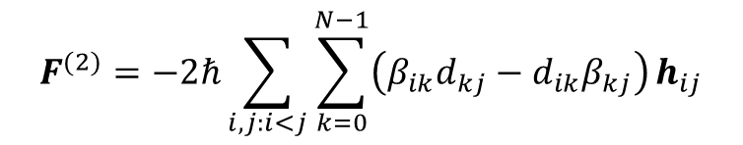
QTSH Forces
$$P=M\dot{q}=p−2ℏ\sum_{i,j:i<j}{β_{ij}h_{ij}}$$
$P$ – kinematic momentum; $p$ – canonical momentum
use_qtsh
$\dot{q}=M^{−1}P$ - QTSH
$\dot{q}=M^{−1}p$ - other methods
[0 – don’t use non-classical force, $F^{(nc)}$]
1 - use
$$\dot{P}=F_{a}+F^{(nc)}$$
$$\dot{P}=−∇V_{aa}+2Re\left[{\left(c^{+}\right)}^{T}h^{+}H_{vib}c\right]+F^{D}$$
$$F_{a}=−∇V_{aa}$$
qtsh_force_option
Nonclassical force options in the adiabatic QTSH. Only used with `use_qtsh == 1`
Options:
- 0: Considering only the first-order force, i.e., off-diagonal Ehrenfest force, $F^{(1)}$
- 1: The whole force including the second-order term is used [default], $F^{(2)}$
$$F^{(nc)}=F^{(1)}+F^{(2)}+F^{D}$$
$$F^{(1)}=2\sum_{i,j:i<j}{\left(V_{ii}−V_{jj}\right)α_{ij}h_{ij}}$$
$$F^{(2)}=−2ℏ\sum_{i,j:i<j}{\sum_{k=0}^{N−1}{\left(β_{ik}d_{kj}−d_{ik}β_{kj}\right)}h_{ij}}$$
$$F^{D}=2ℏ\sum_{i,j:i<j}{β_{ij}\frac{\dot{z}∇_{z}g}{g(z)}h_{ij}}$$
(not computed explicitly, but replaced by decoherence option)

Slide 8
Part 4.2: Electronic Hamiltonian
Initialization
Nuclear dynamics
$\dot{p_{i}}=−\frac{∂H}{∂r_{i}}$ $\dot{r_{i}}=\frac{∂H}{∂p_{i}}$
analytical models or electronic structure codes
Stationary adiabatic states
$${\hat{H}}_{el}ψ_{i}=E_{i}ψ_{i}$$
NAC: Hammes-Schiffer, S.; Tully, J. C. JCP 1994, 101, 4657
Non-adiabatic Couplings
$$d_{ij}=\frac{\left\langle ψ_{i}(t) | ψ_{j}(t+dt)\right\rangle −\left\langle ψ_{i}(t+dt) | ψ_{j}(t)\right\rangle }{2dt}$$
Phase tracking: Akimov, A. V. JPCL 2018 9, 6096
Local Diabatization: Granucci, G.; Persico, M.; Toniolo, A. JCP 2001, 114, 10608; Plasser, F.; Granucci, G.; Pittner, J. et al. JCP 2012, 137, 22A514; Shakiba, M.; Akimov, A. V. TCA 2023, 142, 68
Integrate Coherent Electronic Dynamics
$$Ψ\left(r,R,t\right)=\sum_{i}{c_{i}\left(t\right)ψ_{i}(r;R(t))}$$
$$iℏ\frac{∂c_{i}(t)}{∂t}=\sum_{j}{\left(E_{i}δ_{ij}−iℏd_{ij}\right)}c_{j}$$
NBRA
SDM: Granucci, G.; Persico, M. JCP 2007, 126, 134114; mSDM: Smith, B. A.; Akimov, A. V. JCP, 2019, 151, 124107; IDA: Nelson, T.; Fernandez-Alberti, S.; Roitberg, A. E.; Tretiak, S. JCP 2013, 138, 224111.
Decoherence 1
$$c_{i}→c_{i}\exp\left(−\frac{Δt}{τ_{ij}}\right), ∀i≠j$$
as in SDM
Proposed Hops
Decoherence 2
$$P_{i→j}=Δt∗Re\left(\frac{2{\frac{p}{m}d}_{ij}c_{i}^{∗}c_{j}}{c_{i}^{∗}c_{i}}\right)$$
or as in DISH
FSSH: Tully, J. C. JCP, 1990, 93, 1061
Accept Hops
based on energy conservation or
$$P_{i→f}^{A}=\min\left(1, \exp\left(−\frac{ΔE}{k_{B}T}\right)\right)$$
NBRA: Prezhdo, O. V.; Duncan, W. R.; Prezhdo, V. V. Prog. Surf. Sci. 2009, 84, 30
Change of state/Velocity rescaling
change active electronic state, rescale velocity

Slide 9
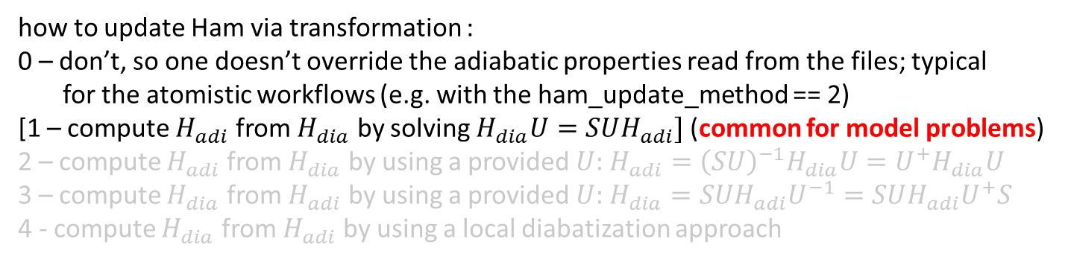
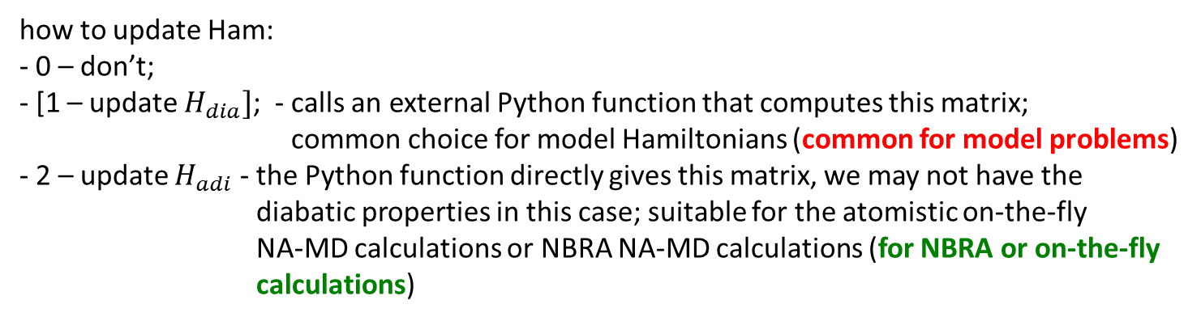
Hamiltonian Options
dyn_control_params
ham_update_method
ham_transform_method
how to update Ham:
- 0 – don’t;
- [1 – update $H_{dia}]$; - calls an external Python function that computes this matrix;
common choice for model Hamiltonians (common for model problems)
- 2 – update $H_{adi}$ - the Python function directly gives this matrix, we may not have the
diabatic properties in this case; suitable for the atomistic on-the-fly
NA-MD calculations or NBRA NA-MD calculations (for NBRA or on-the-fly
calculations)
how to update Ham via transformation :
0 – don’t, so one doesn’t override the adiabatic properties read from the files; typical
for the atomistic workflows (e.g. with the ham_update_method == 2)
[1 – compute $H_{adi}$ from $H_{dia}$ by solving $H_{dia}U=SUH_{adi}]$ (common for model problems)
2 – compute $H_{adi}$ from $H_{dia}$ by using a provided $U:$ $H_{adi}={\left(SU\right)}^{−1}H_{dia}U=U^{+}H_{dia}U$
3 – compute $H_{dia}$ from $H_{adi}$ by using a provided $U:$ $H_{dia}=SUH_{adi}U^{−1}=SUH_{adi}U^{+}S$
4 - compute $H_{dia}$ from $H_{adi}$ by using a local diabatization approach
To be implemented

Slide 10
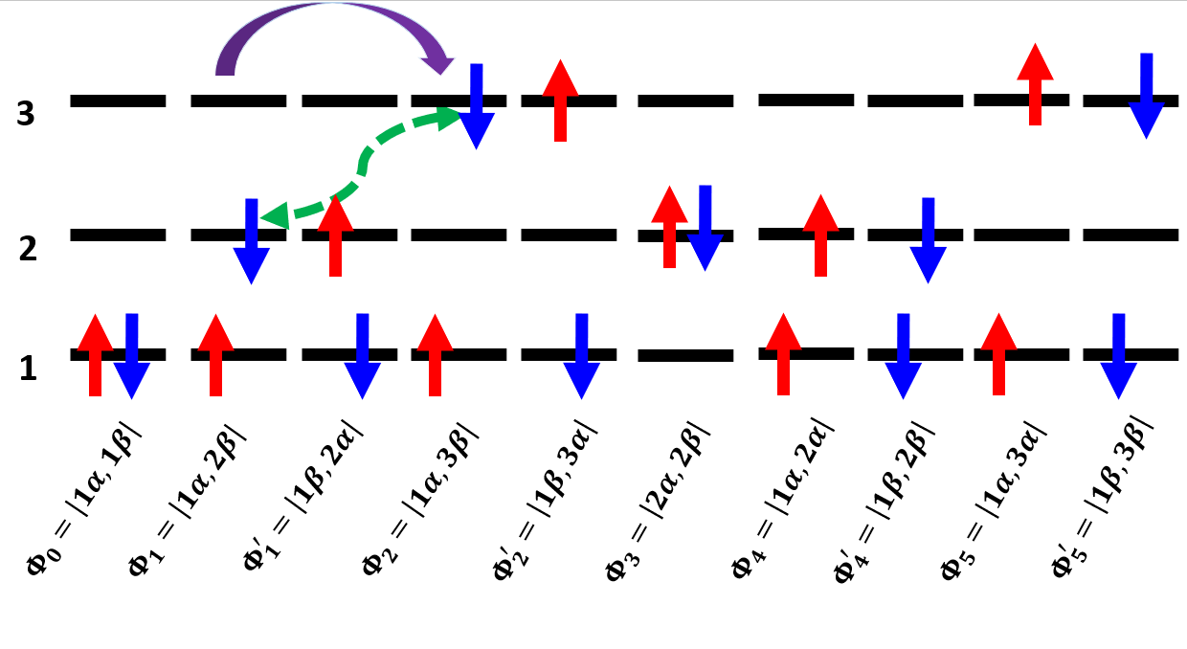
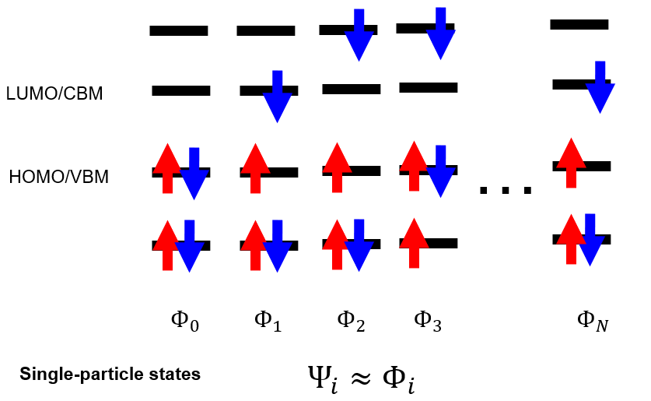
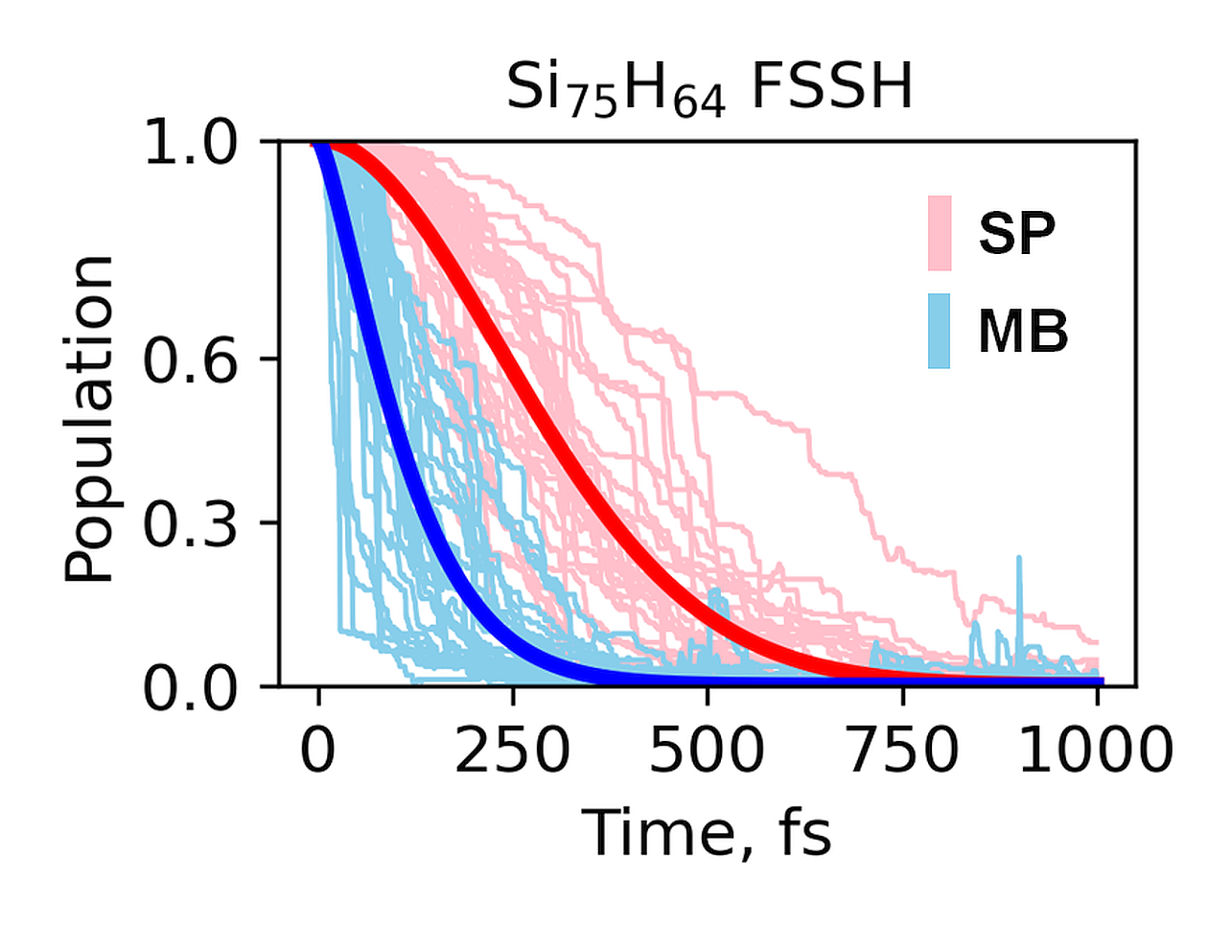
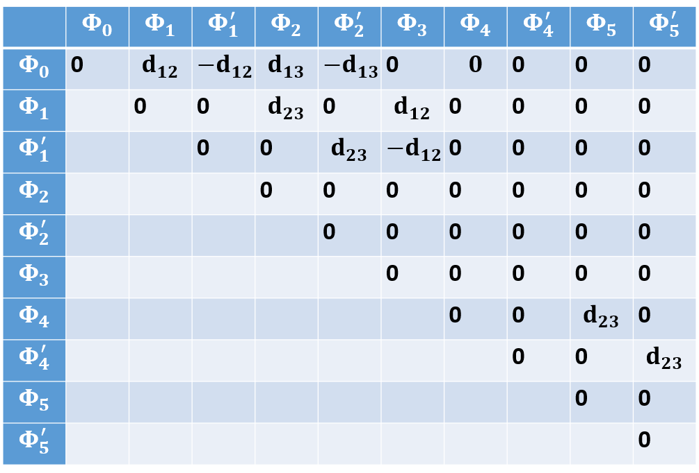
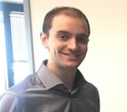

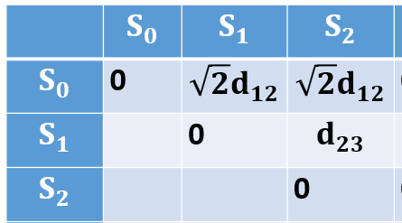



Computing time-overlaps and NACs
Single-particle description of excited states
Many-body description generally accelerates the dynamics
Spin-adapted configurations
$$Ψ=c_{0}Φ_{0}+c_{1}Φ_{1}+c_{2}Φ_{2}+…$$
$$S_{1}=\frac{1}{\sqrt{2}}\left(Φ_{1}−Φ_{1}^{′}\right)$$
$$S_{0}=Φ_{0}$$
$$S_{2}=\frac{1}{\sqrt{2}}\left(Φ_{2}−Φ_{2}^{′}\right)$$
Usually okay for lower excited states
For less symmetric systems
Smith, B. A.; Shakiba, M.; AVA JCTC, 2021, 17, 678
Smith, B. A.; Shakiba, M.; AVA JPCL 2021, 12, 2444
da Silva Oliboni, R.; et al JPCC 2016, 120, 27688
Akimov, A. V.; Prezhdo, O. V. JCTC 2013, 9, 4959
Brendan Smith
Oberhofer, H.; Blumberger, J. PCCP 2012, 14, 13846
Mohammad Shakiba
Shakiba, M.; Stippel, E.; Li, W.; AVA JCTC 2022, 18, 5157

Slide 11

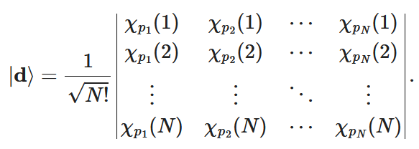
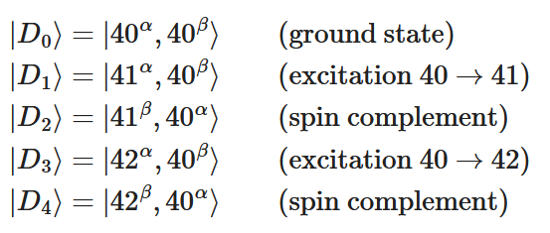
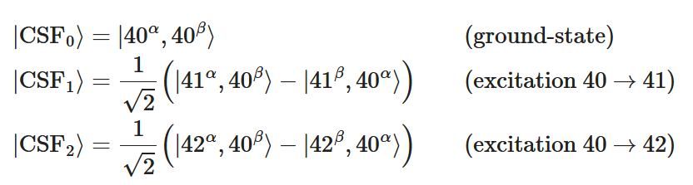
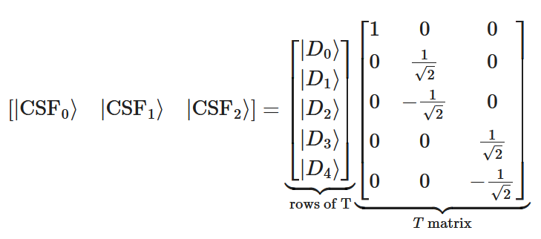

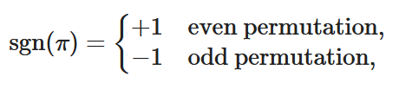

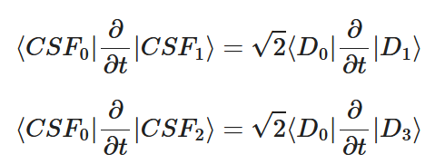

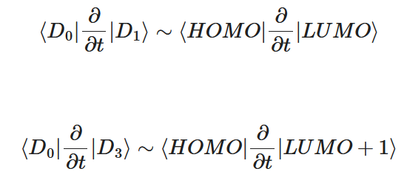
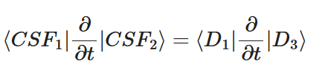
New approach: CI tools
https://github.com/compchem-cybertraining/Tutorials_Libra/tree/master/15_citools
Canonical ordering:

Slide 12

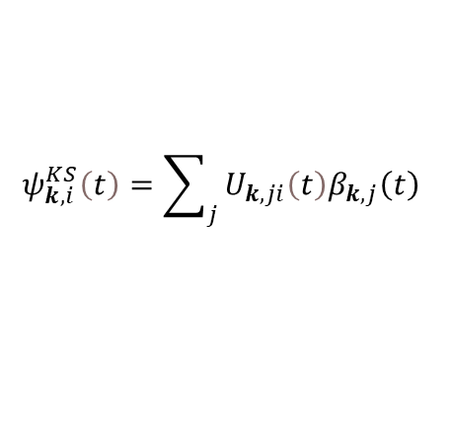



Pushing the size further: xTB (in CP2k)
$$ψ_{k,i}^{KS}\left(t\right)=\sum_{j}{U_{k,ji}\left(t\right)β_{k,j}\left(t\right)}$$
$$β_{k, a}\left(r\right)=\frac{1}{\sqrt{N}}\sum_{t}{e^{ikt}φ_{a}\left(r−t\right)}$$
Previously: cube files, numerically
$$St_{k,a,k^{′},b}^{B}=\left\langle β_{k,a} | β_{k′,b}\right\rangle =\sum_{R}{e^{ik^{′}R}\frac{1}{N} \sum_{t}{e^{i\left(k^{′}−k\right)t}{St}_{ab}^{AO}\left(R\right)}}$$
Smith, B. A.; Shakiba, M.; AVA JCTC, 2021, 17, 678
Smith, B. A.; Shakiba, M.; AVA JPCL 2021, 12, 2444
Mohammad Shakiba
Same k-point
$$St_{k,a,k,b}^{B}=\left\langle β_{k,a} | β_{k,b}\right\rangle =\sum_{R}{e^{ikR}S_{ab}\left(R\right)}$$
Gamma k-point
$$St_{k,a,k,b}^{B}=\left\langle β_{k,a} | β_{k,b}\right\rangle =\left\langle φ_{a} | φ_{b}\right\rangle =St_{ab}^{AO}$$
Current:
numpy.muptiprocessing
Libint2; using molden format
xTB implementation if CP2k
Want to compute these guys
Shakiba, M.; Stippel, E.; Li, W.; AVA JCTC 2022, 18, 5157
https://github.com/compchem-cybertraining/Tutorials_Libra/blob/master/14_molecular_integrals/4_libint2_advanced

Slide 13
Part 4.3: Nonadiabatic Couplings
Initialization
Nuclear dynamics
$\dot{p_{i}}=−\frac{∂H}{∂r_{i}}$ $\dot{r_{i}}=\frac{∂H}{∂p_{i}}$
analytical models or electronic structure codes
Stationary adiabatic states
$${\hat{H}}_{el}ψ_{i}=E_{i}ψ_{i}$$
NAC: Hammes-Schiffer, S.; Tully, J. C. JCP 1994, 101, 4657
Non-adiabatic Couplings
$$d_{ij}=\frac{\left\langle ψ_{i}(t) | ψ_{j}(t+dt)\right\rangle −\left\langle ψ_{i}(t+dt) | ψ_{j}(t)\right\rangle }{2dt}$$
Phase tracking: Akimov, A. V. JPCL 2018 9, 6096
Local Diabatization: Granucci, G.; Persico, M.; Toniolo, A. JCP 2001, 114, 10608; Plasser, F.; Granucci, G.; Pittner, J. et al. JCP 2012, 137, 22A514; Shakiba, M.; Akimov, A. V. TCA 2023, 142, 68
Integrate Coherent Electronic Dynamics
$$Ψ\left(r,R,t\right)=\sum_{i}{c_{i}\left(t\right)ψ_{i}(r;R(t))}$$
$$iℏ\frac{∂c_{i}(t)}{∂t}=\sum_{j}{\left(E_{i}δ_{ij}−iℏd_{ij}\right)}c_{j}$$
NBRA
SDM: Granucci, G.; Persico, M. JCP 2007, 126, 134114; mSDM: Smith, B. A.; Akimov, A. V. JCP, 2019, 151, 124107; IDA: Nelson, T.; Fernandez-Alberti, S.; Roitberg, A. E.; Tretiak, S. JCP 2013, 138, 224111.
Decoherence 1
$$c_{i}→c_{i}\exp\left(−\frac{Δt}{τ_{ij}}\right), ∀i≠j$$
as in SDM
Proposed Hops
Decoherence 2
$$P_{i→j}=Δt∗Re\left(\frac{2{\frac{p}{m}d}_{ij}c_{i}^{∗}c_{j}}{c_{i}^{∗}c_{i}}\right)$$
or as in DISH
FSSH: Tully, J. C. JCP, 1990, 93, 1061
Accept Hops
based on energy conservation or
$$P_{i→f}^{A}=\min\left(1, \exp\left(−\frac{ΔE}{k_{B}T}\right)\right)$$
NBRA: Prezhdo, O. V.; Duncan, W. R.; Prezhdo, V. V. Prog. Surf. Sci. 2009, 84, 30
Change of state/Velocity rescaling
change active electronic state, rescale velocity

Slide 14
Options for the Dynamics: Time-overlaps and NACs
dyn_control_params
time_overlap_method
nac_update_method
nac_algo
How to get the time-overlaps $P_{adi}(t−Δt,t)=\left\langle ψ_{adi}(t−Δt) | ψ_{adi}(t)\right\rangle$ in the dynamics.
[0] - based on the wavefunctions (the Hamiltonian shall have the basis_transform variables updated): $P_{adi}\left(t−Δt,t\right)=U^{+}\left(t−Δt\right)P_{dia}\left(t−Δt,t\right)U(t)$
1 - based on external calculations (the Hamiltonian shall have the time_overlap_adi member updated) - use for NBRA
How to update NACs and vibronic Hamiltonian before electronic TD-SE propagation.
0: don't update them (e.g. for simplest NAC)
[1]: update according to changed momentum and existing derivative couplings
$$d_{ij}=\sum_{n}{D_{ij,n}^{adi}\frac{P_{n}}{M_{n}}}$$
2: update according to time-overlaps (only time-derivative NACs)
How to compute time-derivative NACs (if nac_update_method==2)
(-1): don’t update, e.g. we use NACs from somewhere else [ default ]
0: use HST formula: $d_{ij}\left(t+\frac{Δt}{2}\right)=\frac{St_{ij}\left(t,t+Δt\right])−St_{ij}^{+}\left(t,t+Δt\right])}{2Δt}$
1: use NPI of Meek and Levine
$$T\left(t+Δt\right)=S′\left(t,t+Δt\right)=\left\langle ψ\left(t\right) | ψ\left(t+Δt\right)\right\rangle$$
$$d\left(t+\frac{Δt}{2}\right)≈\frac{1}{Δt}\int_{0}^{dt}{\left\langle ψ\left(t^{′}\right) | \frac{∂}{∂t^{′}} | ψ\left(t^{′}\right)\right\rangle dt^{′}}= \frac{1}{Δt}\int_{0}^{dt}{T^{+}\left(t^{′}\right)\frac{∂}{∂t^{′}}T\left(t^{′}\right)dt^{′}}=\frac{log\left[T\left(t+Δt\right)\right]}{Δt}$$
Meek, G. A.; Levine, B. G. J. Phys. Chem. Lett. 2014, 5, 2351.

Slide 15
Part 4.4: Integrating Electronic EOM
Initialization
Nuclear dynamics
$\dot{p_{i}}=−\frac{∂H}{∂r_{i}}$ $\dot{r_{i}}=\frac{∂H}{∂p_{i}}$
analytical models or electronic structure codes
Stationary adiabatic states
$${\hat{H}}_{el}ψ_{i}=E_{i}ψ_{i}$$
NAC: Hammes-Schiffer, S.; Tully, J. C. JCP 1994, 101, 4657
Non-adiabatic Couplings
$$d_{ij}=\frac{\left\langle ψ_{i}(t) | ψ_{j}(t+dt)\right\rangle −\left\langle ψ_{i}(t+dt) | ψ_{j}(t)\right\rangle }{2dt}$$
Phase tracking: Akimov, A. V. JPCL 2018 9, 6096
Local Diabatization: Granucci, G.; Persico, M.; Toniolo, A. JCP 2001, 114, 10608; Plasser, F.; Granucci, G.; Pittner, J. et al. JCP 2012, 137, 22A514; Shakiba, M.; Akimov, A. V. TCA 2023, 142, 68
Integrate Coherent Electronic Dynamics
$$Ψ\left(r,R,t\right)=\sum_{i}{c_{i}\left(t\right)ψ_{i}(r;R(t))}$$
$$iℏ\frac{∂c_{i}(t)}{∂t}=\sum_{j}{\left(E_{i}δ_{ij}−iℏd_{ij}\right)}c_{j}$$
NBRA
SDM: Granucci, G.; Persico, M. JCP 2007, 126, 134114; mSDM: Smith, B. A.; Akimov, A. V. JCP, 2019, 151, 124107; IDA: Nelson, T.; Fernandez-Alberti, S.; Roitberg, A. E.; Tretiak, S. JCP 2013, 138, 224111.
Decoherence 1
$$c_{i}→c_{i}\exp\left(−\frac{Δt}{τ_{ij}}\right), ∀i≠j$$
as in SDM
Proposed Hops
Decoherence 2
$$P_{i→j}=Δt∗Re\left(\frac{2{\frac{p}{m}d}_{ij}c_{i}^{∗}c_{j}}{c_{i}^{∗}c_{i}}\right)$$
or as in DISH
FSSH: Tully, J. C. JCP, 1990, 93, 1061
Accept Hops
based on energy conservation or
$$P_{i→f}^{A}=\min\left(1, \exp\left(−\frac{ΔE}{k_{B}T}\right)\right)$$
NBRA: Prezhdo, O. V.; Duncan, W. R.; Prezhdo, V. V. Prog. Surf. Sci. 2009, 84, 30
Change of state/Velocity rescaling
change active electronic state, rescale velocity

Slide 16
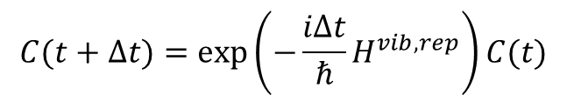
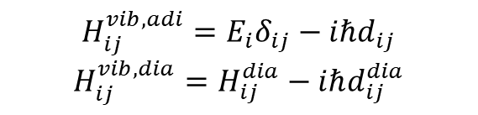
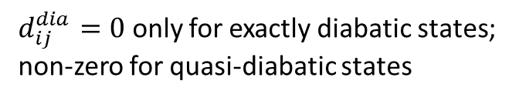
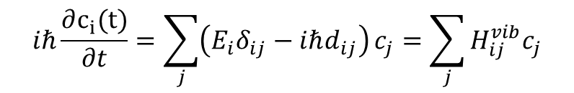
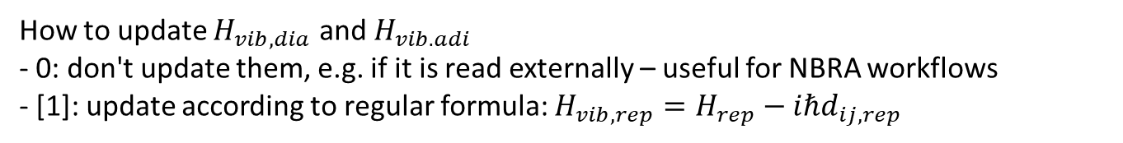
Options for the Dynamics: TD-SE and Hamiltonian
dyn_control_params
rep_tdse
hvib_update_method
how to evolve electronic DOFs: 0 - $C_{dia}$; [1 - $C_{adi}]$; 2 - $P_{dia}$; 3 - $P_{adi}$
How to update $H_{vib,dia}$ and $H_{vib. adi}$
- 0: don't update them, e.g. if it is read externally – useful for NBRA workflows
- [1]: update according to regular formula: $H_{vib,rep}=H_{rep}−iℏd_{ij,rep}$
$$iℏ\frac{∂c_{i}(t)}{∂t}=\sum_{j}{\left(E_{i}δ_{ij}−iℏd_{ij}\right)}c_{j}=\sum_{j}{H_{ij}^{vib}c_{j}}$$
Formally, the solution is:
$$C(t+Δt)=\exp\left(−\frac{iΔt}{ℏ}H^{vib,rep}\right)C(t)$$
electronic_integrator = 5
$$H_{ij}^{vib,adi}=E_{i}δ_{ij}−iℏd_{ij}$$
$$H_{ij}^{vib,dia}=H_{ij}^{dia}−iℏd_{ij}^{dia}$$
In theory, but more complicated in reality…
there is a trivial crossing problem + phase arbitrariness
$d_{ij}^{dia}=0$ only for exactly diabatic states; non-zero for quasi-diabatic states

Slide 17
Trivial Crossing Problem
Arises because of finite $Δt$ or due to inconsistency of energy and NAC (due to approximations)
Not accounting for state tracking can result in – unphysical long-distance charge transfer (e.g. bad carrier mobilities)
Giannini, S.; Carof, A.; Blumberger, J. JPCL 2018, 9, 3116–3123; Bai, X.; Qiu, J.; Wang, L. JCP 2018, 148, 104106.

Slide 18
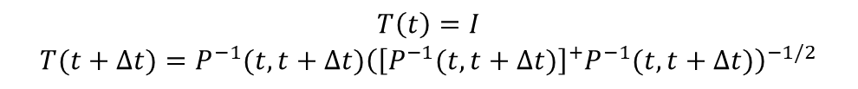

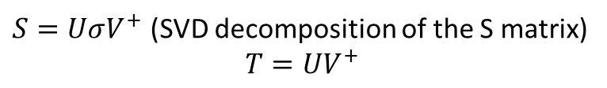


State Tracking Options
state_tracking_algo
State tracking algorithm:
- -1: use LD approach, it includes phase correction too [ default ]
- 0: no state tracking
- 1: method of Kosuke Sato (may fail by getting trapped into an infinite loop)
- 2: Munkres-Kuhn (Hungarian) algorithm
- 21: ChatGPT-generated Munkres-Kuhn (Hungarian) algorithm
- 3: experimental stochastic algorithm, the original version with elimination (known problems)
- 32: experimental stochastic algorithms with all permutations (too expensive)
- 33: the improved stochastic algorithm with good scaling and performance, on par with the mincost
- 4: force-based tracking
- 5: SVD-reformulated LD approach of Granucci and Persico
Shakiba, M.; Akimov, A. V. Theor Chem Acc 2023, 142 (8), 68.
$$T\left(t\right)=I$$
$$T(t+Δt)=P^{−1}(t,t+Δt){\left({\left[P^{−1}(t,t+Δt)\right]}^{+}P^{−1}(t,t+Δt)\right)}^{−1/2}$$
Note: $T=T_{LD}^{−1}$
Granucci G, Persico M, Toniolo A J. Chem. Phys. 2001, 114, 10608
Fernandez-Alberti, S.; Roitberg, A. E.; Nelson, T.; Tretiak, S. J. Chem. Phys. 2012, 137, 014512
$$S\left(t,t+Δt\right)=\left\langle ψ\left(t\right) | ψ\left(t+Δt\right)\right\rangle ↔S_{ij}\left(t,t+Δt\right)=\left\langle ψ_{i}\left(t\right) | ψ_{j}\left(t+Δt\right)\right\rangle$$
Cost matrix: $C_{ij}=−S_{ij}^{2}$
Solution (states’ reordering): $Tr\left(C\right)→min$ same as $Tr\left(S_{ij}^{2}\right)→max$
Akimov, A.V. JPCL 2024 15, 11944
Cost matrix: $C_{ij}=−{\left|\frac{1}{2}\left(1−sign\left(ΔE_{ji}\left(t\right)\right)sign\left(Δ{\tilde{E}}_{ji}\left(t+Δt\right)\right)\right)\right|}^{2}$
Solution: $Tr\left(C\right)→min$
$S=UσV^{+}$ (SVD decomposition of the S matrix)
$$T=UV^{+}$$

Slide 19
Basis of Local Diabatization
Shakiba, M.; Akimov, A. V. Theor Chem Acc 2023, 142 (8), 68.
We want to solve
$$iℏ\frac{∂}{∂t}\left.\left|Ψ\left(t\right)\right.\right\rangle =\hat{H}\left.\left|Ψ\left(t\right)\right.\right\rangle$$
in the adiabatic basis:
$$\left.\left|Ψ\left(t\right)\right.\right\rangle =\left.\left|ψ_{adi}\left(t\right)\right.\right\rangle C_{adi}\left(t\right)$$
Formal solution:
$$\left.\left|Ψ\left(t+Δt\right)\right.\right\rangle =\left[\int_{0}^{Δt}{dτ}\exp\left(−\frac{iτ}{ℏ}\hat{H}\left(t+τ\right)\right)\right]\left.\left|Ψ\left(t\right)\right.\right\rangle =\left.\left|ψ_{adi}\left(t+Δt\right)\right.\right\rangle C_{adi}\left(t+Δt\right)$$
Consider the change of $C_{adi}$ non-adiabatic dynamics
After projection:
$$C_{adi}\left(t+Δt\right)=\left\langle ψ_{adi}\left.\left(t+Δt\right)\right|\right.\left[\int_{0}^{Δt}{dτ}\exp\left(−\frac{iτ}{ℏ}\hat{H}\left(t+τ\right)\right)\right]\left.\left|ψ_{adi}\left(t\right)\right.\right\rangle C_{adi}\left(t\right)$$
However, the bases $\left.|ψ_{adi}(t)\right\rangle$ and$\left.|ψ_{adi}(t+Δt)\right\rangle$ may change their relative order (e.g. in trivial crossing situations) or acquire a spurious phase difference. Consider this as the adiabatic dynamics (e.g. adiabatic charge transfer)

Slide 20
Derivation of Local Diabatization (LD) Approach
Introduce the dynamically-consistent (local diabatic) basis, $\left.|{\tilde{ψ}}_{adi}(t)\right\rangle$: $\left\langle {\tilde{ψ}}_{adi}(t) | {\tilde{ψ}}_{adi}(t+Δt)\right\rangle ≈I$
The idea: these basis functions preserve their identity as much as possible
Closely related to the one in the LD of Granucci et al.
Introduce the basis re-projection matrix, $T(t)$: it describes the adiabatic dynamics of the basis
$$\left.\left|{\tilde{ψ}}_{adi}\left(t\right)\right.\right\rangle =\left.\left|ψ_{adi}\left(t\right)\right.\right\rangle T\left(t\right)$$
$$T=T_{LD}^{−1}$$
Granucci G, Persico M, Toniolo A J. Chem. Phys. 2001, 114, 10608
The wavefunction should stay invariant w.r.t. the choice of the basis:
$$\left.\left|Ψ(t)\right.\right\rangle =\left.\left|{\tilde{ψ}}_{adi}\left(t\right)\right.\right\rangle {\tilde{C}}_{adi}\left(t\right)=\left.\left|ψ_{adi}\left(t\right)\right.\right\rangle C_{adi}\left(t\right)$$
$$C_{adi}\left(t\right)=T\left(t\right){\tilde{C}}_{adi}\left(t\right)$$
Use the definitions above:
$$T^{+}\left(t\right)\left\langle ψ\left(t\right) | ψ\left(t+Δt\right)\right\rangle T\left(t+Δt\right)=T^{+}\left(t\right)P\left(t , t+Δt\right)T\left(t+Δt\right)≈I$$
Time-overlap (transition density matrix):
$$P\left(t,t+Δt\right)=\left\langle ψ\left(t\right) | ψ\left(t+Δt\right)\right\rangle$$
Solving for the re-projection matrix:
$$T\left(t+Δt\right)={\left[T^{+}\left(t\right)P\left(t,t+Δt\right)\right]}^{−1}$$
but this leads to fast accumulation of errors
so, should not evolve the re-projection matrix globally, only locally:
$$T\left(t\right)=I$$
$$T(t+Δt)=P^{−1}(t,t+Δt)$$
Local diabatization assumption

Slide 21
Lowdin normalization in the LD approach
However, this transformation will not preserve the wavefunction norm:
$$T\left(t+Δt\right)={\left[P\left(t,t+Δt\right)\right]}^{−1}$$
$$\left.\left|ψ_{adi}\left(t+Δt\right)\right.\right\rangle =\left.\left|{\tilde{ψ}}_{adi}\left(t+Δt\right)\right.\right\rangle T^{−1}\left(t+Δt\right)$$
$Tr\left[\left\langle ψ\left(t+Δt\right) | ψ\left(t+Δt\right)\right\rangle \right]=Tr\left[{\left(T^{−1}\right)}^{+}\left\langle \tilde{ψ}\left(t+Δt\right) | \tilde{ψ}\left(t+Δt\right)\right\rangle T^{−1}\right]=Tr\left[\left\langle \tilde{ψ}\left(t+Δt\right) | \tilde{ψ}\left(t+Δt\right)\right\rangle T^{−1}{\left(T^{−1}\right)}^{+}\right]=Tr\left[\left\langle \tilde{ψ}\left(t+Δt\right) | \tilde{ψ}\left(t+Δt\right)\right\rangle T^{−1}{\left(T^{+}\right)}^{−1}\right]=Tr\left[\left\langle \tilde{ψ}\left(t+Δt\right) | \tilde{ψ}\left(t+Δt\right)\right\rangle {\left(T^{+}T\right)}^{−1}\right]≠ Tr\left[\left\langle \tilde{ψ}\left(t+Δt\right) | \tilde{ψ}\left(t+Δt\right)\right\rangle \right]$.
Normalize the $T$ matrix: $T→\tilde{T}=TA$ such that ${\tilde{T}}^{+}\left(t+Δt\right)\tilde{T}\left(t+Δt\right)=A^{+}T^{+}\left(t+Δt\right)T\left(t+Δt\right)A=I$
The matrix $A$ can be chosen as: $A={\left(T^{+}\left(t+Δt\right)T\left(t+Δt\right)\right)}^{−1/2}$
So the normalized matrix is: $\tilde{T}\left(t+Δt\right)=T\left(t+Δt\right){\left(T^{+}\left(t+Δt\right)T\left(t+Δt\right)\right)}^{−1/2}$
$$T\left(t\right)=I$$
$$T(t+Δt)=P^{−1}(t,t+Δt){\left({\left[P^{−1}(t,t+Δt)\right]}^{+}P^{−1}(t,t+Δt)\right)}^{−1/2}$$
Local diabatization with Lowdin normalization

Slide 22
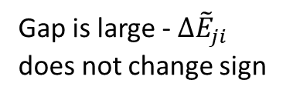
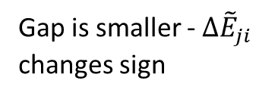
F-tracking approach
Akimov, A.V. JPCL 2024 15, 11944
$$F_{i,α}=−\frac{∂E_{i}}{∂R_{α}}$$
Change of the coordinate under the action of given force:
$$ΔR_{α}=M_{α}^{−1}P_{α}Δt+\frac{1}{2}M_{α}^{−1}F_{α}Δt^{2}$$
so
$$ΔE_{i}\left(t+Δt\right)=−\sum_{α}{F_{i,α}\left(t\right)ΔR_{α}}=−\sum_{α}{F_{i,α}\left(t\right)\left[M_{α}^{−1}P_{α}\left(t+\frac{Δt}{2}\right)Δt+\frac{1}{2}M_{α}^{−1}F_{i,α}\left(t\right)Δt^{2}\right]}$$
Change of energy:
Change of energy gap:
$$Δ{\tilde{E}}_{ji}\left(t+Δt\right)=ΔE_{ji}\left(t\right)+ΔE_{j}−ΔE_{i}=ΔE_{ji}\left(t\right)−\sum_{α}{\left[F_{j,α}\left(t\right)−F_{i,α}\left(t\right)\right]M_{α}^{−1}P_{α}\left(t+\frac{Δt}{2}\right)Δt}−\frac{1}{2}\sum_{α}{\left[F_{j,α}^{2}\left(t\right)−F_{i,α}^{2}\left(t\right)\right]M_{α}^{−1}Δt^{2}}$$
The idea: Need to consider the extrapolated change of the energy gap under the motion with given forces compared to the actual gap change
Cost matrix to be used in the Munkres-Kuhn (Hungarian) maximization algorithm
$$C_{ij}={\left|\frac{1}{2}\left(1−sign\left(ΔE_{ji}\left(t\right)\right)sign\left(Δ{\tilde{E}}_{ji}\left(t+Δt\right)\right)\right)\right|}^{2}$$
$Δ{\tilde{E}}_{ji}$ - changes sign: $C_{ij}=1$ → favors state index permutation
$Δ{\tilde{E}}_{ji}$ - does not change sign: $C_{ij}=0$
Diagonal elements: $Δ{\tilde{E}}_{ji}=0$: $C_{ij}=0.25$
Gap is smaller - $Δ{\tilde{E}}_{ji}$ changes sign
Gap is large - $Δ{\tilde{E}}_{ji}$ does not change sign

Slide 23
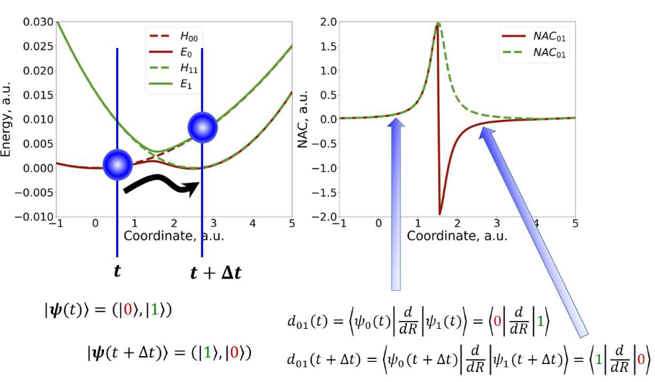



Simple phase correction approach
Akimov, A.V. JPCL 2024 15, 11944
We still assume time-overlaps are not available, but the tNACs are
The available tNACs may still have inconsistent phases
The F-tracking of the states does not fix the phase fluctuations in tNACs
Can we use the tNAC data to fix the signs?
do_nac_phase_correction
Options:
- 0: no correction [ default ]
- 1: do this correction
The idea: while passing the intersection, we want the tNAC not change its sign (be continuous).
$$s_{ij}=sign\left(d_{ij}\left(t−Δt\right)\right)sign\left(d_{ij}\left(t\right)\right),i>j$$
$$d_{ij}\left(t\right)→{\tilde{d}}_{ij}\left(t\right)=d_{ij}\left(t\right)s_{ij}$$
$$d_{ji}\left(t\right)→{\tilde{d}}_{ji}\left(t\right)=d_{ji}\left(t\right)s_{ij}$$
Limitation: if the crossing region is not localized, the tNAC may be changing sign in a continuous way. Then the sign alignment may be incorrect.

Slide 24
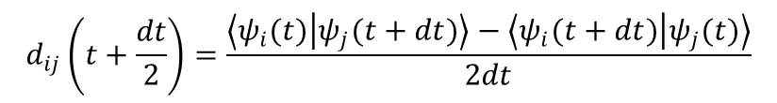
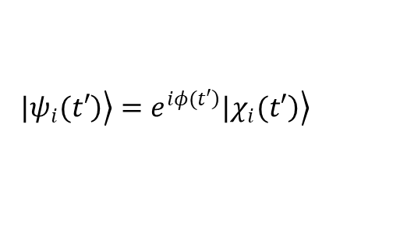

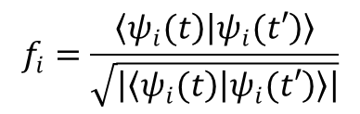
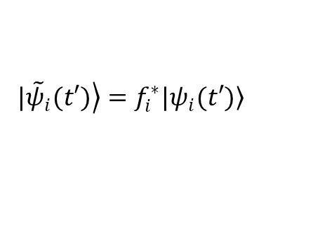
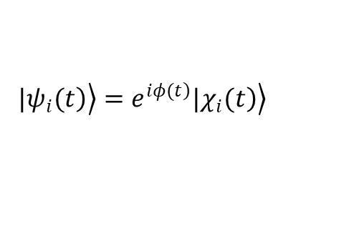
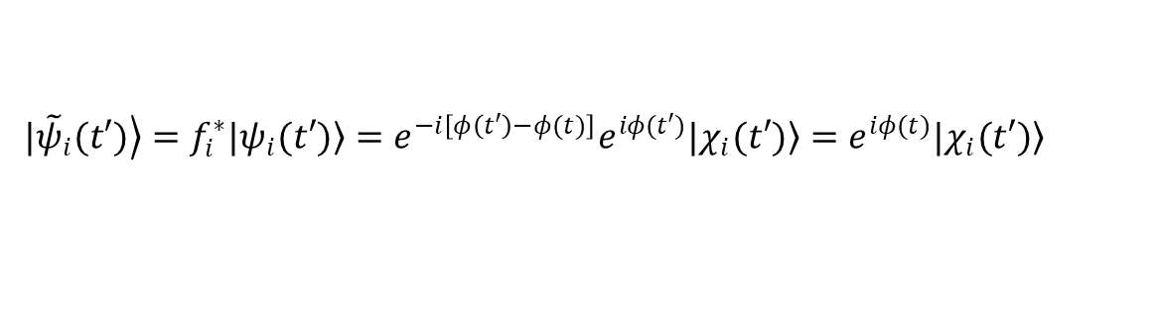
Simple phase correction approach
$$d_{ij}\left(t+\frac{dt}{2}\right)=\frac{\left\langle ψ_{i}(t) | ψ_{j}(t+dt)\right\rangle −\left\langle ψ_{i}(t+dt) | ψ_{j}(t)\right\rangle }{2dt}$$
Hammes-Schiffer, S.; Tully, J. C. J. Chem. Phys. 1994, 101, 4657–4667
But states are defined only up to a complex phase!
Phase correction:
$$f_{i}=\frac{\left\langle \left.ψ_{i}(t\right) | \left.ψ_{i}(t′\right)\right\rangle }{\sqrt{\left|\left\langle \left.ψ_{i}(t\right) | \left.ψ_{i}(t′\right)\right\rangle \right|}}$$
do_phase_correction
Options:
- 0: no phase correction
- 1: according to our phase correction algorithm [ default ]
phase_correction_tol
The minimal magnutude of the matrix element for which we'll be computing the phase correction
If the overlap is zero, then we don't really care about the phase, but if it is not, then this parameter sets out threshold for when we do. [ default: 1e-3 ]
AVA. J. Phys. Chem. Lett. 2018 9, 6096
$\left.|{\tilde{ψ}}_{i}(t′)\right\rangle =f_{i}^{∗}\left.|ψ_{i}(t′)\right\rangle$
$$C_{adi,i}→{\tilde{C}}_{adi,i}=f_{i}C_{adi,i}$$
$$\left.\left.|ψ_{i}(t\right)\right\rangle =e^{\left.iφ(t\right)}\left.\left.|χ_{i}(t\right)\right\rangle$$
Indeed:
$$\left.\left.|ψ_{i}(t′\right)\right\rangle =e^{\left.iφ(t′\right)}\left.\left.|χ_{i}(t′\right)\right\rangle$$
Then:
$\left.|{\tilde{ψ}}_{i}(t′)\right\rangle =f_{i}^{∗}\left.|ψ_{i}(t′)\right\rangle =e^{−i\left[φ\left(t′\right)−φ(t)\right]}e^{iφ(t′)}\left.|χ_{i}(t′)\right\rangle =e^{iφ(t)}\left.|χ_{i}(t′)\right\rangle$

Slide 25
Summary of Electronic Integrators
dyn_control_params
electronic_integrator
rep_tdse = 0 (diabatic):
rep_tdse = 1 (adiabatic):
rep_tdse = 2 ( diabatic, density matrix formalism):
-1 - No propagation
0 - LD, with crude splitting, with exp_ [ default ]
1 - LD, with symmetric splitting, with exp_
2 - LD, original, with exp_
3 - 1-point, Hvib integration, with exp_
4 - 2-points, Hvib integration, with exp_
5 - 3-points, Hvib, integration with the second-point correction of Hvib, with exp_
6 - same as 4, but without projection matrices (T_new = I)
10 - same as 0, but with rotations
11 - same as 1, but with rotations
12 - same as 2, but with rotations
13 - same as 3, but with rotations
14 - same as 4, but with rotations
15 - same as 5, but with rotations
0 - mid-point Hvib with the second-point correction of Hvib
-1 - No propagation
0 - Lowdin exp_ with 2-point Hvib_dia
1 - based on QTAG propagator
2 - based on modified QTAG propagator (Z at two times)
3 - non-Hermitian integrator with 2-point Hvib_dia
rep_tdse = 3 ( adiabatic, density matrix formalism):
0 - mid-point Hvib with the second-point correction of Hvib
1 - Zhu Liouvillian
10 - same as 0, but with rotations

Slide 26
Back to Integrating the TD-SE
$$U\left(t,t+Δt\right)=\left\langle ψ_{adi}\left.\left(t+Δt\right)\right|\right.\left[\int_{0}^{Δt}{dτ}\exp\left(−\frac{iτ}{ℏ}\hat{H}\left(t+τ\right)\right)\right]\left.\left|ψ_{adi}\left(t\right)\right.\right\rangle$$
$$\left[\int_{0}^{Δt}{dτ}\exp\left(−\frac{iτ}{ℏ}\hat{H}\left(τ\right)\right)\right]≈\left[\exp\left(−\frac{iΔt}{2ℏ}\left[\hat{H}\left(t\right)+\hat{H}\left(t+Δt\right)\right]\right)\right]≈\left[\exp\left(−\frac{iΔt}{2ℏ}\hat{H}\left(t+Δt\right)\right)\right]\left[\exp\left(−\frac{iΔt}{2ℏ}\hat{H}\left(t\right)\right)\right]$$
Crude splitting:
$$U\left(t,t+Δt\right)≈\left\langle ψ_{adi}\left.\left(t+Δt\right)\right|\right.\left[\exp\left(−\frac{iΔt}{2ℏ}\hat{H}\left(t+Δt\right)\right)\right]\left[\exp\left(−\frac{iΔt}{2ℏ}\hat{H}\left(t\right)\right)\right]\left.\left|ψ_{adi}\left(t\right)\right.\right\rangle$$
Using properties of the local-diabatic basis:
$$\left|\left.{\tilde{ψ}}_{adi}\left(t+Δt\right)\right\rangle \left\langle {\tilde{ψ}}_{adi}\left.\left(t\right)\right|\right.≈\right|\left.{\tilde{ψ}}_{adi}\left(t\right)\right\rangle \left\langle {\tilde{ψ}}_{adi}\left.\left(t+Δt\right)\right|\right.≈\hat{I}$$
$U\left(t,t+Δt\right)≈\left\langle ψ_{adi}\left.\left(t+Δt\right)\right|\right.\left[\exp\left(−\frac{iΔt}{2ℏ}\hat{H}\left(t+Δt\right)\right)\right]\left.{\tilde{ψ}}_{adi}\left(t+Δt\right)\right\rangle \left\langle {\tilde{ψ}}_{adi}\left.\left(t\right)\right|\right.\left[\exp\left(−\frac{iΔt}{2ℏ}\hat{H}\left(t\right)\right)\right]\left.\left|ψ_{adi}\left(t\right)\right.\right\rangle =\left\langle ψ_{adi}\left.\left(t+Δt\right)\right|\right.\left[\exp\left(−\frac{iΔt}{2ℏ}\hat{H}\left(t+Δt\right)\right)\right]\left.ψ_{adi}\left(t+Δt\right)\right\rangle T\left(t+Δt\right)T^{+}\left(t\right)\left\langle ψ_{adi}\left.\left(t\right)\right|\right.\left[\exp\left(−\frac{iΔt}{2ℏ}\hat{H}\left(t\right)\right)\right]\left.\left|ψ_{adi}\left(t\right)\right.\right\rangle =A(t+Δt)T\left(t+Δt\right)$ $A(t)$
$$A\left(t\right)=\left\langle ψ_{adi}\left.\left(t\right)\right|\right.\left[\exp\left(−\frac{iΔt}{2ℏ}\hat{H}\left(t\right)\right)\right]\left.\left|ψ_{adi}\left(t\right)\right.\right\rangle =\exp\left(−\frac{iΔt}{2ℏ}H\left(t\right)\right)$$
Note: this should be the electronic Hamiltonian, not the vibronic Hamiltonian!

Slide 27
Back to Integrating the TD-SE: Another integrator
$$U\left(t,t+Δt\right)=\left\langle ψ_{adi}\left.\left(t+Δt\right)\right|\right.\left[\exp\left(−\frac{iΔt}{4ℏ}\hat{H}\left(t\right)\right)\right]\left[\exp\left(−\frac{iΔt}{2ℏ}\hat{H}\left(t+Δt\right)\right)\right]\left[\exp\left(−\frac{iΔt}{4ℏ}\hat{H}\left(t\right)\right)\right]\left.\left|ψ_{adi}\left(t\right)\right.\right\rangle$$
Symmetric splitting:
$$U\left(t,t+Δt\right)=\left\langle ψ_{adi}\left.\left(t+Δt\right)\right|\right.\left.\left|{\tilde{ψ}}_{adi}\left(t+Δt\right)\right.\right\rangle \left\langle {\tilde{ψ}}_{adi}\left.\left(t\right)\right|\right.\left[\exp\left(−\frac{iΔt}{4ℏ}\hat{H}\left(t\right)\right)\right]\left.\left|{\tilde{ψ}}_{adi}\left(t\right)\right.\right\rangle \left\langle {\tilde{ψ}}_{adi}\left.\left(t+Δt\right)\right|\right.\left[\exp\left(−\frac{iΔt}{2ℏ}\hat{H}\left(t+Δt\right)\right)\right]\left.\left|{\tilde{ψ}}_{adi}\left(t+Δt\right)\right.\right\rangle \left\langle {\tilde{ψ}}_{adi}\left.\left(t\right)\right|\right.\left[\exp\left(−\frac{iΔt}{4ℏ}\hat{H}\left(t\right)\right)\right]\left.\left|ψ_{adi}\left(t\right)\right.\right\rangle$$
$$U\left(t,t+Δt\right)=\left\langle ψ_{adi}\left.\left(t+Δt\right)\right|\right.\left.\left|ψ_{adi}\left(t+Δt\right)\right.\right\rangle T\left(t+Δt\right)T^{+}\left(t\right)\left\langle ψ_{adi}\left.\left(t\right)\right|\right.\left[\exp\left(−\frac{iΔt}{4ℏ}\hat{H}\left(t\right)\right)\right]\left.\left|ψ_{adi}\left(t\right)\right.\right\rangle T\left(t\right)T^{+}\left(t+Δt\right)\left\langle ψ_{adi}\left.\left(t+Δt\right)\right|\right.\left[\exp\left(−\frac{iΔt}{2ℏ}\hat{H}\left(t+Δt\right)\right)\right]\left.\left|ψ_{adi}\left(t+Δt\right)\right.\right\rangle T\left(t+Δt\right)T^{+}\left(t\right)\left\langle ψ_{adi}\left.\left(t\right)\right|\right.\left[\exp\left(−\frac{iΔt}{4ℏ}\hat{H}\left(t\right)\right)\right]\left.\left|ψ_{adi}\left(t\right)\right.\right\rangle =T\left(t+Δt\right)B\left(t\right)T^{+}\left(t+Δt\right)A\left(t+Δt\right)T\left(t+Δt\right)B\left(t\right)$$
$$B\left(t\right)=\left\langle ψ_{adi}\left.\left(t\right)\right|\right.\left[\exp\left(−\frac{iΔt}{4ℏ}\hat{H}\left(t\right)\right)\right]\left.\left|ψ_{adi}\left(t\right)\right.\right\rangle =\exp\left(−\frac{iΔt}{4ℏ}H\left(t\right)\right)=A^{1/2}$$

Slide 28
Rotation-based Integrators for TD-SE
$$iℏ\frac{∂C}{∂t}=XC$$
$$X_{ij}=Re\left[X_{ij}\right]+iIm\left[X_{ij}\right]$$
$C\left(t+Δt\right)=exp⁡(iLΔt)C(t)$.
$$iL≡\dot{C}\frac{∂}{∂C}=\sum_{i}{\dot{C_{i}}\frac{∂}{∂C_{i}}}$$
$$iL=−\frac{i}{ℏ}\sum_{i}{\sum_{j}{X_{ij}C_{j}}\frac{∂}{∂C_{i}}}=−\frac{i}{ℏ}\sum_{i,j}{X_{ij}C_{j}\frac{∂}{∂C_{i}}}=−\frac{i}{ℏ}\sum_{i}{X_{ii}C_{i}\frac{∂}{∂C_{i}}}−\frac{i}{ℏ}\sum_{i,j:i>j}{\left[X_{ij}C_{j}\frac{∂}{∂C_{i}}\right]}−\frac{i}{ℏ}\sum_{i,j:i<j}{\left[X_{ij}C_{j}\frac{∂}{∂C_{i}}\right]}=−\frac{i}{ℏ}\sum_{i}{X_{ii}C_{i}\frac{∂}{∂C_{i}}}−\frac{i}{ℏ}\sum_{i,j:i>j}{\left[X_{ij}C_{j}\frac{∂}{∂C_{i}}\right]}−\frac{i}{ℏ}\sum_{i,j:i>j}{\left[X_{ji}C_{i}\frac{∂}{∂C_{j}}\right]}=−\frac{i}{ℏ}\sum_{i}{X_{ii}C_{i}\frac{∂}{∂C_{i}}}−\frac{i}{ℏ}\sum_{i,j:i>j}{\left[X_{ij}C_{j}\frac{∂}{∂C_{i}}+X_{ji}C_{i}\frac{∂}{∂C_{j}}\right]}$$
$$iL=−\frac{i}{ℏ}\sum_{i}{X_{ii}C_{i}\frac{∂}{∂C_{i}}}−\frac{i}{ℏ}\sum_{i,j:i>j}{\left[Re\left(X_{ij}\right)\left[C_{j}\frac{∂}{∂C_{i}}+C_{i}\frac{∂}{∂C_{j}}\right]+iIm\left(X_{ij}\right)\left[C_{j}\frac{∂}{∂C_{i}}−C_{i}\frac{∂}{∂C_{j}}\right]\right]}=\sum_{i}{iL_{i}^{\left(1\right)}}+\sum_{i,j:i>j}{iL_{ij}^{\left(2\right)}}+\sum_{i,j:i>j}{iL_{ij}^{\left(3\right)}}$$
$$iL_{ij}^{\left(2\right)}=\frac{Im\left(X_{ij}\right)}{ℏ}\left[C_{j}\frac{∂}{∂C_{i}}−C_{i}\frac{∂}{∂C_{j}}\right]$$
$$iL_{ij}^{\left(3\right)}=−\frac{iRe\left(X_{ij}\right)}{ℏ}\left[C_{j}\frac{∂}{∂C_{i}}+C_{i}\frac{∂}{∂C_{j}}\right]$$
$$iL_{i}^{\left(1\right)}=−\frac{i}{ℏ}X_{ii}C_{i}\frac{∂}{∂C_{i}}$$

Slide 29
Rotation-based Integrators for TD-SE: Action of the operators
$$\exp\left(iL_{i}^{\left(1\right)}Δt\right)C_{i}=\exp\left(−\frac{iΔt}{ℏ}X_{ii}\right)C_{i}$$
$$A=\frac{Im\left(X_{ij}\right)Δt}{ℏ}$$
$$B=\frac{Re\left(X_{ij}\right)Δt}{ℏ}$$
$$\exp\left(iL_{ij}^{\left(2\right)}Δt\right)\left(\begin{matrix}C_{i} \\ C_{j}\end{matrix}\right)=\left(\begin{matrix}C_{i} \\ C_{j}\end{matrix}\right)+A\left(\begin{matrix}C_{j} \\ {−C}_{i}\end{matrix}\right)+\frac{A^{2}}{2!}\left(\begin{matrix}−C_{i} \\ {−C}_{j}\end{matrix}\right)+\frac{A^{3}}{3!}\left(\begin{matrix}−C_{j} \\ C_{i}\end{matrix}\right)+\frac{A^{4}}{4!}\left(\begin{matrix}C_{i} \\ C_{j}\end{matrix}\right)…=\left(\begin{matrix}1−\frac{A^{2}}{2!}+\frac{A^{4}}{4!}… & A−\frac{A^{3}}{3!}+… \\ −A+\frac{A^{3}}{3!}+… & 1−\frac{A^{2}}{2!}+\frac{A^{4}}{4!}…\end{matrix}\right)\left(\begin{matrix}C_{i} \\ C_{j}\end{matrix}\right)=\left(\begin{matrix}\cos\left(A\right) & \sin\left(A\right) \\ −\sin\left(A\right) & \cos\left(A\right)\end{matrix}\right)\left(\begin{matrix}C_{i} \\ C_{j}\end{matrix}\right)$$
$$\exp\left(iL_{ij}^{\left(3\right)}Δt\right)\left(\begin{matrix}C_{i} \\ C_{j}\end{matrix}\right)=\left(\begin{matrix}C_{i} \\ C_{j}\end{matrix}\right)−iB\left(\begin{matrix}C_{j} \\ C_{i}\end{matrix}\right)+\frac{{\left(−iB\right)}^{2}}{2!}\left(\begin{matrix}C_{i} \\ C_{j}\end{matrix}\right)+\frac{{\left(−iB\right)}^{3}}{3!}\left(\begin{matrix}C_{j} \\ C_{i}\end{matrix}\right)+\frac{{\left(−iB\right)}^{4}}{4!}\left(\begin{matrix}C_{i} \\ C_{j}\end{matrix}\right)+…=\left(\begin{matrix}1−\frac{B^{2}}{2!}+\frac{B^{4}}{4!}+… & −iB+\frac{\left(−i{\left.B\right)}^{3}\right.}{3!}+… \\ −iB+\frac{\left(−i{\left.B\right)}^{3}\right.}{3!}+… & 1−\frac{B^{2}}{2!}+\frac{B^{4}}{4!}+…\end{matrix}\right)\left(\begin{matrix}C_{i} \\ C_{j}\end{matrix}\right)=\left(\begin{matrix}\cos\left(B\right) & −i\sin\left(B\right) \\ −i\sin\left(B\right) & \cos\left(B\right)\end{matrix}\right)\left(\begin{matrix}C_{i} \\ C_{j}\end{matrix}\right)$$

Slide 30
Rotation-based Integrators for TD-SE: Overall Factorization
$$\exp\left(iLΔt\right)=\exp\left(\left\{\sum_{i}{iL_{i}^{\left(1\right)}}+\sum_{i,j:i>j}{iL_{ij}^{\left(2\right)}}+\sum_{i,j:i>j}{iL_{ij}^{\left(3\right)}}\right\}Δt\right)≈\left\{\prod_{i}{\exp\left(iL_{i}^{\left(1\right)}\frac{Δt}{2}\right)}\right\}\left\{\prod_{i,j:i>j}{\exp\left(iL_{ij}^{\left(3\right)}\frac{Δt}{2}\right)}\right\}\left\{\prod_{i,j:i>j}{\exp\left(iL_{ij}^{\left(2\right)}\frac{Δt}{2}\right)}\right\}\left\{\prod_{O\{i,j:i>j\}}{\exp\left(iL_{ij}^{\left(2\right)}\frac{Δt}{2}\right)}\right\}\left\{\prod_{O\{i,j:i>j\}}{\exp\left(iL_{ij}^{\left(3\right)}\frac{Δt}{2}\right)}\right\}\left\{\prod_{O\{i\}}{\exp\left(iL_{i}^{\left(1\right)}\frac{Δt}{2}\right)}\right\}$$
$$\exp\left(iL_{0}^{\left(1\right)}\frac{Δt}{2}\right)\exp\left(iL_{1}^{\left(1\right)}\frac{Δt}{2}\right)\exp\left(iL_{2}^{\left(1\right)}\frac{Δt}{2}\right)\exp\left(iL_{01}^{\left(3\right)}\frac{Δt}{2}\right)\exp\left(iL_{02}^{\left(3\right)}\frac{Δt}{2}\right)\exp\left(iL_{12}^{\left(3\right)}\frac{Δt}{2}\right)$$
$$\exp\left(iL_{01}^{\left(2\right)}\frac{Δt}{2}\right)\exp\left(iL_{02}^{\left(2\right)}\frac{Δt}{2}\right)\exp\left(iL_{12}^{\left(2\right)}\frac{Δt}{2}\right)\exp\left(iL_{12}^{\left(2\right)}\frac{Δt}{2}\right)\exp\left(iL_{02}^{\left(2\right)}\frac{Δt}{2}\right)\exp\left(iL_{01}^{\left(2\right)}\frac{Δt}{2}\right)$$
$$\exp\left(iL_{12}^{\left(3\right)}\frac{Δt}{2}\right)\exp\left(iL_{02}^{\left(3\right)}\frac{Δt}{2}\right)\exp\left(iL_{01}^{\left(3\right)}\frac{Δt}{2}\right)\exp\left(iL_{2}^{\left(1\right)}\frac{Δt}{2}\right)\exp\left(iL_{1}^{\left(1\right)}\frac{Δt}{2}\right)\exp\left(iL_{0}^{\left(1\right)}\frac{Δt}{2}\right)$$

Slide 31
Working the Liouville’s space: propagation of density matrix
$$iℏ\frac{∂\hat{ρ}}{∂t}=\left[\hat{H},\hat{ρ}\right]$$
Vectorized form of the QCLE
$${\tilde{L}}_{ij,ab}={\tilde{H}}_{ia}δ_{bj}−{\tilde{H}}_{bj}δ_{ai}$$
$$\frac{∂{\tilde{ρ}}_{ij}}{∂t}=−\frac{i}{ℏ}\sum_{a,b}{{\tilde{L}}_{ij,ab}{\tilde{ρ}}_{ab}}$$
$$\frac{∂vec\left(\tilde{ρ}\right)}{∂t}=−i\tilde{L}∗vec\left(\tilde{ρ}\right)$$
$$\tilde{H}=\left\langle \tilde{ψ} | \hat{H} | \tilde{ψ}\right\rangle =T^{+}\left\langle ψ | \hat{H} | ψ\right\rangle T$$
$N×N$ matrix
$N^{2}×N^{2}$ matrix
$N^{2}×1$ vector
For the “closed” quantum systems, there is a direct correspondence between wavefunction and density matrix, so:
$$ρ_{adi}=C_{adi}C_{adi}^{+}=T{\tilde{C}}_{adi}{\tilde{C}}_{adi}^{+}T^{+}=T{\tilde{ρ}}_{adi}T^{+}$$
$${\tilde{ρ}}_{adi}=T^{−1}ρ_{adi}{\left(T^{+}\right)}^{−1}=T^{+}ρ_{adi}T$$
$$ρ\left(t+Δt\right)=T\left(t+Δt\right)vec^{−1}\left\{\left[\int_{0}^{Δt}{dτ}\exp\left(−\frac{iτ}{ℏ}\tilde{L}\left(t+τ\right)\right)\right]vec\left(ρ\left(t\right)\right)T\right\}T^{+}\left(t+Δt\right)$$
So, the final expression:

Slide 32
Additional flags for the Integrators
dyn_control_params
assume_always_consistent
ampl_transformation_method
If set to True (1), we will force the reprojection matrix T_new to be the identity matrix. This effectively removes basis-reprojection (local diabatization) approach and turns on the "naive" approach where no trivial crossings exist.
- [0]: No - we do want to use the LD approaches by default.
- 1: Yes - one may need to turn on additional state tracking and phase correction methods
Whether transform the amplitudes by the T transformation matrix
- 0: do not transform by the T matrix (naive, but potentially correct approach)
- 1: do transform it (as in LD, but maybe not needed if we directly transform basis)

Slide 33
Part 4.5: Hop Proposal Probabilities
Initialization
Nuclear dynamics
$\dot{p_{i}}=−\frac{∂H}{∂r_{i}}$ $\dot{r_{i}}=\frac{∂H}{∂p_{i}}$
analytical models or electronic structure codes
Stationary adiabatic states
$${\hat{H}}_{el}ψ_{i}=E_{i}ψ_{i}$$
NAC: Hammes-Schiffer, S.; Tully, J. C. JCP 1994, 101, 4657
Non-adiabatic Couplings
$$d_{ij}=\frac{\left\langle ψ_{i}(t) | ψ_{j}(t+dt)\right\rangle −\left\langle ψ_{i}(t+dt) | ψ_{j}(t)\right\rangle }{2dt}$$
Phase tracking: Akimov, A. V. JPCL 2018 9, 6096
Local Diabatization: Granucci, G.; Persico, M.; Toniolo, A. JCP 2001, 114, 10608; Plasser, F.; Granucci, G.; Pittner, J. et al. JCP 2012, 137, 22A514; Shakiba, M.; Akimov, A. V. TCA 2023, 142, 68
Integrate Coherent Electronic Dynamics
$$Ψ\left(r,R,t\right)=\sum_{i}{c_{i}\left(t\right)ψ_{i}(r;R(t))}$$
$$iℏ\frac{∂c_{i}(t)}{∂t}=\sum_{j}{\left(E_{i}δ_{ij}−iℏd_{ij}\right)}c_{j}$$
NBRA
SDM: Granucci, G.; Persico, M. JCP 2007, 126, 134114; mSDM: Smith, B. A.; Akimov, A. V. JCP, 2019, 151, 124107; IDA: Nelson, T.; Fernandez-Alberti, S.; Roitberg, A. E.; Tretiak, S. JCP 2013, 138, 224111.
Decoherence 1
$$c_{i}→c_{i}\exp\left(−\frac{Δt}{τ_{ij}}\right), ∀i≠j$$
as in SDM
Proposed Hops
Decoherence 2
$$P_{i→j}=Δt∗Re\left(\frac{2{\frac{p}{m}d}_{ij}c_{i}^{∗}c_{j}}{c_{i}^{∗}c_{i}}\right)$$
or as in DISH
FSSH: Tully, J. C. JCP, 1990, 93, 1061
Accept Hops
based on energy conservation or
$$P_{i→f}^{A}=\min\left(1, \exp\left(−\frac{ΔE}{k_{B}T}\right)\right)$$
NBRA: Prezhdo, O. V.; Duncan, W. R.; Prezhdo, V. V. Prog. Surf. Sci. 2009, 84, 30
Change of state/Velocity rescaling
change active electronic state, rescale velocity

Slide 34
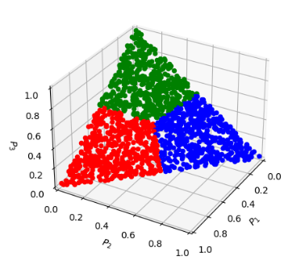
Hop Proposal Probability
FSSH:
Tully, J. C. J. Chem. Phys. 1990, 93, 1061
$$σ\left(x\right)=xH\left(x\right)=\left\{\begin{matrix}x,x≥0 \\ 0, otherwise\end{matrix}\right.$$
$$P_{i→j}^{FSSH}=σ\left(\frac{2Re\left(ρ_{ij}^{∗}d_{ij}\right)Δt}{ρ_{ii}}\right)$$
GFSH:
Wang, L.; Trivedi, D.; Prezhdo, O. V. JCTC 2014, 10, 3598
$$P_{i→j}^{GFSH}=\frac{Δρ_{jj}}{ρ_{ii}}\frac{Δρ_{ii}}{\sum_{k∈A}{Δρ_{kk}}}, i∈A,j∈B$$
MSSH:
Akimov, A. V.; Trivedi, D.; Wang, L.; Prezhdo, O. V. J. Phys. Soc. Jpn. 2015, 84, 094002
$$P_{i→f}^{P,MSSH}(t,t+Δt)=P_{ff}(t+Δt)$$
FSSH2:
Araujo, L.; Lasser, C.; Schmidt, B. J. Chem. Theory Comput. 2024, 20, 3413–3419
$P_{i→j}^{FSSH−2}=\min\left(σ\left(−\frac{ρ_{ii}\left(t+Δt\right)−ρ_{ii}\left(t\right)}{ρ_{ii}\left(t\right)}\right),σ\left(\frac{ρ_{jj}\left(t+Δt\right)−ρ_{jj}\left(t\right)}{ρ_{ii}\left(t\right)}\right)\right),∀j≠i$
$$P_{i→j}^{FSSH−3}=σ\left(−\frac{Δρ_{ii}\left(t\right)}{ρ_{ii}\left(t\right)}\right)\frac{σ\left(J_{j,i}\right)}{\sum_{k}{σ\left(J_{k,i}\right)}},∀j≠i$$
FSSH3:
Akimov, A. V. Mol. Phys. 2024, Mol. Phys. e2376893
$J_{0}=\min_{J}{{\left\|y−Jx\right\|}_{2}^{2}}$
MASH:
(1)Mannouch, J. R.; Richardson, J. O. A JCP 2023, 158, 104111
(2)Runeson, J. E.; Manolopoulos, D. E. A JCP 2023, 159, 094115.
(3)E. Runeson, J.; P. Fay, T.; E. Manolopoulos, D. PCCP 2024, 26, 4929–4938.
$$P_{∗→j}=1, ∃j:ρ_{jj}=\max_{i}\left(ρ_{ii}\right)$$
$$P_{∗→k}=0,∀k≠j$$
ZN:
Zhu, C., Nakamura, H., Re, N., Aquilanti, V., 1992. J. Chem. Phys. 97, 1892
Hanasaki, K., Kanno, M., Niehaus, T.A., Kono, H., 2018. J. Chem. Phys. 149. 244117
Yu, L., Xu, C., Lei, Y., Zhu, C., Wen, Z., 2014. Phys. Chem. Chem. Phys. 16. 25883.
LZ:
Tully, J. C. J. Chem. Phys. 1990, 93, 1061, 1071
Belyaev, A. K.; Lebedev, O. V. Phys. Rev. A 2011, 84, 014701

Slide 35
FSSH and MSSH Hop Proposal Probability
FSSH
$$P_{i→∗}\left(t,t+Δt\right)=σ\left(\frac{ρ_{ii}\left(t\right)−ρ_{ii}\left(t+Δt\right)}{ρ_{ii}\left(t\right)}\right)≈σ\left(\frac{−{\dot{ρ}}_{ii}\left(t\right)Δt}{ρ_{ii}\left(t\right)}\right)=σ\left(−\frac{Δρ_{ii}\left(t\right)}{ρ_{ii}\left(t\right)}\right)=σ\left(−\frac{ρ_{ii}\left(t+Δt\right)−ρ_{ii}\left(t\right)}{ρ_{ii}\left(t\right)}\right)$$
$$σ\left(x\right)=xH\left(x\right)=\left\{\begin{matrix}x,x≥0 \\ 0, otherwise\end{matrix}\right.$$
$$P_{i→∗}\left(t,t+Δt\right)≈σ\left(\frac{−{\dot{ρ}}_{ii}\left(t\right)Δt}{ρ_{ii}\left(t\right)}\right)=2σ\left(\frac{\sum_{j=0}^{N−1}{Re\left(ρ_{ij}^{∗}d_{ij}\right)}Δt}{ρ_{ii}}\right)≈\sum_{j=0}^{N−1}{σ\left(\frac{2Re\left(ρ_{ij}^{∗}d_{ij}\right)Δt}{ρ_{ii}}\right)}$$
References:
$$P_{i→j}^{FSSH}=σ\left(\frac{2Re\left(ρ_{ij}^{∗}d_{ij}\right)Δt}{ρ_{ii}}\right)$$
Tully, J. C. J. Chem. Phys. 1990, 93, 1061
Fabiano, E.; Keal, T. W.; Thiel, W. Chem. Phys. 2008, 349 (1), 334–347.
$$P_{i→j}^{FSSH}=max\left(0, \frac{2Re\left(ρ_{ij}^{∗}d_{ij}\right)Δt}{ρ_{ii}}\right)$$
$$P_{i→j}^{P}=max\left(0,\frac{Δt}{ℏP_{ii}}Im\left[P_{i,j}H_{j,i }^{vib} −H_{i,j }^{vib}P_{j,i}\right]\right)$$
MSSH
$$P_{i→f}^{P,MSSH}(t,t+Δt)=P_{ff}(t+Δt)$$
Akimov, A. V.; Trivedi, D.; Wang, L.; Prezhdo, O. V. J. Phys. Soc. Jpn. 2015, 84, 094002

Slide 36
GFSH and FSSH-2 Hop Proposal Probability
FSSH-2
GFSH – starts with considering the changes of populations of all states
Total flux out of state $i$ is the same as in the FSSH
$P_{i→∗}\left(t,t+Δt\right)≈σ\left(\frac{−{\dot{ρ}}_{ii}\left(t\right)Δt}{ρ_{ii}\left(t\right)}\right)=σ\left(−\frac{Δρ_{ii}\left(t\right)}{ρ_{ii}\left(t\right)}\right)$
$\sum_{i=0}^{N−1}{ρ_{ii}}=1$
$$Δρ_{ii}\left(t\right)=ρ_{ii}\left(t+Δt\right)−ρ_{ii}\left(t\right)$$
$$i∈A:Δρ_{ii}<0$$
$P_{i→∗}\left(t,t+Δt\right)=σ\left(−\frac{Δρ_{ii}\left(t\right)}{ρ_{ii}\left(t\right)}\right)=σ\left(−\frac{ρ_{ii}\left(t+Δt\right)−ρ_{ii}\left(t\right)}{ρ_{ii}\left(t\right)}\right)=σ\left(−\frac{\left(1−\sum_{j≠i}{\left.ρ_{jj}\left(t+Δt\right)\right) }−\left(1−\sum_{j≠i}{\left.ρ_{jj}\left(t\right)\right) }\right.\right.}{ρ_{ii}\left(t\right)}\right)=σ\left(\frac{\sum_{j≠i}{\left(ρ_{jj}\left(t+Δt\right)−ρ_{jj}\left(t\right)\right) }}{ρ_{ii}\left(t\right)}\right)=σ\left(\sum_{j≠i}{\frac{ρ_{jj}\left(t+Δt\right)−ρ_{jj}\left(t\right)}{ρ_{ii}\left(t\right)}}\right)$
$$i∈B:Δρ_{ii}>0$$
$$P_{i→j}^{GFSH}=\frac{Δρ_{jj}}{ρ_{ii}}\frac{Δρ_{ii}}{\sum_{k∈A}{Δρ_{kk}}}, i∈A,j∈B$$
$P_{i→∗}=−\frac{Δρ_{ii}}{ρ_{ii}}$ - total flux out of state $i$
$P_{i→j}^{FSSH−2}=\frac{ρ_{jj}\left(t+Δt\right)−ρ_{jj}\left(t\right)}{ρ_{ii}\left(t\right)}$ - the interpretation is
$P\left(j\left|i\right.\right)=\frac{Δρ_{jj}}{\sum_{k∈A}{\left(−Δρ_{kk}\right)}}=−\frac{Δρ_{jj}}{\sum_{k∈A}{Δρ_{kk}}}$ - conditional probability of ending up in state $j$ if left from state $i$
$P_{i→j}^{FSSH−2}=\min\left(−\frac{ρ_{ii}\left(t+Δt\right)−ρ_{ii}\left(t\right)}{ρ_{ii}\left(t\right)},\frac{ρ_{jj}\left(t+Δt\right)−ρ_{jj}\left(t\right)}{ρ_{ii}\left(t\right)}\right)$ - the correction
$P_{i→j}^{FSSH−2}=\min\left(σ\left(−\frac{ρ_{ii}\left(t+Δt\right)−ρ_{ii}\left(t\right)}{ρ_{ii}\left(t\right)}\right),σ\left(\frac{ρ_{jj}\left(t+Δt\right)−ρ_{jj}\left(t\right)}{ρ_{ii}\left(t\right)}\right)\right),∀j≠i$
$$P_{i→j}^{GFSH}=P\left(j|i\right)P_{i→∗}$$
$$P_{i→i}^{FSSH−2}=1−\sum_{j≠i}{P_{i→j}^{FSSH−2}}$$
Wang, L.; Trivedi, D.; Prezhdo, O. V. JCTC 2014, 10, 3598
Araujo, L.; Lasser, C.; Schmidt, B. J. Chem. Theory Comput. 2024, 20, 3413–3419

Slide 37
FSSH-3 Hop Proposal Probability
Akimov, A. V. Mol. Phys. 2024, to appear in press
FSSH-3
$$ρ\left(t\right)={\left(ρ_{00}\left(t\right),ρ_{11}\left(t\right),…,ρ_{N−1,N−1}\left(t\right)\right)}^{T}$$
$y=Jx$ - the problem to solve
$J_{0}=\min_{J}{{\left\|y−Jx\right\|}_{2}^{2}}$ - solve the optimization problem
$$\frac{ρ\left(t+Δt\right)−ρ\left(t\right)}{Δt}=J\left(t,t+Δt\right)ρ\left(t\right)$$
$J_{0}=\left(yx^{T}\right){\left(xx^{T}\right)}^{−1}$ - the formal solution
$$P_{i→j}^{FSSH−3}=σ\left(−\frac{Δρ_{ii}\left(t\right)}{ρ_{ii}\left(t\right)}\right)\frac{σ\left(J_{j,i}\right)}{\sum_{k}{σ\left(J_{k,i}\right)}},∀j≠i$$
There are two options:
$x=ρ(t)$.
$y=\frac{Δρ}{Δt}=\frac{ρ\left(t+Δt\right)−ρ(t)}{Δt}$
Initial guess for $J=0$
$$P_{i→i}^{FSSH−3}=1−σ\left(−\frac{Δρ_{ii}\left(t\right)}{ρ_{ii}\left(t\right)}\right)$$
$x=ρ(t)$.
$y=ρ(t+Δt)$
Initial guess for $J=I$
The size of the vectorized density matrix in equations to determine hopping probabilities/fluxes
- 0: N elements - only populations; the matrices are overdetermined [ default ]
- 1: N^2 elements - first N elements are populations, then Re and Im parts of upper-triangular coherences
that is rho_{0,1}, rho_{0,2}, ... rho_{0,N-1}, rho_{1,2}, ... rho_{1,N-1}, ... rho_{N-2,N-1}
dyn_control_params
fssh3_size_option
fssh3_approach_option
fssh3_dt
fssh3_max_steps
fssh3_err_tol
The approach to determine the hopping probabilities:
- 0: based on master equation, rho(t+dt) = J * rho(t); J matrix contains hopping probabilities directly [ default ]
- 1: based on kinetic approach, drho/dt = J * rho; J matrix contains fluxes
The time-step of the optimization procedure in the FSSH3 calculations. Default: 0.001
The maximal number of steps in the FSSH3 optimization step. Default: 1000
FSSH3 error tolerance. Default: 1e-7

Slide 38

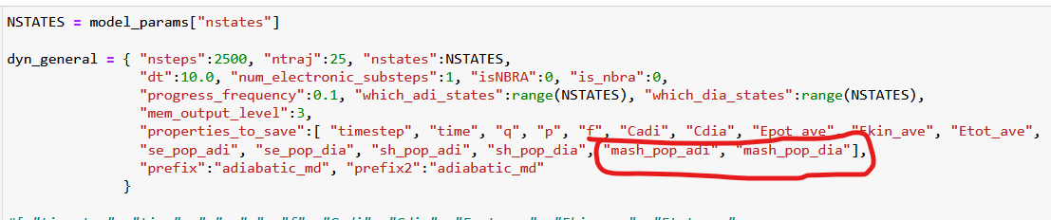
MASH Hop Proposal Probability
1. Initialization of electronic amplitudes:
Initial conditions sampling algorithm:
Make N-1 uniformly distributed random cuts of the [0, 1] interval $\left\{0<ξ_{i}<1\right\}$. Sort them such that $ξ_{i+1}≥ξ_{i}$
The population of i-th state is the distance between cuts: $p_{i}=ξ_{i}−ξ_{i−1}$. Find the maximal value and the index.
Swap the index of the target active state with the corresponding maximal-population index, do the same for the populations
The generated point (a vector of populations) would be considered belonging to the basin of the active state of interest
2. Hop proposal probability:
$$P_{∗→j}=1, ∃j:ρ_{jj}=\max_{i}\left(ρ_{ii}\right)$$
$$P_{∗→k}=0,∀k≠j$$
(1)Mannouch, J. R.; Richardson, J. O. A JCP 2023, 158, 104111
(2)Runeson, J. E.; Manolopoulos, D. E. A JCP 2023, 159, 094115.
(3)E. Runeson, J.; P. Fay, T.; E. Manolopoulos, D. PCCP 2024, 26, 4929–4938.
Proposed hops to the states with the largest population
3. Observables (population estimators):
$$P_{n}^{MASH,rep}=α_{N}{\left|c_{n}^{rep}\right|}^{2}+β_{N}$$
These are the SE populations
$P_{n}^{SH,adi}=\frac{N_{n}}{N}$ - works in adiabatic basis
$P_{n}^{SH,dia}$ - works if the adiabatic SH population is transformed according to Tempelaar
$α_{N}=\frac{N−1}{\sum_{k=1}^{N}{1/k}−1}$; $β_{N}=\frac{1−α_{N}}{N}$

Slide 39
Hop Proposal Probability
Landau-Zener (LZ):
Tully, J. C. J. Chem. Phys. 1990, 93, 1061, 1071
Belyaev, A. K.; Lebedev, O. V. Phys. Rev. A 2011, 84, 014701
dyn_control_params
rep_lz
Hopping only at the gap minimum!
$$P_{i→j}^{P}=\exp\left(−\frac{2π}{ℏ}γ^{LZ}\right)$$
The representation to compute LZ probabilities.
Options:
- 0: diabatic, Eq. 1 of the Belyaev-Lebedev paper, crossing point is determined
by the sign change of the diabatic gap [ default ]
- 1: adiabatic, Eq. 3 of the Belyaev-Lebedev paper, crossing point is determined
by the sign change of the diabatic gap
- 2: adiabatic, Eq. 3 of the Belyaev-Lebedev paper, crossing point is determined
by the sign change of the NAC
$$γ^{LZ}=\frac{{\left|H_{ij}^{dia}\right|}^{2}}{v^{T}\left(∇\left|H_{ii}^{dia}−H_{jj}^{dia}\right|\right)}$$
Zhu, C., Nakamura, H., Re, N., Aquilanti, V., 1992. J. Chem. Phys. 97, 1892
Hanasaki, K., Kanno, M., Niehaus, T.A., Kono, H., 2018. J. Chem. Phys. 149. 244117
Yu, L., Xu, C., Lei, Y., Zhu, C., Wen, Z., 2014. Phys. Chem. Chem. Phys. 16. 25883.
Zhu-Nakamura (ZN):
$$P_{i→j}^{P}=\exp\left(−\frac{π}{4\sqrt{a^{2}}} \sqrt{\frac{2}{b^{2}+\sqrt{\left|b^{4}+sign\left(F_{i}^{T}F_{j}\right)\right|}}}\right)$$
Hopping only at the gap minimum!
$$a^{2}=\frac{ℏ^{2}}{2μ}\frac{\sqrt{\left|F_{i}^{T}F_{j}\right|} \left|F_{i}−F_{j}\right|}{{\left(2H_{ij}^{dia}\right)}^{3}}$$
$$\frac{1}{\sqrt{μ}}\left|F_{i}−F_{j}\right|→\sqrt{{\left(F_{i}−F_{j}\right)}^{T}M^{−1}\left(F_{i}−F_{j}\right)}$$
$$b^{2}=\left(E−E_{i}\left(R=R_{c}\right)\right)\frac{\left|F_{i}−F_{j}\right|}{\sqrt{\left|F_{i}F_{j}\right|} \left(2H_{ij}^{dia}\right)}$$
Multidimensional version
$$\frac{1}{\sqrt{μ}}\sqrt{\left|F_{i}^{T}F_{j}\right|}→\sqrt{\left|{F_{i}}^{T}M^{−1}F_{j}\right|}$$

Slide 40
Part 4.6: Hop Acceptance
Initialization
Nuclear dynamics
$\dot{p_{i}}=−\frac{∂H}{∂r_{i}}$ $\dot{r_{i}}=\frac{∂H}{∂p_{i}}$
analytical models or electronic structure codes
Stationary adiabatic states
$${\hat{H}}_{el}ψ_{i}=E_{i}ψ_{i}$$
NAC: Hammes-Schiffer, S.; Tully, J. C. JCP 1994, 101, 4657
Non-adiabatic Couplings
$$d_{ij}=\frac{\left\langle ψ_{i}(t) | ψ_{j}(t+dt)\right\rangle −\left\langle ψ_{i}(t+dt) | ψ_{j}(t)\right\rangle }{2dt}$$
Phase tracking: Akimov, A. V. JPCL 2018 9, 6096
Local Diabatization: Granucci, G.; Persico, M.; Toniolo, A. JCP 2001, 114, 10608; Plasser, F.; Granucci, G.; Pittner, J. et al. JCP 2012, 137, 22A514; Shakiba, M.; Akimov, A. V. TCA 2023, 142, 68
Integrate Coherent Electronic Dynamics
$$Ψ\left(r,R,t\right)=\sum_{i}{c_{i}\left(t\right)ψ_{i}(r;R(t))}$$
$$iℏ\frac{∂c_{i}(t)}{∂t}=\sum_{j}{\left(E_{i}δ_{ij}−iℏd_{ij}\right)}c_{j}$$
NBRA
SDM: Granucci, G.; Persico, M. JCP 2007, 126, 134114; mSDM: Smith, B. A.; Akimov, A. V. JCP, 2019, 151, 124107; IDA: Nelson, T.; Fernandez-Alberti, S.; Roitberg, A. E.; Tretiak, S. JCP 2013, 138, 224111.
Decoherence 1
$$c_{i}→c_{i}\exp\left(−\frac{Δt}{τ_{ij}}\right), ∀i≠j$$
as in SDM
Proposed Hops
Decoherence 2
$$P_{i→j}=Δt∗Re\left(\frac{2{\frac{p}{m}d}_{ij}c_{i}^{∗}c_{j}}{c_{i}^{∗}c_{i}}\right)$$
or as in DISH
FSSH: Tully, J. C. JCP, 1990, 93, 1061
Accept Hops
based on energy conservation or
$$P_{i→f}^{A}=\min\left(1, \exp\left(−\frac{ΔE}{k_{B}T}\right)\right)$$
NBRA: Prezhdo, O. V.; Duncan, W. R.; Prezhdo, V. V. Prog. Surf. Sci. 2009, 84, 30
Change of state/Velocity rescaling
change active electronic state, rescale velocity

Slide 41
Hop Acceptance Probabilities
Options:
- 0: accept all proposed hops [ default ]
- 10: based on adiabatic energy - accept only those hops that can obey the energy conservation with
adiabatic potential energies
- 11: based on diabatic energy - same as 10, but we use diabatic potential energies
- 20: based on derivative coupling vectors - accept only those hops that can obey the energy conservation
by rescaling nuclear velocities along the directions of derivative couplings for the quantum nuclear DOFs
- 21: based on difference of state-specific forces - same as 20, but the rescaling is done along the vector
parallel to the difference of adiabatic forces on initial and target states
- 31: accept hops with the probability taken from the quantum Boltzmann distribution
- 32: accept hops with the probability taken from the classical Maxwell-Boltzmann distribution
- 33: accept hops with the probability taken from the updated quantum Boltzmann distribution (experimental)
- 40: based on possibility to conserve energy using tcnbra_ekin variables (experimental for TC-NBRA)
$$P_{i→f}^{A}=1$$
Tully, J. C. J. Chem. Phys. 1990, 93, 1061
$$P_{i→f}^{A}=Θ\left(E_{kin}+E_{f}−E_{f}\right)$$
Prezhdo, O. V.; Duncan, W. R.; Prezhdo, V. V. Prog. Surf. Sci. 2009, 84, 30
$$P_{i→f}^{A}=\min\left(1, \exp\left(−\frac{ΔE}{k_{B}T}\right)\right)$$
Smith, B.; Akimov, A. V. J. Chem.Phys. 2019, 151, 124107
$$P_{i→f}^{A}=1−\left[\operatorname{erf}\left({\left(\frac{ΔE}{k_{B}T}\right)}^{\frac{1}{2}}\right)−\sqrt{\frac{4}{π}}{\left(\frac{ΔE}{k_{B}T}\right)}^{\frac{1}{2}}\exp\left(−\frac{ΔE}{k_{B}T}\right)\right]$$
$$P_{i→f}^{A}=Θ\left(E_{i\left(t+Δt\right)}^{tr}\left(t+Δt\right)+e_{kin,i}^{tr}\left(t+Δt\right)−e_{kin,j}^{tr}(t+Δt)\right)$$
Akimov, A. V. J. Phys. Chem. Lett. 2023, 14, 11673–11683

Slide 42
Part 4.7: Momentum Rescaling and Reversal
Initialization
Nuclear dynamics
$\dot{p_{i}}=−\frac{∂H}{∂r_{i}}$ $\dot{r_{i}}=\frac{∂H}{∂p_{i}}$
analytical models or electronic structure codes
Stationary adiabatic states
$${\hat{H}}_{el}ψ_{i}=E_{i}ψ_{i}$$
NAC: Hammes-Schiffer, S.; Tully, J. C. JCP 1994, 101, 4657
Non-adiabatic Couplings
$$d_{ij}=\frac{\left\langle ψ_{i}(t) | ψ_{j}(t+dt)\right\rangle −\left\langle ψ_{i}(t+dt) | ψ_{j}(t)\right\rangle }{2dt}$$
Phase tracking: Akimov, A. V. JPCL 2018 9, 6096
Local Diabatization: Granucci, G.; Persico, M.; Toniolo, A. JCP 2001, 114, 10608; Plasser, F.; Granucci, G.; Pittner, J. et al. JCP 2012, 137, 22A514; Shakiba, M.; Akimov, A. V. TCA 2023, 142, 68
Integrate Coherent Electronic Dynamics
$$Ψ\left(r,R,t\right)=\sum_{i}{c_{i}\left(t\right)ψ_{i}(r;R(t))}$$
$$iℏ\frac{∂c_{i}(t)}{∂t}=\sum_{j}{\left(E_{i}δ_{ij}−iℏd_{ij}\right)}c_{j}$$
NBRA
SDM: Granucci, G.; Persico, M. JCP 2007, 126, 134114; mSDM: Smith, B. A.; Akimov, A. V. JCP, 2019, 151, 124107; IDA: Nelson, T.; Fernandez-Alberti, S.; Roitberg, A. E.; Tretiak, S. JCP 2013, 138, 224111.
Decoherence 1
$$c_{i}→c_{i}\exp\left(−\frac{Δt}{τ_{ij}}\right), ∀i≠j$$
as in SDM
Proposed Hops
Decoherence 2
$$P_{i→j}=Δt∗Re\left(\frac{2{\frac{p}{m}d}_{ij}c_{i}^{∗}c_{j}}{c_{i}^{∗}c_{i}}\right)$$
or as in DISH
FSSH: Tully, J. C. JCP, 1990, 93, 1061
Accept Hops
based on energy conservation or
$$P_{i→f}^{A}=\min\left(1, \exp\left(−\frac{ΔE}{k_{B}T}\right)\right)$$
NBRA: Prezhdo, O. V.; Duncan, W. R.; Prezhdo, V. V. Prog. Surf. Sci. 2009, 84, 30
Change of state/Velocity rescaling
change active electronic state, rescale velocity

Slide 43
Momentum Rescaling
$$P_{n}^{(j)}=P_{n}^{(i)}−γt_{n,ij}$$
$$Δ_{ij}=b_{ij}^{2}+4a_{ij}c_{ij}$$
$$a_{ij}=\frac{1}{2}t_{ij}^{T}M^{−1}t_{ij}$$
$$b_{ij}=t_{ij}^{T}M^{−1}P^{(i)}$$
$$c_{ij}=E_{i}−E_{j}$$
$$Δ_{ij}<0$$
Frustrated hop
$$Δ_{ij}≥0$$
Accepted hop
Options:
- 0: don't rescale [ default ]
- 100: based on adiabatic energy, don't reverse on frustrated hops
- 101: based on adiabatic energy, reverse on frustrated hops
- 110: based on diabatic energy, don't reverse on frustrated hops
- 111: based on diabatic energy, reverse on frustrated hops
- 200: along derivative coupling vectors, don't reverse on frustrated hops
- 201: along derivative coupling vectors, reverse on frustrated hops
- 210: along difference of state-specific forces, don't reverse on frustrated hops
- 211: along difference of state-specific forces, reverse on frustrated hops
- 40: does not rescale velocities, but rescales tcnbra_ekin variables
$$b_{ij}<0$$
$$γ_{ij}=\frac{b_{ij}+\sqrt{Δ_{ij}}}{2a_{ij}}$$
$$b_{ij}≥0$$
$$γ_{ij}=\frac{b_{ij}−\sqrt{Δ_{ij}}}{2a_{ij}}$$
Reversal or not
$$t_{n,ij}=D_{adi,ij}^{n}$$
$$t_{n,ij}=F_{adi,i}^{n}−F_{adi,j}^{n}$$
$$e_{kin}^{tr}\left(t\right)→e_{kin}^{tr}\left(t+Δt\right)=e_{kin}^{tr}\left(t\right)+E_{i(t)}−E_{i(t+Δt)}$$
TC-NBRA rescaling of effective kinetic energy:
Akimov, A. V. J. Phys. Chem. Lett. 2023, 14, 11673–11683

Slide 44
Momentum Reversal on Frustrated Hops: Jasper-Truhlar Criterion
Jasper, A. W.; Truhlar, D. G. Chem. Phys. Lett. 2003, 369, 60− 67
dyn_control_params
use_Jasper_Truhlar_criterion
Options:
- 0: don't use this criterion (naive handling)
- 1: use it [ default ]
use_Jasper_Truhlar_criterion = 1
$$Δ_{ij}<0$$
Frustrated hop
use_Jasper_Truhlar_criterion = 0
the velocities are reversed along the direction $D_{adi,a,j}$ if
a) $\left(F_{a}^{T}D_{aj}\right)\left(F_{j}^{T}D_{aj}\right)<0$
b) $\left(v^{T}D_{aj}\right)\left(F_{j}^{T}D_{aj}\right)<0$
where a - is the active state index;
Only in effect, if `momenta_rescaling_algo == 201`
$$Δ_{ij}<0$$
Frustrated hop
Otherwise
No reversal for momenta_rescaling_algo:
100, 110, 200, 210
Reversal for momenta_rescaling_algo:
101, 111, 201, 211
Reversal
No Reversal

Slide 45
Part 4.8: Decoherence Corrections
Initialization
Nuclear dynamics
$\dot{p_{i}}=−\frac{∂H}{∂r_{i}}$ $\dot{r_{i}}=\frac{∂H}{∂p_{i}}$
analytical models or electronic structure codes
Stationary adiabatic states
$${\hat{H}}_{el}ψ_{i}=E_{i}ψ_{i}$$
NAC: Hammes-Schiffer, S.; Tully, J. C. JCP 1994, 101, 4657
Non-adiabatic Couplings
$$d_{ij}=\frac{\left\langle ψ_{i}(t) | ψ_{j}(t+dt)\right\rangle −\left\langle ψ_{i}(t+dt) | ψ_{j}(t)\right\rangle }{2dt}$$
Phase tracking: Akimov, A. V. JPCL 2018 9, 6096
Local Diabatization: Granucci, G.; Persico, M.; Toniolo, A. JCP 2001, 114, 10608; Plasser, F.; Granucci, G.; Pittner, J. et al. JCP 2012, 137, 22A514; Shakiba, M.; Akimov, A. V. TCA 2023, 142, 68
Integrate Coherent Electronic Dynamics
$$Ψ\left(r,R,t\right)=\sum_{i}{c_{i}\left(t\right)ψ_{i}(r;R(t))}$$
$$iℏ\frac{∂c_{i}(t)}{∂t}=\sum_{j}{\left(E_{i}δ_{ij}−iℏd_{ij}\right)}c_{j}$$
NBRA
SDM: Granucci, G.; Persico, M. JCP 2007, 126, 134114; mSDM: Smith, B. A.; Akimov, A. V. JCP, 2019, 151, 124107; IDA: Nelson, T.; Fernandez-Alberti, S.; Roitberg, A. E.; Tretiak, S. JCP 2013, 138, 224111.
Decoherence 1
$$c_{i}→c_{i}\exp\left(−\frac{Δt}{τ_{ij}}\right), ∀i≠j$$
as in SDM
Proposed Hops
Decoherence 2
$$P_{i→j}=Δt∗Re\left(\frac{2{\frac{p}{m}d}_{ij}c_{i}^{∗}c_{j}}{c_{i}^{∗}c_{i}}\right)$$
or as in DISH
FSSH: Tully, J. C. JCP, 1990, 93, 1061
Accept Hops
based on energy conservation or
$$P_{i→f}^{A}=\min\left(1, \exp\left(−\frac{ΔE}{k_{B}T}\right)\right)$$
NBRA: Prezhdo, O. V.; Duncan, W. R.; Prezhdo, V. V. Prog. Surf. Sci. 2009, 84, 30
Change of state/Velocity rescaling
change active electronic state, rescale velocity

Slide 46
Decoherence Options
dyn_control_params
decoherence_algo
SDM: Granucci, G.; Persico, M. J. Chem. Phys. 2007, 126, 134114.
mSDM: Smith, B.; Akimov, A. V. J. Chem. Phys. 2019, 151, 124107.
ID-A: Nelson, T.; Fernandez-Alberti, S.; Roitberg, A. E.; Tretiak, S. J. Chem. Phys. 2013, 138, 224111.
ID-F: Zhang, Q.; Shao, X.; Li, W.; Mi, W.; Pavanello, M.; Akimov, A. V. J. Phys.: Condens. Matter 2024, 36, 385901.
A-FSSH:
Landry, B. R.; Subotnik, J. E. The Journal of Chemical Physics 2012, 137, 22A513.
Jain, A.; Herman, M. F.; Ouyang, W.; Subotnik, J. E. The Journal of Chemical Physics 2015, 143, 134106.
Jain, A.; Alguire, E.; Subotnik, J. E. J. Chem. Theory Comput. 2016, 12, 5256–5268.
BCSH: Xu, J.; Wang, L. J. Chem. Phys. 2019, 150, 164101.
MF-SD: Bedard-Hearn, M. J.; Larsen, R. E.; Schwartz, B. J. J. Chem. Phys. 2005, 123, 234106.
DISH:
Jaeger, H. M.; Fischer, S.; Prezhdo, O. V. J. Chem. Phys. 2012, 137, 22A545
Akimov, A. V. J. Chem. Phys. 2021, 155, 134106.
- [-1]: no decoherence [ default ]
- 0: SDM and alike
- 1: instantaneous decoherence options (ID-S, ID-A, ID-C, ID-F)
- 2: AFSSH
- 3: BCSH of Linjun Wang
- 4: MF-SD of Bedard-Hearn, Larsen, Schwartz
- 5: SHXF of Min
- 6: MQCXF
- 7: DISH, rev2023
- 8: diabatic IDA, experimental
- 9: simple decoherence, experimental (in progress)
DISH_rev2023: Zhang, Q.; Shao, X.; Li, W.; Mi, W.; Pavanello, M.; Akimov, A. V. J. Phys.: Condens. Matter 2024, 36, 385901.
SHXF and MQCXF:
Ha, J.-K.; Lee, I. S.; Min, S. K. J. Phys. Chem. Lett. 2018, 9, 1097
Han, D.; Akimov, A.V. J. Chem. Theory Comput. 2024, 20, 5022–5042

Slide 47
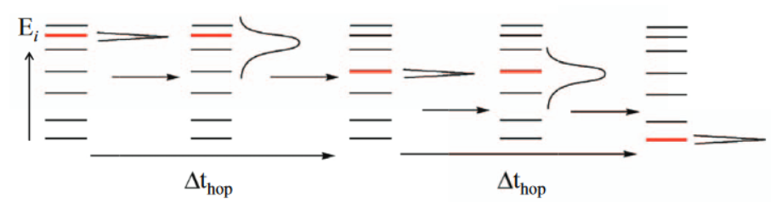

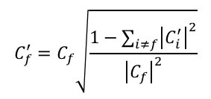
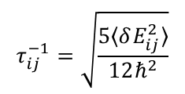


Decoherence: SDM and ID
SDM
Granucci, G.; Persico, M. J. Chem. Phys. 2007, 126, 134114.
mSDM (modified SDM)
gradually change the amplitudes
$$C_{f}^{′}=C_{f}\sqrt{\frac{1−\sum_{i≠f}{{\left|C_{i}^{′}\right|}^{2}}}{{\left|C_{f}\right|}^{2}}}$$
Akimov, A. V.; Prezhdo, O. V. JPCL, 2013, 4, 3857
Smith, B.; Akimov, A. V. JCP 2019, 151, 124107
$$C_{i}^{′}=C_{i}\exp\left(−\frac{Δt}{τ_{if}}\right), ∀i≠f$$
The only difference is that the decoherence times defined as:
$$τ_{ij}^{−1}=\sqrt{\frac{5〈δE_{ij}^{2}〉}{12ℏ^{2}}}$$
Implicit: energy-based decoherence (EDC) is used:
$$τ_{ij}^{EDC}=\frac{ℏ}{\left|E_{i}−E_{j}\right|}\left(C+\frac{ε}{E_{kin}}\right)$$
ID
instantaneous_decoherence_variant
collapse_option
How to collapse wavefunction amplitudes in the decoherence schemes:
- 0: by rescaling the magnitude of the amplitude vector elements, but preserving "phase" [ default ]
- 1: by resetting the amplitudes to 1.0+0.0j. This option changes phase
$$C_{f}=1, C_{i}=0, ∀i≠f$$
Option to control the instantaneous decoherence methodology, only used with decoherence_algo == 1
- 0: ID-S – on the successful hop
- 1: ID-A [default] - if the proposed hop is not successful, we project back to the initial state if the proposed hop is accepted - we project onto that state
- 2: ID-C - consistent ID - an experimental algorithm
- 3: ID-A, new: if the proposed hop is not successful, we project out the proposed states if the proposed hop is accepted - we project onto that state
- 4: ID-F, new: if the proposed hop is not successful, we project out the proposed states but we don't do anything if the hop is successful
Nelson, T.; Fernandez-Alberti, S.; Roitberg, A. E.; Tretiak, S. J. Chem. Phys. 2013, 138, 224111.
Zhang, Q.; Shao, X.; Li, W.; Mi, W.; Pavanello, M.; Akimov, A. V. J. Phys.: Condens. Matter 2024, 36, 385901.

Slide 48
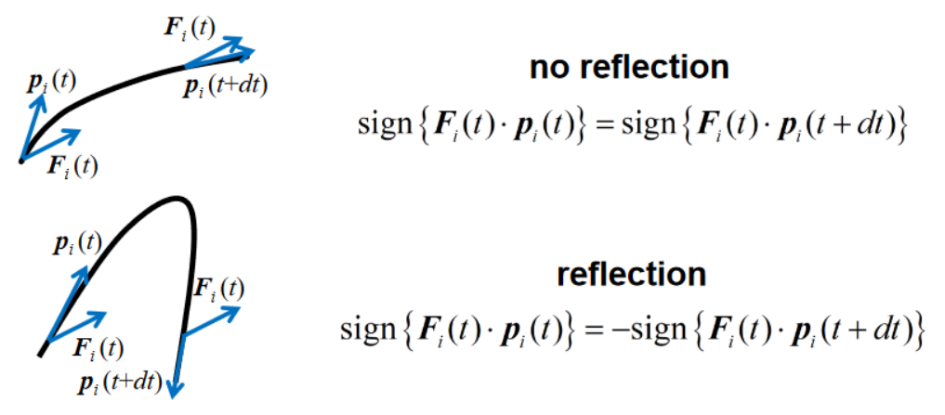
Decoherence: BCSH and MF-SD
Branching-corrected SH (BCSH)
MF-SD
Xu, J.; Wang, L. J. Chem. Phys. 2019, 150, 164101.
Bedard-Hearn, M. J.; Larsen, R. E.; Schwartz, B. J. J. Chem. Phys. 2005, 123, 234106.
* decoherence is a way to enforce the self-consistency, so:
at every nonadiabatic interaction region, there is a possibility of the wavepacket branching into reflecting and transmitting wavepackets on different surfaces.
the idea is to eliminate the wavepackets that go in the opposite direction with the main wavepacket on the active state.
the correction is applied only at the reflection points (not the reflection of active trajectory, but the reflection of the wavepacket on other surfaces in comparison to that of the active surface)
the reflection is judged as:
This method is essentially like Ehrenfest,
but there is always a probability to collapse the coherent superposition to a pure state.
The probability of such a collapse is given by the quantum amplitude of the state and by the decoherence time to collapse onto a particular state k. $P_{i}=\frac{ρ_{ii}}{τ_{i}}Δt$
The decoherence time is given by
$$τ_{i}^{−2}=\frac{1}{4ℏ^{2}}{\left(F_{MF}−F_{i}\right)}^{T}α^{−1}\left(F_{MF}−F_{i}\right)$$

Slide 49
Decoherence: DISH
Jaeger, H. M.; Fischer, S.; Prezhdo, O. V. J. Chem. Phys. 2012, 137, 22A545
Hops are the consequences of decoherence
Coherence interval for state $i:$ $\frac{1}{τ_{i}}=\sum_{j≠i}{ρ_{jj}}r_{ij}$ ; $ρ_{jj}={\left|c_{j}\right|}^{2}$; $r_{ij}$- pure dephasing time for the pair of states i and j
The time at which decoherence event takes place is distributed exponentially: $P\left(t\right)\sim \exp\left(−\frac{t}{τ_{i}}\right)$, which corresponds to the Poisson distribution of the number of events to take place in a given time interval.
At decoherence event: coherent superposition $Ψ=\sum_{i}{c_{i}ψ_{i}}$ is projected in the following way:
- with the probability ${\left|c_{i}\right|}^{2}$, the superposition is collapsed on the pure state $ψ_{i}$ (set $c_{i}=1$, set $c_{j}=0, ∀j≠i$)
-- but do this only if the hop to this state + velocity rescaling associated with this transition is possible
- with the probability $1−{\left|c_{i}\right|}^{2}$, the state $ψ_{i}$ is projected out from the superposition (reset $c_{i}=0$, renormalize others)
What if the decohered state is the active state?
- If we collapse on this state – fine;
- If we project out the state from the superposition – the SE and SH populations become inconsistent (e.g. say the ground state is active, but $c_{0}=0$)
Akimov, A. V. J. Chem. Phys. 2021, 155, 134106.
if the decohered state turns out to be the active one, we project the corresponding amplitude out only if a successful hop to any other state can occur. The hop to any other state j is proposed with the probability ${\left|c_{j}\right|}^{2}$ and if the hop into this state is successful, the superposition is collaped onto this new state and the hop occurs.
Note: DISH is invoked by tsh_method==5 (hopping scheme) and decoherence_algo==-1 (no additional decoherence)

Slide 50
DISH
Initialize “coherence time” for each state $t_{i}=0, ∀i$
Advance “coherence time”: $t_{i}=t_{i}+Δt, ∀i$
Initialize set of “decohering” states: $D=∅$
For all states $i$:
compute coherence interval for this state $τ_{i}^{−1}=\sum_{j≠i}{ρ_{jj}(t)τ_{ij}^{−1}}$
If $t_{i}≥T[τ_{i}]$, add $i$ to set $D$: $D=D∪\{i\}$
int dish_decoherence_event_option;
0 – direct compare
1 -Poisson
$$D≠∅$$
No (B)
Continue coherent evolution:
$$c\left(t+Δt\right)=\exp\left(−\frac{iH}{ℏ}Δt\right)c\left(t\right)$$
Yes (A)
Select a single decohered state, $i$, our of the set randomly
reset $t_{i}=0$
don’t change the variables for other states
Yes
…
Yes (1)
Is $i$ active state?
No (2)
…
Finish scheme in panel (b)

Slide 51
DISH
Yes (1)
Is $i$ active state?
No (2)
$$ξ<{\left|c_{i}\right|}^{2}$$
$$ξ<{\left|c_{i}\right|}^{2}$$
Yes (1.1)
No (1.2)
Yes (2.1)
No (2.2)
Collapse onto state $i$:
$c_{i}=\text{"1}“$; $c_{j}=0$
Stay on the active state $i$
Exit
$P=\left\{all\right\}/\{i\}$ becomes a set of proposed states
$i$ becomes a proposed state
Project out state $i$:
$c_{i}=0$; $c_{j}→\tilde{c_{j}};j≠i$
Exit
Yes (1.2.1)
$P=∅$?
Do nothing
Exit
Is hop accepted?
No (1.2.2)
No (2.1.2)
Select $j$ randomly with prob.~ ${\left|c_{j}\right|}^{2},$ $j∈P$
Mark $j$ as a proposed hop
Do nothing
Exit
Yes (2.1.1)
Yes (1.2.2.1)
Is hop accepted?
Collapse onto state $i$, $c_{i}=\text{"1}“$, $c_{j}=0;j≠i$
Hop onto $i$
Exit
Project out state $i$, $c_{i}=0$, $c_{k}→\tilde{c_{k}}, k≠i$
Hop onto $j$
Exit
No (1.2.2.2)
Exclude state $j$ from $P$

Slide 52
Decoherence: DISH_rev2023
Original DISH:
Jaeger, H. M.; Fischer, S.; Prezhdo, O. V. J. Chem. Phys. 2012, 137, 22A545
First revision:
Akimov, A. V. J. Chem. Phys. 2021, 155, 134106.
tsh_method = 5
Coherence interval for state $i:$ $\frac{1}{τ_{i}}=\sum_{j≠i}{ρ_{jj}}r_{ij}$ ; $ρ_{jj}={\left|c_{j}\right|}^{2}$; $r_{ij}$- pure dephasing time for the pair of states i and j
The time at which decoherence event takes place is distributed exponentially: $P\left(t\right)\sim \exp\left(−\frac{t}{τ_{i}}\right)$, which corresponds to the Poisson distribution of the number of events to take place in a given time interval.
At decoherence event: coherent superposition $Ψ=\sum_{i}{c_{i}ψ_{i}}$ is projected in the following way:
- with the probability ${\left|c_{i}\right|}^{2}$, the superposition is collapsed on the pure state $ψ_{i}$ (set $c_{i}=1$, set $c_{j}=0, ∀j≠i$)
-- but do this only if the hop to this state + velocity rescaling associated with this transition is possible
- with the probability $1−{\left|c_{i}\right|}^{2}$, the state $ψ_{i}$ is projected out from the superposition (reset $c_{i}=0$, renormalize others)
Branched-out revision:
Zhang, Q.; Shao, X.; Li, W.; Mi, W.; Pavanello, M.; Akimov, A. V. J. Phys.: Condens. Matter 2024, 36, 385901.
tsh_method = * ; decoherence_algo = 7
DISH revision of 2023 simply applies the wavefunction collapse/projection out correction to the TD-SE wavefunction, similar to IDA or SDM, except that if a state "i" is decided to experience a decoherence event, the wavefunction is collapsed onto this state with the probability of ${\left|c_{i}\right|}^{2}$ and with the probability $1−{\left|c_{i}\right|}^{2}$ the state is projected out from the coherent superposition. In this case, it doesn't matter if the decoherent state is an active state or not.
Projector operator introduced in the original DISH paper of Jaeger et al.:
$${\hat{L}}_{i}=\left\{\begin{matrix}\frac{1}{{\left|c_{i}\right|}^{2}}\left|ψ_{i}\right\rangle \left\langle ψ_{i}\right|,ξ_{i}<{\left|c_{i}\right|}^{2} \\ \frac{1}{1−{\left|c_{i}\right|}^{2}}\left(\hat{I}−\left|ψ_{i}\right\rangle \left\langle ψ_{i}\right|\right), ξ_{i}≥{\left|c_{i}\right|}^{2}\end{matrix}\right.$$
DISH_rev2023 only applies this operator to the electronic part only regardless whether the projection can be consistent with the energy conservation, which is already broken in the NBRA anyways

Slide 53
Decoherence: XFSH and MQCXF
Original: Ha, J.-K.; Lee, I. S.; Min, S. K. J. Phys. Chem. Lett. 2018, 9, 1097
Libra implementation: Han, D.; Akimov, A.V. J. Chem. Theory Comput. 2024, 20, 5022–5042
$$iℏ\frac{d}{dt}\left|Φ_{R}\left(t\right)\right\rangle =\left[{\hat{H}}_{BO}\left(R\left(t\right)\right)+{\hat{H}}_{XF}\left(R , t\right)\right]\left|Φ_{R}\left(t\right)\right\rangle$$
$$\dot{P}=F$$
$$F\left(R,t\right)=F^{MF}\left(R,t\right)+F^{XF}\left(R,t\right)$$
$$H_{XF}=−\sum_{ν}{\frac{iℏ𝒫_{ν}}{M_{ν}}⋅\left(∇_{ν}CC^{†}+C∇_{ν}C^{†}\right) }=\sum_{ν}{\frac{𝒫_{ν}}{M_{ν}}⋅\left(φ_{ν}CC^{†}−CC^{†}φ_{ν}\right) }=−\sum_{ν}{\frac{𝒫_{ν}}{M_{ν}}⋅\left(ρφ_{ν}−φ_{ν}ρ\right) }$$
$$F^{MF}\left(R,t\right)=−\left\langle Φ_{R}\left(t\right)\left|∇{\hat{H}}_{BO}\right|Φ_{R}\left(t\right)\right\rangle$$
$${\left(H_{XF}\right)}_{ab}=\sum_{ν}{ρ_{ab}\left(φ_{ν,aa}−φ_{ν,bb}\right)\frac{𝒫_{ν}}{M_{ν}}}$$
$$F_{ν}^{XF}=−\frac{i}{ℏ }\sum_{a,b}{ρ_{aa}ρ_{bb}}\sum_{μ}{\left(φ_{ν,bb}−φ_{ν,aa}\right)\left(φ_{μ,bb}−φ_{μ,aa}\right)\frac{𝒫_{μ}}{M_{μ}}}$$
$$C_{j}\left(R\right)=\left|C_{j}\left(R\right)\right|\exp\left(iθ_{j}{\left(R\right)}/ℏ\right)$$
$$∇_{ν}θ_{j}=\frac{i}{ℏ}φ_{jν}$$
$$𝓟\left(R,t\right)=−iℏ\frac{∇\left|χ\left(R,t\right)\right|}{\left|χ\left(R,t\right)\right|}=−iℏ\frac{∇{\left|χ\right|}^{2}}{2{\left|χ\right|}^{2}}=\frac{iℏ}{2}σ^{−2}\left(R−〈R〉\right)≈\frac{iℏ}{2}σ^{−2}\sum_{i}{ρ_{ii}}\left(R_{a}−R_{i}\right)$$
Both ${\hat{H}}_{BO}\left(R(t)\right)$ and ${\hat{H}}_{XF}(R,t)$ are used
MFXF, aka EhXF
Only $F^{MF}\left(R,t\right)$
Both ${\hat{H}}_{BO}\left(R(t)\right)$ and ${\hat{H}}_{XF}(R,t)$ are used
SHXF (DISH-XF)
Adiabatic forces of the active state
Both ${\hat{H}}_{BO}\left(R(t)\right)$ and ${\hat{H}}_{XF}(R,t)$ are used
MQCXF
Both $F^{MF}\left(R,t\right)$and $F^{XF}\left(R,t\right)$ are used

Slide 54
Part 4.9: Computing Decoherence Times
Initialization
Nuclear dynamics
$\dot{p_{i}}=−\frac{∂H}{∂r_{i}}$ $\dot{r_{i}}=\frac{∂H}{∂p_{i}}$
analytical models or electronic structure codes
Stationary adiabatic states
$${\hat{H}}_{el}ψ_{i}=E_{i}ψ_{i}$$
NAC: Hammes-Schiffer, S.; Tully, J. C. JCP 1994, 101, 4657
Non-adiabatic Couplings
$$d_{ij}=\frac{\left\langle ψ_{i}(t) | ψ_{j}(t+dt)\right\rangle −\left\langle ψ_{i}(t+dt) | ψ_{j}(t)\right\rangle }{2dt}$$
Phase tracking: Akimov, A. V. JPCL 2018 9, 6096
Local Diabatization: Granucci, G.; Persico, M.; Toniolo, A. JCP 2001, 114, 10608; Plasser, F.; Granucci, G.; Pittner, J. et al. JCP 2012, 137, 22A514; Shakiba, M.; Akimov, A. V. TCA 2023, 142, 68
Integrate Coherent Electronic Dynamics
$$Ψ\left(r,R,t\right)=\sum_{i}{c_{i}\left(t\right)ψ_{i}(r;R(t))}$$
$$iℏ\frac{∂c_{i}(t)}{∂t}=\sum_{j}{\left(E_{i}δ_{ij}−iℏd_{ij}\right)}c_{j}$$
NBRA
SDM: Granucci, G.; Persico, M. JCP 2007, 126, 134114; mSDM: Smith, B. A.; Akimov, A. V. JCP, 2019, 151, 124107; IDA: Nelson, T.; Fernandez-Alberti, S.; Roitberg, A. E.; Tretiak, S. JCP 2013, 138, 224111.
Decoherence 1
$$c_{i}→c_{i}\exp\left(−\frac{Δt}{τ_{ij}}\right), ∀i≠j$$
as in SDM
Proposed Hops
Decoherence 2
$$P_{i→j}=Δt∗Re\left(\frac{2{\frac{p}{m}d}_{ij}c_{i}^{∗}c_{j}}{c_{i}^{∗}c_{i}}\right)$$
or as in DISH
FSSH: Tully, J. C. JCP, 1990, 93, 1061
Accept Hops
based on energy conservation or
$$P_{i→f}^{A}=\min\left(1, \exp\left(−\frac{ΔE}{k_{B}T}\right)\right)$$
NBRA: Prezhdo, O. V.; Duncan, W. R.; Prezhdo, V. V. Prog. Surf. Sci. 2009, 84, 30
Change of state/Velocity rescaling
change active electronic state, rescale velocity

Slide 55
Decoherence times
DISH
dyn_control_params
decoherence_times_type
Decoherence interval
$$τ_{i}^{−1}=\sum_{j≠i}{P_{jj}τ_{ij}^{−1}}$$
[-1]: set all dephasing rates to zero [ default ]
0: use the rates read out from the input
1: use the energy-based decoherence method (EDC)
2: Schwartz - mean-field Force-based decoherence (Schwartz 1), using inv_alpha
3: Schwartz - pair-wise-based decoherence, (Schwartz 2), using inv_alpha
4: Schwartz - mean-field Force-based decoherence (Schwartz 1), but using interaction width
5: Gu-Franco
Jaeger, H. M.; Fischer, S.; Prezhdo, O. V. J. Chem. Phys. 2012, 137, 22A545
SDM/EDC
Granucci, G.; Persico, M. JCP 2007, 126, 134114.
$$τ_{ij}^{EDC}=\frac{ℏ}{\left|E_{i}−E_{j}\right|}\left(C+\frac{ε}{E_{kin}}\right)$$
Bedard-Hearn, M. J.; Larsen, R. E.; Schwartz, B. J. JCP 2005, 123, 234106.
MF-SD
dyn_control_params
decoherence_C_param
decoherence_eps_param
$$τ_{i}^{−2}=\frac{1}{4ℏ^{2}}{\left(F_{MF}−F_{i}\right)}^{T}α^{−1}\left(F_{MF}−F_{i}\right)$$
Phase-informed Decoherence times
Sifain, A. E.; Wang, L.; Tretiak, S.; Prezhdo, O. V.
dyn_control_params
- schwartz_decoherence_inv_alpha
$$τ_{ij}^{−1,PI}=τ_{ij}^{−1}\frac{\left|E_{i}−E_{j}\right|}{\left\langle \left|E_{i}−E_{j}\right|\right\rangle }$$
mSDM
$$τ_{ij}^{−1}=\sqrt{\frac{5〈δE_{ij}^{2}〉}{12ℏ^{2}}}$$
dyn_control_params
- dephasing_informed
- 0: don't apply [ default ]
- 1: use it
$$τ_{ij}^{−2}=\frac{1}{ℏ^{2}}{\left(F_{i}−F_{j}\right)}^{T}α^{−1}\left(F_{i}−F_{j}\right)$$
Akimov, A. V.; Prezhdo, O. V. JPCL, 2013, 4, 3857
Smith, B.; Akimov, A. V. JCP 2019, 151, 124107
Independent stochastic pairwise decoherence (ISPD)
Esch, M. P.; Levine, B. G. JCP 2020, 152, 234105.

Slide 56
Part 4.10: Additional Options and Recipes
Initialization
Nuclear dynamics
$\dot{p_{i}}=−\frac{∂H}{∂r_{i}}$ $\dot{r_{i}}=\frac{∂H}{∂p_{i}}$
analytical models or electronic structure codes
Stationary adiabatic states
$${\hat{H}}_{el}ψ_{i}=E_{i}ψ_{i}$$
NAC: Hammes-Schiffer, S.; Tully, J. C. JCP 1994, 101, 4657
Non-adiabatic Couplings
$$d_{ij}=\frac{\left\langle ψ_{i}(t) | ψ_{j}(t+dt)\right\rangle −\left\langle ψ_{i}(t+dt) | ψ_{j}(t)\right\rangle }{2dt}$$
Phase tracking: Akimov, A. V. JPCL 2018 9, 6096
Local Diabatization: Granucci, G.; Persico, M.; Toniolo, A. JCP 2001, 114, 10608; Plasser, F.; Granucci, G.; Pittner, J. et al. JCP 2012, 137, 22A514; Shakiba, M.; Akimov, A. V. TCA 2023, 142, 68
Integrate Coherent Electronic Dynamics
$$Ψ\left(r,R,t\right)=\sum_{i}{c_{i}\left(t\right)ψ_{i}(r;R(t))}$$
$$iℏ\frac{∂c_{i}(t)}{∂t}=\sum_{j}{\left(E_{i}δ_{ij}−iℏd_{ij}\right)}c_{j}$$
NBRA
SDM: Granucci, G.; Persico, M. JCP 2007, 126, 134114; mSDM: Smith, B. A.; Akimov, A. V. JCP, 2019, 151, 124107; IDA: Nelson, T.; Fernandez-Alberti, S.; Roitberg, A. E.; Tretiak, S. JCP 2013, 138, 224111.
Decoherence 1
$$c_{i}→c_{i}\exp\left(−\frac{Δt}{τ_{ij}}\right), ∀i≠j$$
as in SDM
Proposed Hops
Decoherence 2
$$P_{i→j}=Δt∗Re\left(\frac{2{\frac{p}{m}d}_{ij}c_{i}^{∗}c_{j}}{c_{i}^{∗}c_{i}}\right)$$
or as in DISH
FSSH: Tully, J. C. JCP, 1990, 93, 1061
Accept Hops
based on energy conservation or
$$P_{i→f}^{A}=\min\left(1, \exp\left(−\frac{ΔE}{k_{B}T}\right)\right)$$
NBRA: Prezhdo, O. V.; Duncan, W. R.; Prezhdo, V. V. Prog. Surf. Sci. 2009, 84, 30
Change of state/Velocity rescaling
change active electronic state, rescale velocity

Slide 57
Other ways of computing Decoherence times
$$\frac{1}{τ_{ij}^{NDM}}=\frac{ℏ}{\left|H_{ii}^{dia}−H_{jj}^{dia}\right|}\frac{E_{tot}}{E_{vib}}$$
2001, Hack, Truhlar
Natural decay of mixing
$$τ_{ij}^{SCDM}=\frac{ℏ}{\left|H_{ii}^{dia}−H_{jj}^{dia}\right|}+\frac{ℏ}{4E_{vib}}$$
Hack, M.D., Truhlar, D.G., 2001, JCP 114, 9305.
2004, Zhu, Jasper, Truhlar
Self-consistent decay of mixing
Zhu, C., Jasper, A.W., Truhlar, D.G., 2004, JCP 120, 5543.
2005, Jasper, Truhlar
$$χ_{a}=\frac{1}{{\left(2πσ_{a}^{2}\right)}^{1/4}}\exp\left(−\frac{{\left(x−x_{a}\right)}^{2}}{4σ_{a}^{2}}−\frac{iP_{a}x}{ℏ}\right)$$
$$O_{ab}\left(t\right)=\left\langle χ_{a} | χ_{b}\right\rangle$$
$${\dot{O}}_{ab}=−k_{ab}O_{ab}$$
$$\frac{1}{τ_{ab}}=k_{ab}=\frac{\left(x_{a}−x_{b}\right)\left(P_{a}−P_{b}\right)}{2m\left(σ_{a}^{2}+σ_{b}^{2}\right)}+\frac{2σ_{a}^{2}σ_{b}^{2}\left(P_{a}−P_{b}\right)\left(F_{a}−F_{b}\right)}{ℏ^{2}\left(σ_{a}^{2}+σ_{b}^{2}\right)}$$
$$\frac{1}{τ_{ab}}=k_{ab}=\frac{π}{2}\frac{\left|F_{a}−F_{b}\right|}{\left|\overline{P}\right|}+\sqrt{\frac{{\left(P_{a}−P_{b}\right)}^{2}\left|E_{a}−E_{b}\right|}{4mℏ^{2}π^{2}}+{\left(\frac{π}{2}\frac{\left|F_{a}−F_{b}\right|}{\left|\overline{P}\right|}\right)}^{2}}$$
Classical GWP center motion, etc.
$$\overline{P}=\frac{P_{a}+P_{b}}{2}$$
Jasper, A.W., Truhlar, D.G., 2005, JCP 123, 064103
Parallel surfaces
$$τ_{ab}^{Truhlar}=\frac{ℏ}{\left|E_{a}−E_{b}\right|}\sqrt{\frac{\left|\overline{P}\right|}{\left|P_{a}−P_{b}\right|}}$$
2006, Larsen, Bedard-Hearn, Schwartz
$$\frac{1}{τ_{i}^{BLS,}}=\sqrt{\frac{1}{4ℏ^{2}}{\left(F^{MF}−F_{i}\right)}^{T}A^{−1}\left(F^{MF}−F_{i}\right)}$$
Larsen, R.E., Bedard-Hearn, M.J., Schwartz, B.J., 2006, JPCB 110, 20055.
$$τ_{ij}^{SDM}=\frac{ℏ}{\left|E_{i}−E_{j}\right|}\left(1+\frac{C}{E_{kin}}\right)$$
2007, Granucci, Persico
Simplified decay of mixing
Granucci, G., Persico, M., 2007, JCP, 126, 134114

Slide 58
Other ways of computing Decoherence times
$$τ_{ij}^{SCDM′}=\frac{C_{1}πℏ}{\left|H_{ii}^{dia}−H_{jj}^{dia}\right|}+\frac{C_{2}ℏ}{4E_{vib}}$$
2008, Cheng, Truhlar, et al
2-parameters self-consistent decay of mixing
Cheng, S.C., Zhu, C., Liang, K.K., Lin, S.H., Truhlar, D.G., 2008 JCP 129. 024112
$$χ_{a}={\left(\frac{2Re\left[α_{a}\right]}{π}\right)}^{1/4}\exp\left(−α{\left(x−x_{a}\right)}^{2}+\frac{iP_{a}x}{ℏ}\right)$$
2011, Shenvi, Subotnik, Yang
Exclude the momentum difference terms
$$\left|σ_{ij}\right|=\left|\frac{Re{\left[2α_{i}\right]}^{1/4}Re{\left[2α_{j}\right]}^{1/4}}{{\left(α_{i}+α_{j}^{∗}\right)}^{1/2}}\right|\exp\left(−Re\left[\frac{α_{i}α_{j}^{∗}{\left(x_{i}−x_{j}\right)}^{2}}{α_{i}+α_{j}^{∗}}\right]\right)$$
Shenvi, N., Subotnik, J.E., Yang, W., 2011, JCP 134. 144102.
$$\frac{1}{τ_{ij}^{SSY}}=−\frac{1}{\left|σ_{ij}\right|} \frac{d\left|σ_{ij}\right|}{dt}=Re\left[\frac{α_{i}α_{j}^{∗}{\left(x_{i}−x_{j}\right)}^{2}}{α_{i}+α_{j}^{∗}}\left(\dot{x_{i}}−\dot{x_{j}}\right)\right]$$
2012, Jaeger, Fisher, Prezhdo
DISH
2013,Akimov, Prezhdo
$$\frac{1}{τ_{i}^{DISH}}=\sum_{j≠i}{k_{ij}^{deph}{\left|c_{j}\right|}^{2}}$$
$$k_{ij}^{deph}=\frac{1}{ℏ}\sqrt{\frac{5}{12}〈δ^{2}E_{ij}〉}$$
$$\frac{1}{τ_{0}^{DISH}}=\frac{{\left|c_{1}\right|}^{2}}{ℏ}\sqrt{\frac{5}{12}〈δ^{2}E_{01}〉}$$
So:
Jaeger, H.M., Fischer, S., Prezhdo, O.V., 2012, JCP 137. 22A545.
Akimov, A.V., Prezhdo, O.V., 2013, JPCL 4, 3857.
2017, Gu and Franco
As a purity decay rate
$$σ\left(t\right)=Tr_{S}\left\{ρ\right\}=\sum_{i}{p_{i}\left.\left|i\right.\right\rangle \left\langle \left.i\right|\right.}$$
$$P(t)=Tr_{S}\left\{σ^{2}\left(t\right)\right\}=\exp\left(−\frac{t^{2}}{τ_{d}^{2}}\right)$$
$$τ_{d}=\frac{ℏ}{\sqrt{2\sum_{ab}{Δ_{ab}^{S}×Δ_{ab}^{B}}}}$$
Gu, B., Franco, I., 2017, JPCL 8, 4289.
Gu, B., Franco, I., 2018, JPCL 9, 773
$$\hat{H}={\hat{H}}_{S}+{\hat{H}}_{B}+{\hat{H}}_{SB}$$
$${\hat{H}}_{SB}=\sum_{a}{{\hat{S}}_{a}⨂{\hat{B}}_{a}}$$
$$Δ_{ab}^{X}=〈{\hat{X}}_{a}{\hat{X}}_{b}〉−〈{\hat{X}}_{a}〉〈{\hat{X}}_{b}〉, X=S, B$$
For a 2-level system with constant diabatic coupling = pure dephasing limit:
$$\frac{1}{k^{deph}}=\frac{ℏ}{\left|c_{0}\right|\left|c_{1}\right|\sqrt{2〈δ^{2}E_{01}〉}}$$
$$\frac{1}{τ_{d}^{Gu−Franco}}=\frac{\left|c_{0}\right|\left|c_{1}\right|}{ℏ}\sqrt{2〈δ^{2}E_{01}〉}$$
So:

Slide 59
Other ways of computing Decoherence times
$$k_{ij}^{deph}=\frac{1}{ℏ}\sqrt{\frac{5}{12}〈δ^{2}E_{ij}〉}$$
is a problematic at the points of zero gap (where coherence times should be infinite)
2019, Sifain, Wang, Tretiak, Prezhdo
Dephasing-informed correction
$$k_{ij}^{deph,corr}\left(t\right)=k_{ij}^{deph}\frac{\left|E_{i}\left(t\right)−E_{j}\left(t\right)\right|}{〈\left|E_{i}−E_{j}\right|〉}$$
Sifain, A.E., Wang, L., Tretiak, S., Prezhdo, O.V., 2019, JCP 150. 194104.
$$\frac{1}{τ_{ij}^{Esch−Levine}}=\sqrt{\frac{1}{4ℏ^{2}}{\left(F_{i}−F_{j}\right)}^{T}A^{−1}\left(F_{i}−F_{j}\right)}$$
2020, Esch, Levine
Pairwise decoherence scheme
2021, Vindel-Zandbergen et al.
In the context of exact factorization approach
$$τ_{i}^{SHXF,−1}=\sum_{j}{Q^{T}M^{−1}\left(F_{i}−F_{j}\right){\left|c_{j}\right|}^{2}}$$
$$Q=−ℏ\frac{∇\left|χ\right|}{\left|χ\right|}$$
Vindel-Zandbergen, P., Ibele, L.M., Ha, J.-K., et al., 2021 JCTC 17, 3852.

Slide 60
Shenvi-Subotnik-Yang (SSY) Phase correction
2011, Shenvi-Subotnik-Yang
int do_ssy
A Gaussian $g_{n}(x)$ moving on the surface $n$ would acquire an additional phase with respect to Gaussian $g_{m}(x)$ moving on the surface $m$ such that: $\frac{g_{m}\left(x=x_{n}\left(t\right)\right)}{g_{n}(x=x_{n}\left(t\right))}=\exp\left(Δφ\right)=\exp\left(iℏt P_{n}^{T}M^{−1}\left(P_{m}−P_{n}\right)\right)$.
Shenvi, N., Subotnik, J.E., Yang, W., 2011. J. Chem. Phys. 135. 024101.
Such a phase difference can also be acquired if the effective Hamiltonian used in the TD-SE (coherent dynamics) is constructed as: $H(state n is active)=\left(\begin{matrix}−P_{n}^{T}M^{−1}P_{n} & −iℏP_{n}^{T}d_{nm} \\ iℏP_{n}^{T}d_{nm} & −P_{n}^{T}M^{−1}P_{m}\end{matrix}\right)$
$E_{n}+\frac{1}{2}P_{n}^{T}M^{−1}P_{n}=E_{m}+\frac{1}{2}P_{m}^{T}M^{−1}P_{m}$.
2019, Miao, Subotnik: Generalization to multiple states:
Miao, G., Subotnik, J., 2019. J. Phys. Chem. A 123, 5428.
$$H_{ij}\left(state n is active\right)=−P_{n}^{T}M^{−1}P_{i}δ_{ij}−iℏP_{n}^{T}M^{−1}D_{ij}$$
$$P_{n}=\left\{\begin{matrix}sign\left(P\right) \sqrt{P^{T}P+2m\left(E_{i}\left(R\right)−E_{n}\left(R\right)\right)}, if P^{T}P+2m\left(E_{i}\left(R\right)−E_{n}\left(R\right)\right)≥0 \\ 0, otherwise\end{matrix}\right.$$
2016, Zhu: in terms of QCLE
rep_tdse = 3; electronic_integrator=1
rep_tdse = 3; electronic_integrator=0
$$iℏ\frac{dρ_{nm}}{dt}=2\left(\sqrt{E−E_{m}}−\sqrt{E−E_{n}}\right)\sqrt{E−E_{eff}}ρ_{nm}−iℏ\sum_{i}{\left[ρ_{im}d_{ni}−ρ_{ni}d_{im}\right]}$$
$$iℏ\frac{dρ_{nm}\left(R,P\right)}{dt}=\sum_{i}{\left[\left[E_{n}δ_{ni}−iℏd_{ni}\right]ρ_{im}−ρ_{ni}\left[E_{m}δ_{im}−iℏd_{im}\right]\right]}=\left(E_{n}−E_{m}\right)ρ_{nm}−iℏ\sum_{i}{\left[ρ_{im}d_{ni}−ρ_{ni}d_{im}\right]}$$
$$E_{eff}=\sum_{i}{ρ_{ii}E_{i}}$$
Zhu, C., 2016. Sci. Rep. 6. 24198.

Slide 61
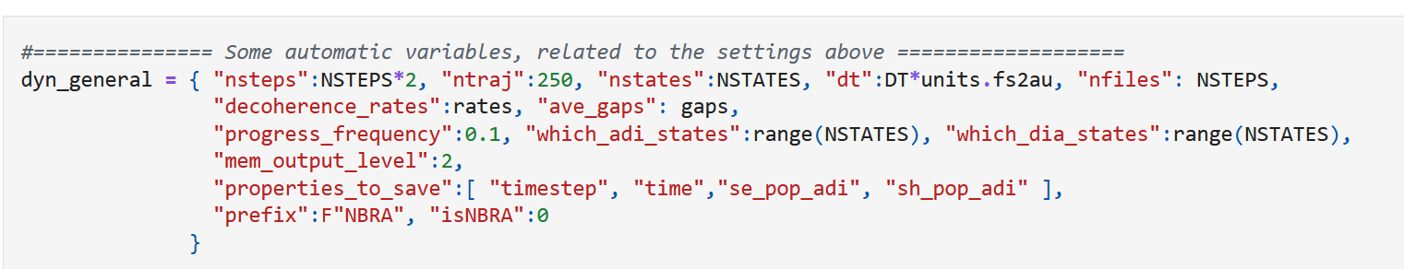
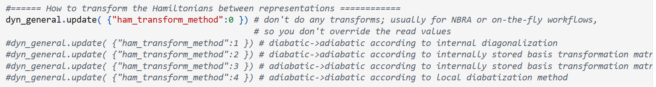
Setting up parameters controlling dynamics

Slide 62
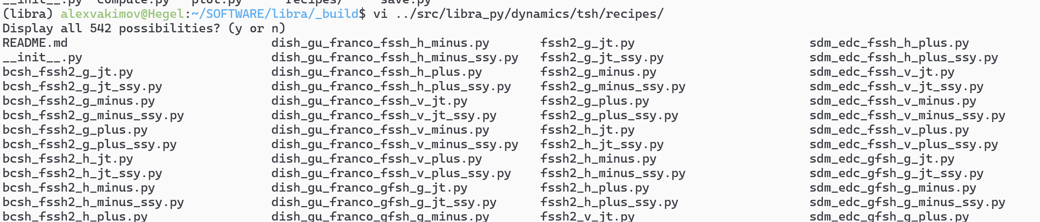
Composite schemes
How to evolve electronic amplitudes
Decoherence correction
Decoherence
times
Electron-nuclear dynamics
Hop proposal
XF variants
GFSH
SDM/mSDM
DISH
FSSH
IDA/IDF
EDC
MF
With SSY
BCSH
Schwartz 1
Decoherence
time
hyperparameters
Adiabatic
FSSH-2
DISH (rev)
Schwartz 2
Without SSY
QTSH
FSSH-3
XF
As a result: SSY-GFSH-mSDM, etc.

Slide 63


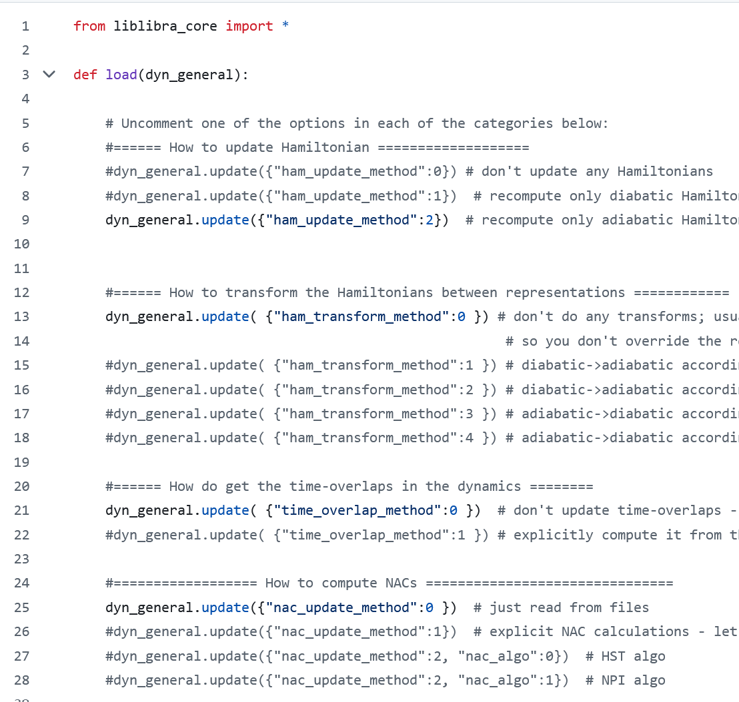

Recipes

Slide 64
Part 4.11: Observables and Properties
Initialization
Nuclear dynamics
$\dot{p_{i}}=−\frac{∂H}{∂r_{i}}$ $\dot{r_{i}}=\frac{∂H}{∂p_{i}}$
analytical models or electronic structure codes
Stationary adiabatic states
$${\hat{H}}_{el}ψ_{i}=E_{i}ψ_{i}$$
NAC: Hammes-Schiffer, S.; Tully, J. C. JCP 1994, 101, 4657
Non-adiabatic Couplings
$$d_{ij}=\frac{\left\langle ψ_{i}(t) | ψ_{j}(t+dt)\right\rangle −\left\langle ψ_{i}(t+dt) | ψ_{j}(t)\right\rangle }{2dt}$$
Phase tracking: Akimov, A. V. JPCL 2018 9, 6096
Local Diabatization: Granucci, G.; Persico, M.; Toniolo, A. JCP 2001, 114, 10608; Plasser, F.; Granucci, G.; Pittner, J. et al. JCP 2012, 137, 22A514; Shakiba, M.; Akimov, A. V. TCA 2023, 142, 68
Integrate Coherent Electronic Dynamics
$$Ψ\left(r,R,t\right)=\sum_{i}{c_{i}\left(t\right)ψ_{i}(r;R(t))}$$
$$iℏ\frac{∂c_{i}(t)}{∂t}=\sum_{j}{\left(E_{i}δ_{ij}−iℏd_{ij}\right)}c_{j}$$
NBRA
SDM: Granucci, G.; Persico, M. JCP 2007, 126, 134114; mSDM: Smith, B. A.; Akimov, A. V. JCP, 2019, 151, 124107; IDA: Nelson, T.; Fernandez-Alberti, S.; Roitberg, A. E.; Tretiak, S. JCP 2013, 138, 224111.
Decoherence 1
$$c_{i}→c_{i}\exp\left(−\frac{Δt}{τ_{ij}}\right), ∀i≠j$$
as in SDM
Proposed Hops
Decoherence 2
$$P_{i→j}=Δt∗Re\left(\frac{2{\frac{p}{m}d}_{ij}c_{i}^{∗}c_{j}}{c_{i}^{∗}c_{i}}\right)$$
or as in DISH
FSSH: Tully, J. C. JCP, 1990, 93, 1061
Accept Hops
based on energy conservation or
$$P_{i→f}^{A}=\min\left(1, \exp\left(−\frac{ΔE}{k_{B}T}\right)\right)$$
NBRA: Prezhdo, O. V.; Duncan, W. R.; Prezhdo, V. V. Prog. Surf. Sci. 2009, 84, 30
Change of state/Velocity rescaling
change active electronic state, rescale velocity

Slide 65

Properties and variables
"properties_to_save": […, "states",
"SH_pop",
"SH_pop_raw",
"se_pop_adi",
"se_pop_dia",
"sh_pop_adi",
"D_adi",
"D_adi_raw",
"D_dia",
"D_dia_raw",
"q",
"p",
"f",
"Cadi",
"Cdia",
"q_mm",
"p_mm",
"hvib_adi",
"hvib_dia",
"St",
"basis_transform",
"projector“, …]
"mem_output_level": -1
1 – 1D: e.g. `time[timestep]` or `Epot_ave[timestep]`
2 – 2D: e.g. `se_pop_adi[timestep, istate]` or `states[timestep, itraj]`
3 – 3D: e.g. Cadi[timestep, istate, itraj]
4 – 4D: e.g. St
5 - 5D: only `dc1_adi[timestep, itraj, idof, istate, jstate]` so far

Slide 66
1D data
["timestep",
"time",
"Ekin_ave",
"Epot_ave",
"Etot_ave",
"dEkin_ave",
"dEpot_ave",
"dEtot_ave",
“Etherm”,
“E_NHC”,
“tcnbra_ekin”,
“tcnbra_thermostat_energy”,
“Ekin_ave_qtsh”,
“ekin_aux_var”]
Time axis (integer steps)
Time axis (a.u. of time)
Average kinetic energy
Average potential energy
Average total energy
Fluctuation of average kinetic energy
Fluctuation of average potential energy
Fluctuation of average total energy
Thermostat energy
System + thermostat energy
TC-NBRA kinetic energy - averaged over all trajectories
TC-NBRA thermostat energy
Average kinetic energy in QTSH
KC-RPMD auxiliary electronic variable kinetic energy

Slide 67


2D data
["states",
“states_dia",
“se_pop_adi",
“se_pop_dia",
“sh_pop_adi",
“sh_pop_dia",
“sh_pop_adi_TR”,
“sh_pop_dia_TR”,
“mash_pop_adi”,
“mash_pop_dia”,
“fssh3_average_errors”,
“y_aux_var”,
“p_aux_var”,
“f_aux_var”
]
Trajectory-resolved instantaneous adiabatic states, nsteps x ntraj
Trajectory-resolved instantaneous diabatic states, nsteps x ntraj
Average adiabatic SE populations, nsteps x nstates, $p_{i}^{SE, adi}(t)=\frac{1}{N_{traj}}\sum_{j=1}^{N_{traj}}{{\left|c_{i,j}^{adi} \left(t\right)\right|}^{2}}$
Average diabatic SE populations, nsteps x nstates, $p_{i}^{SE, dia}(t)=\frac{1}{N_{traj}}\sum_{j=1}^{N_{traj}}{{\left|c_{i,j}^{dia} \left(t\right)\right|}^{2}}$
Average adiabatic SH populations, nsteps x nstates, $p_{i}^{SH,adi}(t)=\frac{N_{i}^{adi}(t)}{N_{traj}}$
Average diabatic SH populations, nsteps x nstates, $p_{i}^{SH,dia}(t)=\frac{N_{i}^{dia}(t)}{N_{traj}}$
Average adiabatic SH populations from the Tempelaar and Reichman's method, nsteps x nstates
Average diabatic SH populations from the Tempelaar and Reichman's method, nsteps x nstates
Average adiabatic MASH populations, nsteps x nstates
Average diabatic MASH populations, nsteps x nstates
Average errors from FSSH3, nsteps x 5
Trajectory-resolved auxiliary electronic variable coordinate in kc-RPMD, nsteps x 1
Trajectory-resolved auxiliary electronic variable momentum, nsteps x 1
Trajectory-resolved auxiliary electronic variable force, nsteps x 1

Slide 68
3D data
["coherence_adi",
“coherence_dia",
“q“, “p”, “f”,
“Cadi”, “Cdia”,
“p_quant",
“wp_quant”,
“VP”,
“f_xf”,
“qtsh_f_nc”,
“ave_decoherence_rates”
]
Average coherence indicator matrices, nsteps x nstates x nstates
Trajectory-resolved coordinates, momenta, and forces, nsteps x ntraj x ndof
Trajectory-resolved (a)diabatic TD-SE amplitudes, nsteps x ntraj x nstates (complex)
Trajectory-resolved quantum momenta, nsteps x ntraj x ndof
Trajectory-resolved width parameters for quantum momenta, nsteps x ntraj x ndof
Trajectory-resolved exact vector potential, nsteps x ntraj x ndof
Trajectory-resolved decoherence forces based on XF, nsteps x ntraj x ndof
Trajectory-resolved nonclassical forces in QTSH, nsteps x ntraj x ndof
Trajectory-averaged decoherence rates, nsteps x nstates x nstates

Slide 69
4D data
[“hvia_adi", “hvib_dia”,
“St”,
“basis_transform”,
“projector”,
“q_aux”, “p_aux”,
“nab_phase”,
“energy_gaps”,
“mean_energy_gaps”,
“energy_gaps2”,
“mean_energy_gaps2”
“energy_gap_fluctuations”,
“energy_gap_correlations”
]
Trajectory-resolved vibronic (a)diabatic Hamiltonian, nsteps x ntraj x nstates x nstates (complex)
Trajectory-resolved time-overlaps of the adiabatic states, nsteps x ntraj x nstates x nstates (complex)
Trajectory-resolved diabatic-to-adiabatic transformation matrices, nsteps x ntraj x nstates x nstates (complex)
Trajectory-resolved projector matrices (from the raw adiabatic to consistent adiabatic), nsteps x ntraj x nstates x nstates (complex)
Trajectory-resolved auxiliary coordinates/momenta for XF methods, nsteps x ntraj x nstates x ndofs
Trajectory-resolved nabla_phase for XF methods, nsteps x ntraj x nstates x ndofs
Trajectory-resolved energy gaps, nsteps x ntraj x nstates x nstates
Trajectory-resolved running-average (mean) energy gaps
Trajectory-resolved energy gaps squared
Trajectory-resolved running-average (mean) energy gaps squared
Trajectory-resolved energy gap fluctuations
Trajectory-resolved gap correlation functions

Slide 70
Computing state populations in Libra
Diagonal elements of the density matrices $P_{rep}$:$p_{n}^{SE,rep}=P_{rep,n,n}$
$p_{n}^{SE,adi}={\left|c_{n,adi}\right|}^{2}$ - adiabatic SE populations – “quantum” populations
$p_{n}^{SE,dia}={\left|c_{n,dia}\right|}^{2}$ - diabatic SE populations – “quantum” populations
$$\left.\left|Ψ\left(t\right)\right.\right\rangle =\left.\left|ψ_{adi}\left(t\right)\right.\right\rangle C_{adi}\left(t\right)=\left.\left|ψ_{dia}\left(t\right)\right.\right\rangle C_{dia}\left(t\right)$$
$$H_{dia}U=SUH_{adi}$$
$C_{adi}C_{adi}^{+}=P_{adi}$ ➔ $P_{dia}=U^{+}SP_{adi}SU$
$p_{n}^{SH,adi}=\frac{N_{n}}{N}$ - adiabatic SH populations – counting trajectories
$p_{n}^{SH,dia}$ - ???
This is a mixture of the SH populations and SE coherences
For each trajectory: $P_{dia}=U^{+}S{\tilde{P}}_{adi}SU$
$${\tilde{P}}_{adi,k,l}=δ_{k,l}δ_{k,a}+\left(1−δ_{k,l}\right)c_{k}c_{l}^{∗}$$
Tempelaar, R.; Reichman, D. R. JCP 2018, 148, 102309.
Bondarenko, A. S.; Tempelaar, R. JCP 2023, 158, 054117.
Active state index for the given trajectory

