Slide 1


Excitons in Hematite Fe₂O₃
1- Electronic Structure
2- Short-time Dynamics from TD-DFT and non-Adiabatic Dynamics Theories
Libra Workshop and Summer School on Excited States and Nonadiabatic Dynamics 2024
Lili Rassouli
Under supervision of
Prof. Dupuis
July 2024
Chemical and Biological Engineering
University at Buffalo
State University of New York

Slide 2
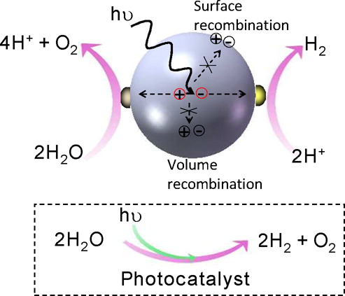
Introduction
PEC’s mechanism¹
Environmental challenges → turn to green energies
Photoelectrochemical cells (PECs) convert solar energy
to fuels (chemical energy)
Three phases of PECs:
light absorption and charge carrier generation
charge transport
redox reactivity
Hematite = attractive photocatalyst: abundant, cost-effective, chemically stable, narrow bandgap (high visible light absorption)
Limitations include high charge carrier recombination rate and low carrier mobility
Experimental results are available for hematite: bandgap around 2.1 eV for a bulk of hematite² and lifetime around hundreds of ps for a hematite film.^{3,4}
Goal: characterize, understand, and control carrier dynamics
1- J. Yang et al., Accounts of Chemical Research, 2013, 46, 1900.
2- S.I. Srikrishna Ramya, C.K. Mahadevan, Journal of Solid State Chemistry, 2014, 211, 37.
3- A.G. Joly et al., Journal of Applied Physics, 2006, 99.
4- Z. Zhou et al., Journal of the American Chemical Society, 2017, 139, 6707.

Slide 3
Methods
Cell optimization
Atomic positions and cell parameters of 2×2×1
Atomic positions of 2×2×3 cells
4 ps molecular dynamics after reaching the equilibrium (4000 steps with 1 fs timestep in NVT)
DFT and TDDFT at each time-step
AIMD
Periodic DFT
Functional: PBE+U(Fe,O)
Molecular orbital overlaps and time-overlaps using Libra
Nonadiabatic couplings (NACs) between pairs of many-body excited states generated from TD-DFT calculations for each geometry in the MD trajectory.
Performing stochastic NAMD using the NACs on the many-body basis.
NAMD^{1,2}
(Libra^{3,4} & CP2K)
1- B. Smith, M. Shakiba, A. V. Akimov, Journal of Chemical Theory and Computation, 2021, 17, 678.
2- M. Shakiba et al., Journal of Chemical Theory and Computation, 2022, 18, 5157.
3- A. V. Akimov, The Journal of Chemical Physics, 2021, 155, 134106.
4- A.V. Akimov, J. Comput. Chem, 2016, 37, 1626−1649.

Slide 4
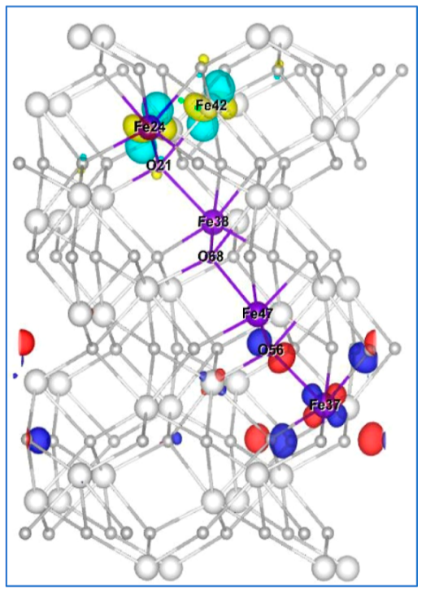
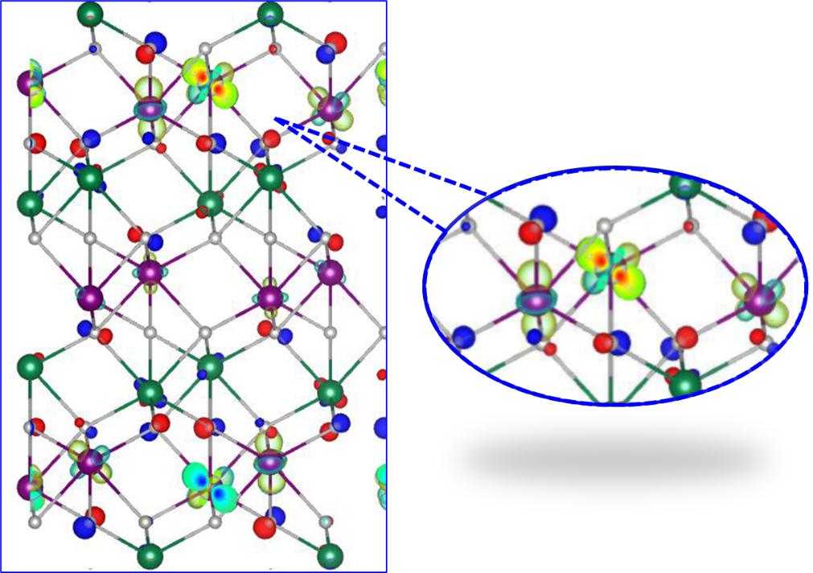
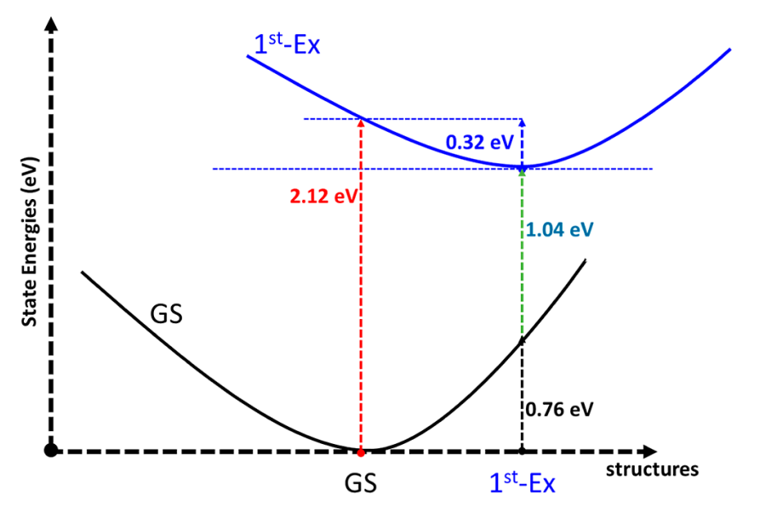
Results: Exciton Structure in small cell
L. Rassouli, M. Dupuis The Journal of Chemical Physics C, 2024, 128, 743–758.c

Slide 5
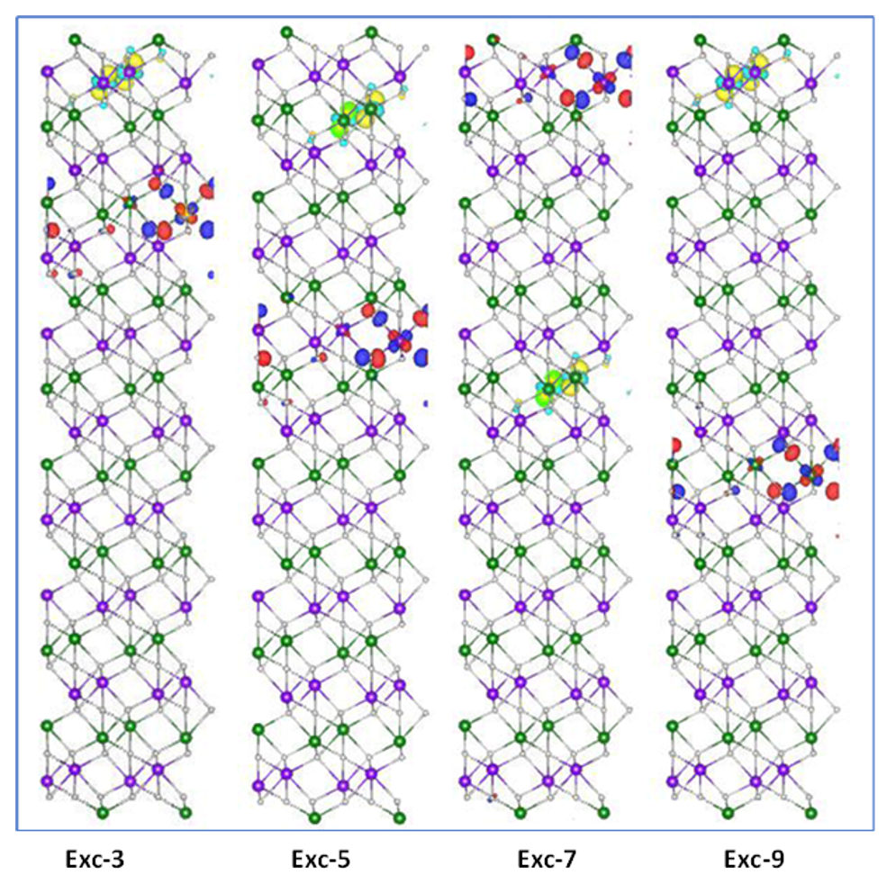
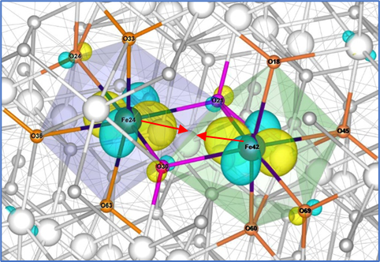
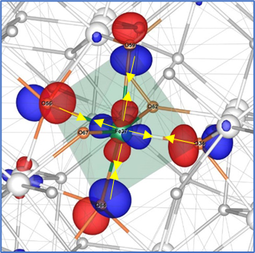
Results: Exciton Structure in 2×2×3 supercell
CB_{min} = Fe(3d)
electron LUMO localization (~80%) over two Fe atoms at the centers of two edge-sharing octahedra belonging to a basal plane
in-phase (bonding)shortening
n-basal plane
(n = 3, 5, 7, 9)
VB_{max} = O(2p)
hole HOMO localization (~ 50%) over the four equatorial O atoms of an FeO₆ octahedron
out-of-phase (anti-bonding) shortening
L. Rassouli, M. Dupuis The Journal of Chemical Physics C, 2024, 128, 743–758.c

Slide 6
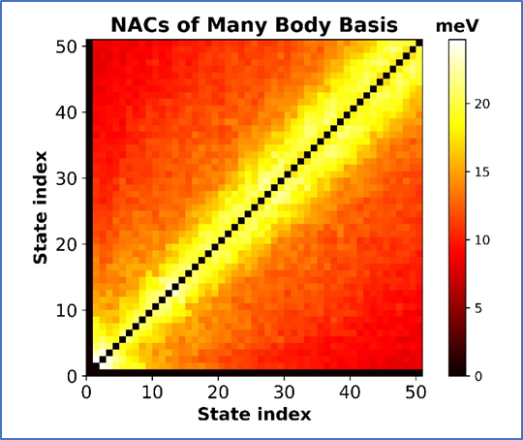
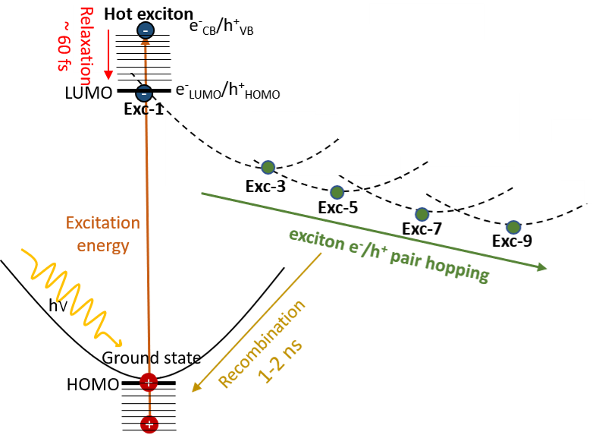
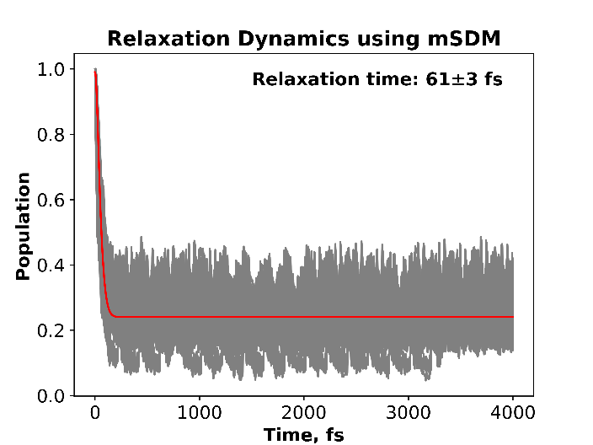
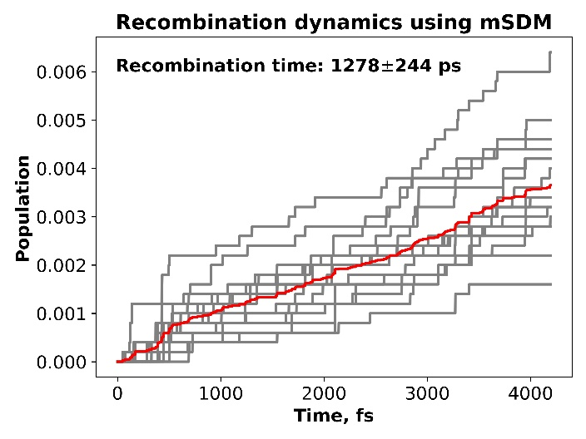
Results: Dynamics of Exciton using Libra

Slide 7
Conclusion
Electron excitation from O 2p states to Fe 3d
Exciton self-traps into stable electron-hole pair
Hole localization on (FeO₆)⁺ octahedral in HOMO
Electron localization on (FeFe)⁻ in accordance with previous computational studies ¹
Computed recombination time is 1210 ps
Computed relaxation time is in fs range
1- C.S. Ahart, K.M. Rosso, J. Blumberger, Journal of the American Chemical Society, 2022, 144, 4623

Slide 8
Libra Tutorials
https://github.com/compchem-cybertraining/Tutorials_Libra/tree/75701a6114782d1597cf5b1931c0cce42096b9e0/6_dynamics/2_nbra_workflows
https://github.com/compchem-cybertraining/Tutorials_Libra/blob/master/VIDEOS.md
Email:
lilirass@buffalo.edu

Slide 9
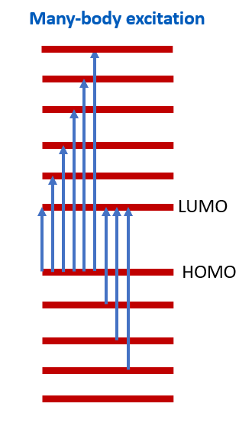
Many-body excitation
The non-adiabatic coupling coefficients between excited states were calculated based on many-body (MB) treatment of excited states rather than single particle (SP) treatment. The MB approach provides a more accurate treatment of excited states because the SP approach neglects the interaction between electronic states and relies on the properties of single-electron molecular Kohn-Sham orbitals to calculate state energies and NACs. In contrast, the MB approach involves a linear combination of single-particle excitations for each excited state, considering the weight of different contributions. Since the excited states of small molecules are almost always multiconfigurational, even for low-lying excited states, the SP description is inadequate, and many-body effects must be considered.
neglect-of-back-reaction approximation: NBRA
During excitation and relaxation, the electronic states change, but the NBRA neglects the effect of new electronic states (electronic state transitions) on nuclear evolution

Slide 10
