Slide 1
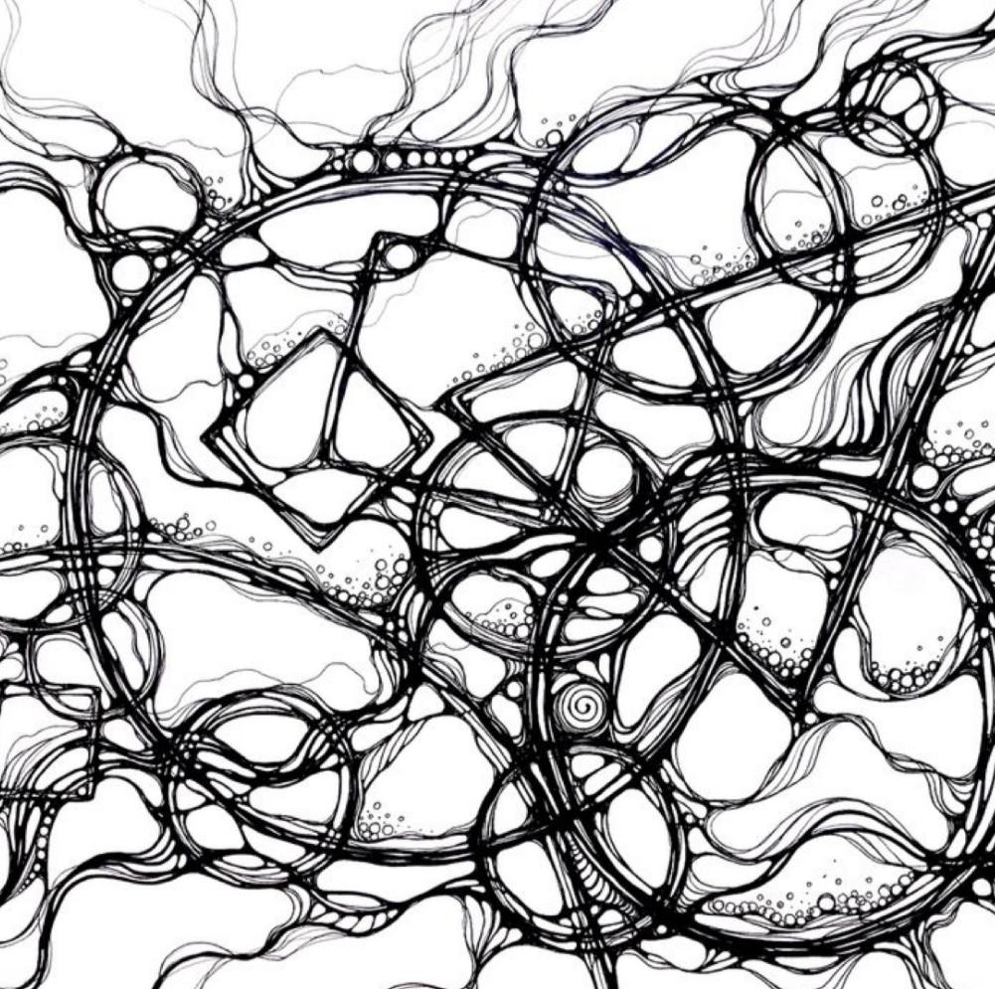
Relevance and impact of neurography in Kazakhstan
Neurography is a modern method of art therapy developed in 2014.
Used to visualize and transform internal conflicts.
The study is aimed at assessing the perception of the method by specialists and its impact on adolescents.

Slide 2
The research questions and its significance
Research questions
- Is neurography relevant to Kazakhstan? Do experts believe it is effective?
- How does it compare to other methods?
- What is the impact of art therapy on teenagers and adolescents?
Justification
Supporting adolescent mental health requires new approaches, and neurography can become an effective tool if its perception and application are investigated and understood.

Slide 3
Data collection methodology
Method
Semi-structured interviews with psychologists and teachers working in Shymkent, Kazakhstan.
Justification of the method choice
Interviews allow you to gather diverse opinions and experiences, providing an in-depth analysis of the relevance and effectiveness of neurography.
The choice of Shymkent is justified as an example of a city with the active introduction of art therapy methods, which allows us to obtain relevant data.

Slide 4
Data overview Participants 6 professionals with work experience from 8 to 22 years. Education Participants with qualifications in psychology, pedagogy and related disciplines. Interview topics The use and perception of neurography in therapeutic and educational processes; experience and results of working with adolescents.

Slide 5
Findings
Practical application
Evaluating the effectiveness of neurography

Slide 6
Relevance in Kazakhstan
Growing popularity
Some experts predict that in 2-3 years the method may become more widely applicable and in demand.
Limited recognition
However, in some professional circles, where more traditional therapies prevail, neurography has not yet been widely recognized and applied.

Slide 7
Q&A

